Slide 1
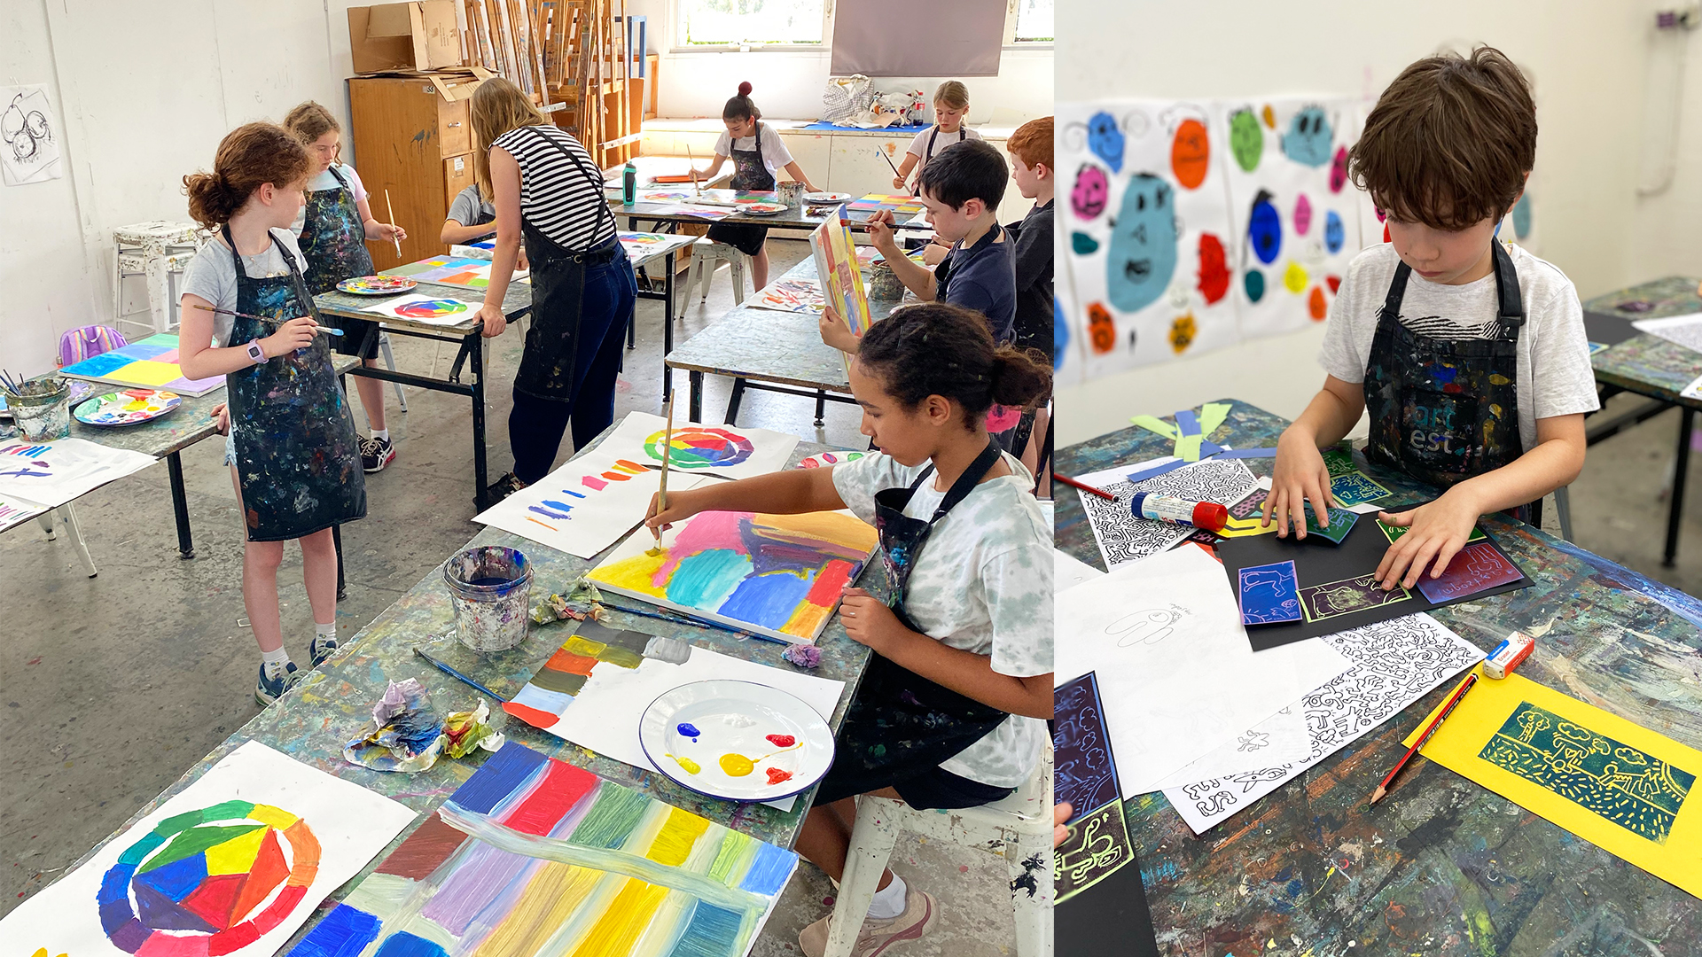
LOOK AT THE PICTURES, SAY THEN SPELL!
art

Slide 2
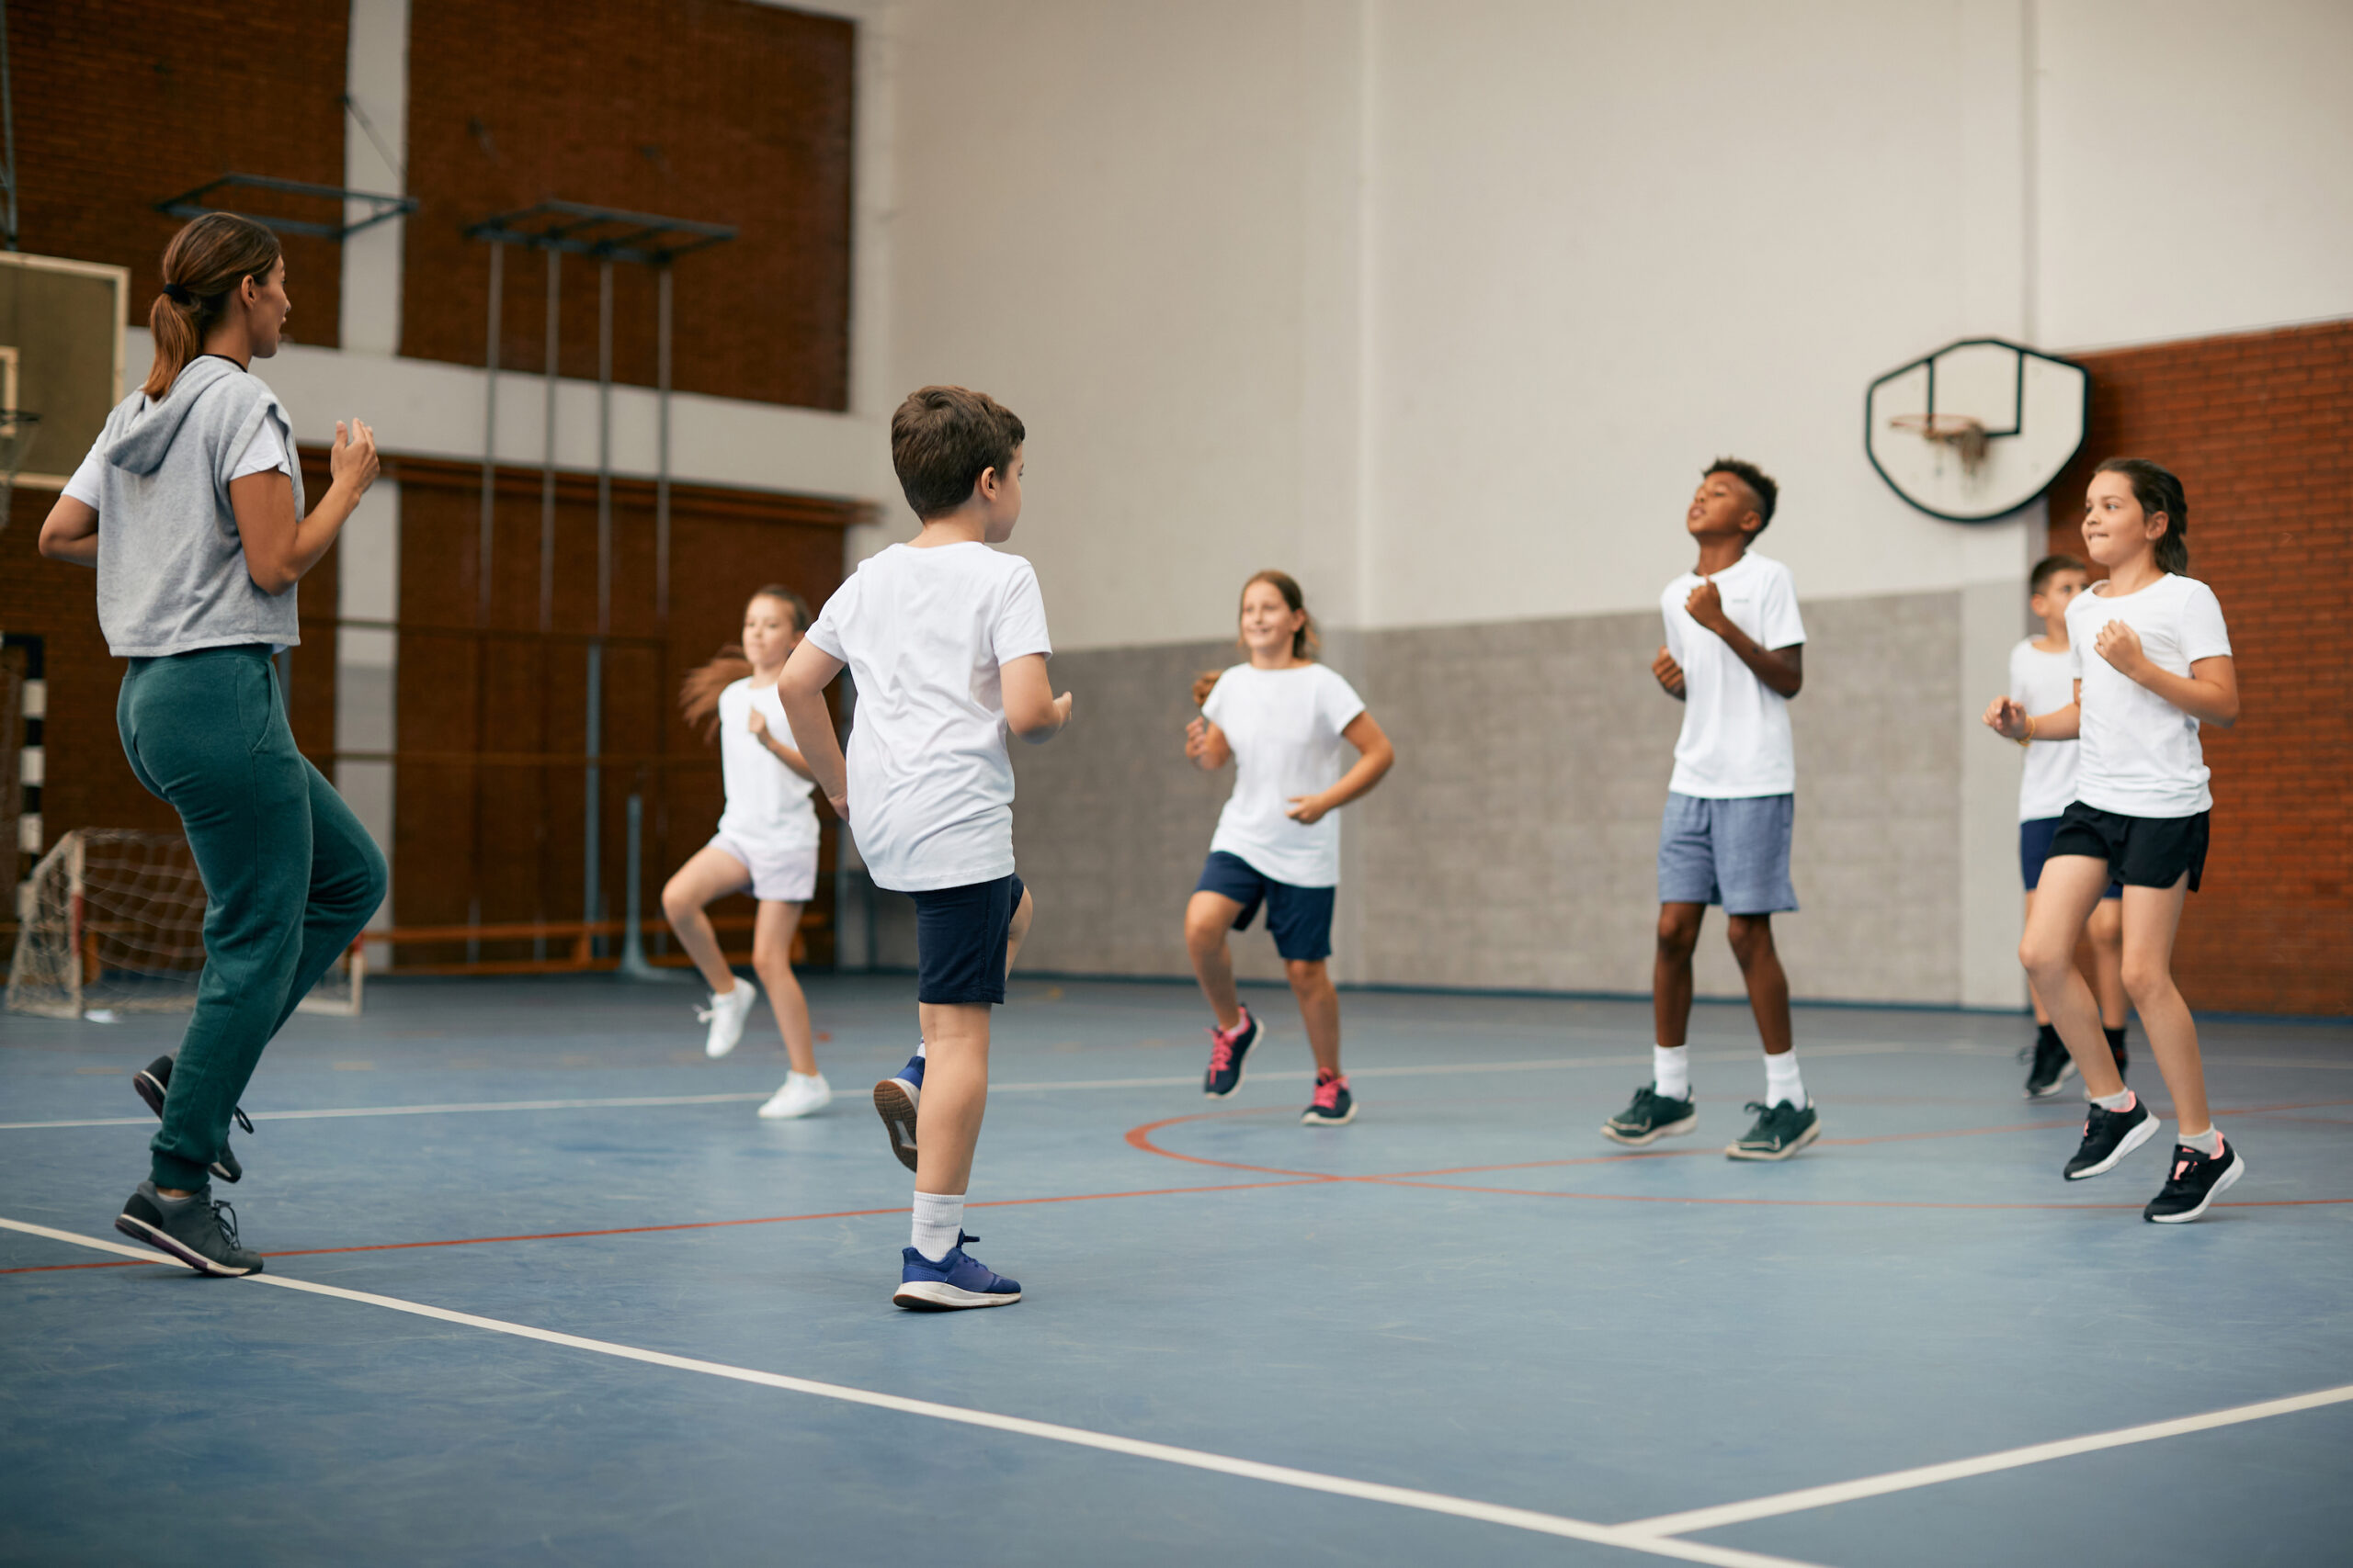
PE

Slide 3
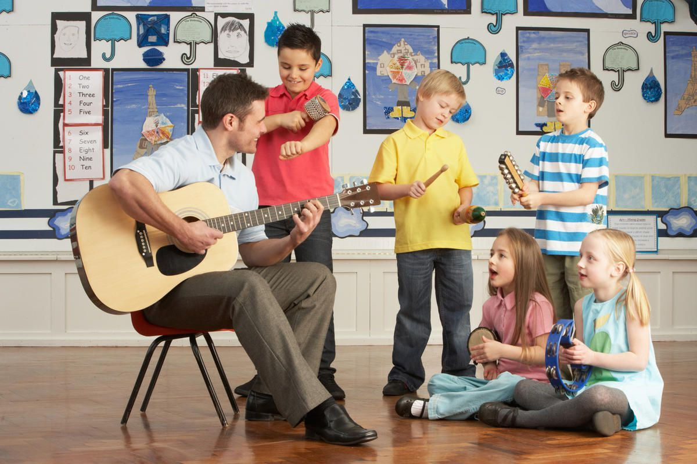
music

Slide 4
IT

Slide 6
✓
✗
✓
✗

Slide 8
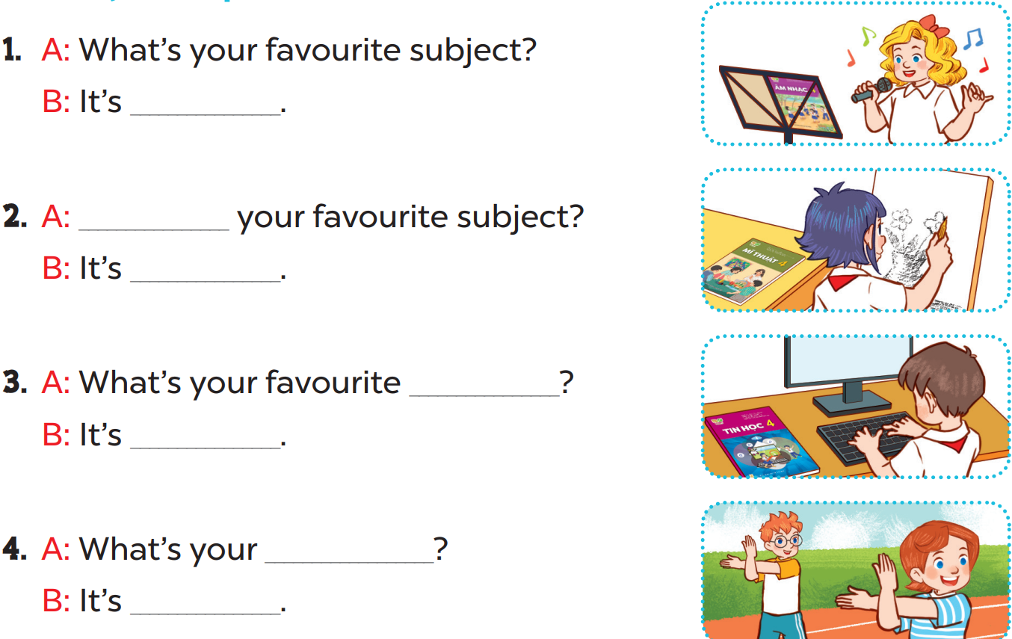

Slide 9
music
What’s
art
subject
IT
favourite subject
PE

