Slide 1
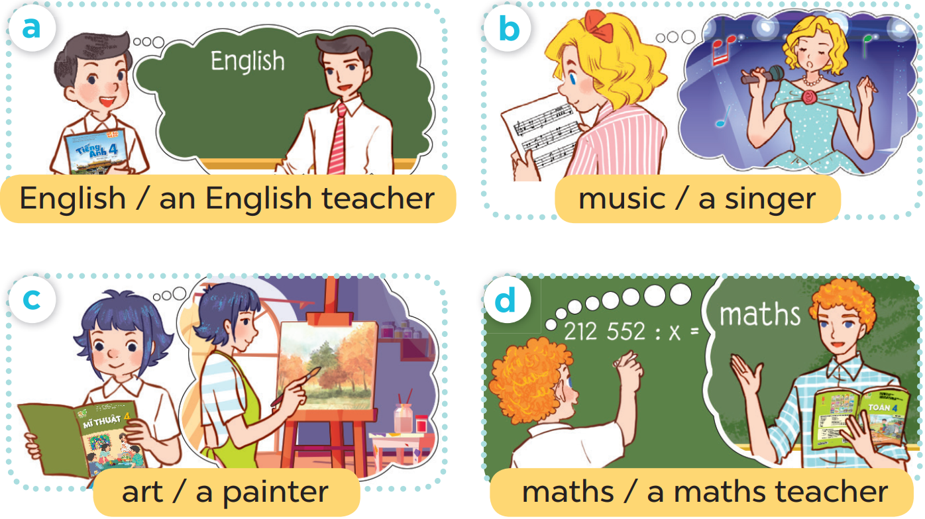

Slide 3
3
1
4
2

Slide 4
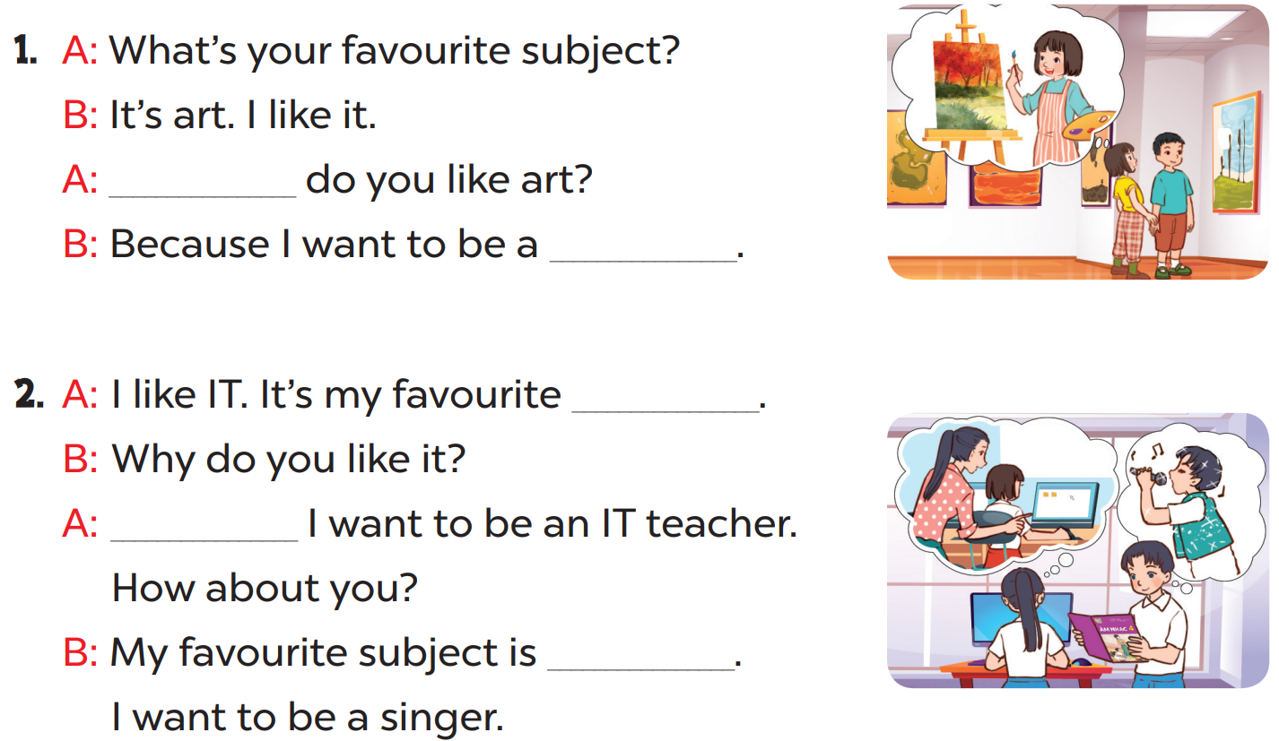

Slide 5
Why
painter
subject
Because
music

Slide 7
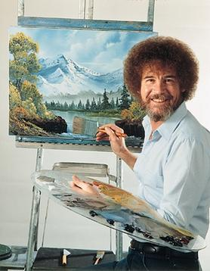
I
be
to
want
???
I want to be a painter.

Slide 8
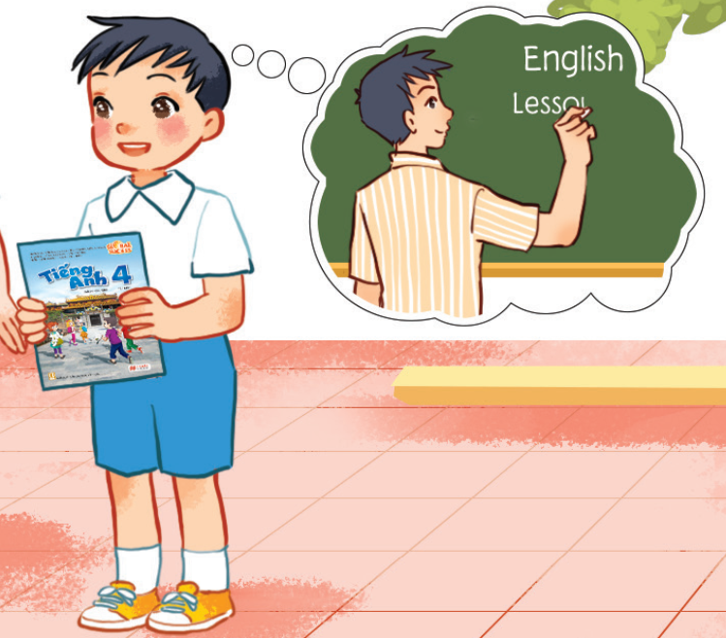
He
be
wants
to
???
He wants to be an English teacher.

Slide 9
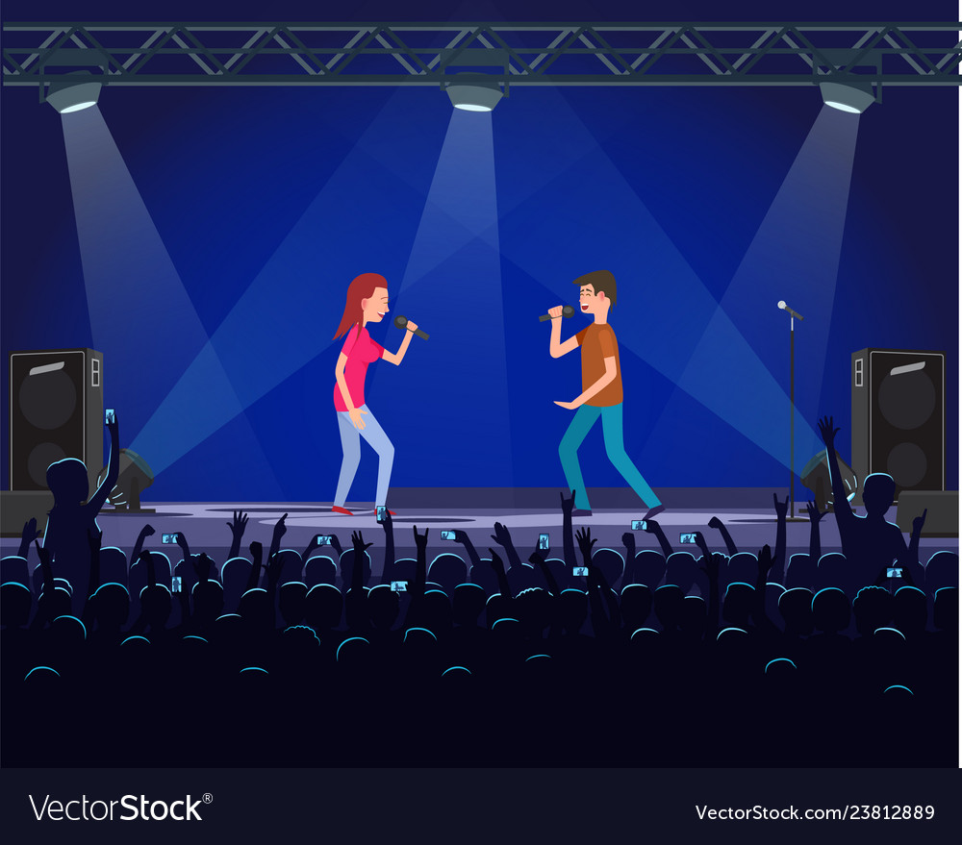
What’s your favourite subject?
It’s ________.
Why do you like _________?
Because I want to be a _______.
music
music
singer

Slide 10
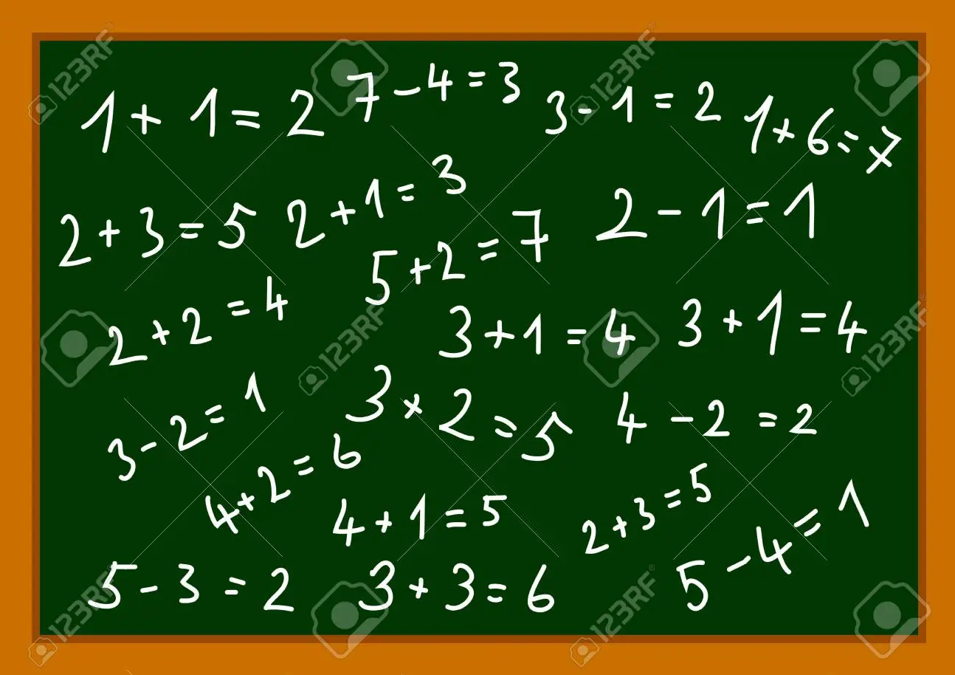
Make a dialogue with these clues!

