Slide 1
Our sports day
9
Lesson 1 - Period 1

Slide 2
Table of contents
Warm-up
01
02
03
04
Let’s talk.
Look, listen and repeat.
05
Game
Listen, point and say.

Slide 3
01
Warm-up

Slide 4
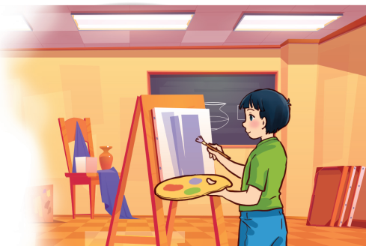
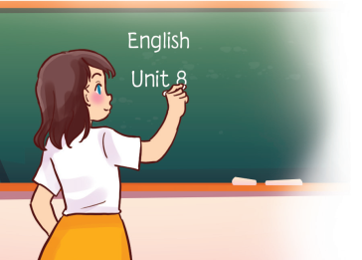
Art, art.
My favourite subject is art. Why do you like it?
Because I want to be a painter.
English, English.
My favourite subject is English. Why do you like it?
Because I want to be an English teacher.

Slide 5
02
Look, listen and repeat.

Slide 6
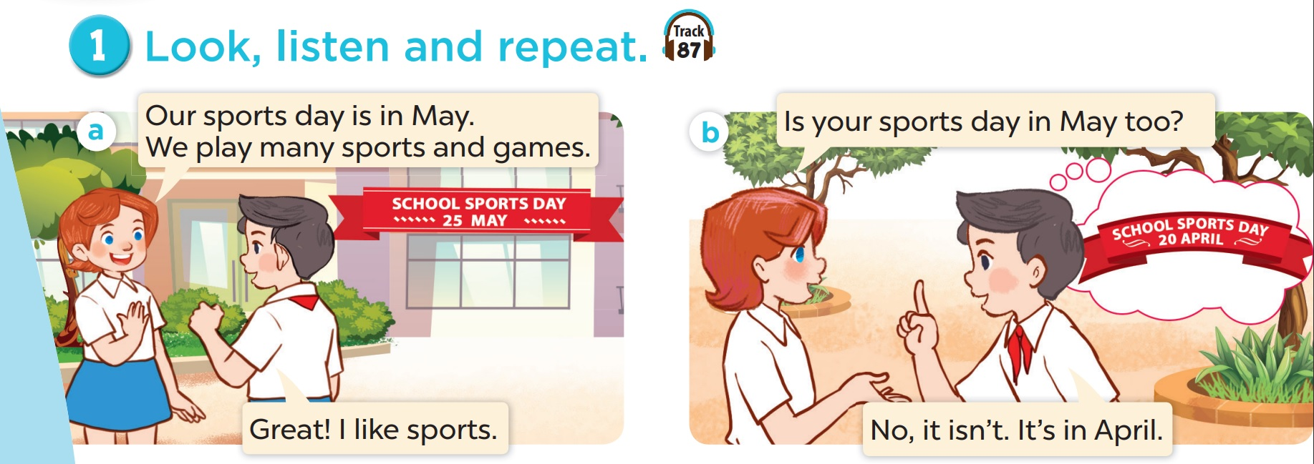
Who is the girl? Who is the boy?

Slide 7
When is the girl's school sports day?
When is the boy's school sports day?

Slide 8
Look, listen and repeat.

Slide 9
04
Listen, point and say.

Slide 10
Vocabulary

Slide 11
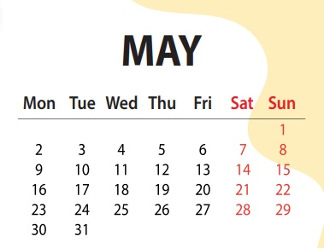

Slide 12
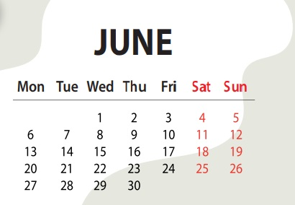

Slide 13
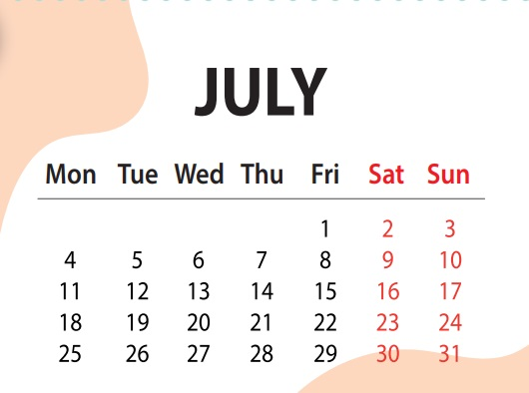

Slide 14
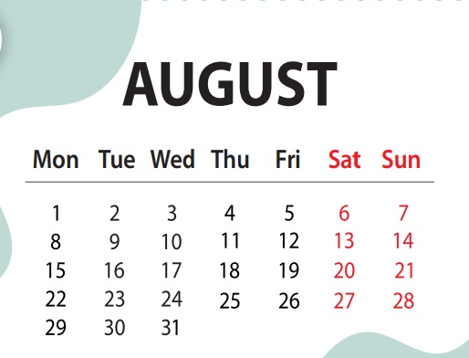

Slide 15
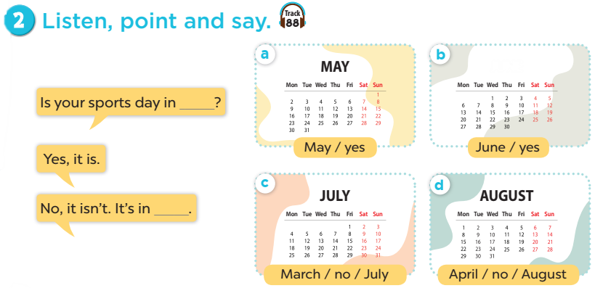
Notes:
Click on the Speaker Icon to play the audio.

Slide 16
04
Let's talk.

Slide 17
Is your sports day in ___?
Yes, it is.
No, it isn't. It's in ____.

Slide 18
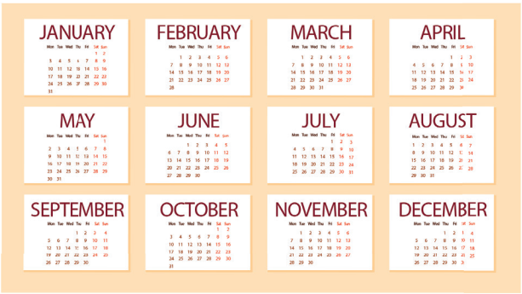

Slide 19
06
Game

Slide 20
0
0
0
O
O
O
X
X
X
1
2
3
X
X
X
0
0
0
O
O
O
X
X
X
4
5
6
X
X
X
0
0
0
O
O
O
X
X
X
7
8
9
X
X
X
Notes:
- Divide Ss into 2 teams: one team is X, one team is O.
- Students select a number on the grid, then 2 students from that team ask and answer based on the cue. If they answer correctly, teacher clicks on the home button to go back to the first slide, then click on X or O (depending on which team is answering).
- The first team to get three Xs or three Os in a row wins!

Slide 21
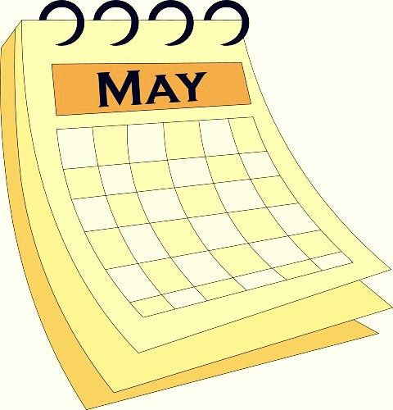
your sports day / May?
Is your sports day in May?
Yes, it is.

Slide 22
your sports day / June?
Is your sports day in June?
No, it isn't.
It's in May.

Slide 23
your sports day / July?
Is your sports day in July?
Yes, it is.

Slide 24
your sports day / July?
Is your sports day in July?
No, it isn't. It's in June.

Slide 25
your sports day / February?
Is your sports day in February?
No, it isn't. It's in June.

Slide 26
What's the 4th month of the year?
It's April.

Slide 27
What's the 5th month of the year?
It's May.

Slide 28
What's the 6th month of the year?
It's June.

Slide 29
What's the 7th month of the year?
It's July.

