Slide 1


Our sports day
9
Lesson 1 - Period 2

Slide 2
Table of contents
Warm-up
01
02
03
04
Let’s sing.
Listen and match.
Game
05
Look, complete and read.

Slide 3
01
Warm-up

Slide 4
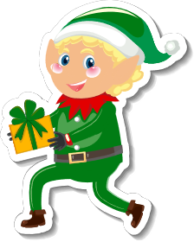
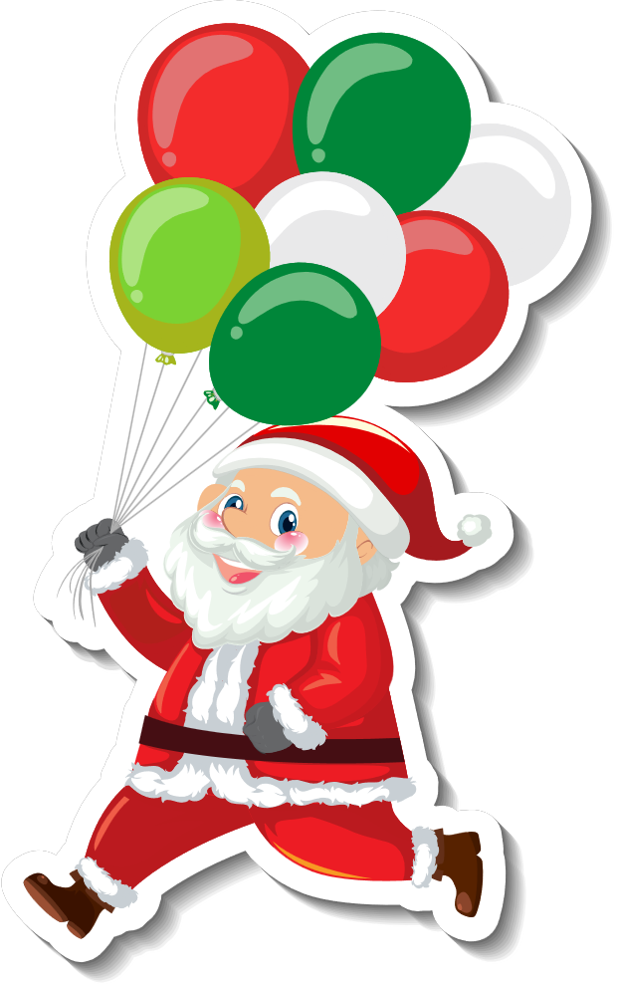




In which month can you see these?

Slide 5
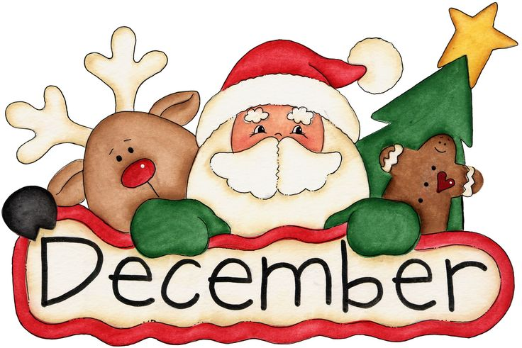
The 12th month of the year

Slide 6
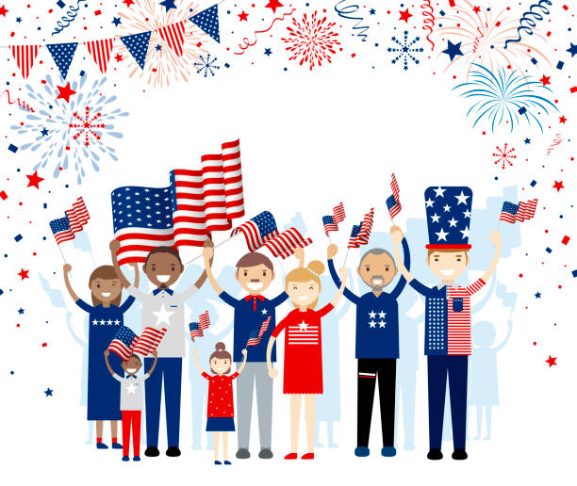

American Independence Day
Summer Holiday

Slide 7

The 7th month of the year

Slide 8

Summer holiday
starts

Slide 9
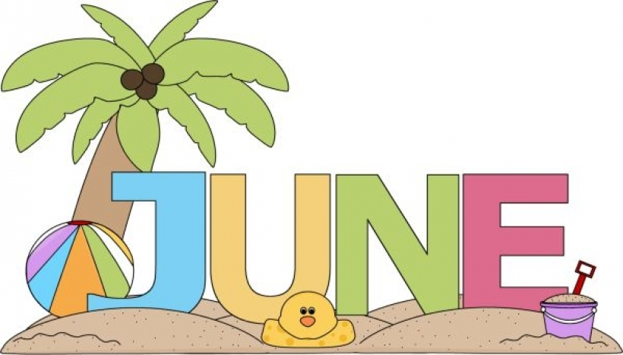
The 6th month of the year

Slide 10


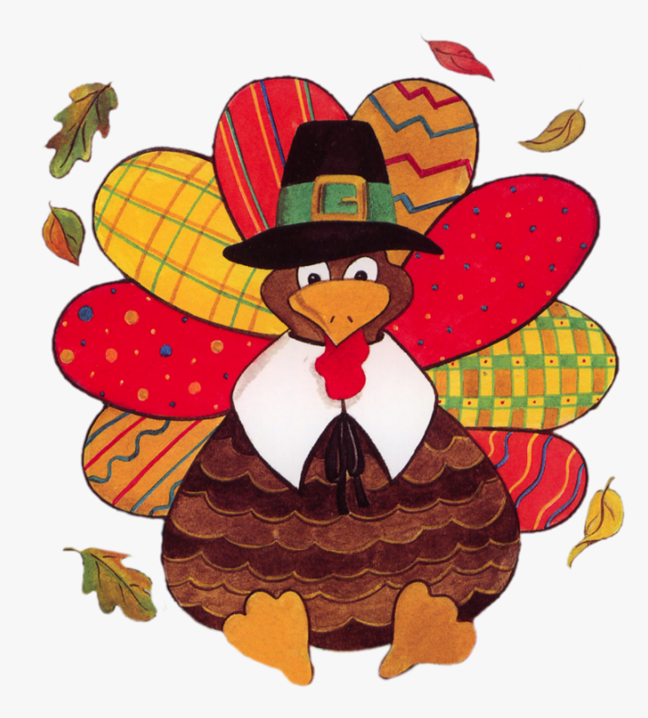

Slide 11

The 11th month of the year

Slide 12

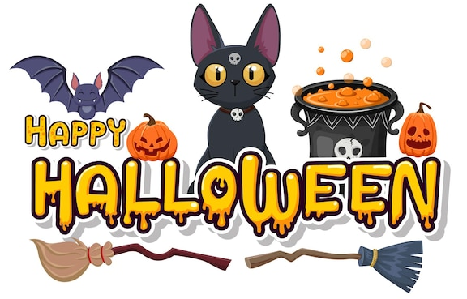

Slide 13
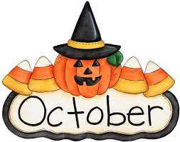
The 10th month of the year

Slide 14


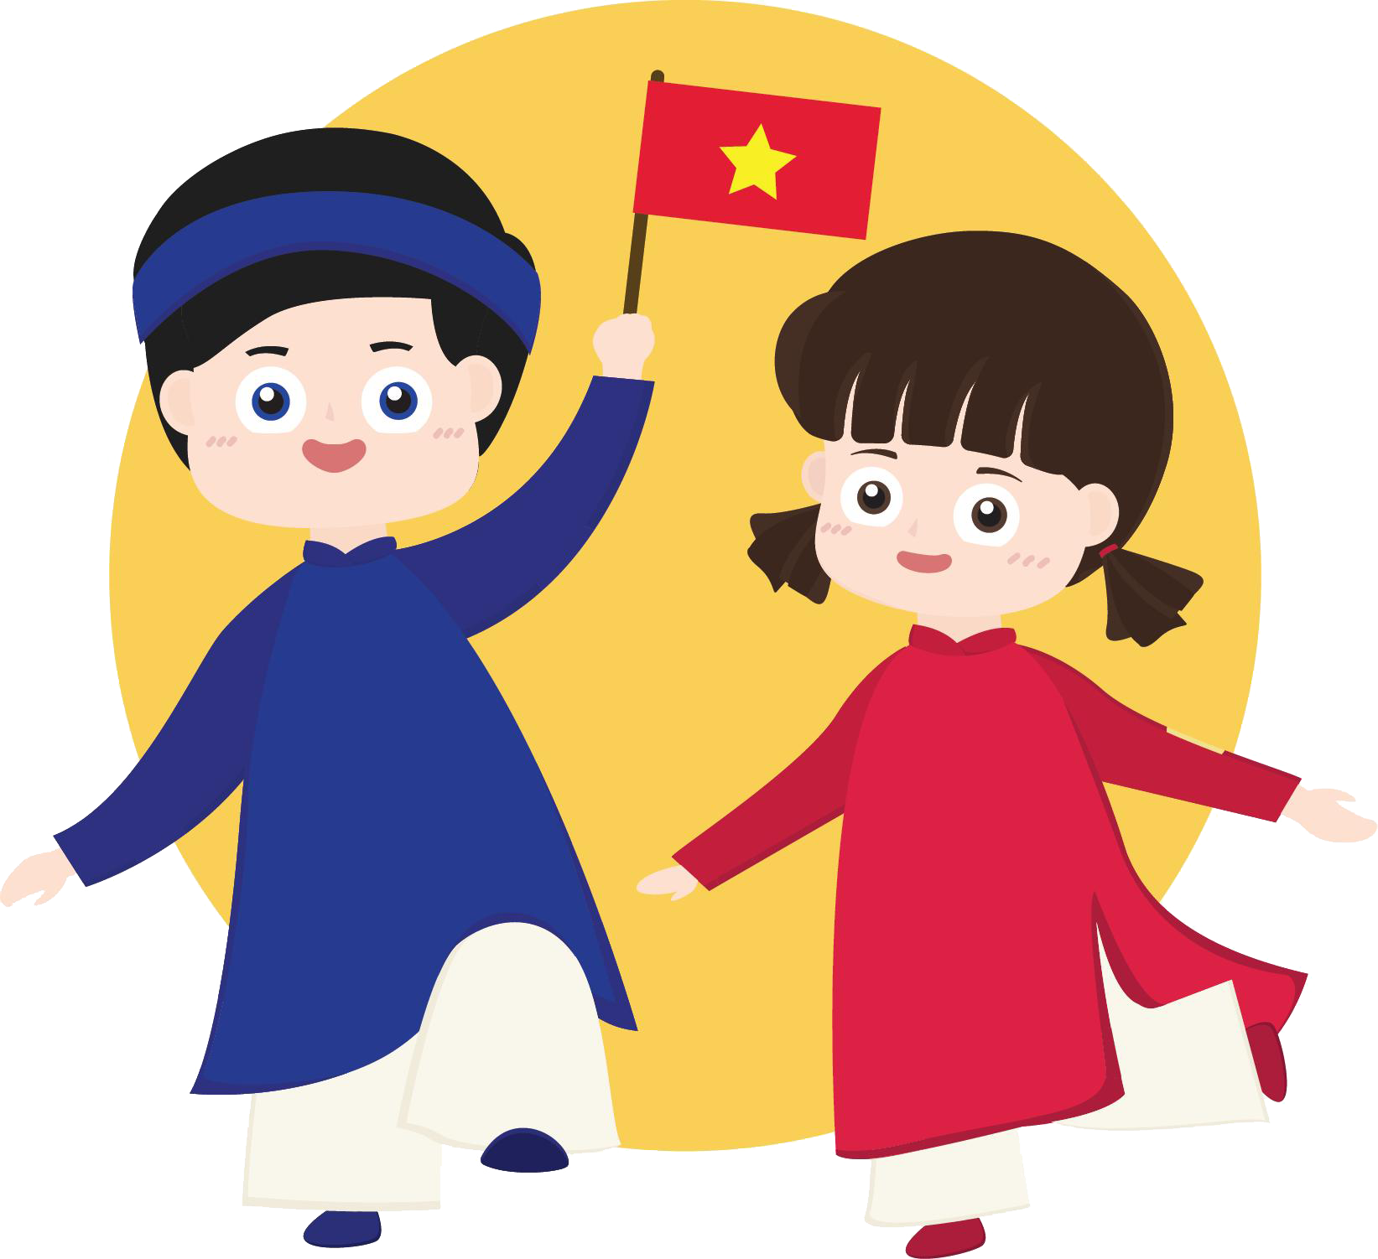

Slide 15
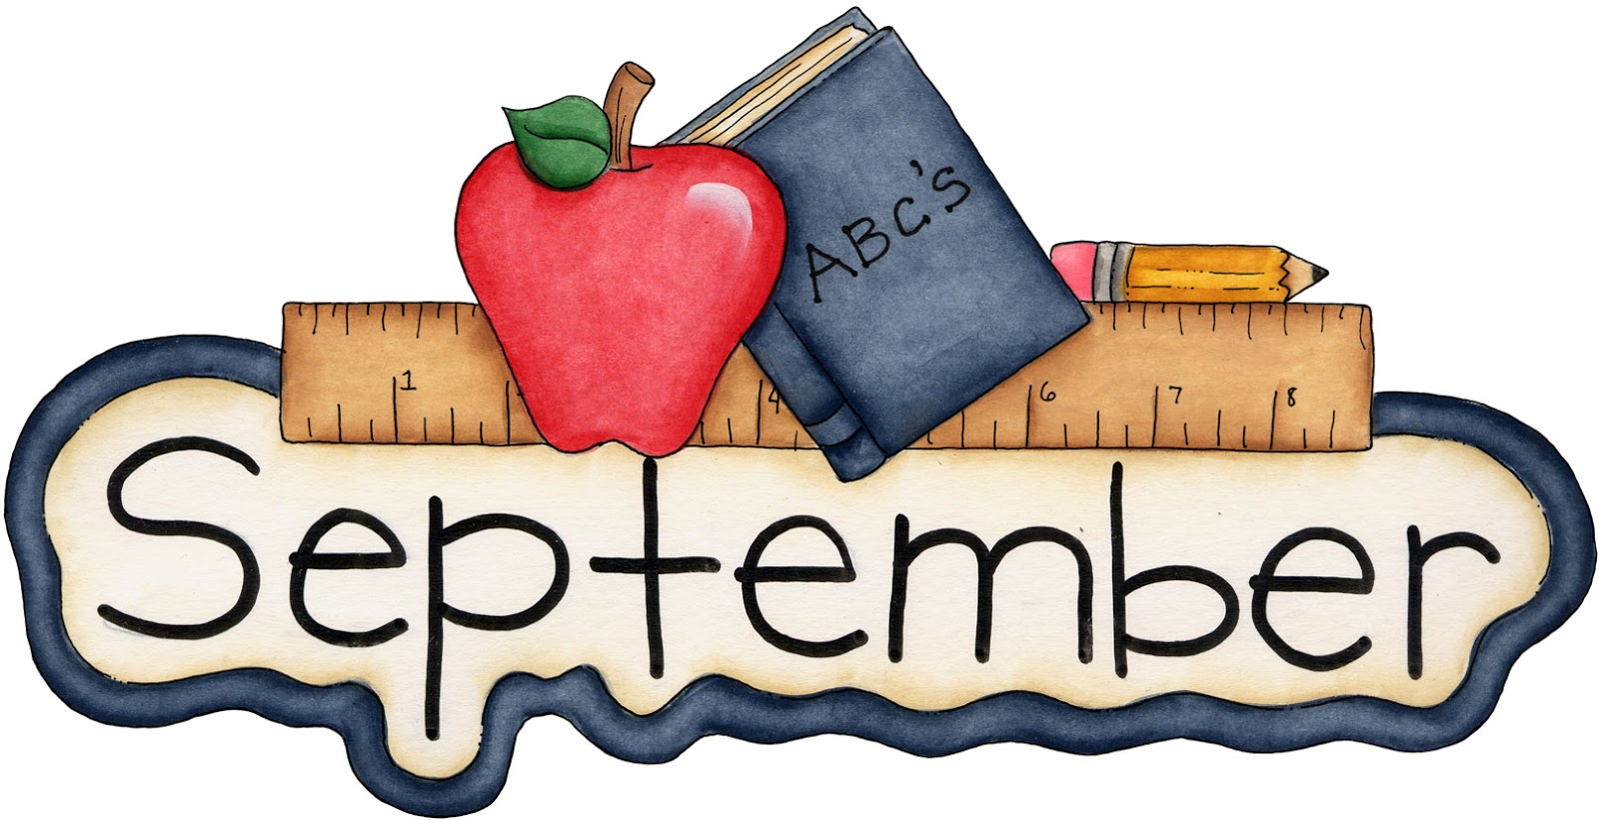
The 9th month of the year

Slide 16
02
Listen and match.

Slide 17
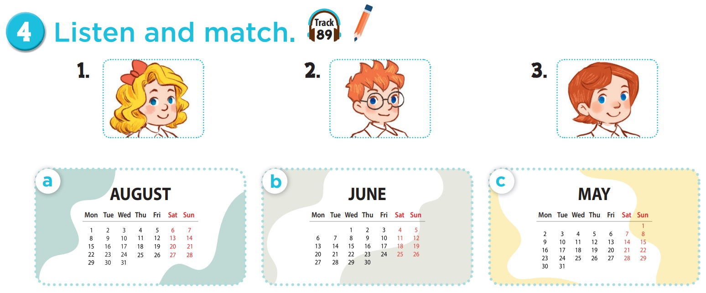

Who is she? Who is he?

Slide 18
Which month do you see?

Slide 19


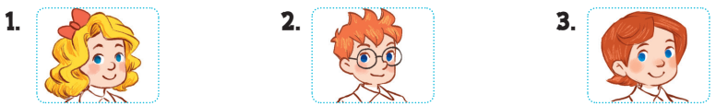
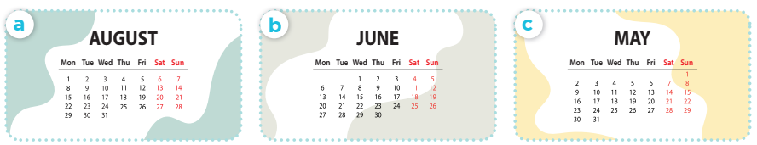

Slide 20
03
Look, complete and read.

Slide 21

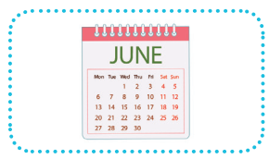
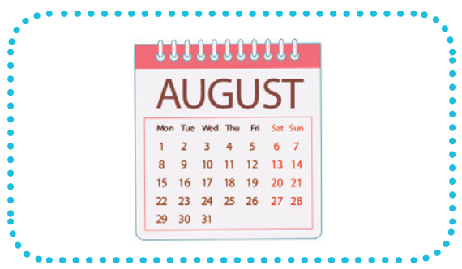
1.
A: Is your sports day in June?
B: Yes, ______.
2.
A: Is your sports day in ________?
B: Yes, it is.
it is
August

Slide 22
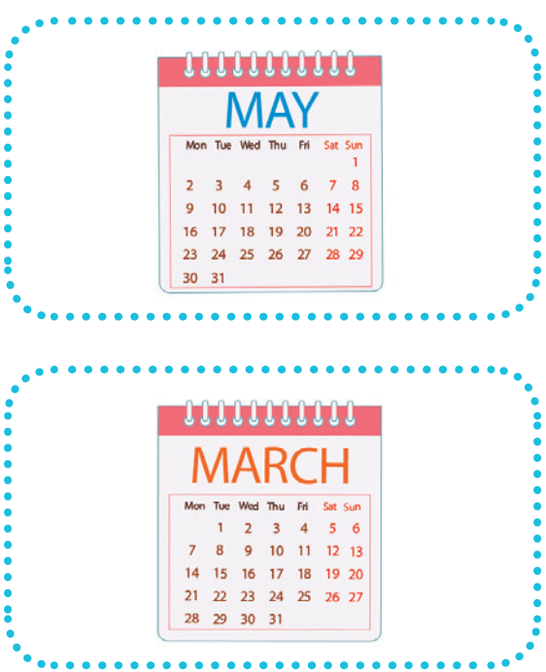
3.
A: _____ your sports day in February?
B: No, it isn’t. It’s in _____.
4.
A: Is your sports day ____ July?
B: _________. It’s in March.
Is
May
in
No, it isn’t

Slide 23
04
Let's sing.

Slide 24



Our sports day
Sports day, sports day.
Is your sports day in May?
Yes, it is. Yes, it is.
It’s in May.
Sports day, sports day.
Is your sports day in June?
No, it isn’t. No, it isn’t.
It’s in July.

Slide 25
05
Game

Slide 26



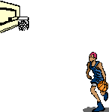

All-Star

Slide 27

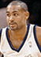
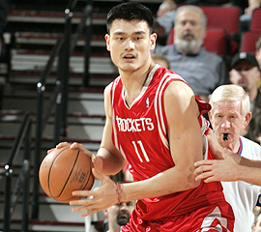

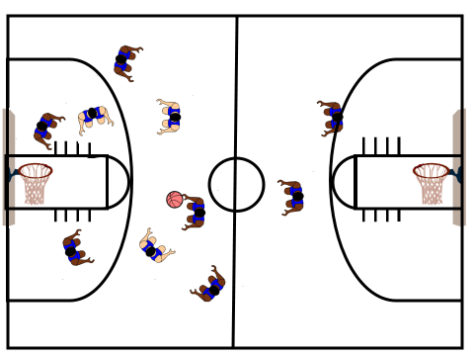
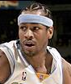
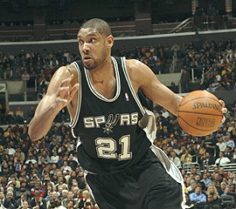


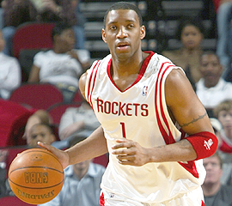

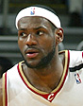

Scoreboard
Grant Hill
Yao Ming
Pippin
Tim Duncan
Allen
Michael Jordan
Grady
Nick
James

Slide 28
Is your sports day _____ June?
in
B
A. on
B. in
C. at
D. for

Slide 29


Slam Dunk
Slam Dunk

Slide 30
___ your sports day in May?
A
A. Is
B. It

Slide 31
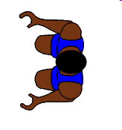
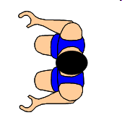

No point!

Slide 32
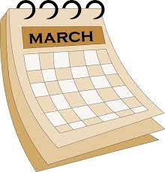
Is your sports day
in April?
B
A. Yes, it is.
B. No, it isn't.
Notes:
Encourage students to say "It's in March."

Slide 33

Slam Dunk
Slam Dunk

Slide 34

Is your sports day in July?
C
A. Yes, it isn't.
B. No, it isn't.
C. Yes, it is.
D. No, it is.

Slide 35

Slam Dunk
Slam Dunk

Slide 36

A: Is your sports day
in ___?
B: Yes, it is.
A
A. March
B. May

Slide 37
Slam Dunk
Slam Dunk

Slide 38
A: Is your sports day
in ___?
B: No, it isn't.
B
A. March
B. May

Slide 39
No point!

Slide 40
A: Is your sports day
in February?
B: Yes, _____.
A
A. it is
B. it isn't

Slide 41

Slam Dunk
Slam Dunk

Slide 42
A: Is your sports day in September?
B: No, _____.
B
A. it is
B. it isn't

Slide 43

Slam Dunk
Slam Dunk

Slide 44
A: Is your sports day
in January?
B: _____. It's in March.
C
A. Yes, it isn't.
B. Yes, it is.
C.No, it isn't.
D. No, it is.

Slide 45
Slam Dunk
Slam Dunk

