Slide 1
Our Sports Day
9
Lesson 2 - Period 3

Slide 2
TABLE OF CONTENTS
01
02
03
04
Warm-up
Look, listen and repeat.
Listen, point and say.
Let’s talk.
05
Fun time

Slide 3
01
Warm-up

Slide 4
Notes:
Link: https://youtu.be/SSl-SbVz2oA

Slide 5
Unscramble the letters
Notes:
- Divide pupils into teams.
- Show the scrambled letters. Have pupils think and whisper the answer to their friend.
- Teacher calls out the representatives to race to the board and write the answer.
- Teacher gives stars/ points to the team with correct answer. Give extra stars/ points to the fast team(s).

Slide 6
E U R Y A F B R
FEBRUARY
Notes:
Click on the red button to reveal the answer.

Slide 7
R A I P L
APRIL
Notes:
Click on the red button to reveal the answer.

Slide 8
Y J U A R A N
JANUARY
Notes:
Click on the red button to reveal the answer.

Slide 9
U S A T U G
AUGUST
Notes:
Click on the red button to reveal the answer.

Slide 10
C R A H M
MARCH
Notes:
Click on the red button to reveal the answer.

Slide 11
YLUJ
JULY
Notes:
Click on the red button to reveal the answer.

Slide 12
03
Look, listen and repeat.

Slide 13
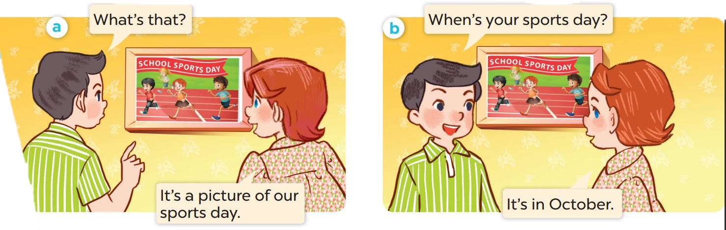
Who is the girl? Who is the boy?

Slide 14
Look, listen and repeat.

Slide 15
Work in pairs. Practise.

Slide 16
03
Listen, point and say.

Slide 17
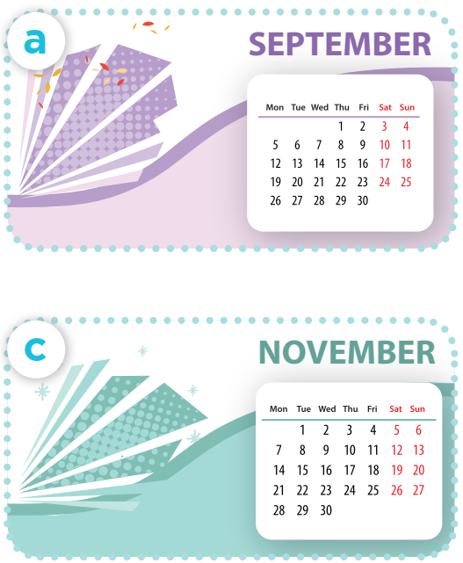
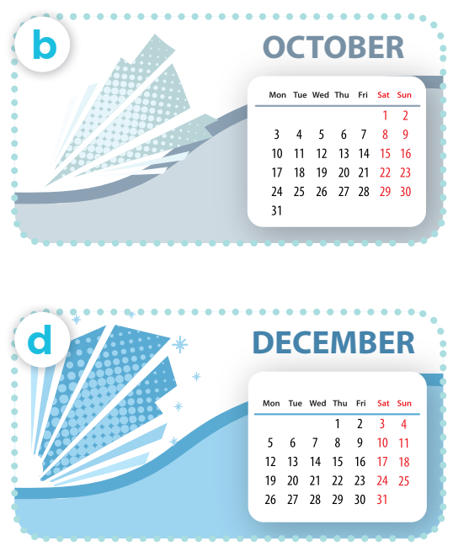
Listen, point and say.
Work in pairs. Practise.
When’s your sports day?
It’s in ___.
Notes:
Click on the Speaker Icon to play the audio.

Slide 18
04
Let's talk.

Slide 19
When's your sports day?
It's in December.

Slide 20
When's your sports day?
NOVEMBER
It's in November.

Slide 21
When's your sports day?
It's in _____.

Slide 22
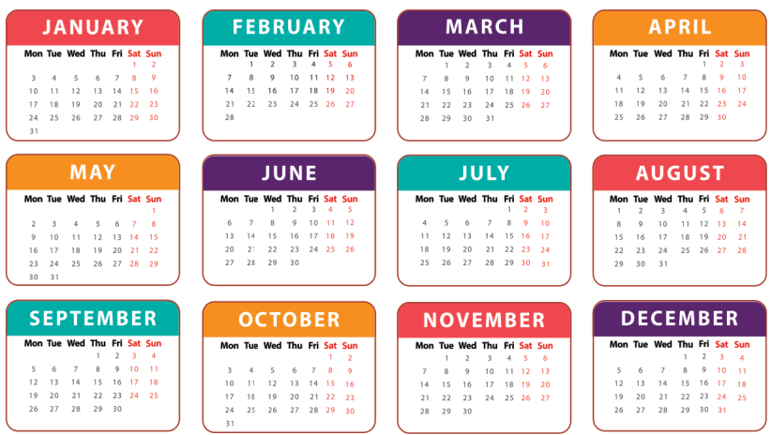
3
Let’s talk.
When’s your sports day?
It’s in ___.

Slide 23
06
Game

Slide 24
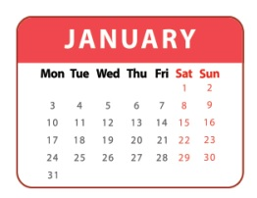
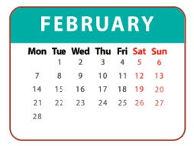
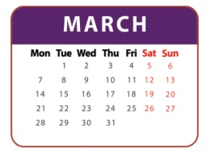
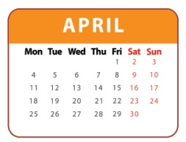
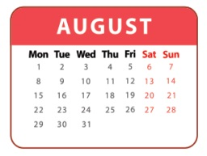
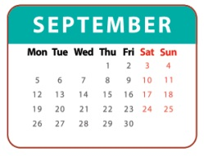
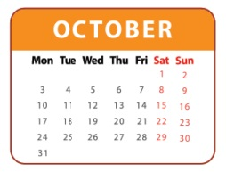
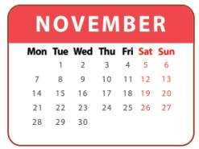
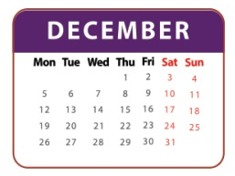
1
2
3
= +1 point
4
5
6
= lose 2 points
= rock, paper, scissors
(winner takes 2)
7
8
9
Notes:
- Divide the class into 3 teams.
- Pupils from each team choose a number (or throw sticky ball on the grid to choose the number), then have 2 pupils from each team ask and answer with the picture in that number.
- Pupils or teacher clicks on the month to reveal the icons indicating the points for that team.
- After 9 numbers, the team with the most points is the winner.

