Slide 1


Our sports day
9
Lesson 3 - Period 5

Slide 2
TABLE OF CONTENTS
01
02
03
04
Review
Listen and repeat.
Listen and circle.
Let’s chant.

Slide 3
01
Review

Slide 4
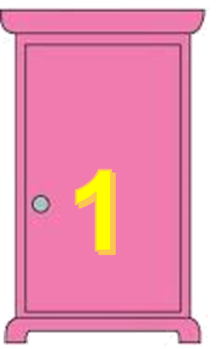
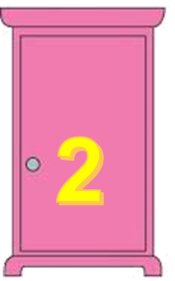
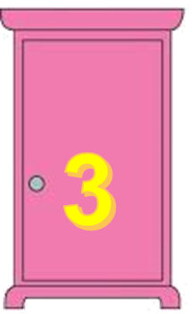
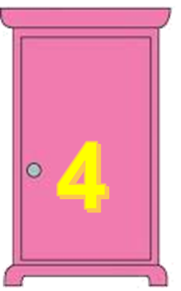

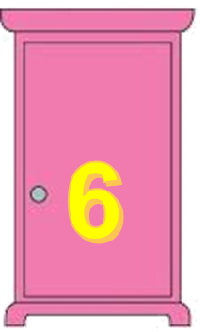
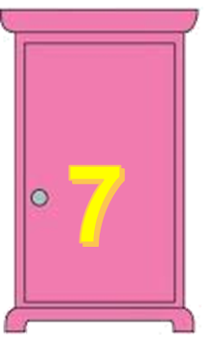
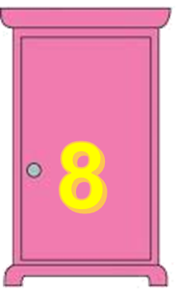

TEAM 1
TEAM 2

Slide 5
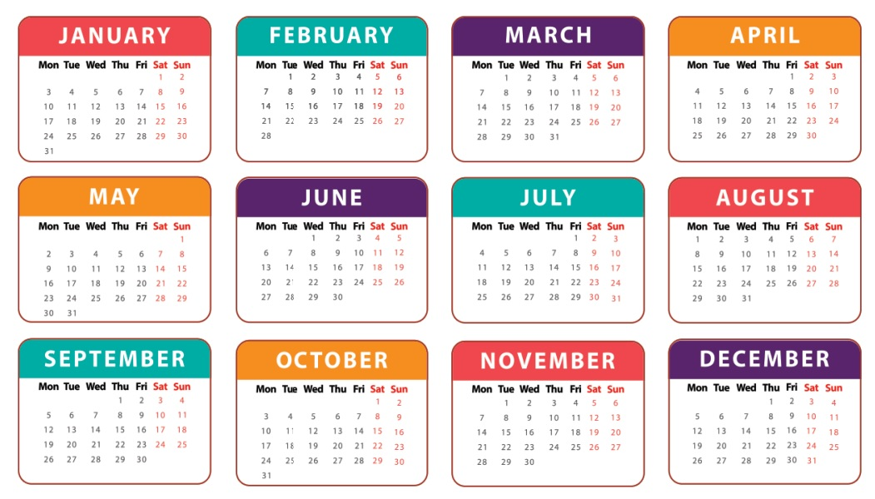
When’s your sports day?
It’s in June.

Slide 6
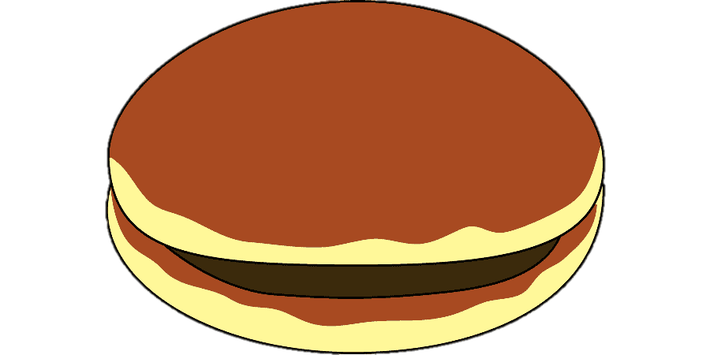
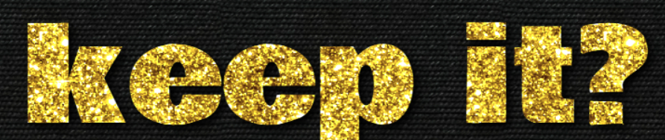
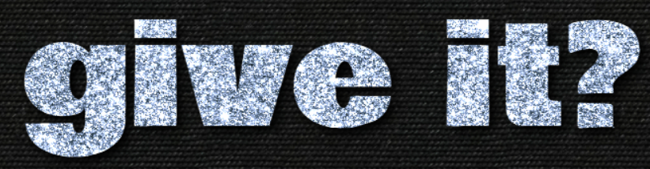
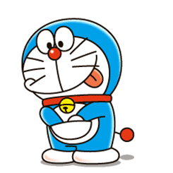
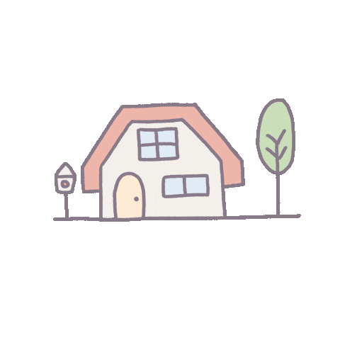
4 points
or

Slide 7
Is your sports day in February?
Yes, it is.

Slide 8
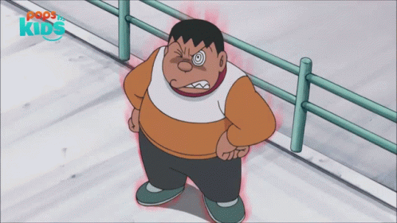

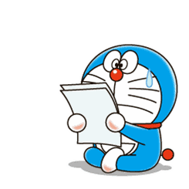
1 points
or

Slide 9
Is your sports day in July?
No, it isn’t.

Slide 10
3 points
or

Slide 11
When’s your sports day?
It’s in December.

Slide 12
2 points
or

Slide 13
When’s your birthday?
It’s in April.

Slide 14
2 points
or

Slide 15
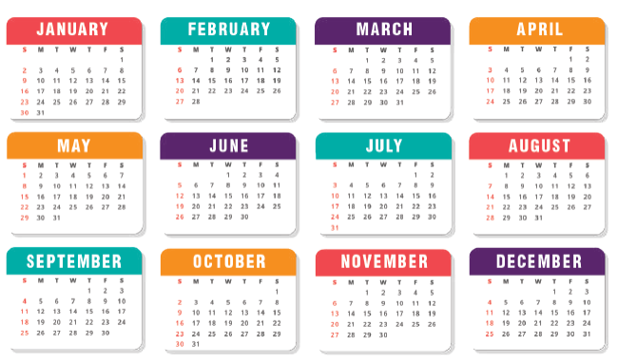
Is your sports day in October?
Yes, it is.

Slide 16
3 points
or

Slide 17
When’s your birthday?
It’s in May.

Slide 18
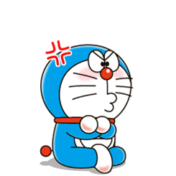
0 points
or

Slide 19
Is your sports day in January?
No, it isn’t.

Slide 20
6 points
or

Slide 21
02
Listen and repeat.

Slide 22
letter y
/i/
/aɪ/
February
July

Slide 23

1
Listen and repeat.
y February
Our sports day is in February.
y July
My birthday is in July.

Slide 24
03
Listen and circle.

Slide 25
2
Listen and circle.
1. Is your sports day in ___?
a. July b. February c. January
2. I like ___.
a. July b. January c. cycling

Slide 26
04
Let’s chant.

Slide 27


3
Let’s chant.
When’s your sports day?
In January, February or May?
In January, in January.
It’s in January.
When’s your sports day?
In May, June or July?
In July, in July.
It’s in July.

Slide 28
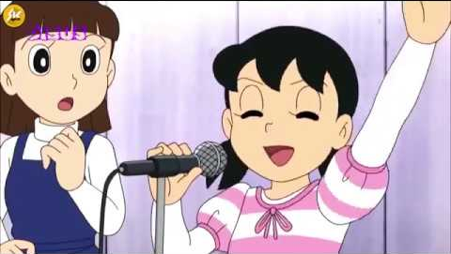
Chant like Shizuka does!

Slide 29
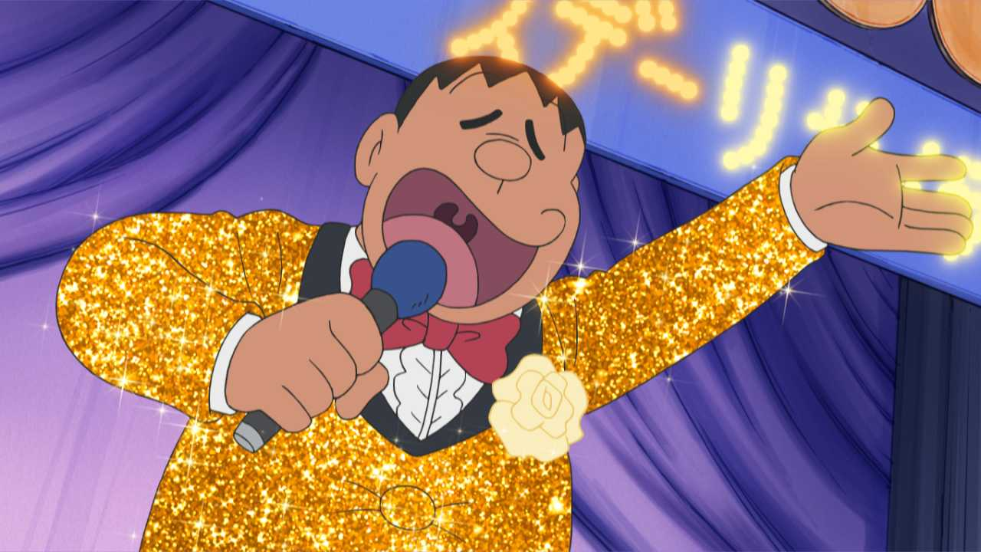
Chant like Jaian does!

Slide 30
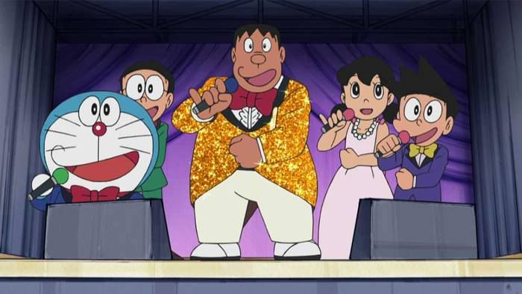
Let’s chant together!

