Slide 1
Our sports day
9
Lesson 3 - Period 6

Slide 2
TABLE OF CONTENTS
01
02
03
04
Review
Read and tick True or False.
Let’s write.
Project
05
Fun time

Slide 3
01
Review

Slide 4
Let’s chant.
When’s your sports day?
In January, February or May?
In January, in January.
It’s in January.
When’s your sports day?
In May, June or July?
In July, in July.
It’s in July.

Slide 5
02
Read and tick True or False.

Slide 6
Read the passage.
Our sports day is in November. It is in the school playground. There are many pupils and teachers. We play different sports and games. The boys play badminton. The girls play football. The teachers play basketball. It is a lot of fun!

Slide 7
True or False.
 | True | False
1. The sports day is in November.
2. The sports day is in the school gym.
3. The boys play badminton.
4. The girls play basketball.

Slide 8
03
Let’s write.

Slide 9
5
Let’s write.
Our school sports day is in ________. We play sports and games in the school playground. The girls _________. The boys __________. The teachers _________. We all love our sports day.
October
play chess
play football
play volleyball

Slide 10
04
Project

Slide 11
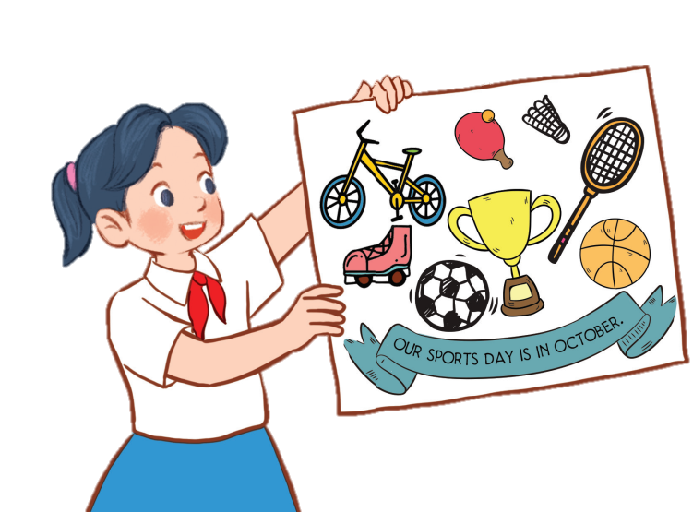
6
Project
Our sports day poster
Our sports day is in October. _______.

Slide 12
05
Fun time

Slide 13
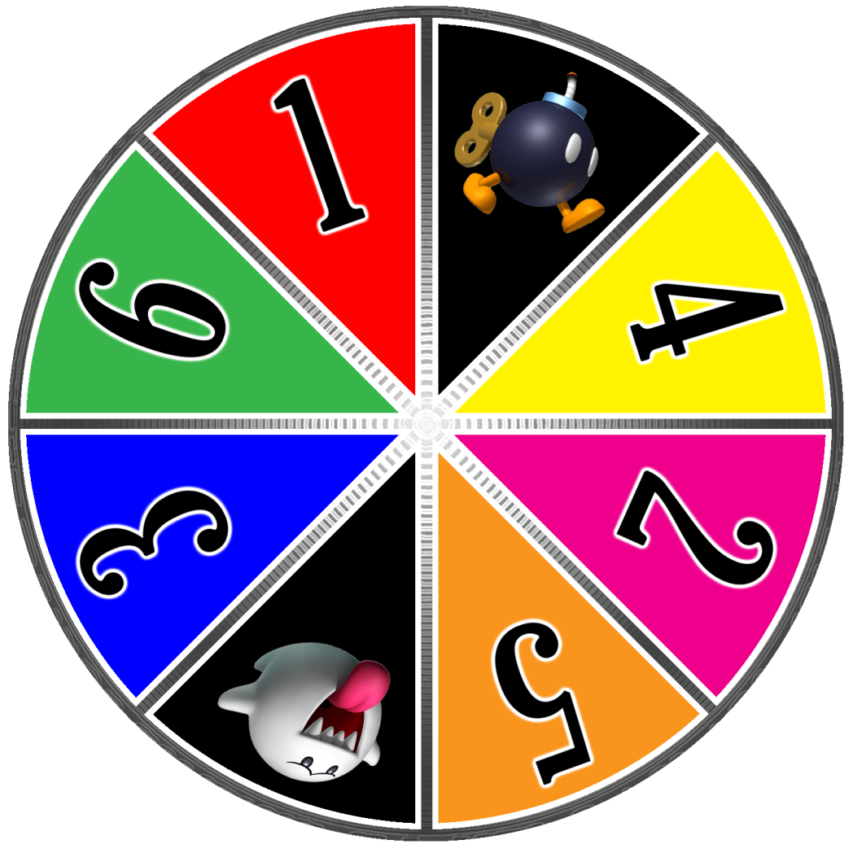

Slide 14
A
B
C
1
2
3
4
Notes:
24 Questions
Teacher says the first sentence. Student replies using the new structure. Click the rabbit to go back to question slide.

Slide 15
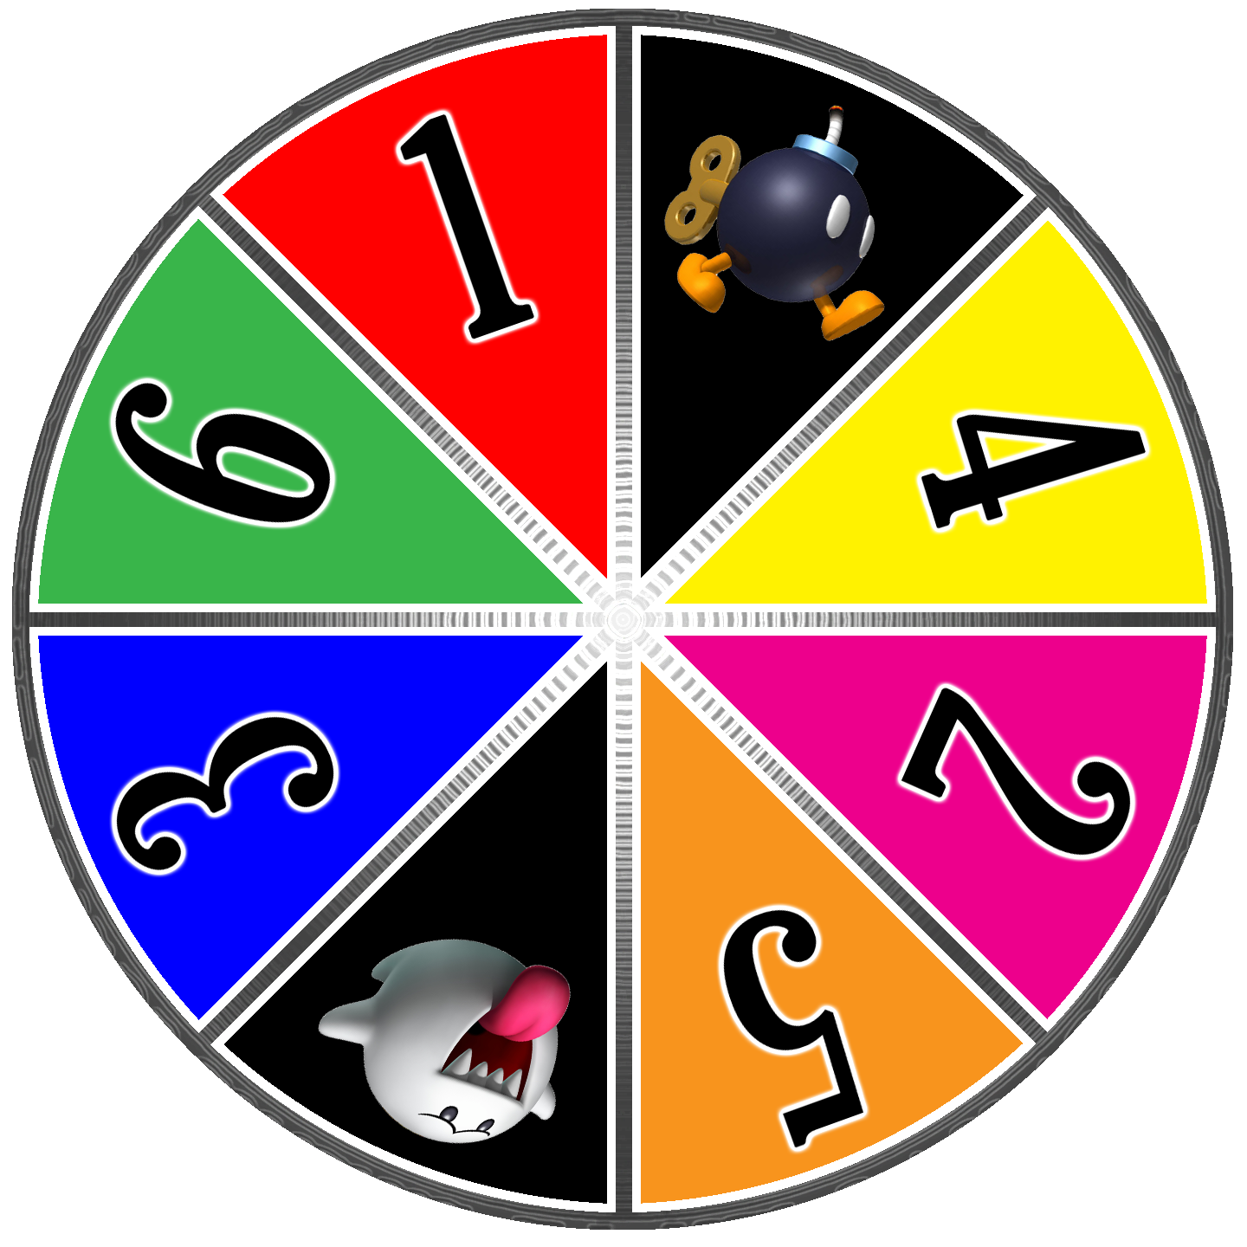
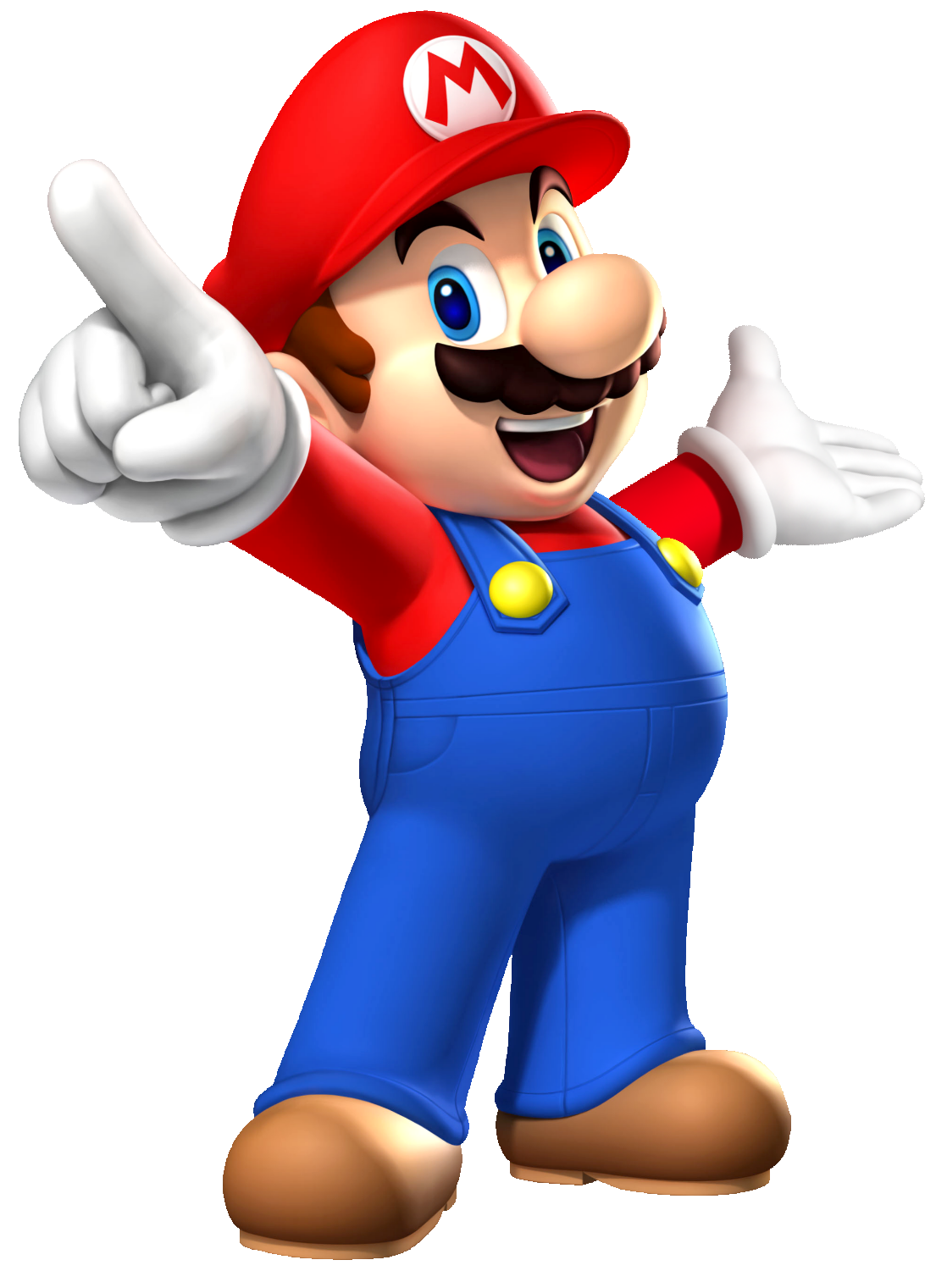

Slide 16
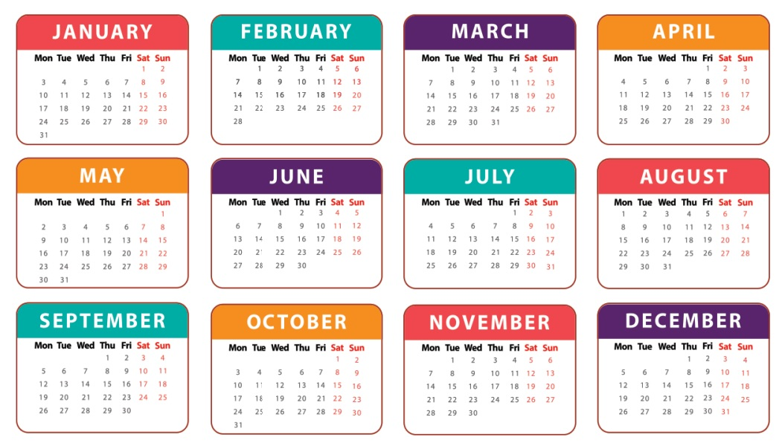
When’s your sports day?
It’s in August.

Slide 17
When’s your sports day?
It’s in September.

Slide 18
Is your sports day in June?
No, it isn’t. It’s in May.

Slide 19
When’s your sports day?
It’s in November.

Slide 20
Our …………..…… is in July.
sport days
sports day
Notes:
Students fill in the blank

Slide 21
My …………..…… is in December.
birth day
birthday
Notes:
Students fill in the blank

Slide 22
When’s your sports day?
It’s in April.

Slide 23
When’s your birthday?
It’s in …….
Notes:
Students fill in the blank

Slide 24
Our sports day is ……… March.
in
on

Slide 25
Our sports day is in November.
True
False

Slide 26
Our sports day is in ………...
July
August
Notes:
Students fill in the blank

Slide 27
Our sports day is in February.
True
False

