Slide 1



UNIT 6 – UNIT 10
Review

Slide 2


WARM-UP ACTIVITY
Song: Move!
Song With Actions
Stand up
Listen to the song
Dance along
Notes:
Link youtube: https://www.youtube.com/watch?v=YzSJBowPECY&t=1s

Slide 3
REVIEW VOCABULARY

Slide 4




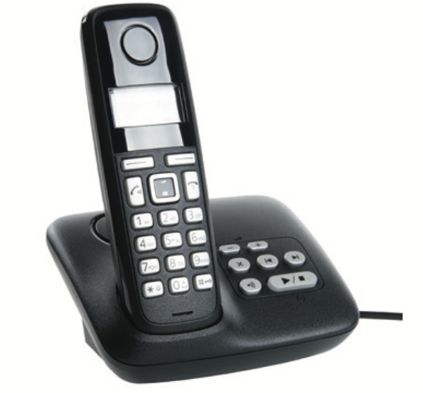

VOCABULARY – Unit 6
REVIEW
computer
tablet
email
letter
telephone
mobile phone
- Show picture one by one, students look and say the word.
- Show the word, students spell it again.

Slide 5

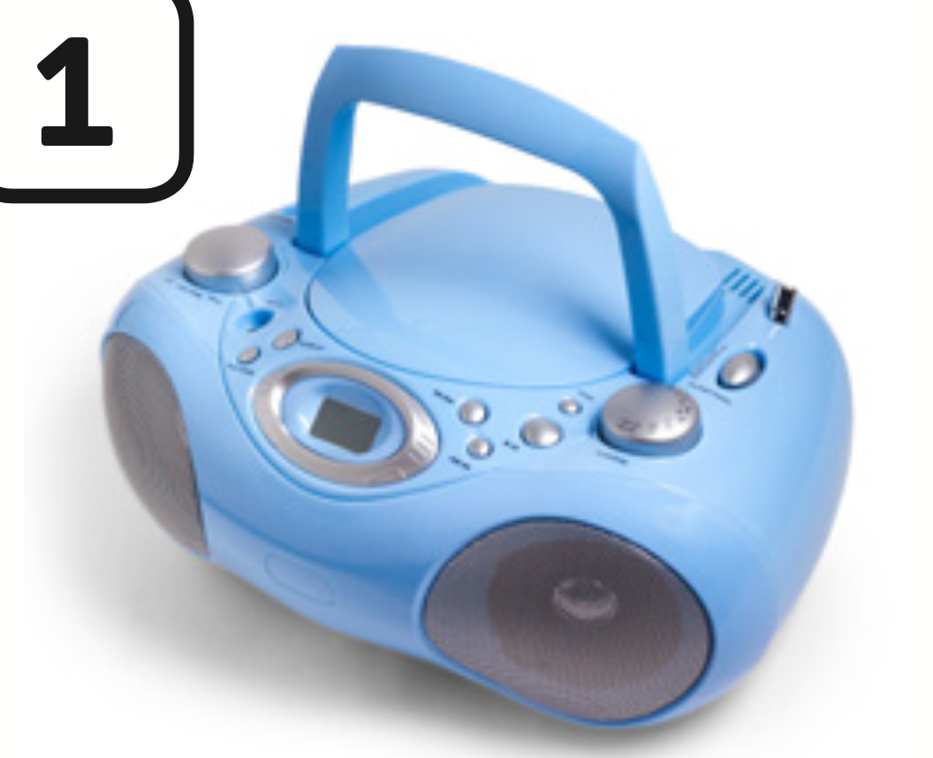





VOCABULARY – Unit 6
REVIEW
CD player
mouse
keyboard
study
use
call
- Show one by one picture, students look and say the word.
- Show the word, students spell it again.

Slide 6

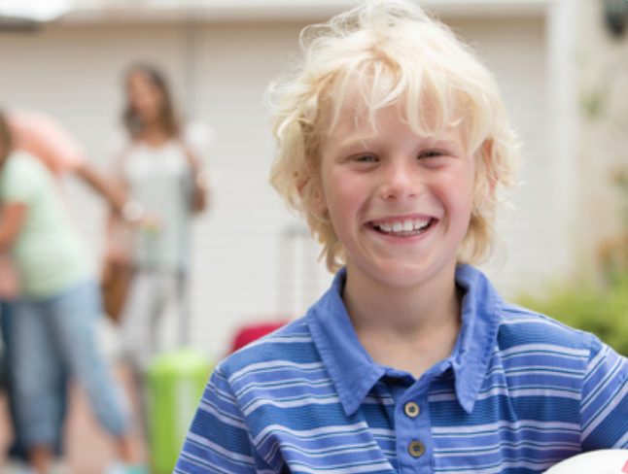

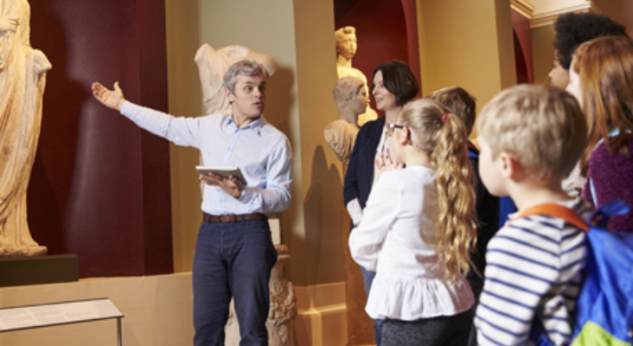
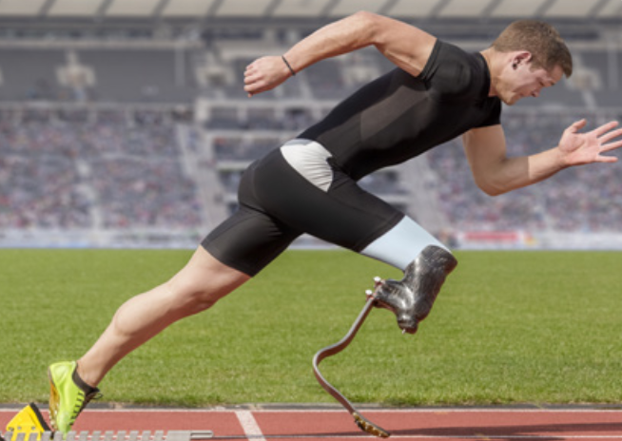
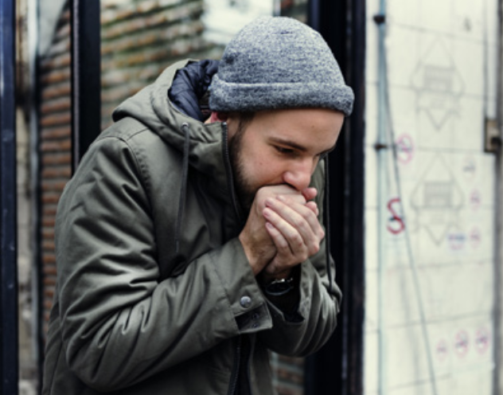

VOCABULARY – Unit 6
REVIEW
c
c
c
live
visit
arrive
c
c
c
start
stop
need
Show each picture, students look at and say the word.

Slide 7
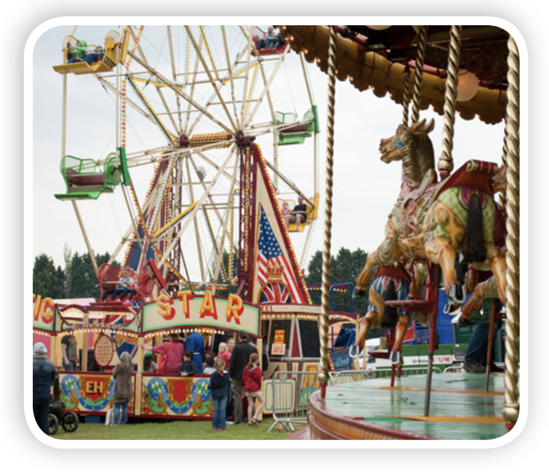
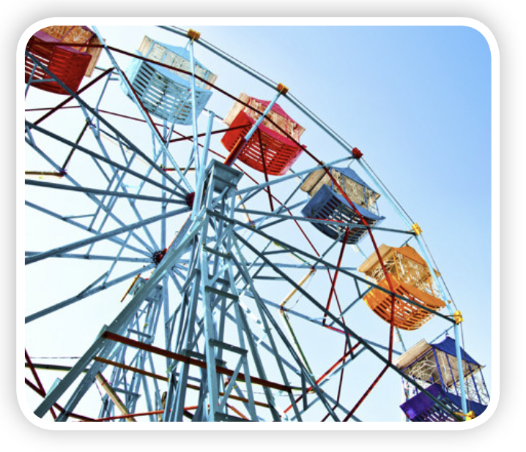
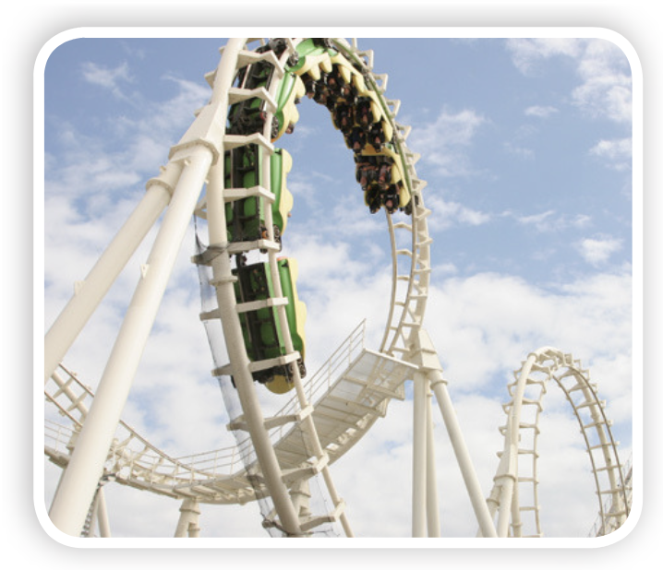
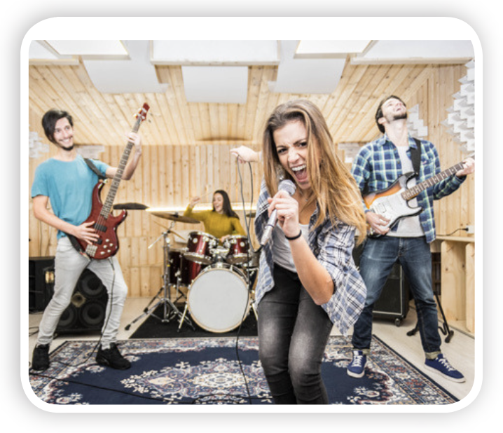

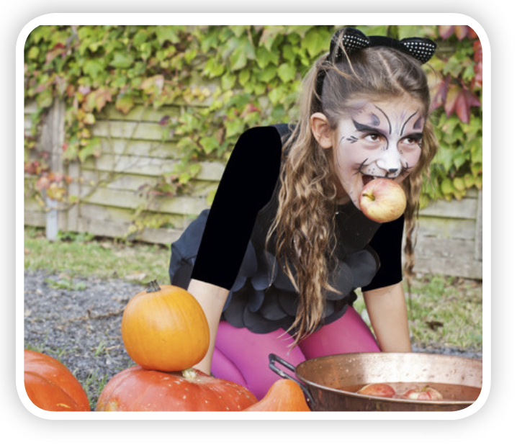
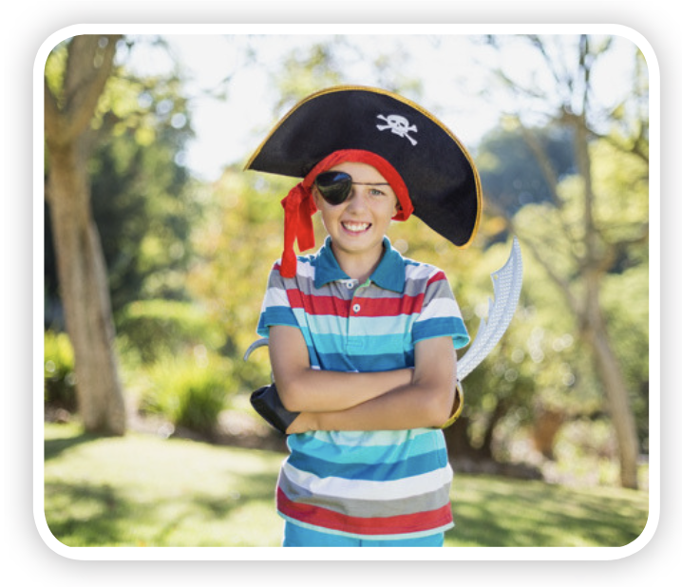

VOCABULARY – Unit 7
REVIEW
c
c
c
c
funfair
big wheel
rollercoaster
band
c
c
c
c
party
party games
costume
party hat
Show each picture, students look at and say the word.

Slide 8
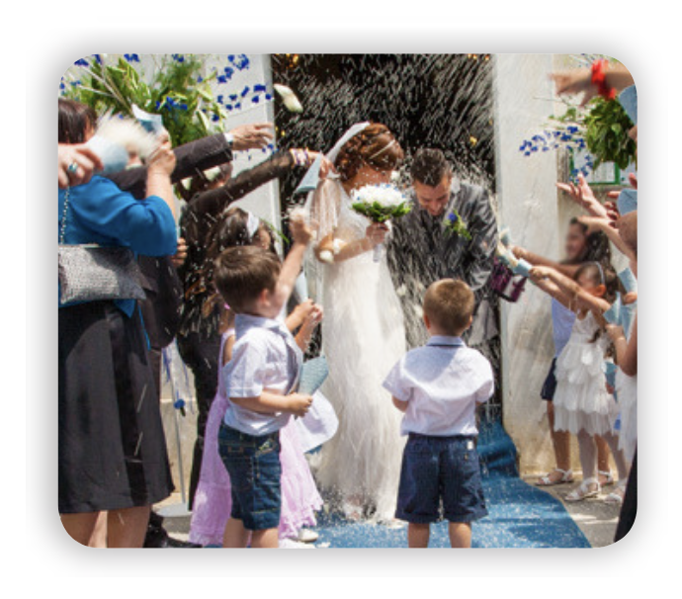
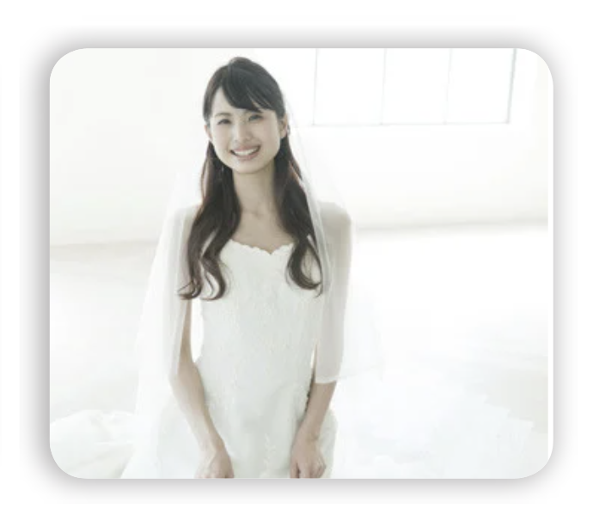
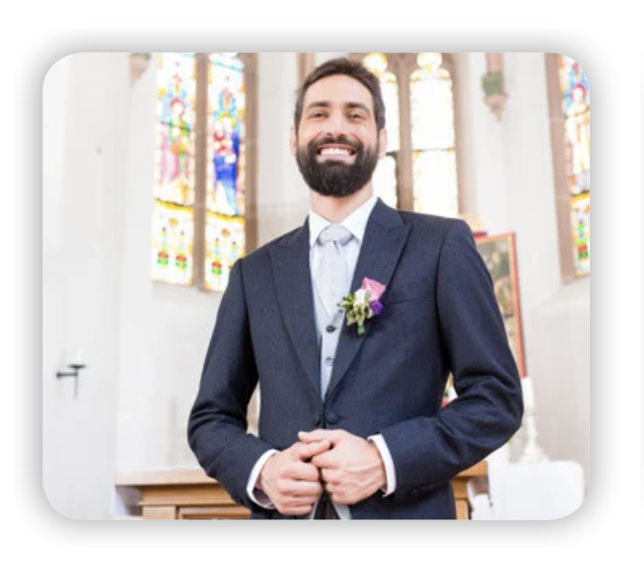


VOCABULARY – Unit 7
REVIEW
wedding
bride
groom
invitation
honeymoon
Show each picture, students look at and say the word.

Slide 9
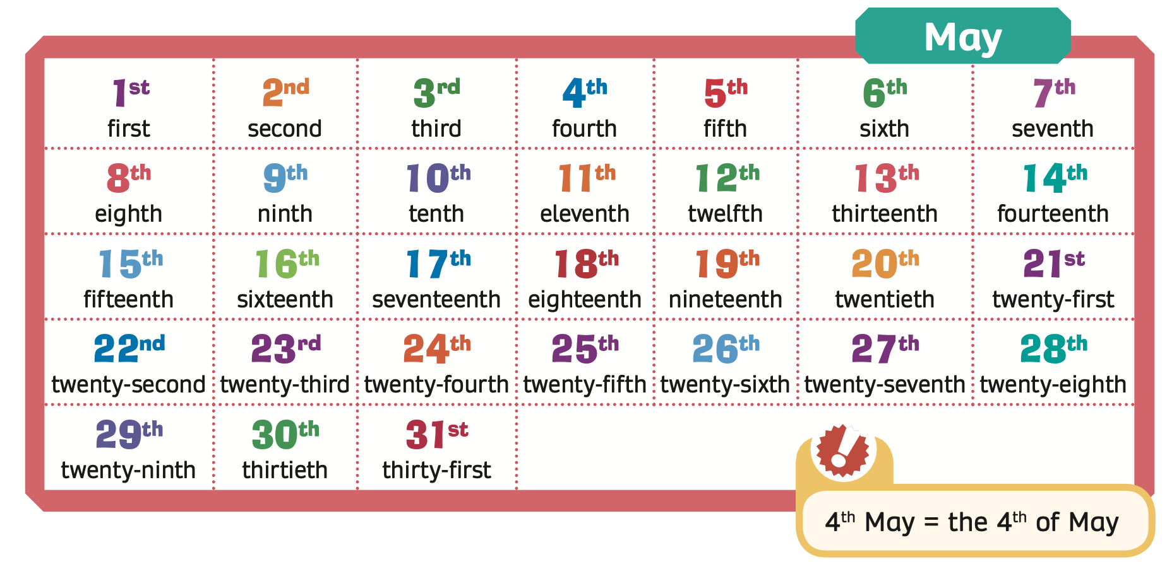
VOCABULARY – Unit 7
REVIEW
Show the picture, students look at and say the word.

Slide 10




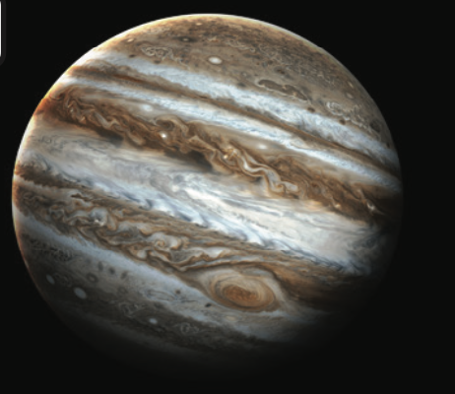



VOCABULARY – Unit 8
REVIEW
1
2
3
4
Mercury
Venus
Earth
Mars
5
6
7
8
Jupiter
Saturn
Uranus
Neptune
- Show all the pictures; the teacher says the number, and students say the word.
- Click on each number to show the word, students spell it again.

Slide 11


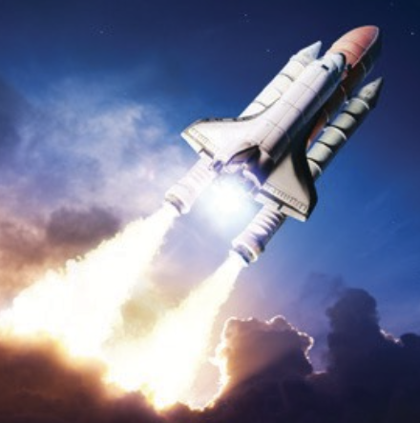
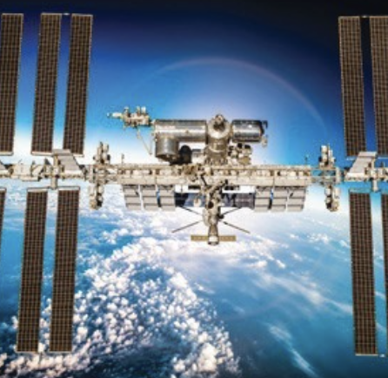
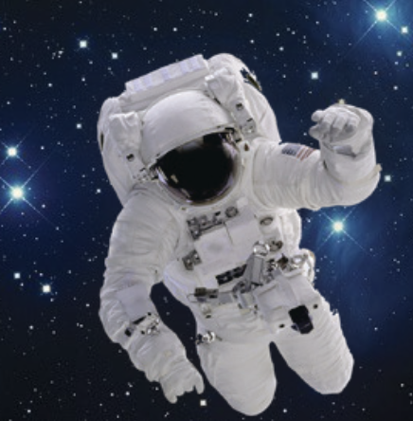
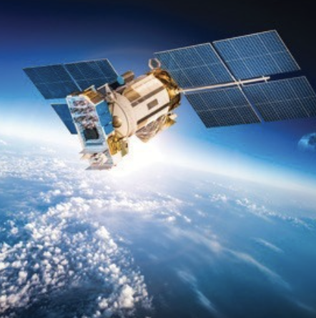
VOCABULARY – Unit 8
REVIEW
1
2
3
telescope
comet
rocket
4
5
6
space station
spacesuit
satellite
The teacher says a number and the students say a word.
Click on “Number” to show the word to check.

Slide 12








VOCABULARY – Unit 8
REVIEW
a hundred
five hundred
a thousand
five thousand
ten thousand
fifty thousand
a hundred thousand
a million
Show one by one picture, students look and say the word aloud.

Slide 13
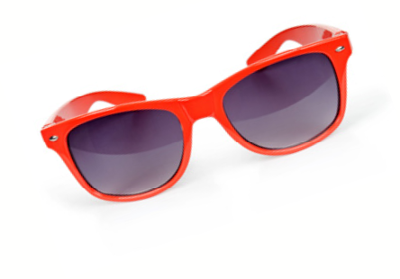

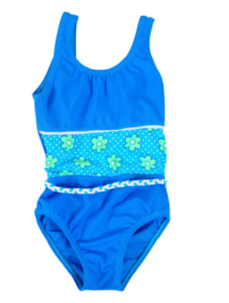
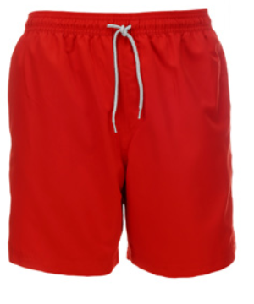

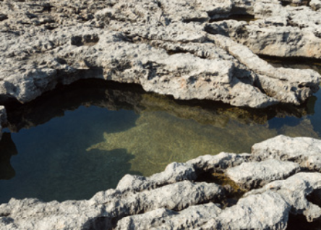

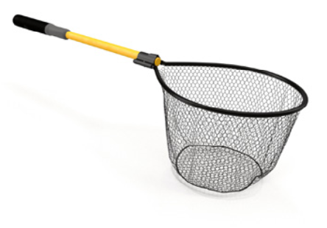
VOCABULARY – Unit 9
REVIEW
1
2
3
4
sunglasses
beach towel
swimsuit
swimming trunks
5
6
7
8
sun hat
rockpool
bucket
fishing net
- Show all the pictures; the teacher says the number, and students say the word.
- Click on each number to show the word, students spell it again.

Slide 14
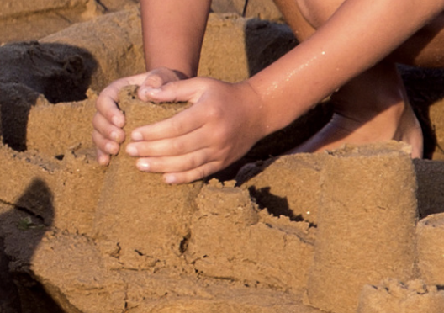
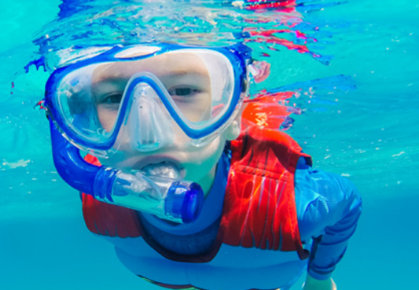
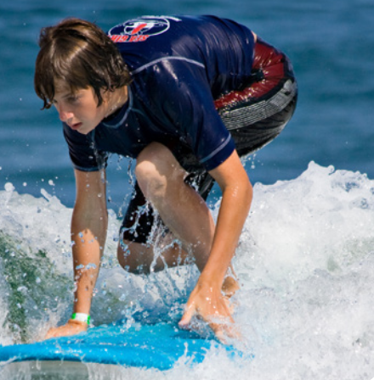
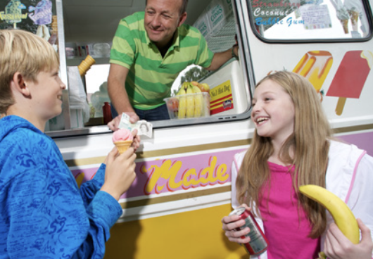
VOCABULARY – Unit 9
REVIEW
build a sandcastle
go snorkelling
go surfing
buy an ice cream
- Show all the pictures; students look at and say the words aloud.

Slide 15
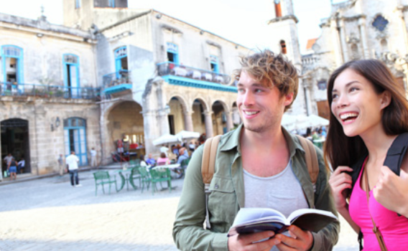
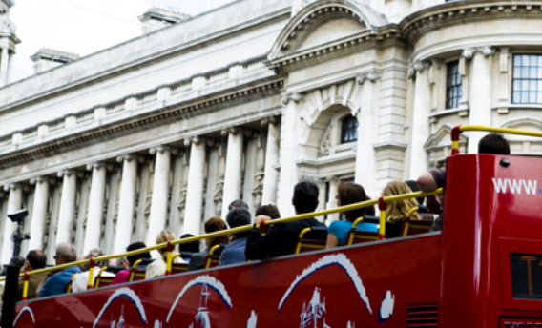
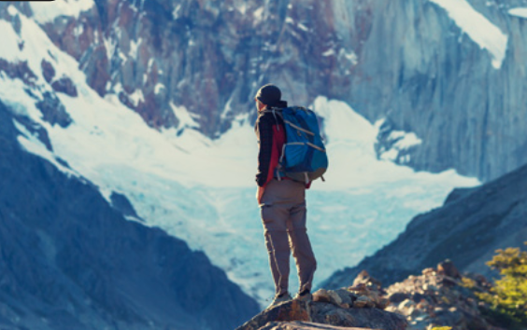
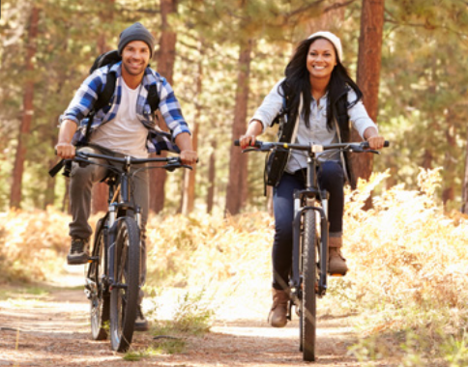

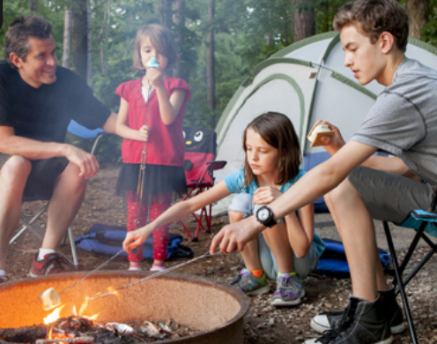
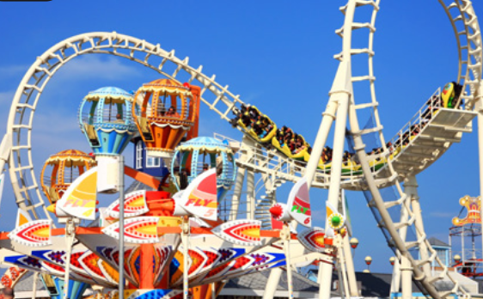
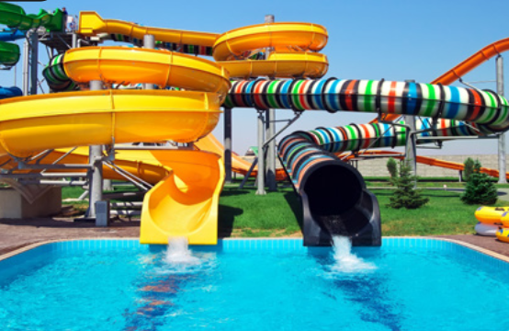
VOCABULARY – Unit 9
REVIEW
1
2
3
4
go sightseeing
take a bus tour
go hiking
go mountain biking
5
6
7
8
climb a mountain
go camping
visit a theme park
visit a waterpark
- Show all the pictures; the teacher says the number, and students say the word.
- Click on each number to show the word, students spell it again.

Slide 16
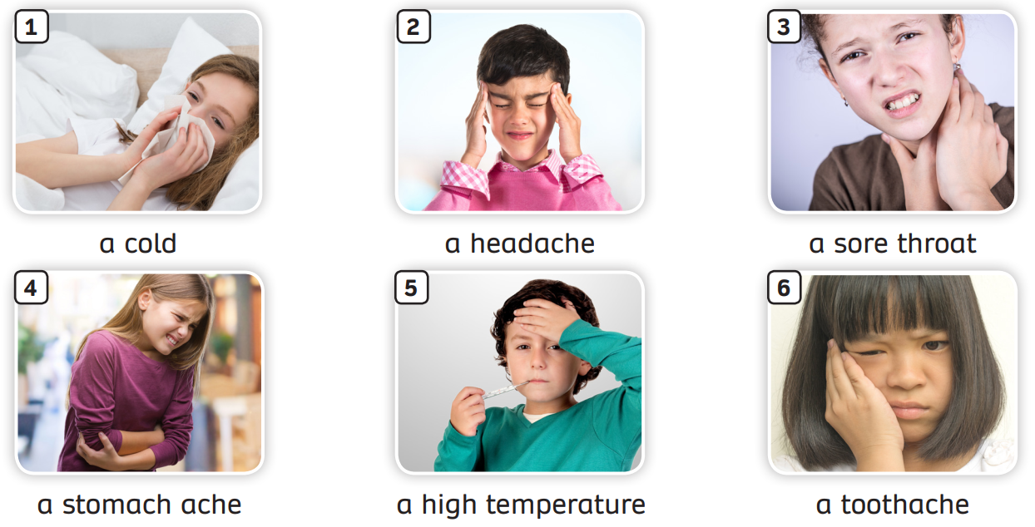
VOCABULARY – Unit 10
REVIEW
Try to memorise all the pictures and the numbers within 30 seconds.
The teacher moves to a different slide, calls a number randomly. (Ex: Number 2)
Students raise their hands and answer.

Slide 17
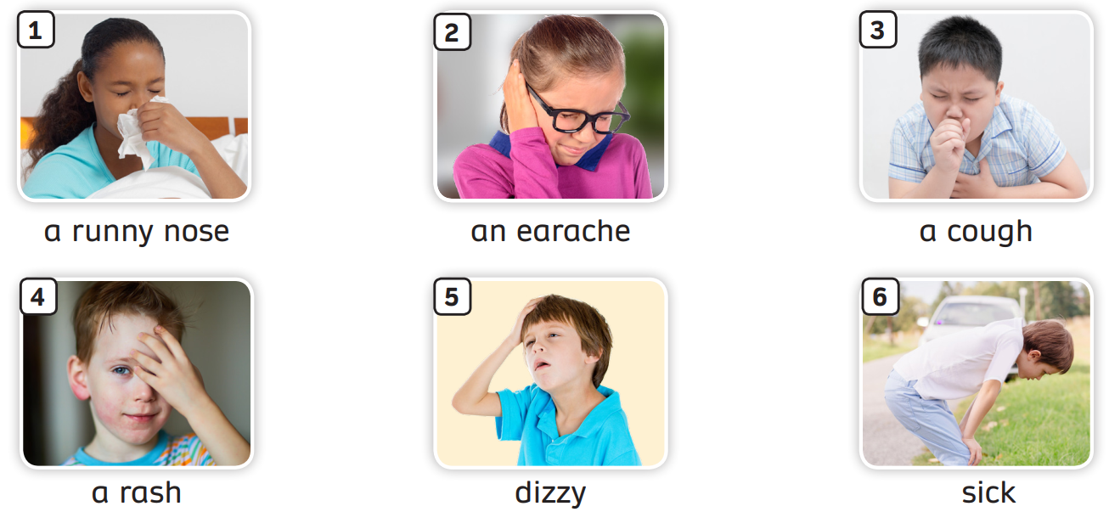
VOCABULARY – Unit 10
REVIEW
The teacher asks students to review all the words.

Slide 18
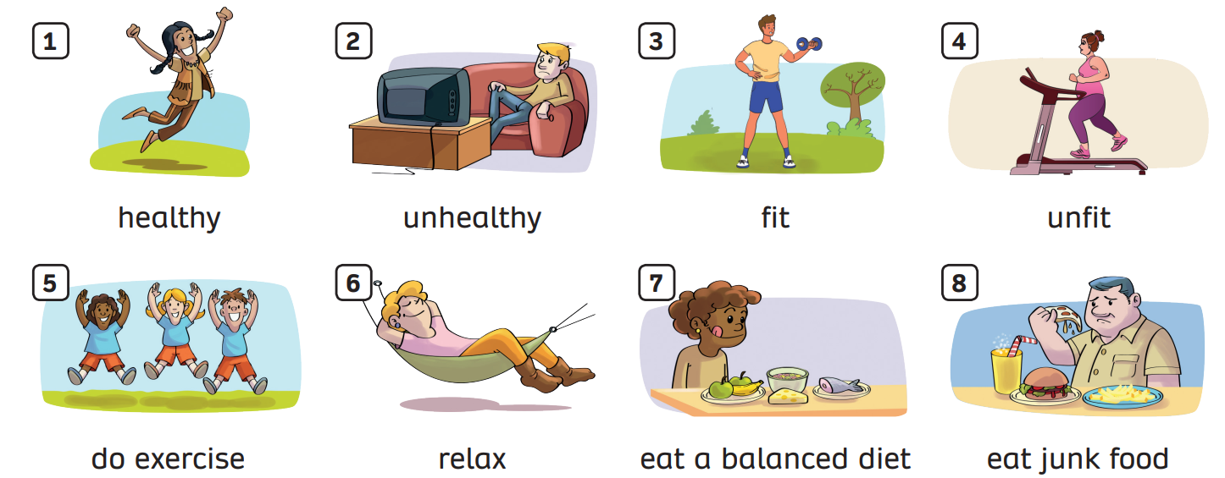
VOCABULARY – Unit 10
REVIEW
The teacher asks students to review all the words.

Slide 19


VOCABULARY – Practice
Divide the class into two teams: team A and team B.
Each student takes out a mini-board.
Students look at the picture and write down the answer.
If all students in the team write the correct answer, that team will receive 2 points. But if the team has 2 or 3 students write the wrong picture, they won’t receive points.
The team with the highest points wins the game.

Slide 20




Slide 21


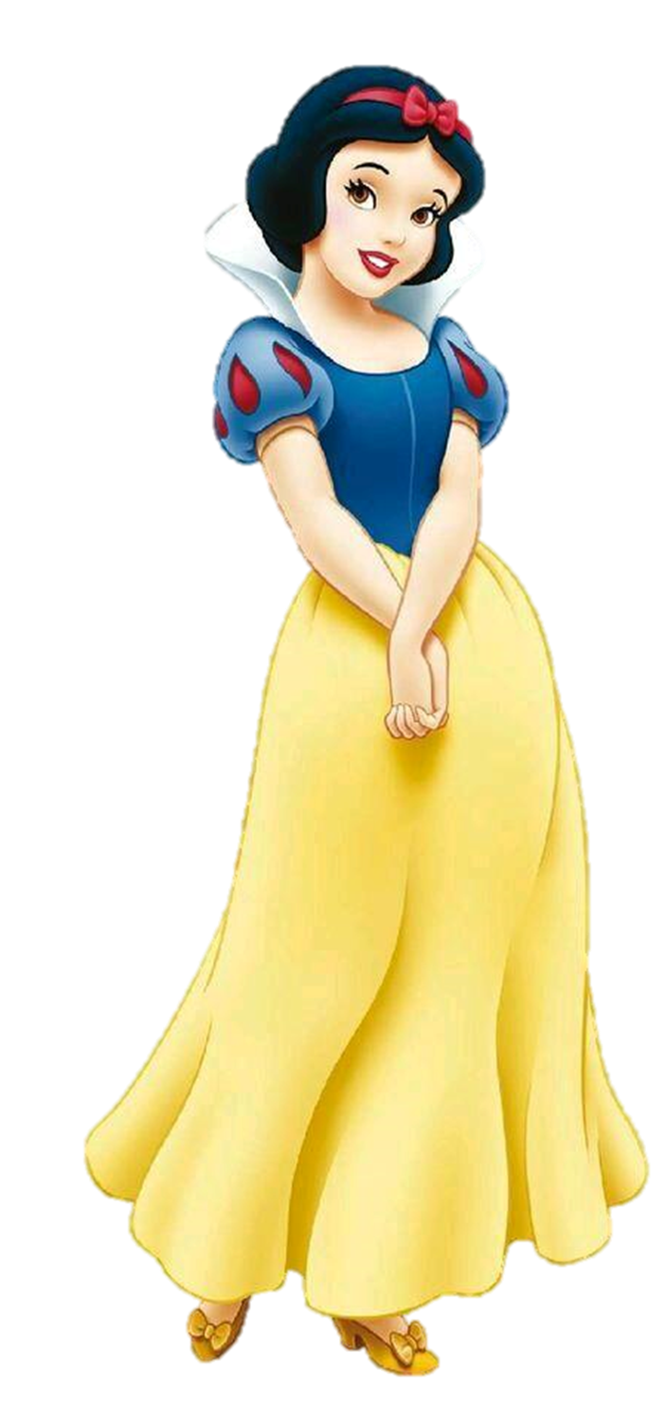
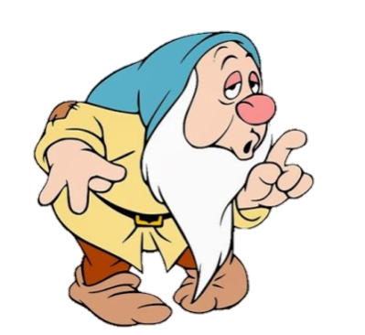
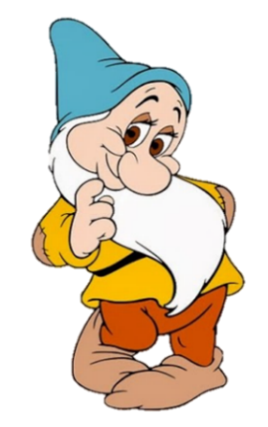
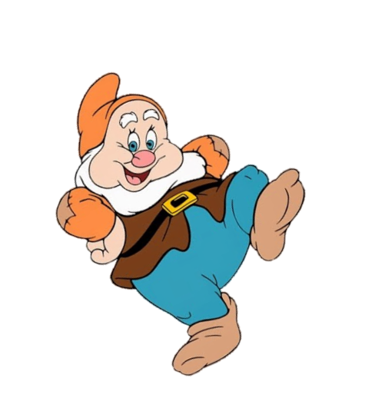
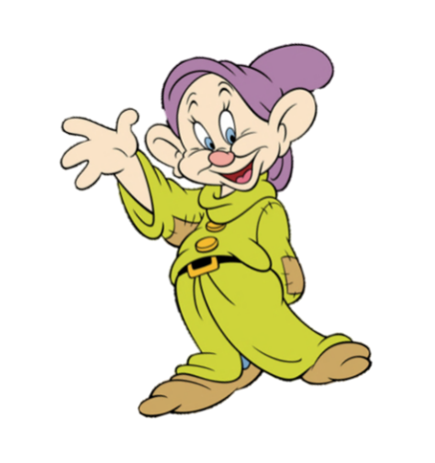
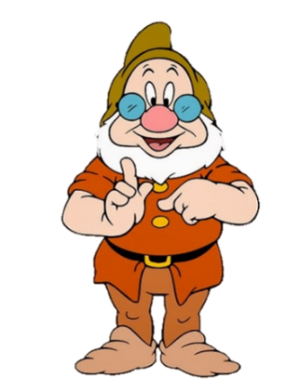
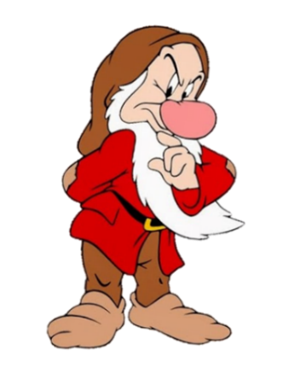
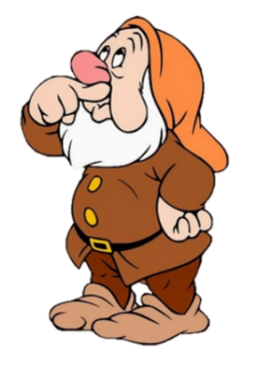

telescope
rocket
space station
honeymoon
next

Slide 22
bride
groom
invitation
honeymoon
next

Slide 23
fun fair
party games
rollercoaster
party hats
next

Slide 24
swimming trunks
hat
swimsuit
beach towel
next

Slide 25
wedding
groom
honeymoon
invitation
next

Slide 26
stop
use
start
need
next

Slide 27
healthy
unhealthy
fit
relax
next

Slide 28
go sightseeing
go hiking
take a bus tour
go camping
next

Slide 29
groom
bride
honeymoon
wedding
next

Slide 30
Venus
Uranus
Jupiter
Saturn
next

Slide 31
healthy
relax
do exercise
fit
next

Slide 32
keyboard
DVD player
mouse
CD player
next

Slide 33
five thousand
fifty
fifty million
fifty thousand
next

Slide 34
go sightseeing
go swimming
go snorkelling
go surfing
next

Slide 35
dizzy
runny nose
earache
sick
next

Slide 36
mobile phone
computer
telephone
email
next

Slide 37
twelfth, thirteenth, fourteenth
twelveth, thirteenth, fourteenth
twelfth, thirteenth, forteenth
twelfth, thirdteenth, fourteenth
next

Slide 38
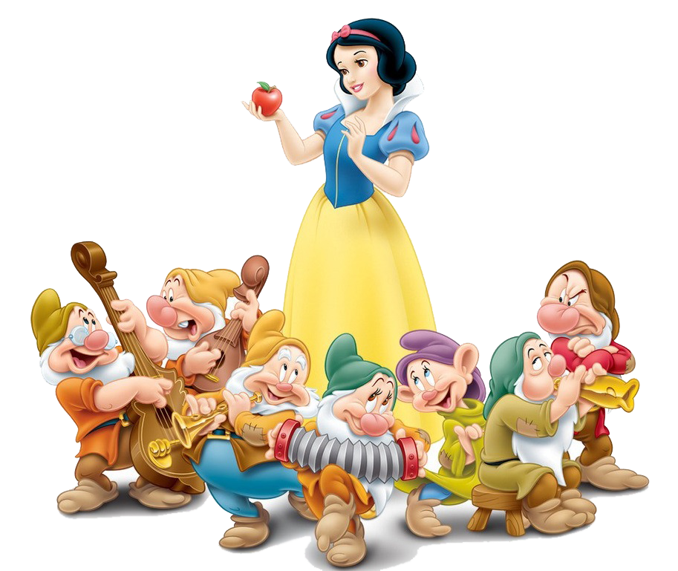

Slide 39
REVIEW GRAMMAR

Slide 40

GRAMMAR – Unit 6
REVIEW
STRUCTURE – SENTENCES
Use these sentences about the past tense with regular verbs
S + V-ed + O
S + didn’t + V_inf

Slide 41
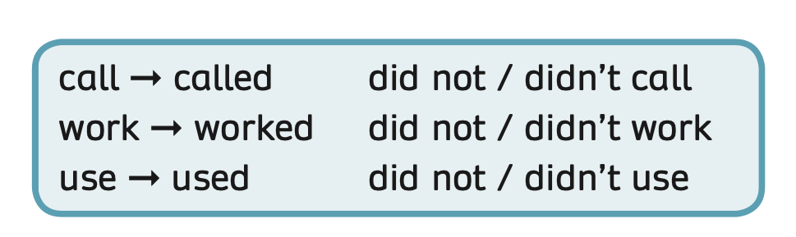
GRAMMAR – Unit 6
REVIEW
Have students look at the box.
Review the regular verbs in past tense end “-ed”.

Slide 42
GRAMMAR – Unit 6
REVIEW
STRUCTURE – SENTENCES
How to make questions in the past simple
When + did + S + V_inf?
S + V-ed

Slide 43


GRAMMAR – Unit 7
REVIEW
V_inf
Irregular verbs
get
got
have
had
write
wrote
wear
wore
eat
ate
go
went
drink
drank
- Show the table of irregular verbs, students listen and repeat.

Slide 44
GRAMMAR – Unit 7
REVIEW
STRUCTURE – SENTENCES
Use these sentences to ask about the date of birth.
When is your birthday?
It’s on …

Slide 45
GRAMMAR – Unit 8
REVIEW
STRUCTURE – SENTENCES
Use these sentences to tell about the present future (will).
- They will/ They’ll …
- They will not …

Slide 46
GRAMMAR – Unit 8
REVIEW
STRUCTURE – SENTENCES
Make Wh-questions with How.
Use the structures How far…? How tall…? How deep…?
How will + S + V_inf ?
How + adjective + will + S + V_inf?

Slide 47
GRAMMAR – Unit 9
REVIEW
STRUCTURE
Use these sentences to talk about planned events in the future.
going to + V_inf
- I’m going to … / We’re going to …
- I’m not going to … / We aren’t going to…

Slide 48
GRAMMAR – Unit 9
REVIEW
STRUCTURE – QUESTION?
Use the question to ask about planned events in the future.
Are + S + going to + V_inf?
- Are you going to …?

Slide 49
GRAMMAR – Unit 9
REVIEW
STRUCTURE – ANSWERS
We will use:
Yes, I am.
No, I’m not.

Slide 50
GRAMMAR – Unit 10
REVIEW
S + should + V (bare inf) + …
ex: You should take a rest.
S + shouldn’t + V (bare inf) + …
ex: You shouldn’t go outside.
Ask students to look and make some sentences.

Slide 51

GRAMMAR – Unit 10
REVIEW
We use to + be / verb to show the purpose.
ex: I’m running to be fit and healthy.
I went to the supermarket to buy fruit.
Ask students to look at the example.

Slide 52
PRACTICE
Activity: Make the sentences
Divide the class into groups of 4.
Each team prepares a mini-board. Students take turns to write (One student one word)
Read the sentence and discuss finishing it using the given words.
Write the sentence on the board.
The faster team with the correct answer can get 2 points

Slide 53


Make the sentences
Start

Slide 54



go to the doctor’s / go outside
Check
Next
You should go to the doctor’s. You shouldn’t go outside.

Slide 55

Check
Did/like/they/country/this?
Next
Did they like this country?

Slide 56
People/call/each other/by a telephone.
Check
People called each other by a telephone.
Next

Slide 57

The guests/ wear/ nice/ costumes
Check
Next
The guests wore nice costumes.

Slide 58
I need to buy some trainers. I’m going to a sports shop.
Check
Next
I’m going to a sports shop to buy some trainers.

Slide 59
My parents/ get/ married/ 2005
Check
Next
My parents got married in 2005.

Slide 60

Check
Next
9th

Slide 61
We/not/will/bring/clothes/many/and/a/of/lot/water/./
Check
Next
We will not bring many clothes and a lot of water.

Slide 62

Check
drink/ lemonade / Lily’s party
Next
We drank lemonade at Lily’s party.

Slide 63

How/ you/ stay/ space station?
Check
Next
How will you stay in space station?

Slide 64
will/We/do/Maths/homework/ tomorrow/our/./
Check
Next
We will do our Maths homework tomorrow.

Slide 65

How/ many/ planets/ solar system?
Check
Next
How many planets in the solar system?

Slide 66

I/ will/ snorkelling/ tomorrow
Check
Next
I will go snorkelling tomorrow.

Slide 67
will/They/use/modern/a/ telescope/study/to/the/planets/./
Check
They will use a modern telescope to study the planets.
Next

Slide 68

She/ go/ fun fair/ her family/last weekend
Check
Next
She went to a funfair with her family last weekend.

Slide 69
Excellent!
End

Slide 70

PRODUCTION
Put students in pairs.
Students look at the pictures related to birthday party on the slide or Activity 4 on page 85 of Pupils’ Book.
Then, they switch roles to ask and answer about birthdays.
After practising, the teacher invites some pairs to play roles ask and answer about birthdays.

Slide 71



PRODUCTION
- Draw students’ attention to 2 questions and elicit how they might answer.
- Show the example bubbles, students look at them and read aloud.

Slide 72


PRODUCTION
When’s your birthday?
It’s on …
January
April
July
October
February
May
August
November
March
June
September
December
- Divide the class into 2 teams. One team asks and one team answers.
- Then, they switch roles.

Slide 73
PRODUCTION
What did you do on your last birthday?
I ….
played in a band
played party games
dressed up
- Divide the class into 2 teams. One team asks and one team answers.
- Then, they switch roles.

Slide 74
PRODUCTION
What did you eat at
your birthday?
I ….
ate cake
drank lemonade
ate spring rolls
- Divide the class into 2 teams. One team asks and one team answers.
- Then, they switch roles.

Slide 75
HOMEWORK
Review vocabulary and grammar.
Do exercises in the Activity Book.

