Slide 1


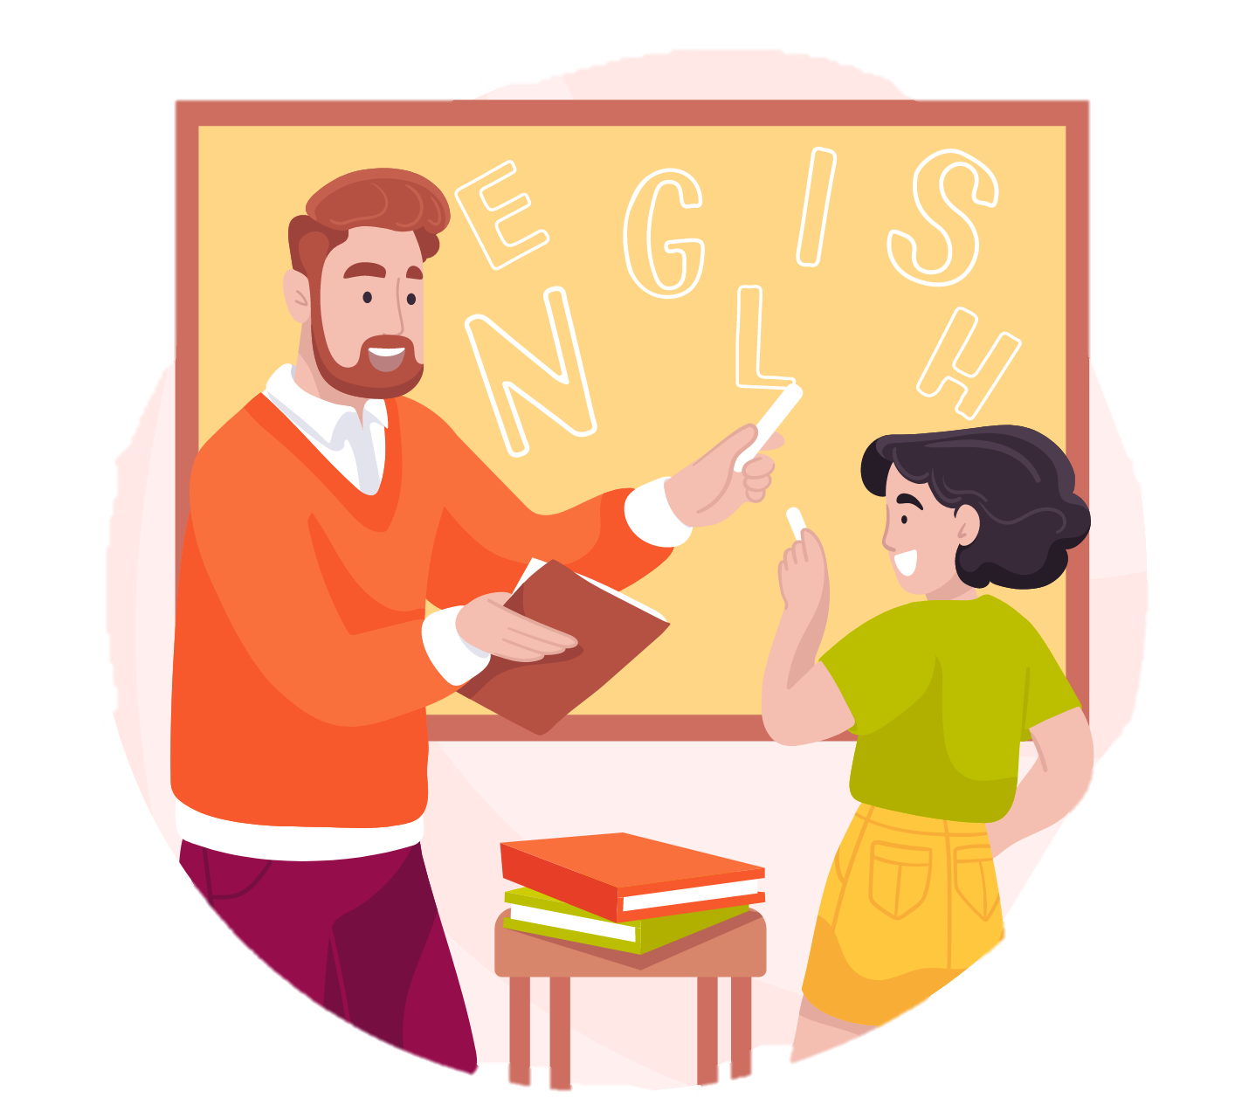
UNIT 0 – MY NEW NEIGHBOURS
Lesson 1 – Classroom Language

Slide 2


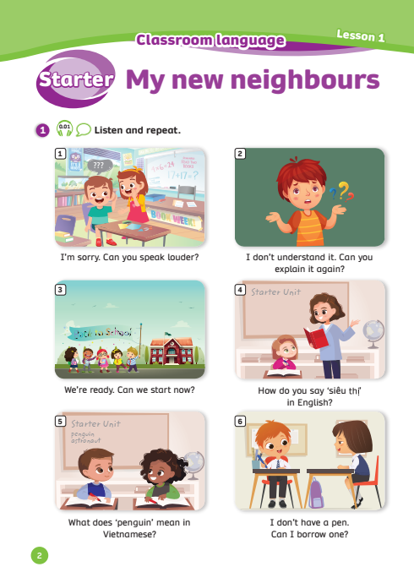
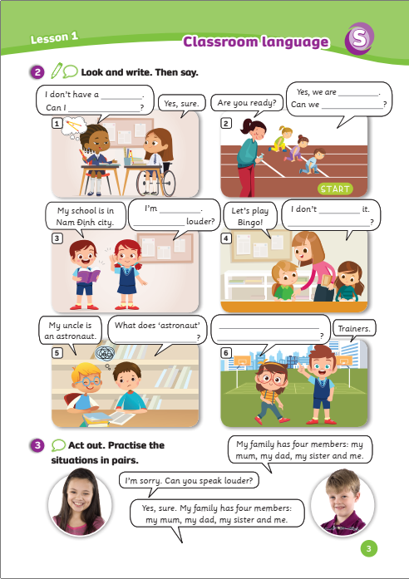
UNIT 0 – Lesson 1
We’re learning…
- Classroom language
- PB p.2,3
- AB p.2

Slide 3

WARM-UP ACTIVITY
Activity: THE NAME GAME
- The teacher asks students to walk around and clap their hands.
- The students shake the closest student’s hands when the teacher say “stop”.
- Then, introduce themselves with simple sentences (Ex: Hi, Nice to meet you! My name is …. What’s your name?) in 30 seconds.
- The teacher opens the music again, and students walk around and find a new partner (repeat the process 3 to 4 times).

Slide 4

WARM-UP SONG

Slide 5

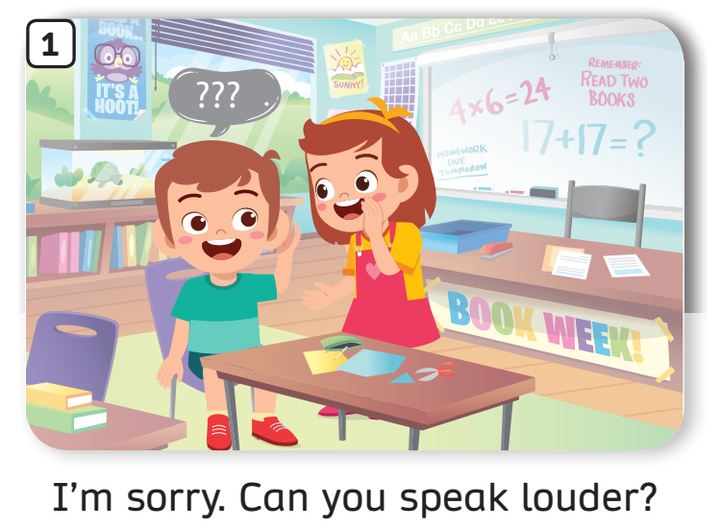
LISTEN AND REPEAT – Pupils’ book (p.2)
Play the audio, students listen and repeat the sentences.

Slide 6
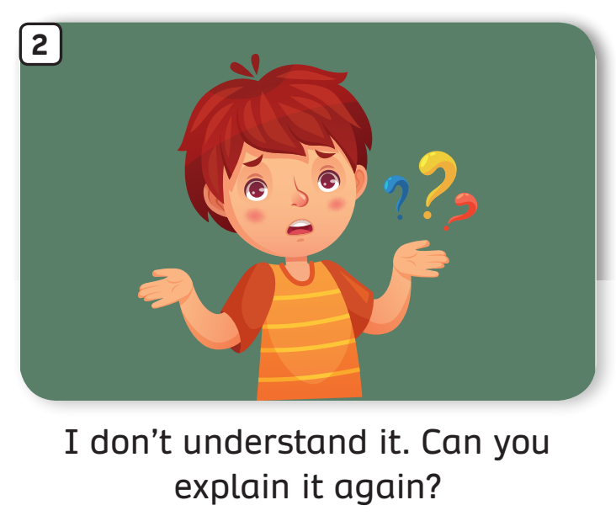
LISTEN AND REPEAT – Pupils’ book (p.2)
Play the audio, students listen and repeat the sentences.

Slide 7
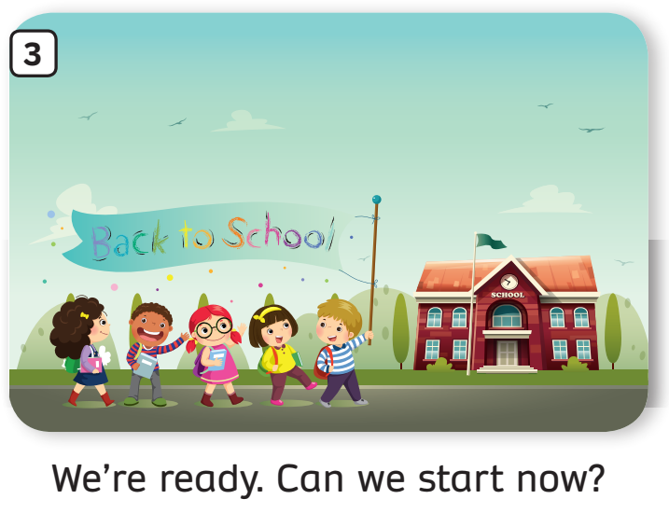
LISTEN AND REPEAT – Pupils’ book (p.2)
Play the audio, students listen and repeat the sentences.

Slide 8
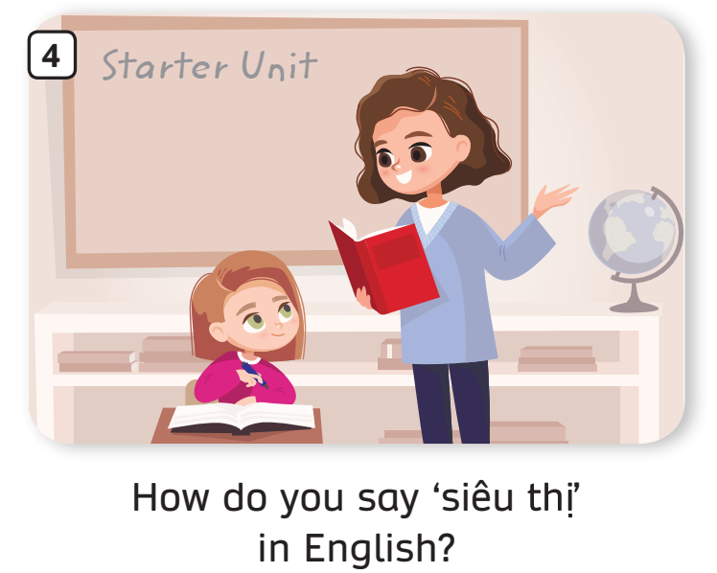
LISTEN AND REPEAT – Pupils’ book (p.2)
Play the audio, students listen and repeat the sentence.

Slide 9
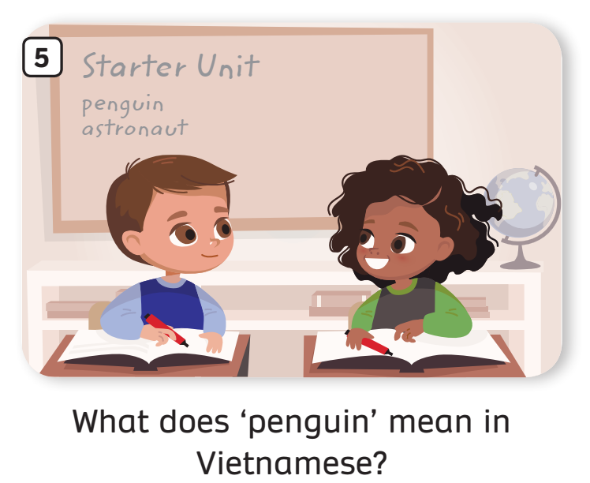
LISTEN AND REPEAT – Pupils’ book (p.2)
Play the audio, students listen and repeat the sentence.

Slide 10
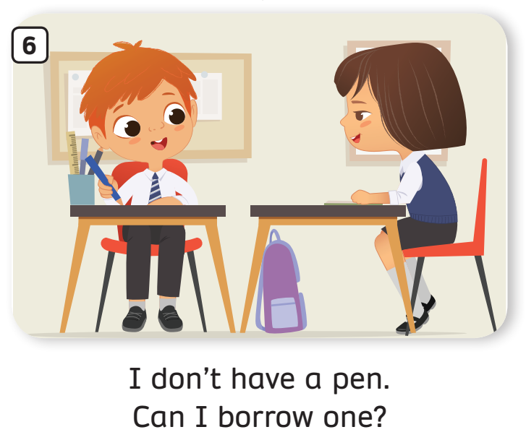
LISTEN AND REPEAT – Pupils’ book (p.2)
Play the audio, students listen and repeat the sentences.

Slide 11
Classroom Language
The teacher says the numbers, students say the sentence.

Slide 12
Classroom Language
Activity: Finish the sentence
Divide the class into pairs.
Each student in pairs takes out a mini-board.
Look at the conversation in the picture.
Discuss and write down the correct word on the board in 20 seconds.
One correct answer = +2 points (If 2 members write the correct word).
The pair with the highest point wins the game.

Slide 13

Finish the sentence

Slide 14
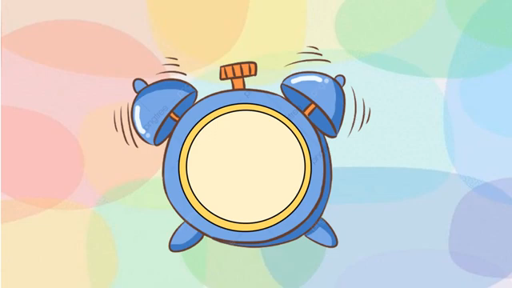
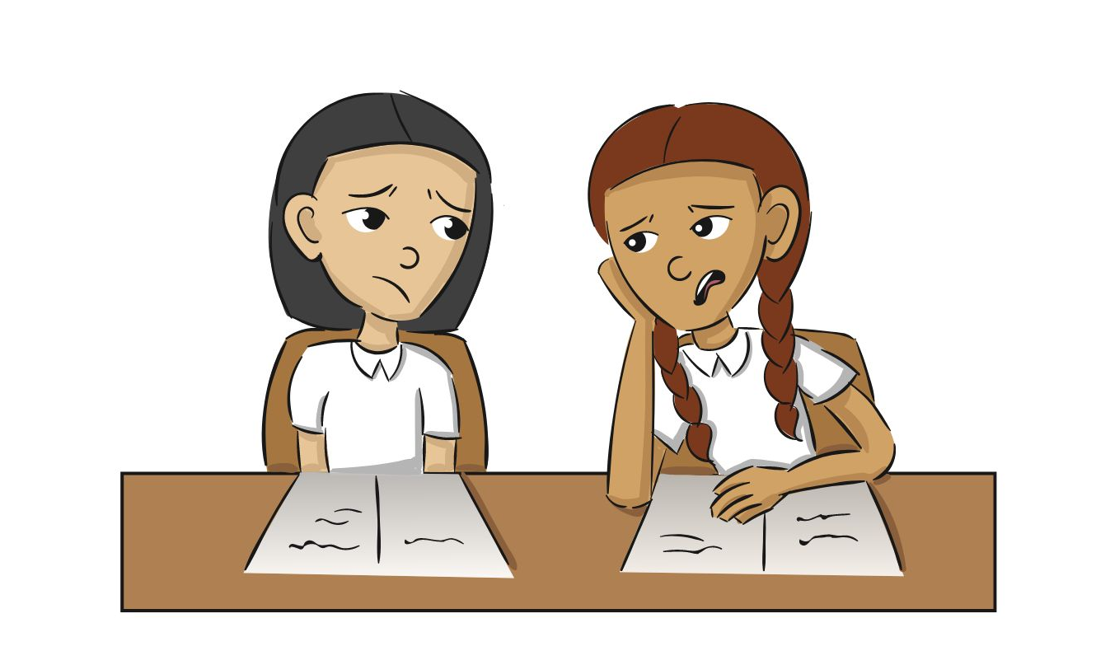
Finish the sentence
What does “hard” mean in ___________?
Vietnamese
This exercise is so hard. ☹
Answer
Write the answer on the mini board.
Click “Answer” to check. Read the speech.

Slide 15
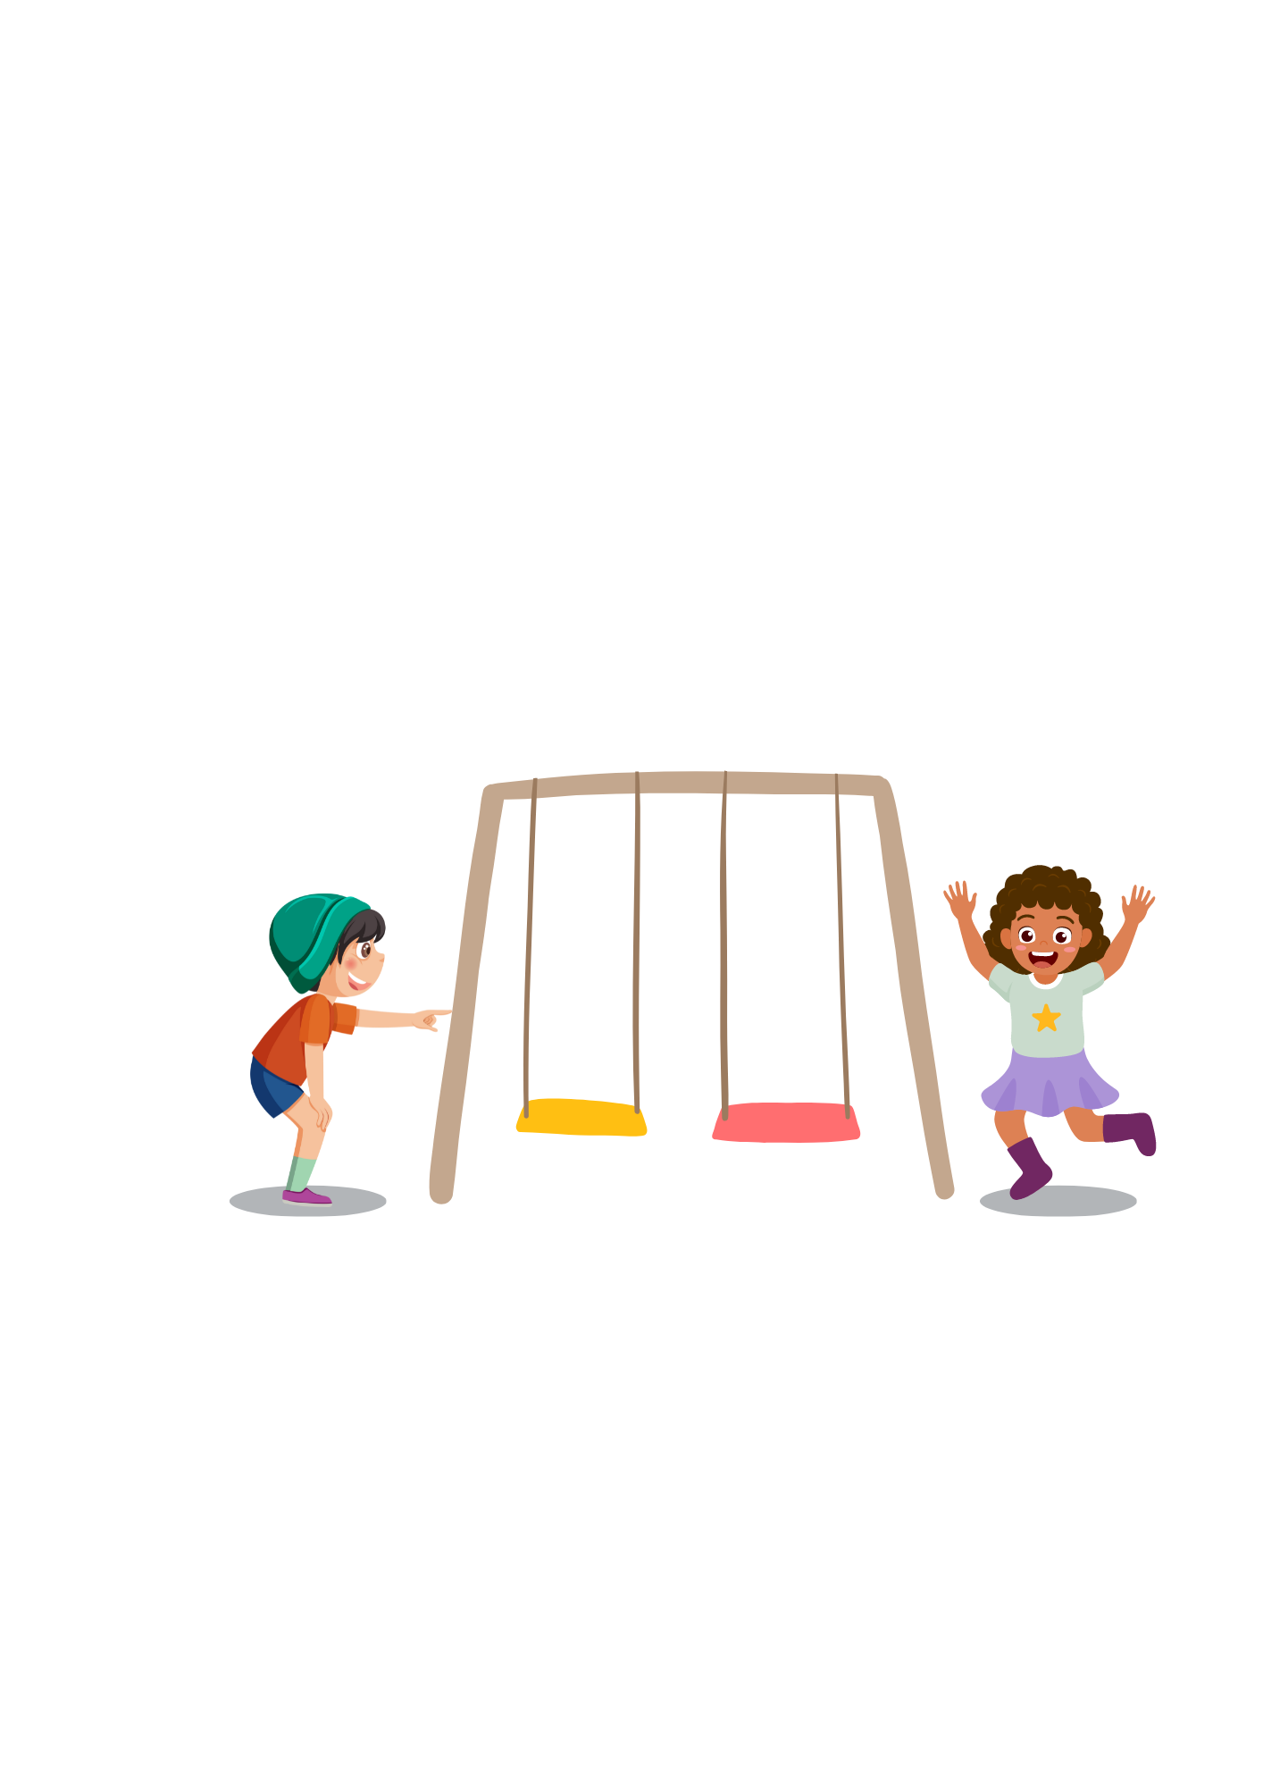
Finish the sentence
How do we say “xích đu”
in ________?
Swing.
English
Answer
Write the answer on the mini board.
Click “Answer” to check. Read the speech.

Slide 16

Finish the sentence
Are you ready?
Can we ________?
start now
Yes, we are _______.
ready
Answer
Write the answer on the mini board.
Click “Answer” to check. Read the speech.

Slide 17
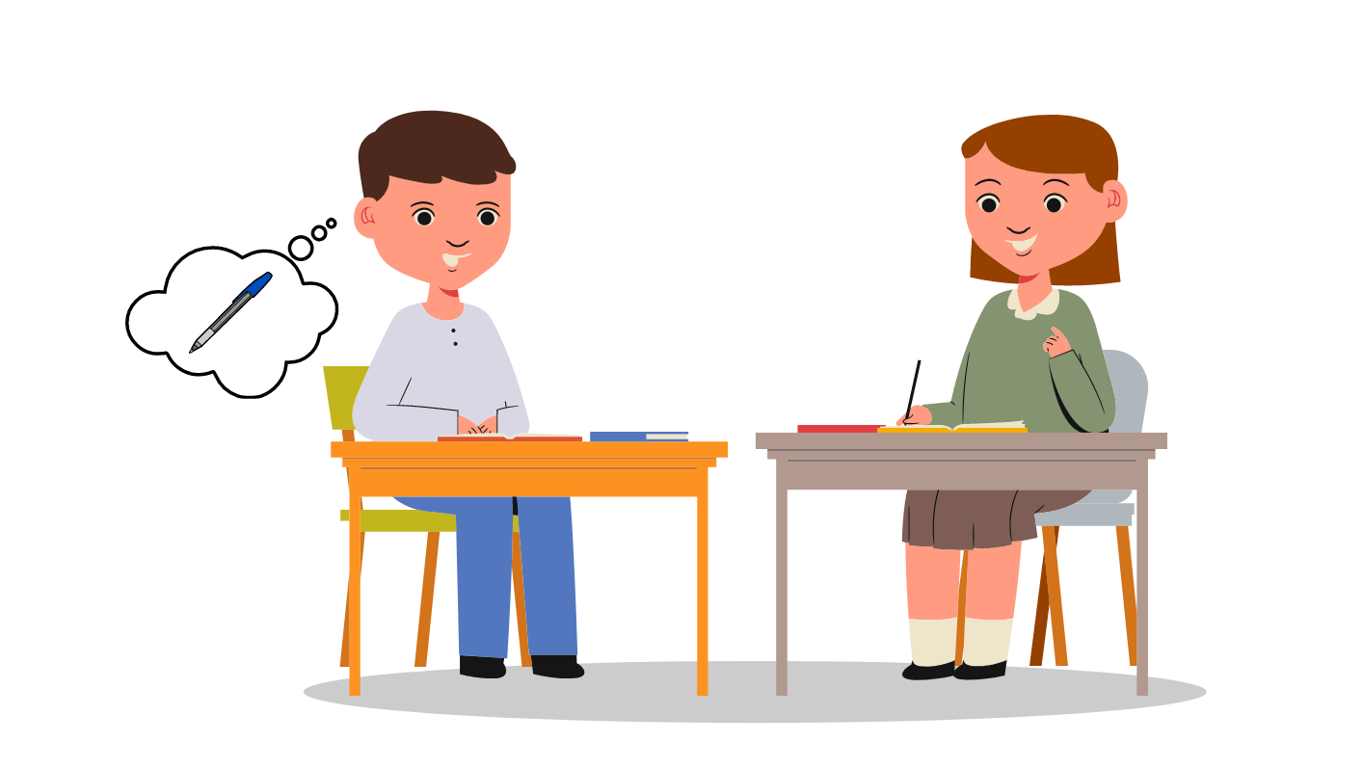

Finish the sentence
I _________ a pen .
Can I ______ one?
don’t have
borrow
Yes, sure.
Answer
Write the answer on the mini board.
Click “Answer” to check. Read the speech.

Slide 18
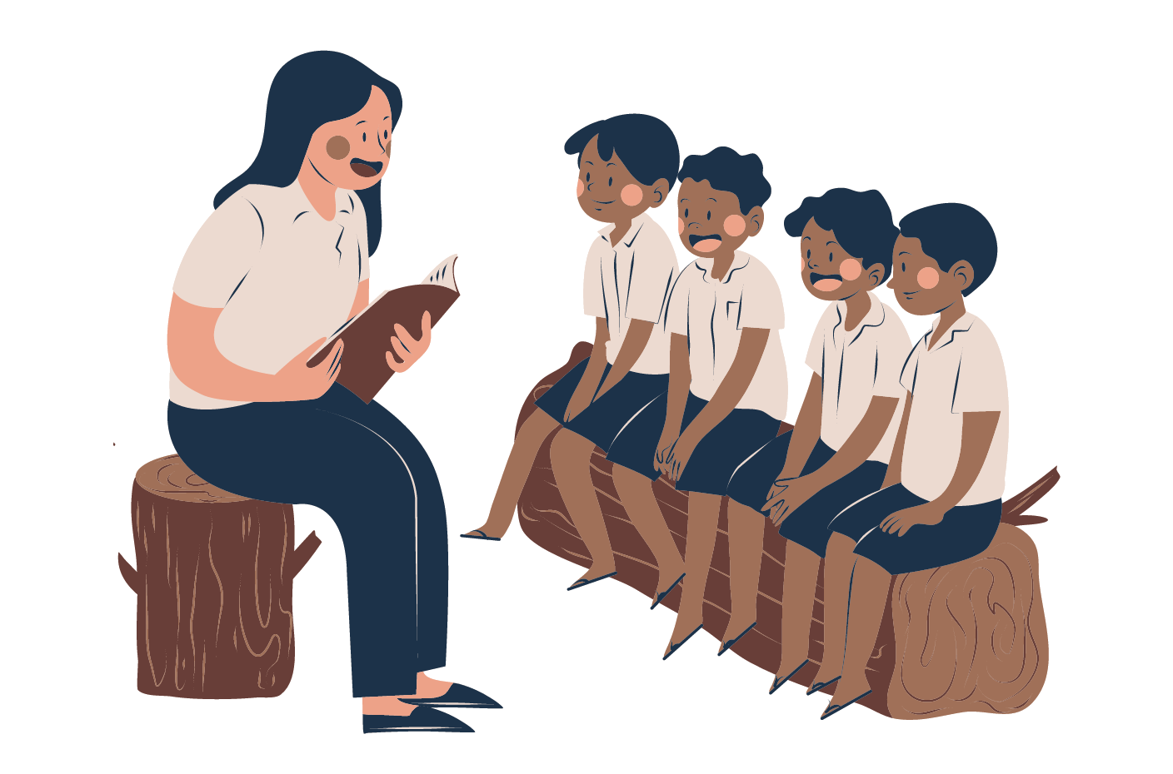
Finish the sentence
We are playing in the park.
I’m _______.
Can you______ aloud?
sorry
speak
Answer
Write the answer on the mini board.
Click “Answer” to check. Read the speech.

Slide 19

Finish the sentence
Let’s finish!
I don’t __________ it.
Can you _______ it again?
understand
explain
Answer
Write the answer on the mini board.
Click “Answer” to check. Read the speech.

Slide 20
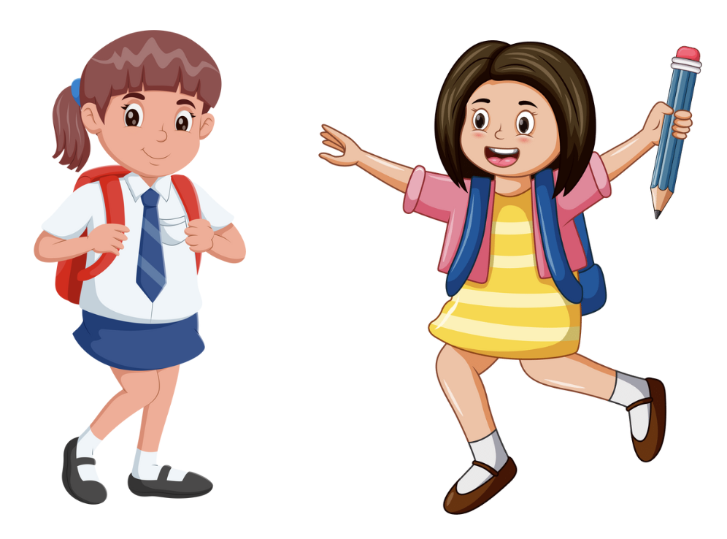
Finish the sentence
pencil
I don’t have a ______.
Can I borrow one?
Yes, sure.
Answer
Write the answer on the mini board.
Click “Answer” to check. Read the speech.

Slide 21

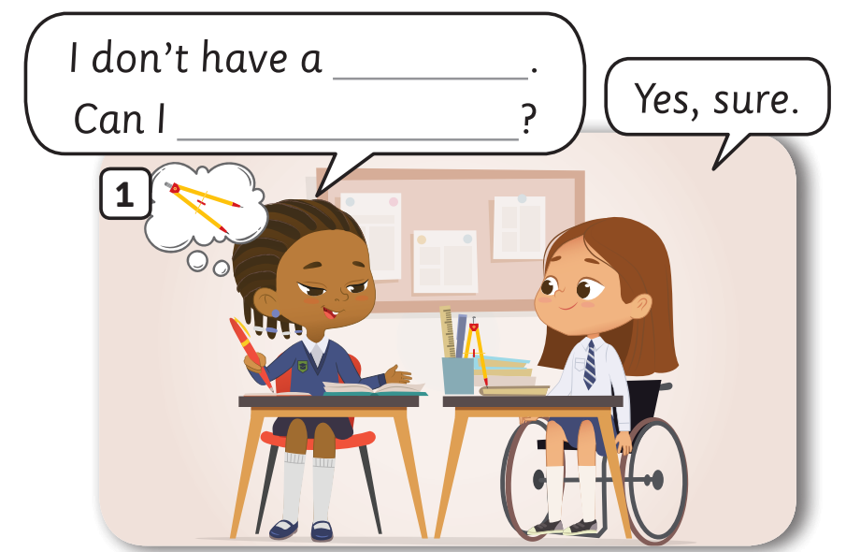
Pupils’ book (p.3)
compass
borrow one
Answer
Put students into pairs. Have students open their books and work to complete the speech bubbles.
Check the answer with the whole class.
In pairs, say the conversation.

Slide 22
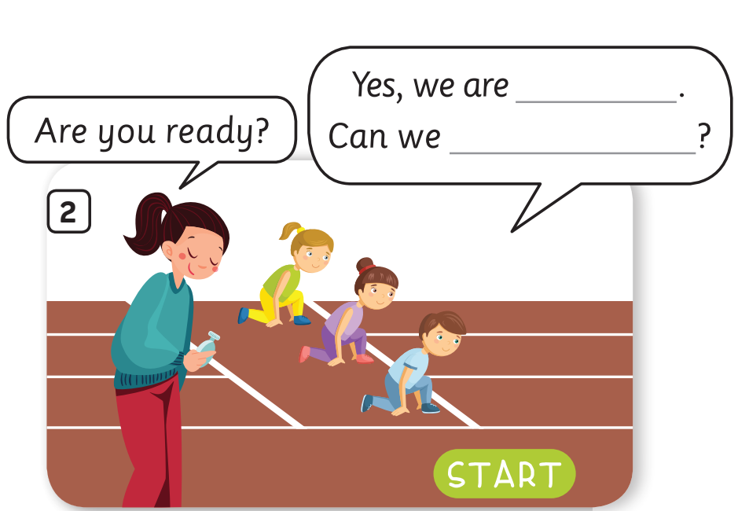
Pupils’ book (p.3)
ready
start now
Answer
Put students into pairs. Have students open their books and work to complete the speech bubbles.
Check the answer with the whole class.
In pairs, say the conversation.

Slide 23
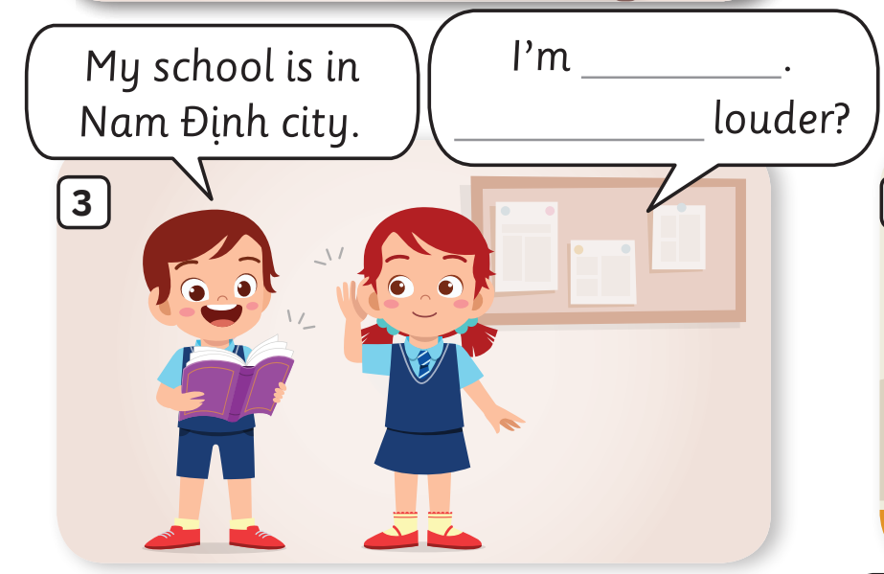
Pupils’ book (p.3)
sorry
Can you speak
Answer
Put students into pairs. Have students open their books and work to complete the speech bubbles.
Check the answer with the whole class.
In pairs, say the conversation.

Slide 24
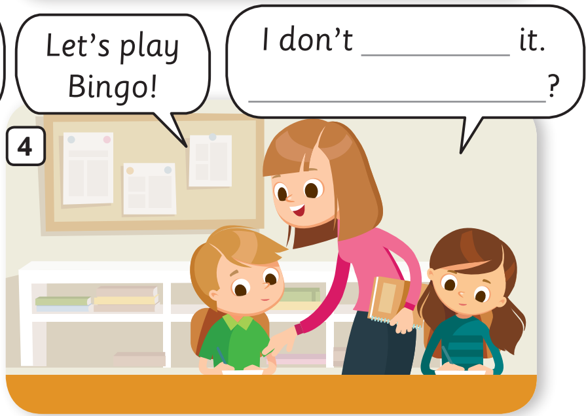
Pupils’ book (p.3)
understand
Can you explain it again
Answer
Put students into pairs. Have students open their books and work to complete the speech bubbles.
Check the answer with the whole class.
In pairs, say the conversation.

Slide 25
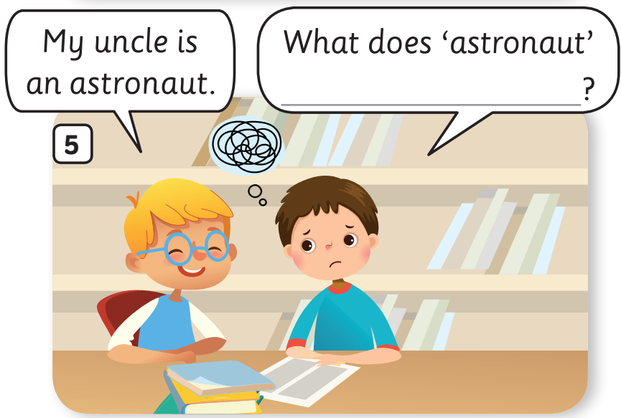
Pupils’ book (p.3)
mean in Vietnamese
Answer
Put students into pairs. Have students open their books and work to complete the speech bubbles.
Check the answer with the whole class.
In pairs, say the conversation.

Slide 26
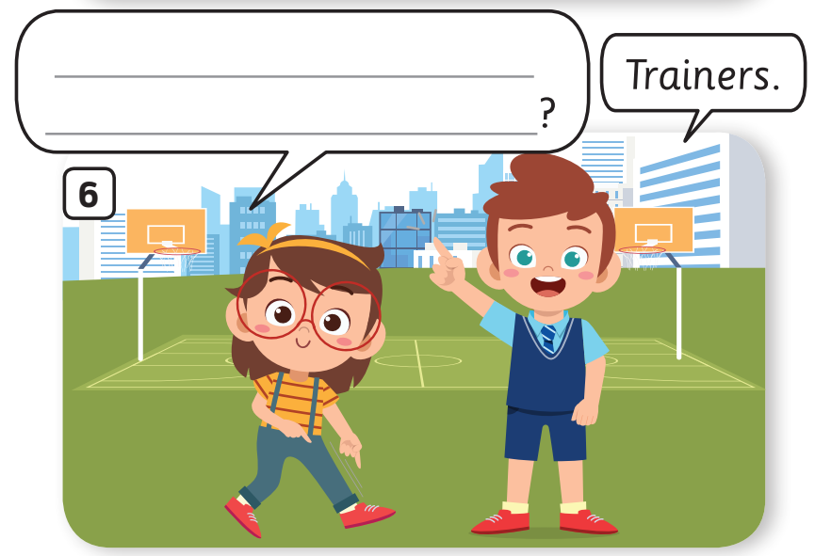
Pupils’ book (p.3)
How do we say
“giày thể thao” in English
Answer
Put students into pairs. Have students open their books and work to complete the speech bubbles.
Check the answer with the whole class.
In pairs, say the conversation.

Slide 27
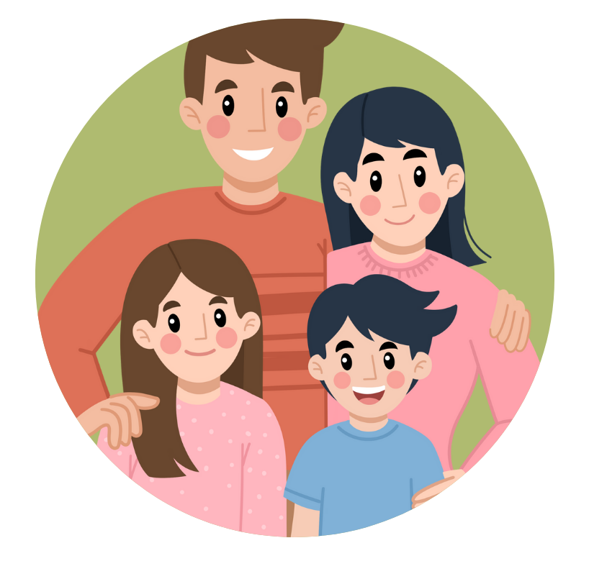

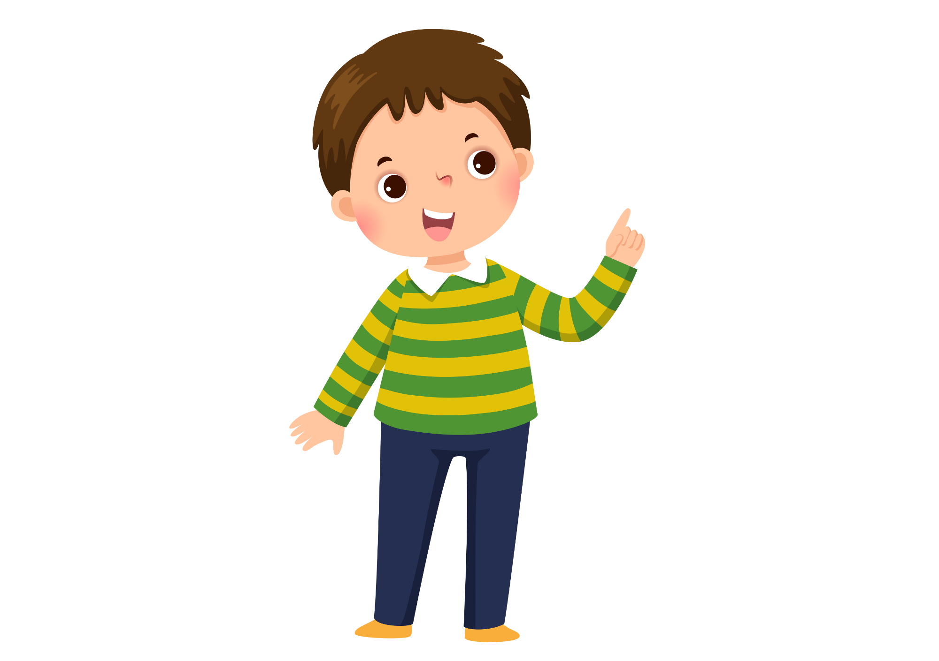


Practice - Pupils’ book (p.3)
My family has four members.
My mum, my dad, my brother
and me.
Yes, sure. My family has four members.
My mum, my dad, my brother and me.
I’m sorry. Can you speak aloud?
- Ask students to look, listen to and repeat the conversation.

Slide 28

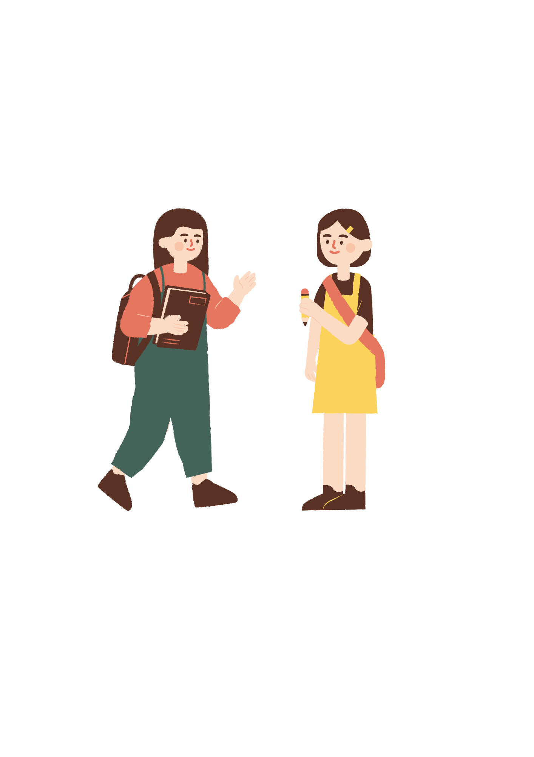
Practice - Pupils’ book (p.3)
Hi, Linda.
I don’t have a pencil.
Can I borrow one?
Thank you.
Yes, sure.
- Ask students to look, listen to and repeat the conversation.

Slide 29
Practice - Pupils’ book (p.3)
I don’t understand it.
Can you explain it again?
Let’s finish!
- Ask students to look, listen to and repeat the conversation.

Slide 30
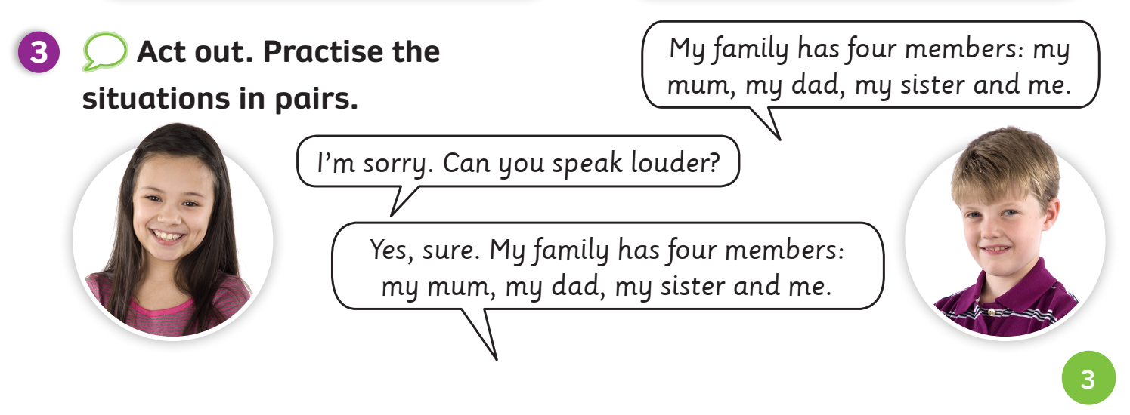
Practice - Pupils’ book (p.3)
- Invite a student to stand up and demonstrate the dialogue in Activity 3.
- Divide the class into two teams. Practice dialogue a few times.
- Put students in pairs. Tell them to describe their own family by personalising dialogue.

Slide 31
Practice - Pupils’ book (p.3)
Practise the situations in pairs.
- Look through the example situations on the previous slides.
- Put students in pairs. Tell them to describe their situation by personalising dialogue.
- Call out a few other pairs to come up and do the role play by personalising these dialogues.

Slide 32
HOMEWORK
Review the classroom language.
Do exercises in the Activity book (pages 2).
Check answers in the Teacher’s book (page 32) or Active Teach.

Slide 33
UNIT 0 – Lesson 1
We’ve learned…
- Classroom language
- PB p.2,3
- AB p.2

