Slide 1
UNIT 0 – My new neighbours!
Lesson 2 – Vocabulary and Grammar 1

Slide 2
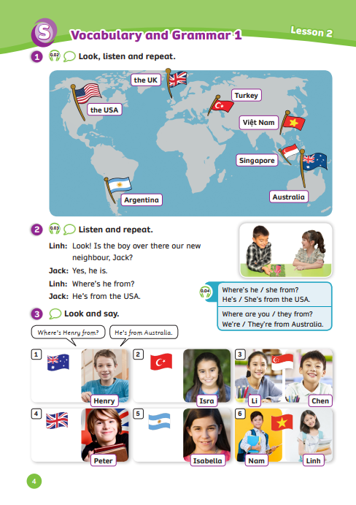
UNIT 0 – Lesson 2
We’re learning…
- Name of the countries
- “Where is he from?
He’s from …”
- PB p.4
- AB p.3

Slide 3
Warm-up
Activity: What do you say?
Divide the class into groups of 6. Each team prepares a pencil case.
Look at the picture and read the clue together.
Guess what happens next with your teammate.
Catch the pencil case to get a chance to answer.
Note: The teacher can use the clues in L1
The team with the correct answer can get 2 points.

Slide 4
Warm-up
When you forget a rubber, you say ….
I don’t have a rubber.
Can I borrow one?
Answer
- Look at the picture and read the clue together
- Guess what happens with your teammate
- Catch the pencil case to get a chance to answer.

Slide 5
Warm-up
When you don’t understand the lesson, you say ….
I don’t understand it. Can you explain it again?
Answer
- Look at the picture and read the clue together
- Guess what happens with your teammate
- Catch the pencil case to get a chance to answer.

Slide 6
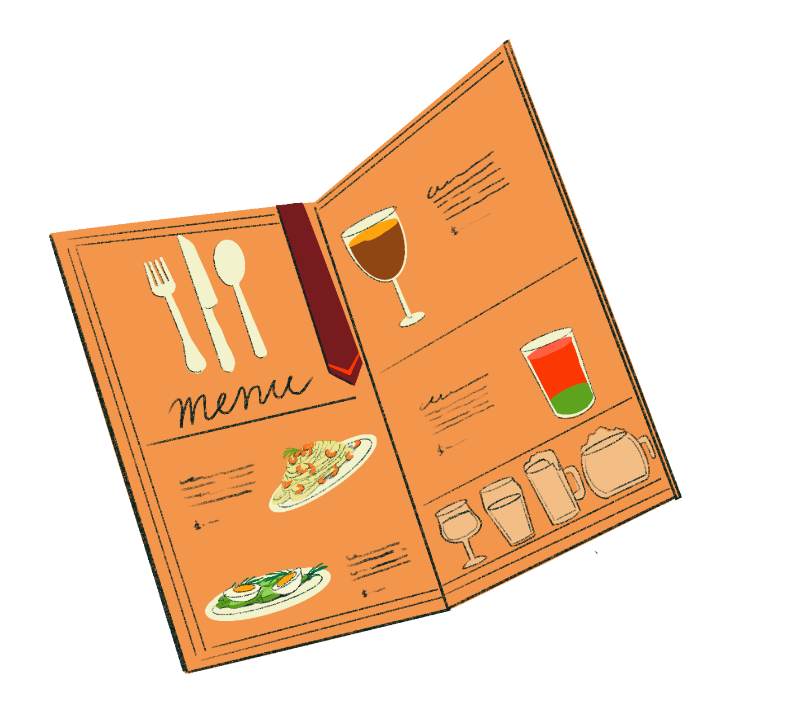
Warm-up
When you don’t know the word “thực đơn” in English, you say ….
How do we say “thực đơn” in English?
Answer
- Look at the picture and read the clue together
- Guess what happens with your teammate
- Catch the pencil case to get a chance to answer.

Slide 7
Warm-up
When you’re ready to start, you say ….
We’re ready. Can we start now?
Answer
- Look at the picture and read the clue together
- Guess what happens with your teammate
- Catch the pencil case to get a chance to answer.

Slide 8
VOCABULARY – Lead-in
Sudan
Singapore
S
…
Spain
Example names
Ask students “What letter is this?”
Tell them to look at some countries’ names starting with the letter S on the slide.
Call out together.

Slide 9
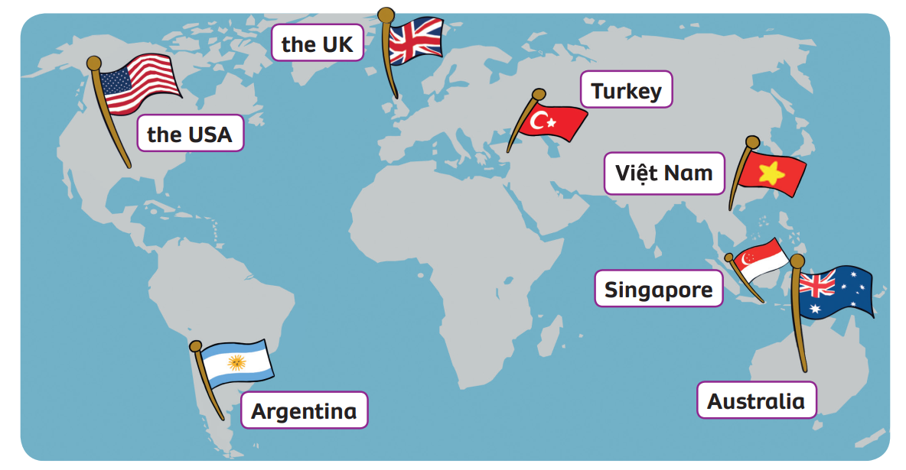
VOCABULARY – Name of countries
Play the audio, students listen and repeat the words.

Slide 10
VOCABULARY – Name of countries
Let’s spell!
c
the USA
t
h
e
U
S
A

Slide 11
VOCABULARY – Name of countries
c
Let’s spell!
the UK
t
h
e
U
K

Slide 12
VOCABULARY – Name of countries
Let’s spell!
c
Argentina
A
r
g
e
n
t
i
n
a

Slide 13
VOCABULARY – Name of countries
c
Let’s spell!
Turkey
T
u
r
k
e
y

Slide 14
VOCABULARY – Name of countries
c
Let’s spell!
Việt Nam
V
i
ệ
t
N
a
m

Slide 15
VOCABULARY – Name of countries
Let’s spell!
c
Singapore
S
i
n
g
a
p
o
r
e

Slide 16
VOCABULARY – Name of countries
Let’s spell!
c
Australia
A
u
s
t
r
a
l
i
a

Slide 17
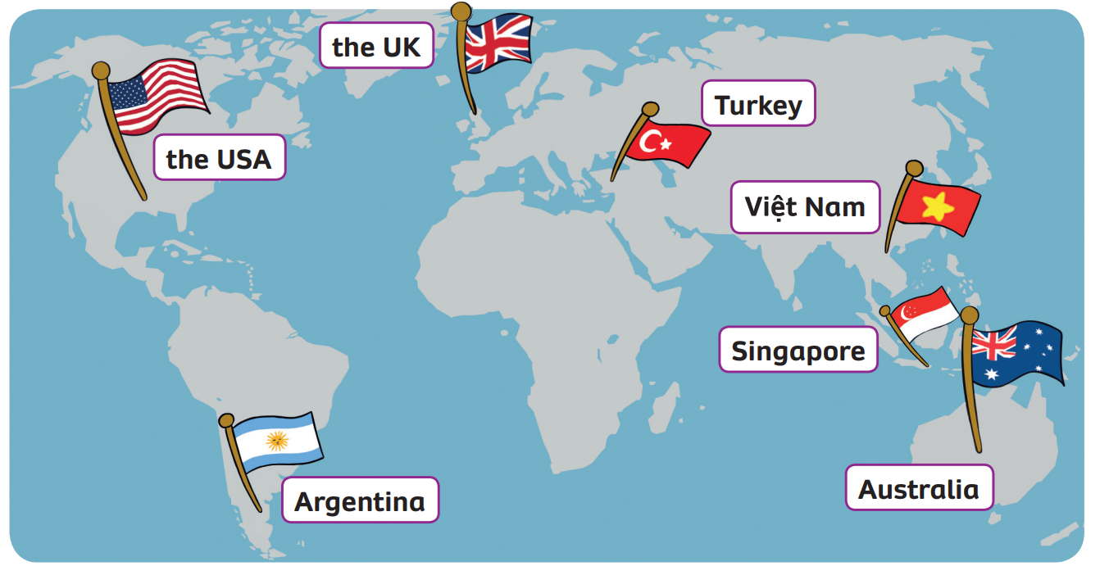
VOCABULARY – Name of countries
REVIEW
2
3
1
4
5
6
7
Click on each number, students look and say the word.

Slide 18
VOCABULARY – Practice
Activity: The flag
Divide the class into groups of 6.
Each student in the team takes out a mini-board.
Read the clues and discuss with your teammate to guess what country is.
Write down the correct answer on the board.
If all students in the team write the correct word, that team will receive 2 points. But if the team has 2 or 3 students write the wrong word, they won’t receive points.
The team with the highest point wins the game.

Slide 19
The Flag
Notes:
Ms Huyền Phạm - 0936.082.789 – YOUTUBE: MsPham. Facebook: Dạy và học cùng công nghệ.

Slide 20
Read the clues, write the answer on the board.
This
It’s got white, red and blue. It’s got lots of stars.
The USA
The UK
Việt Nam
Argentina
Notes:
Ms Huyền Phạm - 0936.082.789 – YOUTUBE: MsPham. Facebook: Dạy và học cùng công nghệ.

Slide 21
Read the clues, write the answer on the board.
This
It’s red and yellow. It’s got a star in the middle.
Turkey
Singapore
The UK
Việt Nam
Notes:
Ms Huyền Phạm - 0936.082.789 – YOUTUBE: MsPham. Facebook: Dạy và học cùng công nghệ.

Slide 22
Read the clues, write the answer on the board.
This
It’s white, blue and red. It’s got many stripes.
Singapore
Australia
Turkey
The UK
Notes:
Ms Huyền Phạm - 0936.082.789 – YOUTUBE: MsPham. Facebook: Dạy và học cùng công nghệ.

Slide 23
Read the clues, write the answer on the board.
This`
It’s blue and white. It’s got a sun in the middle.
Việt Nam
Argentina
The USA
Turkey
Notes:
Ms Huyền Phạm - 0936.082.789 – YOUTUBE: MsPham. Facebook: Dạy và học cùng công nghệ.

Slide 24
Read the clues, write the answer on the board.
This
It’s red and white. It’s got a big moon and a star.
Turkey
The UK
Singapore
The USA
Notes:
Ms Huyền Phạm - 0936.082.789 – YOUTUBE: MsPham. Facebook: Dạy và học cùng công nghệ.

Slide 25
Read the clues, write the answer on the board.
This
It’s blue, white and red. It’s got 7-pointed stars.
Việt Nam
The UK
Australia
Singapore
Notes:
Ms Huyền Phạm - 0936.082.789 – YOUTUBE: MsPham. Facebook: Dạy và học cùng công nghệ.

Slide 26
Read the clues, write the answer on the board.
This
It’s red and white. It’s got a moon and 5 stars on top.
Turkey
Singapore
The USA
Argentina
Notes:
Ms Huyền Phạm - 0936.082.789 – YOUTUBE: MsPham. Facebook: Dạy và học cùng công nghệ.

Slide 27
STRUCTURE – Pupils’ book (p.4)
Play the audio for the students as they read and listen. Then repeat.
Put them in pairs to practice the dialogue.

Slide 28
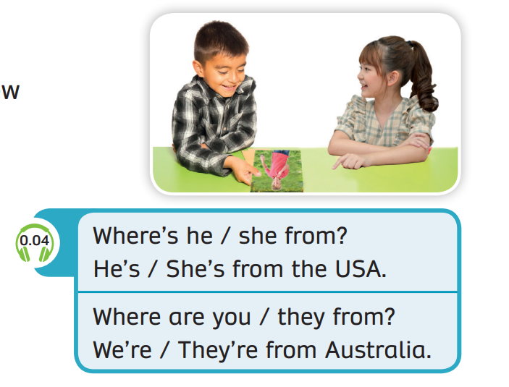
STRUCTURE – Pupils’ book (p.4)
Play the audio for the students as they look and listen. Then repeat.

Slide 29
STRUCTURE – Pupils’ book (p.4)
Where’s he from?
He’s from the USA.
- Show a question and an answer with audio, students listen and repeat.
- Divide class into two teams. One team asks and one team answers.

Slide 30
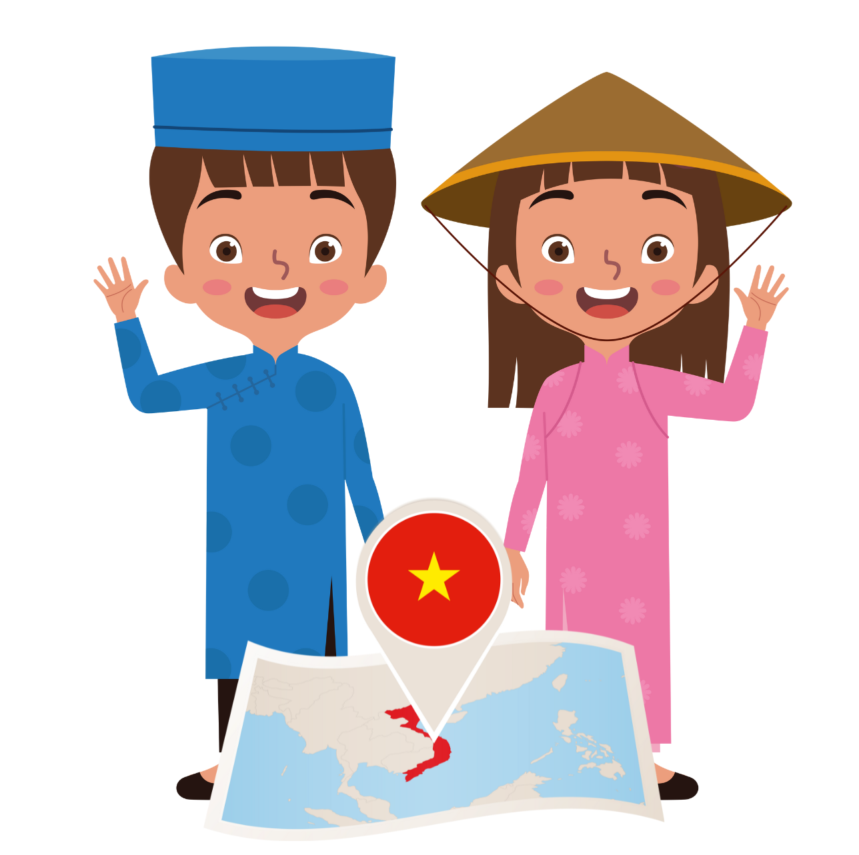
STRUCTURE – Pupils’ book (p.4)
Where are they from?
They’re from Việt Nam.
- Show a question and an answer with audio, students listen and repeat.
- Divide class into two teams. One team asks and one team answers.

Slide 31
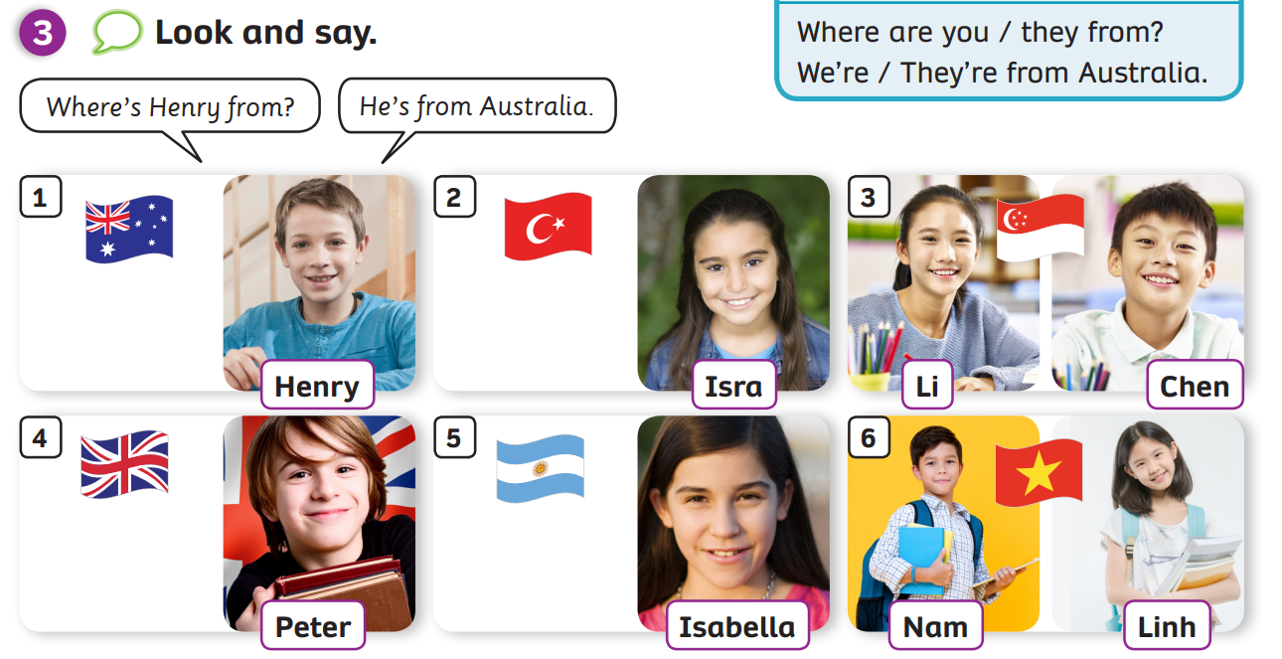
STRUCTURE – Pupils’ book (p.4)
Ask students to look at picture 1, point out the flat and the student’s name.
Read off the information from the speech bubble.
In pairs, practice all 5 pictures.

Slide 32
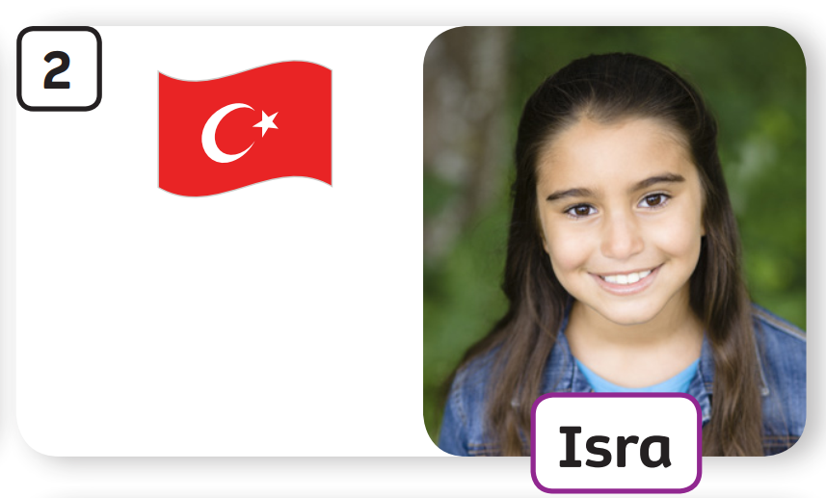
STRUCTURE – Pupils’ book (p.4)
Where’s Isra from?
She’s from Turkey.

Slide 33
STRUCTURE – Pupils’ book (p.4)
Where are Li and Chen from?
They’re from Singapore.

Slide 34
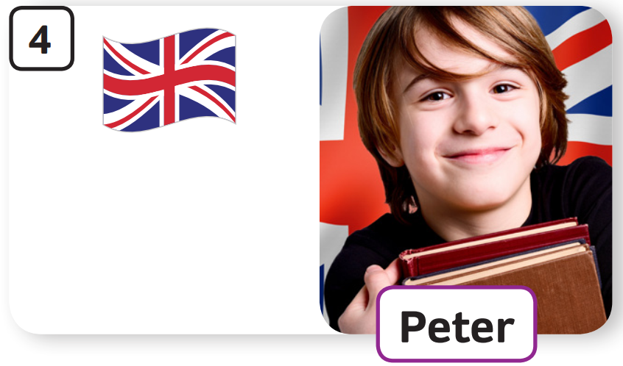
STRUCTURE – Pupils’ book (p.4)
Where’s Peter from?
He’s from the UK.

Slide 35
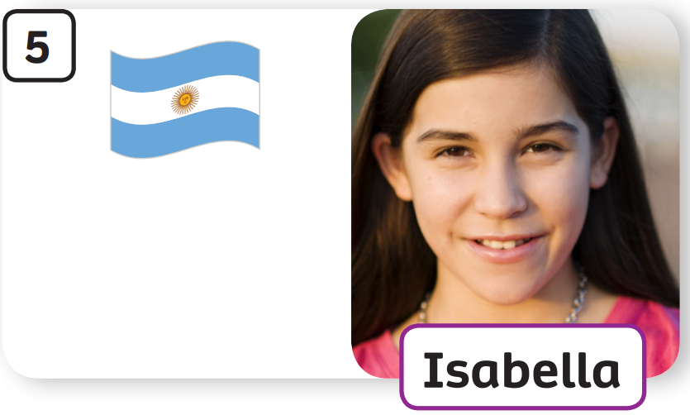
STRUCTURE – Pupils’ book (p.4)
Where’s Isabella from?
She’s from Argentina.

Slide 36
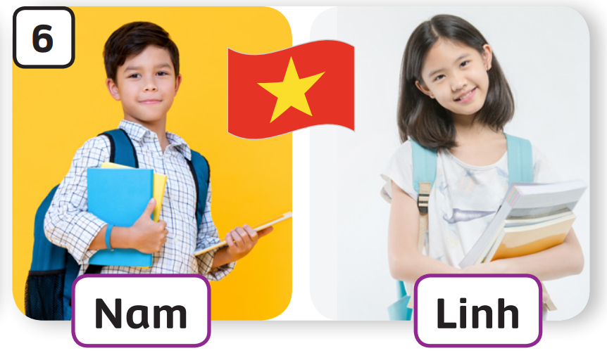
STRUCTURE – Pupils’ book (p.4)
Where are Nam and Linh from?
They’re from
Việt Nam.

Slide 37
SUM - UP
Jack
Sam
Emma & Ben
Linh
Lina
Ryan
Tom
Lion
Kim
The teacher divides the class into 2 teams, shows the pictures and tells students to ask and answer.
Each team takes turns asking and answering. (Ex: team A : Where’s Jack from? – Team B: He’s from the USA.

Slide 38
HOMEWORK
Review vocabulary and grammar.
Do exercises in the Activity book (page 4).
Check answers in the Teacher’s book (page 32) or Active Teach.

Slide 39
UNIT 0 – Lesson 2
We’ve learned…
- Name of the countries
- “Where is he from?
He’s from …”
- PB p.4
- AB p.3

