Slide 1
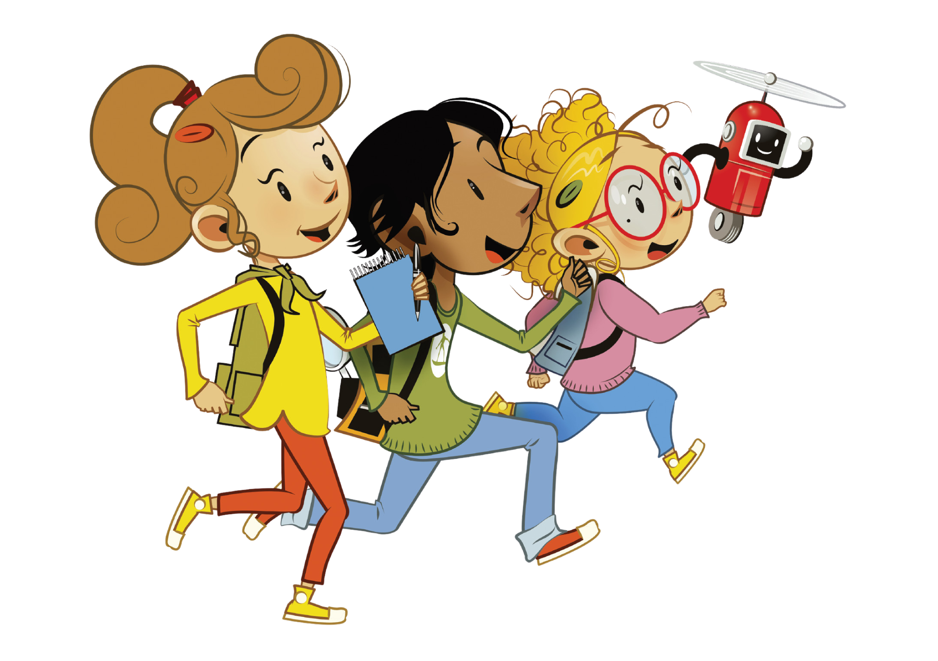
UNIT 0 – MY NEW NEIGHBOURS
Lesson 4 – Phonics

Slide 2
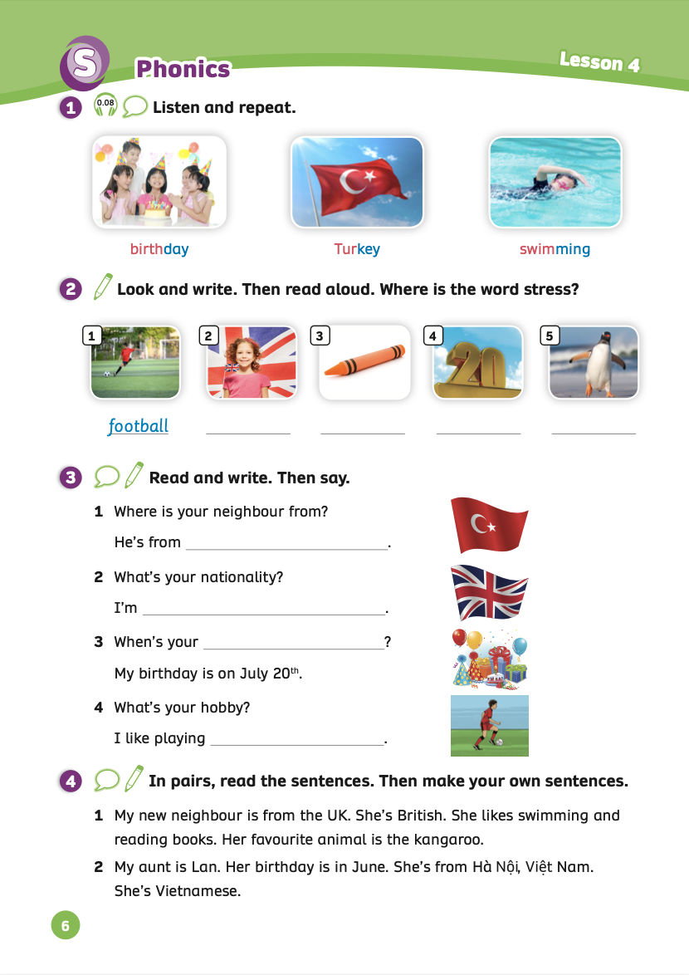
UNIT 0 – Lesson 4
We’re learning…
Word stress
- PB p.6
- AB p.6

Slide 3
WARM-UP
Word stress – Two-syllable words
Have students watch and sing along.

Slide 4
LEAD-IN
apple
park
cat
syllable
farmer
popular
cinema
Have students look at, listen and repeat these words.
Ask students to clap their hands for each syllable.
Explain that they will learn about the stress in words in this lesson.

Slide 5
PUPILS’ BOOK (p.6)
birth-day
Tur-key
swim-ming
Answer
Have students look at these pictures. Play the audio, students listen carefully.
Ask them how many syllables are in each of the three words.
Play the audio again to check their answers.

Slide 6
PUPILS’ BOOK (p.6)
British
crayon
twenty
penguin
Answer
Ask students to look at Picture A, pronounce the word “football” and elicit that its stress is syllable 1.
Work in pairs to finish the exercise.
Check the answer with the whole class.
Ask them to pronounce the word and raise their fingers to show where the word stress is.

Slide 7
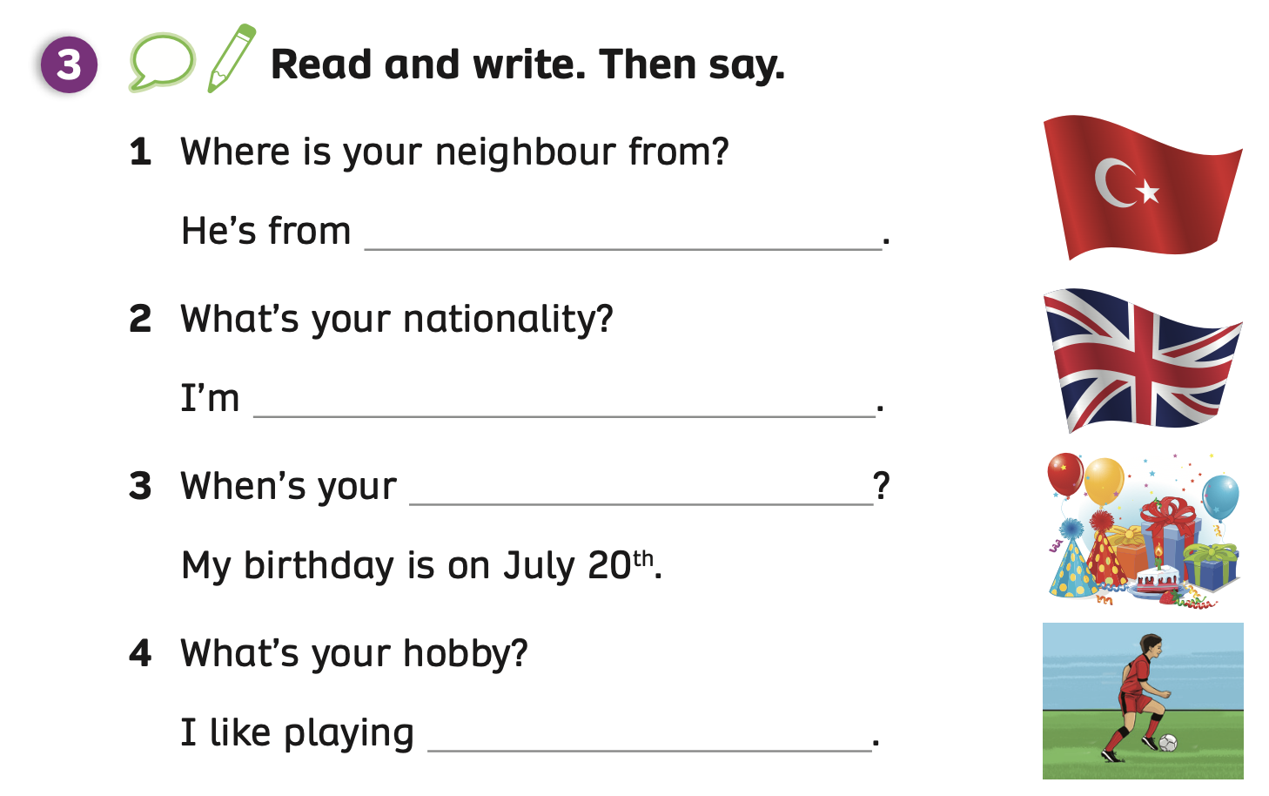
PUPILS’ BOOK (p.6)
Turkey
British
birthday
football
Answer
Put students into groups of 6.
Discuss to answer the questions. Then, students take turns to say the sentence.
Check the answers together.

Slide 8
PRODUCTION - PUPILS’ BOOK (p.6)
In pairs, read the sentences and stress the underlined words in the sentence.
My new neighbour is from the UK.
neighbour
1
Answer
Put students in pairs, ask them to count how many syllables in the underlined word and stress it.
Check the answers together.

Slide 9
PRODUCTION - PUPILS’ BOOK (p.6)
In pairs, read the sentences and stress the underlined words in the sentence.
She’s British.
British
1
Answer
Put students in pairs, ask them to count how many syllables in the underlined word and stress it.
Check the answers together.

Slide 10
PRODUCTION - PUPILS’ BOOK (p.6)
In pairs, read the sentences and stress the underlined words in the sentence.
She likes swimming and reading books.
swimming
reading
1
1
Answer
Put students in pairs, ask them to count how many syllables in the underlined words and stress them.
Check the answers together.

Slide 11
PRODUCTION - PUPILS’ BOOK (p.6)
In pairs, read the sentences and stress the underlined words in the sentence.
Her favourite animal is the kangaroo.
favourite
animal
kangaroo
1
1
3
Answer
Put students in pairs, ask them to count how many syllables in the underlined words and stress them.
Check the answers together.

Slide 12
PRODUCTION - PUPILS’ BOOK (p.6)
In pairs, read the sentences and stress the underlined words in the sentence.
Her birthday is in June.
Birthday
1
Answer
Put students in pairs, ask them to count how many syllables in the underlined word and stress it.
Check the answers together.

Slide 13
PRODUCTION - PUPILS’ BOOK (p.6)
In pairs, read the sentences and stress the underlined words in the sentence.
She’s Vietnamese.
Vietnamese
3
Answer
Put students in pairs, ask them to count how many syllables in the underlined word and stress it.
Check the answers together.

Slide 14
PRODUCTION - PUPILS’ BOOK (p.6)
Ask the whole class to read the sentences.

Slide 15
PRODUCTION - PUPILS’ BOOK (p.6)
Then make your own sentences.
1 My new neighbour is from Turkey. She’s Turkish.
She likes singing and dancing. Her favourite animal is a rabbit.
2 My uncle is John. His birthday is in November. He’s from the USA. He’s American.
Example sentences
After reading, make your own sentences.
Look at the example sentences.

Slide 16
WRAP - UP
1
1
1
Click on each number, students look, say and clap the word stress out loud (once for syllable 1, twice for syllable 2).

Slide 17
HOMEWORK
HOMEWORK
Review vocabulary and grammar.
Do exercises in the Activity Book (page 6).
Check answers in the Teacher’s Book (page 11) or Active Teach.

Slide 18
UNIT 0 – Lesson 4
We’ve learned…
Word stress
- PB p.6
- AB p.6

