Slide 1
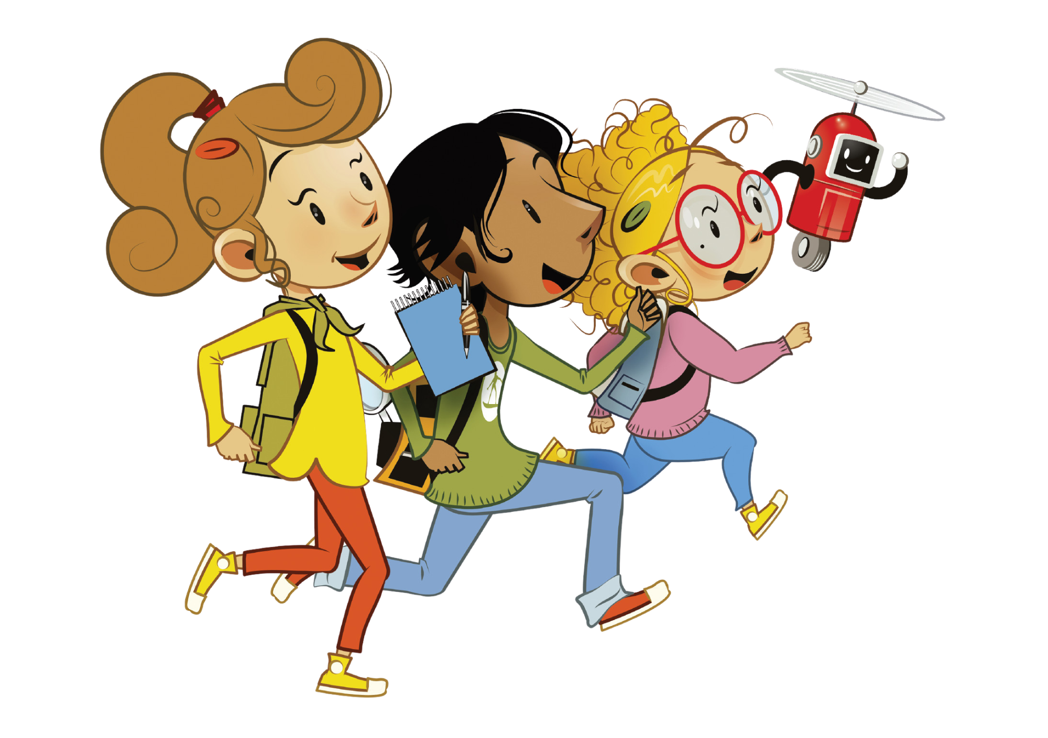
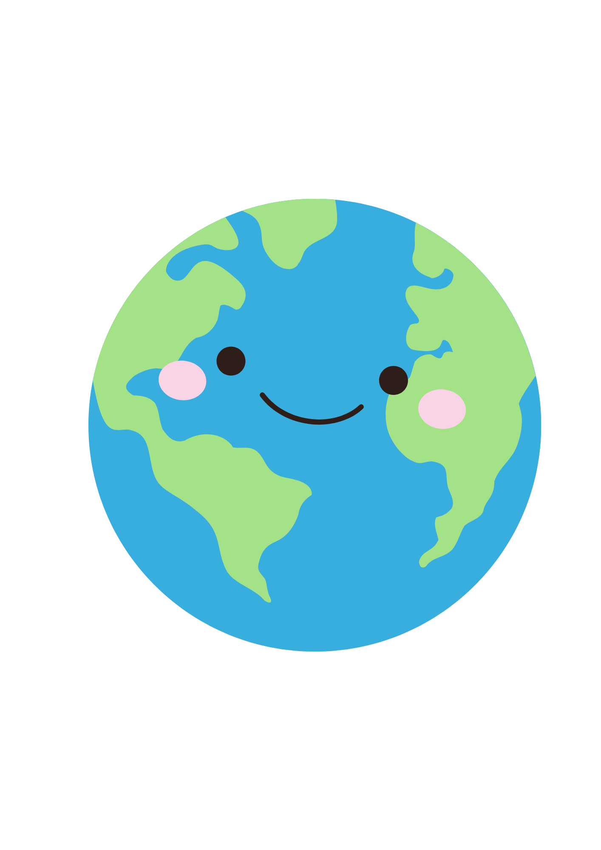
UNIT 0 – MY NEW NEIGHBOURS
Lesson 5A - STORY

Slide 2
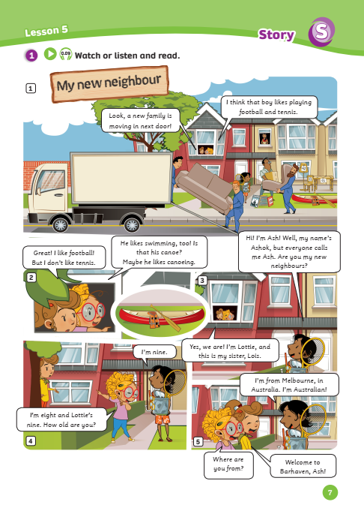
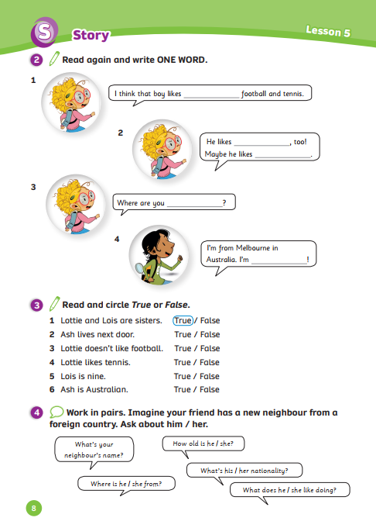
UNIT 0 – Lesson 5A
We’re learning…
- To understand simple cartoon stories.
- PB pp. 7,8
- AB p.6

Slide 3
WARM-UP ACTIVITY
Activity: The syllable
Divide the class into groups of 4.
Ask each team to prepare a piece of paper.
Each team must find out that three words have one syllable, 4 have two syllables, and 2 have four syllables.
One student reads off the words, and the others listen and clap their hands for each syllable.
Check with the whole class.
One correct word = 1 point.

Slide 4
REVIEW
Activity: Find the mistake
A: What’s her nationality?
B: She’s Việt Nam.
Answer
A: What’s her nationality?
B: She’s Vietnamese.
In pairs, prepare a mini-board.
Discuss and find the mistake, then write the correct word on the board.
The five first pairs with the correct answer can get 2 points.
Check the answer with the whole class.

Slide 5
REVIEW
Activity: Find the mistake
A: Where is your aunt from?
B: She’s Australian.
Answer
A: Where is your aunt from?
B: She’s from Australia.
In pairs, prepare a mini-board.
Discuss and find the mistake, then write the correct word on the board.
The five first pairs with the correct answer can get 2 points.
Check the answer with the whole class.

Slide 6
REVIEW
Activity: Find the mistake
A: What’s his nationality?
B: He’s Turkey.
Answer
A: What’s his nationality?
B: He’s Turkish.
In pairs, prepare a mini-board.
Discuss and find the mistake, then write the correct word on the board.
The five first pairs with the correct answer can get 2 points.
Check the answer with the whole class.

Slide 7
REVIEW
Activity: Find the mistake
A: What’s her nationality?
B: She’s Argentina.
Answer
A: What’s her nationality?
B: She’s Argentinian.
In pairs, prepare a mini-board.
Discuss and find the mistake, then write the correct word on the board.
The five first pairs with the correct answer can get 2 points.
Check the answer with the whole class.

Slide 8
REVIEW
Activity: Find the mistake
A: What’s your new neighbour from?
B: She’s from American.
Answer
A: What’s your new neighbour from?
B: She’s from the USA.
In pairs, prepare a mini-board.
Discuss and find the mistake, then write the correct word on the board.
The five first pairs with the correct answer can get 2 points.
Check the answer with the whole class.

Slide 9
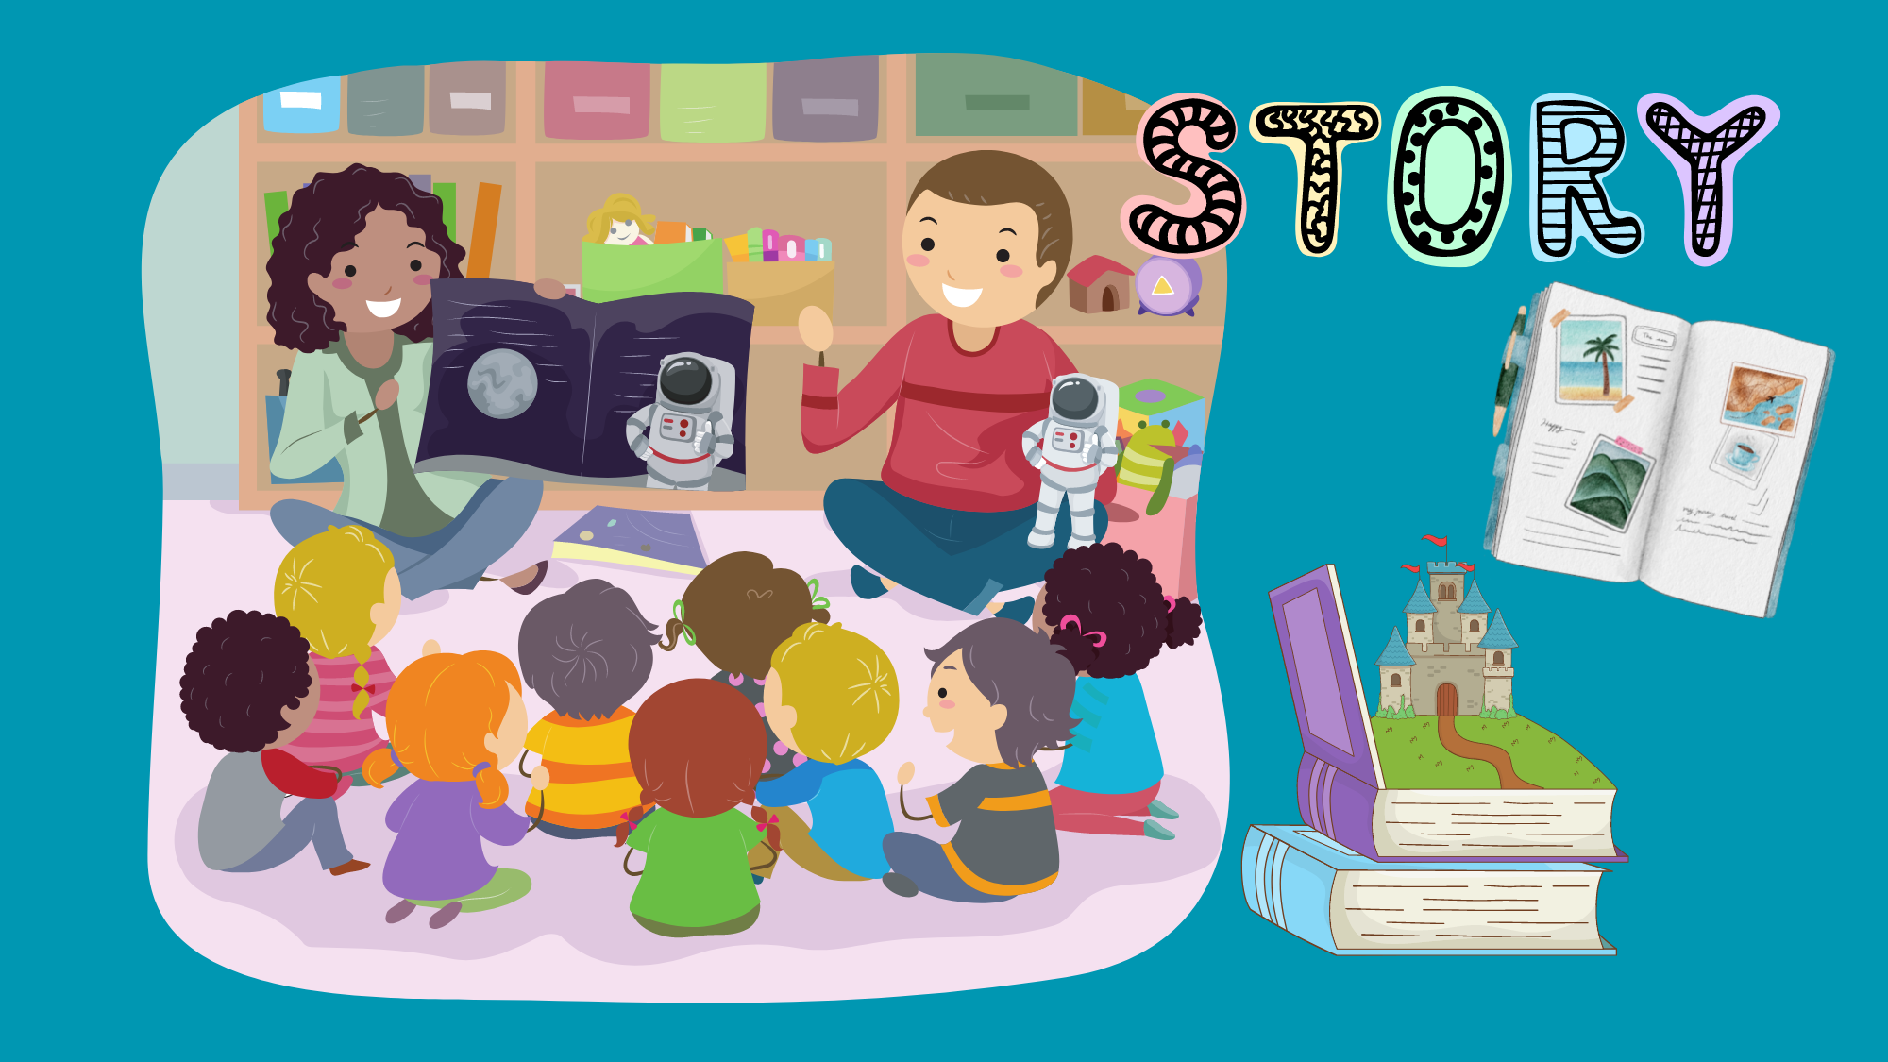
STORY

Slide 10
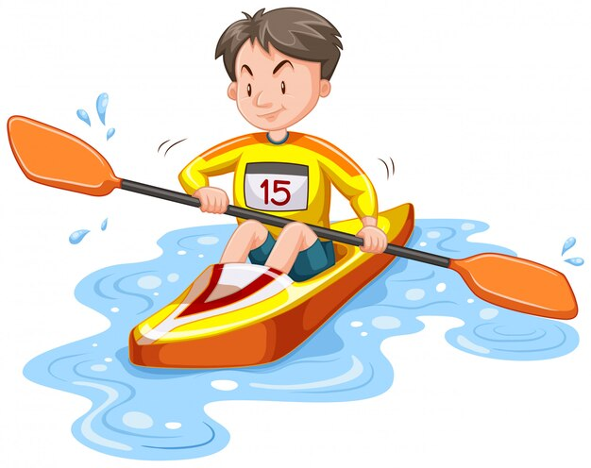
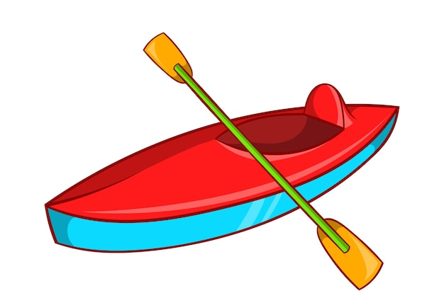
STORY: Vocabulary & Phrase
canoe
He likes canoeing.

Slide 11
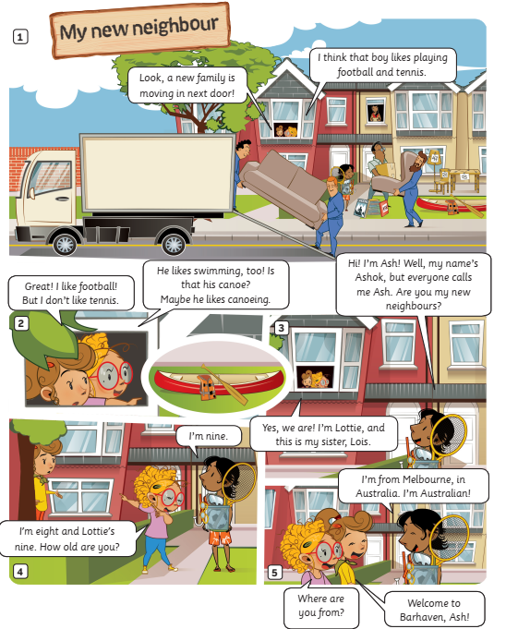
STORY: Introduction
1. What’s the story title?
→
2. How many story frames?
→
3. How many characters?
→
My new neighbour
5 story frames
3 characters
Click on each number, students look, say and clap the word out loud.

Slide 12
STORY: Watch a video

Slide 13
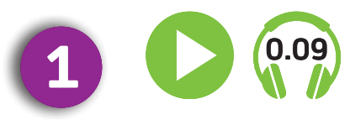
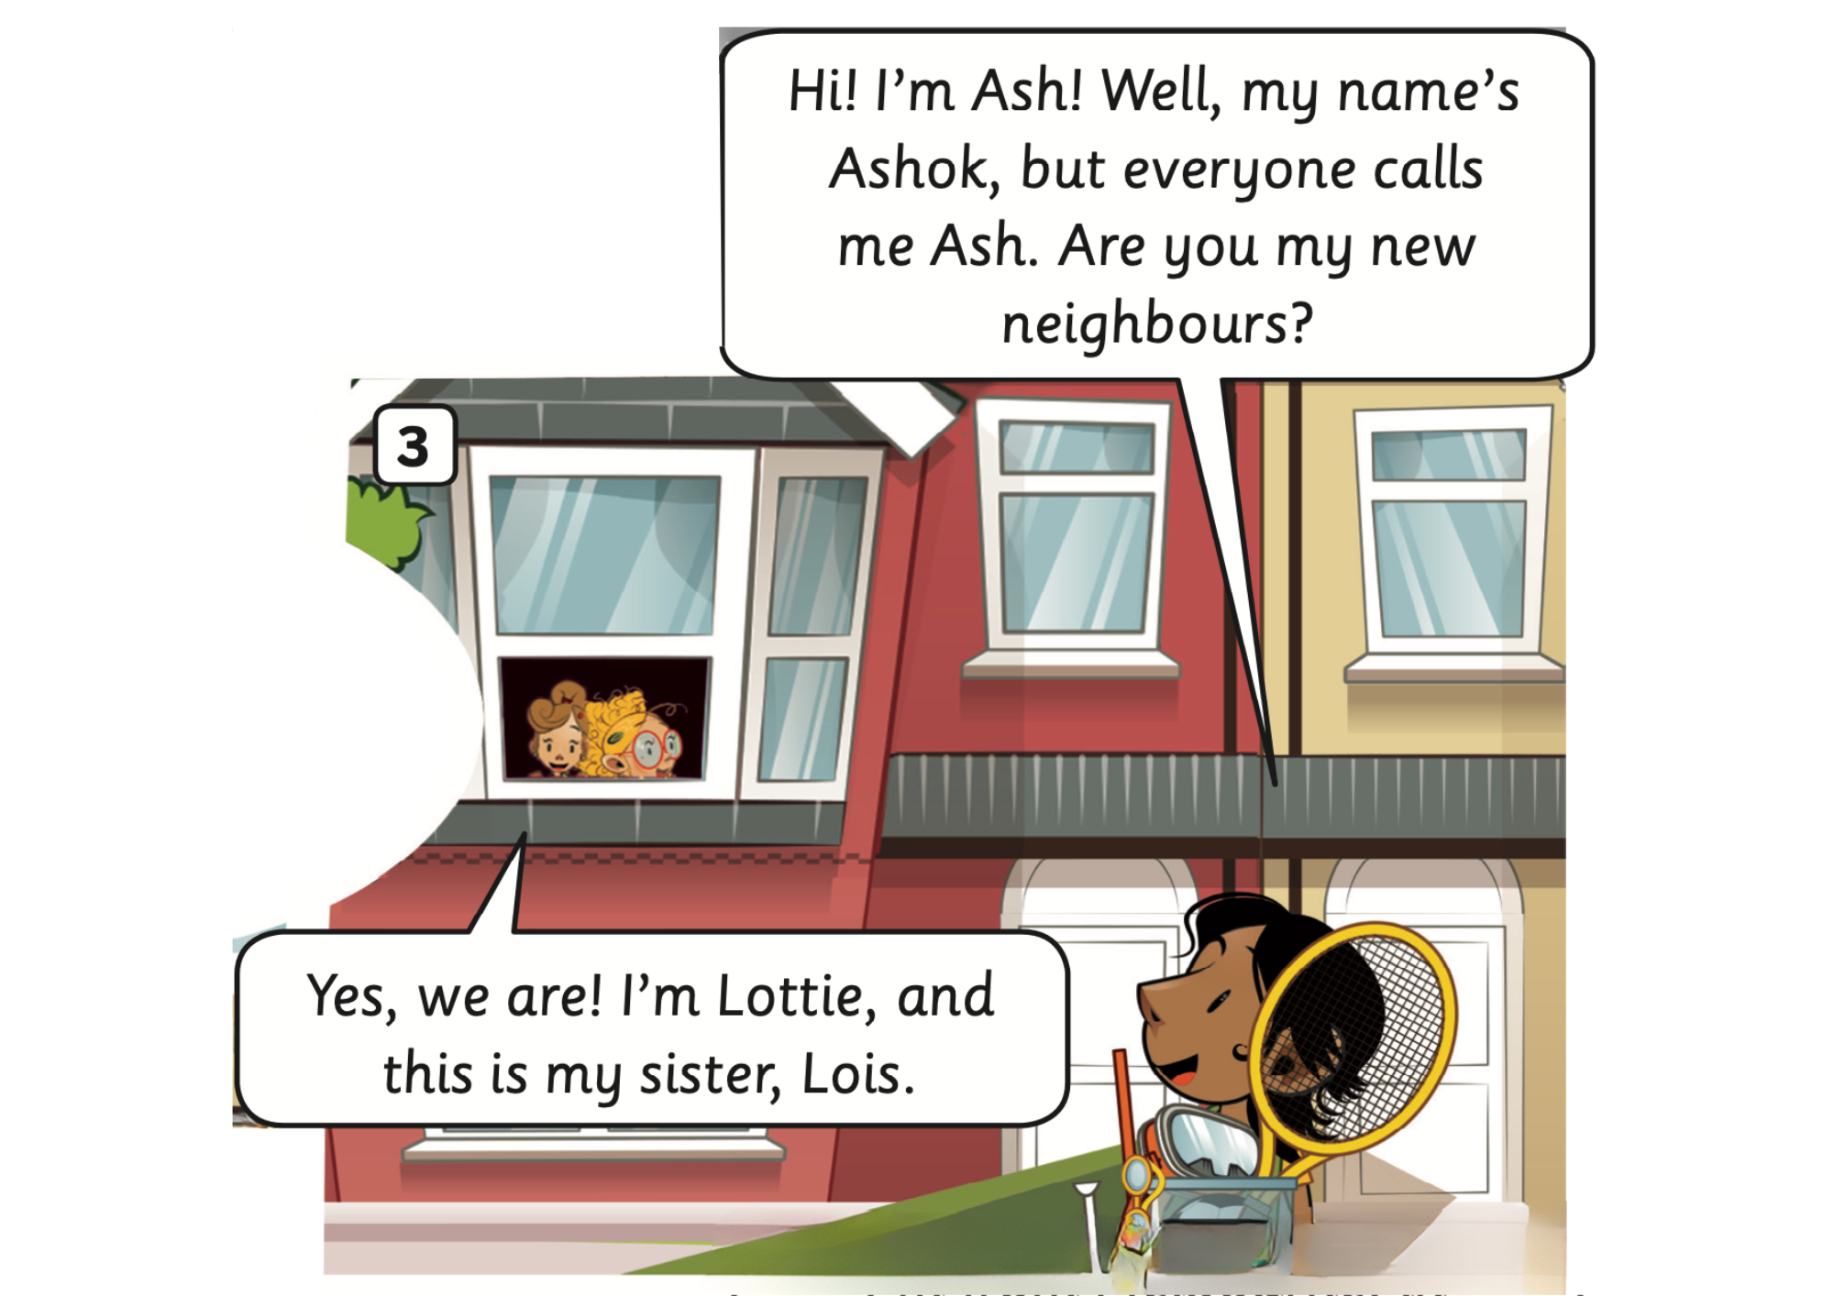
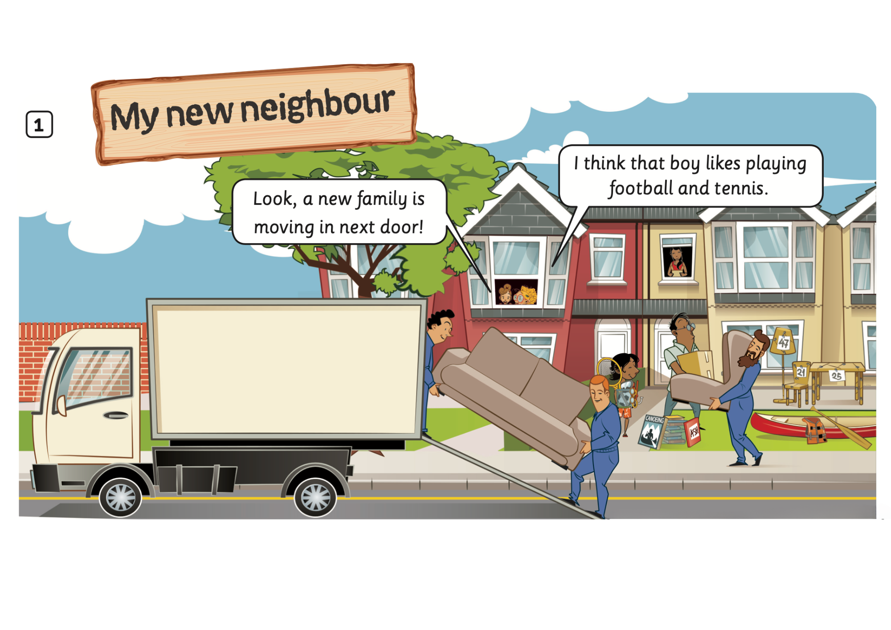
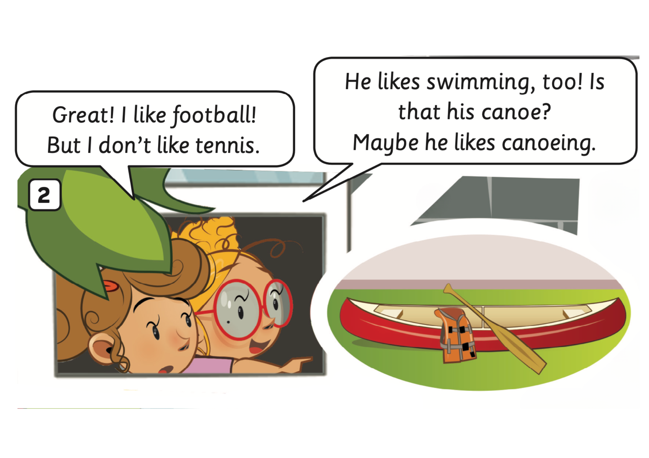
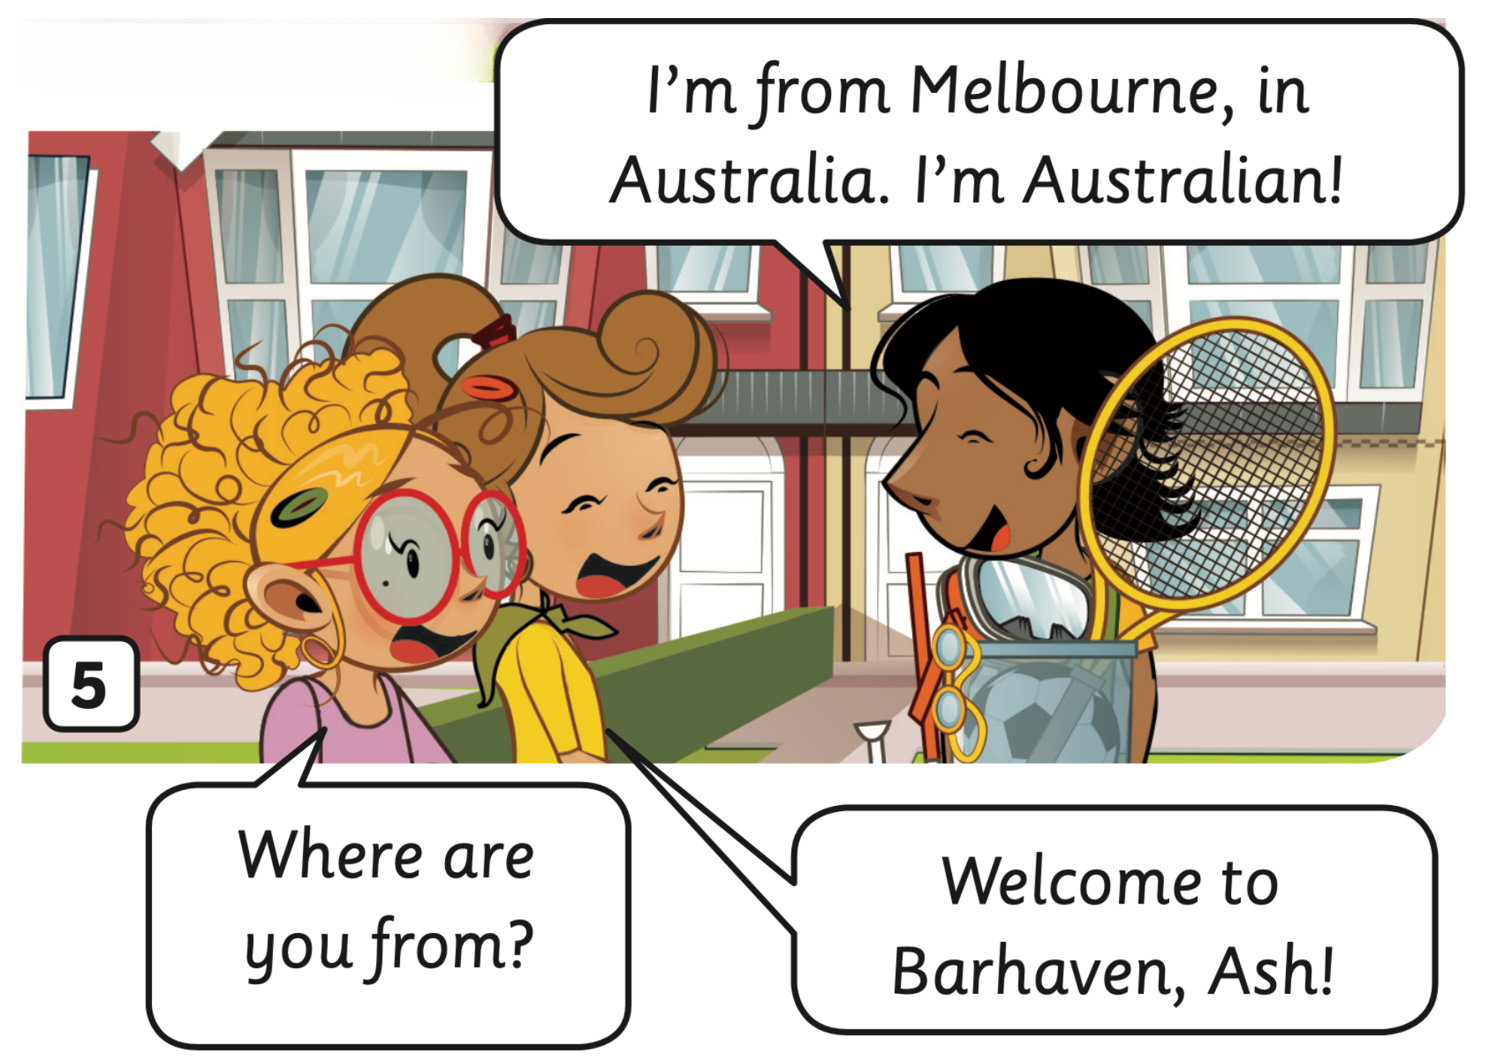
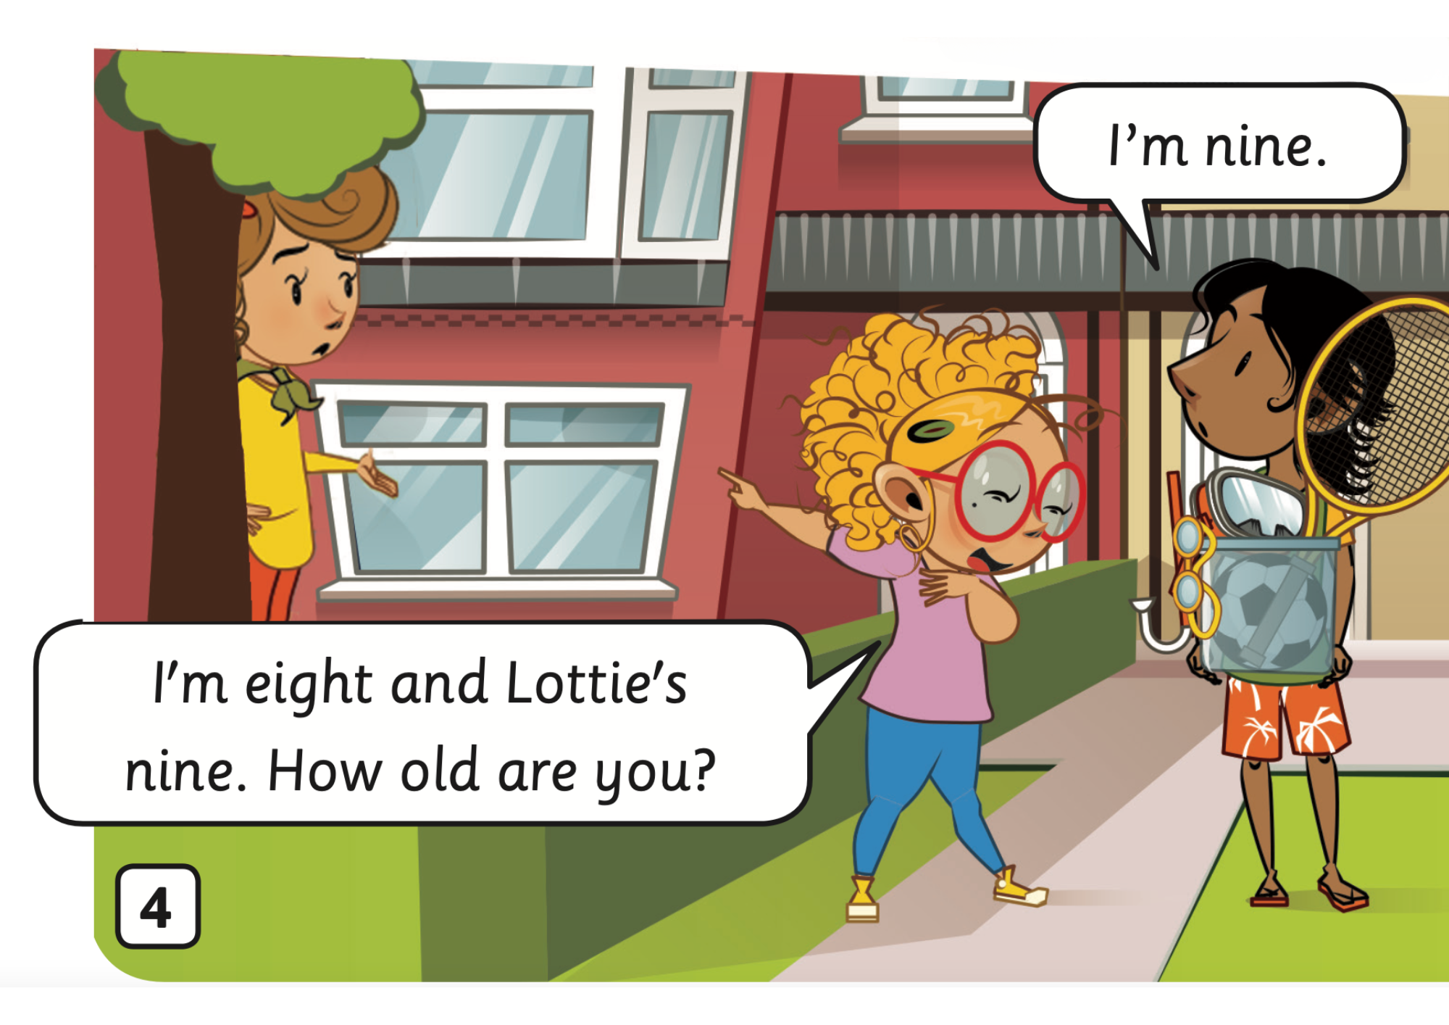
Listen
STORY: Listen to the story
Students open their book, listen to the story.

Slide 14
STORY: Listen and read
2
1
1
2
Click on the number, students listen and repeat

Slide 15
STORY: Listen and read
2
1
1
2
Click on the number, students listen and repeat

Slide 16
STORY: Listen and read
1
1
2
2
Click on the number, students listen and repeat

Slide 17
STORY: Listen and read
2
1
2
1
Click on the number, students listen and repeat

Slide 18
STORY: Listen and read
2
1
2
3
1
3
Click on the number, students listen and repeat

Slide 19
PRACTICE
Activity: The missing word
Divide the class into pairs.
Ask each team to prepare two mini-board.
Look at the picture and the sentence, discuss the missing word, and then write them on the board.
The perfect pair is all boards have the same answer.
The 4 first pairs with the correct answer can get 2 points.
Note: Ask them to write ONE word.

Slide 20
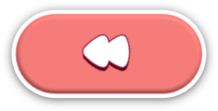
The missing word

Slide 21
I think that boy like playing football and _______
badminton
volleyball
tennis

Slide 22
Great! I like football! But I _____ like tennis.
don’t
really
very

Slide 23
Is that his ______ ?
Maybe he likes _________ .
boat / boating
canoe / canoeing
shoes / running

Slide 24
My name’s Ashok, but everyone calls me Ash. Are you my new ________ ?
neighbour
friend
classmate

Slide 25
I’m eight and Lottie’s _____. How old are you?
eight
nine
seven

Slide 26
I’m from Melbourne, in Australia. I’m _______.
The USA
Australia
Australian

Slide 27
Well-done

Slide 28
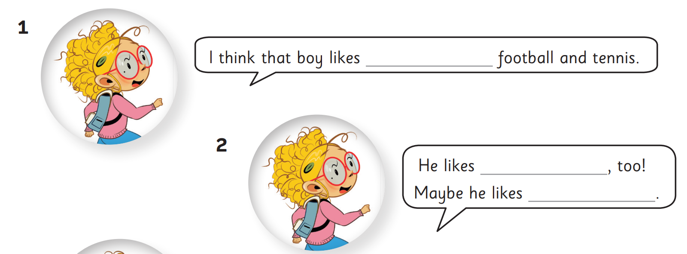
PRACTICE (Pupils’ book (p.7)
tennis,
swimming
canoeing
Answer
Work individually to complete each blank with one word.
Check the answer with the whole class.

Slide 29
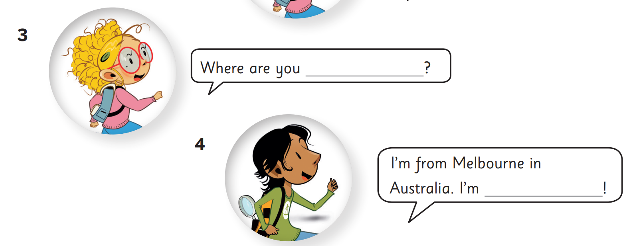
PRACTICE (Pupils’ book (p.7)
from
Australian
Answer
Work individually to complete each blank with one word.
Check the answer with the whole class.

Slide 30
STORY: Production
1. What’s the story title?
→
2. How many story frames?
→
3. How many characters?
→
My new neighbour
5 story frames
3 characters
Click on each number, students look, say and clap the word out loud.

Slide 31
UNIT 0 – Lesson 5A
We’ve learned…
- To understand simple cartoon stories.
- PB pp. 7,8
- AB p.6

