Slide 1



UNIT 1 – NEW SCHOOL
Lesson 1 – Vocabulary

Slide 2

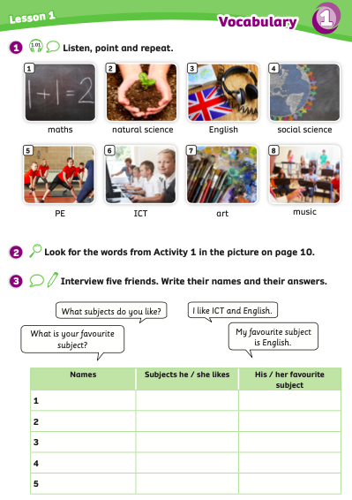
UNIT 1 – Lesson 1
We’re learning…
- School Subjects
- PB pp.10, 11
- AB p.8

Slide 3

WARM-UP ACTIVITY
Divide the class into groups of 4 to 5 students.
Each group takes out a mini-board or a sheet of paper.
Write the topic “school” on the board and count 3, 2, 1.
Students start to write words that relate to the topic.
Ex: board, teachers, book, students, ……
Set a limit of 2 minutes for students.
Then, each group says out loud their words.
The group with the most correct words receives 2 points.

Slide 4



WARM-UP ACTIVITY
school

Slide 5
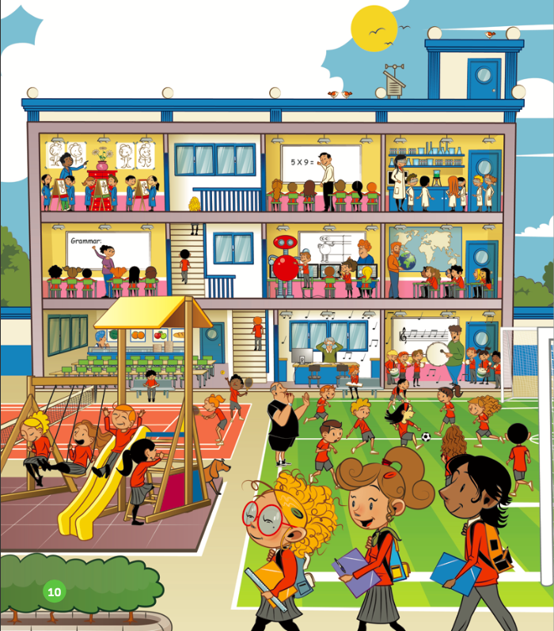
LEAD-IN
How many classrooms do you see?
I see 7 classrooms.
ANSWER
Teacher asks the question and students raise their hands to get a chance to answer.
Give a point if they have a correct answer.

Slide 6
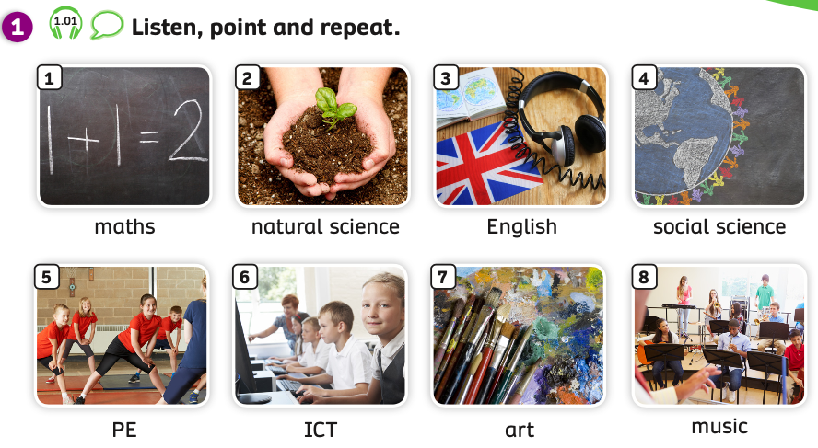

VOCABULARY – School Subjects
Listen and point:
Play the audio, students listen and point to the words.

Slide 7

VOCABULARY – School Subjects
Let’s spell!
c
maths
m
a
t
h
s

Slide 8
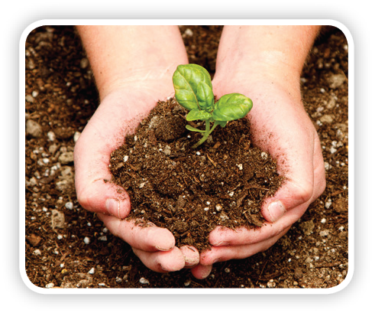
VOCABULARY – School Subjects
Let’s spell!
c
natural science
n
a
t
u
r
a
l
s
c
i
e
n
c
e

Slide 9

VOCABULARY – School Subjects
Let’s spell!
c
English
E
n
g
l
i
s
h

Slide 10

VOCABULARY – School Subjects
Let’s spell!
c
social science
s
o
c
i
a
l
s
c
i
e
n
c
e

Slide 11
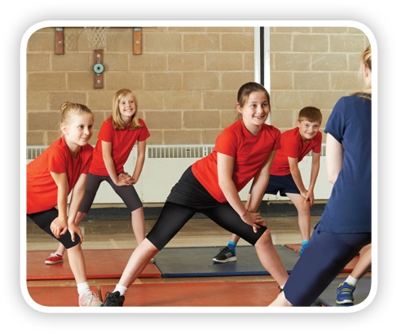
VOCABULARY – School Subjects
Let’s spell!
c
PE
P
E

Slide 12

VOCABULARY – School Subjects
Let’s spell!
c
ICT
l
C
T

Slide 13

VOCABULARY – School Subjects
Let’s spell!
c
art
a
r
t

Slide 14
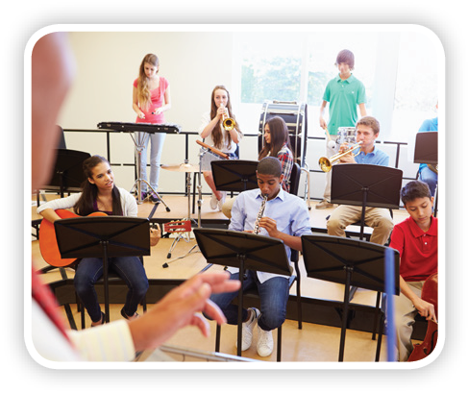
VOCABULARY – School Subjects
Let’s spell!
c
music
m
u
s
i
c

Slide 15
VOCABULARY – School Subjects
REVIEW
1
4
natural science
2
3
music
English
social science
5
6
7
maths
art
ICT
8
PE
Click on each number, students look and say the word.

Slide 16
VOCABULARY – Practice
Divide the class into two teams: team A and team B.
Each student takes out a mini-board.
Click on one-by-one number for each turn.
Students look at the picture and write down the correct word on the board.
If all students in the team write the correct word, that team will receive 2 points. But if the team has 2 or 3 students write the wrong word, they won’t receive points.
The team with the highest points wins the game.

Slide 17





Slide 18







Slide 19





maths
English
social science

Slide 20
PE
art
ICT

Slide 21
science
natural science
social science

Slide 22
musik
music
mucis

Slide 23
ICT
TCI
ITC

Slide 24
science
social science
natural science

Slide 25
Englihs
English
Egnlish

Slide 26
science
ICT
PE

Slide 27
VOCABULARY – Pupils’ book (pp.10,11)

Slide 28
VOCABULARY – Pupils’ book (pp.10,11)
Put students into pairs. Have students open their books, repair 8 small pieces of paper and write a word on each piece of paper.
Give them 2 minutes to write school subjects and find 8 classrooms for them.
Check the answer with the whole class.
The pairs who have all the correct answers receive 2 points.
All students repeat the answers.

Slide 29
VOCABULARY – Pupils’ book (pp.10,11)
art
natural science
English
social science
maths
music
PE
ICT
ANSWER

Slide 30
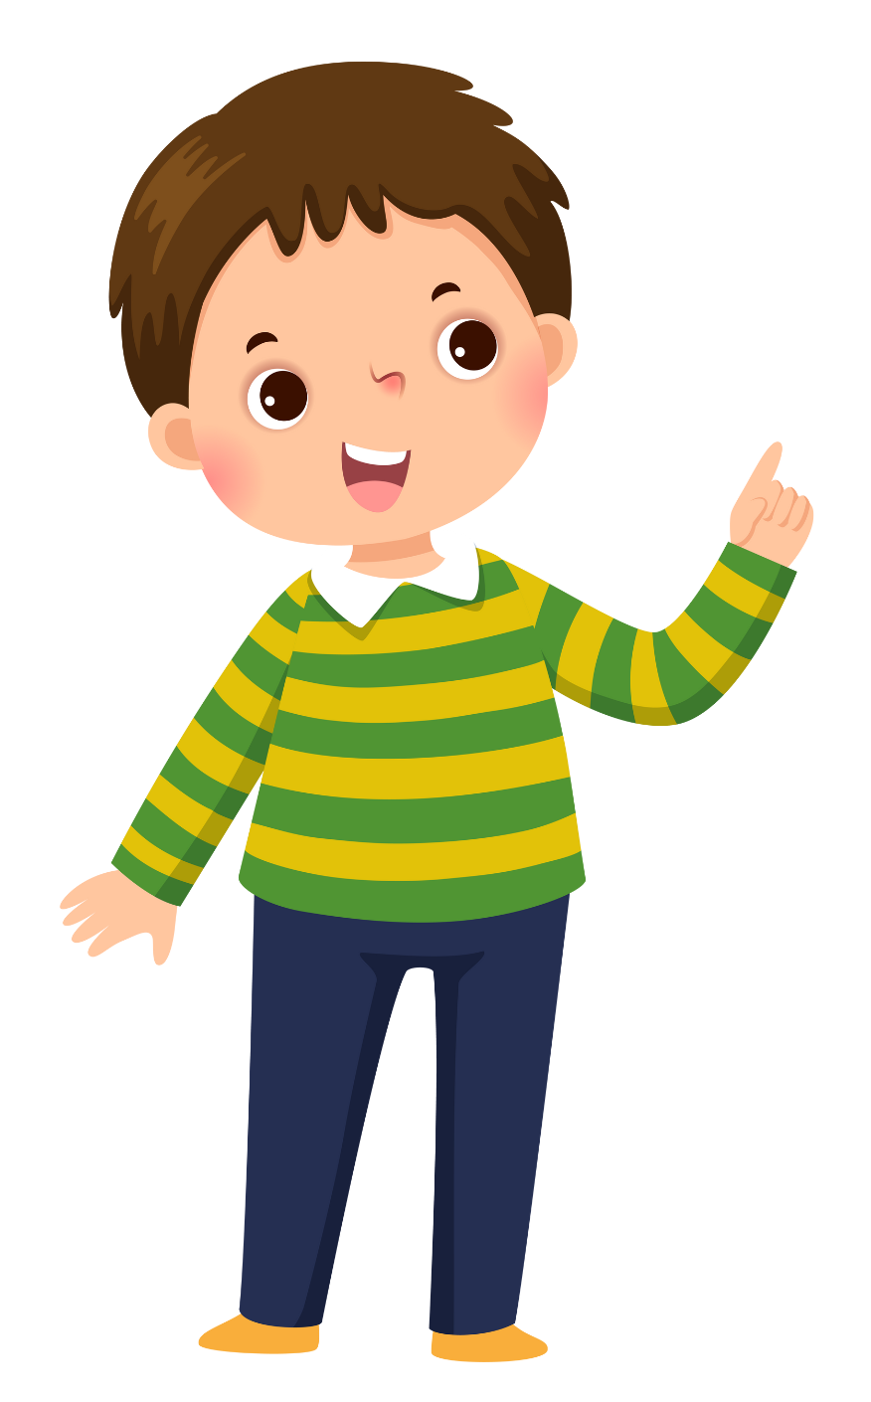

STRUCTURE – Pupils’ book (p.11)
What subjects do you like?
I like ICT and English.
- Show a question and an answer with audio, students listen and repeat.
- Divide class into two teams. One team asks and one team answers.

Slide 31
STRUCTURE – Pupils’ book (p.11)
My favourite subject is English.
What is your favourite subject?
- Show a question and an answer with audio, students listen and repeat.
- Divide class into two teams. One team asks and one team answers.

Slide 32
STRUCTURE – Practice
Put students work in pairs.
One student asks and one student answers 2 questions.
“What subjects do you like?” and “What is your favourite subject?”
Then, the teacher asks students to change pairs. We can use the bell or the noisy chicken to make a signal for students.

Slide 33
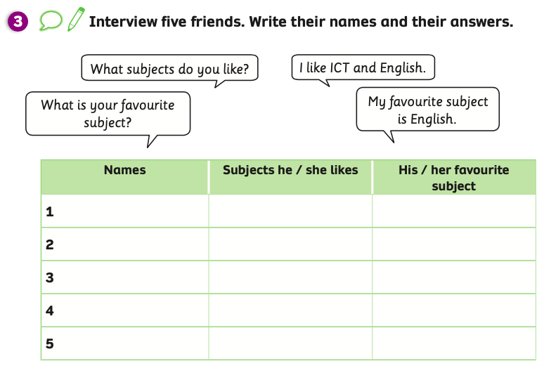
STRUCTURE – Pupils’ book (p.11)
- Show the table and introduce the activity.

Slide 34


STRUCTURE – Pupils’ book (p.11)
What subjects do you like?
I like art and maths
Tom
art and maths
Mary
Tom
- Students look at the example conversation.

Slide 35
STRUCTURE – Pupils’ book (p.11)
What is your favourite subject?
My favourite subject is maths
Tom
art and maths
maths
Mary
Tom
- Students look at the example conversation.

Slide 36
PRODUCE
Teacher says a school subject and students take turns making one sentence about that subject.
(Ex: teacher: “maths”. Students: ”I don’t like maths.” – I have maths on Tuesday.”)
Students with the correct sentence receive a point.

Slide 37
HOMEWORK
Review vocabulary and grammar.
Do exercises in the Activity Book (page 8).
Check answers in the Teacher’s book (page 22) or Active Teach.

Slide 38
UNIT 1 – Lesson 1
We’ve learned…
- School Subjects
- PB pp.10, 11
- AB p.8

