Slide 1

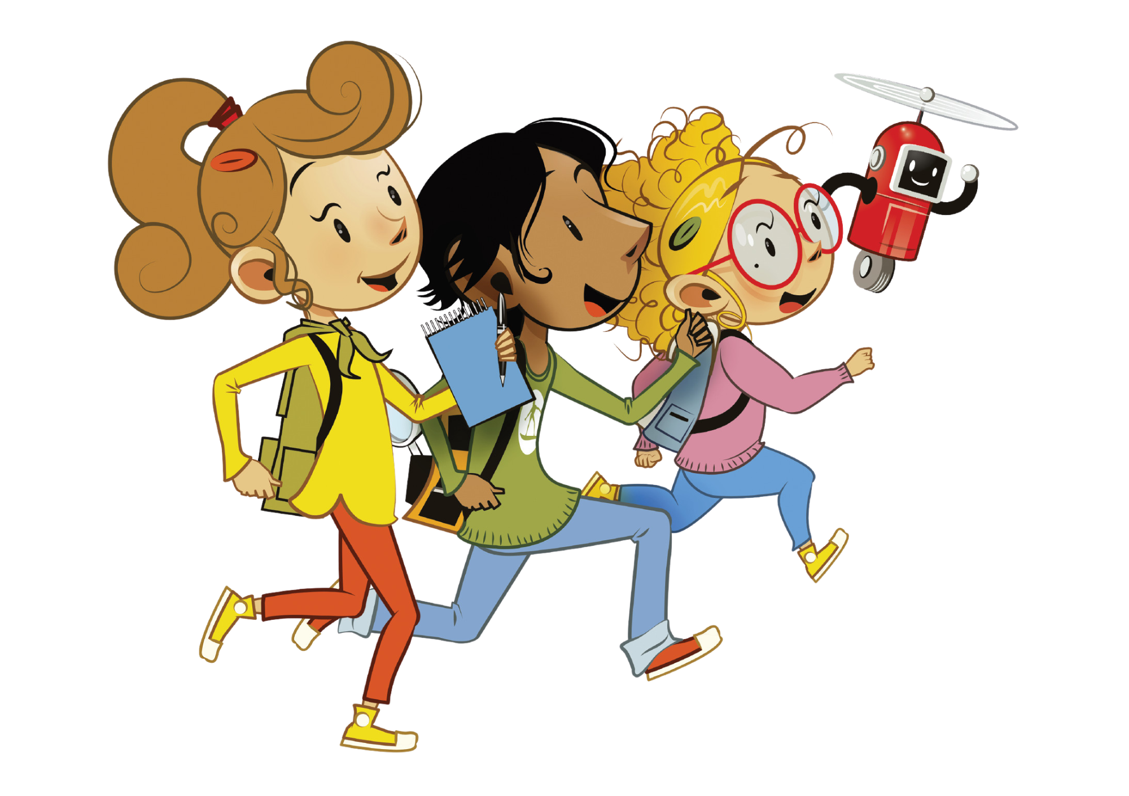

UNIT 1 – NEW SCHOOL
Lesson 2 – Review

Slide 2
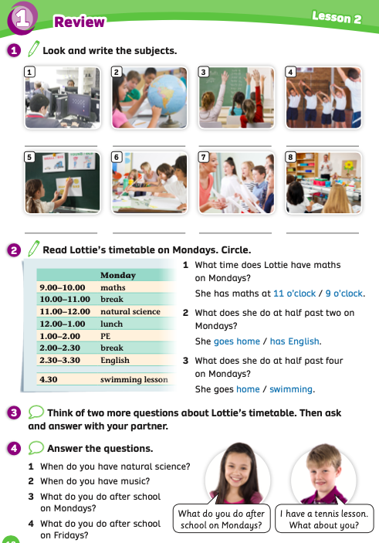
UNIT 1 – Lesson 2
We’re learning…
- School Subjects
- PB p.12
- AB p.9

Slide 3

WARM-UP ACTIVITY
Divide the class into teams.
The first student of each team stands up and looks at the teacher.
Show a picture, students look and say the word.
The fastest student with the correct answer receives a point for the team.
Then, the next student takes turns joining in the activity.
The team with the highest points wins the game.

Slide 4


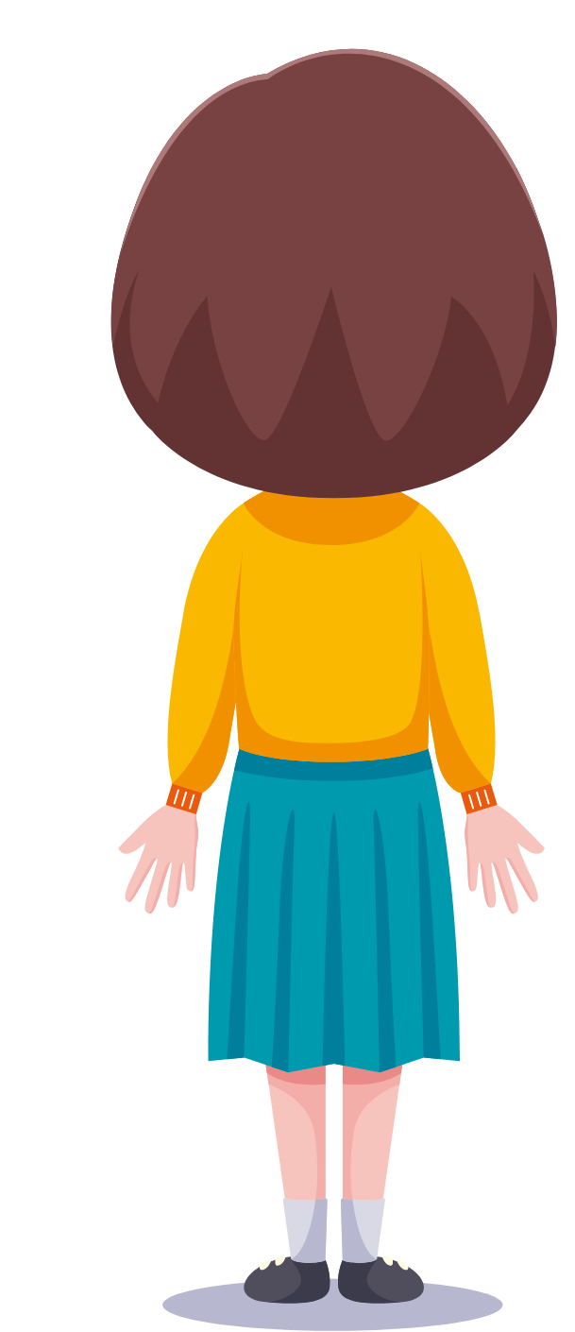
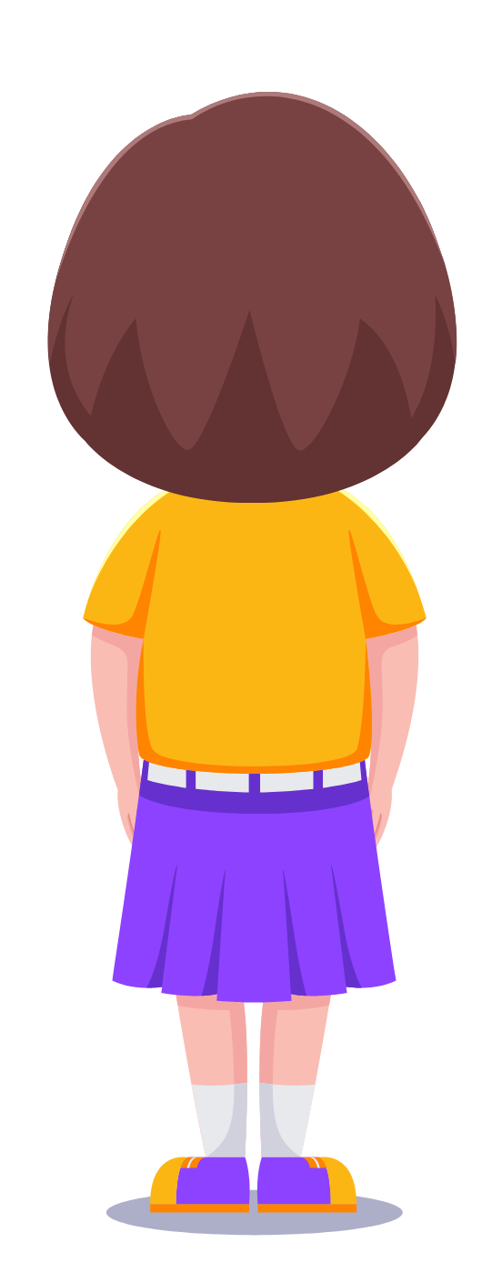
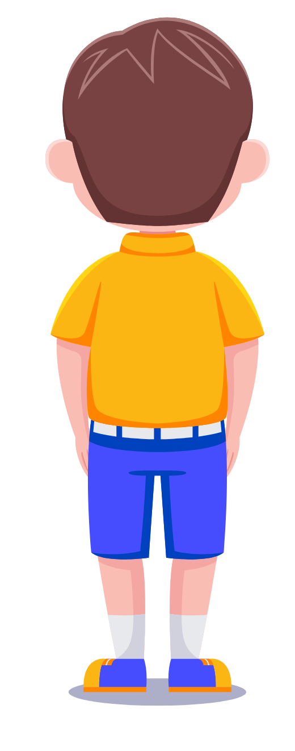
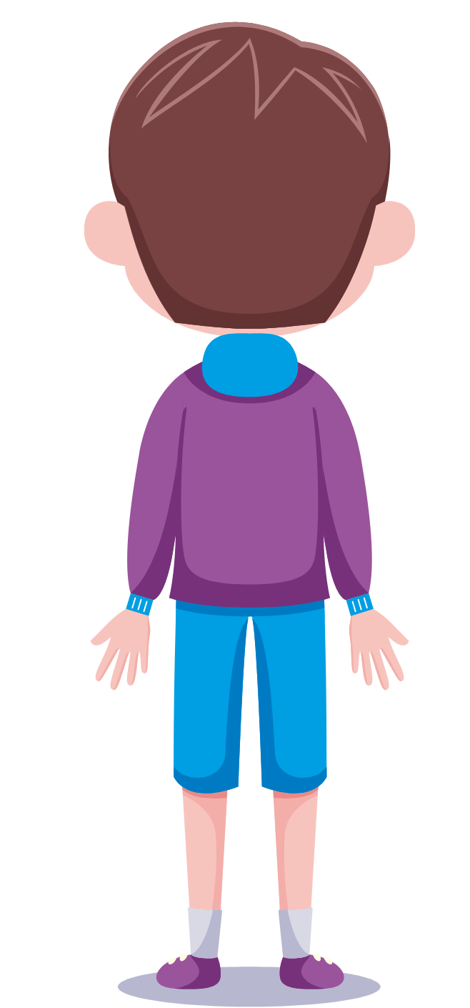

WARM-UP ACTIVITY
English

Slide 5
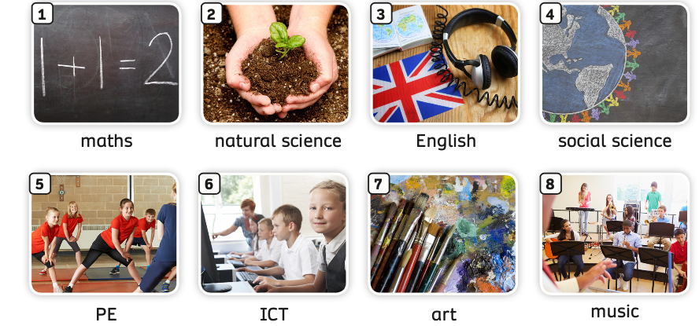
VOCABULARY – REVIEW
- The teacher says a number. Students listen and raise their hands to get a chance to say the word aloud.
The fastest student with the correct answer receives a point.

Slide 6
VOCABULARY
Activity: UNSCRAMBLE WORDS
Divide the class into groups of 4 to 5 students.
Each group takes out a mini-board. Students in the group will take turns writing down the answer.
Show unscrambled letters on each slide, students look and write them into the correct word.
Students raise the board after finishing the word. The teacher looks and checks the answer.
The first group with the correct answer receives 2 points.

Slide 7
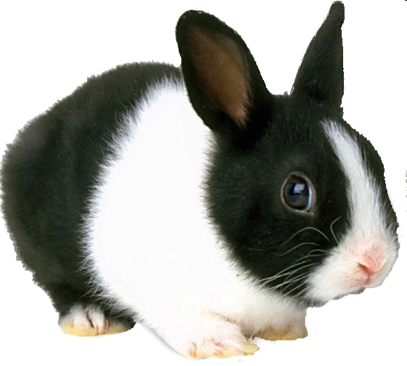
UNSCRAMBLE
b
R
b
a
i
t
GAME!

Slide 8
smaht
Ready?
GO!
maths
10s

Slide 9
sciecen
Ready?
GO!
science
10s

Slide 10
atr
Ready?
GO!
art
10s

Slide 11
miucs
Ready?
GO!
music
10s

Slide 12
ngElsih
Ready?
GO!
English
10s

Slide 13
natlaru siecenc
Ready?
GO!
natural science
20s

Slide 14
oscial cisenec
Ready?
GO!
social science
20s

Slide 15
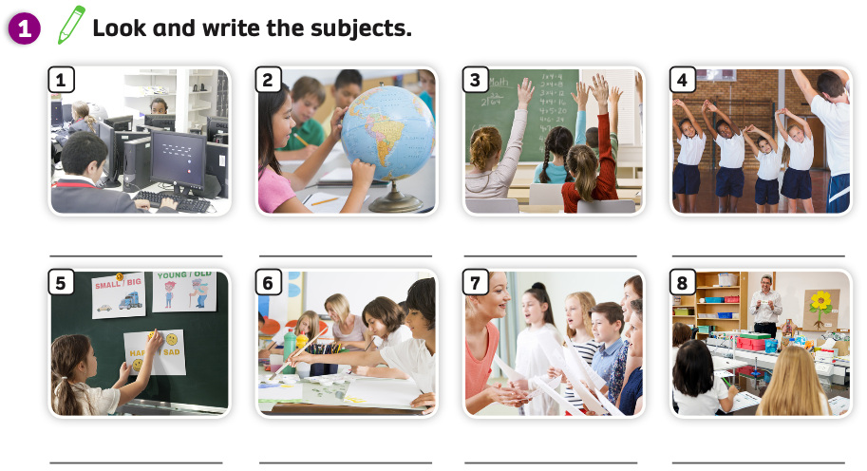
Pupils’ book (p.12)
ANSWER
ICT
social science
maths
PE
English
art
music
natural science
Have students open their books and work individually.
Students look at the pictures and write a word for each picture.

Slide 16
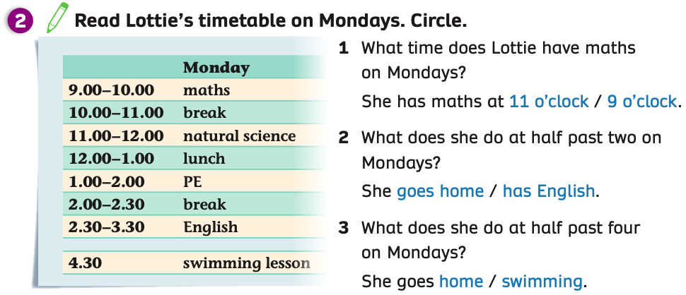
Pupils’ book p.12
ANSWER
Put students into pairs. Students look at the timetable and choose the correct answer.
Then they open their books to circle the answers.
Click on “Answer” to show the answers to check.

Slide 17
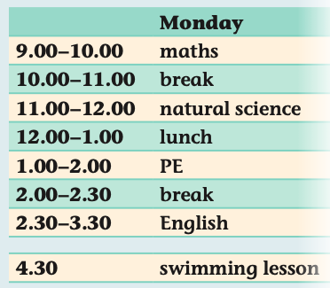
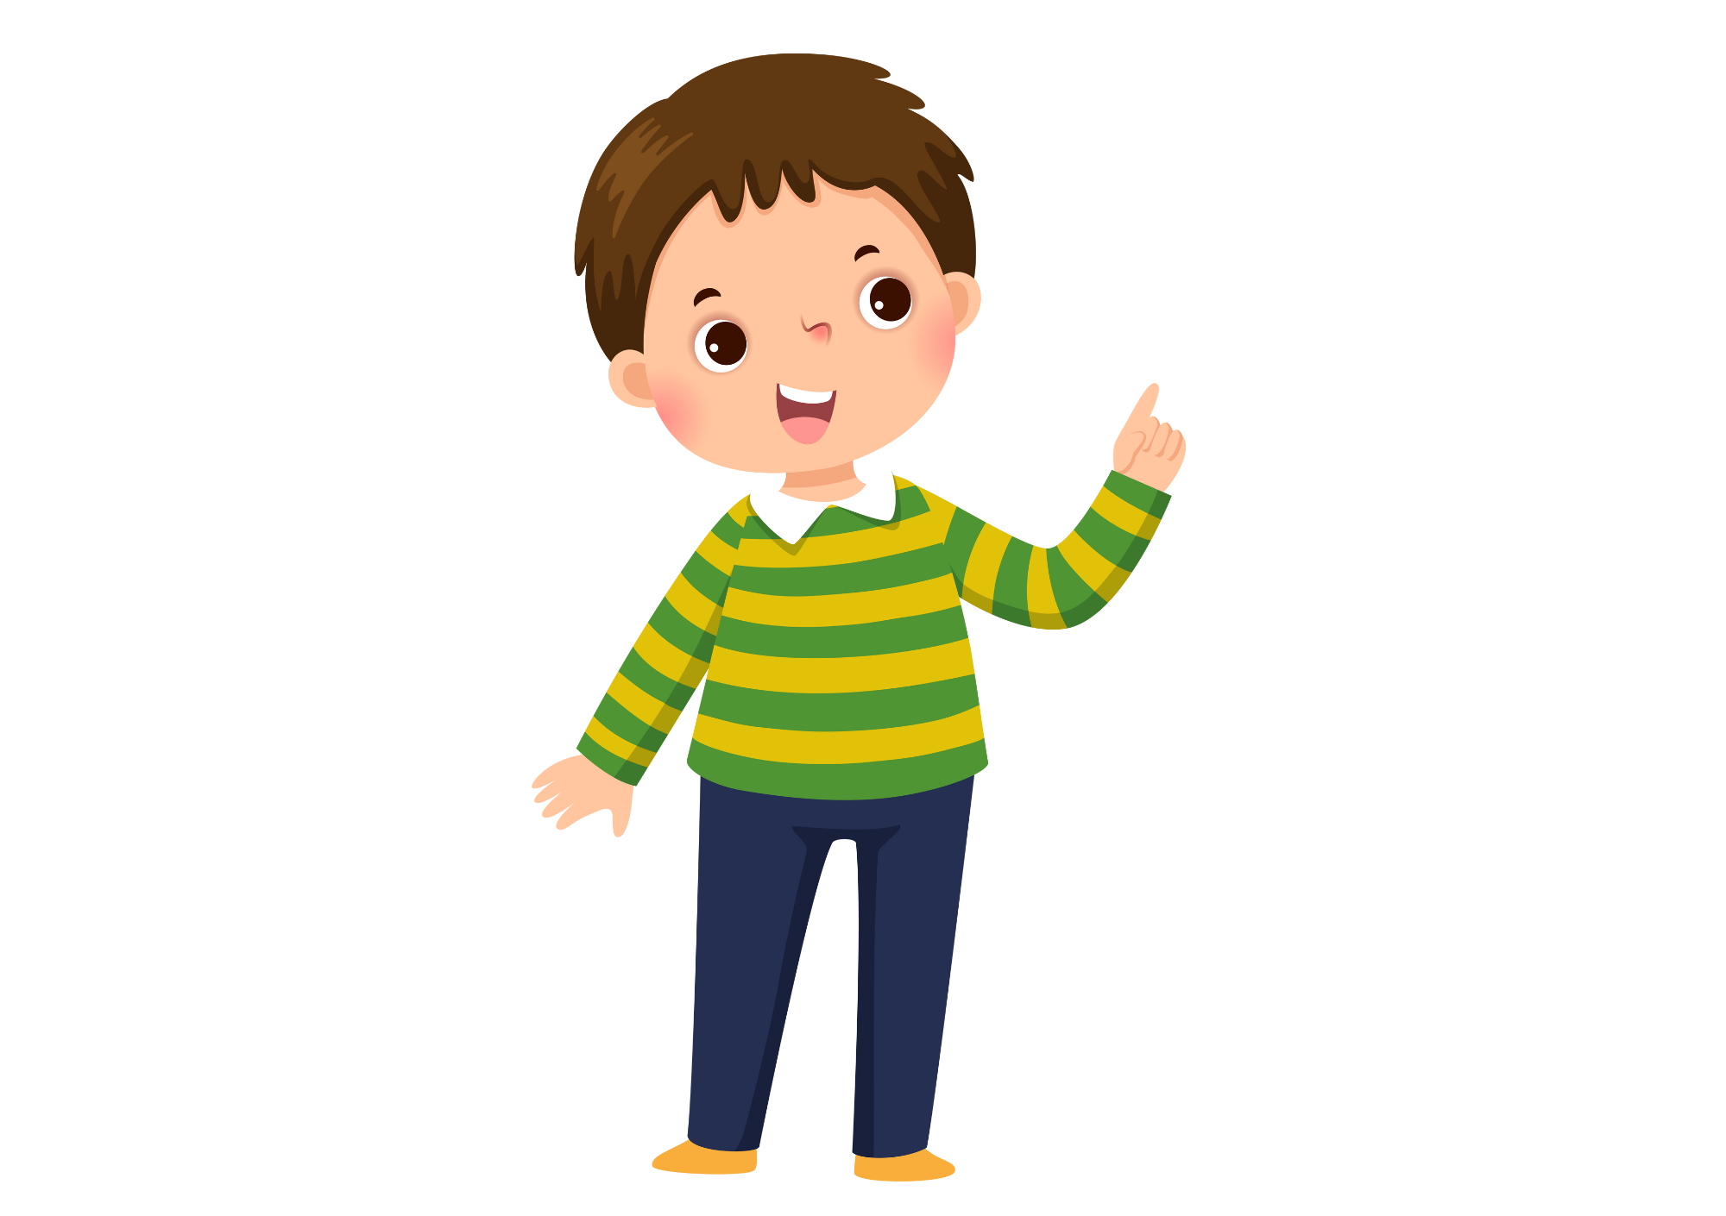
Pupils’ book p.12
What time does Lottie have lunch?
Put students into pairs. Students look at the timetable and work with their partners to ask and answer more questions about Lottie’s timetable.
The teacher goes around and checks.

Slide 18
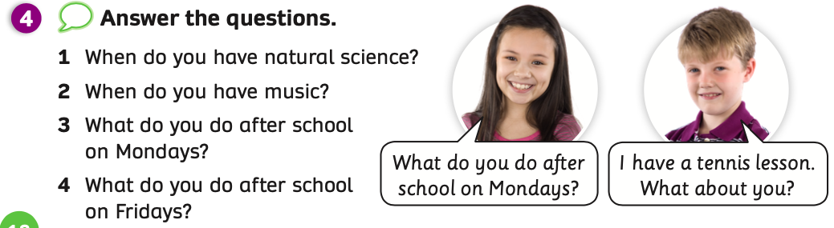
Pupils’ book p.12
Students take out a sheet of paper. Students look at 4 questions and write down the answers.
The teacher sets a timeout (in 2 minutes).

Slide 19

Pupils’ book p.12
I have natural science on Tuesdays. What about you?
When do you have natural science?
I have natural science on Wednesdays.
Divide the class into 2 teams. One team asks and one team answers.
Students look at and read aloud the examples.

Slide 20
Pupils’ book p.12
I have music on Thursdays. How about you?
When do you have music?
I have music on Mondays.
Students look at and read aloud the examples.

Slide 21
Pupils’ book p.12
What do you after school on Mondays?
What do you after school on Mondays?
I go to a piano class.
I have a tennis lesson.
Students look at and read aloud the examples.

Slide 22
Pupils’ book p.12
What do you after school on Fridays?
I go swimming. What about you?
I play football after school.
Students look at and read aloud the examples.

Slide 23
Pupils’ book p.12
Put students into pairs. Students look at the questions, one student asks and one student answers.
The teacher goes around and checks.
Invite some pairs to present in front of the class.

Slide 24
SUM - UP
Divide the class into groups of 4 to 5 students. Each group takes out a sheet of paper and writes down the list of as many school subjects in English as they can.
After finishing the lists, they say Bingo and the teacher checks the list and gives points.

Slide 25
HOMEWORK
Review vocabulary and grammar.
Do exercises in the Activity Book (page 9).
Check answers in the Teacher’s book (page 24) or Active Teach.

Slide 26
UNIT 1 – Lesson 2
We’ve learned…
- School Subjects
- PB p.12
- AB p.9

