Slide 1



UNIT 1 – NEW SCHOOL
Lesson 5A – Vocabulary and Grammar 2

Slide 2
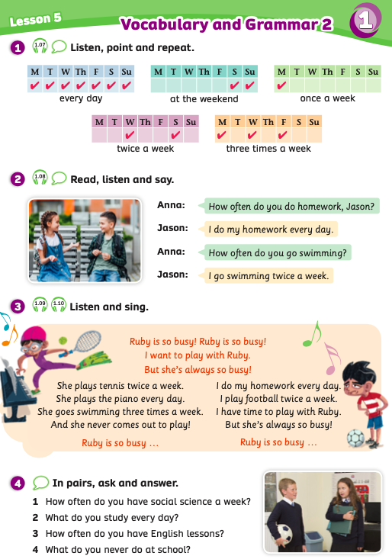
UNIT 1 – Lesson 5A
We’re learning…
To use the structure:
“How often do you learn science”
- PB p.15
- AB p.12

Slide 3

WARM-UP ACTIVITY
Show the slide or write on the board the unscrambled words:
1. day/every – 2. the/ weekend/ at – 3. a/once/week – 4. a/ three/week/times – 5. week/ a/ twice
Put students into pairs. Each pair takes out a sheet of paper. Students look at these words and write them into the correct phrases.
After fishing these phrases, they say Bingo and give the paper to check.
The 3 first pairs with all the correct answers receive 2 points.

Slide 4

WARM-UP ACTIVITY
1. day/ every
2. the/ weekend/at
3. a/ once/ week
4. a/ three/ week/ times
5. week/ a/ twice
Students look at these words and write the answer on the board.

Slide 5
ANSWER
WARM-UP ACTIVITY
1. everyday
2. at the weekend
3. once a week
4. three times a week
5. twice a week
Click on ”Answer” to show the answers.

Slide 6

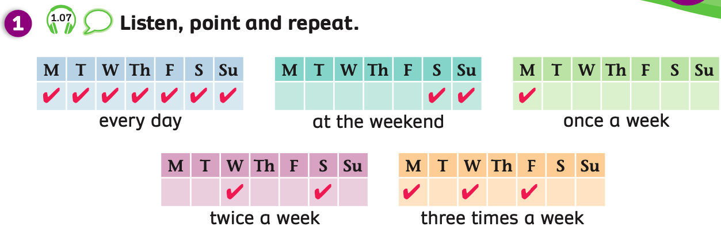
VOCABULARY
- Have students look at the slide, listen and repeat.

Slide 7

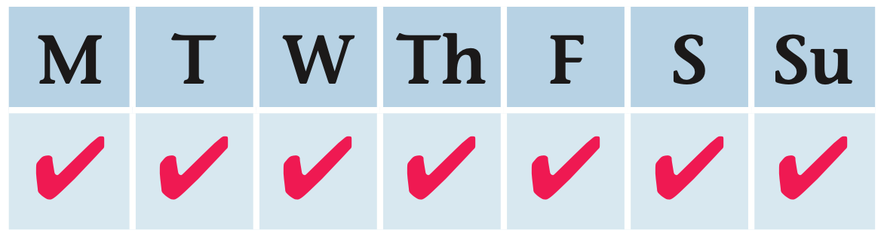
VOCABULARY – School Subjects
c
every day
Students look, listen and repeat.

Slide 8
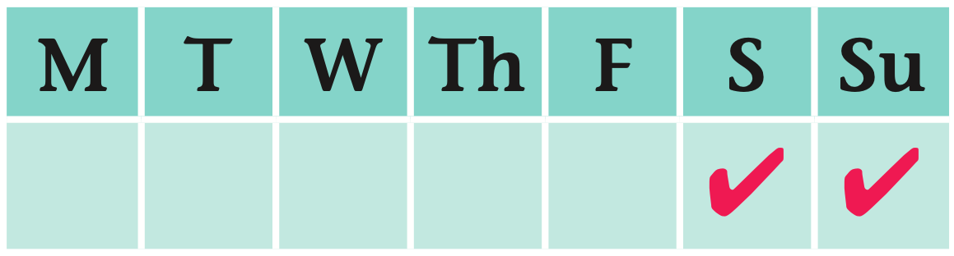
VOCABULARY – School Subjects
c
at the weekend
Students look, listen and repeat.

Slide 9
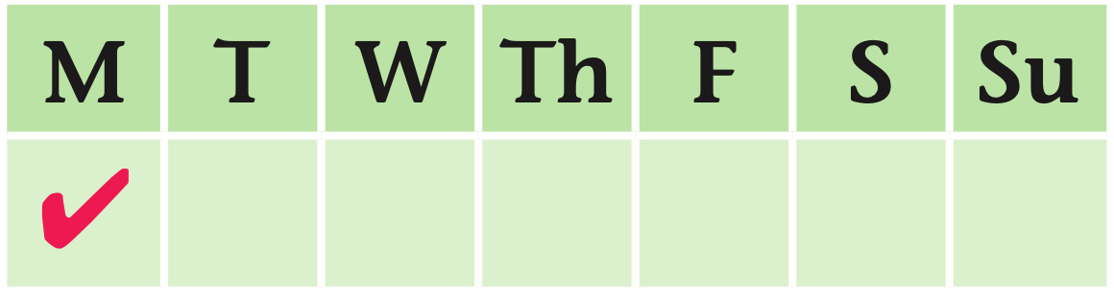
VOCABULARY – School Subjects
c
once a week
Students look, listen and repeat.

Slide 10
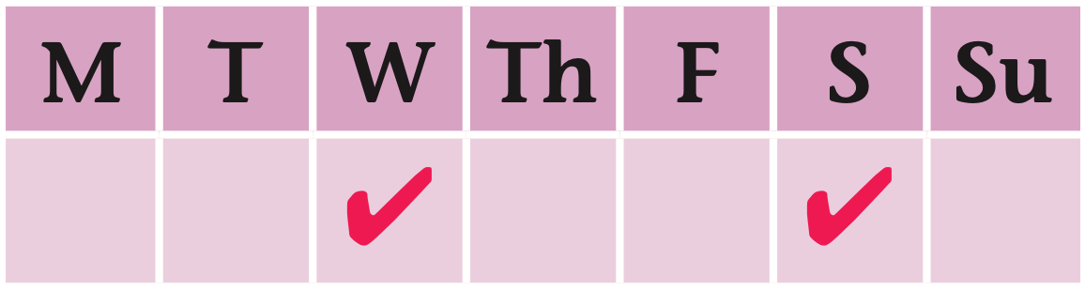
VOCABULARY – School Subjects
c
twice a week
Students look, listen and repeat.

Slide 11
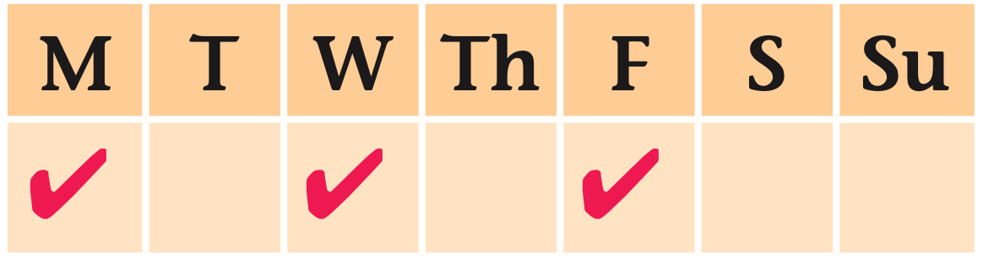
VOCABULARY – School Subjects
c
three times a week
Students look, listen and repeat.

Slide 12
VOCABULARY - Review
Show each picture, students look at and say the word aloud.

Slide 13
VOCABULARY - PRACTICE
Divide the class into groups of 4 to 6 six students.
Call out one by one students from each team to come to play, and stand behind the line and in front of the board.
Write 6 words on the board: every day, at the weekend, once a week, twice a week, three times a week, four times a week.
The teacher throws a dice, if it stops at number 3, students will say the correct word aloud. “
The fastest student with the correct word receives 2 points.
Then, the next member will continue the next turn.

Slide 14

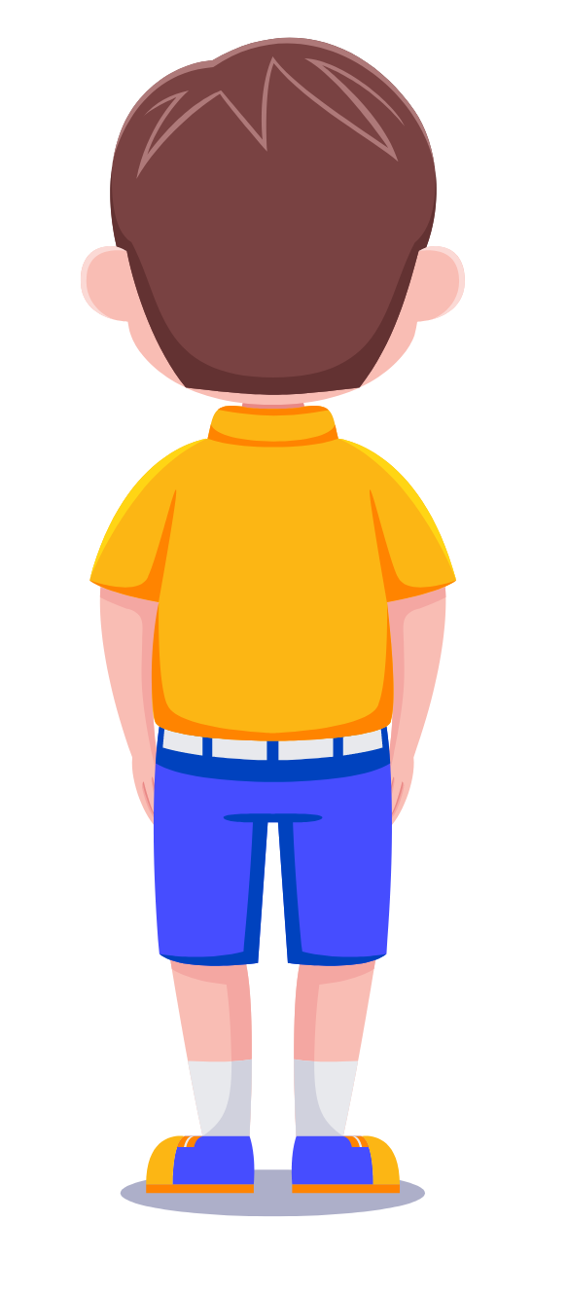
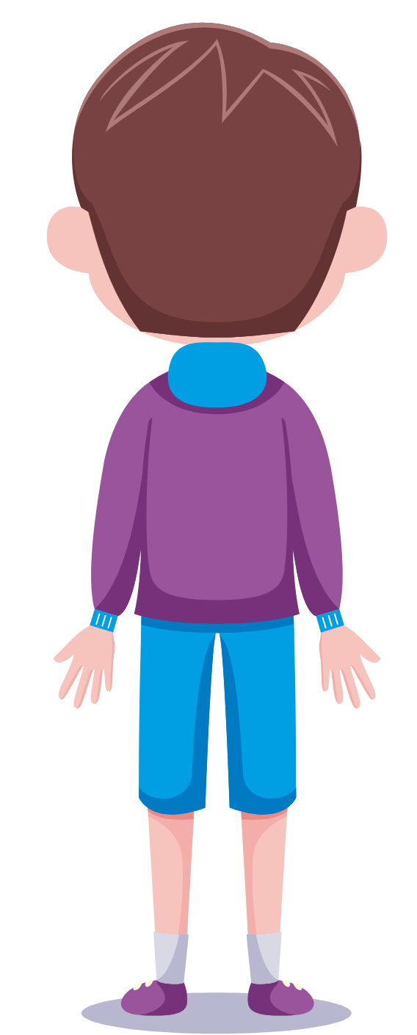

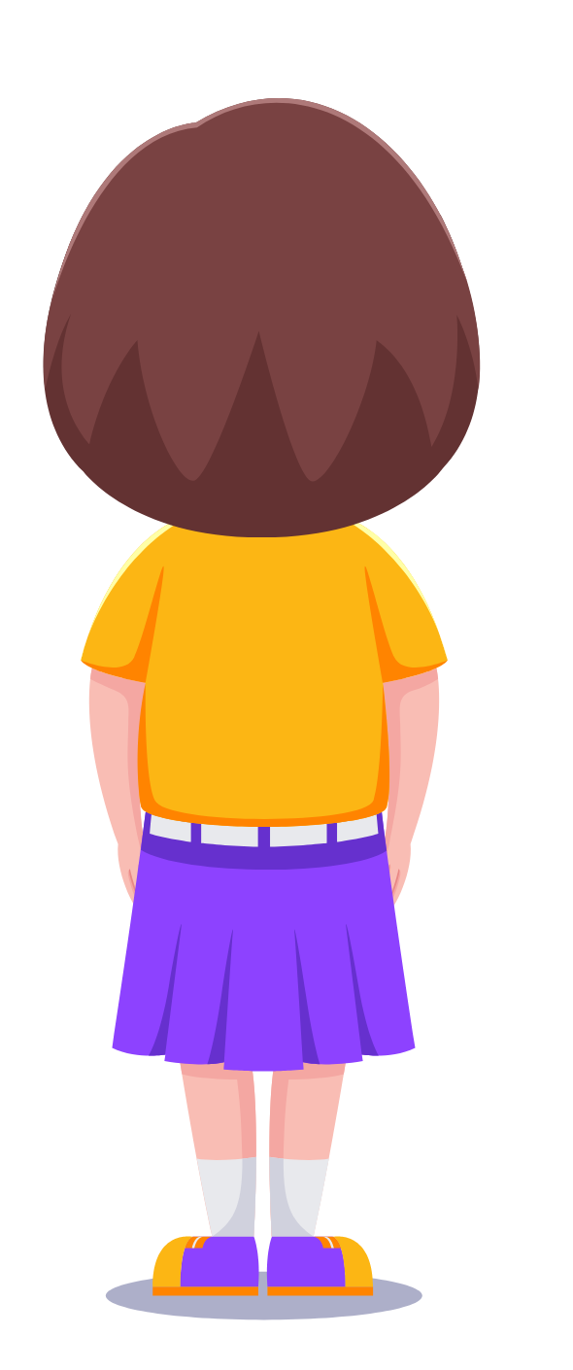
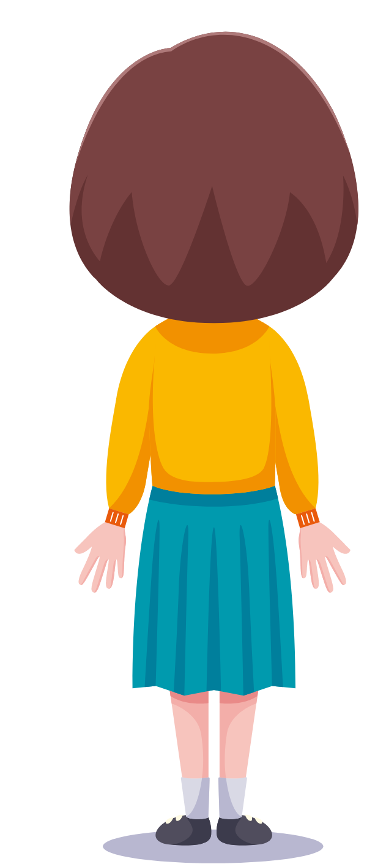
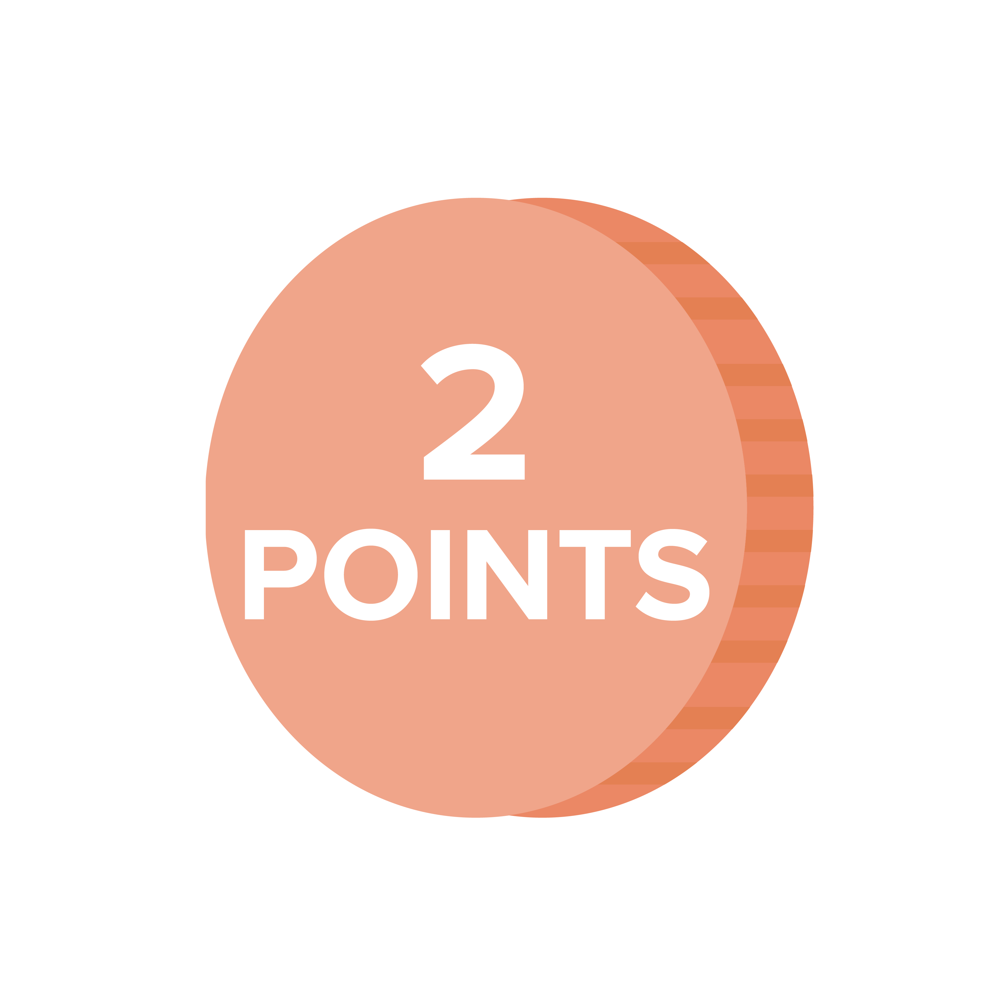
VOCABULARY - PRACTICE
Number 3
3. every day
1. at the weekend
5. once a week
2. three times a week
4. twice a week
6. four times a week
every day

Slide 15
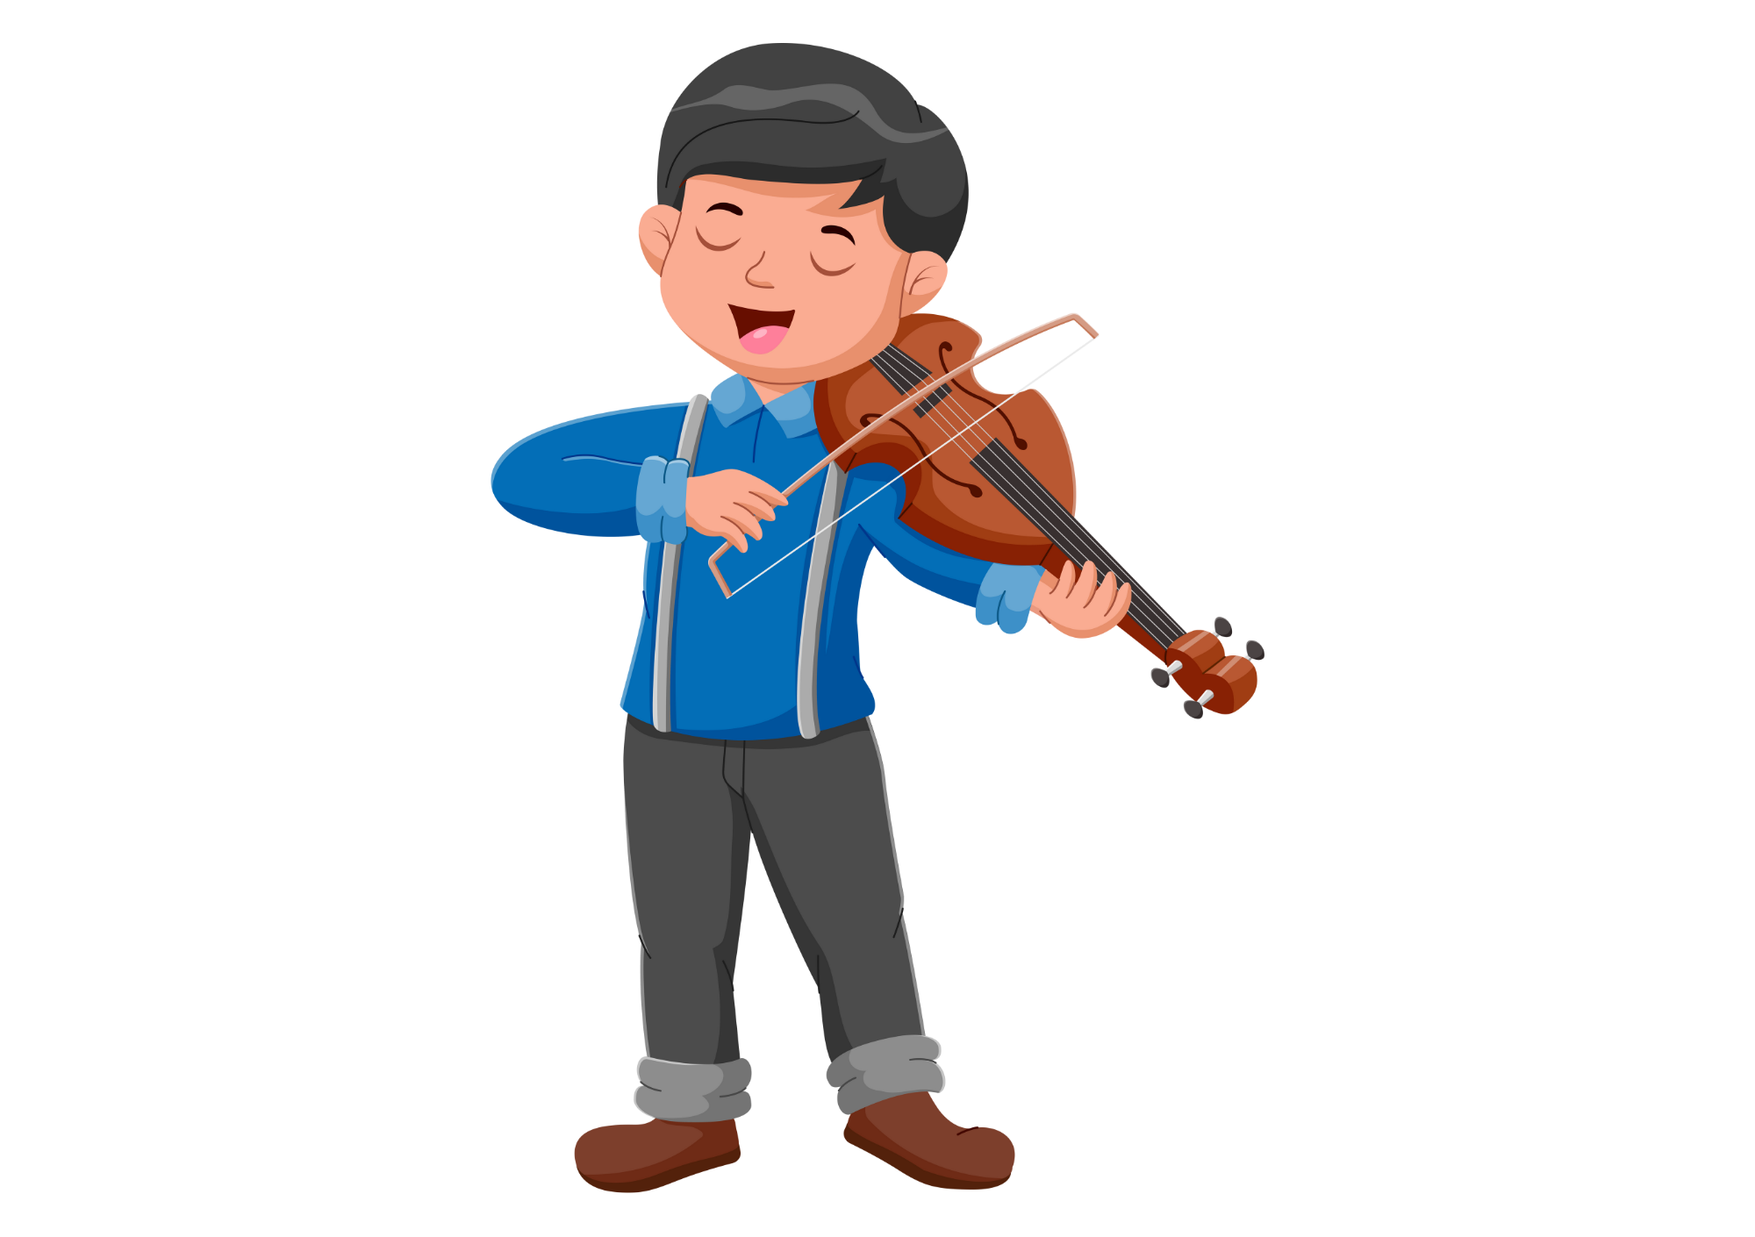
GRAMMAR - INTRODUCE
I have music lessons twice a week.
Show the sentence with audio, students listen and repeat.

Slide 16
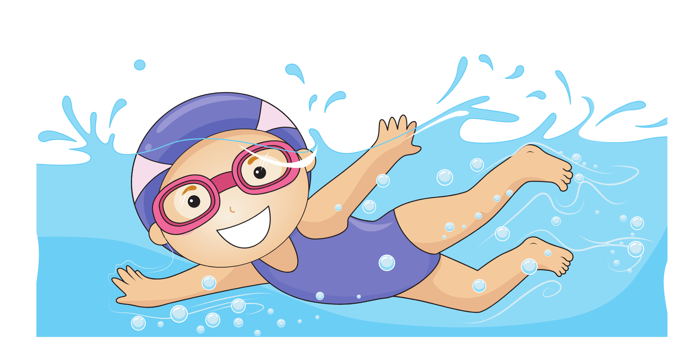
GRAMMAR - INTRODUCE
She goes swimming once a week.
Show the sentence with audio, students listen and repeat.

Slide 17
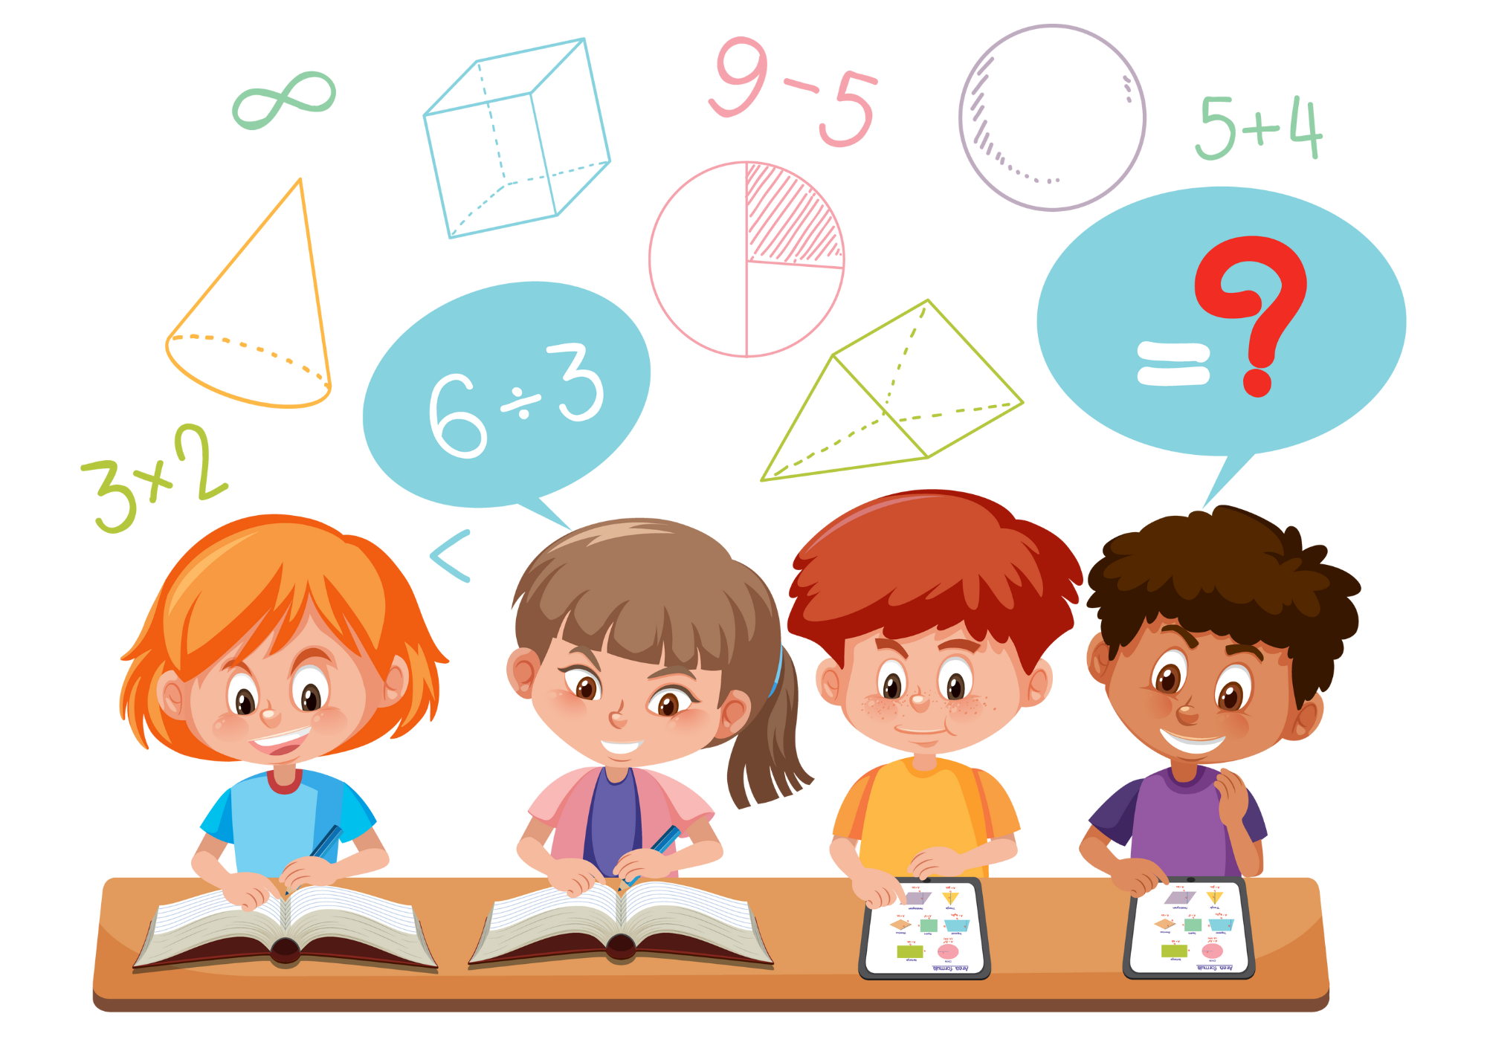
GRAMMAR - INTRODUCE
We have maths lessons three times a week.
Show the sentence with audio, students listen and repeat.

Slide 18
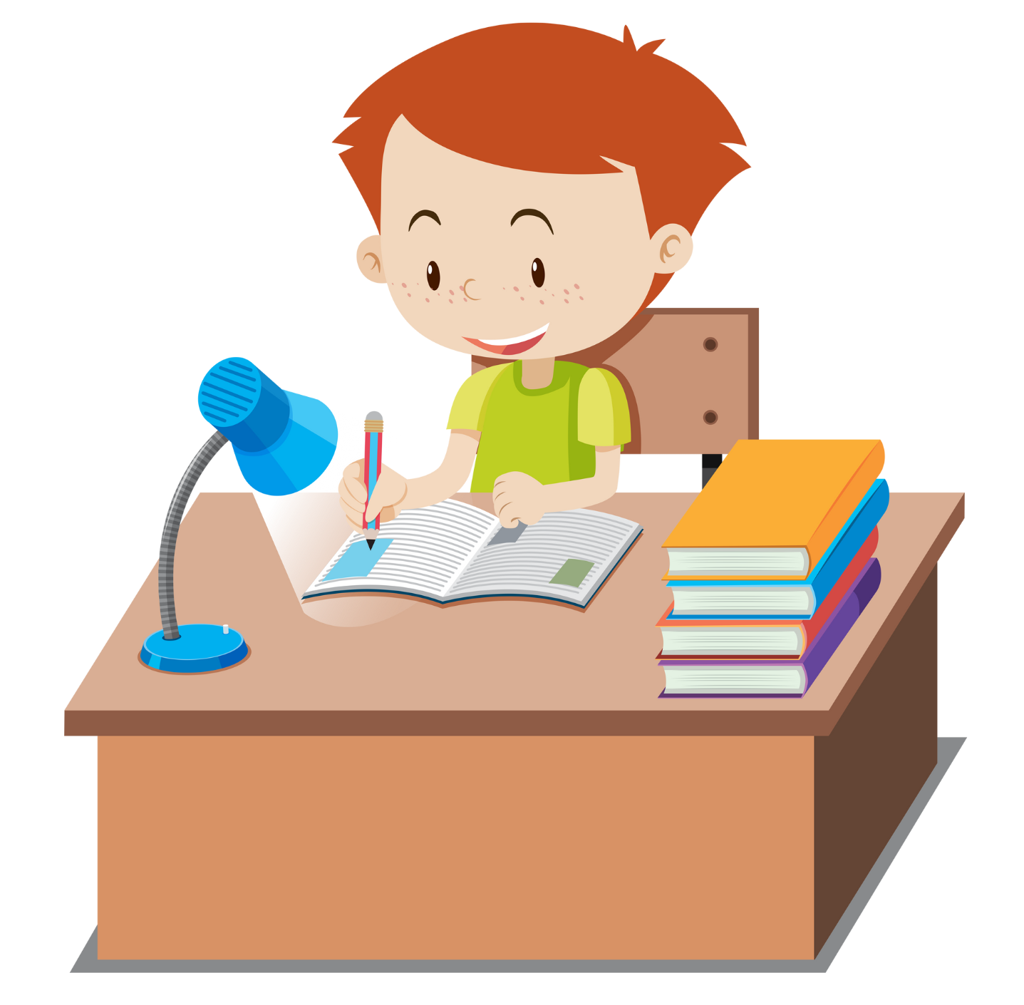
GRAMMAR - INTRODUCE
He does his homework every day.
Show the sentence with audio, students listen and repeat.

Slide 19
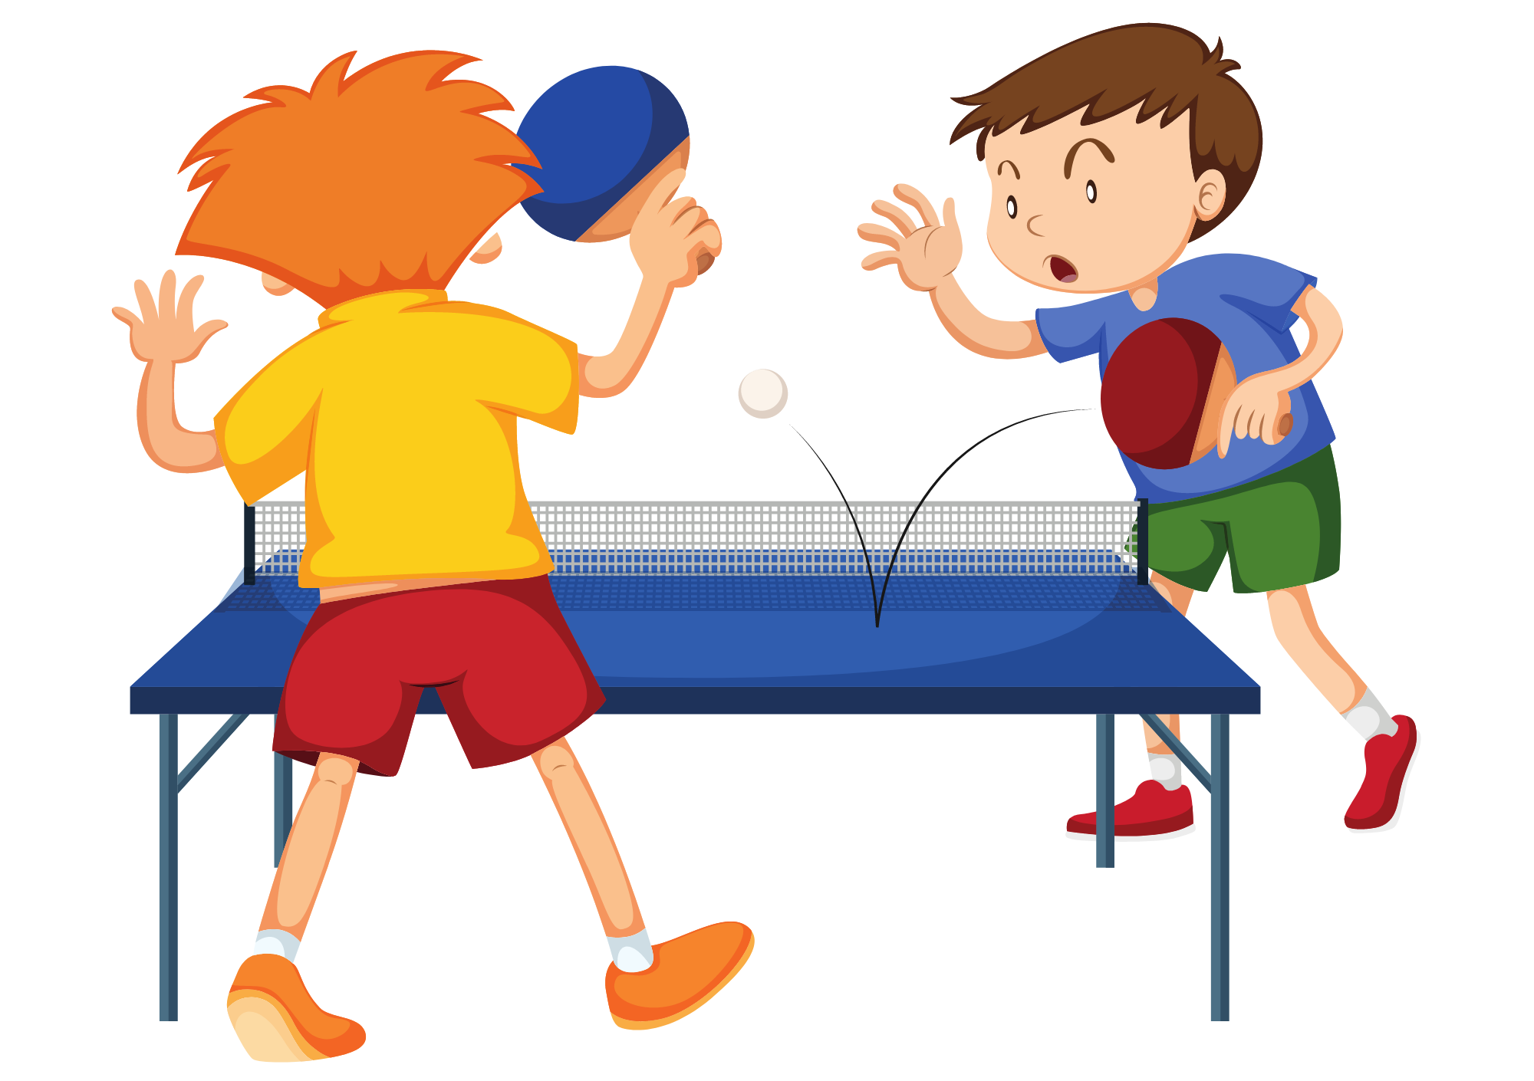
GRAMMAR - INTRODUCE
They play table tennis at the weekend.
Show the sentence with audio, students listen and repeat.

Slide 20
STRUCTURE - PRACTICE
Put students into groups of 4.
Students look at 2 pictures with a subject and make a sentence.
They raise their hands to get a chance to say the answer.
The fastest group with the correct sentence receives 2 points.

Slide 21
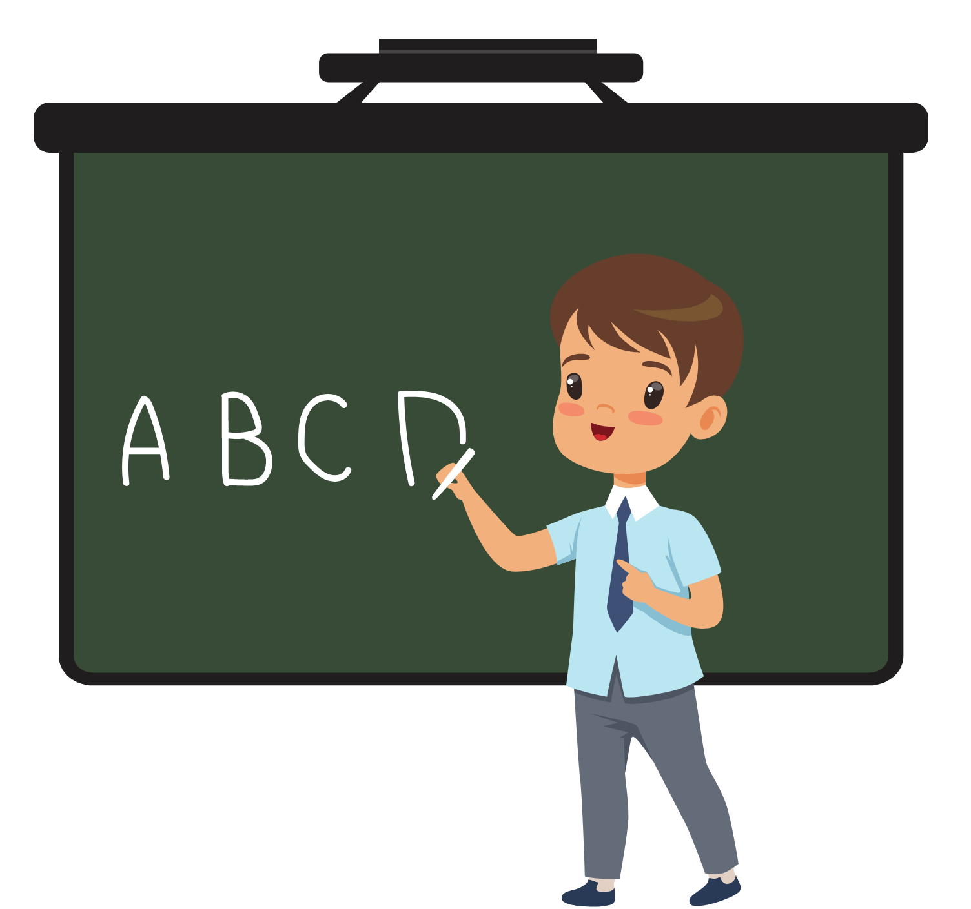
GRAMMAR - PRACTICE
ANSWER
(He)
He has English lessons twice a week.
Click on ”Answer” to show the answers.

Slide 22

GRAMMAR - PRACTICE
ANSWER
(I)
I do my homework every day.
Click on ”Answer” to show the answers.

Slide 23
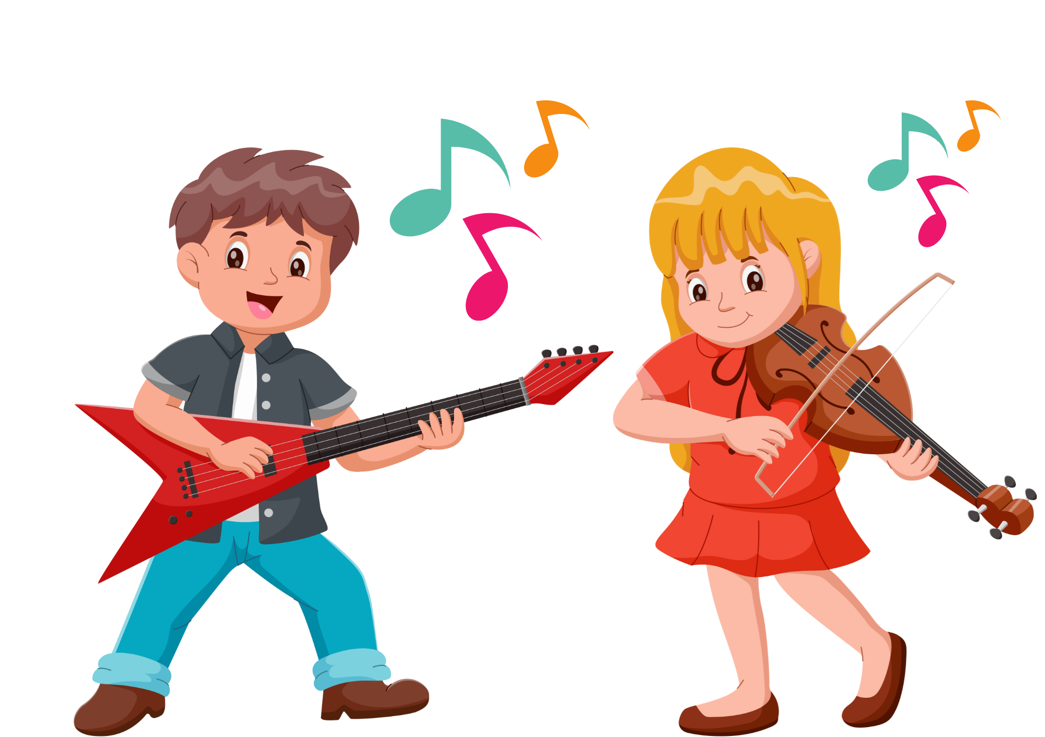
GRAMMAR - PRACTICE
ANSWER
(We)
We have music lessons three times a week.
Click on ”Answer” to show the answers.

Slide 24
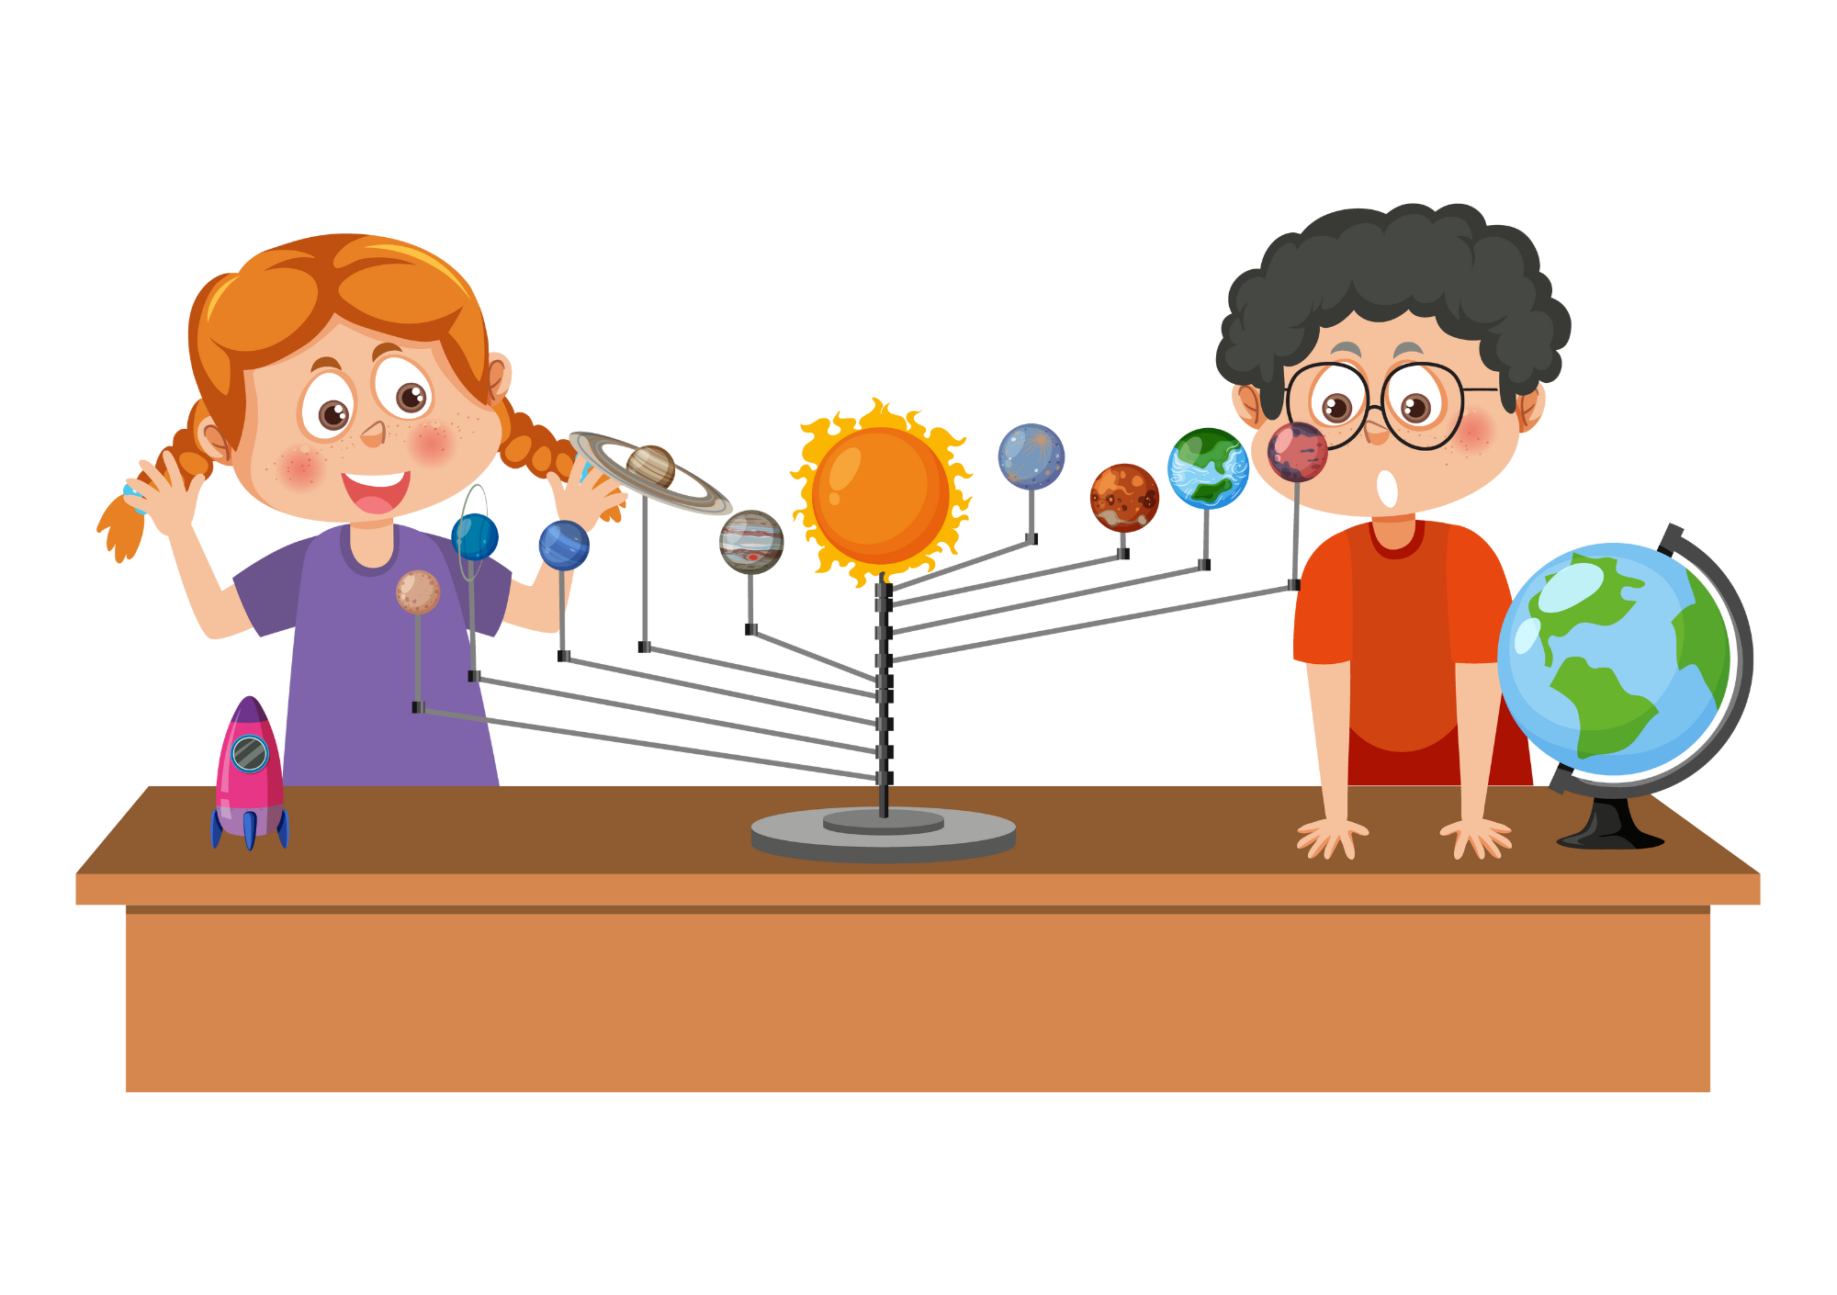
GRAMMAR - PRACTICE
(They)
ANSWER
They have a social science lesson once a week.
Click on ”Answer” to show the answers.

Slide 25
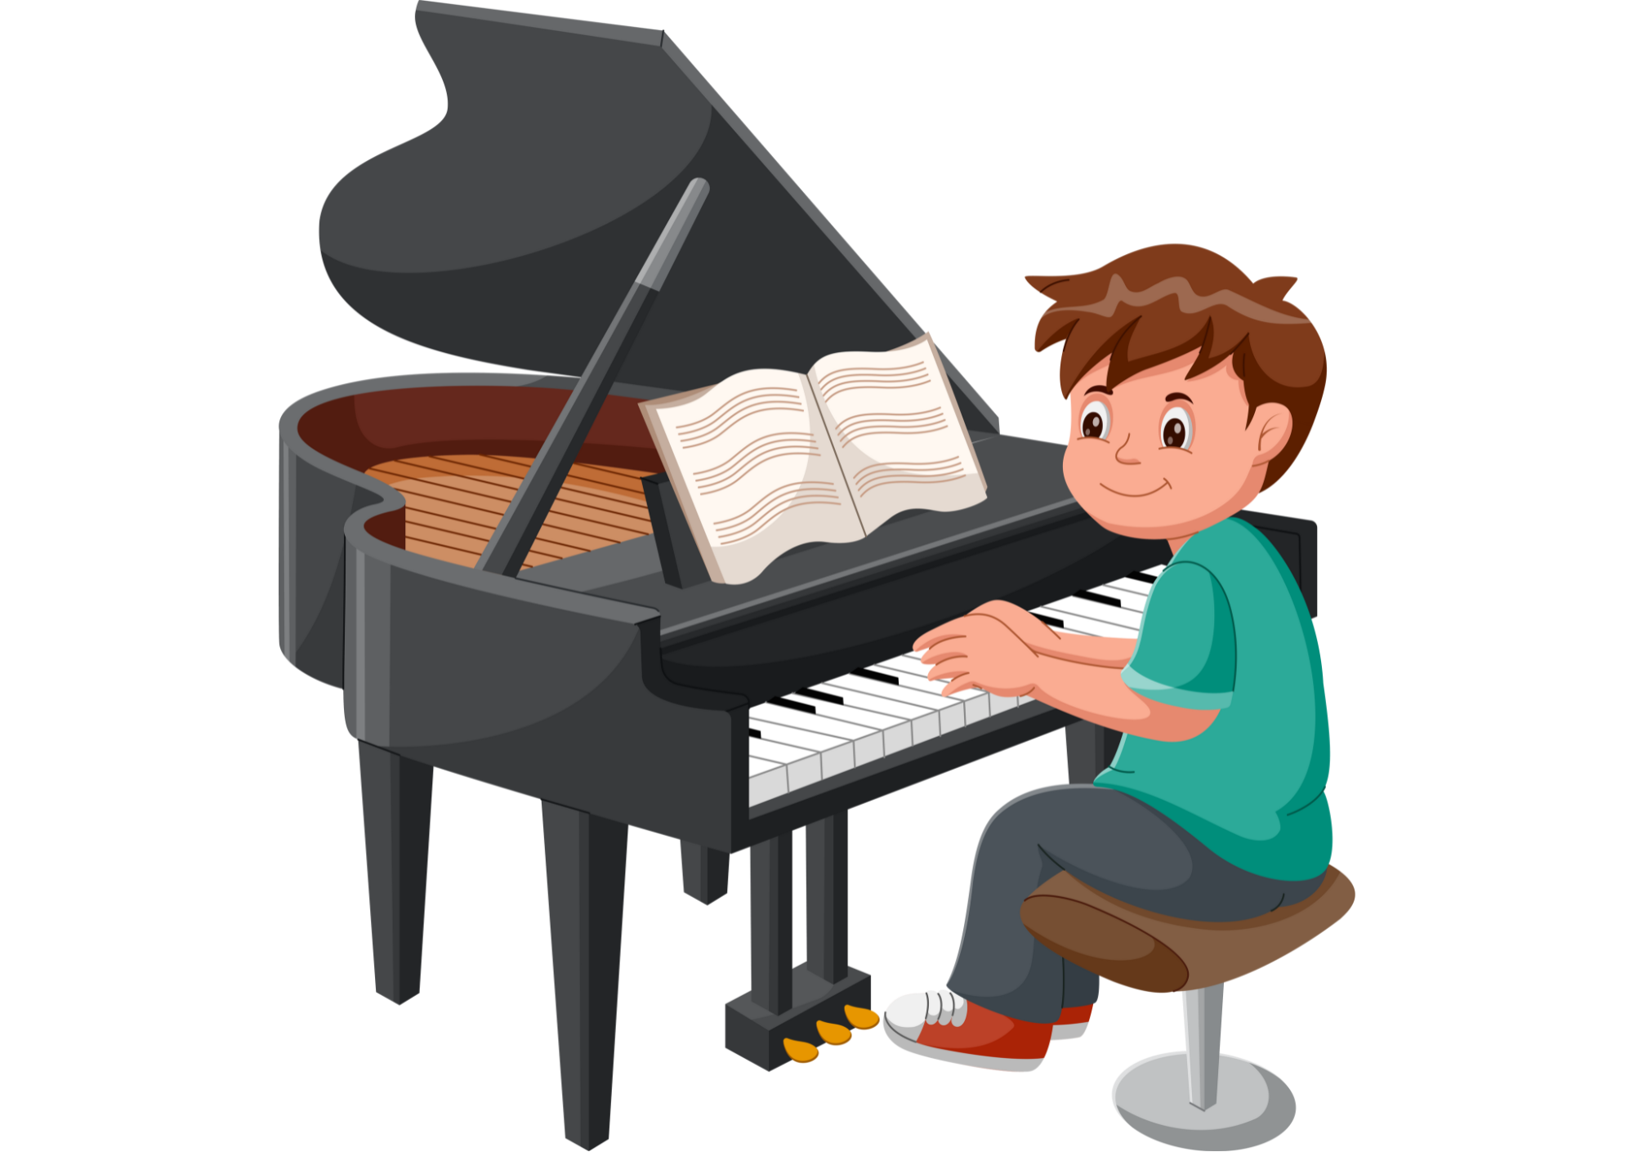
GRAMMAR - PRACTICE
ANSWER
(My friend)
My friend plays the piano twice a week.
Click on ”Answer” to show the answers.

Slide 26
STRUCTURE - PRACTICE
Put students into pairs. Each pair takes out a mini-board.
Show 2 pictures with a subject, students look at and write the sentence on the board.
They raise the board to check answers.
The 3 first pairs with the correct sentence receive 2 points.

Slide 27

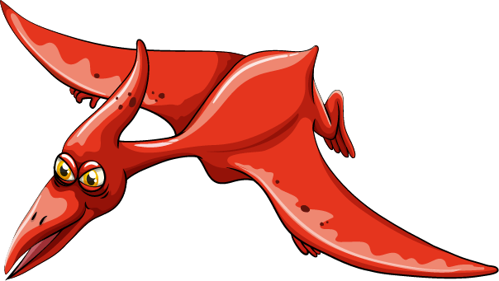
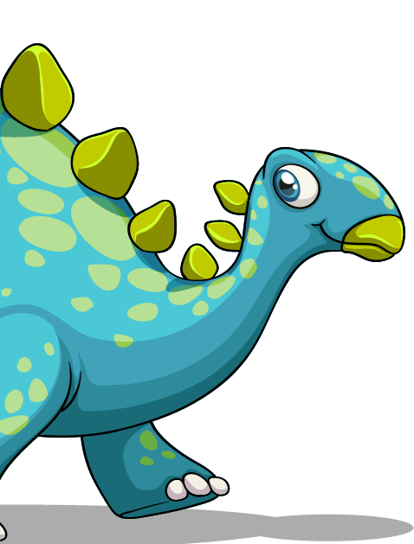
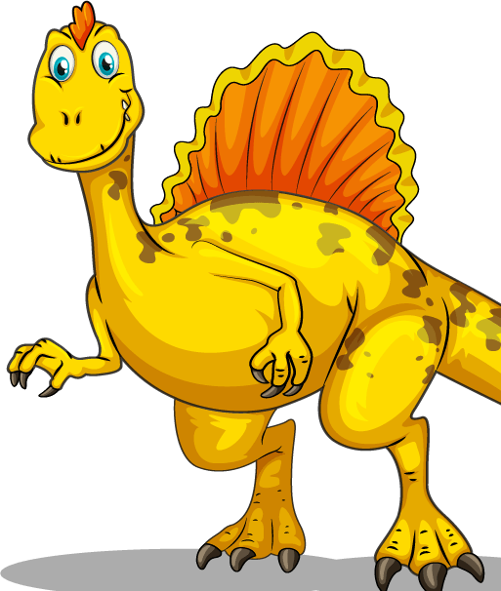

Slide 28

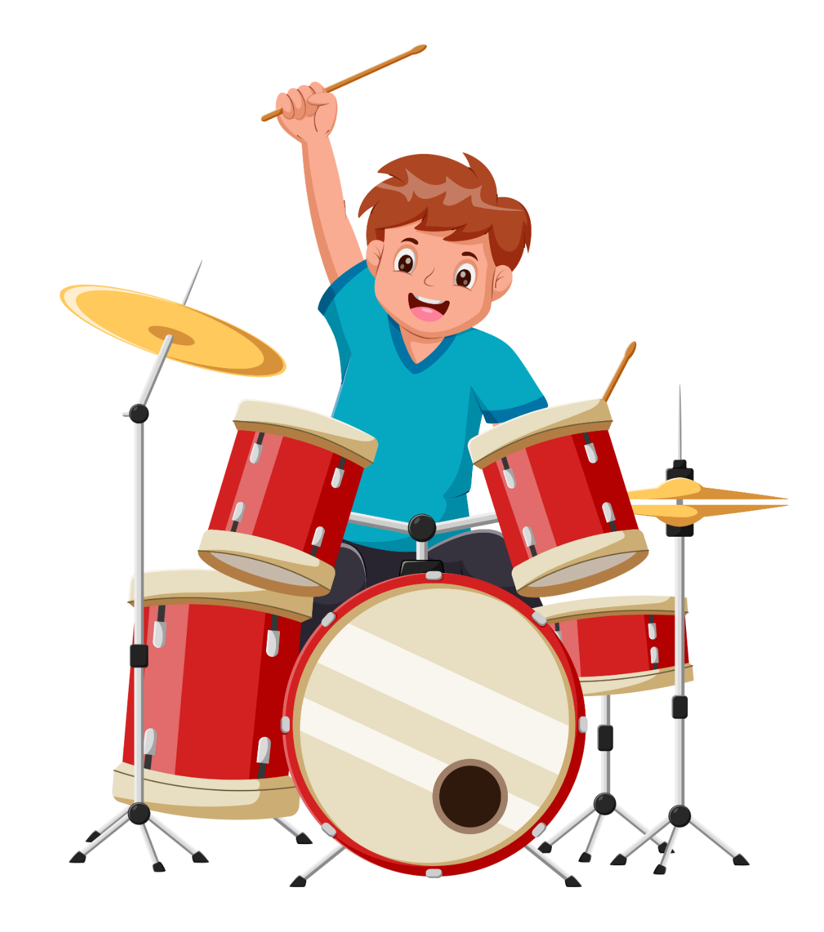


(He)
He plays drums three times a week.
PENCIL

Slide 29
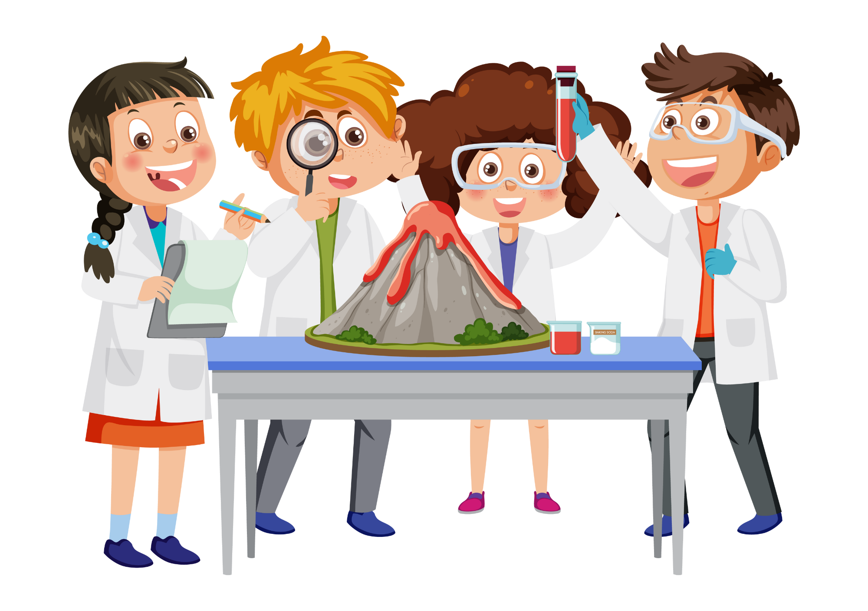
(They)
They have a natural science lesson once a week.
PENCIL

Slide 30
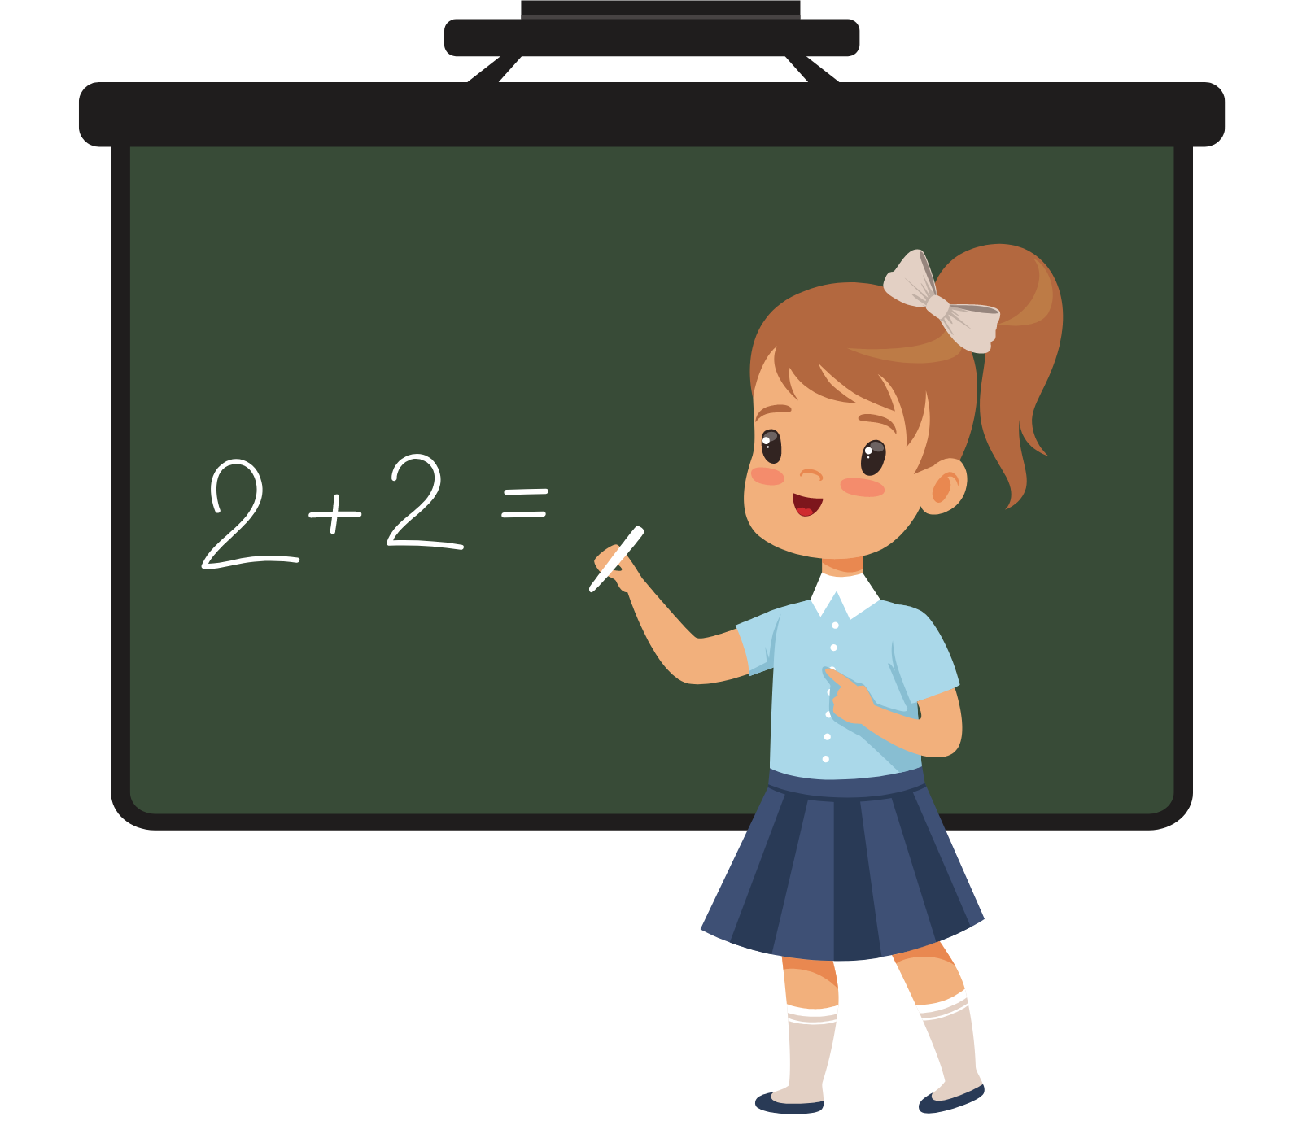
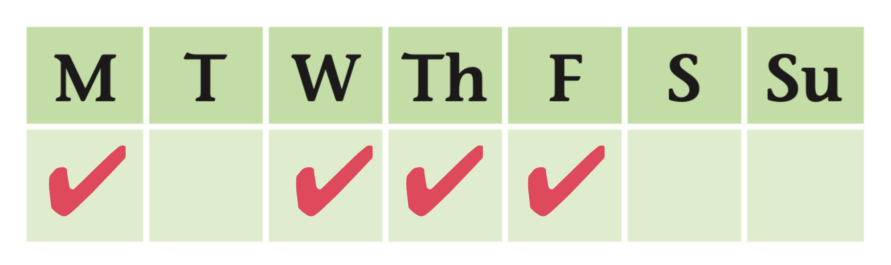
(Mary)
Mary has Maths lessons four times a week.
PENCIL

Slide 31
(My best friend)
My best friend plays the violin twice a week.
PENCIL

Slide 32
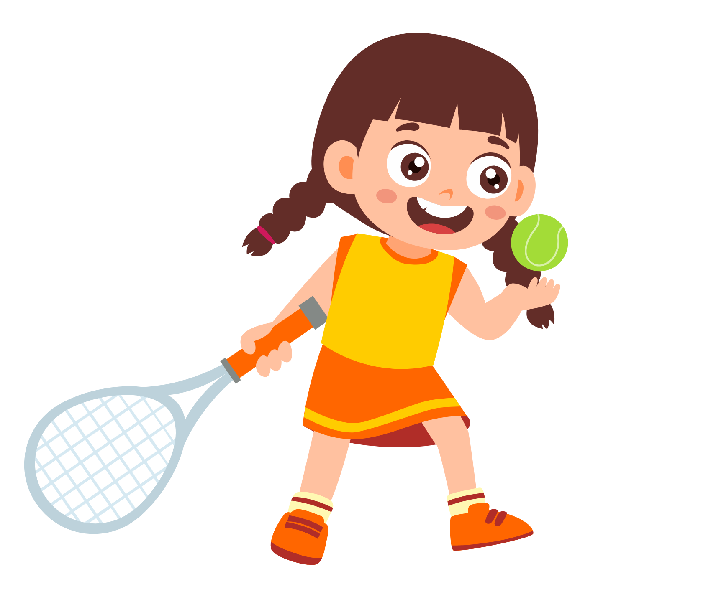
(I)
I play tennis every day.
PENCIL

Slide 33
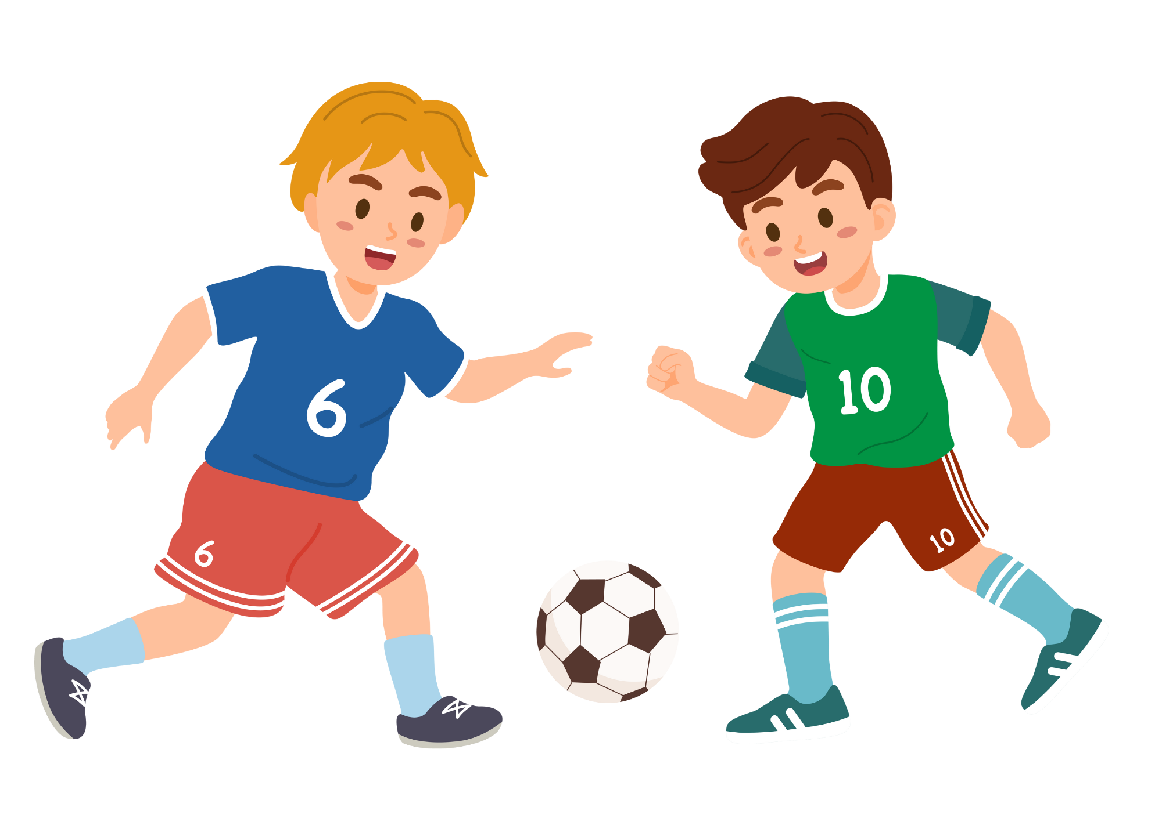
(We)
We play football
at the weekend.
PENCIL

Slide 34
PRODUCE
Show the pictures and ask students to give a sentence about them with one of these adverbs. Ex: “I have English three times a week. I play football every day.”
- The students with the correct sentence can finish the lesson.

Slide 35
HOMEWORK
Review vocabulary and grammar.
Do exercise 1 in the Activity Book (page 12).
Check answers in the Teacher’s book (page 30) or Active Teach.

Slide 36
UNIT 1 – Lesson 5A
We’ve learned…
To use the structure:
“How often do you learn science”
- PB p.15
- AB p.12

