Slide 1



UNIT 1 – NEW SCHOOL
Lesson 6 – Review

Slide 2
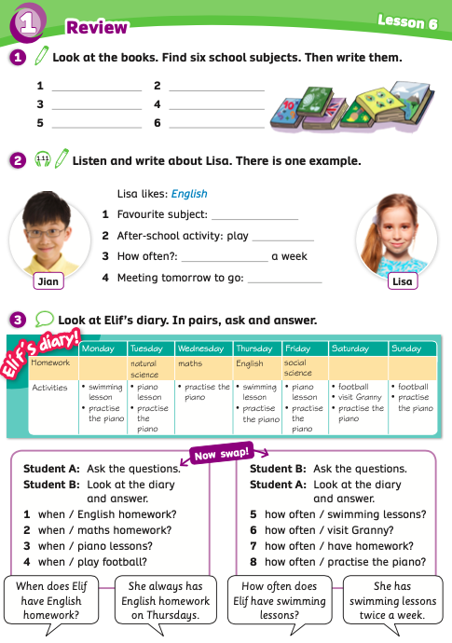
UNIT 1 – Lesson 6
We’re learning…
To review vocabulary and structures.
- PB p.16
- AB p.13

Slide 3

WARM-UP ACTIVITY
Activity: QUICK WRITING
Put students into groups of 4. Each group takes out a sheet of paper.
After the teacher counts “3-2-1 Go”, a first-person of the group writes the name of a subject and then passes the paper to the next person and that person continues to write the name.
Set a limit of time. (2 or 3 minutes)
After finishing the words, students raise their papers to check the answers.
The group with the most correct words receives 2 points.

Slide 4
WARM-UP ACTIVITY
English
maths
art
ICT
PE
social science
music
natural science

Slide 5
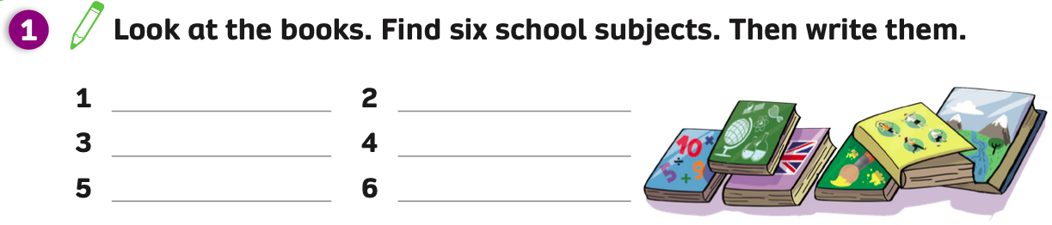
PUPILS’ BOOK p.16
maths
natural science
English
art
PE
social science
ANSWER
- Have students open the books, look at the picture and try to find which subject each book represents.
Then, students write the name of the subject next appropriate number.
Click on “Answer” to show the answers.

Slide 6
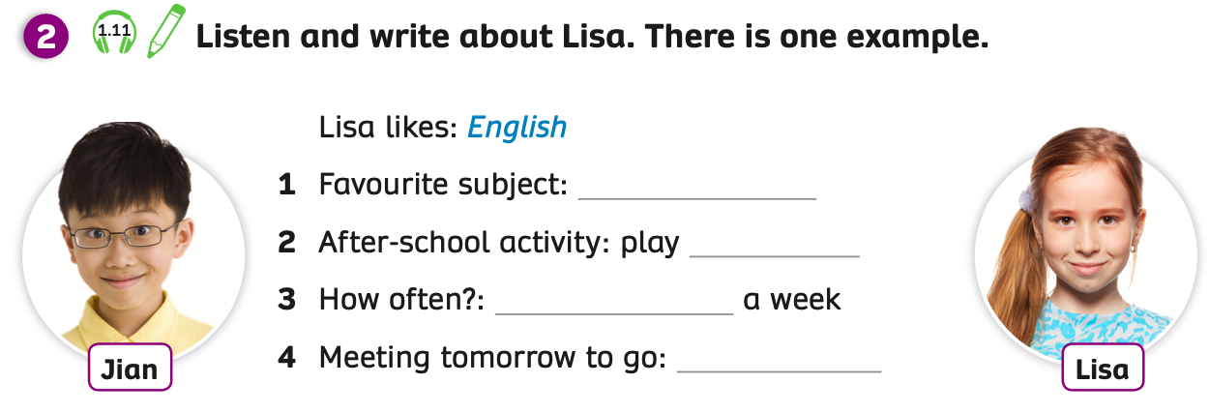
PUPILS’ BOOK p.16 - PRE LISTENING
Activity: GUESS THE ANSWERS
Ask students to look at 4 blanks and guess 4 words to fill in the blank.
Students take out a sheet of paper and write 4 answers they guess.
The teacher goes around and checks if necessary.

Slide 7

PUPILS’ BOOK p.16 - LISTENING
Arts
basketball
twice
swimming
ANSWER
Play the audio, students listen and write words to fill in the blanks.
Play the audio again, students listen and check the answers.
Click on “Answers” to show the answers.
Students look back at 4 words they guess with 4 answers, if students have 2 same words, they receive 2 points.

Slide 8
GRAMMAR
Activity: GO FISHING
Divide the class into groups of 4 to 6 students. Each group takes a turn choosing a random number.
Each group takes out a pen or ruler and puts it in the middle of the group.
After the teacher clicks on the number, students look at the timetable and a question, discuss together and give the answer.
After the teacher counts “Go”, students raise a pen or ruler to get a chance to say the answer.
The fastest group with the correct answer receives points.

Slide 9

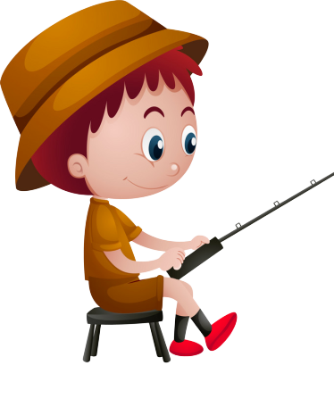


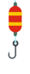

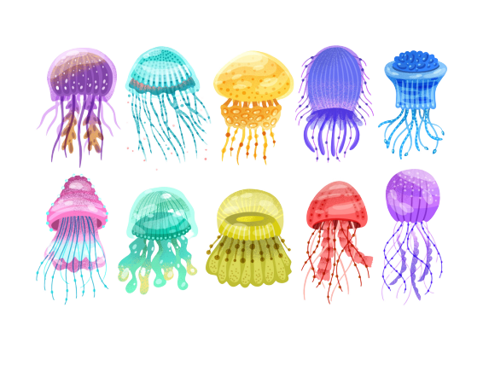




GO FISHING
Game
PLAY
Notes:
Ms Huyền Phạm - 0936.082.789 – YOUTUBE: MsPham. Facebook: Dạy và học cùng công nghệ.

Slide 10












EXIT
8
2
7
6
1
4
5
3
Click on “Number” to show the question.
Click on the fish to get points.
13
11
14
15
Notes:
Ms Huyền Phạm - 0936.082.789 – YOUTUBE: MsPham. Facebook: Dạy và học cùng công nghệ.

Slide 11
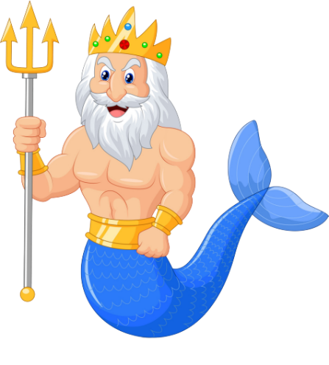
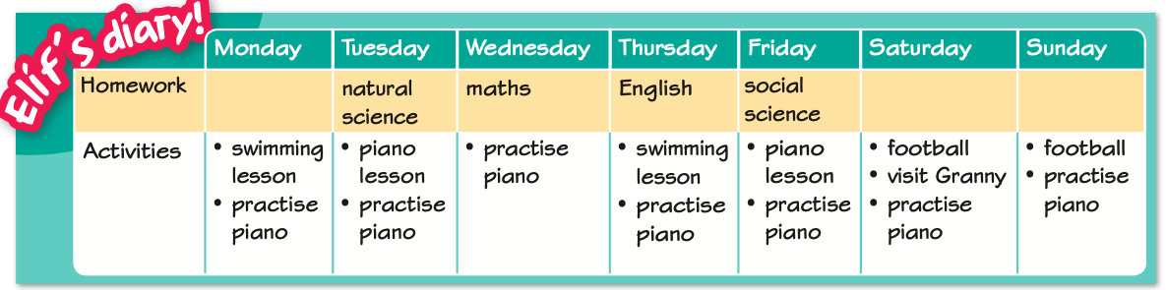

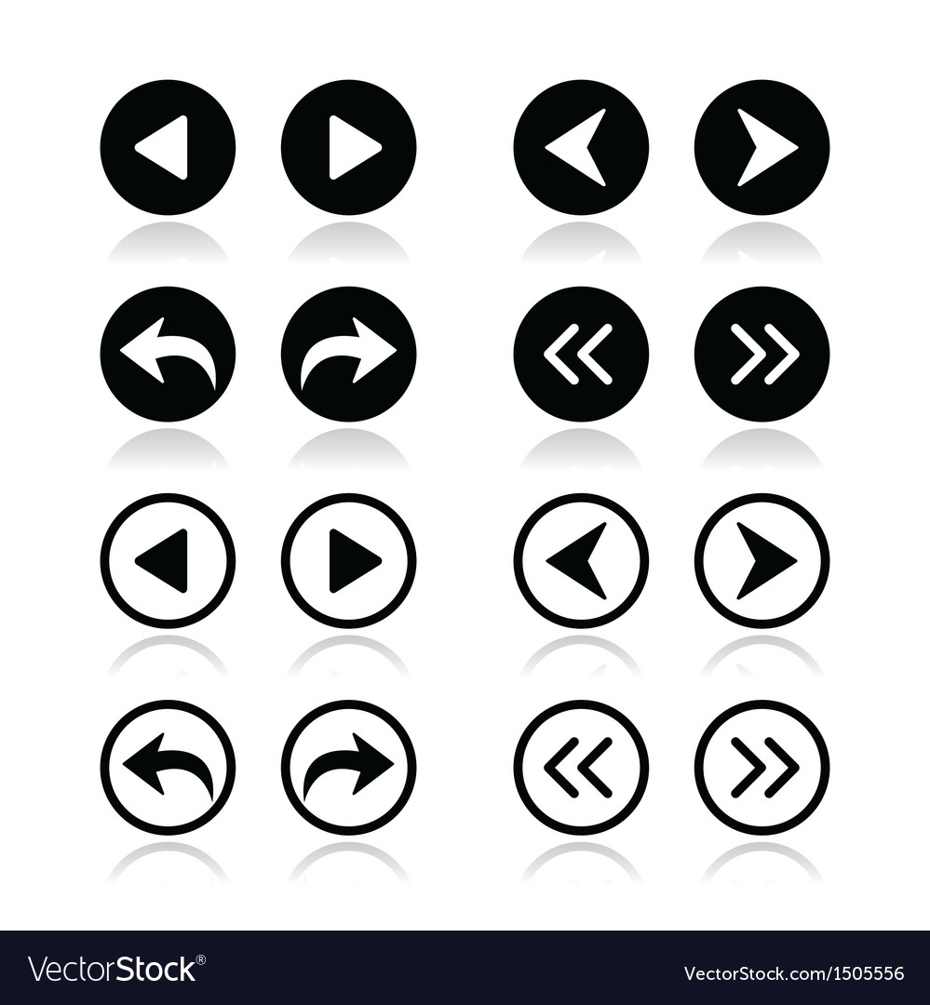
When does Elif have English homework?
She always has English homework
on Thursdays.
D
STOVE
ANSWER
Notes:
Ms Huyền Phạm - 0936.082.789 – YOUTUBE: MsPham. Facebook: Dạy và học cùng công nghệ.

Slide 12
When does Elif have maths homework?
She always has maths homework
on Wednesday.
D
Climb
ANSWER
Notes:
Ms Huyền Phạm - 0936.082.789 – YOUTUBE: MsPham. Facebook: Dạy và học cùng công nghệ.

Slide 13
How often does Elif have swimming lessons?
D
May
She has swimming lessons twice a week.
ANSWER
Notes:
Ms Huyền Phạm - 0936.082.789 – YOUTUBE: MsPham. Facebook: Dạy và học cùng công nghệ.

Slide 14
How often does Elif practise piano?
D
Watch
She practises piano every day.
ANSWER
Notes:
Ms Huyền Phạm - 0936.082.789 – YOUTUBE: MsPham. Facebook: Dạy và học cùng công nghệ.

Slide 15
When does Elif have piano lessons?
D
Next to
She has piano lessons on Tuesdays and Fridays.
ANSWER
Notes:
Ms Huyền Phạm - 0936.082.789 – YOUTUBE: MsPham. Facebook: Dạy và học cùng công nghệ.

Slide 16
How often does Elif visit Granny?
D
Next to
She visits Granny once a week.
ANSWER
Notes:
Ms Huyền Phạm - 0936.082.789 – YOUTUBE: MsPham. Facebook: Dạy và học cùng công nghệ.

Slide 17
When does Elif play football?
D
She plays chess
in his free time.
She plays football at the weekend.
ANSWER
Notes:
Ms Huyền Phạm - 0936.082.789 – YOUTUBE: MsPham. Facebook: Dạy và học cùng công nghệ.

Slide 18
How often does Elif have homework?
D
They likes sport.
She has homework four times a week.
ANSWER
Notes:
Ms Huyền Phạm - 0936.082.789 – YOUTUBE: MsPham. Facebook: Dạy và học cùng công nghệ.

Slide 19
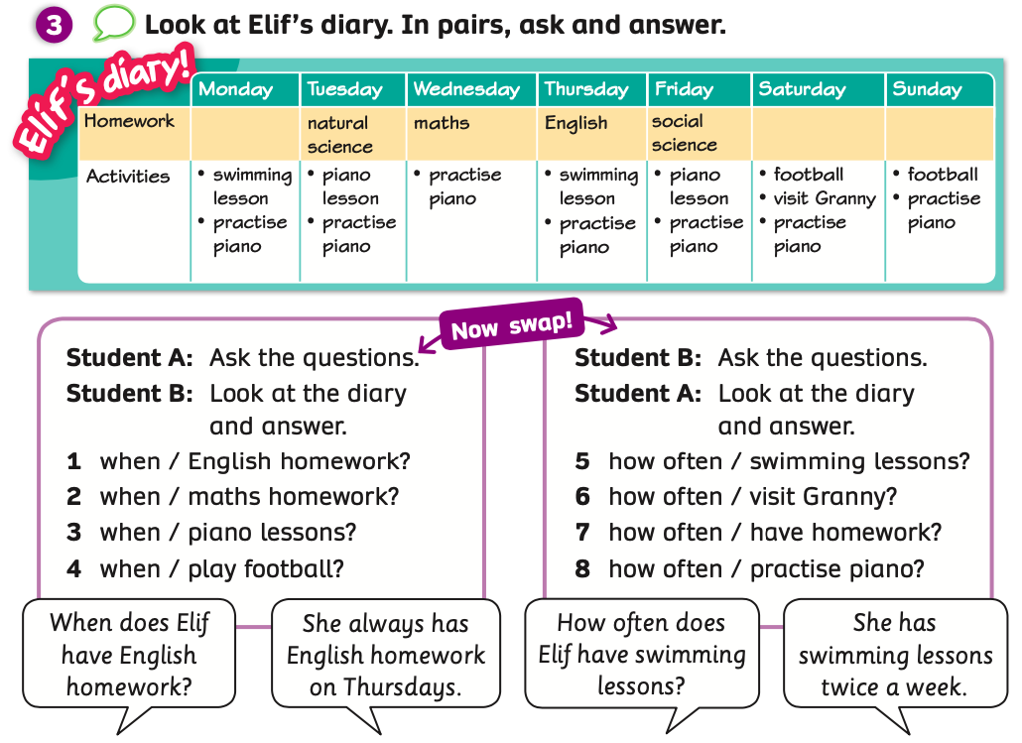
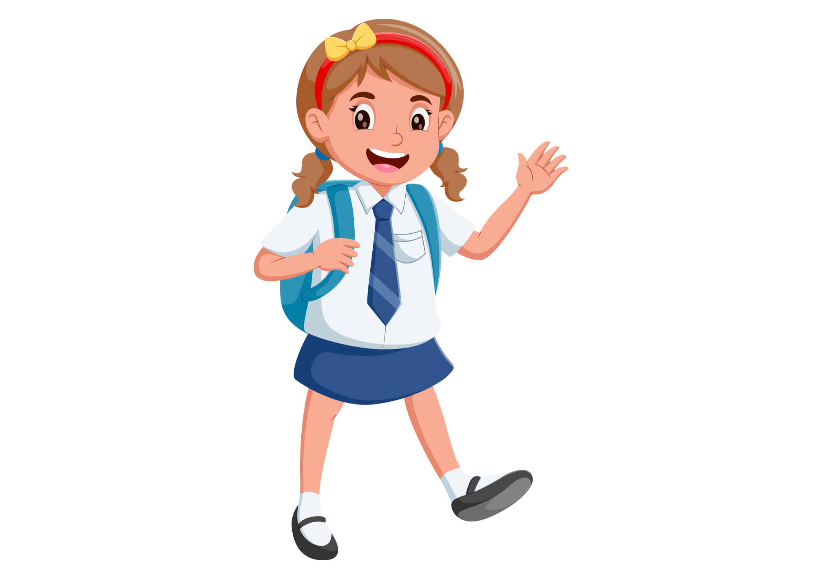
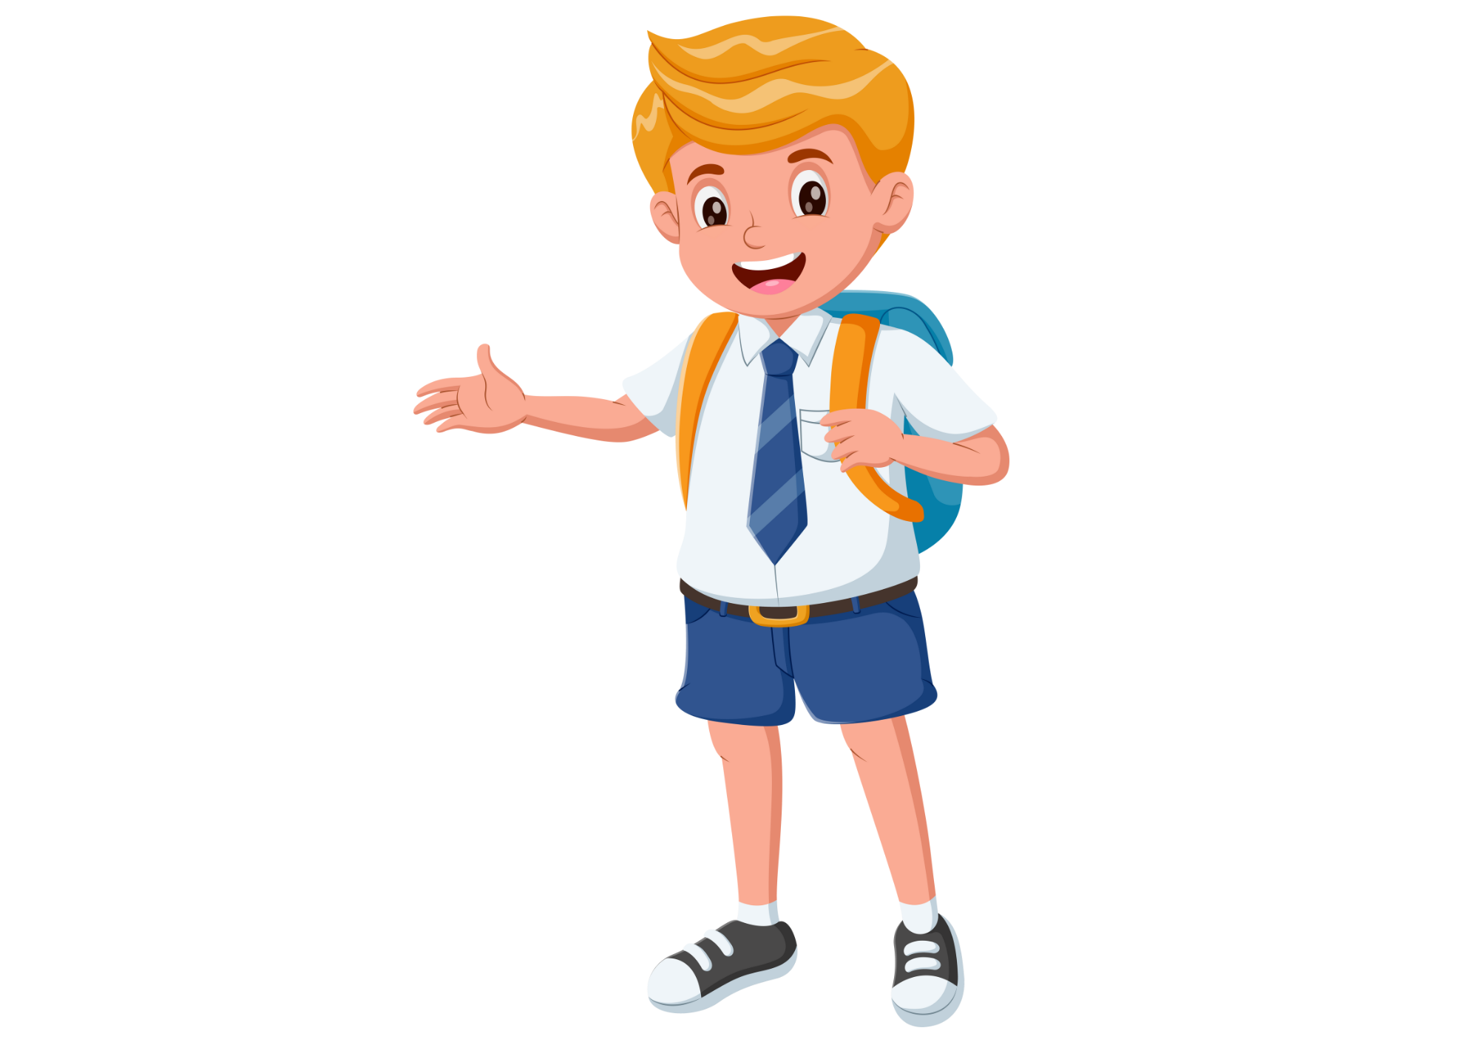
PUPILS’ BOOK p.16
Put students into pairs. Have students open the book, look at the diary and discuss.
Together ask and answer questions using prompts in the instructions.
Draw students’ attention to the speech bubbles.

Slide 20
PUPILS’ BOOK p.16
When does Elif have English lessons?
She always has English lessons on Thursdays.
Student A
Student B
Have students look at the speech bubbles. Divide students into 2 teams. One team asks and one team answers.
Then, they switch roles.

Slide 21
PUPILS’ BOOK p.16
When does Elif have maths lessons?
She always has maths lessons on Wednesday.
Student A
Student B
Have students look at the speech bubbles. Divide students into 2 teams. One team asks and one team answers.
Then, they switch roles.

Slide 22
PUPILS’ BOOK p.16
How often does Elif have swimming lessons?
She has swimming lessons twice a week.
Student B
Student A
Have students look at the speech bubbles. Divide students into 2 teams. One team asks and one team answers.
Then, they switch roles.

Slide 23
PUPILS’ BOOK p.16
How often does Elif visit Granny?
She visits Granny once a week.
Student B
Student A
Have students look at the speech bubbles. Divide students into 2 teams. One team asks and one team answers.
Then, they switch roles.

Slide 24
PUPILS’ BOOK p.16
Put students into pairs. One student asks and one student answers the question.
Then they switch roles.

Slide 25
PRODUCTION
Activity: MY FRIEND’S SCHEDULE
Ask students to take out a sheet of paper, draw their diaries and write down the information on the paper in 2 minutes.
After students finish their papers, the teacher picks up all the papers.
Put students work in pairs. The teacher gives a random diary to each pair.
Students look at the friend’s diary, one student asks the questions with “How often”, “When” and one student finds the information and answers the questions.
Call out random pairs to present in front of the class and give points.

Slide 26




PRODUCTION
Nam
Danh
Linh
Mai

Slide 27
PRODUCTION
When does Linh have English lessons?
She has English lessons on Tuesdays.
How often does Nam go to school?
He goes to school every day.
Nam
Linh

Slide 28
HOMEWORK
HOMEWORK
Review vocabulary and grammar.
Do exercises in the Activity Book (page 13).
Check answers in the Teacher’s book (page 32) or Active Teach.

Slide 29
UNIT 1 – Lesson 6
We’ve learned…
To review vocabulary and structures.
- PB p.16
- AB p.13

