Slide 1
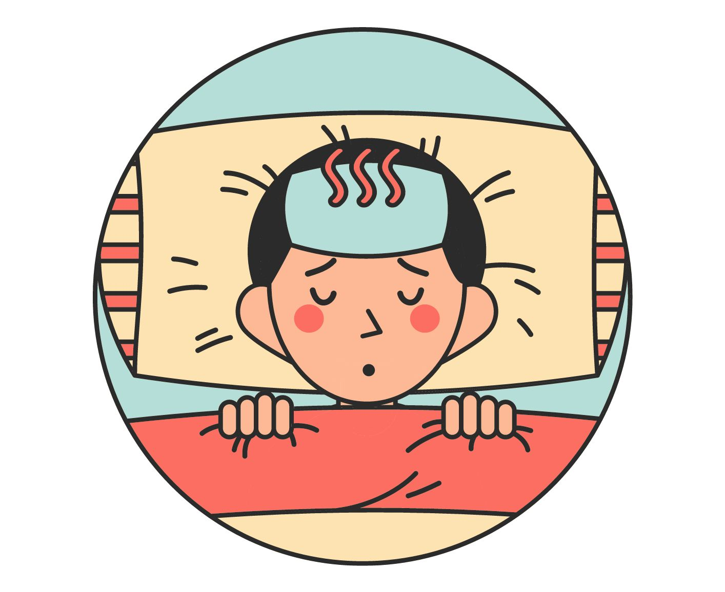
UNIT 10 – STAYING HEATHY
Lesson 1 - VOCABULARY

Slide 2
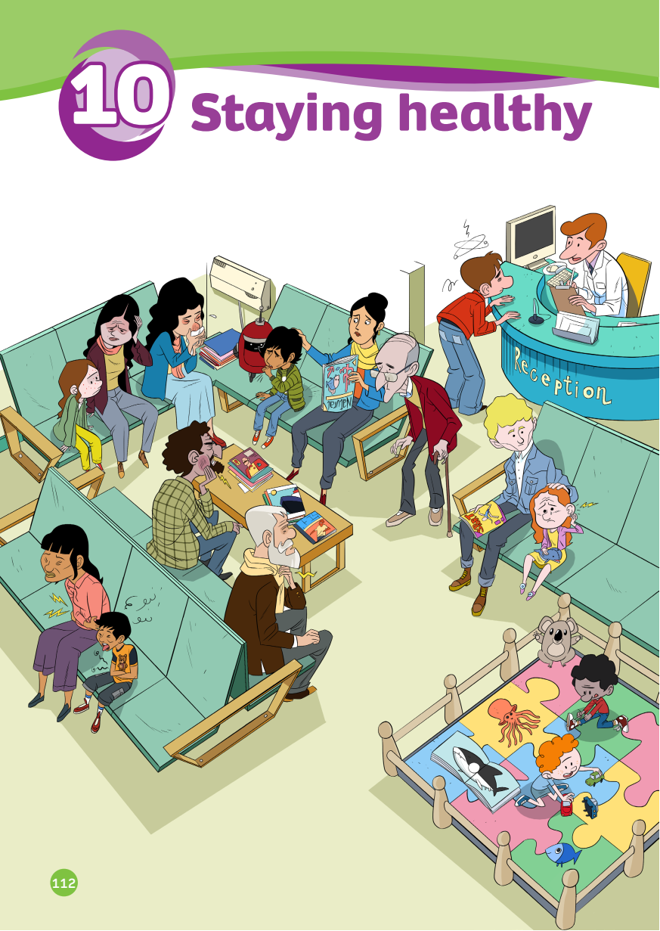
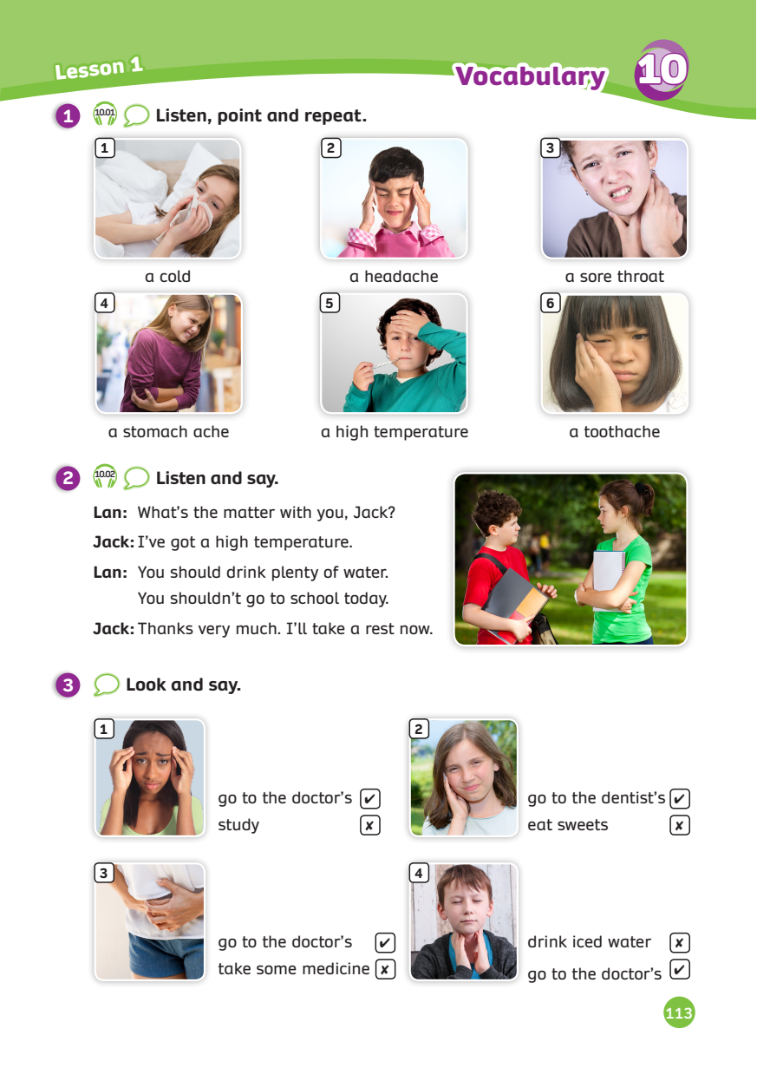
UNIT 10 – Lesson 1
We’re learning…
- To correctly read and pronounce words related to illnesses
- To give advice using structures: “S + should/ shouldn’t + V”
- PB pp. 112, 113
- AB p.88

Slide 3
WARM-UP ACTIVITY
Activity: The Hungry Shark
Divide the class into two teams. Each team has a character.
Quickly review the holiday words by showing flashcards from the previous unit.
Each team got five lines between the shark’s mouth and their character.
The teacher shows the flashcard and asks a random student in the team how to spell it.
If the student is correct, continue with a different students. If that student is wrong, erase a line.
The team that loses all lines first will be out of the game.

Slide 4
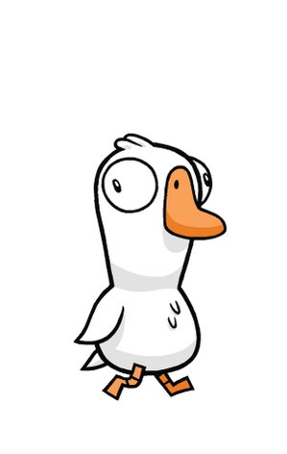
WARM-UP ACTIVITY
☹
☹
The teacher shows the flashcard and asks a random student to spell that word.
Click on “sad face” to erase one line.

Slide 5
VOCABULARY – Lead-in
Where are they?
They’re in the hospital.
Look at the picture and answer the question.

Slide 6
VOCABULARY – Lead-in
How many people look ill?
10 people.
Look at the picture and answer the question.

Slide 7
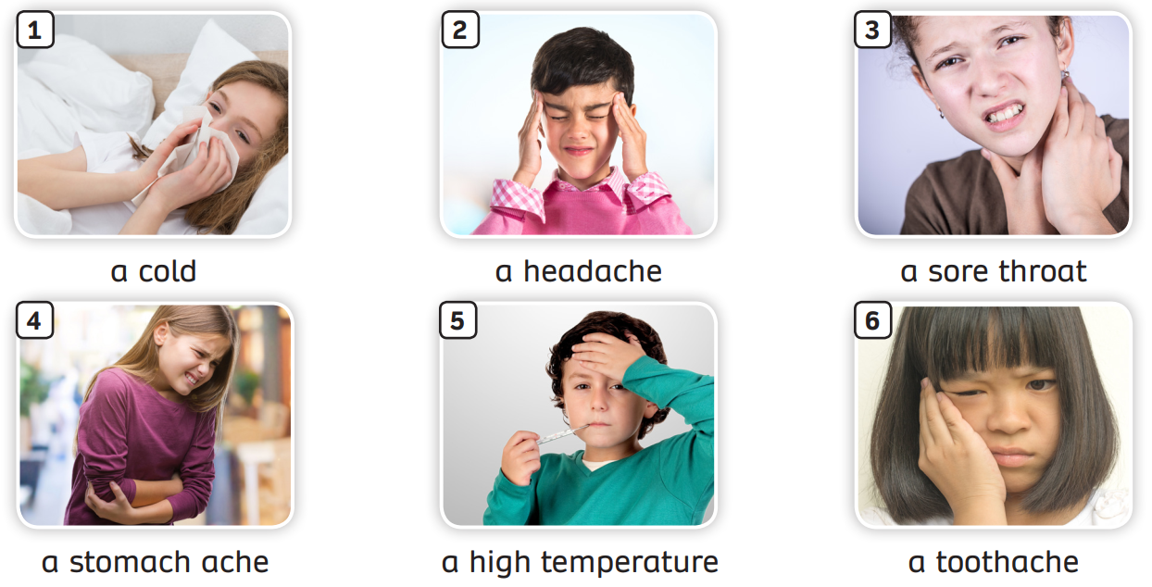
VOCABULARY – Illness
- Have students look at the pictures, listen and repeat.

Slide 8
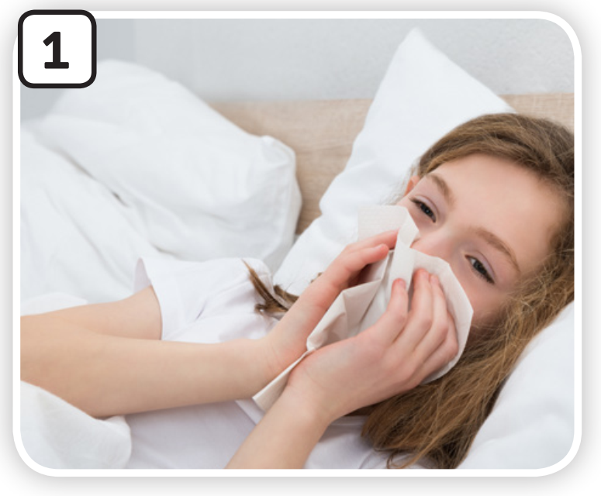
VOCABULARY – Illness
c
Let’s spell!
a cold
a
c
o
l
d

Slide 9
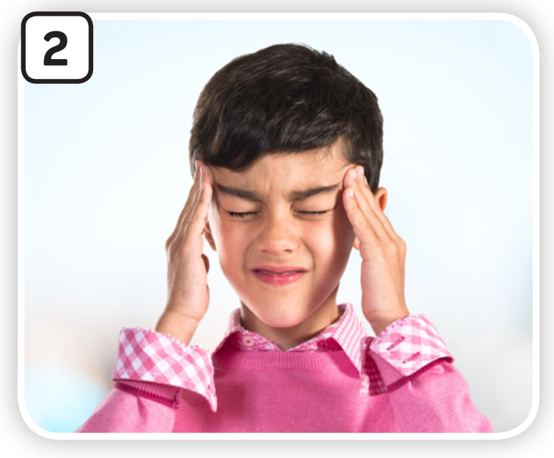
VOCABULARY – Illness
Let’s spell!
c
a headache
a
h
e
a
d
a
c
h
e

Slide 10
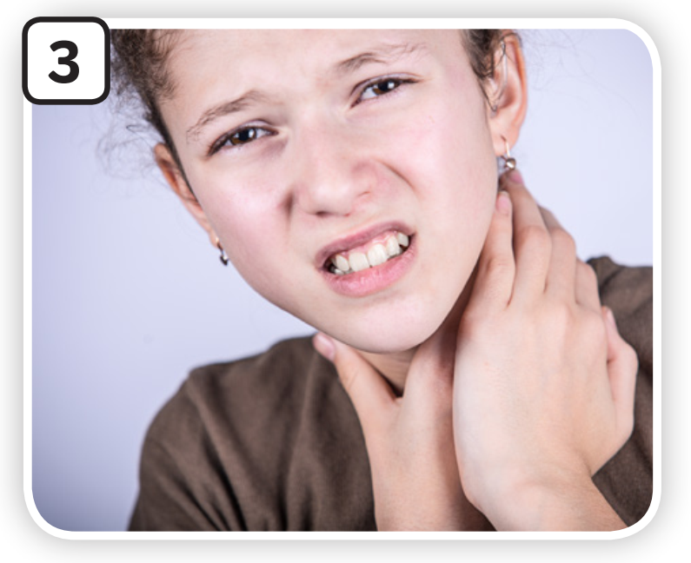
VOCABULARY – Illness
Let’s spell!
c
a sore throat
a
s
o
r
e
t
h
r
o
a
t

Slide 11
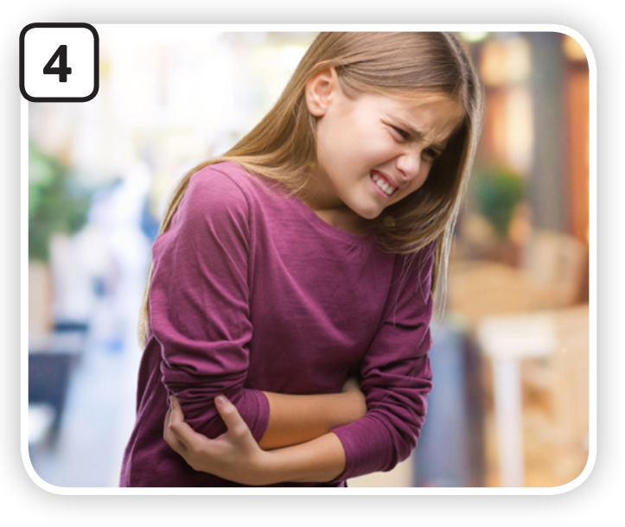
VOCABULARY – Illness
Let’s spell!
c
a stomach ache
a
s
t
o
m
a
c
h
a
c
h
e

Slide 12
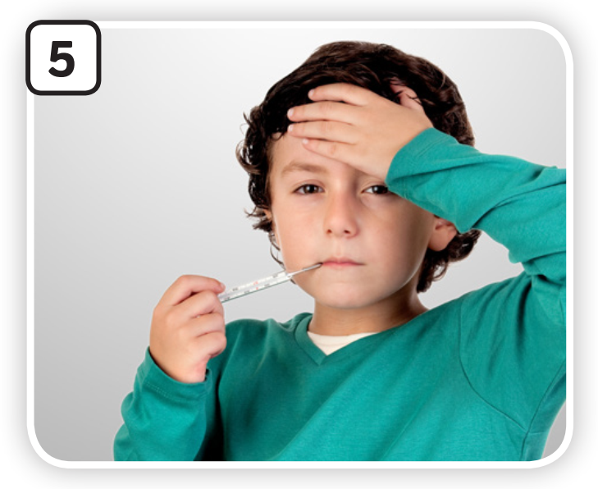
VOCABULARY – Illness
Let’s spell!
c
a high
temperature
a
h
i
g
h
t
e
m
p
e
r
a
t
u
r
e

Slide 13
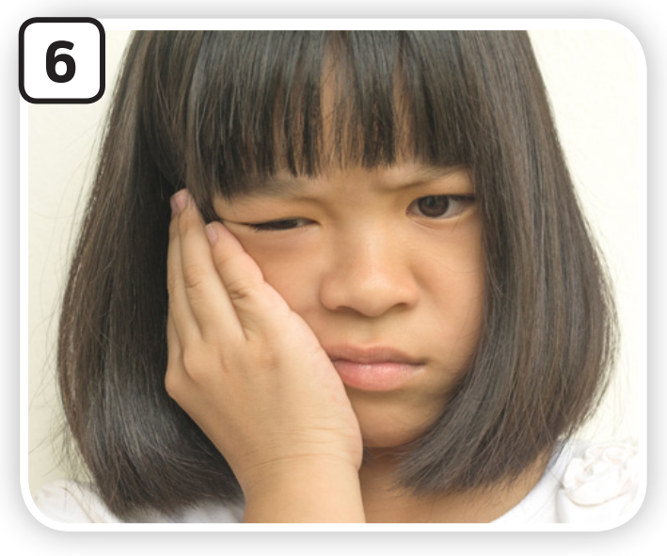
VOCABULARY – Illness
Let’s spell!
c
a toothache
a
t
o
o
t
h
a
c
h
e

Slide 14
VOCABULARY – Illness
- Try to memorise all the pictures and the numbers within 30 seconds.
- The teacher moves to a different slide, calls a number randomly. (Ex: Number 2)
- Ask students to raise their hands and answer.

Slide 15
VOCABULARY – Illness
Activity: Choose the correct answers
Divide the class into 4 teams.
Each team prepares a mini-board.
Ask students to read the questions and discuss. them with their teammates to find the answers.
Write no more than THREE words.
Students take turns to write.

Slide 16
Choose the correct answer
PLAY
Notes:
Ms Huyền Phạm - 0936.082.789 – YOUTUBE: MsPham. Facebook: MsPham Powerpoint

Slide 17
What’s matter with you?
a toothache
I’ve got ………………….. .
Answer
Next
Notes:
Ms Huyền Phạm - 0936.082.789 – YOUTUBE: MsPham. Facebook: MsPham Powerpoint

Slide 18
What’s matter with you?
a cold
I’ve got ………….. .
Answer
Next
Notes:
Ms Huyền Phạm - 0936.082.789 – YOUTUBE: MsPham. Facebook: MsPham Powerpoint

Slide 19
What’s matter with you?
a high temperature
I’ve got …..………………….. .
Answer
Next
Notes:
Ms Huyền Phạm - 0936.082.789 – YOUTUBE: MsPham. Facebook: MsPham Powerpoint

Slide 20
What’s matter with you?
a stomach ache
I’ve got ....………………….. .
Answer
Next
Notes:
Ms Huyền Phạm - 0936.082.789 – YOUTUBE: MsPham. Facebook: MsPham Powerpoint

Slide 21
What’s matter with you?
a headache
I’ve got ………………….. .
Answer
Next
Notes:
Ms Huyền Phạm - 0936.082.789 – YOUTUBE: MsPham. Facebook: MsPham Powerpoint

Slide 22
What’s matter with you?
a sore throat
I’ve got ………………….. .
Answer
Next
Notes:
Ms Huyền Phạm - 0936.082.789 – YOUTUBE: MsPham. Facebook: MsPham Powerpoint

Slide 23
Great job!
s
EXIT
Notes:
Ms Huyền Phạm - 0936.082.789 – YOUTUBE: MsPham. Facebook: MsPham Powerpoint

Slide 24
STRUCTURE – Pupils’ Book (p.113)
Play the audio, tell students to listen and repeat.
In pairs, practice the dialogue.

Slide 25
STRUCTURE – Pupils’ Book (p.113)
STRUCTURE
What’s matter with you, Nam?
You should stay in bed and relax.
I’ve got a cold.
You shouldn’t go outside.
- Show a question and an answer, students listen and repeat.
- Divide class into two teams. One team asks and one team answers.

Slide 26
STRUCTURE – Pupils’ Book (p.113)
STRUCTURE
You should take some medicine.
You shouldn’t eat candies.
What’s matter with you, Linh?
I’ve got a toothache.
- Show a question and an answer, students listen and repeat.
- Divide class into two teams. One team asks and one team answers.

Slide 27
STRUCTURE
S + should + V(bare inf)
ex: You should take a rest.
S + shouldn’t + V(bare inf)
ex: You shouldn’t drink cold water.

Slide 28
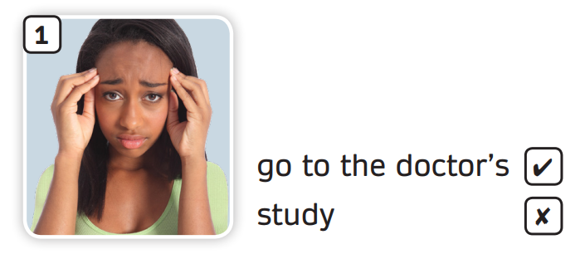
Pupils’ book (p.113)
You should go to the doctor’s.
You shouldn’t study.
What’s matter with you?
I don’t feel well.
Look at the example dialogue on the slide.

Slide 29
Pupils’ book (p.113)
A: What’s matter with you?
B: I don’t feel well.
A: You should _______. You shouldn’t ________.
In pairs, ask and answer giving advice using “should” in activity 3 using the dialogue.
Invite a couple of pairs to demonstrate in front of the class.

Slide 30
SUM - IN
- The teacher moves to a different slide, calls a number randomly. (Ex: Number 2)
- Students raise their hands and answer. Then ask them to give advise on each illness.

Slide 31
HOMEWORK
HOMEWORK
Review vocabulary and grammar.
Do exercises in the Activity book (page 88).
Check answers in the Teacher’s book (page 194) or Active Teach.

Slide 32
UNIT 10 – Lesson 1
We’re learned…
- To correctly read and pronounce words related to illnesses
- To give advice using structures: “S + should/ shouldn’t + V”
- PB pp. 112, 113
- AB p.88

