Slide 1
UNIT 10 – STAYING HEALTHY
Lesson 2 - REVIEW

Slide 2
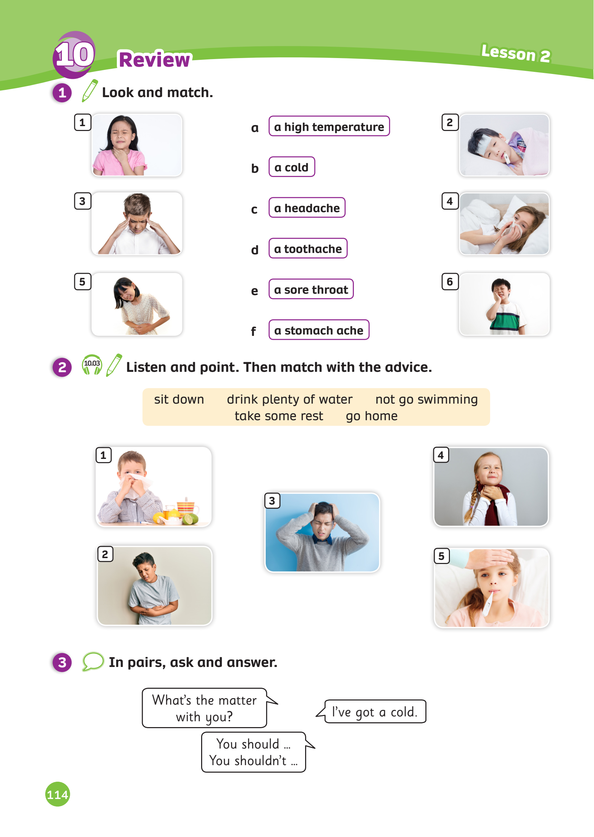
UNIT 10 – Lesson 2
We’ve learning…
- To review words related to illness.
- To give advice using structures: “S + should / shouldn’t + V should”
- PB p. 114
- AB p.89

Slide 3
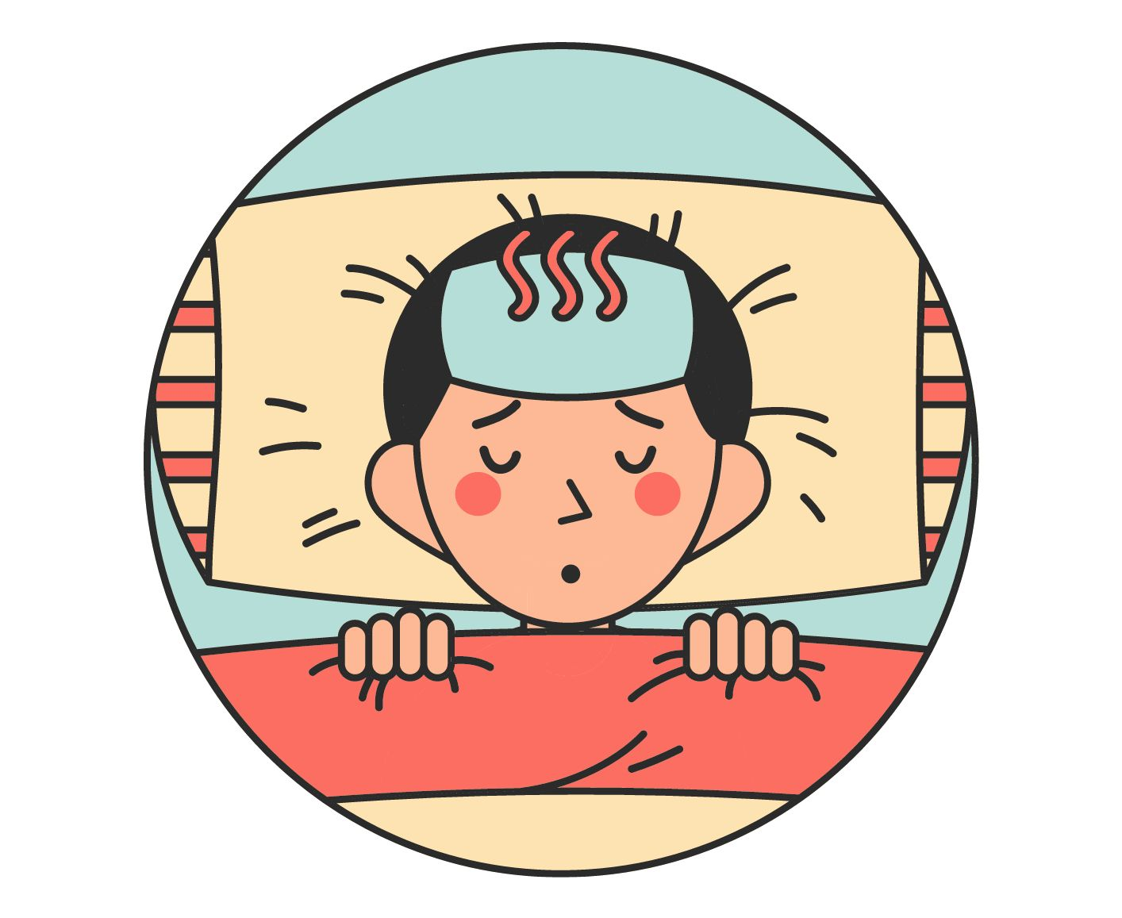
WARM-UP ACTIVITY
Activity: Guess the correct illness
Divide the class into two groups.
Quickly review the words related illness by showing pictures from the previous lesson.
The teacher can say the given sentence (or ask students say) and ask them to guess the illness.
The students listen and say the correct words.
The fastest team with the correct answer can get 2 points.

Slide 4
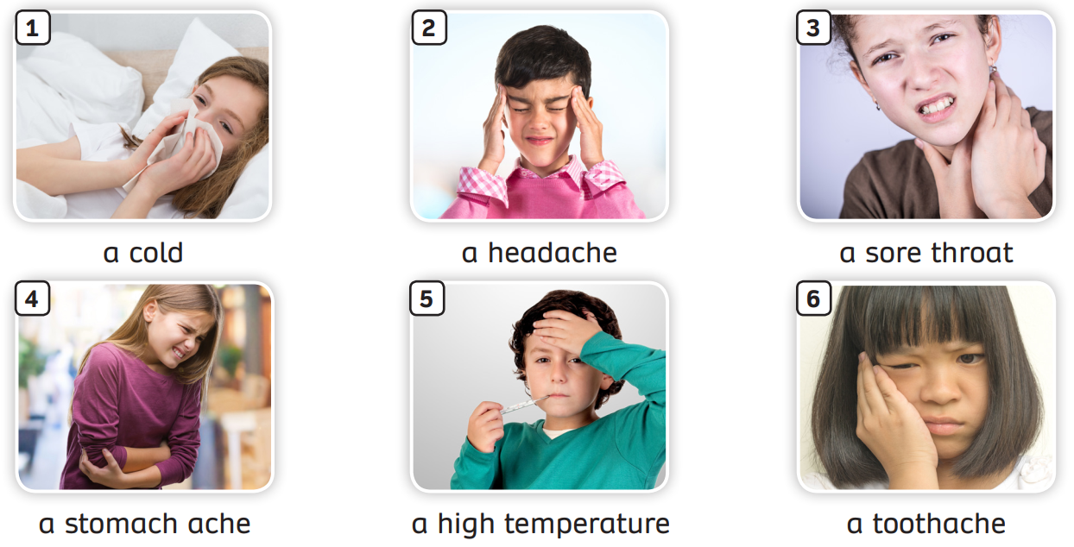
REVIEW – Illness
Review all words

Slide 5
WARM-UP ACTIVITY
1. My stomach hurts. I’ve got a _______
stomachache
2. My head is spinning. I think I’ve got a __
headache
3. It’s difficult to talk and I’m coughing all the time. I’ve got a ___________
sore throat
4. My tooth hurts. I think I’ve got a ______
toothache
5. I feel really hot. I’ve got a ___________
high temperature
6. I feel really cold. I think I’ve got a _____
cold
Answer
The teacher can say the given sentence (or ask students say).
Students guess the illness.

Slide 6
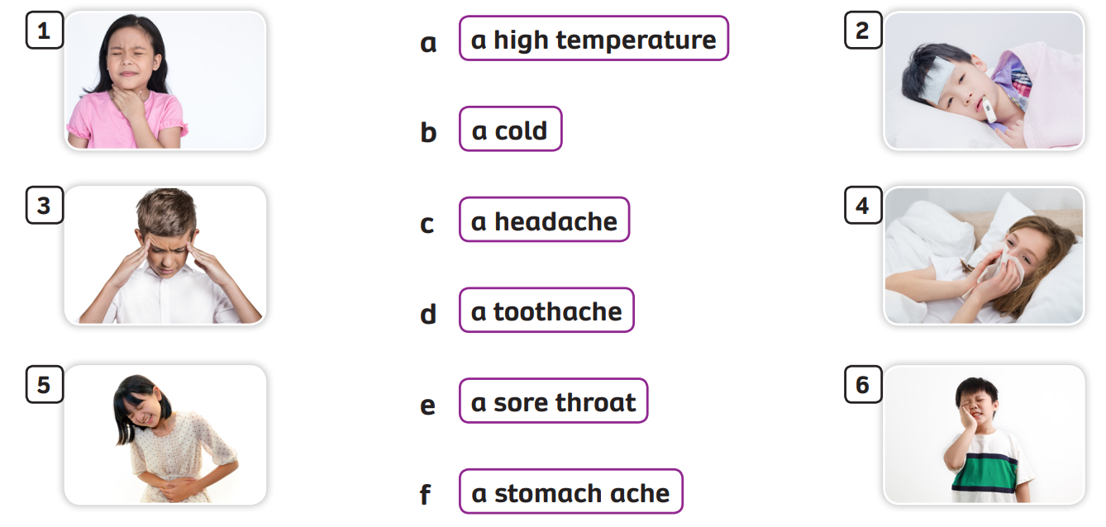
Pupils’ book – p.114
square
Answer
Individual, match the phrases to the correct pictures. Check the answers in pairs.

Slide 7
VOCABULARY – Illness
Activity: The missing letters
Divide the class into groups of 6.
Tell students to number themselves in their group. (Ex: Student A – 1, student B – 2,…)
The teacher says the number. (Ex: number 2)
All students who are number 2 in each team stand up and say the complete phrase.
The faster students with the correct answers can get 2 points for their team.

Slide 8
The missing word

Slide 9
o
c_ld
Check

Slide 10
a
so_e thro_t
r
Check

Slide 11
e
h
h_adac_e
Check

Slide 12
e
high t_mper_ture
a
Check

Slide 13
t
a
a
s_om_ch _che
Check

Slide 14
a
to_th_ch_
o
e
Check

Slide 15
Well done!!!

Slide 16
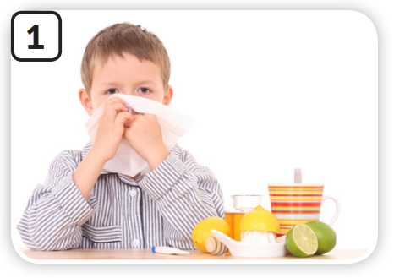
Pupils’ book – p.114
Pre-listening: Activity - Giving advice
You should go home.
You shouldn’t go swimming.
Example
In pairs, look at the picture and example. Then, give advice using the structure “You should / shouldn’t …

Slide 17
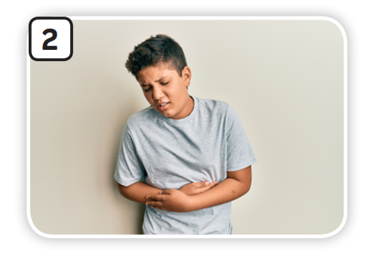
Pupils’ book – p.114
Pre-listening: Activity - Giving advice
You should sit down.
You should take some rest.
Example
In pairs, look at the picture and example. Then, give advice using the structure “You should / shouldn’t …”

Slide 18
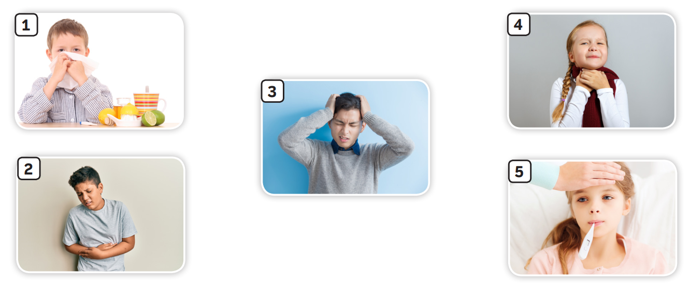
Pupils’ book – p.113
Pre-listening: Activity - Giving advice
In pairs, look at the picture and example. Then, give advice using the structure “You should / shouldn’t …”

Slide 19
Pupils’ book – p.114
take some rest
drink plenty of water
go home
sit down
not go swimming
Answer
Listen to the audio and match with the advice.
Check the answer with the whole class.

Slide 20
Give advice using “should”
Activity: The best doctor
Divide the class into groups of 6.
Each team prepares a mini-board.
Take turns to finish the sentence (one student one word).
Say “bingo” and raise the boards when finishing.
The faster team with the correct answer can get more points.

Slide 21
Activity: The best doctor
I’ve got a headache. What should I do?
take a rest
watch TV
You should take a rest. You shouldn’t watch TV.
Answer

Slide 22
Activity: The best doctor
I’ve got a cold. What should I do?
take some medicine
go outside
You should take some medicine.
You shouldn’t go outside.
Answer

Slide 23
Activity: The best doctor
I’ve got a stomach ache. What should I do?
go to the doctor’s
eat hard food
You should go to the doctor’s.
You shouldn’t eat hard food.
Answer

Slide 24
Activity: The best doctor
I’ve got a sore throat. What should I do?
drink warm water
eat ice-cream
You should drink warm water.
You shouldn’t eat ice-cream.
Answer

Slide 25
Activity: The best doctor
I’ve got a high temperature. What should I do?
stay in bed and relax
use the computer
You should stay in bed and relax.
You shouldn’t use the computer.
Answer

Slide 26
Activity: The best doctor
I’ve got a toothache. What should I do?
go to the dentist’s
eat sweets
You should go to the dentist’s.
You shouldn’t eat sweets.
Answer

Slide 27
PRODUCTION - Pupils’ book (p.114)
In pairs, ask and answer the questions provided.
Invite some students to share information with the class.

Slide 28
WRAP-UP
Read the words, ask students to give some advice.

Slide 29
HOMEWORK
HOMEWORK
Review vocabulary and grammar.
Do exercises in the Activity book (page 89).
Check answers in the Teacher’s Book (page 196, 197) or Active Teach.

Slide 30
UNIT 10 – Lesson 2
We’ve learned…
- To review words related to illness.
- To give advice using structures: “S + should / shouldn’t + V should”
- PB p. 114
- AB p.89

