Slide 1
UNIT 10 – STAYING HEALTHY
Lesson 3A – Vocabulary and Grammar 1

Slide 2
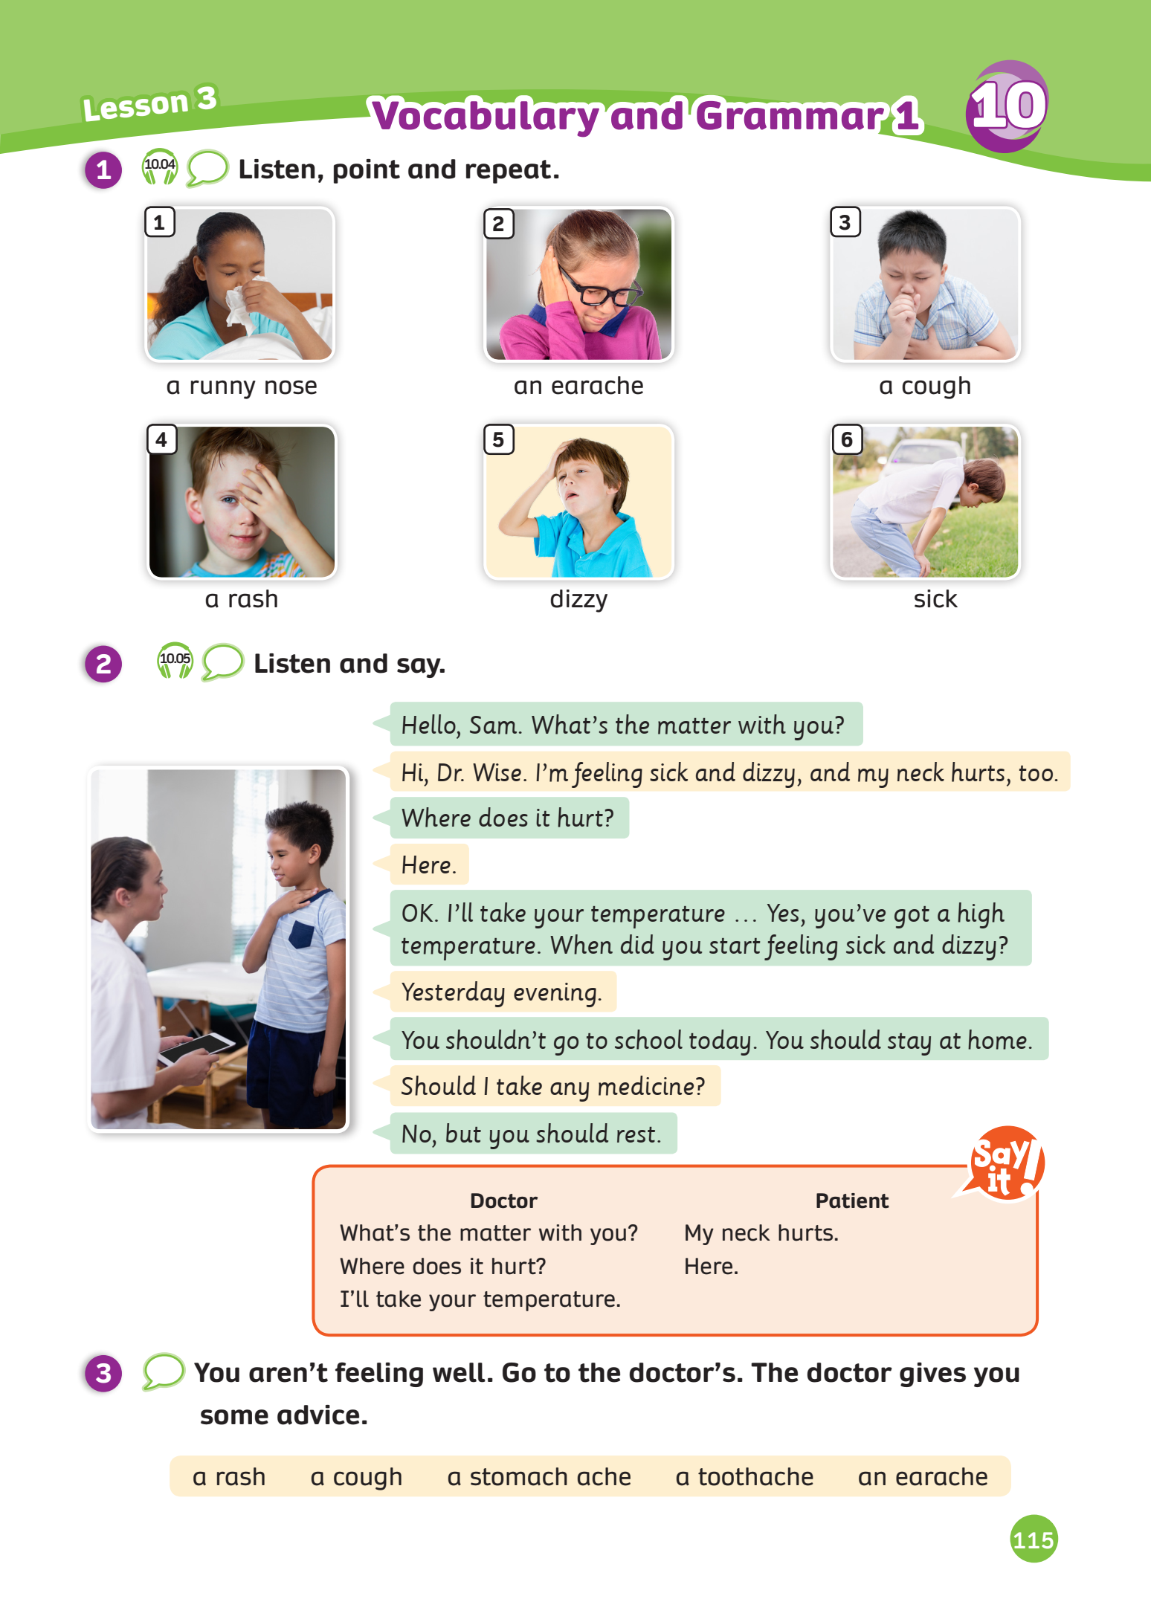
UNIT 10 – Lesson 3A
We’re learning…
- To correctly read and pronounce words related to illnesses.
- To use the structures.
- PB p. 115
- AB p.90

Slide 3
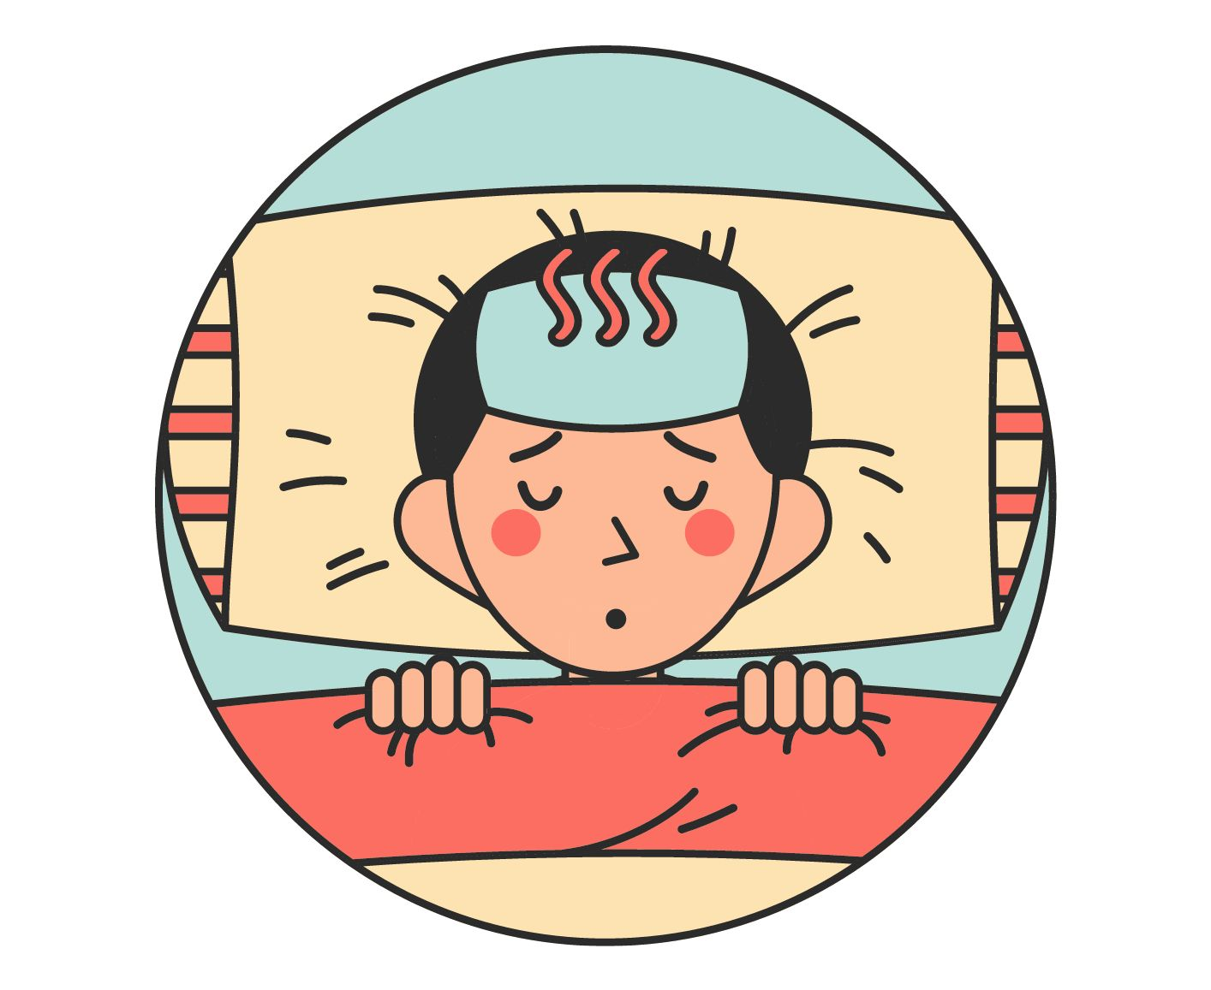
WARM-UP ACTIVITY
Activity: Fill in the blank.
Divide the class into groups of 4.
Each team prepares a pencil case and puts it in the middle of the team.
Ask students to look at the illness, discuss with your teammates.
Catch the pencil case to get a chance to answer.
The faster team with the correct answer can get more points.
Note: The teacher can ask students to make a complete sentence using the given advice phrase.

Slide 4
WARM-UP ACTIVITY
Take some ________
Not _____ candies.
Go to the ________
medicine
eat
doctor’s
Answer

Slide 5
WARM-UP ACTIVITY
Stay at ______
Take a _______
Drink warm _______
home
rest
water
Answer

Slide 6
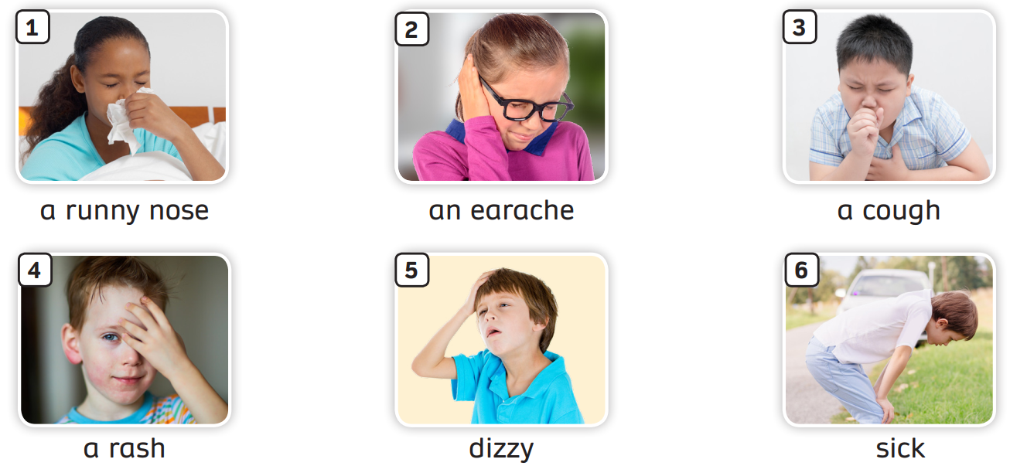
VOCABULARY – Words related to Illnesses
- Have students look at the pictures, listen and repeat.

Slide 7
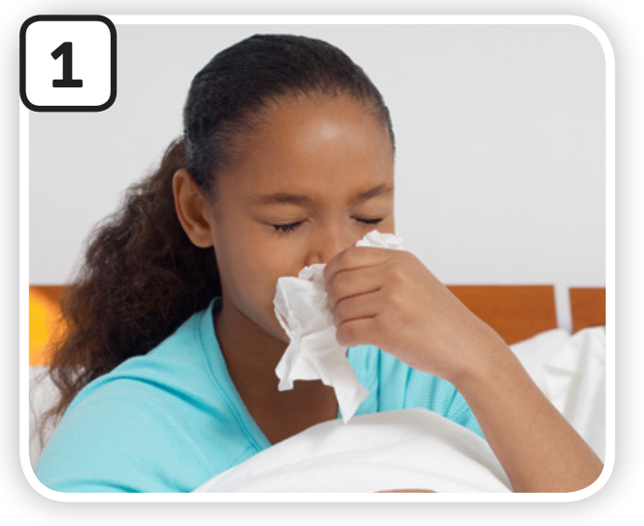
VOCABULARY – Words related to Illnesses
Let’s spell!
c
a runny nose
a
r
u
n
n
y
n
o
s
e

Slide 8
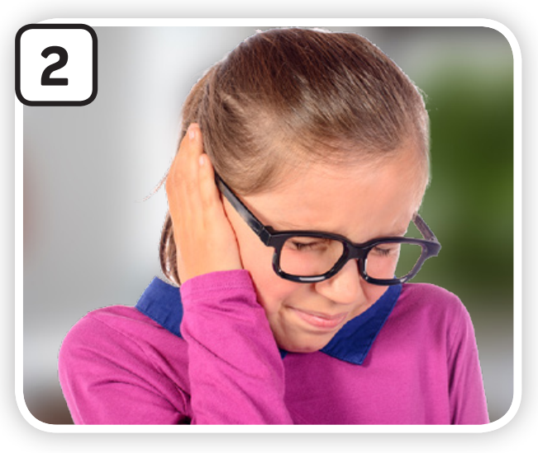
VOCABULARY – Words related to Illnesses
Let’s spell!
c
an earache
a
n
e
a
r
a
c
h
e

Slide 9
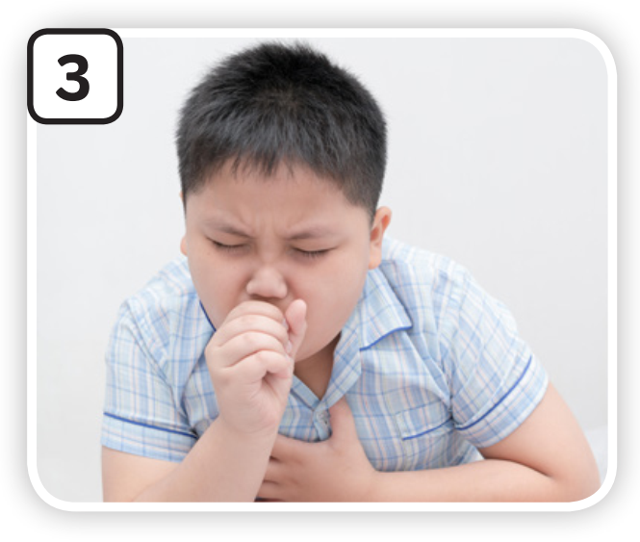
VOCABULARY – Words related to Illnesses
Let’s spell!
c
a cough
a
c
o
u
g
h

Slide 10
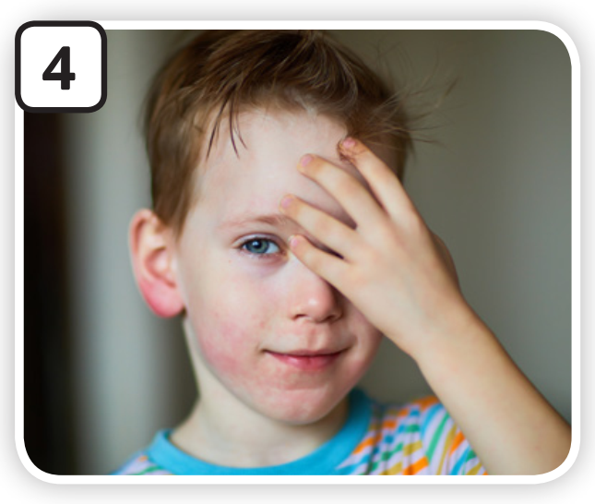
VOCABULARY – Words related to Illnesses
Let’s spell!
c
a rash
a
r
a
s
h

Slide 11
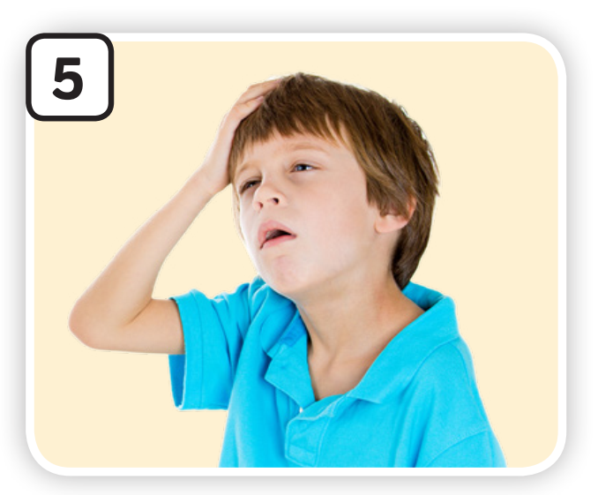
VOCABULARY – Words related to Illnesses
Let’s spell!
c
dizzy
d
i
z
z
y

Slide 12
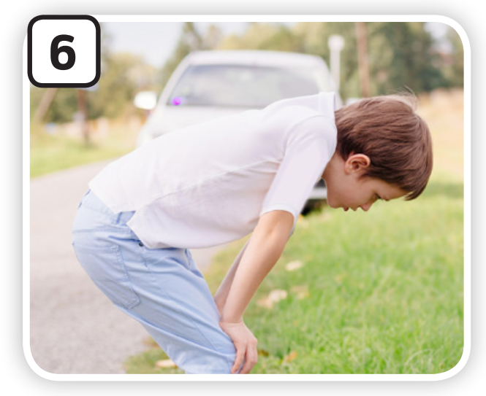
VOCABULARY – Words related to Illnesses
Let’s spell!
c
sick
s
i
c
k

Slide 13
VOCABULARY – Words related to Illnesses
The teacher asks students to review all the words.

Slide 14
VOCABULARY – Words related to Illnesses
Activity: Mix-up Letters
Divide the class into groups of four. Each team prepares a mini-board.
Students take turns to play the game.
Tell students to listen to the spelling.
Write the correct number on the board.
The faster team with the correct answer need to spell and say the word ( b-u-s-y busy)
The faster students with the correct answer can get 2 points for their team.

Slide 15
a cghou
Check
a cough

Slide 16
kics
Check
sick

Slide 17
a rhas
Check
a rash

Slide 18
dzziy
Check
dizzy

Slide 19
an erachea
Check
an earache

Slide 20
a rynnu
noes
Check
a runny nose

Slide 21
End

Slide 22
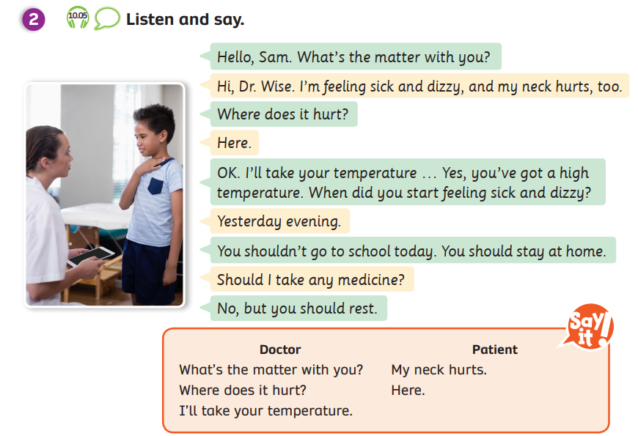
STRUCTURE – Pupils’ book (p.115)
Play the audio, tell students to listen and repeat.
Stop at each line and ask students to repeat.
In pairs, practice the dialogue.

Slide 23
STRUCTURE
You shouldn’t go to school. You should take a rest.
What’s the matter with you?
Where does it hurt?
I’ll take your temperature.
My neck hurts.
Here.

Slide 24
STRUCTURE
You shouldn’t go swimming. You should take some medicine.
What’s the matter with you?
Where does it hurt?
I’ll take your temperature.
I feel sick.
I think I’ve got a rash.
Here.

Slide 25
STRUCTURE – Give Advice Using “Should”
S + should + V (bare inf) + …
ex: You should take a rest.
S + shouldn’t + V (bare inf) + …
ex: You shouldn’t go outside.
Ask students to look and make some sentences.

Slide 26
Complete the sentence – Give Advice
go to the doctor’s / listen to music.
You should go to the doctor’s.
You shouldn’t listen to music.
I’ve got an earache.
Answer
Ask students to look at the picture and the sentence which describes the illness.
Give advice by using the given phrases.

Slide 27
Complete the sentence – Give Advice
go outside / wear a mask
You should wear a mask.
You shouldn’t go outside.
I’ve got a runny nose.
Answer
Ask students to look at the picture and the sentence which describes the illness.
Give advice by using the given phrases.

Slide 28
Complete the sentence – Give Advice
drink cold water / take some medicine
You should take some medicine.
You shouldn’t drink cold water.
I’ve got a cough.
Answer
Ask students to look at the picture and the sentence which describes the illness.
Give advice by using the given phrases.

Slide 29
Complete the sentence – Give Advice
go to the doctor’s / go swimming.
You should go to the doctor’s.
You shouldn’t go swimming.
I’ve got a rash.
Answer
Ask students to look at the picture and the sentence which describes the illness.
Give advice by using the given phrases.

Slide 30
HOMEWORK
HOMEWORK
Review vocabulary and grammar.
Do exercises in the Activity book (page 90).
Check answers in the Teacher’s book (page 198) or Active Teach.

Slide 31
UNIT 10 – Lesson 3A
We’re learned…
- To correctly read and pronounce words related to illnesses.
- To use the structures.
- PB p. 115
- AB p.90

