Slide 1
UNIT 10 – STAYING HEALTHY
Lesson 3B – Vocabulary and Grammar 1

Slide 2
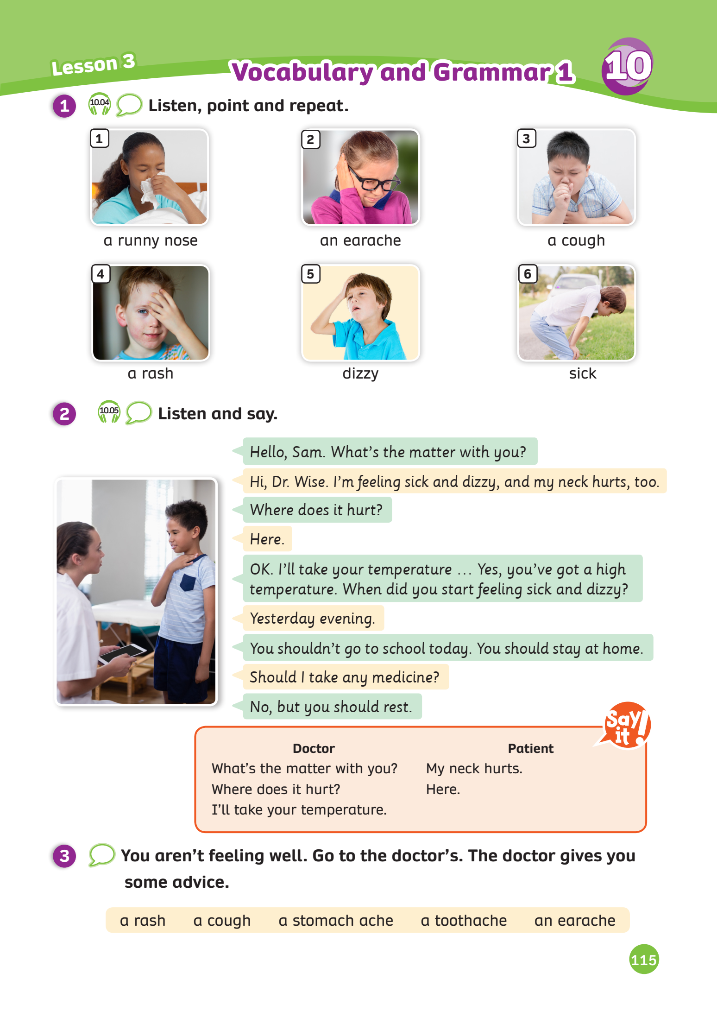
UNIT 10 – Lesson 3B
We’re learning…
- To review words related to illnesses.
- To use the structures.
- PB p. 115
- AB p.90

Slide 3
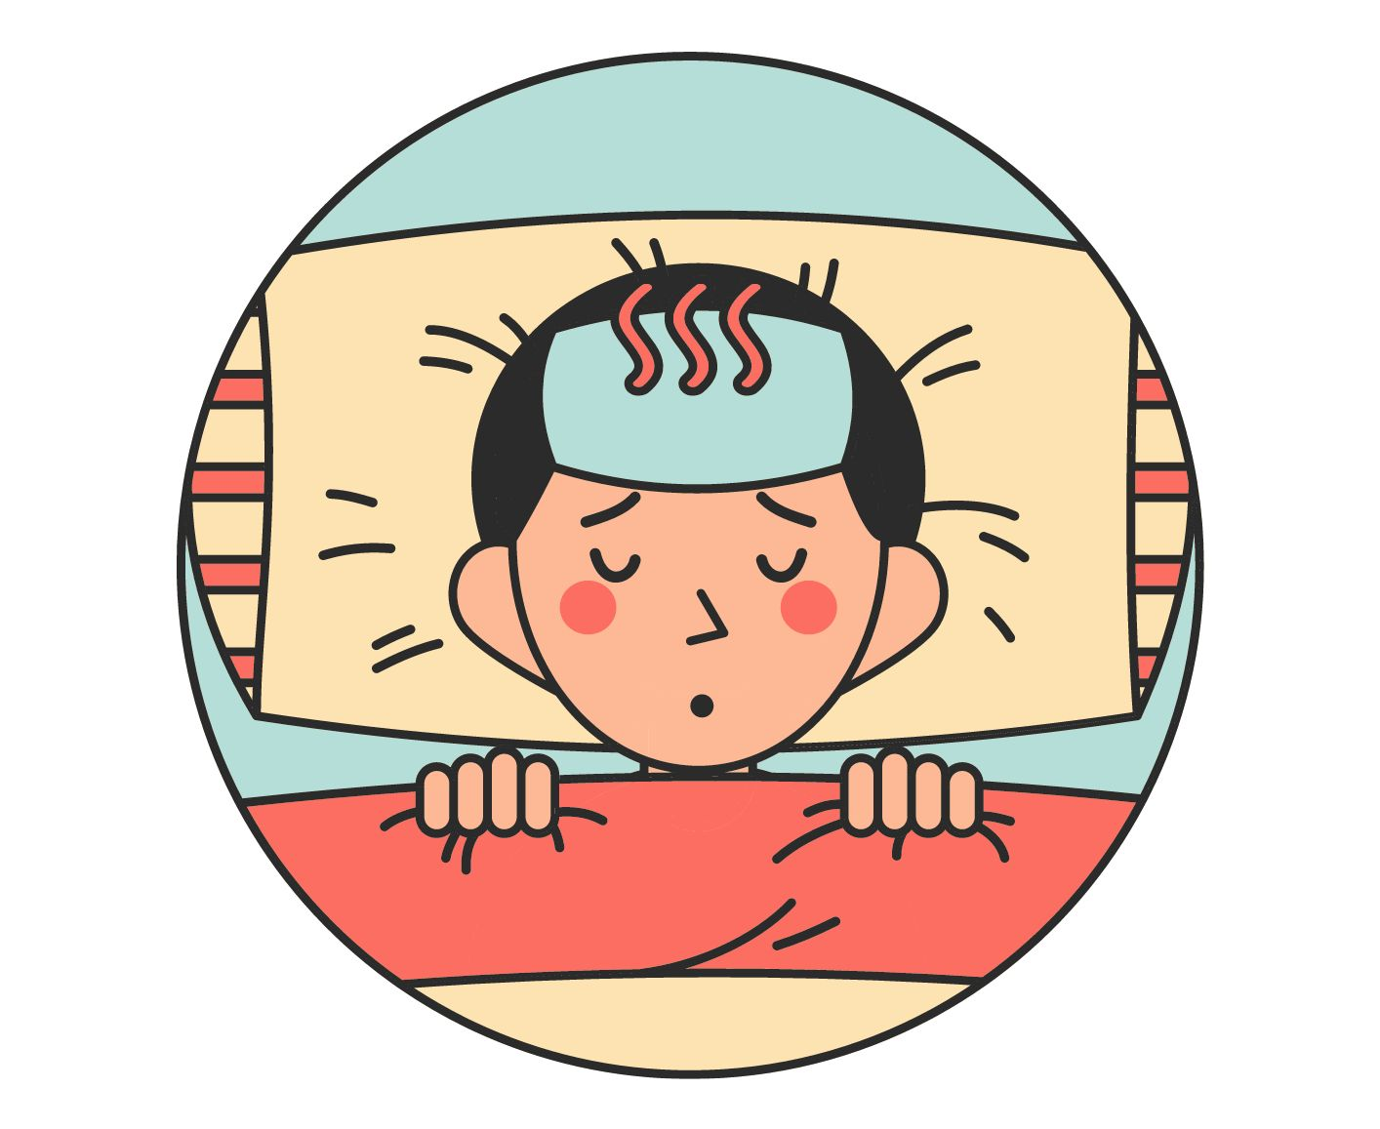
VOCABULARY - REVIEW
Activity: Popcorn.
Divide the class into groups of 6.
Review all the words in the previous lesson by showing pictures
Teacher takes turns to show words one by one. Keep going to show the letter until the student can recognize what the word is.
If they know the answer, say “Popcorn” to get a chance to answer.
The teams didn’t say “Popcorn”, that answer will not be scored.
The faster team with a correct answer can get 2 points.

Slide 4
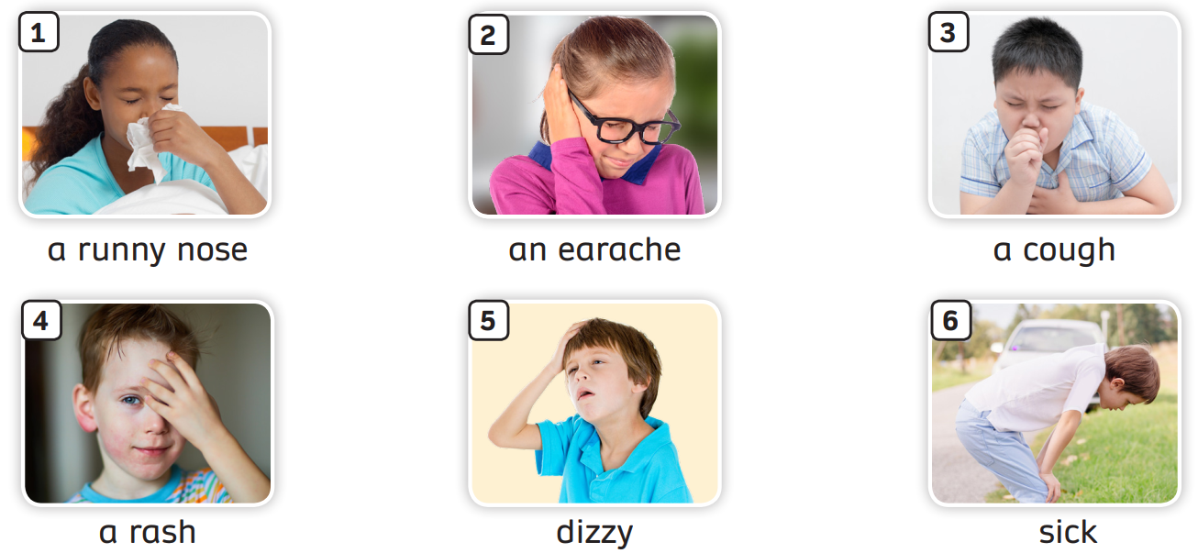
VOCABULARY – Words related to Illnesses
The teacher asks students to review all the words.

Slide 5
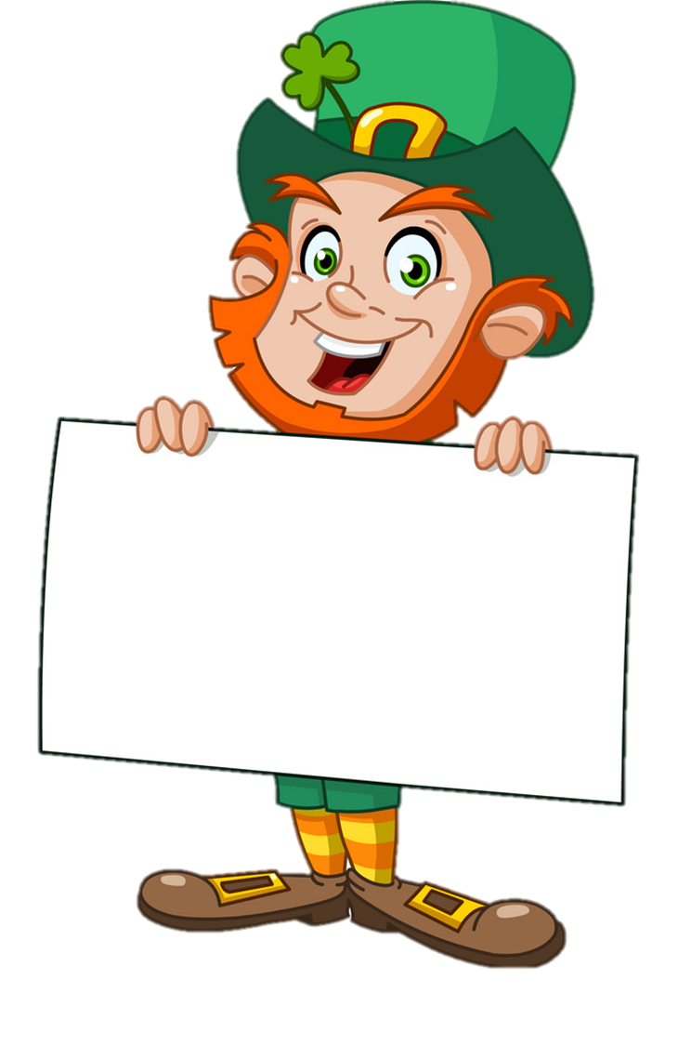
*Click on “show” to show the letter
Click on “answer” to check
d
i
z
z
y
dizzy
Show
Answer

Slide 6
*Click on “show” to show the letter
Click on “answer” to check
a
c
o
u
g
h
a cough
Show
Answer

Slide 7
*Click on “show” to show the letter
Click on “answer” to check
s
i
c
k
sick
Show
Answer

Slide 8
*Click on “show” to show the letter
Click on “answer” to check
a
r
a
s
h
a rash
Show
Answer

Slide 9
*Click on “show” to show the letter
Click on “answer” to check
a
n
e
a
r
a
c
h
e
Show
an earache
Answer

Slide 10
*Click on “show” to show the letter
Click on “answer” to check
a
r
u
n
n
y
n
o
s
e
Show
a runny nose
Answer

Slide 11
REVIEW STRUCTURE
What’s the matter with you?
You shouldn’t go outside. You should take some medicine.
Where does it hurt?
I’ll take your temperature.
I feeling sick. I’ve got a runny nose.
Here.
Look at the pictures and the sentences in the box.
Ask the whole class to read.

Slide 12
REVIEW STRUCTURE
What’s the matter with you?
You shouldn’t go outside. You should take some medicine.
Where does it hurt?
I’ll take your temperature.
I’m feeling sick. I’ve got a runny nose.
Here.
Look at the pictures and the sentences in the box.
Ask the whole class to read.

Slide 13
STRUCTURE – Give Advice Using “Should”
S + should + V (bare inf) + …
ex: You should take a rest.
S + shouldn’t + V (bare inf) + …
ex: You shouldn’t go outside.
Review the structures.

Slide 14
STRUCTURE
Activity: Lucky wheel
Divide the class into groups of 4.
Each team prepares a mini-board.
Students take turns to write.
Ask students to look at the pictures and the given clues, then write the complete sentences on the boards.
The points are on the wheel.
The team with higher scores will be the winner.

Slide 15
Lucky wheel
50
10
Rules:
Click “spin” to turn the wheel.
Write down the answer on the mini-board.
The points are on the wheel.
20
30
10
20
30
40
Spin
PLAY
LUẬT CHƠI
Nhấn nút để quay.
Trả lời đúng câu hỏi sẽ được cộng số điểm tương ứng vị trí mũi tên dừng.
Kết thúc trò chơi đội cao điểm hơn sẽ chiến thắng.
Spin

Slide 16
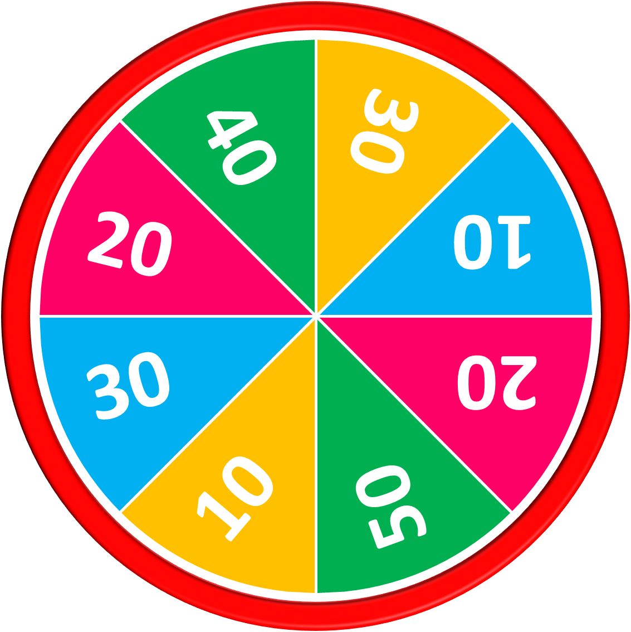
drink cold water / take some medicine.
50
10
20
30
10
20
30
40
Answer
You shouldn’t drink cold water. You should take some medicine.
Stop
Spin

Slide 17
go to the doctor’s / go swimming
50
10
20
30
10
20
30
40
You should go to the doctor’s. You shouldn’t go outside.
Answer
Stop
Spin

Slide 18
eat ice-cream / wear a mask
50
10
20
30
10
20
30
40
You shouldn’t eat ice-cream. You should wear a mask.
Answer
Stop
Spin

Slide 19
take a rest /
run with your friends
50
10
20
30
10
20
30
40
You should take a rest. You shouldn’t run with your friends.
Answer
Stop
Spin

Slide 20
take a rest / go outside
50
10
20
30
10
20
30
40
You should take a rest. You shouldn’t go outside.
Answer
Stop
Spin

Slide 21
listen to music / go to the doctor’s.
50
10
20
30
10
20
30
40
You shouldn’t listen to music. You should go to the doctor’s.
Answer
Stop
Spin

Slide 22
50
10
20
30
10
20
30
40
Exit

Slide 23
PRODUCTION - Pupils’ book – p.115
I’ve got a rash.
You shouldn’t put scream on your skin. You should take a rest and some medicine.
Answer

Slide 24
PRODUCTION - Pupils’ book (p.115)
Activity: Roleplay
Divide the class into pairs; one student takes on the role of the doctor and the other student takes on the role of the patient.
The patient uses a few of the expressions in the word box, and the doctor gives some advices.
Invite some pairs come up and do role plays in front of the class.

Slide 25
WRAP-UP
The teacher asks students to review all the words.

Slide 26
HOMEWORK
HOMEWORK
Review vocabulary and grammar.
Do exercises in the Activity book (page 90).
Check the answers in the Teacher’s Book (page 198) or Active Teach.

Slide 27
UNIT 10 – Lesson 3B
We’re learned…
- To review words related to illnesses.
- To use the structures.
- PB p. 115
- AB p.90

