Slide 1
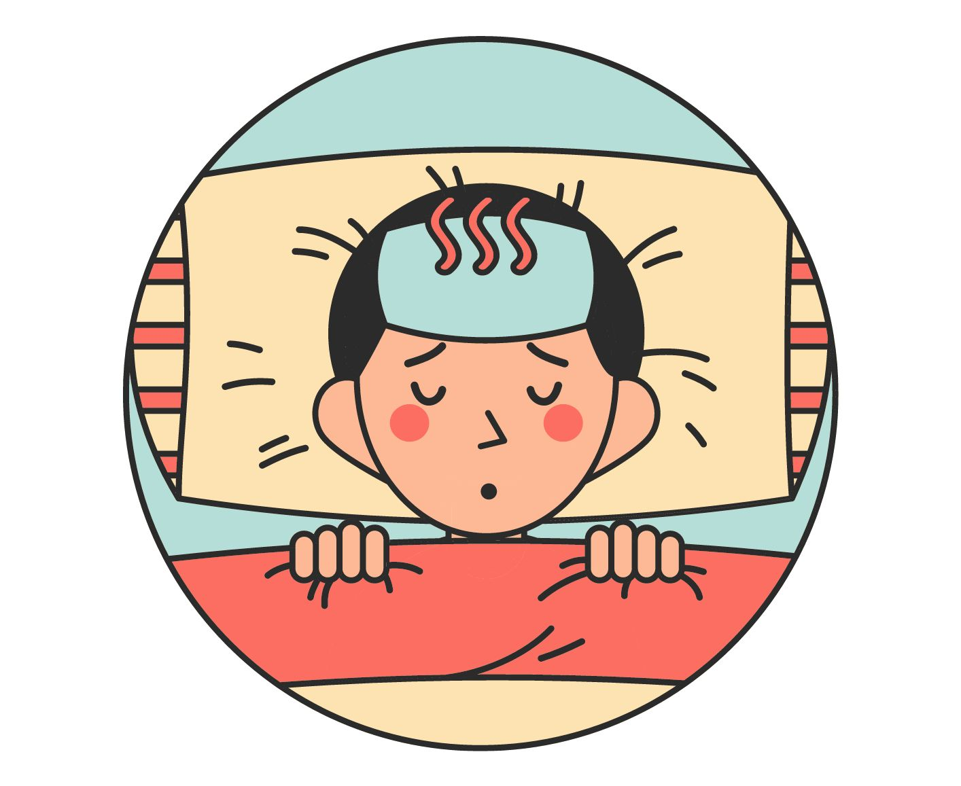
UNIT 10 – STAYING HEALTHY
Lesson 5A – Vocabulary and Grammar 2

Slide 2
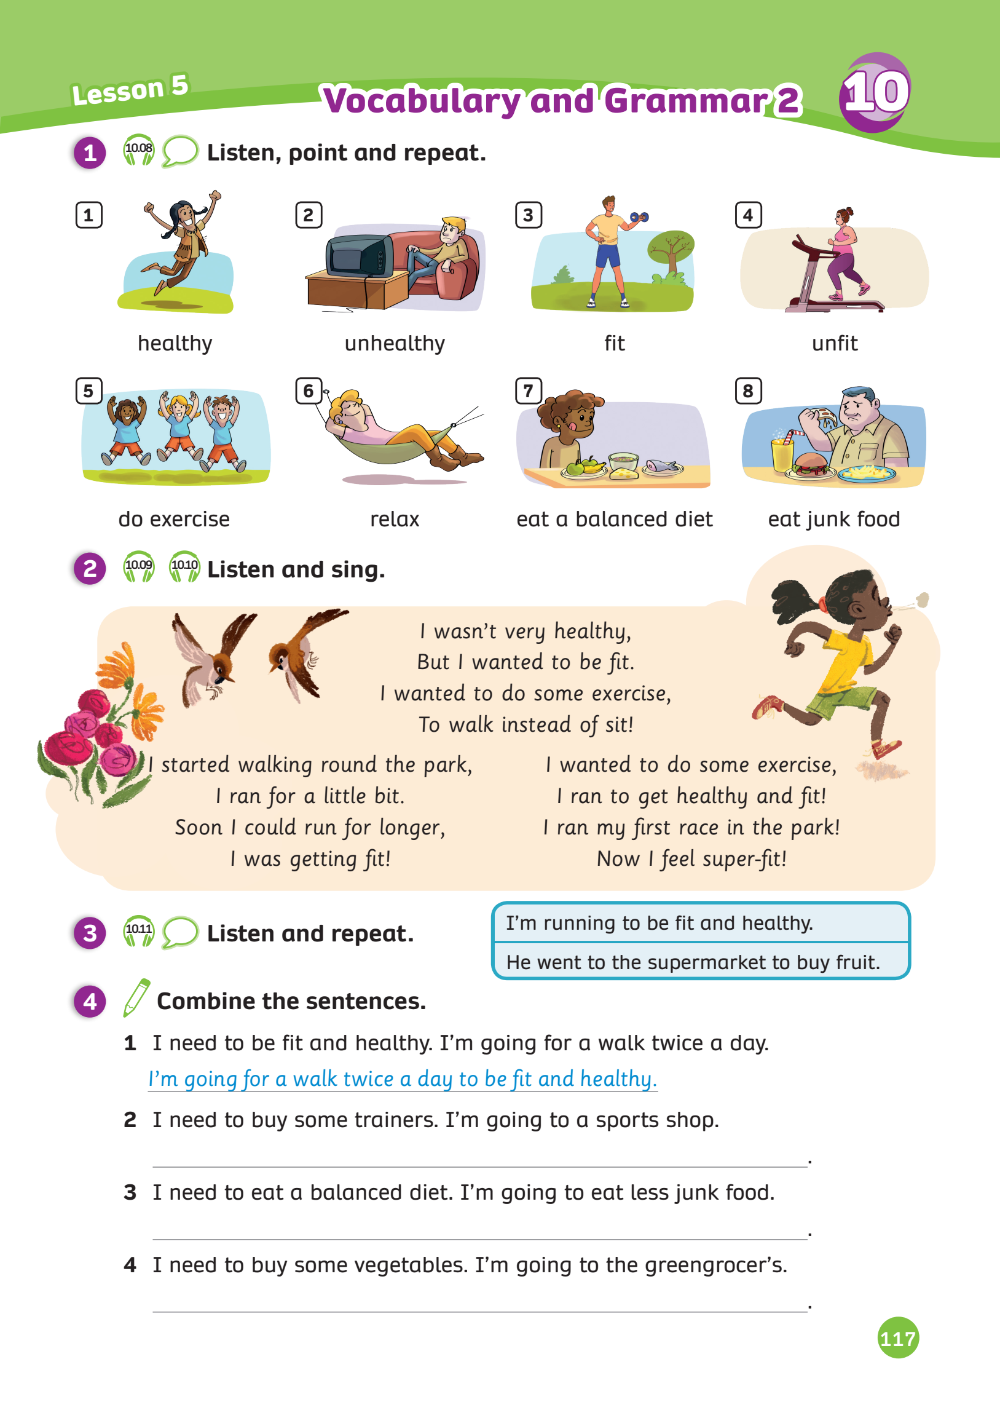
UNIT 10 – Lesson 5A
We’re learning…
To correctly read and pronounce words / phrases related to health
To use the structure:
to + be / verb to show purpose
- PB p.117
- AB p.92

Slide 3
WARM-UP ACTIVITY – The correct intonation
1. Are you feeling okay?
2. Do you want to go to the cinema tonight?
3. Can you speak English?
4. Should I drink a lot of water?
5. Should I take rest now?
In pairs, practice saying these sentences with the correct intonation
Teacher can play the audio 10.07 to check their answers.

Slide 4
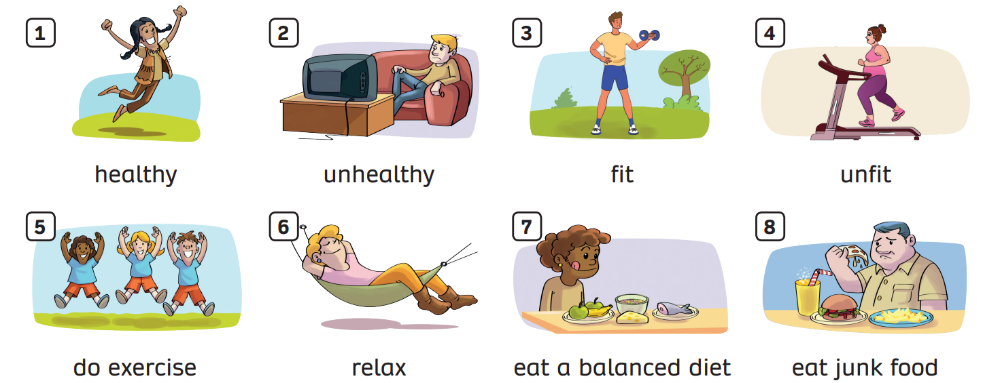
VOCABULARY – Heathy / Unhealthy habits
- Have the students look at the pictures, listen and repeat.

Slide 5
VOCABULARY – Heathy / Unhealthy habbits
c
Let’s spell!
healthy
h
e
a
l
t
h
y

Slide 6
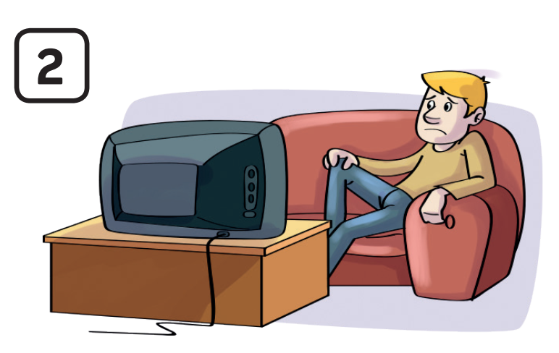
VOCABULARY – Heathy / Unhealthy habbits
Let’s spell!
c
unhealthy
u
n
h
e
a
l
t
h
y

Slide 7
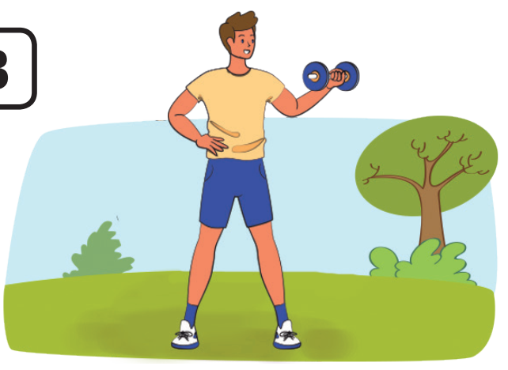
VOCABULARY – Heathy / Unhealthy habits
Let’s spell!
c
fit
f
i
t

Slide 8
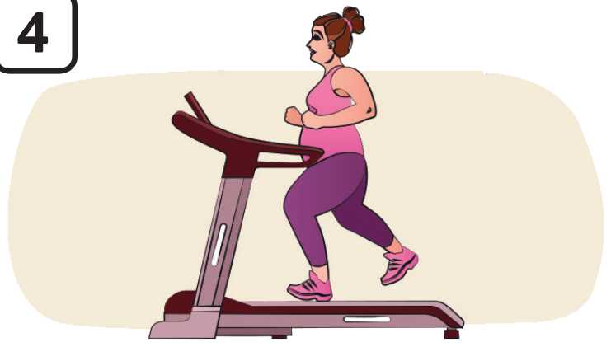
VOCABULARY – Heathy / Unhealthy habits
c
Let’s spell!
unfit
u
n
f
i
t

Slide 9
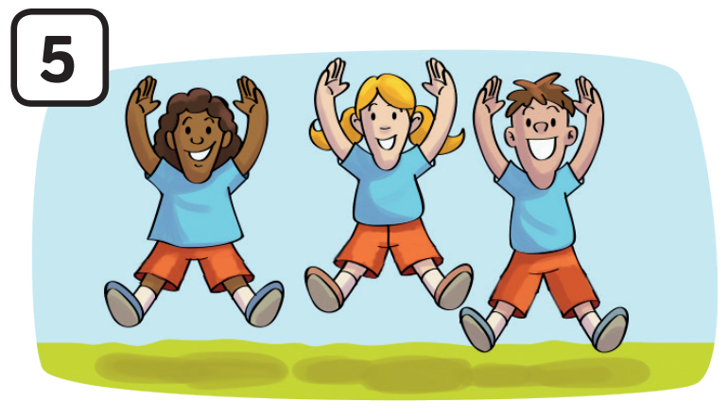
VOCABULARY – Heathy / Unhealthy habits
Let’s spell!
c
do exercise
d
o
e
x
e
r
c
i
s
e

Slide 10
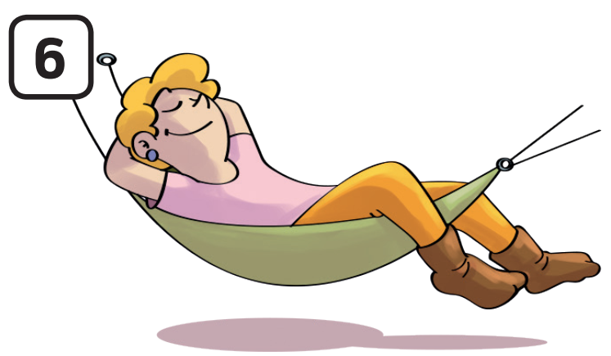
VOCABULARY – Heathy / Unhealthy habits
c
Let’s spell!
relax
r
e
l
a
x

Slide 11
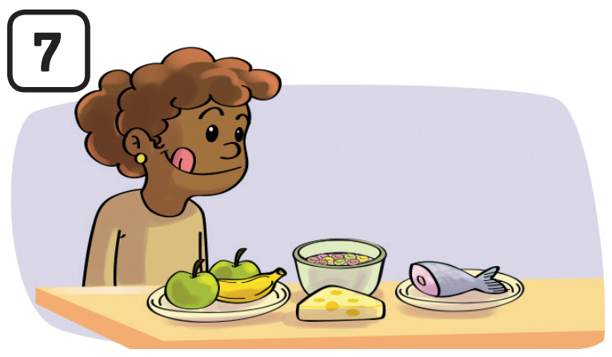
VOCABULARY – Heathy / Unhealthy habits
Let’s spell!
c
eat a
balanced diet
e
a
t
a
b
a
l
a
n
c
e
d
d
i
e
t

Slide 12
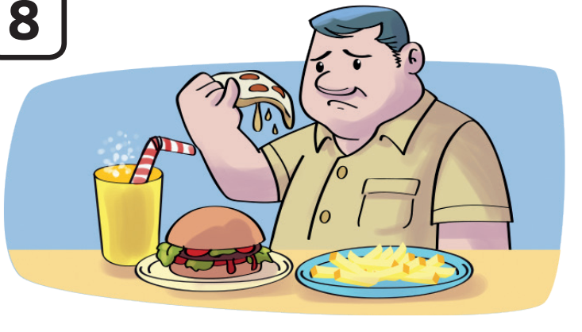
VOCABULARY – Heathy / Unhealthy habits
Let’s spell!
c
eat junk food
e
a
t
j
u
n
k
f
o
o
d

Slide 13
VOCABULARY – Heathy / Unhealthy habits
The teacher asks students to review all the words.

Slide 14
VOCABULARY – Heathy / Unhealthy habits
Activity: Picking up
Divide the class into groups of 4, each team prepares eight pieces of paper.
Tell students to write new words / phrases they learned before on the papers.
Each student keeps two cards.
Ask students to look at the picture, the students who hold the correct card in each team stand and raise the card up. Then say aloud the word.
The faster team with the correct answer can get 2 points.
Note: All team members need to say the correct word to win.

Slide 15
Raise the correct card
healthy
Answer

Slide 16
Raise the correct card
do exercise
Answer

Slide 17
Raise the correct card
fit
Answer

Slide 18
Raise the correct card
relax
Answer

Slide 19
Raise the correct card
unhealthy
Answer

Slide 20
Raise the correct card
unfit
Answer

Slide 21
Raise the correct card
eat junk food
Answer

Slide 22
Raise the correct card
eat a balanced diet
Answer

Slide 23
VOCABULARY – Activity: Make a pair
healthy
-
unhealthy
do exercise
-
relax
fit
-
unfit
eat a balanced diet
eat junk food
-
Check
Ask the whole class to look at the words “healthy” and “unhealthy” and ask them to make a pair..
Work in pairs, to find more pairs.

Slide 24
Pupils’ book – p.117
Ask students to look at the lyrics and clap their hands when they hear the new words from the lesson.

Slide 25
Pupils’ book – p.117
Teacher opens the karaoke version, the students to sing along.

Slide 26
STRUCTURE (Pupils’ book – p.117)
Ask students to listen and repeat.

Slide 27
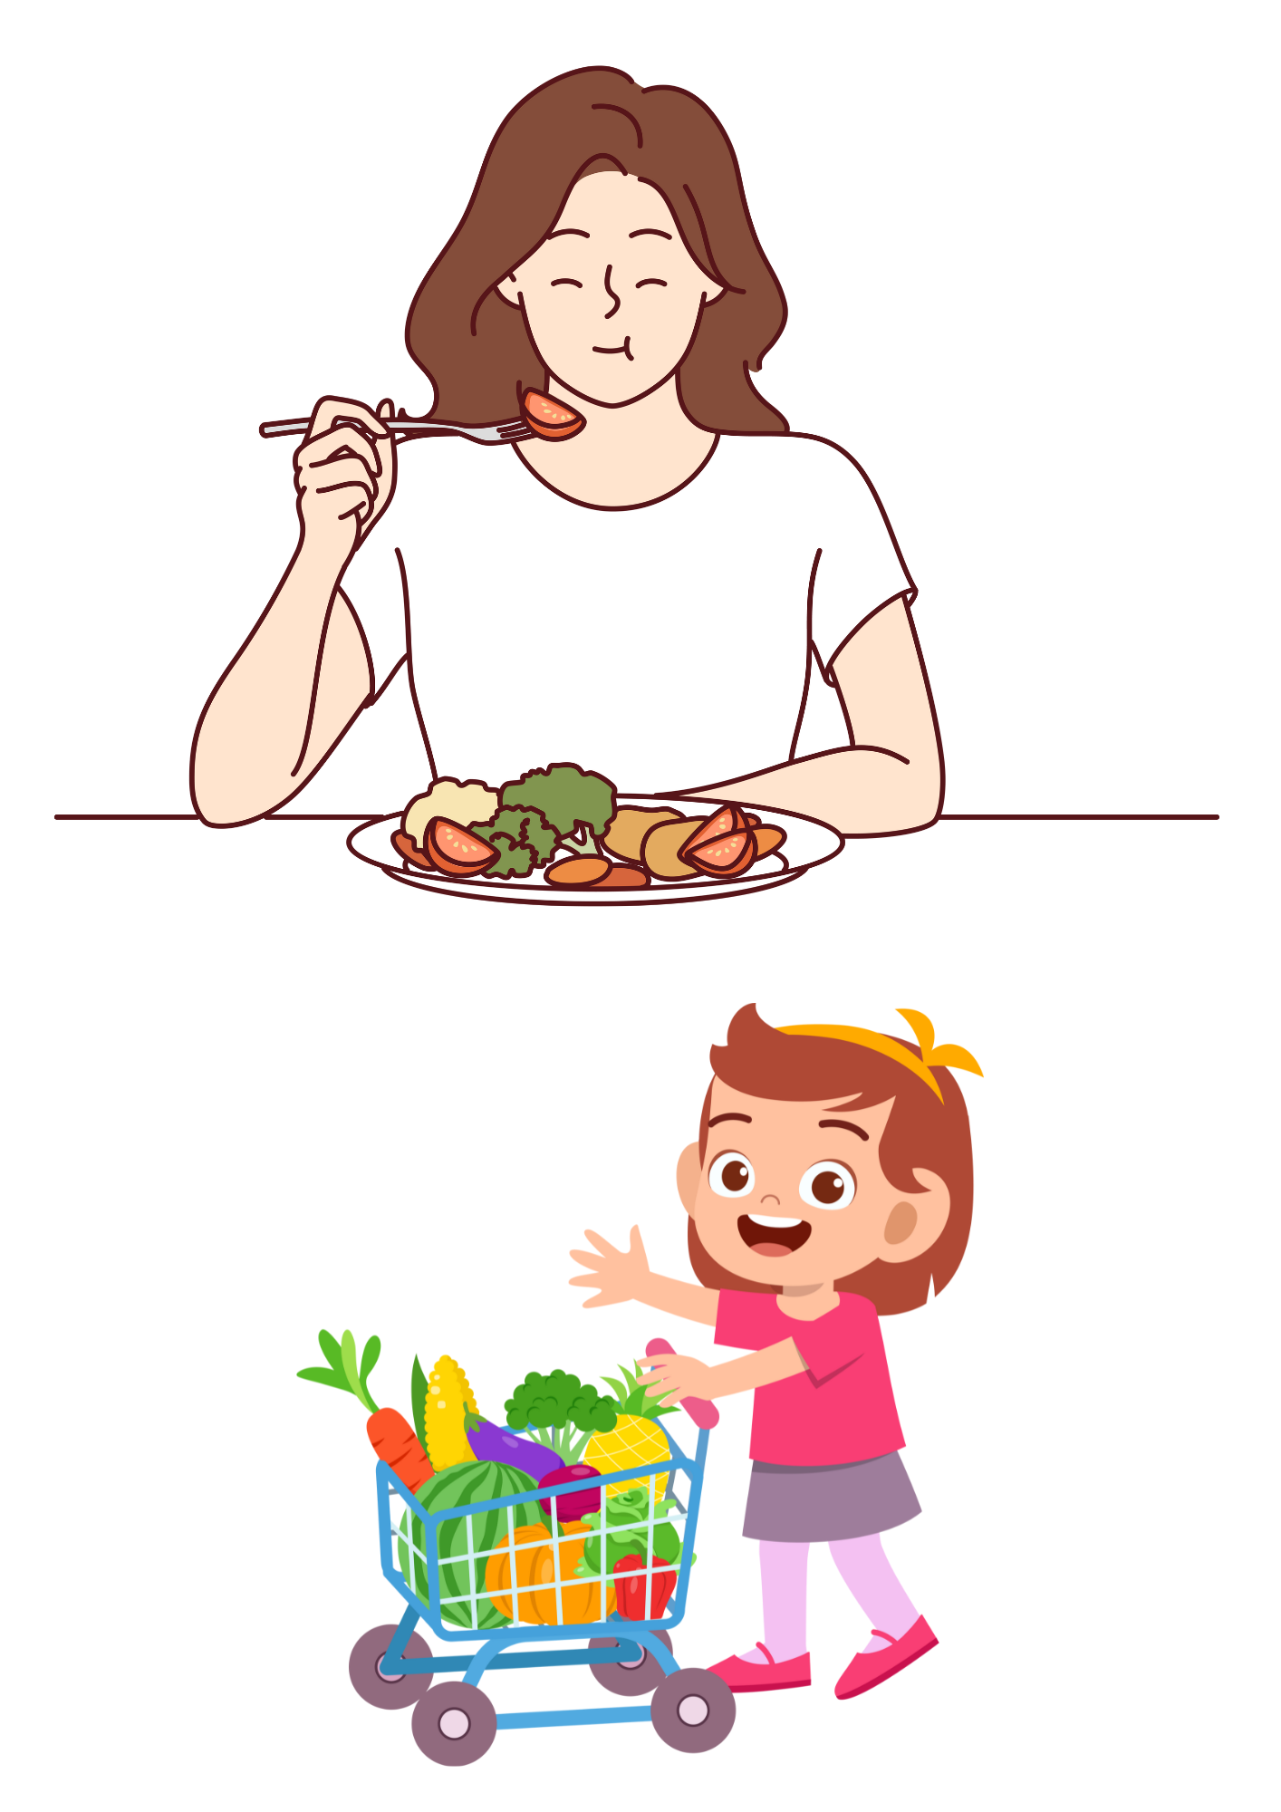
STRUCTURE
I’m eating more vegetables to have healthy diet.
Students to look at the example.

Slide 28
STRUCTURE
I went to the supermarket to buy some foods.
Students to look at the example.

Slide 29
STRUCTURE
We use to + be / verb to show the purpose.
ex: I’m running to be fit and healthy.
I went to the supermarket to buy fruit.
Students to look at the example.

Slide 30
SUM - IN
Ask students to open books, look at the pictures on page 117 again.
Students memorize the words learned in lesson 1, then close their books.
The teacher says the numbers and the students try to say the word.
The teacher can say 2 or 3 numbers at the same time.

Slide 31
HOMEWORK
HOMEWORK
Review vocabulary and grammar.
Do exercises in the Activity book (page 92).
Check answers in the Teacher’s Book (page 202) or Active Teach.

Slide 32
UNIT 10 – Lesson 5A
We’re learning…
To correctly read and pronounce words / phrases related to health
To use the structure:
to + be / verb to show purpose
- PB p.117
- AB p.92

