Slide 1
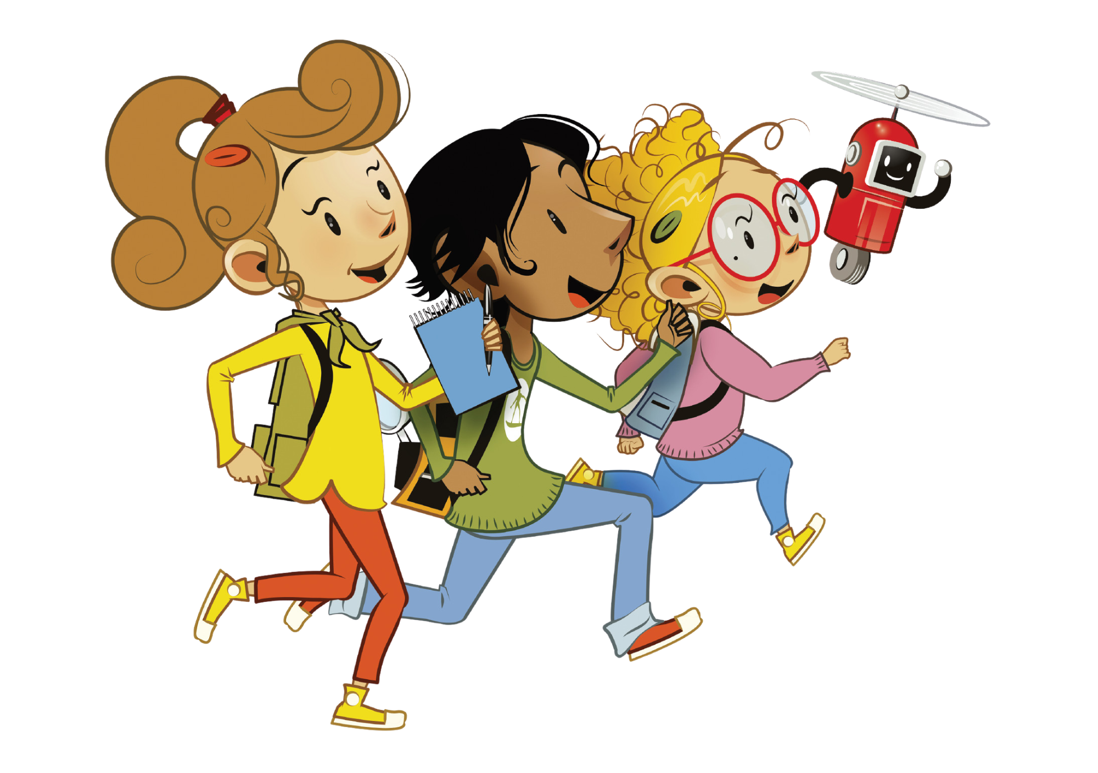
UNIT 10 – STAYING HEALTHY
Lesson 7A - STORY

Slide 2
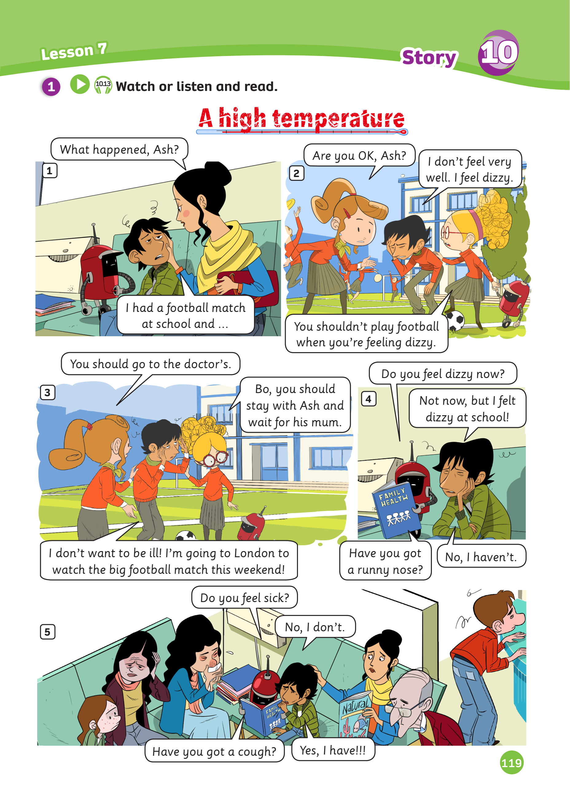
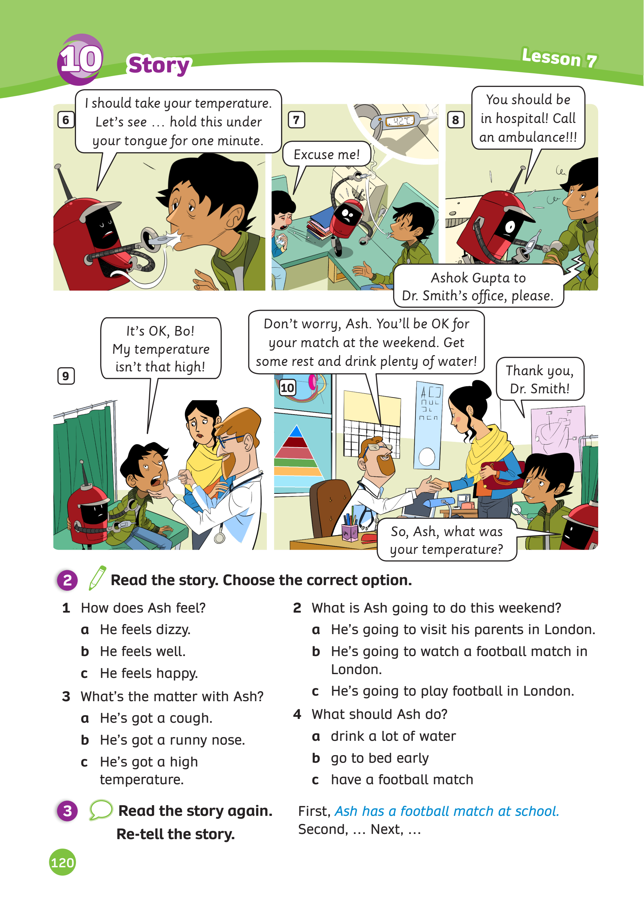
UNIT 10 – Lesson 7A
We’re learning…
- To understand simple cartoon stories.
- PB pp.119,120
- AB p.94

Slide 3
WARM-UP ACTIVITY
Activity: Listing out
Divide the class into groups of 6. Each team prepares a mini-board.
Each student takes turns to list out as many words related to illnesses in 2 minutes.
After that, students exchange their boards to check do peer check.
(A correct answer = one points)
Ask students to read aloud the words to review.
The team with the correct answers will win the activity.

Slide 4
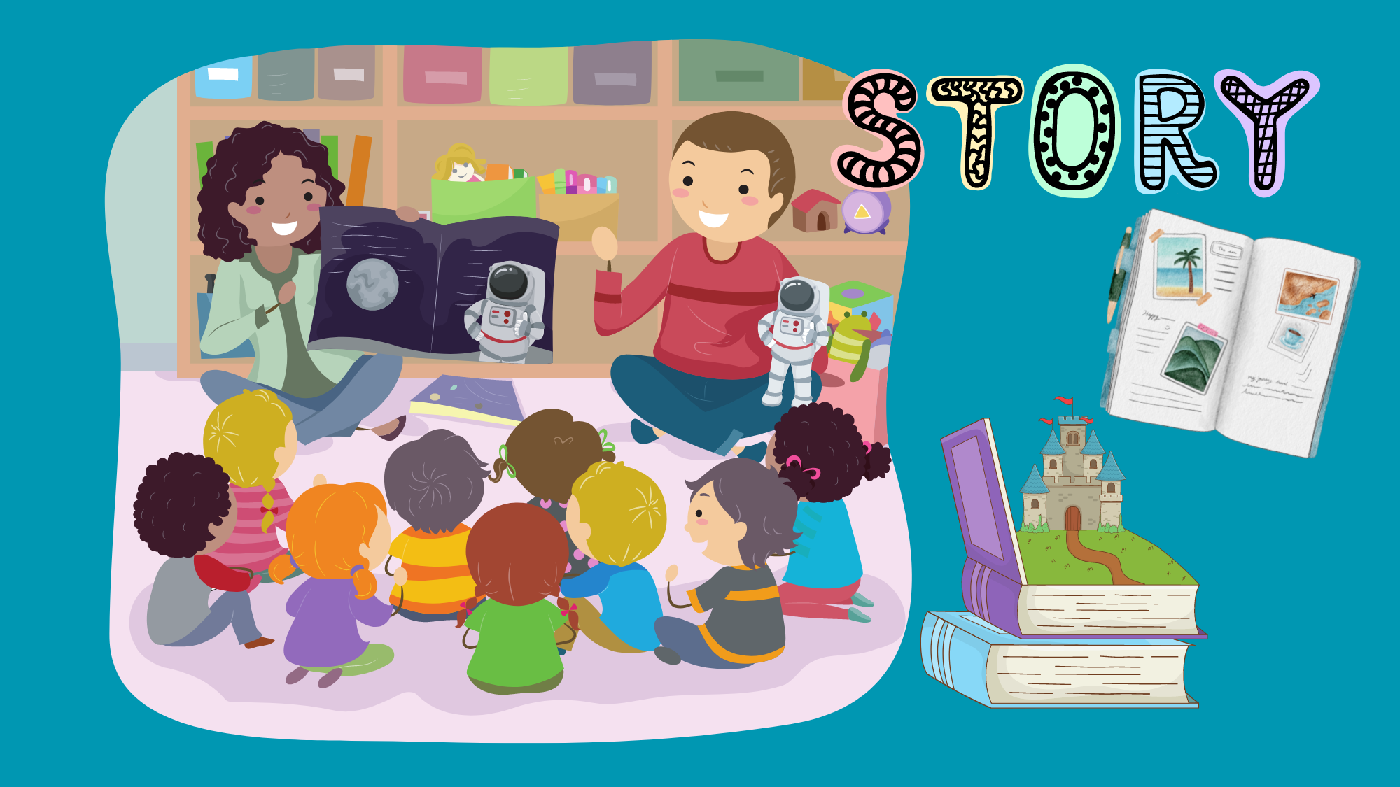
STORY

Slide 5
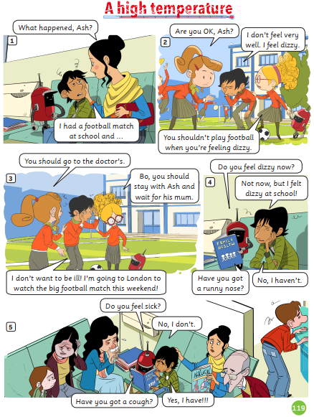
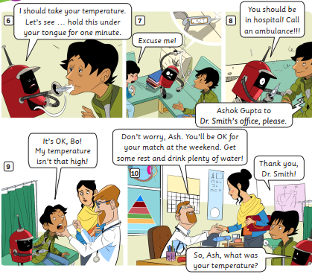
STORY: Introduction
1. What’s the story title?
→
2. How many story frames?
→
3. How many characters?
→
A high temperature
10 story frames
6 characters
Click on each number, students look and say the word out loud.

Slide 6
STORY: Watch a video

Slide 7
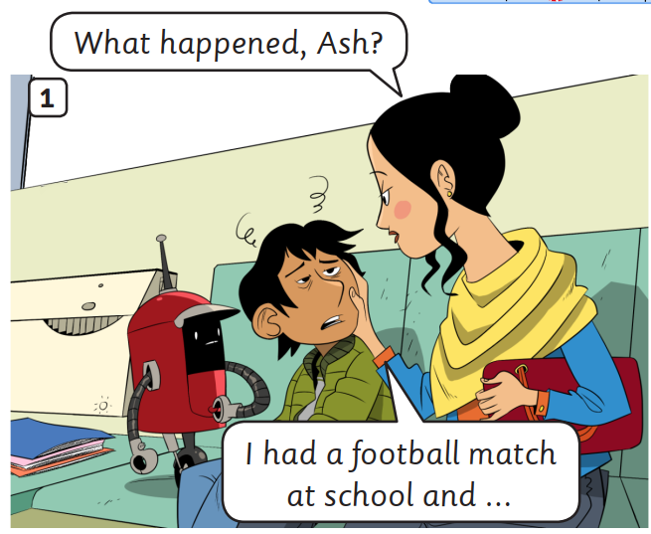
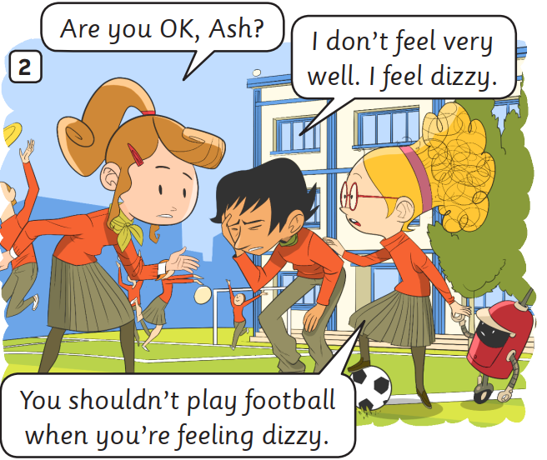
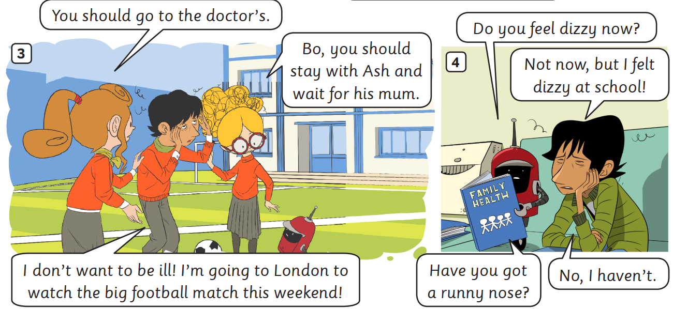
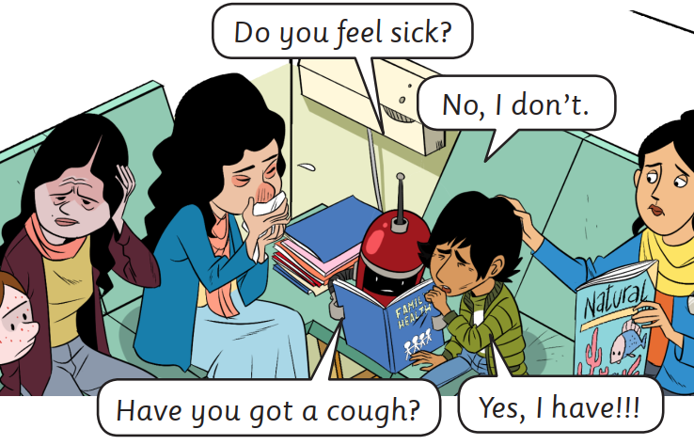
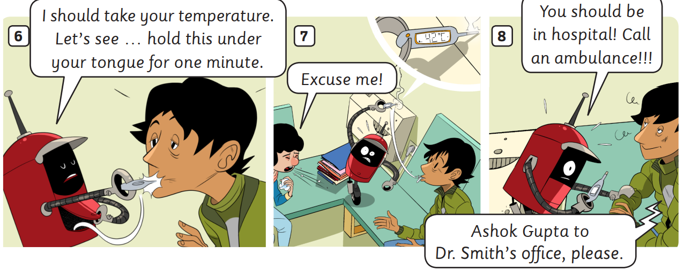
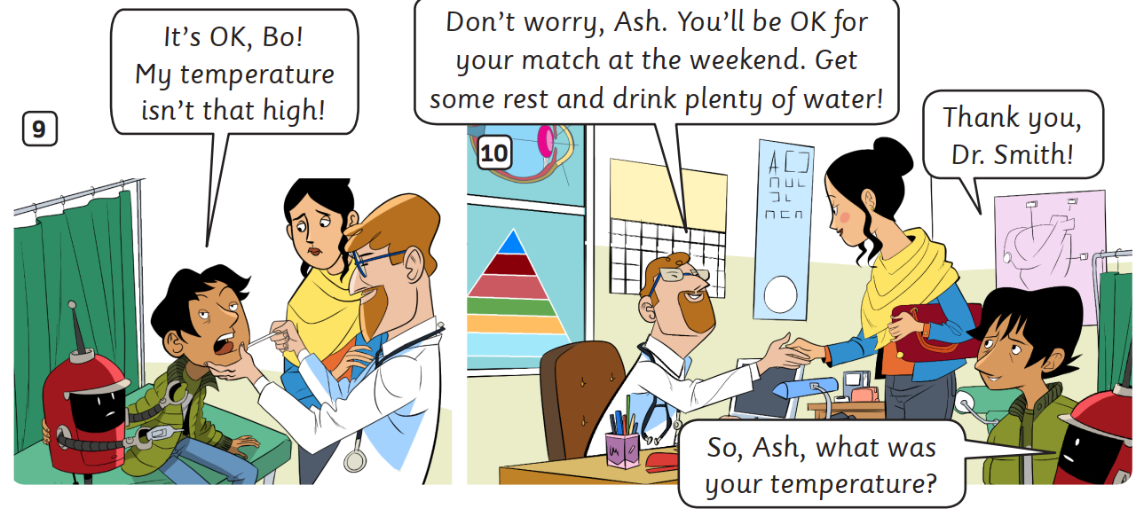
Listen
STORY: Listen to the story
Students open their book, listen to the story.

Slide 8
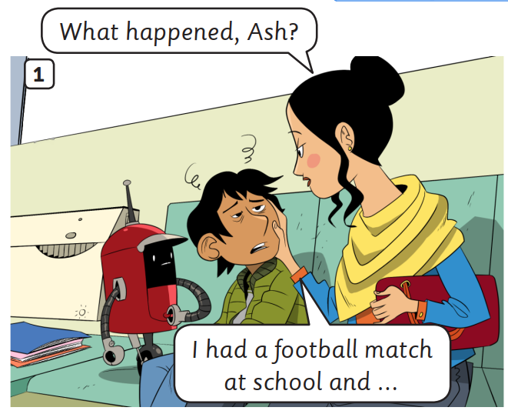
STORY: Listen and read
1
1
2
2
Click on the number, students listen and repeat

Slide 9
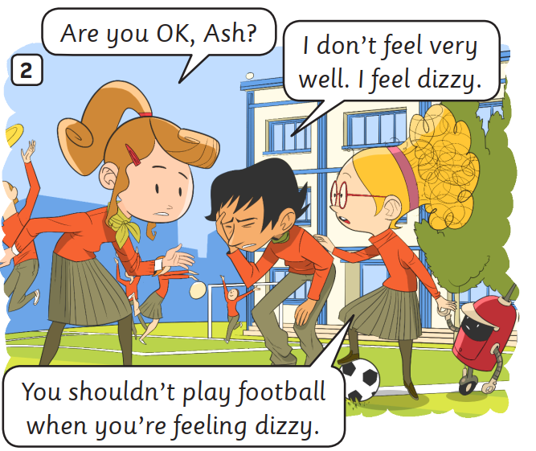
STORY: Listen and read
1
2
1
2
3
3
Click on the number, students listen and repeat

Slide 10
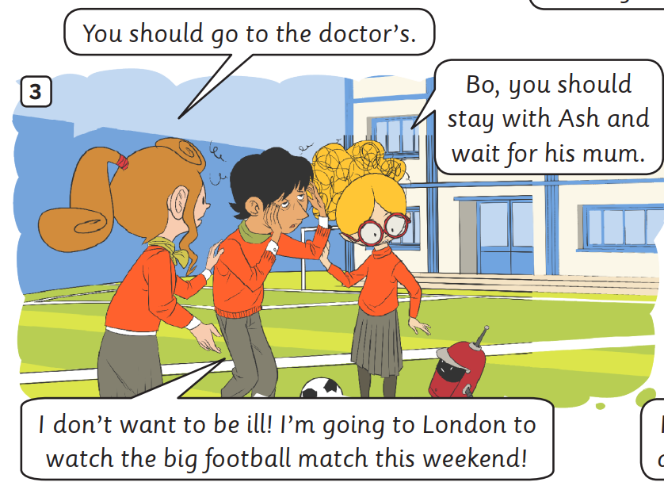
STORY: Listen and read
1
1
3
2
3
2
Click on the number, students listen and repeat

Slide 11
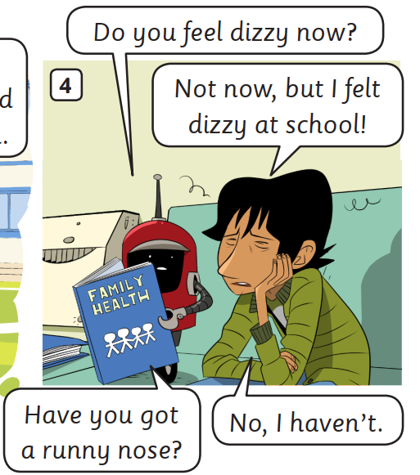
STORY: Listen and read
1
1
2
2
3
4
3
4
Click on the number, students listen and repeat

Slide 12
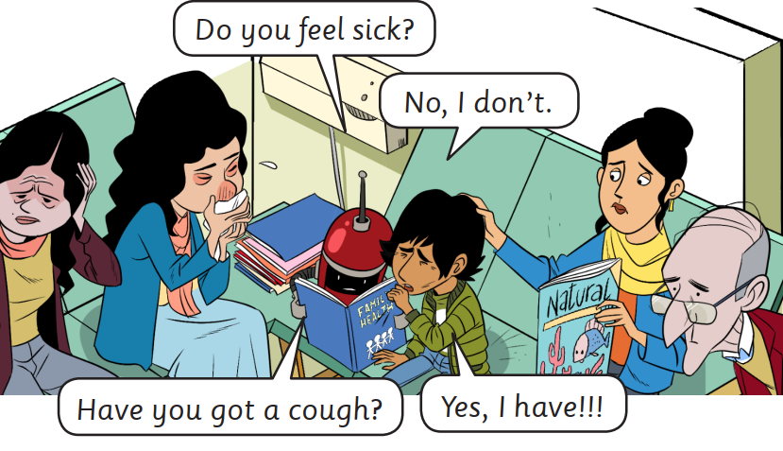
STORY: Listen and read
1
1
2
2
3
4
3
4
Click on the number, students listen and repeat

Slide 13
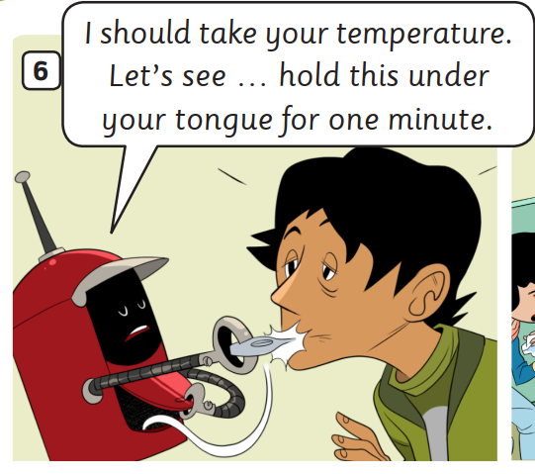
STORY: Listen and read
1
1
Click on the number, students listen and repeat

Slide 14
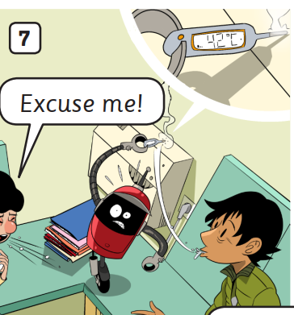
STORY: Listen and read
1
1
Click on the number, students listen and repeat

Slide 15
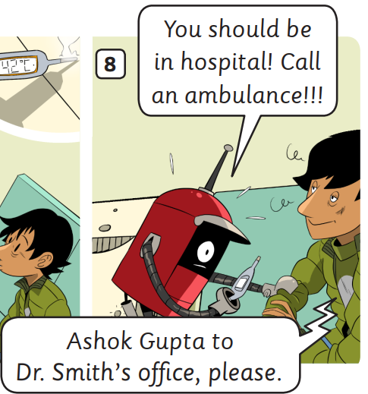
STORY: Listen and read
1
1
2
2
Click on the number, students listen and repeat

Slide 16
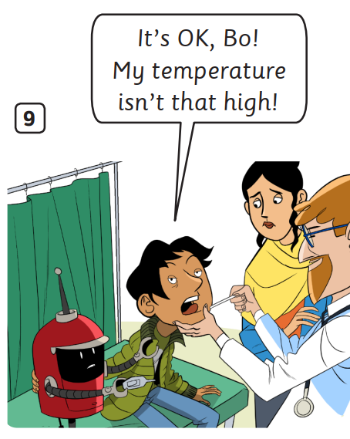
STORY: Listen and read
1
1
Click on the number, students listen and repeat

Slide 17
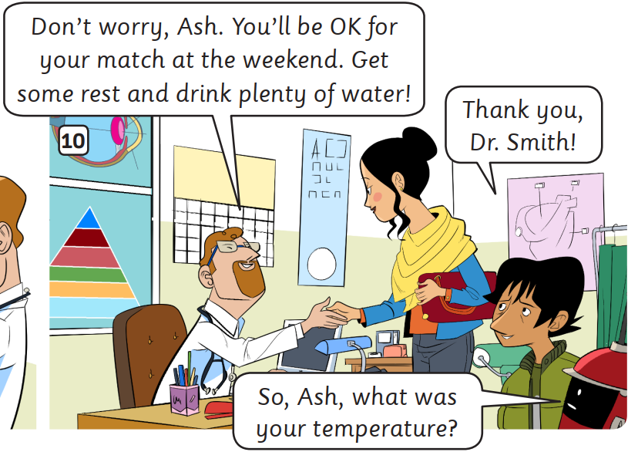
STORY: Listen and read
1
1
2
2
3
3
Click on the number, students listen and repeat

Slide 18
PRACTICE
Activity: Choose the correct character
Divide the class into groups of 4.
Students read the sentences and discuss with teammates to choose the correct character who said that line.
Students show the fingers to choose the correct answers (all members of the team).
The faster team with the correct answer can get 2 points.

Slide 19
Choose the correct character
I don’t feel very well. I feel dizzy.
1
2
3

Slide 20
Choose the correct picture
You should go to the doctor’s.
a
b
c

Slide 21
Choose the correct picture
Bo, you should stay with Ash and wait for his mom.
a
b
c

Slide 22
Choose the correct picture
Have you got a runny nose?
a
b
c

Slide 23
Choose the correct picture
You should be in hospital! Call an ambulance.
a
b
c

Slide 24
Choose the correct picture
My temperature isn’t that high!
a
b
c

Slide 25
Choose the correct picture
You will be OK for your match at the weekend. Get some rest and drink plenty of water.
a
b
c

Slide 26
Well-done

Slide 27
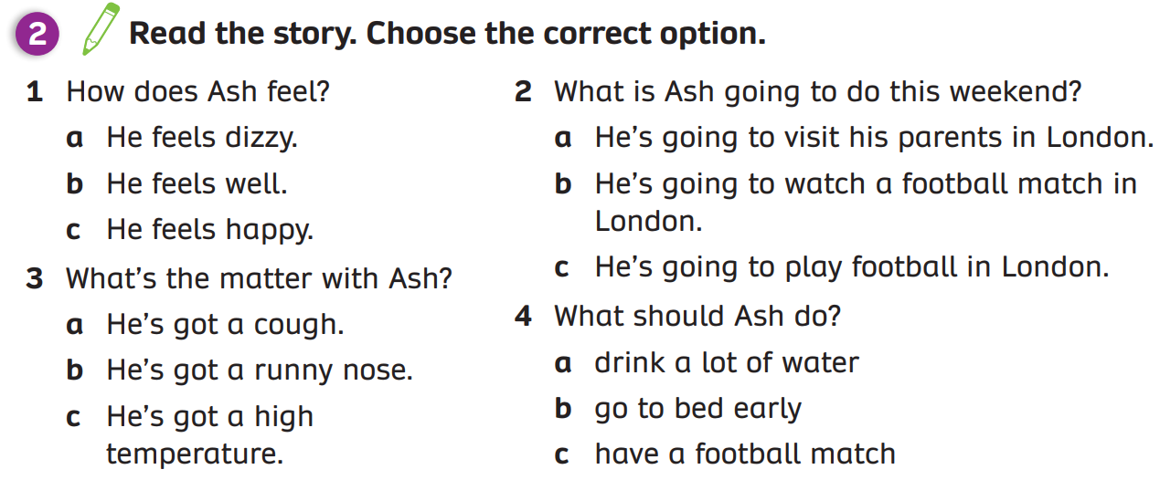
PRACTICE (Pupils’ book (p.120)
Answer
Students work in groups of 3, read and answer the questions by using their memory.
Check the answer with the whole class.

Slide 28
WRAP-UP
1. What’s the story title?
→
2. How many story frames?
→
3. How many characters?
→
A high temperature
10 story frames
6 characters
Click on each number, students look and say the word out loud.

Slide 29
HOMEWORK
HOMEWORK
Review vocabulary and grammar.
Do exercises in the Activity book (page 94).
Check answers in the Teacher’s book (page 206) or Active Teach.

Slide 30
UNIT 10 – Lesson 7A
We’ve learned…
- To understand simple cartoon stories.
- PB pp.119, 120
- AB p.94

