Slide 1


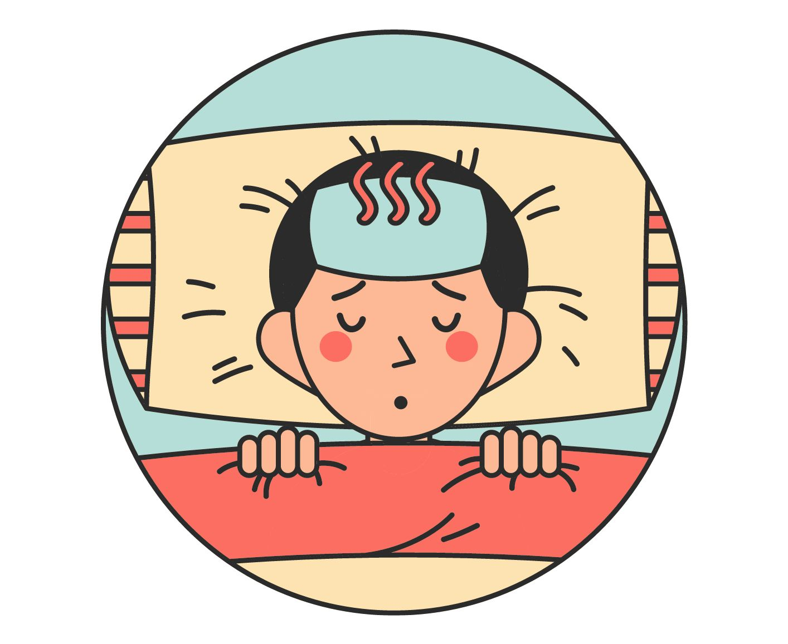
UNIT 10 – STAYING HEALTHY
Lesson 8 - PROJECT

Slide 2
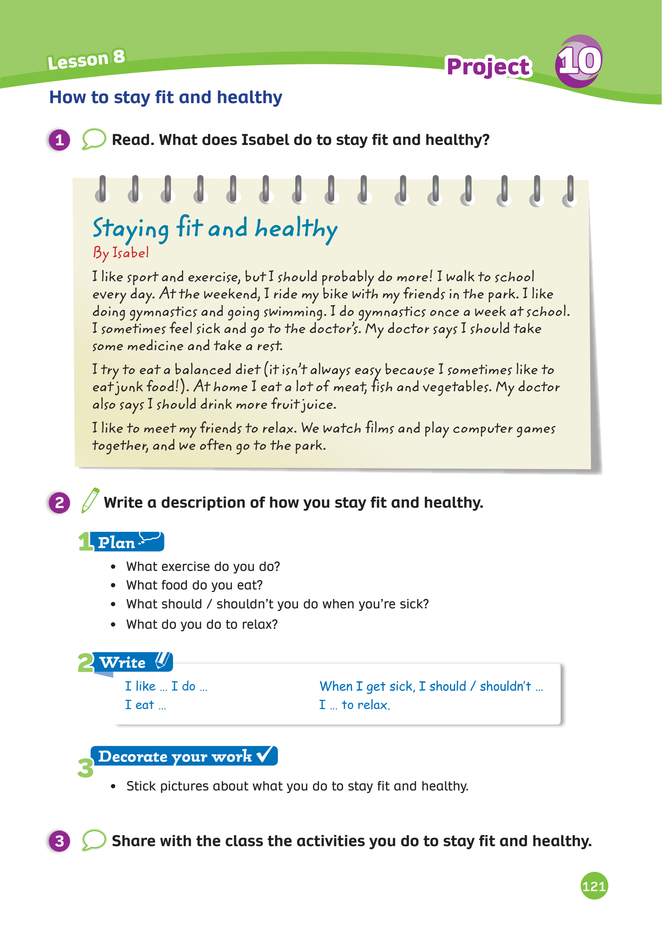
UNIT 10 – Lesson 8
We’re learning…
- To review.
- To write and talk about: How to stay fit and healthy.
- PB p. 121
- AB p.95

Slide 3

WARM-UP ACTIVITY
Activity: Answer the question
Students work in groups of 4. Each group takes out a pen or ruler and puts it in the middle of each group.
Teacher shows the text and give 2 minutes for students to read the information.
Teacher asks the questions and students listen, find the information in the picture, then raise the pens or ruler to get a chance to answer.
The fastest group with the correct information receives 2 points.

Slide 4
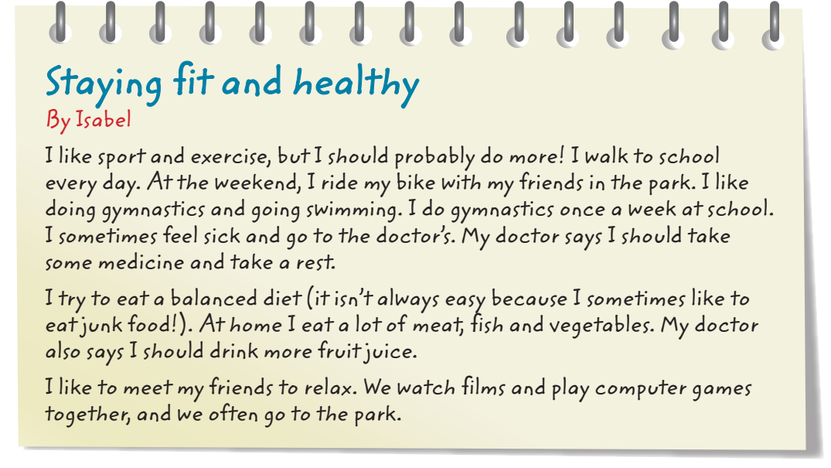

WARM-UP ACTIVITY

Slide 5

WARM-UP ACTIVITY
It’s about Staying fit and healthy.
What does the text talk about?
Answer

Slide 6
WARM-UP ACTIVITY
The text talks about “Isabel”.
Who is the text about?
Answer

Slide 7
WARM-UP ACTIVITY
What activities does Isabel like?
She likes sport and exercise.
Answer

Slide 8
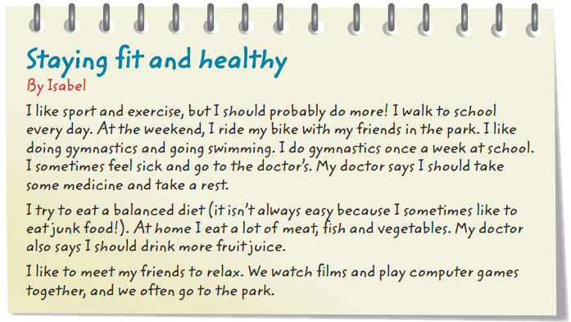
Pupils’ Book – p.121
Ask students to close their book, recall the text from the previous lesson and predict the text is about.

Slide 9
Pupils’ Book – p.121
Students look at the book and read the text in three minutes.
Then, underline any useful phrases that help them to understand the main idea of the text.
A few students share their work in front of the class.
Students work in pairs to answer the question in the title.

Slide 10
Pupils’ Book – p.121
She rides her bike, does gymnastics, goes swimming and eats a balanced diet.
Example Answer
Students look at the book and read the text in three minutes.
Then, underline any useful phrases that help them to understand the main idea of the text.
A few students share their work in front of the class.
Students work in pairs to answer the question in the title.

Slide 11
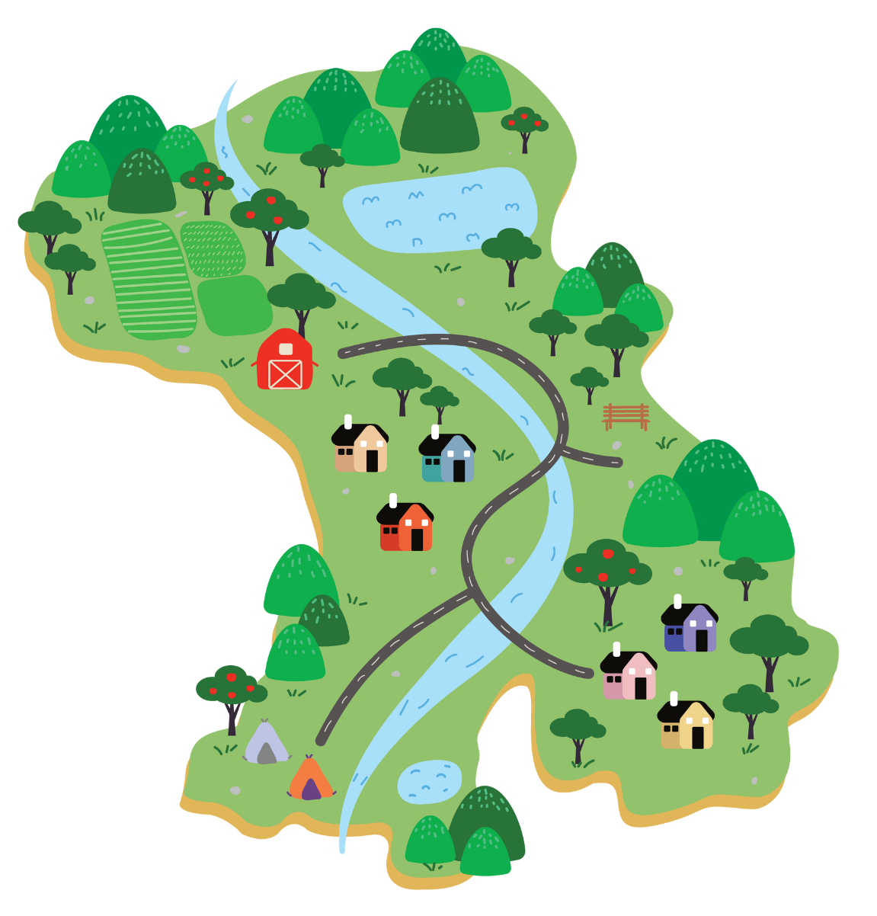
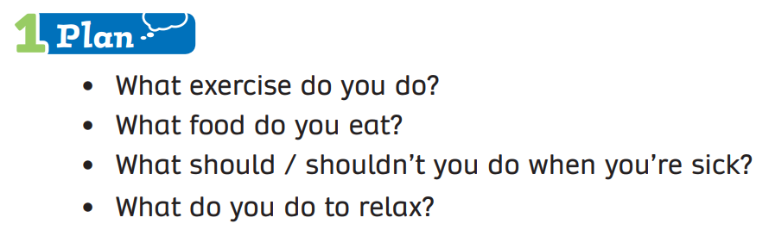
Pupils’ book – p.121
Activity: Write a description
Put students into groups of 4. Each group takes out a sheet of paper. Students in the group discuss and write the answer for each question.
Each member takes turns writing the answer.
Show the example on the next slide.

Slide 12



Pupils’ Book – p.121
Example
Activity: Write a description
1. What exercise do you do?
- play badminton, ride a bike, go swimming
2. What food do you eat?
meat, fish, beans, fruit and vegetables
3. What should / shouldn’t you do when you’re sick?
should: take some rest, eat more meat
shouldn’t: go outside, drink cold water
4. What to you do to relax?
listen to music, read books

Slide 13
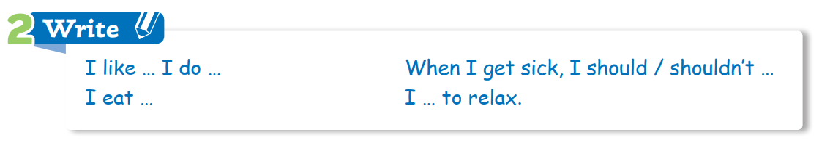
Pupils’ book – p.121
Activity: Write a description
Next, students in the group discuss writing about the ways to stay fit and healthy.
Use the clues and the helpful language on top.
The example is on the next slide.

Slide 14
Pupils’ book – p.121
Activity: Write a description
I like sports and exercise. I play badminton, ride a bike and go swimming with my friends.
At home, I eat a lot of meat, fish, beans, vegetables and fruits because they are a balanced diet.
When I get sick, I should take some rest and eat more meat. I shouldn’t go outside and drink cold water.
I listen to music and read books to relax.

Slide 15

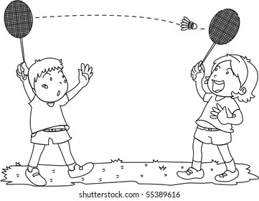
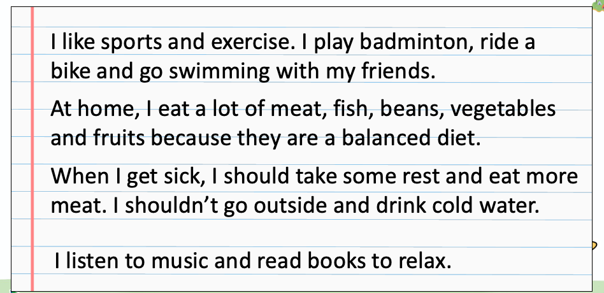

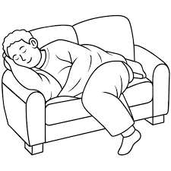

Pupils’ book – p.121
Activity: Write a description
Example
After the students finish writing a description to show how to stay fit and healthy,
stick or draw pictures to decorate what they do.

Slide 16

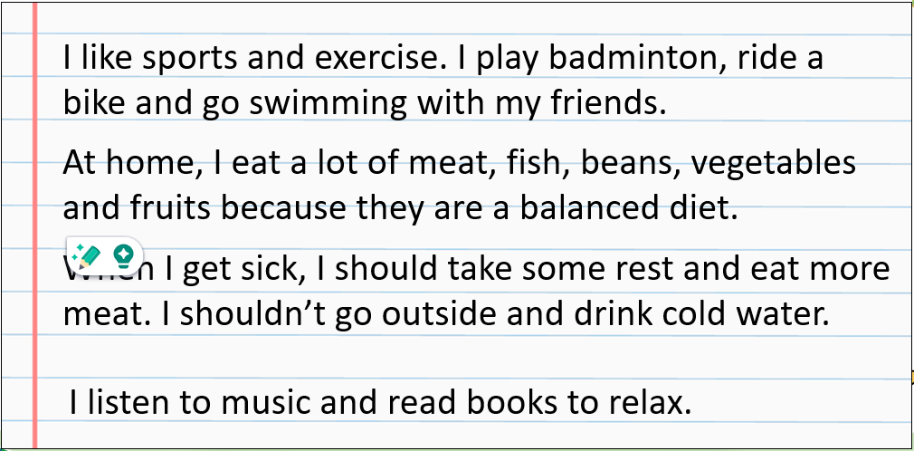
Pupils’ book – p.121
Students to practice sharing in teams first, then share with the class the activities that they do to stay fit and healthy.
a few students to present in front of the class.
Students receive points for the good performances.

Slide 17
HOMEWORK
HOMEWORK
Review vocabulary and grammar.
Do exercises in the Activity book (page 95).
Check answers in the Teacher’s book (page 208) or Active Teach.

Slide 18
UNIT 10 – Lesson 8
We’ve learned…
- to write description
- PB p. 121
- AB p.95

