Slide 1

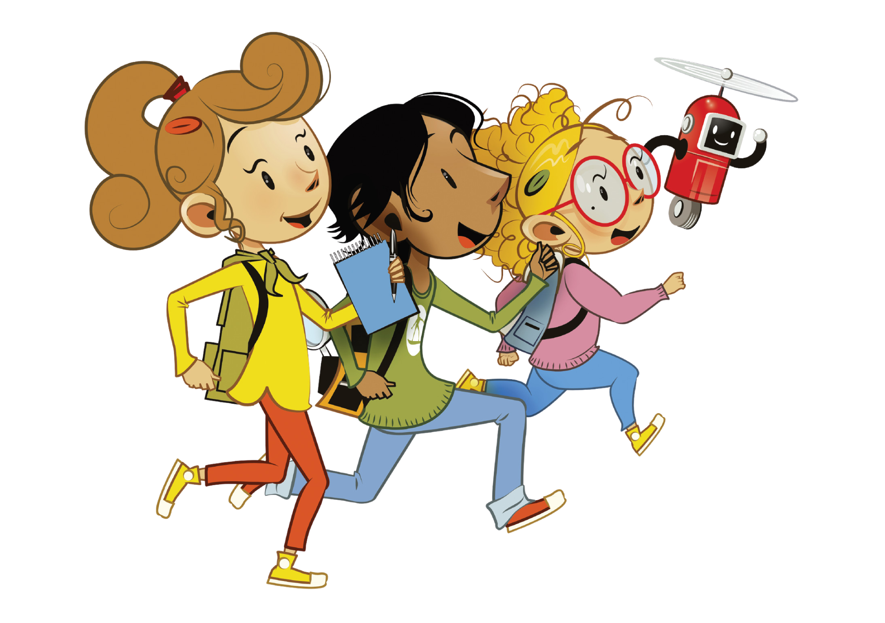
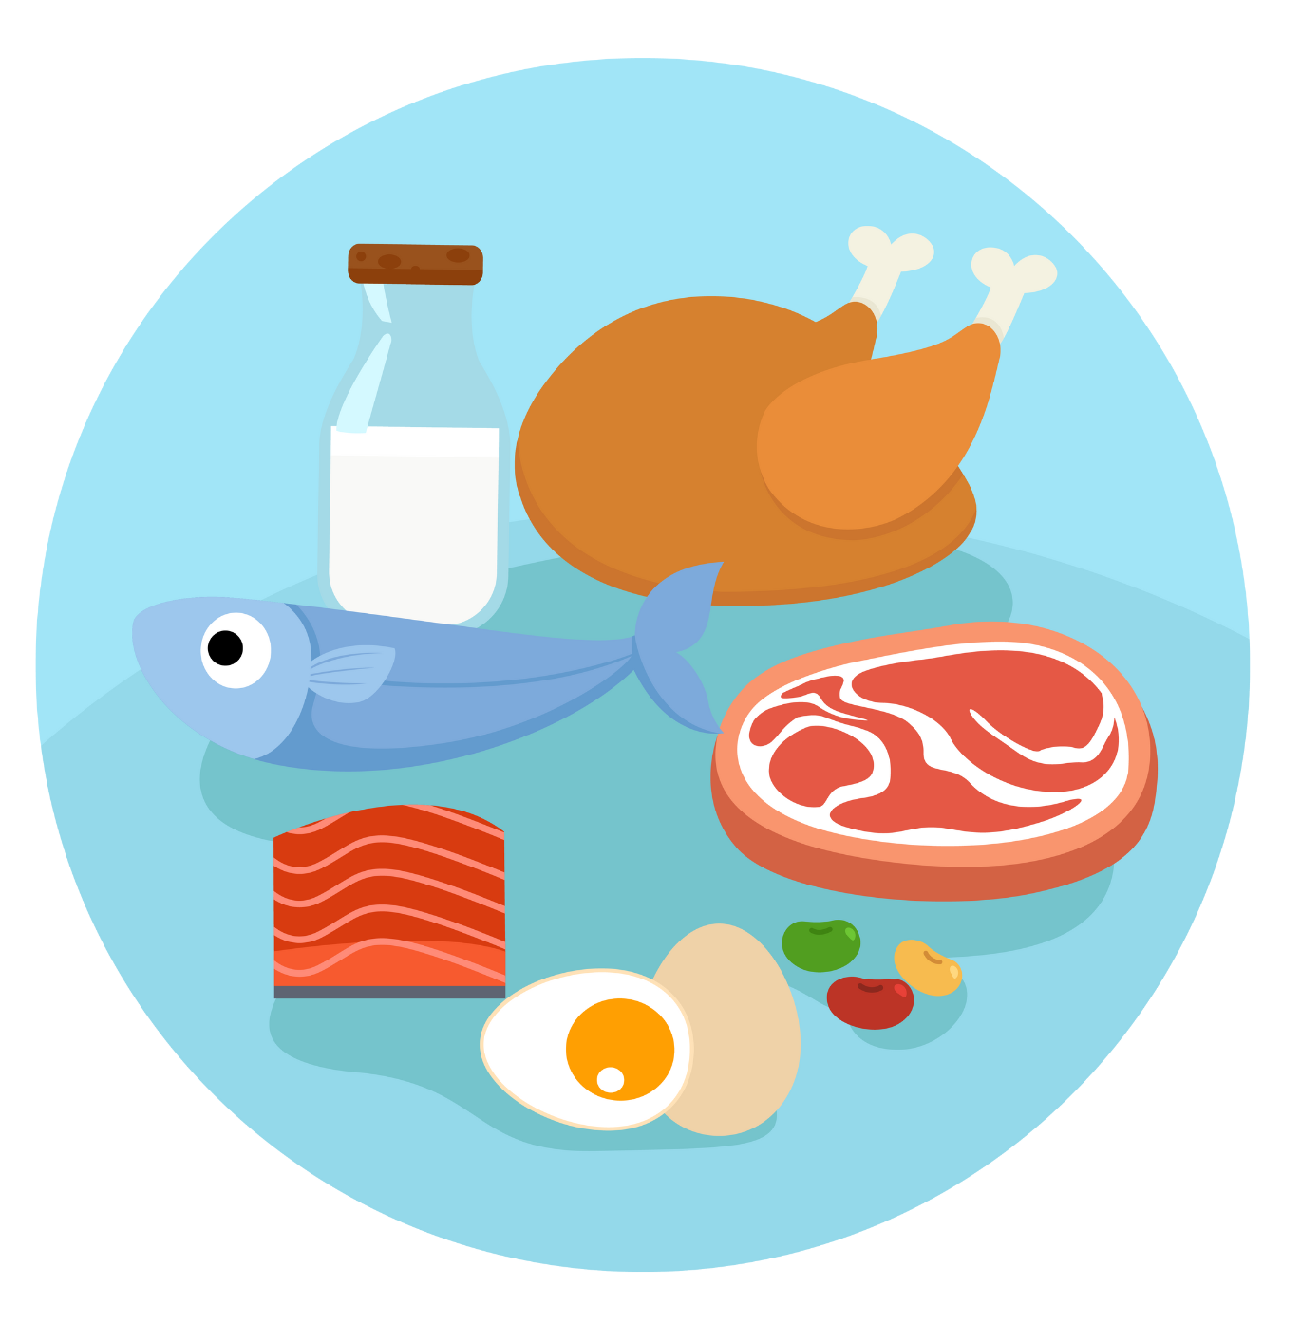
UNIT 2 – PICNIC TIME!
Lesson 4 – Phonics

Slide 2
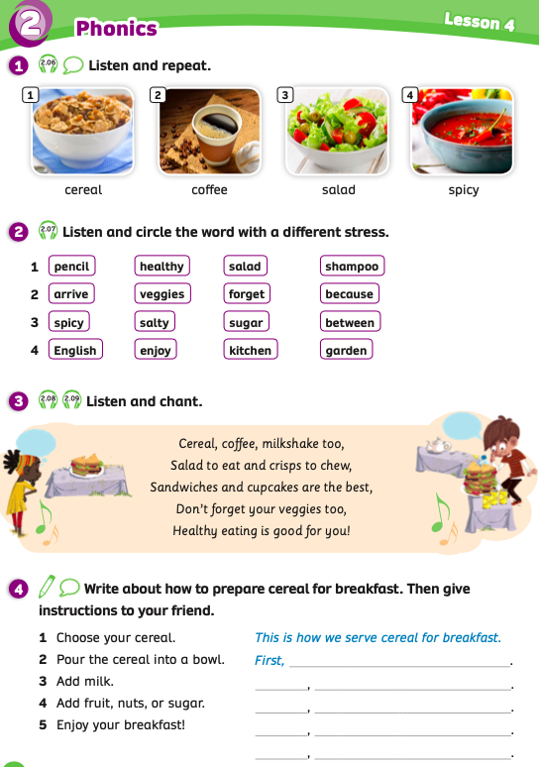
UNIT 2 – Lesson 4
We’re learning…
to correctly read and stress in two syllables words 2.
- PB p.26
- AB p.21

Slide 3
WARM-UP ACTIVITY
Activity: RAISE YOUR NUMBER
Divide the class into groups of 4. Each student takes out 2 pieces of paper and writes numbers 1 and 2 on each piece.
Show the word with the audio, students listen and choose the number 1 if a word is stressed on the first syllable and number 2 if a word is stressed on the second syllable.
Students raise their papers to check the answers.
The fastest group with all members who have correct answers receives 2 points.

Slide 4

WARM-UP ACTIVITY
1
1
2
1
salad
cereal
enjoy
coffee
2
2
1
forget
prepare
veggies
1
2
1
spicy
shampoo
healthy

Slide 5
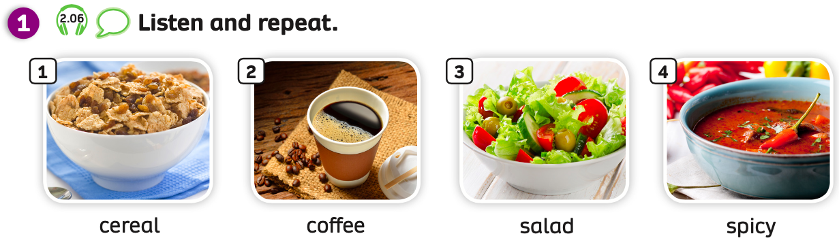
PUPILS’ BOOK p.26
Have students look at the pictures and words.
Play the audio, students listen and repeat.
Divide the class into 2 teams. Each team takes a turn to repeat these words.

Slide 6
WARM-UP ACTIVITY
Activity: ODD ONE OUT
Divide the class into pairs. Each pair takes out a mini-board.
The teacher clicks on “Listen” and students listen one by one word.
Then, students discuss with their partners to choose the word which has a different stress mark from the other three words. Each student takes turns writing the answer.
After finishing, students raise their boards to check the answers.
The 5 fastest pairs with the correct answer receive 2 points.

Slide 7

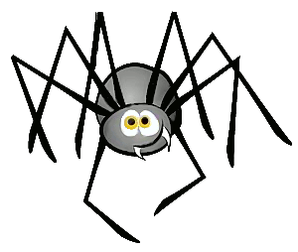

PLAY

Slide 8

LISTEN
shampoo
forget
pencil
between
NEXT
CHECK
Stressed on the first syllable.
Click on “Listen” to hear the sound.

Slide 9
LISTEN
salad
veggies
healthy
between
NEXT
CHECK
Stressed on the second syllable.
Click on “Listen” to hear the sound.

Slide 10
LISTEN
sugar
spicy
enjoy
salty
NEXT
Stressed on the second syllable.
CHECK
Click on “Listen” to hear the sound.

Slide 11
LISTEN
because
veggies
forget
arrive
NEXT
Stressed on the first syllable.
CHECK
Click on “Listen” to hear the sound.

Slide 12
LISTEN
English
garden
kitchen
enjoy
NEXT
CHECK
Stressed on the second syllable.
Click on “Listen” to hear the sound.

Slide 13
LISTEN
because
forget
salad
between
NEXT
CHECK
Stressed on the second syllable.
Click on “Listen” to hear the sound.

Slide 15
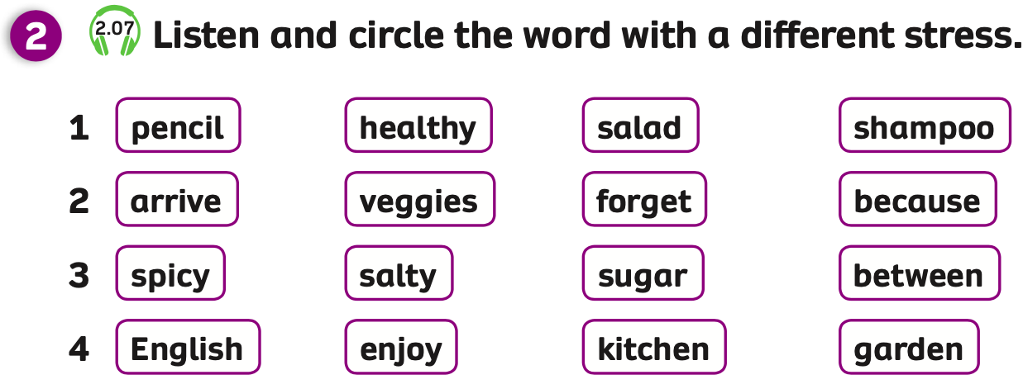

PUPILS’ BOOK p.26
ANSWER
Have students open their books and look at the task.
Play the audio, students, look, listen and repeat each of the four words in each group.
Play the audio again, students listen and circle the word which has a different
stress from the other three words.
Click on “Answer” to show the answers to check.

Slide 16
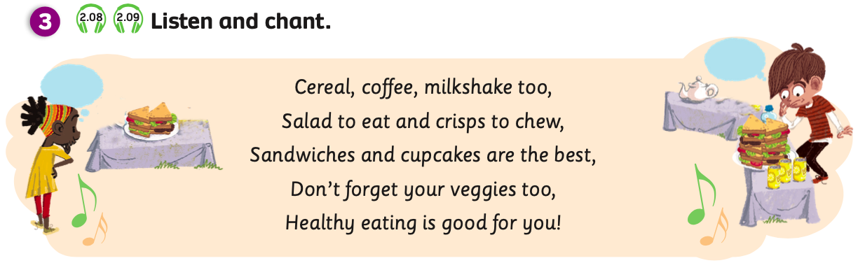
PUPILS’ BOOK p.26
Have students look at the lyrics of the chant.
Play the audio and students listen and clap to the beat of the chant.
Play the audio again, students listen and chant.
Divide the class into groups of 4. Each group takes a turn listening and chanting.

Slide 17
PUPILS’ BOOK p.26
ANSWER
Listen and write:
1
2
3
4
5
Put students into pairs. Each pair takes out a sheet of paper.
Students look at the lyrics with one word missing from each line.
Play the audio, students listen and write the missing words.
After finishing, students raise their papers to check the answers.
Give points if students have all the correct answers.

Slide 18

PRODUCTION
Discussing Time
STEPS
How do we prepare cereal for breakfast?
1. Choose the cereal.
2. Pour the cereal into the bowl.
3. Add milk.
4. Add fruits, nuts and sugar.
5. Enjoy our breakfast.
Put students into groups of 4. Ask students to close their books and look at the question on the slide.
Ask students to discuss and give the steps of preparing cereal for breakfast.
Click on the “Steps” to show the answers. Students look at and say them aloud.

Slide 19
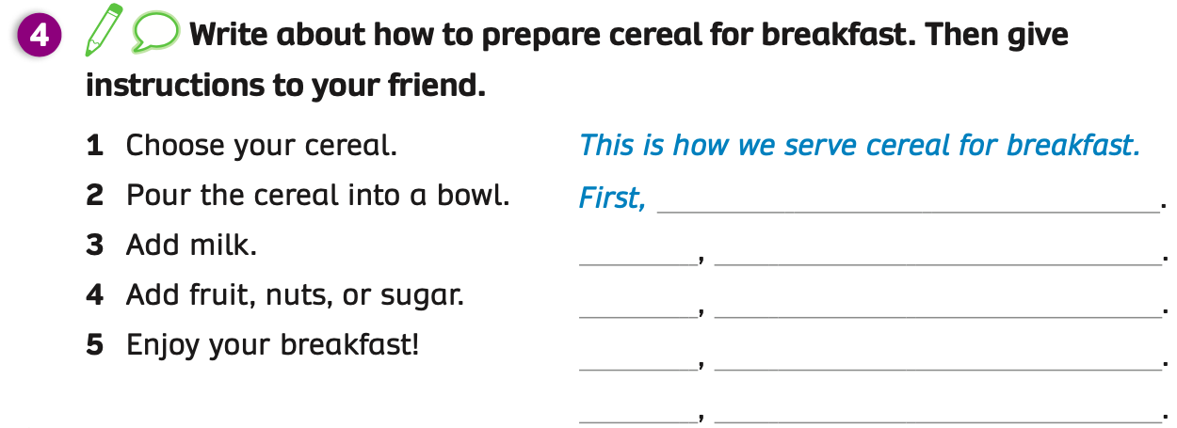
PRODUCTION
EXAMPLE
we choose our cereal
Second
we pour the cereal into a bowl
Next
we add milk to the cereal
Then
we add fruit, nuts and sugar
Finally
we enjoy our breakfast!
Ask students to open their books and complete the text.
After they finish the text, the teacher puts students into pairs. Students share the text with their partners.
Invite some students to present their texts in front of the class.
Then, the teacher clicks on “Example” and students look, read and check again.

Slide 20

HOMEWORK
Review vocabulary and grammar.
Do exercises in the Activity Book (page 21).
Check answers in the Teacher’s Book (page 48) or Active Teach.

Slide 21
UNIT 2 – Lesson 4
We’ve learned…
To correctly read and stress in two syllables words 2.
- PB p.26
- AB p.21

