Slide 1


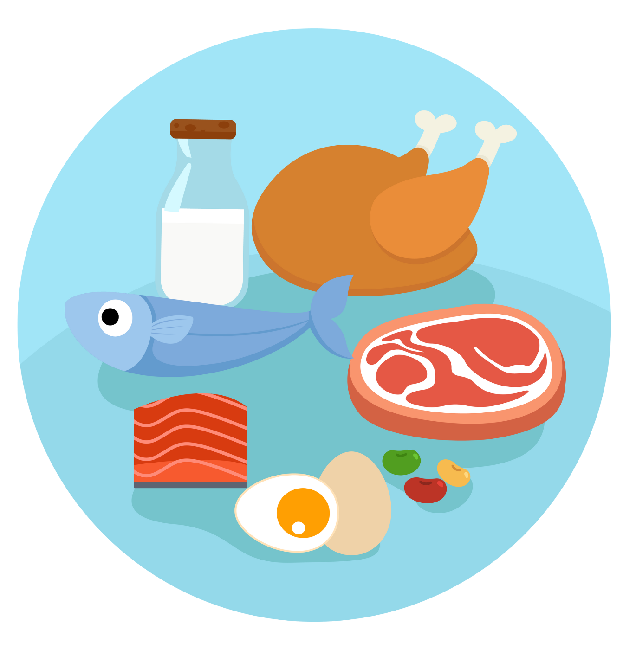
UNIT 2 – PICNIC TIME!
Lesson 5A – Vocabulary and Grammar 2

Slide 2
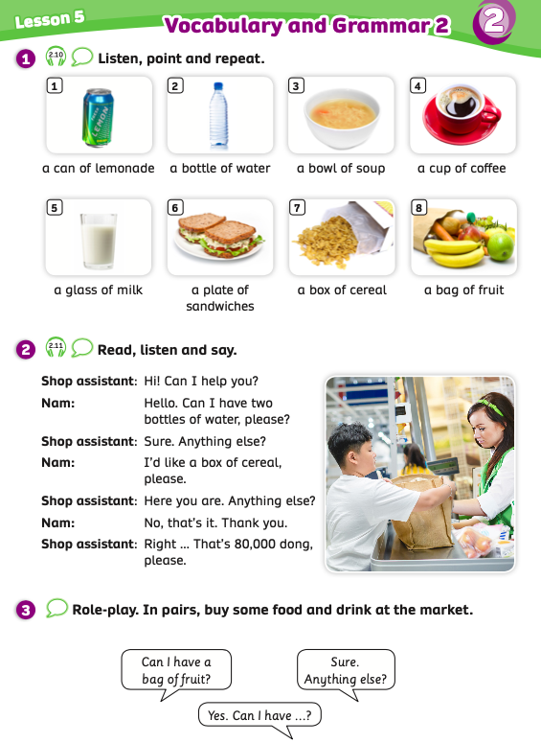
UNIT 2 – Lesson 5A
We’re learning…
To read and pronounce some expressions used to describe the qualities of food and drink.
- PB p.27
- AB p.22

Slide 3
WARM-UP ACTIVITY
Activity: THE FOOD ALPHABET
Divide the class into groups of 4. Each group takes out a sheet of paper.
The teacher writes the letters on the board from A to P.
Students look at the letters and write the word food that begins with that letter. Ex: A – apple, B – bread, C – crisps, …..
After finishing all the letters on the board, students raise their papers to check.
The groups with all the correct word receive 2 points.

Slide 4

WARM-UP ACTIVITY
A -
apple
F -
fish
L -
lemon
G -
grape
M -
milk
B -
bread
H -
hot dog
C -
cereal
N -
nuts
I -
ice cream
D -
donut
O -
orange
J -
jam
E -
egg
P -
pasta
K -
kiwi
If students have the other food words but they’re correct, the teacher also gives points.

Slide 5

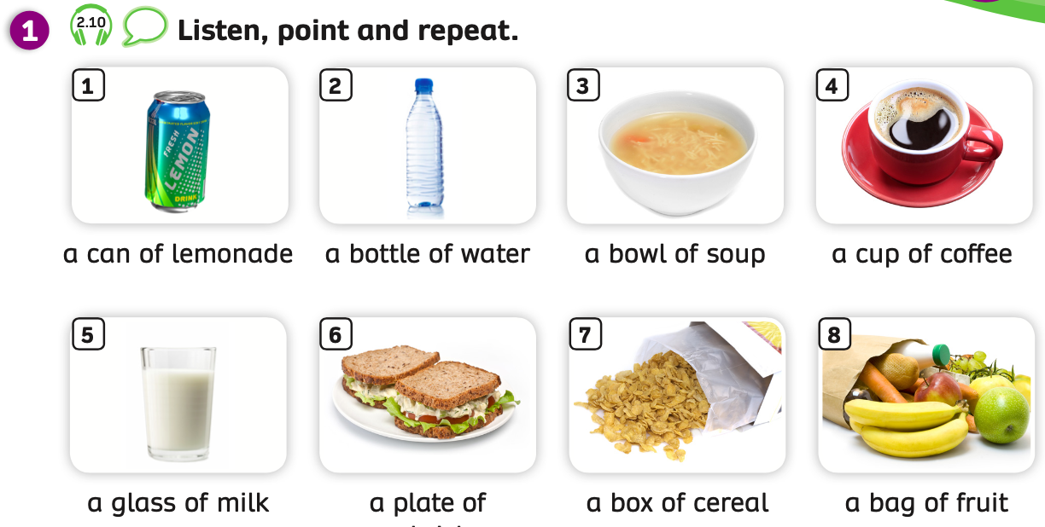
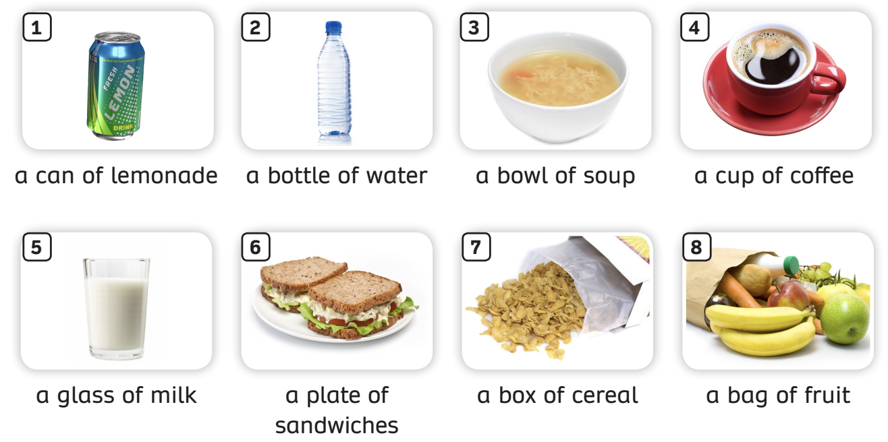
VOCABULARY
Listen and point.
Have students look at the pictures and explain that in this lesson they will learn some expressions used to describe the quantities of food and drink.
Students listen and point to each picture.

Slide 6
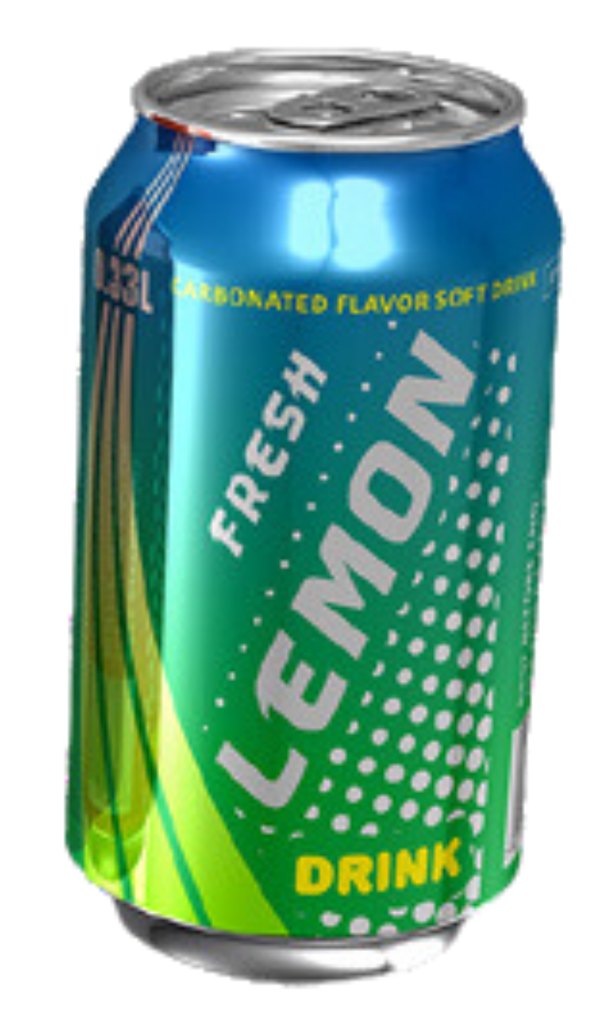

VOCABULARY
Let’s listen and repeat!
c
a can of lemonade
Have students look at the pictures, listen and repeat the word.

Slide 7
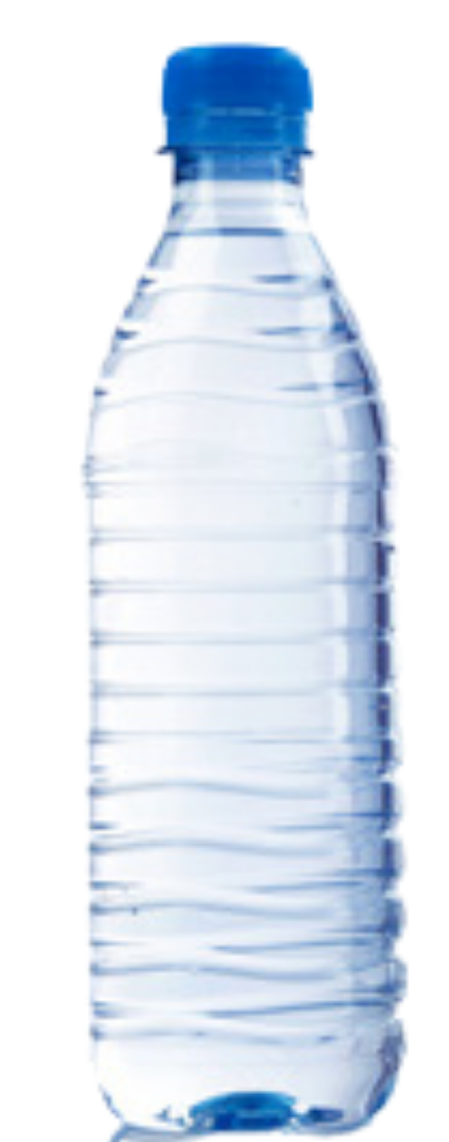
VOCABULARY
c
Let’s listen and repeat!
a bottle of water
Have students look at the pictures, listen and repeat the word.

Slide 8
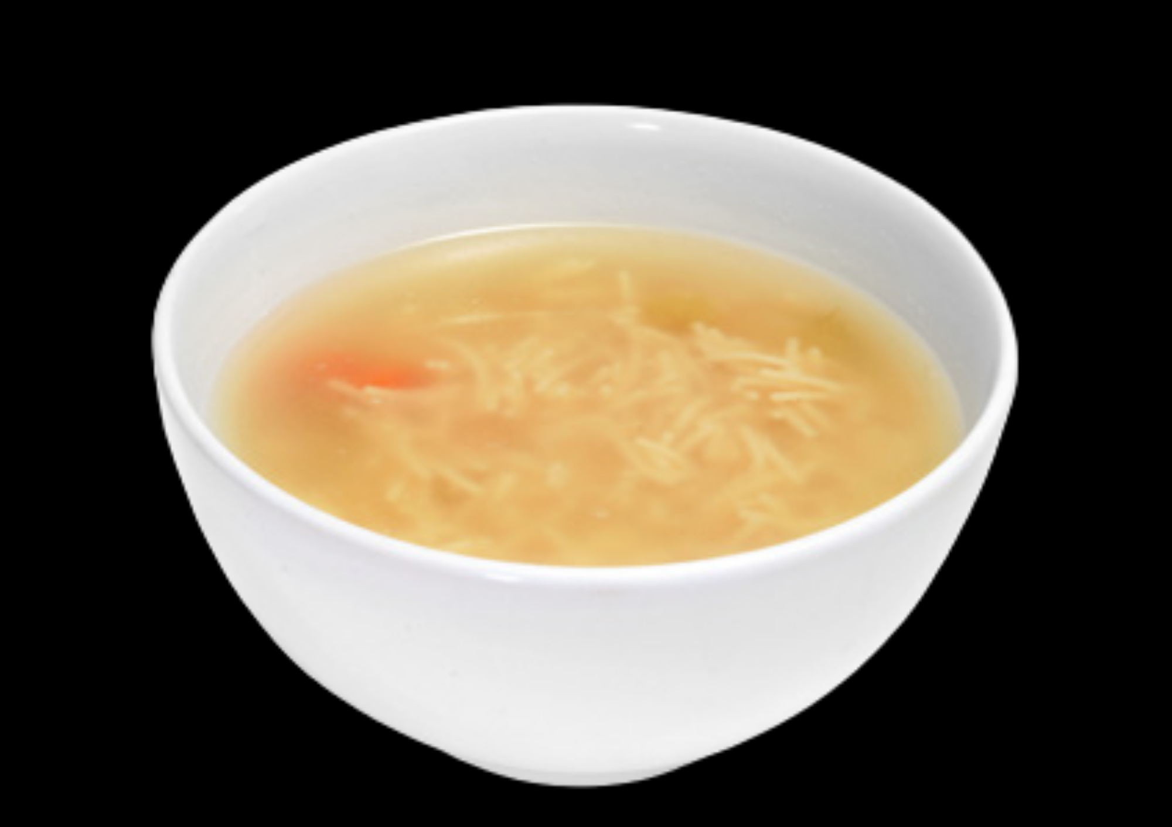
VOCABULARY
c
Let’s listen and repeat!
a bowl of soup
Have students look at the pictures, listen and repeat the word.

Slide 9

VOCABULARY
c
Let’s listen and repeat!
a cup of coffee
Have students look at the pictures, listen and repeat the word.

Slide 10
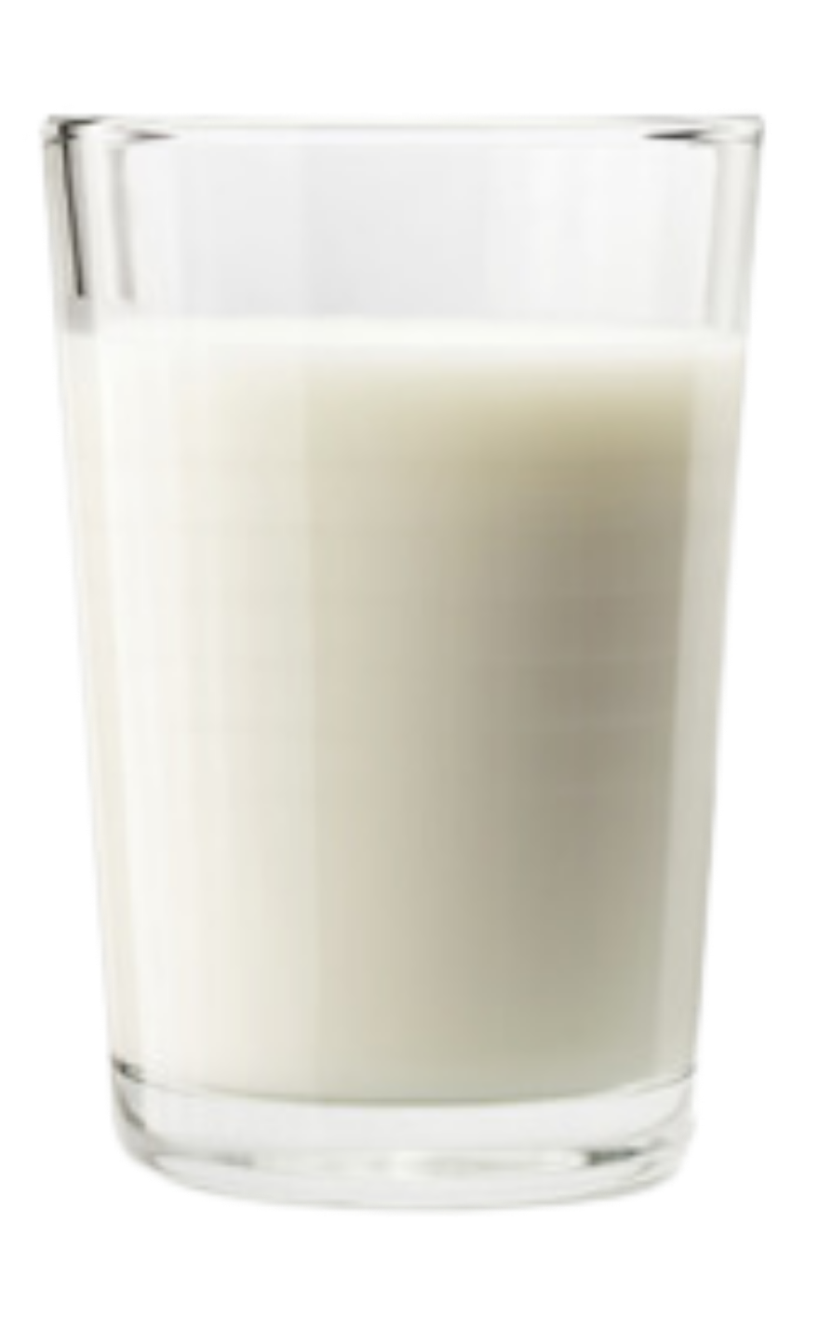
VOCABULARY
c
Let’s listen and repeat!
a glass of milk
Have students look at the pictures, listen and repeat the word.

Slide 11
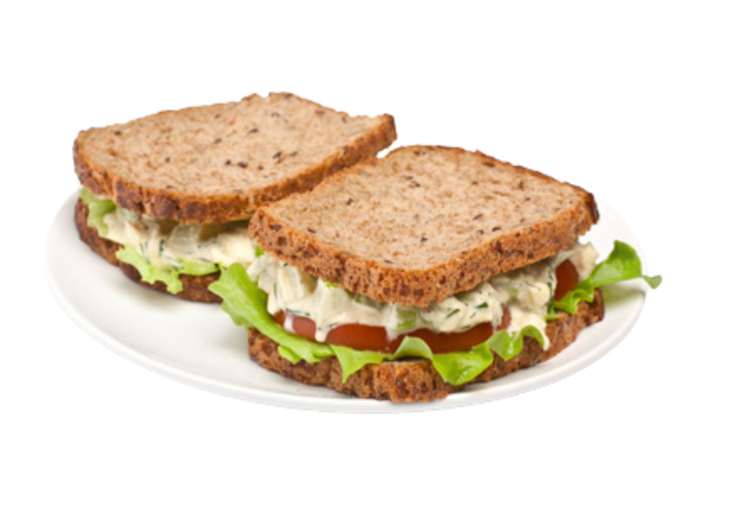
VOCABULARY
c
Let’s listen and repeat!
a plate of sandwiches
Have students look at the pictures, listen and repeat the word.

Slide 12
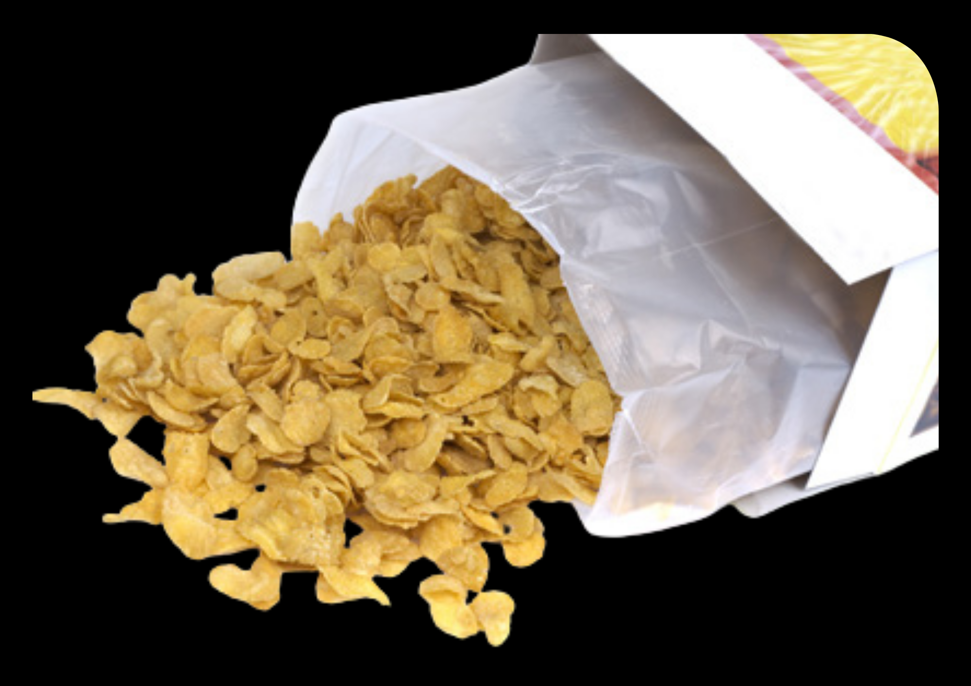
VOCABULARY
c
Let’s listen and repeat!
a box of cereal
Have students look at the pictures, listen and repeat the word.

Slide 13
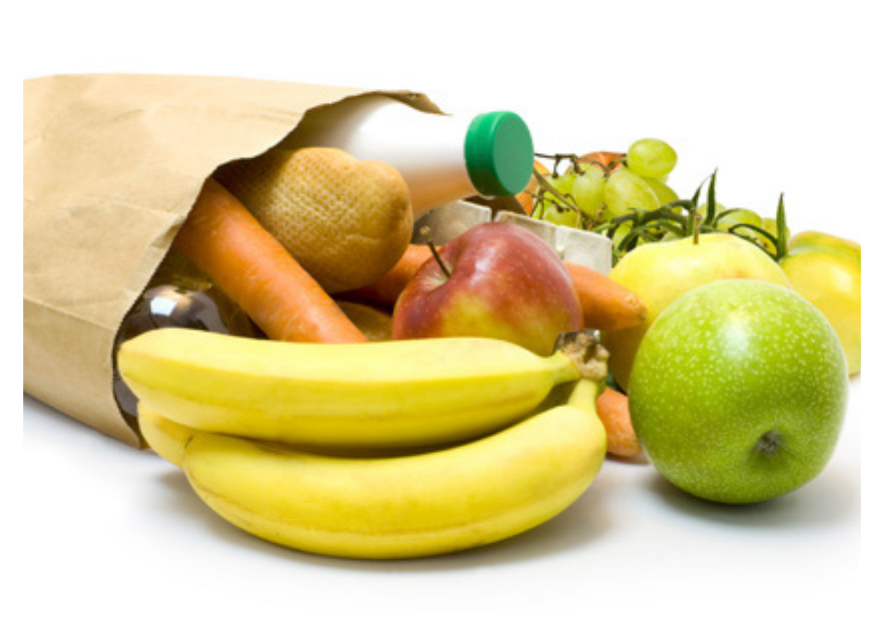
VOCABULARY
c
Let’s listen and repeat!
a bag of fruit
Have students look at the pictures, listen and repeat the word.

Slide 14
VOCABULARY
Have students look at the pictures, listen and repeat the word.

Slide 15
VOCABULARY - REVIEW
Show each picture, students look at and say the word.

Slide 16
VOCABULARY - Practice
Activity: PICK UP MUSHROOM
Divide the class into 2 teams: Team Bear and Team Fox. Each team takes turns choosing one number of mushrooms.
Each student takes out a mini-board.
Show a word with the blank and 3 option answers. Students in the team look and write the correct answer on the board. Ex: “coffee”
Then, all students in the team raise the board to check.
The team with all the correct answers receives 1 point.
Note: Click on “Bear and Fox” to show the points.

Slide 17








2
3
1
4
6
7
8
5
9
10
10
1
2
6
4
9
7
5
3
8
5
4
2
7
8
9
10
3
1
6

Slide 18







milk
a glass of ………
BACK
milk
fruit
soup

Slide 19
fruit
a bag of …………
BACK
coffee
fruit
water

Slide 20
soup
a bowl of ………...
BACK
soup
lemonade
water

Slide 21
coffee
a cup of ………..
BACK
cereal
soup
coffee

Slide 22
sandwiches
a plate of ………..........
BACK
lemonade
sandwiches
soup

Slide 23
water
a bottle of ………
BACK
cereal
water
fruit

Slide 24
lemonade
a can of …………
BACK
sandwiches
soup
lemonade

Slide 25
cereal
a box of …………
BACK
milk
water
cereal

Slide 26
GRAMMAR
I have a bottle of water.
mix
mex
mxi
Students listen and repeat.

Slide 27
GRAMMAR
I have 3 bottles of water.
mix
mex
mxi
Students listen and repeat.

Slide 28

GRAMMAR
I’d like 2 plates of sandwiches.
mix
mex
mxi
Students listen and repeat.

Slide 29

GRAMMAR
I’d like 3 boxes of cereal.
mix
mex
mxi
Students listen and repeat.

Slide 30
GRAMMAR
SINGULAR
PLURAL
- a can of lemonade
cans of lemonade
- a bottle of water
bottles of water
- a bowl of soup
bowls of soup
- a cup of coffee
cups of coffee
- a glass of milk
glasses of milk
mix
- a plate of sandwiches
plates of sandwiches
mex
mxi
- a box of cereal
boxes of cereal
- a bag of fruit
bags of fruit
Students look at these words and say aloud.

Slide 31
PRODUCE
Activity: YOUR FOOD AND DRINK
Ask students to take out a sheet of paper and draw one picture of food and drink using the quantities of food and drink that they’ve learnt.
After finishing, the teacher invites some students to present in front of the class.
Give points if students say the correct words and have a beautiful picture.

Slide 32


PRODUCE
EXAMPLE
This is my picture.
I have two glasses of milk.

Slide 33

HOMEWORK
Review vocabulary and grammar.
Do exercises in the Activity Book (page 22).
Check answers in the Teacher’s Book (page 50) or Active Teach.

Slide 34
UNIT 2 – Lesson 5A
We’ve learned…
To read and pronounce some expressions used to describe the qualities of food and drink.
- PB p.27
- AB p.22

