Slide 1
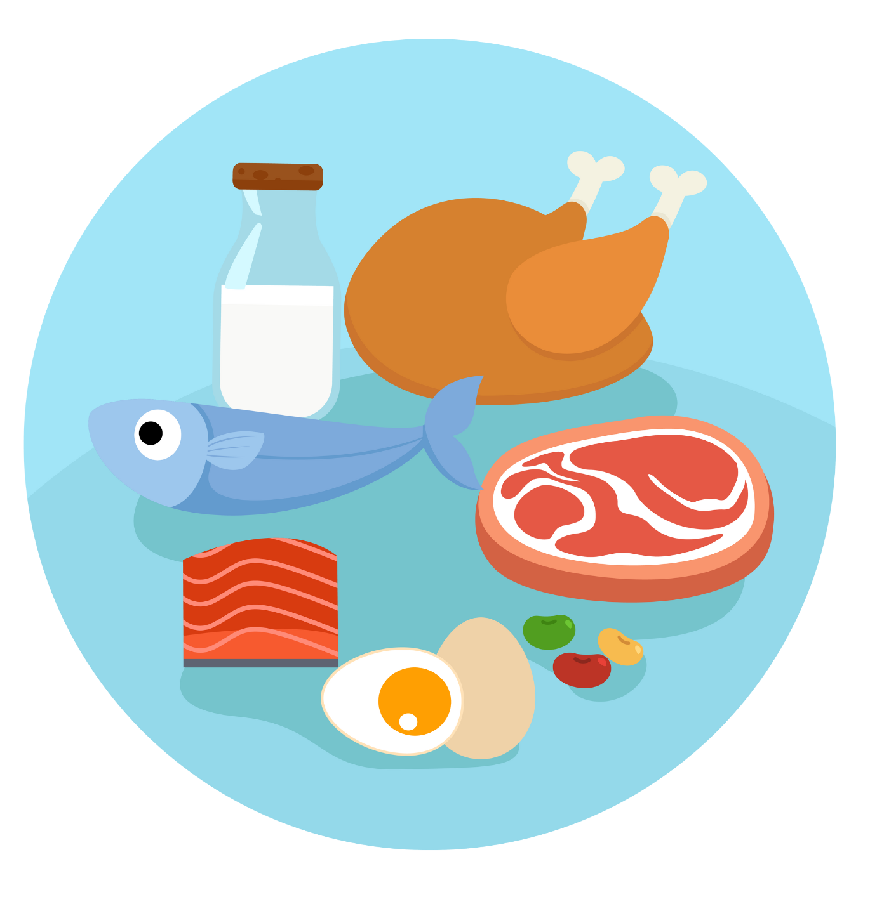
UNIT 2 – PICNIC TIME!
Lesson 5B – Vocabulary and Grammar 2

Slide 2
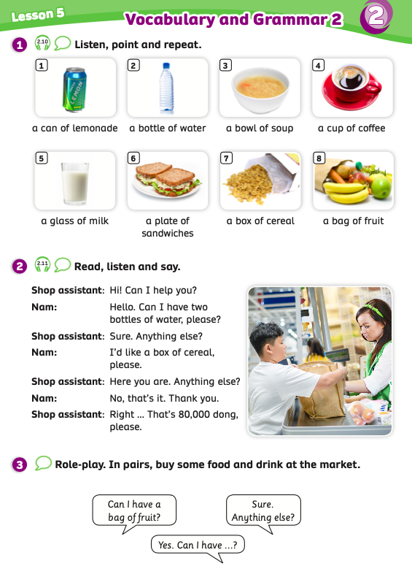
UNIT 2 – Lesson 5B
We’re learning…
To use the structures:
Can I have two bottles of water?
Sure. Anything else?
I’d like a box of cereal, please.
- PB p.27
- AB p.22

Slide 3
WARM-UP ACTIVITY
Activity: WHAT PICTURES ARE MISSING?
Divide the class into groups of 4. Invite each member of each team to stand up and join in the activity.
The teacher shows 8 pictures on the slide. Students look carefully and then, they close their eyes. 2 pictures will disappear.
Students open their eyes and raise their hands to get a chance to say the names of 2 pictures.
The fastest student with the correct answer receives 2 points.

Slide 4
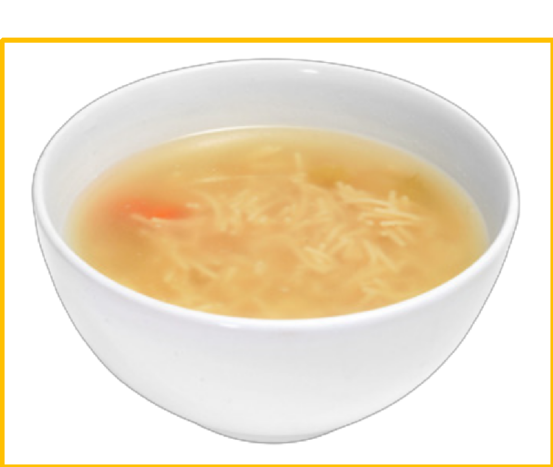
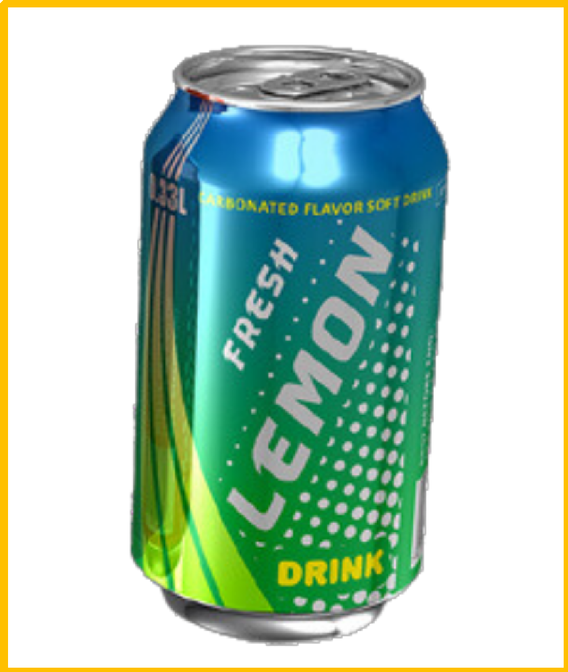
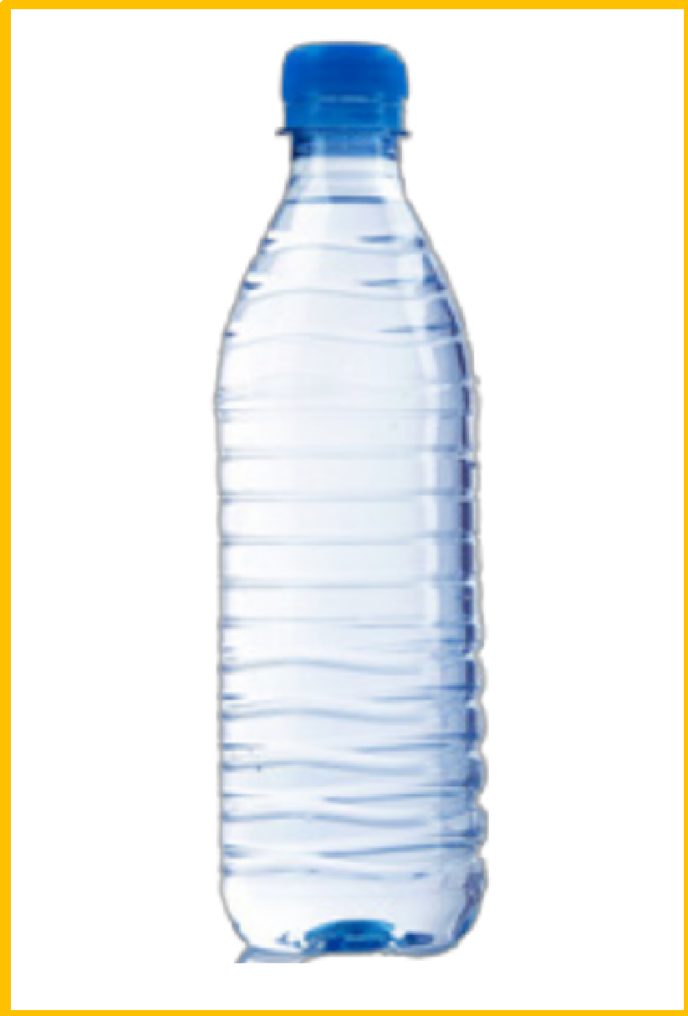
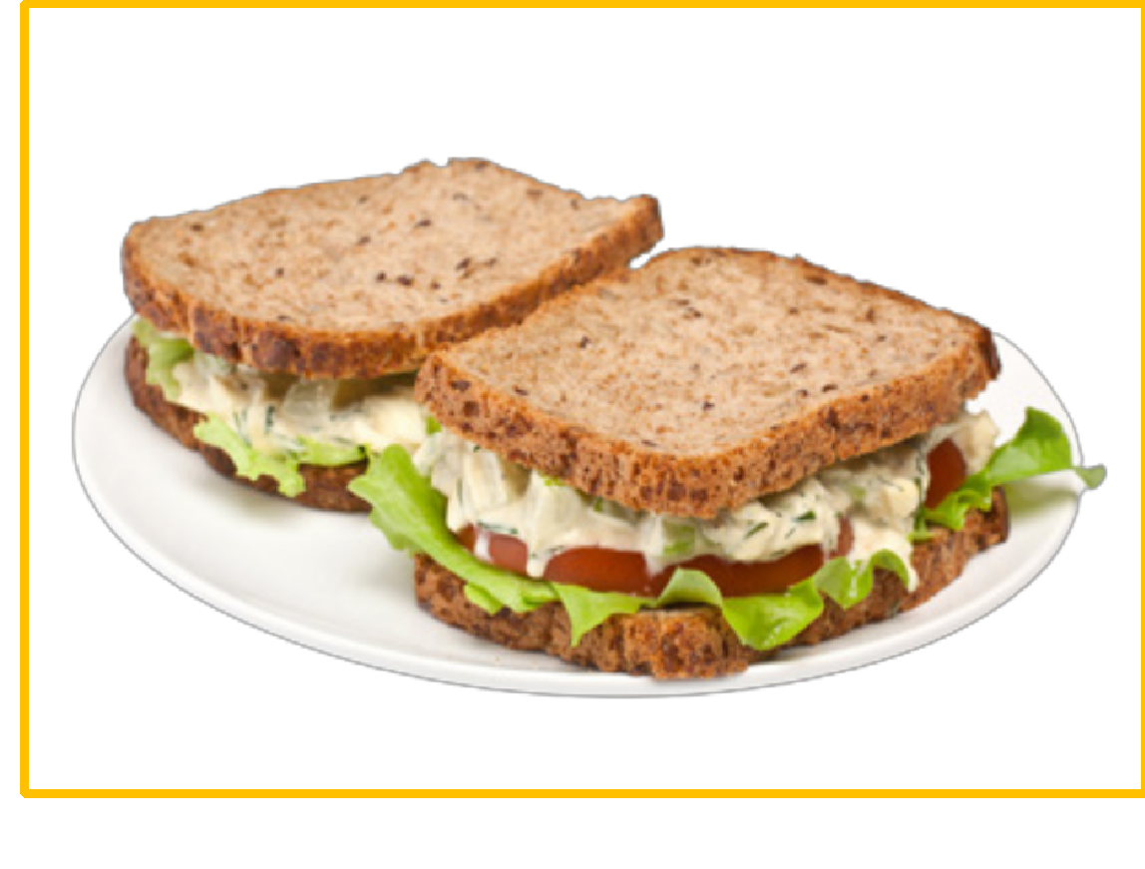
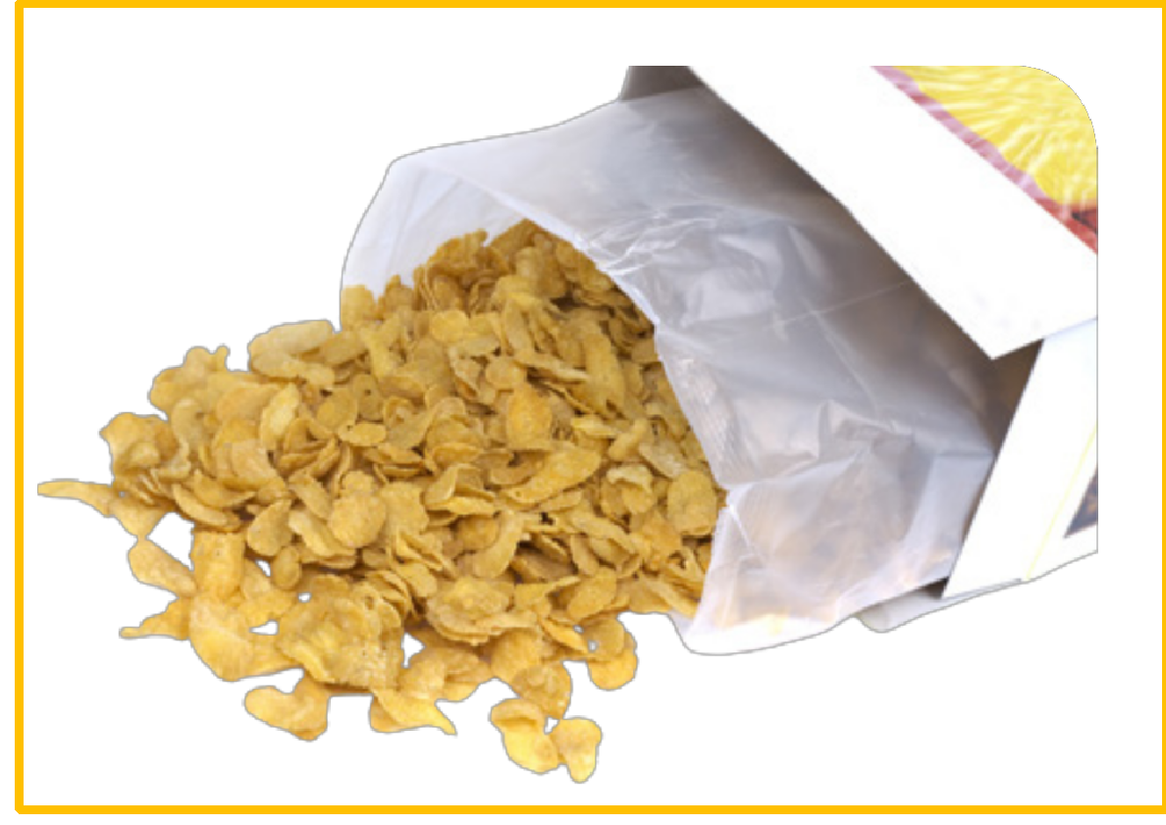
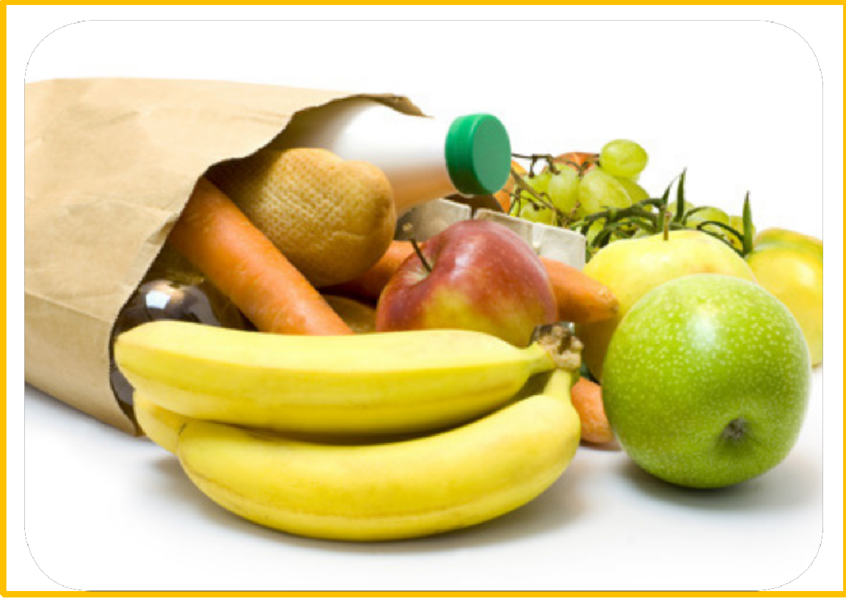
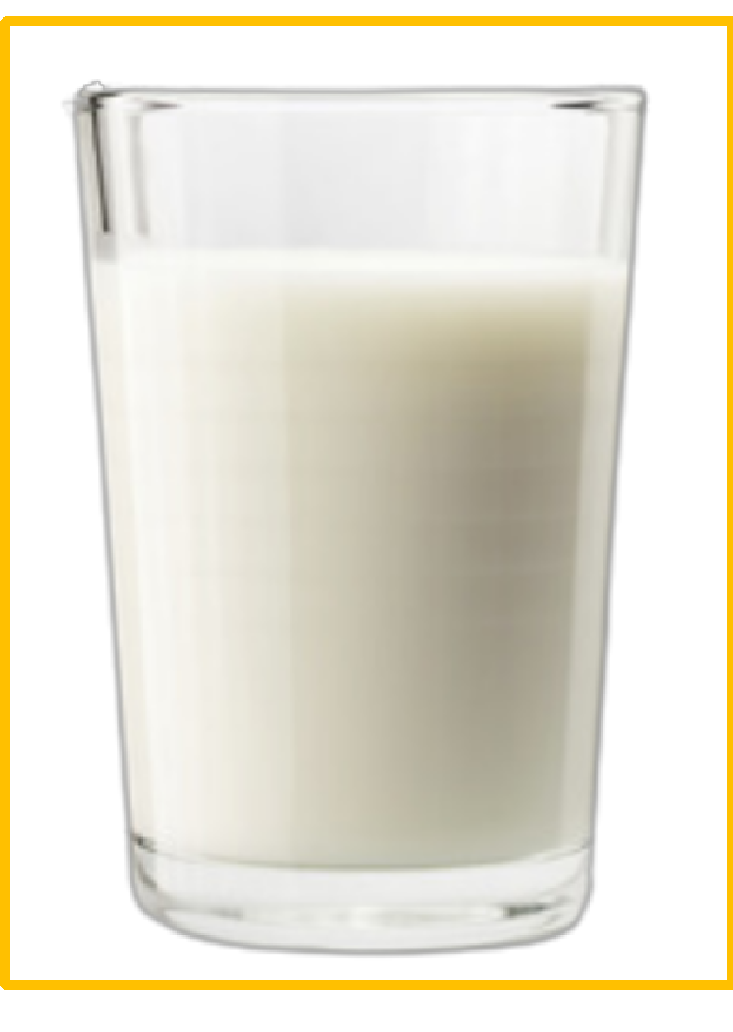
WARM-UP ACTIVITY

Slide 5
WARM-UP ACTIVITY

Slide 6
WARM-UP ACTIVITY

Slide 7
WARM-UP ACTIVITY

Slide 8
WARM-UP ACTIVITY

Slide 9
VOCABULARY - REVIEW
1. a can of …………..
5. a box of …………
lemonade
cereal
2. a bowl of ………...
6. a plate of ………………..
soup
sandwiches
3. a cup of ……………
7. a bag of …………
coffee
fruit
4. a bottle of …………
8. a glass of …………
water
milk
ANSWER
Put students into pairs. Each pair takes out a sheet of paper.
Students look at 8 phrases with blanks on the slide and write the correct word for each blank.
After finishing, students raise their papers to check. The 5 first pairs with the correct answer receive 2 points.

Slide 10
GRAMMAR
SINGULAR
PLURAL
- a can of lemonade
cans of lemonade
- a bottle of water
bottles of water
- a bowl of soup
bowls of soup
- a cup of coffee
cups of coffee
- a glass of milk
glasses of milk
mix
- a plate of sandwiches
plates of sandwiches
mex
mxi
- a box of cereal
boxes of cereal
- a bag of fruit
bags of fruit
Show one by one word, students look at that and say aloud.

Slide 11
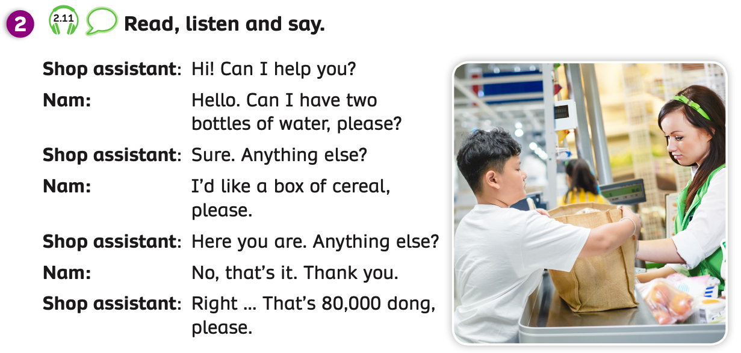
GRAMMAR
Have students look at the conversation. Give students a few minutes to read a dialogue.
Play the audio for them to listen to and repeat.

Slide 12
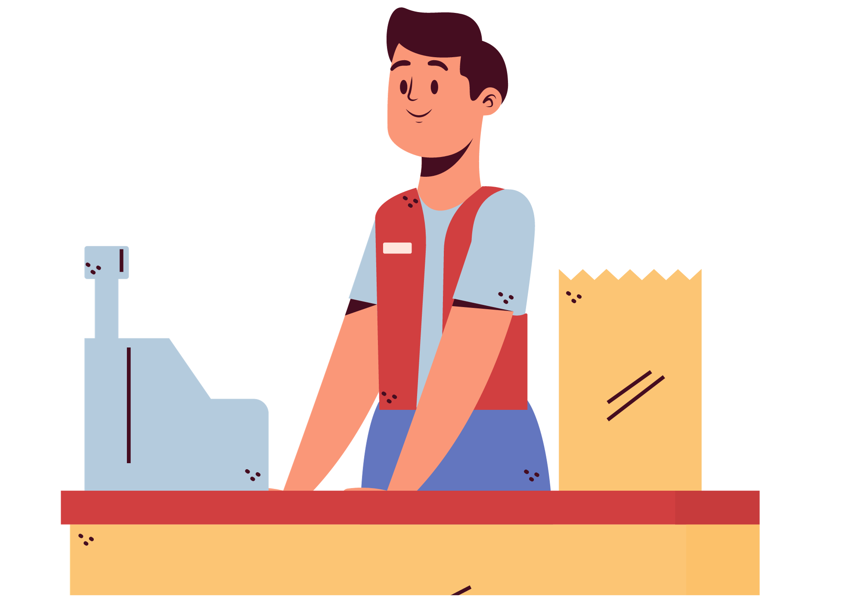
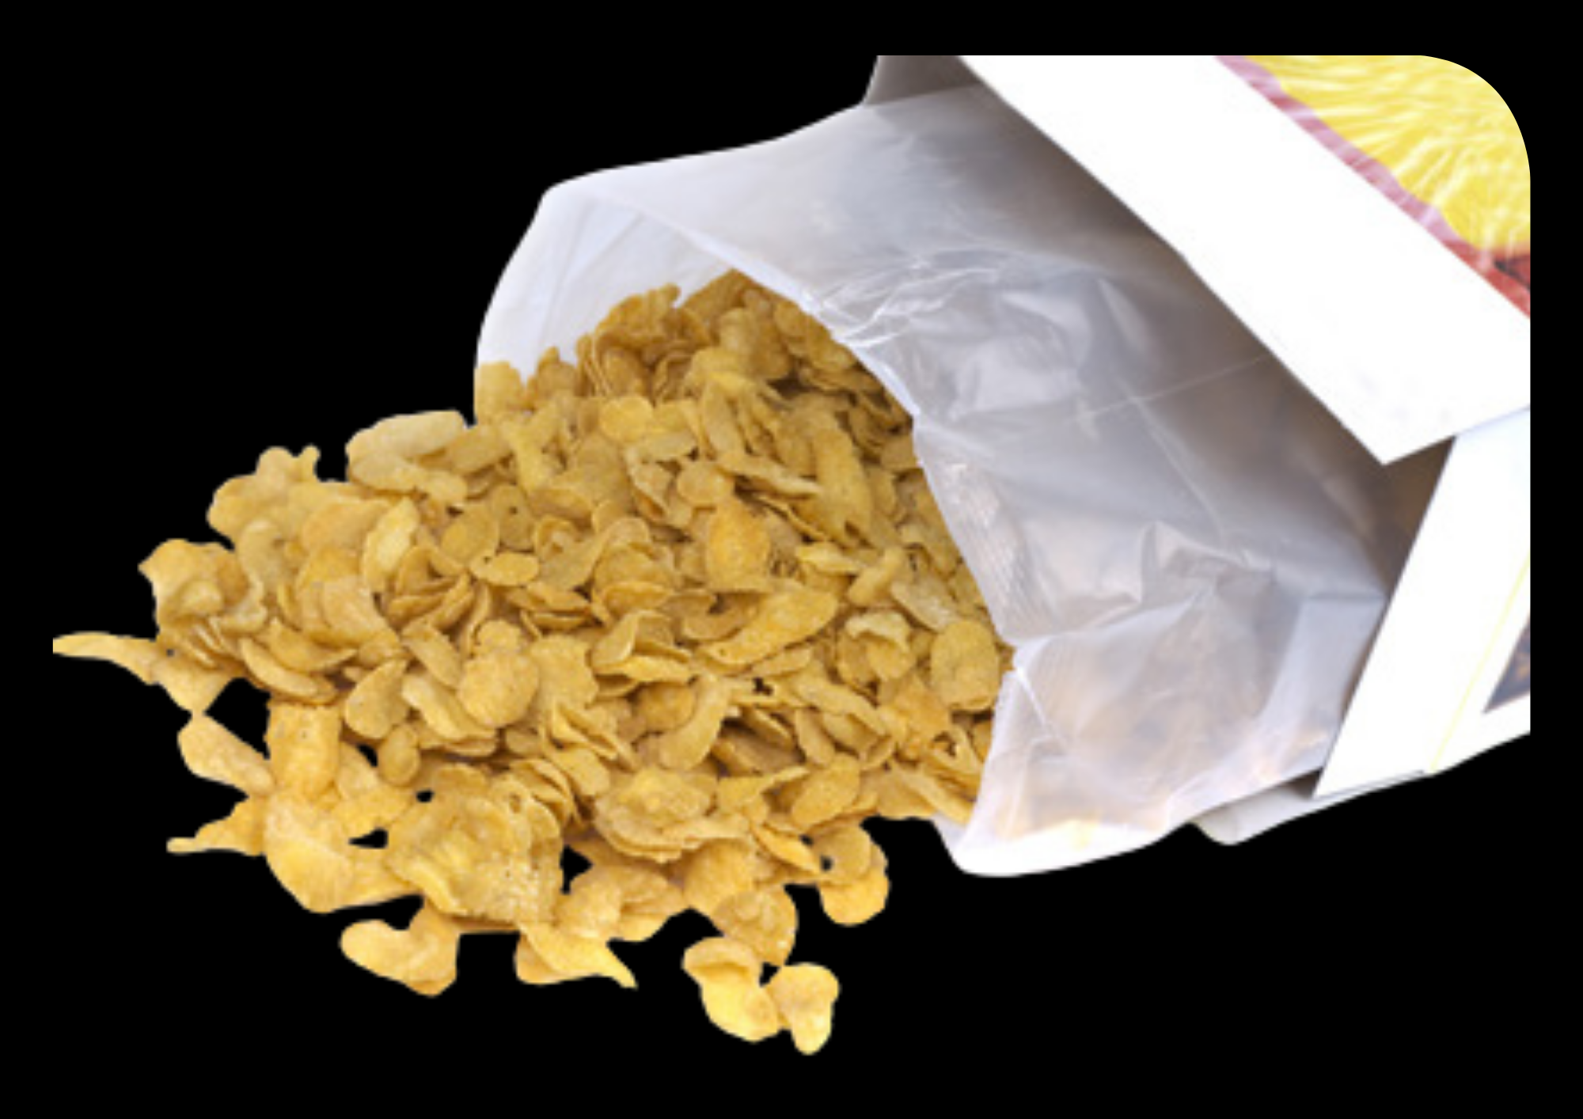
GRAMMAR
Here you are. Anything else?
Right……. That’s 80.000 dong, please.
Sure. Anything else?
Hi! Can I help you?
Hello. Can I have two bottles of water, please?
I’d like a box of cereal, please.
No, that’s it. Thank you.
Divide the class into 2 teams. One team plays the role of shop assistant and one team plays the role of Nam.
Then they switch roles.

Slide 13
GRAMMAR
Divide students into pairs and have them practice.
Then, they switch roles and practice again.

Slide 14
GRAMMAR
STRUCTURE
- Can I help you?
- Anything else?

Slide 15
GRAMMAR
STRUCTURE
- Can I have …….., please?
- I’d like …………..., please.

Slide 16
GRAMMAR - PRACTICE
Activity: GO SHOPPING!
Divide the class into groups of 4. Each student draws 2 pictures of food and drink.
One member takes on the role of a shop assistant and three other members take on the role of customers. They use the pictures for the real food and drink.
The teacher goes around and checks if necessary.
Call out each group to present in front of the class.
Give points if they have a good conversation.

Slide 17
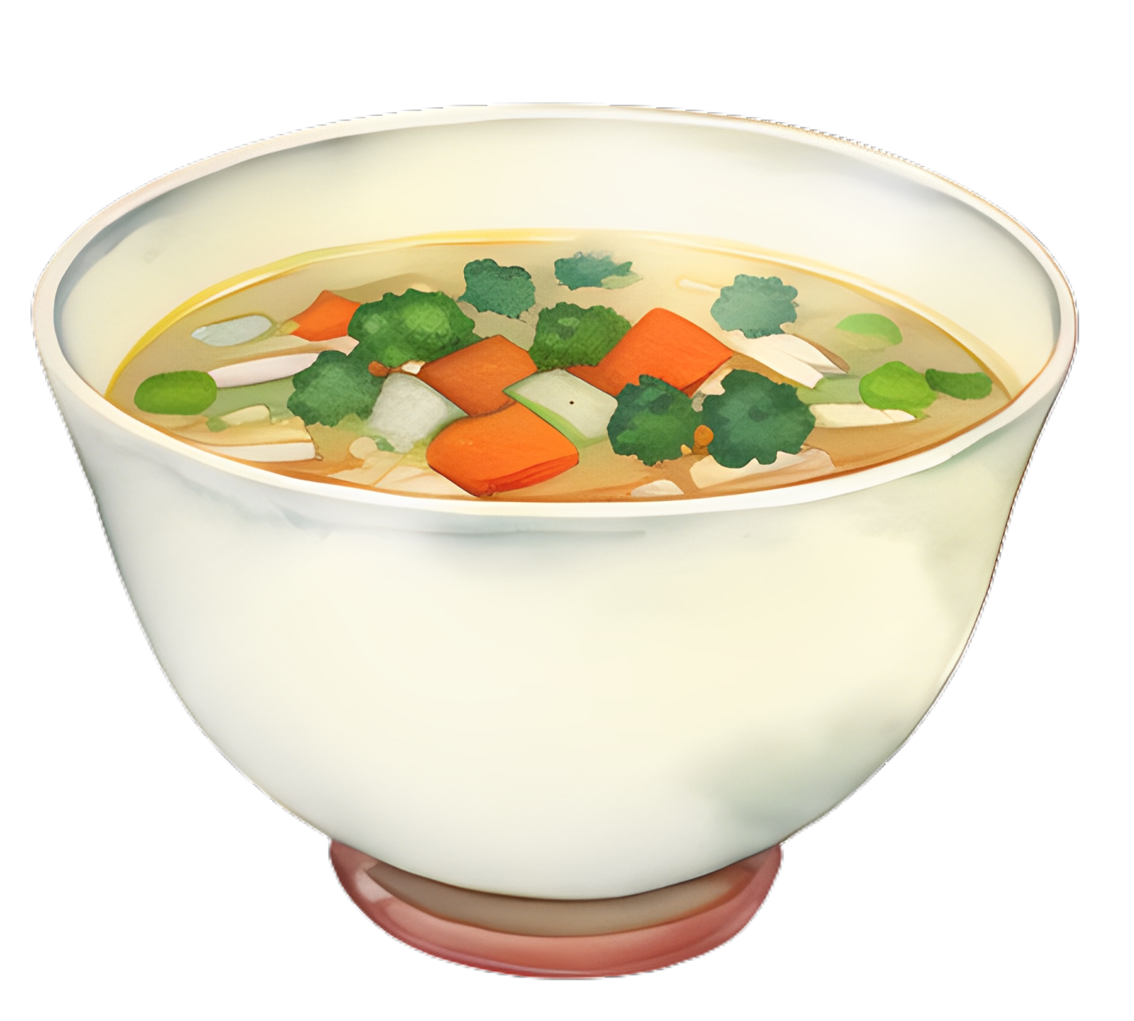
GRAMMAR - PRACTICE
Hi. Can I a cup of coffee, please?
Right…That’s 20,000 dong.
buyer
Sure. Here you are.
Okay. Anything else?
Hello! Can I help you?
shop assistant
I’d like a can of lemonade.
buyer
buyer
Can I have a bottle of water, please?

Slide 18
GRAMMAR - PRACTICE
buyer
shop assistant
buyer
buyer

Slide 19
PRODUCTION
Draw students’ attention to the speech bubbles and have them read each speech bubble silently.
Put students into pairs. One student takes on the role of a customer and one student takes on the role of a shop assistant. Then they switch roles.
Call out some pairs to present in front of the class and give points.

Slide 20
PRODUCE
Can I help you?
Can I have a bag of fruit, please?
shop assistant
buyer

Slide 21
HOMEWORK
Review vocabulary and grammar.
Do exercises in the Activity book (page 22).
Check answers in the Teacher’s book (page 50) or Active Teach.

Slide 22
UNIT 2 – Lesson 5B
We’ve learned…
To use the structures:
Can I have two bottles of water?
Sure. Anything else?
I’d like a box of cereal, please.
- PB p.27
- AB p.22

