Slide 1
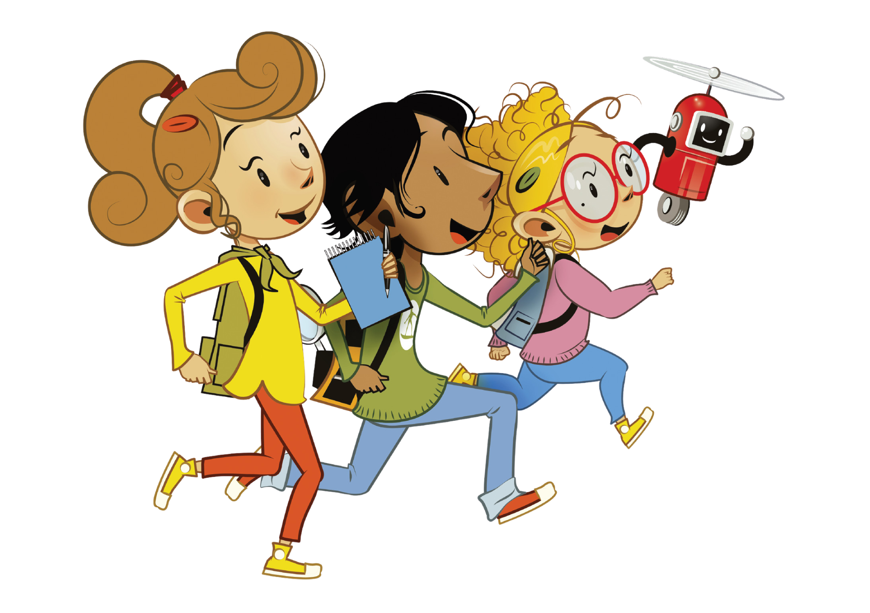
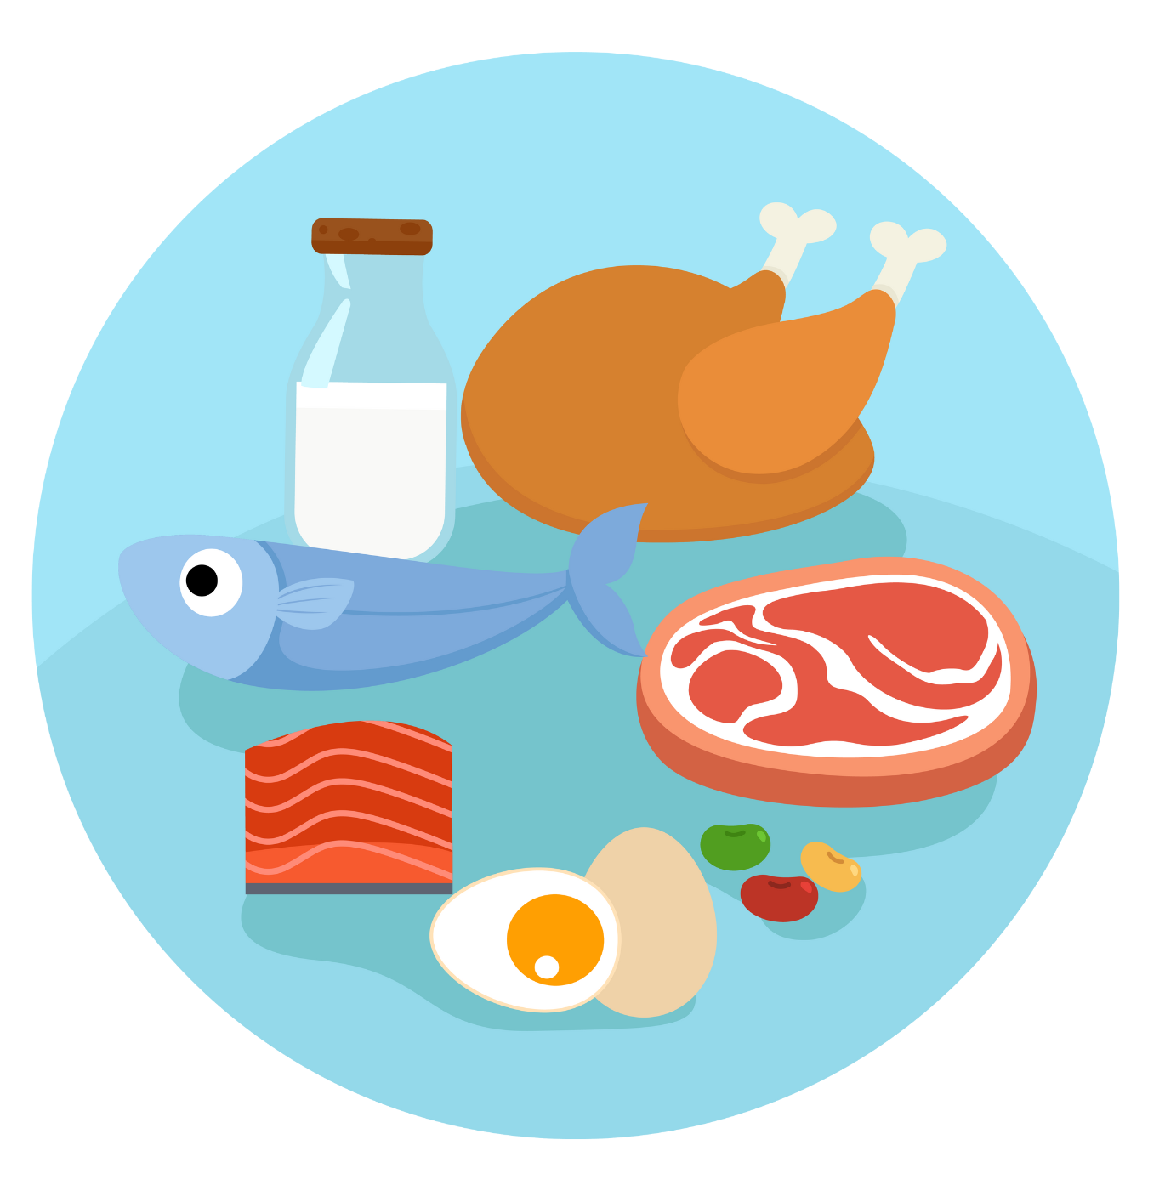
UNIT 2 – PICNIC TIME!
Lesson 8 – Project

Slide 2
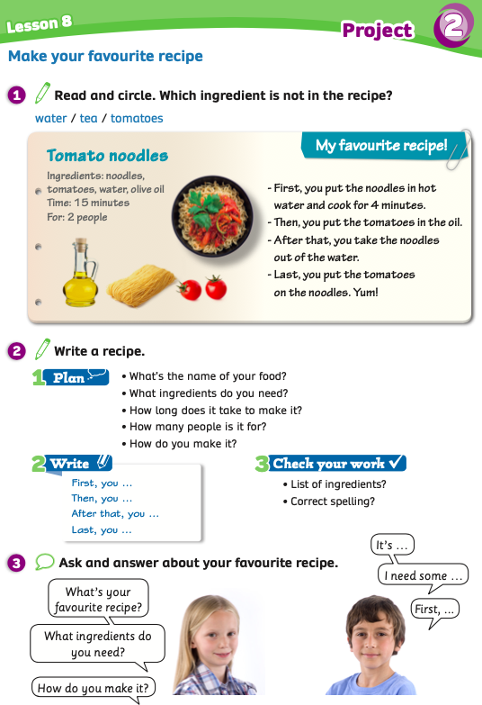
UNIT 2 – Lesson 8
We’re learning…
- to write a recipe
- PB p.31
- AB p.25

Slide 3
WARM-UP ACTIVITY
Activity: ANSWER THE QUESTION
Put students into groups of 4. Each group takes out a pen or a ruler and puts it in the middle of each group.
Show the text and give 2 minutes for students to read the information.
Ask the questions, students listen, find the information in the picture and raise their pens or ruler to get a chance to say the answer.
The fastest group with the correct information receives 2 points.

Slide 4
WARM-UP ACTIVITY

Slide 5
WARM-UP ACTIVITY
What is the name of the recipe?
It’s tomato noodles.
ANSWER

Slide 6
WARM-UP ACTIVITY
There are 4 ingredients: noodles, tomatoes, water, olive oil.
How many ingredients are in this recipe?
ANSWER

Slide 7
WARM-UP ACTIVITY
It’s for 2 people.
How many people is it for?
ANSWER

Slide 8
WARM-UP ACTIVITY
How long does it take to make it?
It takes 15 minutes.
ANSWER

Slide 9
WARM-UP ACTIVITY
How many steps of making tomato noodles?
There are 4 steps.
ANSWER

Slide 10
PUPILS’ BOOK p.31
ANSWER
Have students open their books and read the text again. Students read and choose which ingredient is not in the recipe. Then, they circle the word.
Show the answer to check.

Slide 11
PUPILS’ BOOK p.31
Activity: MAKE YOUR RECIPE
Put students into groups of 4. Each group takes out a sheet of paper. Students in the group discuss and write the answer for each question.
Each member takes turns writing the answer.
Show the example on the next slide.

Slide 12
PUPILS’ BOOK p.31
Activity: MAKE YOUR RECIPE
1. Name of food:
Chocolate cupcakes
EXAMPLE
2. Ingredients:
Chocolate, flour, sugar, eggs, butter and milk.
3. Time:
It takes 20 minutes.

Slide 13
PUPILS’ BOOK p.31
Activity: MAKE YOUR RECIPE
4. It makes for 4 people.
5. Steps:
- Mix sugar and butter.
EXAMPLE
- Add eggs and milk.
- Add flour and chocolate and mix them.
- Fill them in the cups and bake them in the oven
- Decorate and serve on the table.

Slide 14
PUPILS’ BOOK p.31
Activity: MAKE YOUR RECIPE
Next, students in the group discuss how to make their food.
They write the steps of making their food on the paper.
Show the example on the next slide.

Slide 15
PUPILS’ BOOK p.31
Activity: MAKE YOUR RECIPE
- First, you mix sugar and butter in the bowl.
- Second, you add eggs and milk.
- Then, add flour and chocolate to the bowl and mix them.
- After that, you fill them in the cups and bake them in the oven.
- Last, you decorate and serve them
on the table.

Slide 16
PUPILS’ BOOK p.31
Activity: MAKE YOUR RECIPE
After students finish their work, they raise their papers to check.
Call out each group to present their recipe in front of the class.
Give points.

Slide 17
PUPILS’ BOOK p.31
Have students open their books, use the prompts and write their recipes in their books.
After finishing, they say Bingo. The teacher reads and checks students’ work.

Slide 18
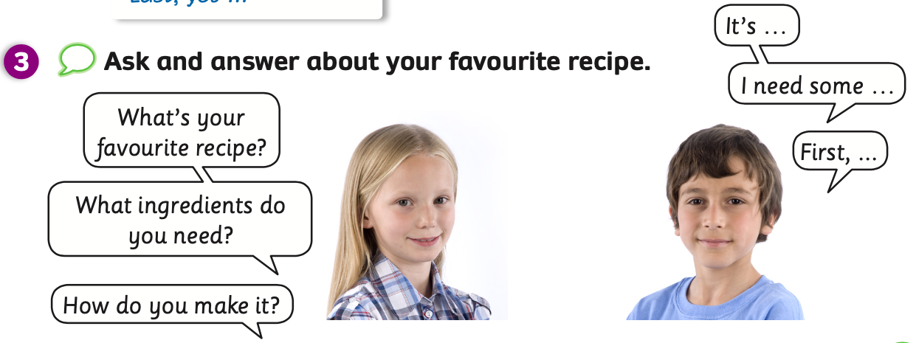
PUPILS’ BOOK p.31
Ask students to look at the bubbles questions. Students ask the questions and the teacher answers.
Students will get the ideas and know how to answer the questions.
Put students into pairs and have them practice the dialogue using the clues in their work
in Activity 2.
- Call out some pairs to present in front of the class.

Slide 19
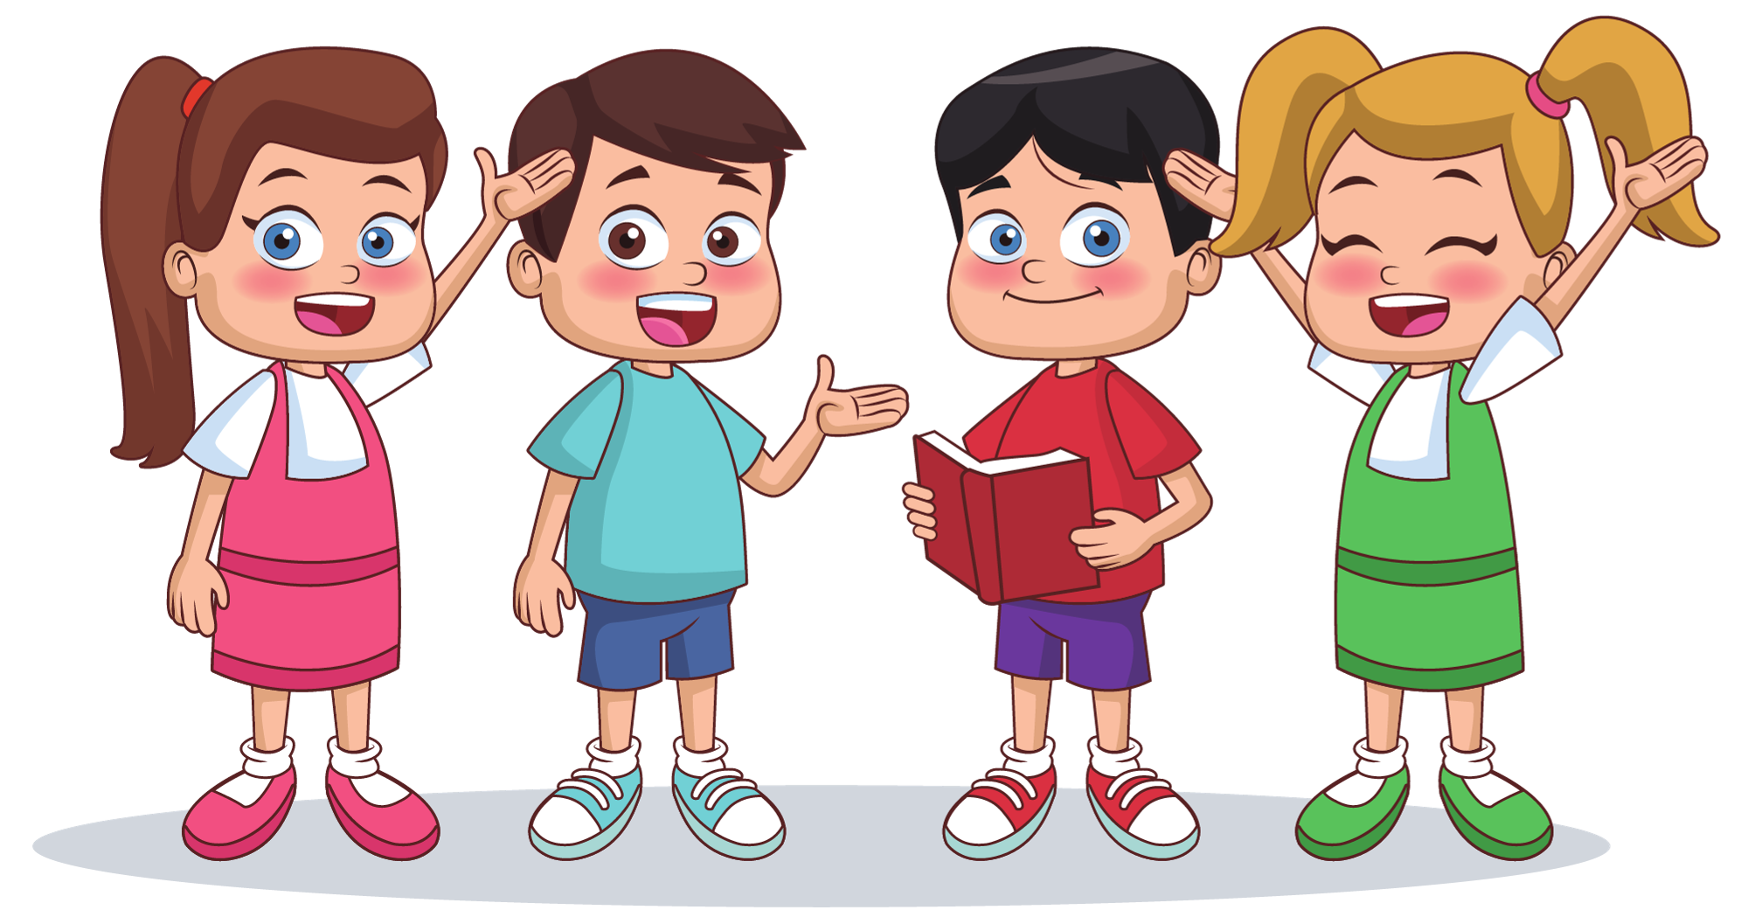
PUPILS’ BOOK p.31
It’s chocolate cupcakes.
What’s your favourite recipe?

Slide 20
PUPILS’ BOOK p.31
I need some chocolate, flour, sugar, eggs and milk.
What ingredients do you need?

Slide 21
PUPILS’ BOOK p.31
After that, I fill them in the cups and bake them in the oven.
Last, I decorate and serve them on the table.
Then, I add flour and chocolate
to the bowl and mix them.
First, I mix sugar and butter
in the bowl.
How do you make it?
Second, I add eggs and milk.

Slide 22
HOMEWORK
HOMEWORK
Review vocabulary and grammar.
Do exercises in the Activity Book (page 25).
Check answers in the Teacher’s Book (page 56) or Active Teach.

Slide 23
UNIT 2 – Lesson 8
We’ve learned…
- to write a recipe
- PB p.31
- AB p.25

