Slide 1



UNIT 3 – HOBBIES
Lesson 1 – Vocabulary

Slide 2

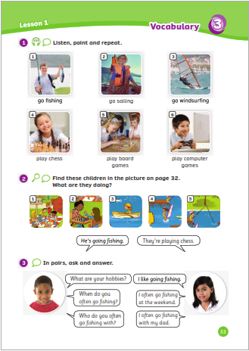
UNIT 3 – Lesson 1
We’re learning…
- To read and pronounce words related to hobbies.
- To use struture:
He’s going fishing.
- PB p.32,33
- AB p.26

Slide 3
WARM-UP ACTIVITY
Activity: BRAINSTORMING
Divide the class into groups of 4. Each group takes out a sheet of paper.
Show the slide with 6 pictures and ask students to look at and write 6 food/drink words they can see on the paper. Ex: “cereal, coffee, salad, sandwiches, noodles,…..”
They have 2 minutes to write and then each group says their words aloud.
The group with the most correct words receives 2 points.

Slide 4
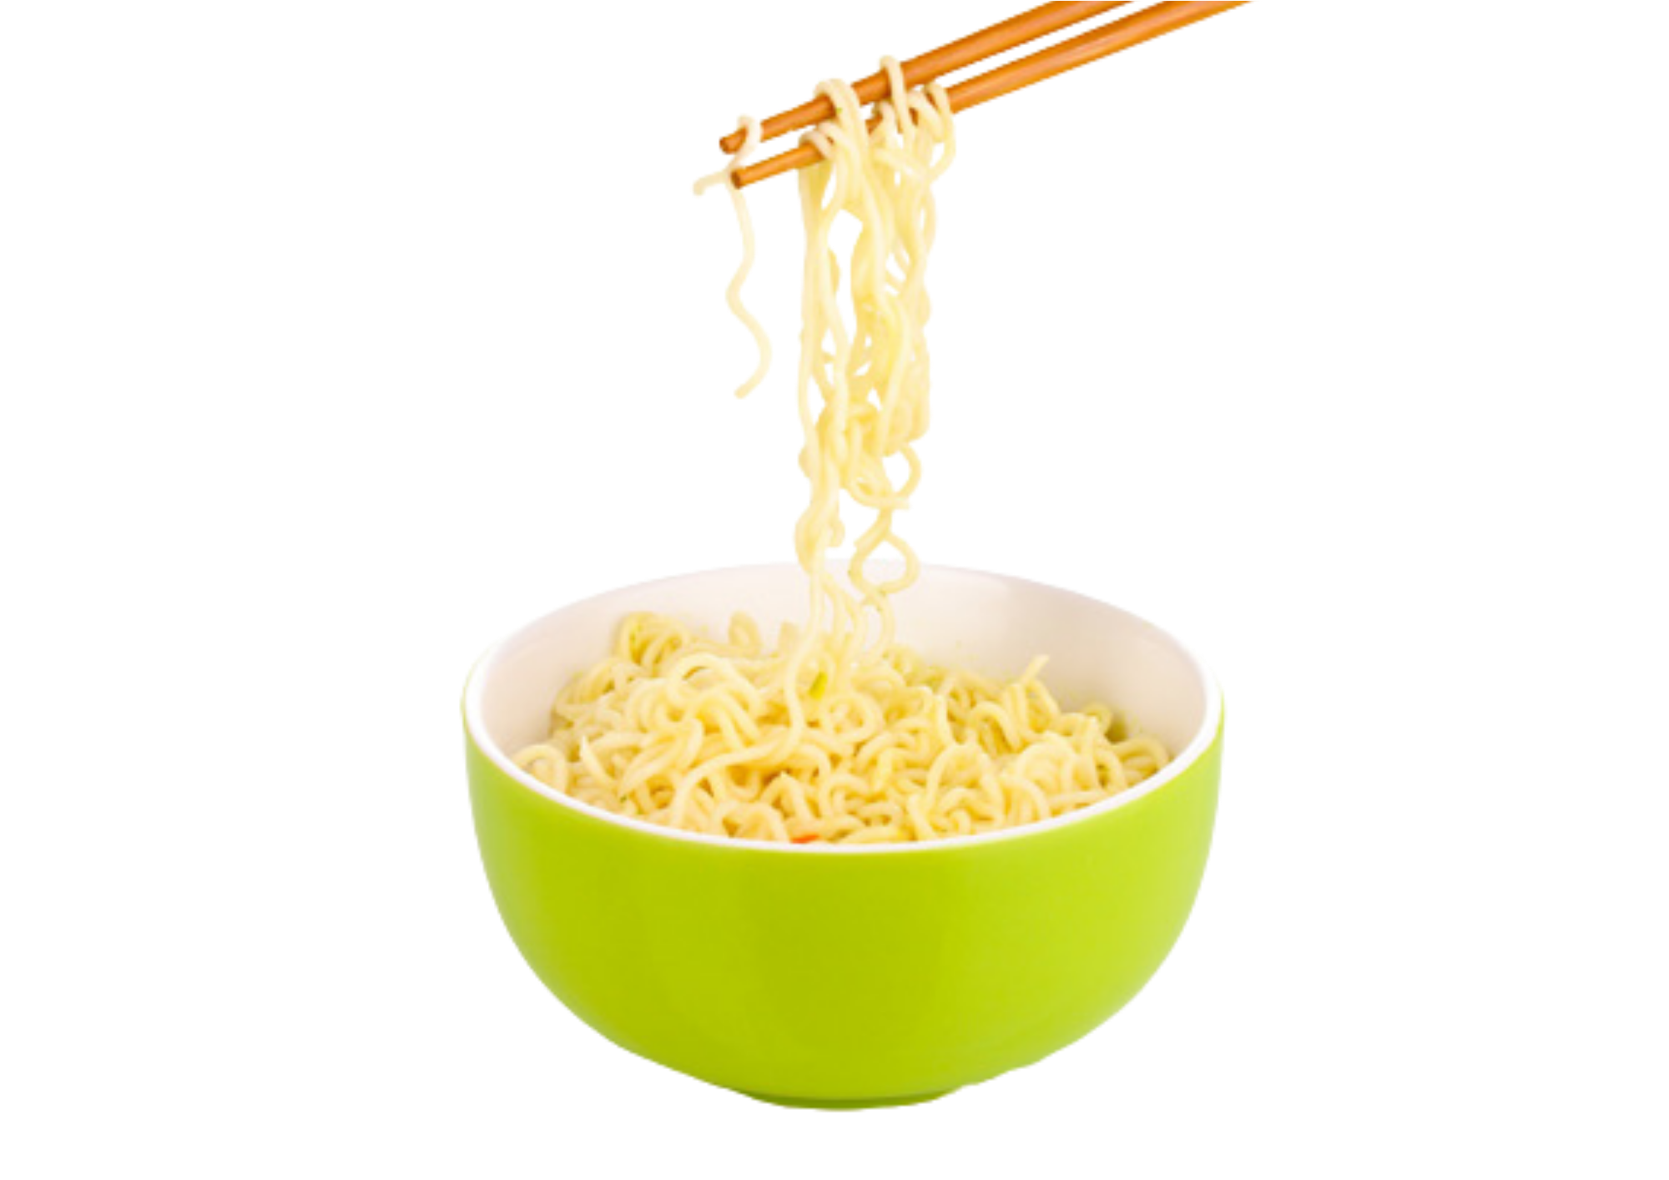
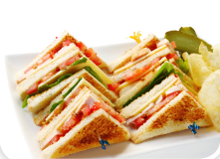
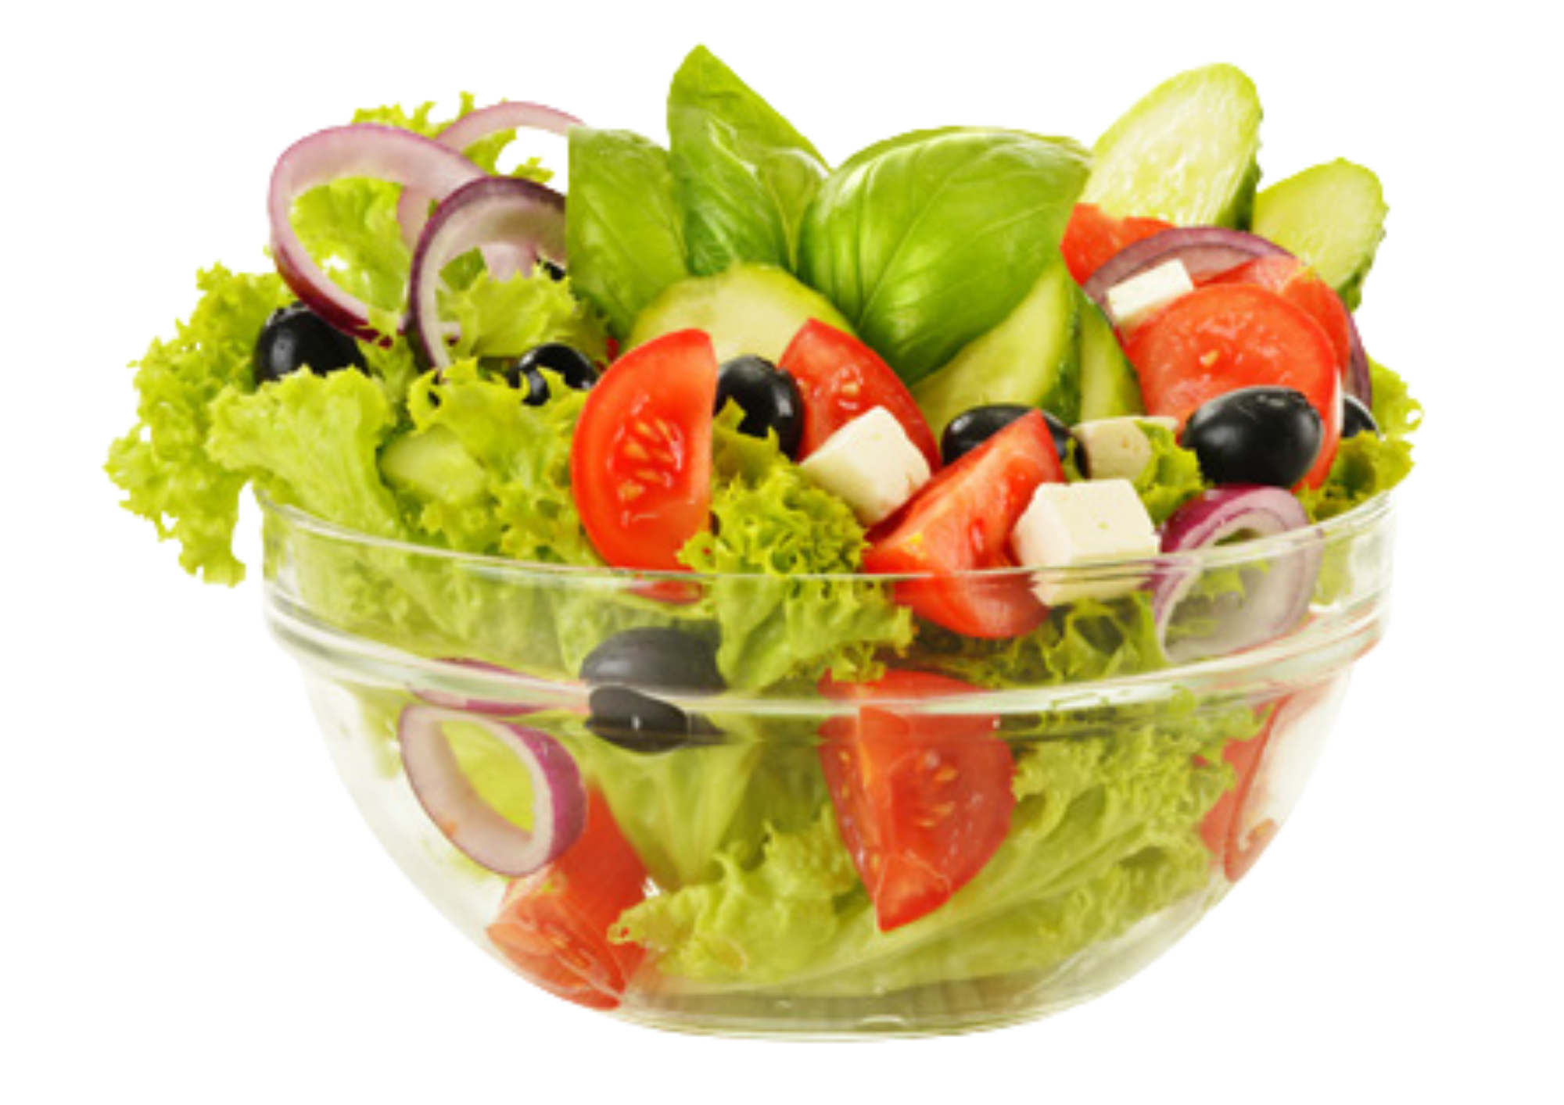
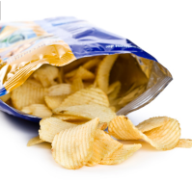
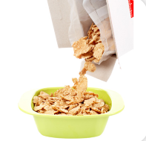

WARM-UP ACTIVITY
noodles
salad
sandwiches
cereal
crisps
cupcakes
ANSWER

Slide 5
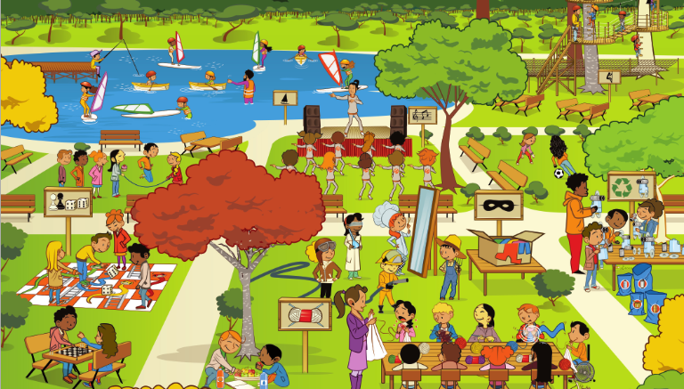
LEAD-IN
play chess
go fishing
go sailing
play computer
games
go windsurfing
play board
games
Ask students the question: “Which activities in the picture do you like doing?”
Invite some students to answer the question.
Explain that in this lesson students will learn new hobby words.

Slide 6

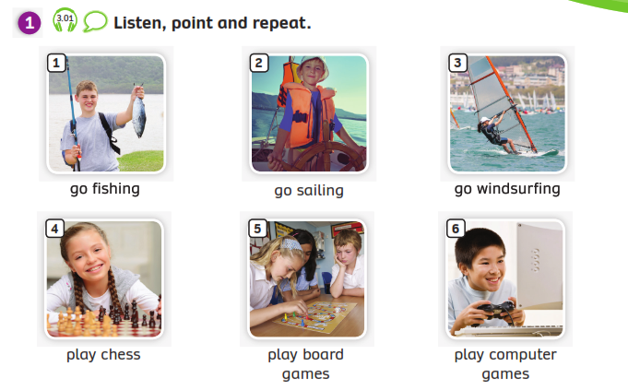
VOCABULARY – Hobbies
Play the audio, students listen and repeat the words.

Slide 7
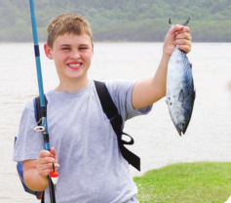

VOCABULARY – Hobbies
c
Let’s spell!
go fishing
g
o
f
i
s
h
i
n
g
Students listen and repeat the word.

Slide 8
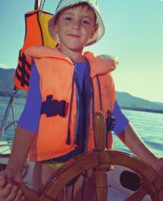
VOCABULARY – Hobbies
c
Let’s spell!
go sailing
g
o
s
a
i
l
i
n
g
Students listen and repeat the word.

Slide 9
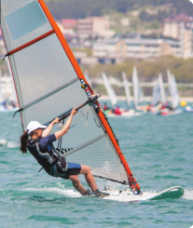
VOCABULARY – Hobbies
c
Let’s spell!
go windsurfing
g
o
w
i
n
d
s
u
r
f
i
n
g
Students listen and repeat the word.

Slide 10
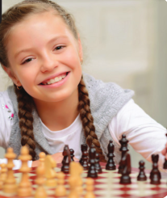
VOCABULARY – Hobbies
c
Let’s spell!
play chess
p
l
a
y
c
h
e
s
s
Students listen and repeat the word.

Slide 11
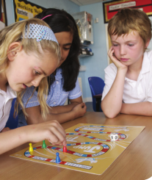
VOCABULARY – Hobbies
c
Let’s spell!
play board games
p
l
a
y
b
o
a
r
d
g
a
m
e
s
Students listen and repeat the word.

Slide 12
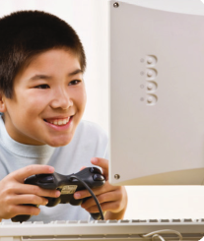
VOCABULARY – Hobbies
Let’s spell!
c
play computer games
p
l
a
y
c
o
m
p
u
t
e
r
g
a
m
e
s
Students listen and repeat the word.

Slide 13
VOCABULARY – Hobbies
REVIEW
go fishing
go sailing
go windsurfing
play chess
play board games
play computer games
- Show one by one picture, students look and say the word.
- Show the words, students spell it again.

Slide 14

VOCABULARY – Practice
Activity: FIND THE LETTERS
Divide the class into pairs. Each pair takes out a mini-board.
Show the word with blanks. Students look at and write the missing letters.
After finishing, students raise their boards to check the answers.
The 3 first pairs with the correct answer receive a point.

Slide 15

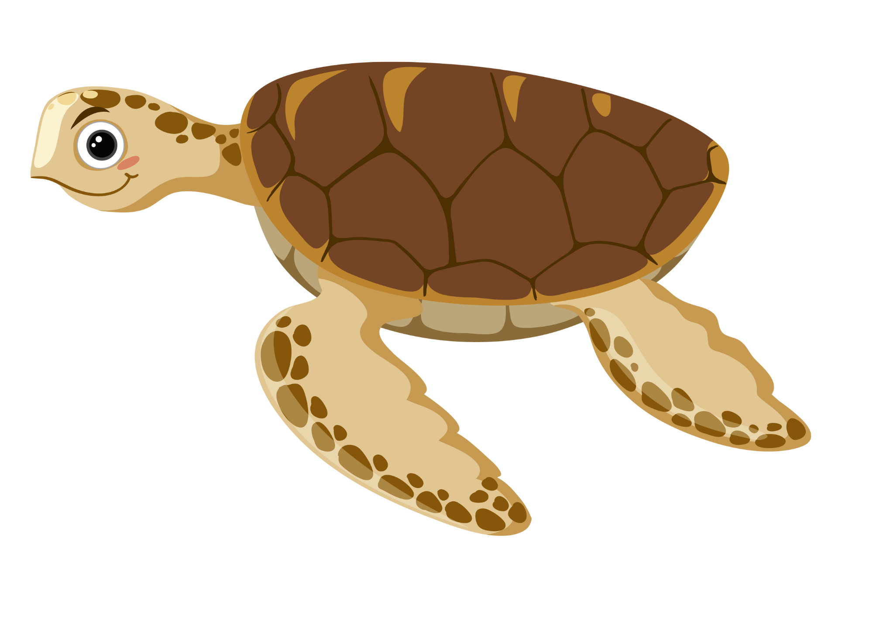


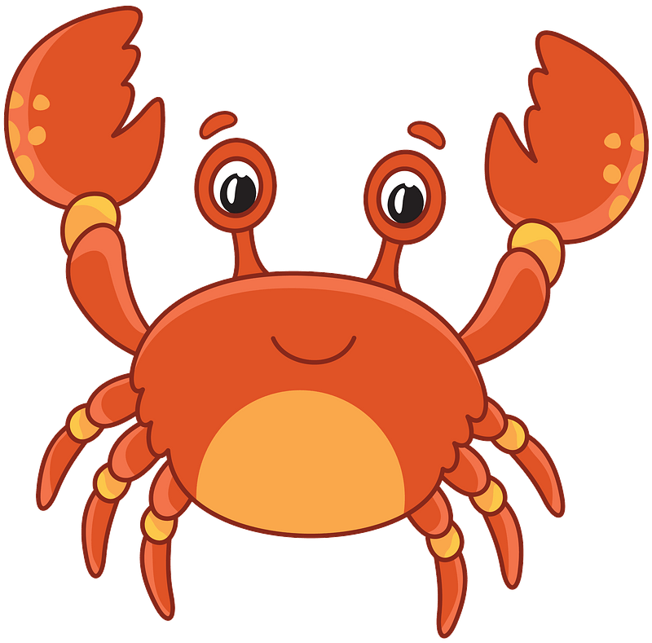


MsPham-0936082789
START

Slide 16

o
h
g
g_ fis_in_
MsPham-0936082789
Next
Check

Slide 17
o
l
g
g_ sai_in_
MsPham-0936082789
Next
Check

Slide 18
u
go _inds_rfing
w
MsPham-0936082789
Next
Check

Slide 19
a
e
pl_y ch_ss
MsPham-0936082789
Next
Check

Slide 20
pla_ bo_rd
ga_ es
y
a
m
MsPham-0936082789
Next
Check

Slide 21
e
p_ay comp_t_r
ga_ es
l
u
m
MsPham-0936082789
Next
Check

Slide 22
MsPham-0936082789
FINISH

Slide 23
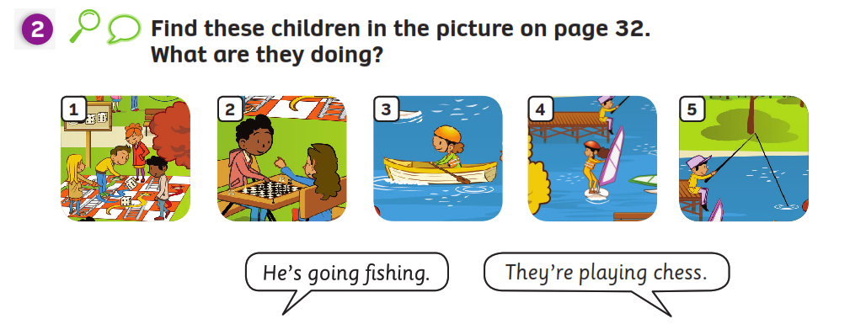
STRUCTURE – Pupils’ book (p.33)
Have students look at the picture on page 32.
- Ask students to use the Present Continuous tense and practice with question:” What are they doing?”
- Then, open the bubbles speech on the next slide.

Slide 24
STRUCTURE – Pupils’ book (p.33)
Activity: SPEAKING TIME
- Put students work in pairs. Have students look at the pictures on page 32.
Ask students to use the present continuous tense and practice with question: ” What are they doing?”
Invite some pairs to present in front of the class.
Give points if they give the correct answers.

Slide 25
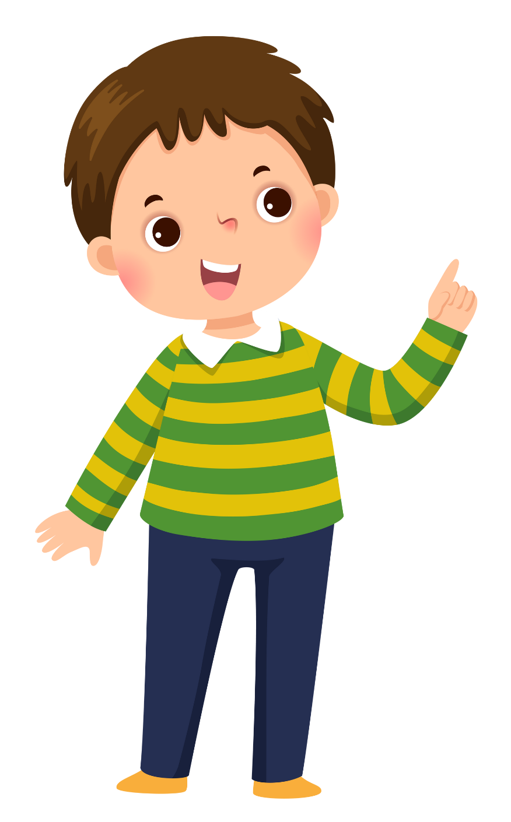

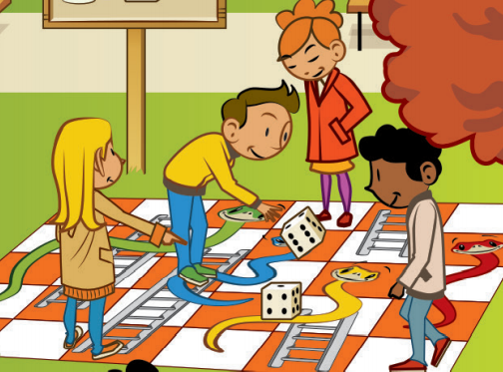

STRUCTURE – Pupils’ book (p.33)
They’re playing
board games.
What are they doing?
Invite some pairs to present in front of the class. Give points if they give the correct answers.

Slide 26
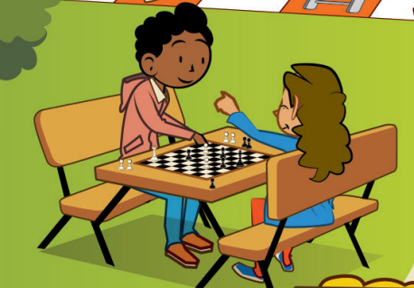
STRUCTURE – Pupils’ book (p.33)
They’re playing chess.
What are they doing?
Invite some pairs to present in front of the class. Give points if they give the correct answers.

Slide 27
STRUCTURE – Pupils’ book (p.33)
What is she doing?
She’s going sailing.
Invite some pairs to present in front of the class. Give points if they give the correct answers.

Slide 28
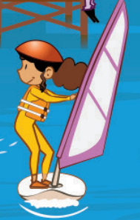
STRUCTURE – Pupils’ book (p.33)
She’s going
windsurfing.
What is she doing?
Invite some pairs to present in front of the class. Give points if they give the correct answers.

Slide 29
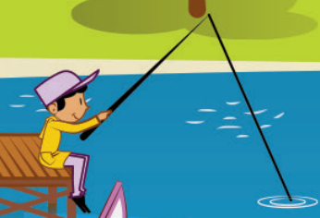
STRUCTURE – Pupils’ book (p.33)
He’s going fishing.
What is he doing?
Invite some pairs to present in front of the class. Give points if they give the correct answers.

Slide 30
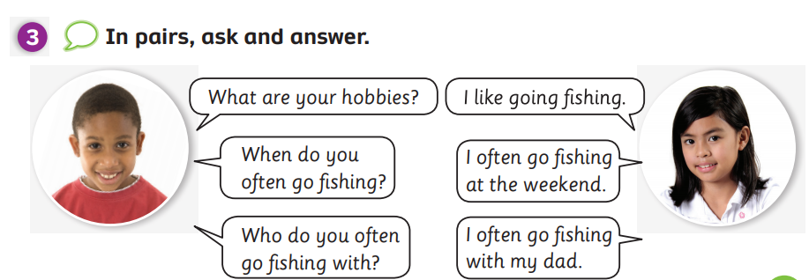
PRODUCTION
Put students work in pairs and have them ask/answer the questions. Then switch roles.
Do this a few times.
Invite some pairs to present in front of the class. Give points if they give the good dialogue.

Slide 31
PRODUCTION
What are your hobbies?
I like…..
going sailing
going fishing
going windsurfing
playing chess
playing board games
Practice in pairs or in groups of 3 or 4

Slide 32
PRODUCTION
When do you often….?
I often …..
…….
at the weekend
once a week
in June
on Sundays
Practice in pairs or in groups of 3 or 4 to prepare present in front of the class.

Slide 33
PRODUCTION
Who do you often…..with?
I often ….. with….
my dad
my grandpa
my mum
my sister
my brother
Practice in pairs or in groups of 3 or 4 to prepare present in front of the class.

Slide 34
PRODUCTION
What are your hobbies?
I like…..
When do you often….?
I often … …
Who do you often…with?
I often … with …
Invite some pairs to present in front of the class. Give points if they give the good dialogue.

Slide 35
VOCABULARY – Hobbies
REVIEW
go sailing
go fishing
play board games
play chess
go windsurfing
play computer games
Put students into groups of 4 to 6. Call out each member from each group to stand up and look at the slide.
Show the picture, students look at and spell the word.
The first student with the correct word receives a point for the team.

Slide 36
HOMEWORK
Review vocabulary.
Do exercises in the Activity Book (page 26).
Check answers in the Teacher’s book (page 60) or Active Teach.

Slide 37
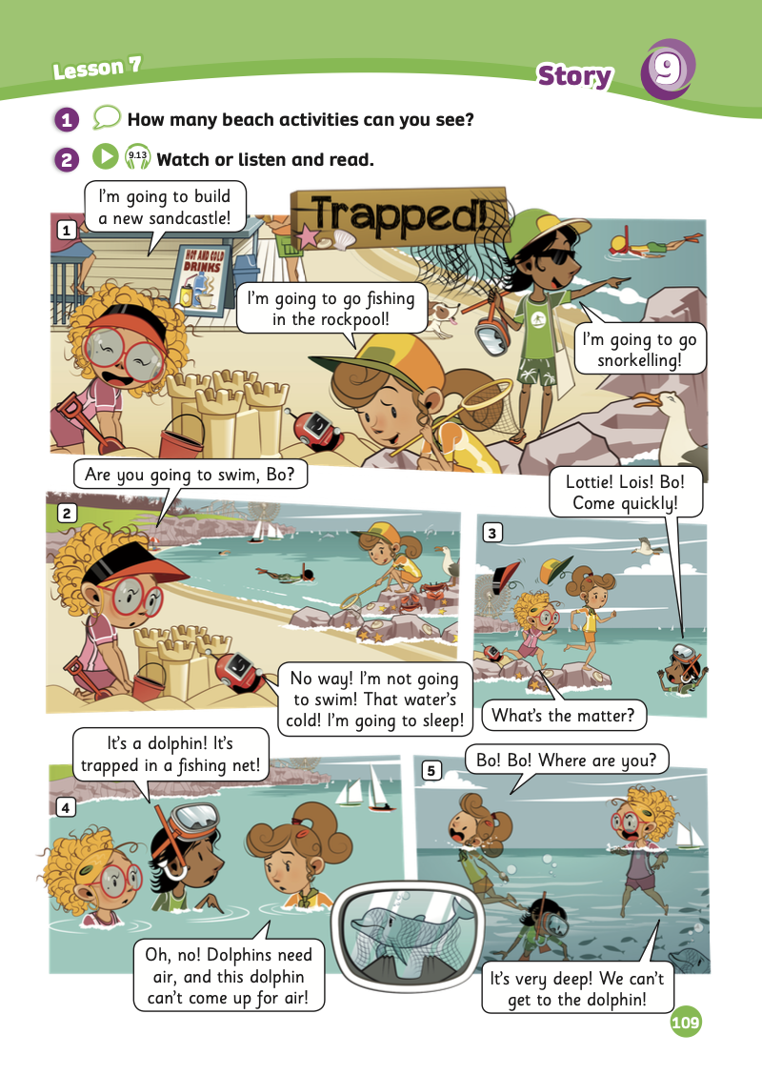
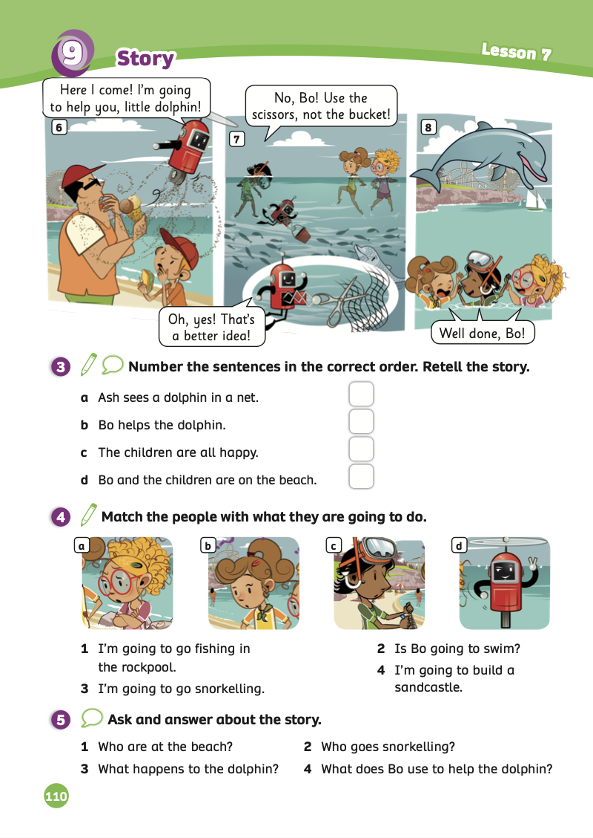
UNIT 9 – Lesson 7B
We’re learning…
- To understand simple cartoon stories.
- To review.
- PB p.109 & 110.
- AB p.86

