Slide 1
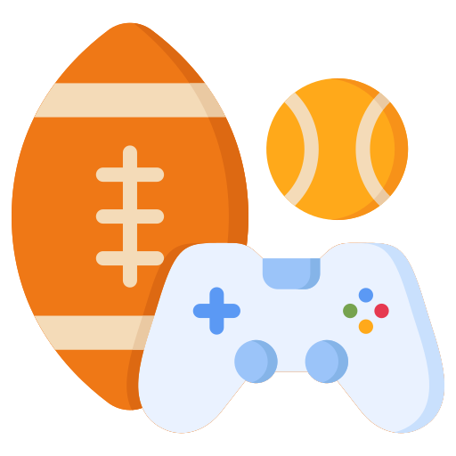
UNIT 3 – HOBBIES
Lesson 2 – Review

Slide 2
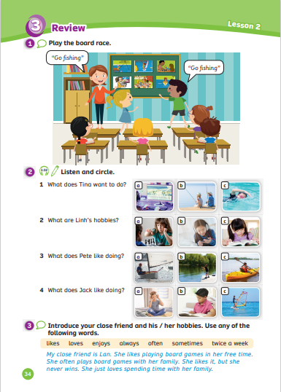
UNIT 3 – Lesson 2
We’re learning…
- To review and spell words related to hobbies
- PB p.34
- AB p.27

Slide 3
WARM-UP ACTIVITY
Activity: VERBS AND NOUN
go …
fishing
windsurfing
sailing
Teacher says one of these verbs. E.g:” go”, “play”
Have students tell the noun/ noun phrase that should follow it. E.g:” fishing”, “sailing”, “chess”,….

Slide 4
WARM-UP ACTIVITY
Activity: VERBS AND NOUN
play …
chess
computer games
board games
Teacher says one of these verbs. E.g:” go”, “play”
Have students tell the noun/ noun phrase that should follow it. E.g:” fishing”, “sailing”, “chess”,….

Slide 5
VOCABULARY – Practice
Activity: FIND THE LETTERS
Put students in groups of 3 or 4. Each group takes out a mini-board.
Teacher write on the board in a vertical column with blanks except the first letter of phrases.
Students look at and write the missing letters.
After finishing, students raise their boards to check the answers, then read the words out loud.
The 3 first groups with the correct answer receive 2 points.

Slide 6
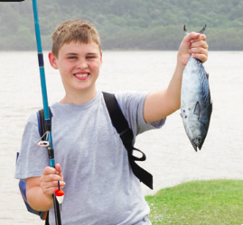
VOCABULARY – Practice
G
O
F
l
S
H
l
N
G
- Students read the words out loud.

Slide 7
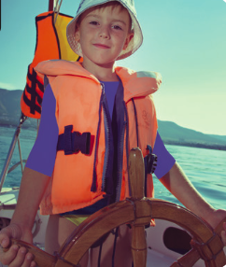
VOCABULARY – Practice
G
O
S
A
I
L
l
N
G
- Students read the words out loud.

Slide 8
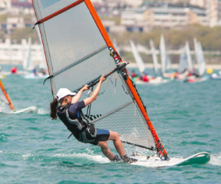
VOCABULARY – Practice
G
O
W
I
N
D
S
U
R
F
I
N
G
- Students read the words out loud.

Slide 9
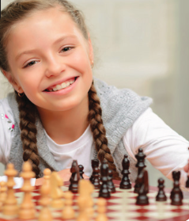
VOCABULARY – Practice
P
L
A
Y
C
H
E
S
S
- Students read the words out loud.

Slide 10
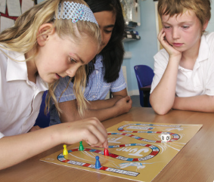
VOCABULARY – Practice
P
L
A
Y
B
O
A
R
D
G
A
M
E
S
- Students read the words out loud.

Slide 11
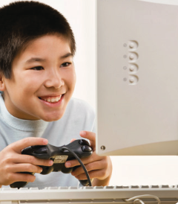
VOCABULARY – Practice
P
L
A
Y
C
O
M
P
U
T
E
R
G
A
M
E
S
- Students read the words out loud.

Slide 12
VOCABULARY – Practice
Activity: THE BOARD RACE
Divide the class into 2 teams.
Put all the flashcards from Lesson 1 on the board using Blutac.
Call on one team member from each group to come to the front of the class.
Name one of the pictures, and the two students compete to be the first to touch it. Award a point to the winning team.
Both players sit down and are replaced by two new players, who continue with another word.
The team with the most points at the end wins.

Slide 13
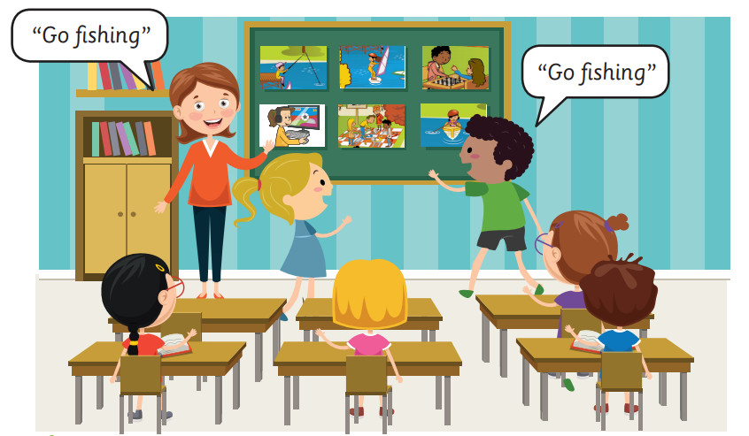
VOCABULARY – Practice
Explain the activity again if necessary.
The team with the most points at the end wins.

Slide 14
PUPILS’ BOOK p.34 (Pre-Listening)
Activity: MAKE THE SENTENCES
Have students work in pairs and look at 4 questions with 12 hobby pictures.
Ask students to discuss about 4 questions and they can answer with “like, want to, and don’t/doesn’t like”.
Invite some pairs to present in front of the class. Give points if they give the correct sentences.

Slide 15
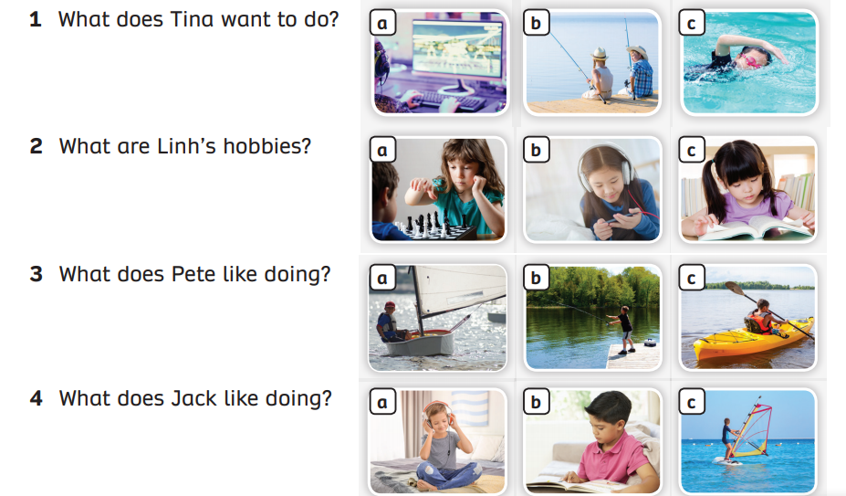
PUPILS’ BOOK p.34 – PRE LISTENING
Pre-Listening: MAKE THE SENTENCES
Ask students to discuss 4 questions and they can answer with “like, want to, and don’t/doesn’t like”.
Point to each picture of hobbies. Students look at and say it aloud.

Slide 16
PUPILS’ BOOK p.34 – PRE LISTENING
a. Tina wants to play computer games.
What does Tina want to do?
b. She wants to go fishing.
c. She wants to go swimming.

Slide 17
PUPILS’ BOOK p.34 – PRE LISTENING
a. Linh likes playing chess.
What are Linh’s hobbies?
b. Linh likes listening to music.
c. Linh likes reading book.

Slide 18
PUPILS’ BOOK p.34 – PRE LISTENING
a. Pete likes going sailing.
What does Pete like doing?
b. He likes going fishing.
c. He likes kayaking.

Slide 19
PUPILS’ BOOK p.34 – PRE LISTENING
a. Jack likes listening to music.
What does Jack like doing?
b. He likes reading book.
c. He likes going windsurfing.

Slide 20
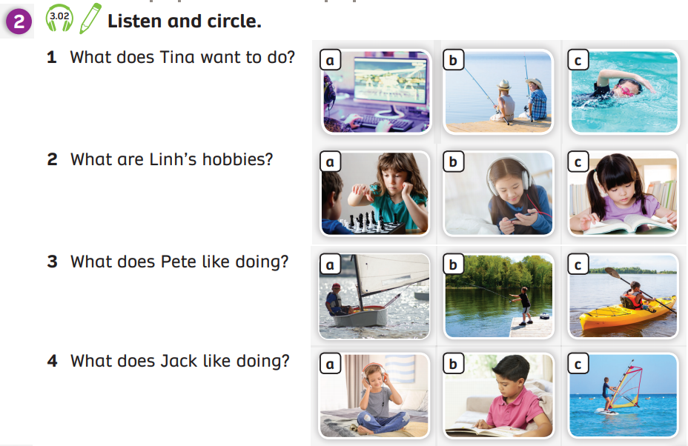
PUPILS’ BOOK p.34 – LISTENING
x
ANSWER
Have students open their books and look at the task.
Play the audio, students listen and circle the correct activity.
Play the audio again, students listen and check the answers.

Slide 21
POST LISTENING
Activity: SPEAKING TIME
After listening, have students work in pairs and retell about the hobbies of 4 friends on the listening task.
Ask some students to present in front of the class and receive 2 points.

Slide 22
POST LISTENING
Tina likes going fishing and going swimming in her free time. She doesn’t like playing computer games. She often goes fishing on the lake.
Ask some students to present in front of the class and receive 2 points

Slide 23
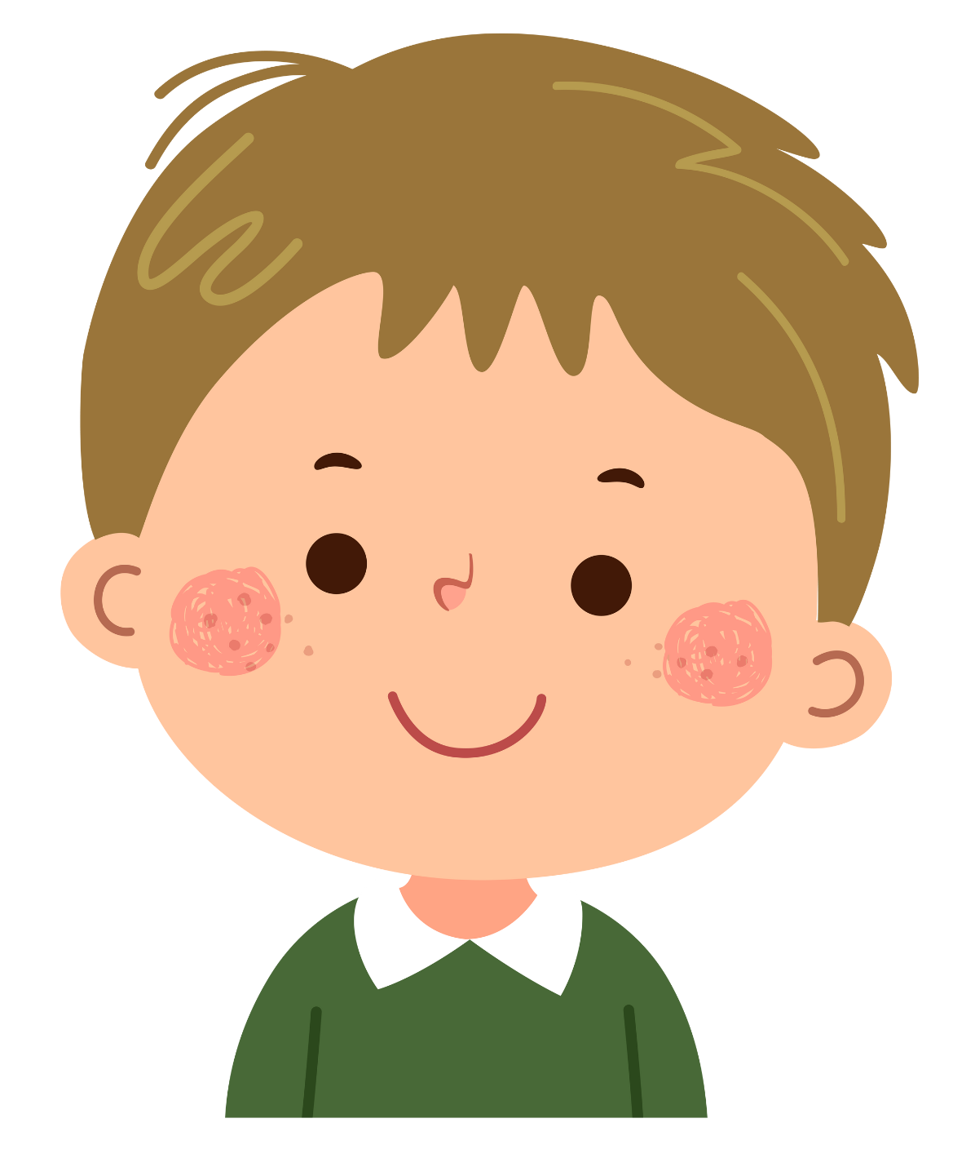
POST LISTENING
Linh’s hobbies are playing chess and watching TV in her free time. She doesn’t like listening to music but her brother likes it.
Ask some students to present in front of the class and receive 2 points

Slide 24
POST LISTENING
Pete likes going fishing but he doesn’t like going sailing in his free time.
Ask some students to present in front of the class and receive 2 points

Slide 25
POST LISTENING
Jack likes going windsurfing with his friends because it’s a lot of fun.
Ask some students to present in front of the class and receive 2 points

Slide 26
PUPILS’ BOOK p.34
x
Read the text with the students.
Ask students to name the adverbs of frequency they find in the text.

Slide 27
PUPILS’ BOOK p.34
My close friend is Lan. She likes playing board games in her free time. She…………………plays board games with her family. She likes it, but she ………………. wins. She just loves spending time with her family.
sometimes
sometimes
sometimes
often
twice a week
always
EXAMPLE
Click on “Example” to show the example sentences and play the audio.
Ask a few students to read the text substituting the original adverbs of frequency with different ones from vocabulary box.
Play the audio, ask students to look at them, listen and repeat.

Slide 28
PRODUCTION
Activity: HOBBIES OF YOUR CLOSE FRIEND
Have students work in pairs and ask 3 questions about the hobbies of their close friends and note the answers of their partners.
Invite some students to present in front of the class. Give points if they give a good presentation.

Slide 29
PRODUCTION
Q&A
Your close friend’s name
Nam
What are his/her hobbies?
play chess
How often does he/she …?
everyday
Who does she/he often … with?
his dad
Have students work in pairs ask 3 questions about the hobbies of their close friends and note the answers of their partners.
Invite some students to present in front of the class. Give points if they give a good presentation.

Slide 30
PRODUCTION
EXAMPLE
Name: Lan, Hoa, Kien,….
Hobbies: going fishing, going sailing, playing chess,….
Frequency: often, always, sometimes, never,…
Do it with: family, dad, mum,…
My close friend is ….
She/He likes …. in her/his free time.
She/He …. ….
She/He does it with her/his ….
Invite some students to present in front of the class. Give points if they give a good presentation.

Slide 31
HOMEWORK
Review vocabulary in Lesson 1.
Do exercises in the Activity Book (page 27).
Check answers in the Teacher’s book (page 62) or Active Teach.

Slide 32
UNIT 3 – Lesson 2
We’ve learned…
- To review and spell words related to hobbies
- PB p.34
- AB p.27

