Slide 1
UNIT 3 – HOBBIES
Lesson 3A – Vocabulary and Grammar 1

Slide 2
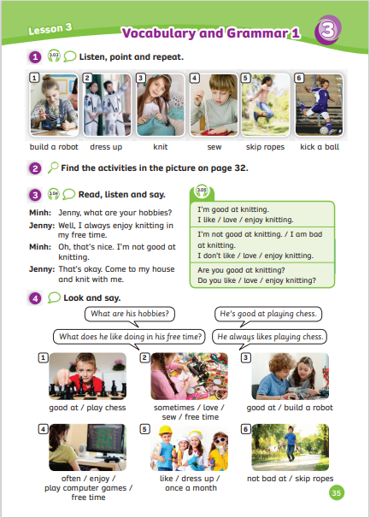
UNIT 3 – Lesson 3A
We’re learning…
To read and pronounce the words related to hobbies.
To use the structure:
“I am/ am not good at…”
“Are you good at…?”
- PB p.35
- AB p.28

Slide 3
WARM-UP ACTIVITY
Activity: CROSSWORDS GAME
Divide the class into groups of 4. Each group takes out a sheet of paper.
Show the slide with 7 numbers and 7 lines. Each line has 1 bold word, it will create one keyword of crosswords with 7 letters.
Students look at, discuss and complete 7 words and find the keyword.
Each member takes a turn writing a word. After finishing, they raise the paper to check the answers.
The fastest group with all the correct answers receives 2 points.

Slide 4
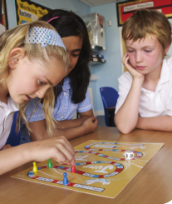
WARM-UP ACTIVITY
1
G
O
F
I
S
H
I
N
G
2
P
L
A
Y
C
H
E
S
S
3
G
O
W
I
N
D
S
U
R
F
I
N
G
4
G
O
S
A
I
L
I
N
G
5
P
L
A
Y
B
O
A
R
D
G
A
M
E
S
6
P
L
A
Y
C
O
M
P
U
T
E
R
G
A
M
E
S
7
R
E
A
D
I
N
G
B
O
O
K
Click on “Number” to see picture.
Then, click on the picture to review the answer.

Slide 5
WARM-UP ACTIVITY
1
G
O
F
I
S
H
I
N
G
2
P
L
A
Y
C
H
E
S
S
KEYWORD
3
G
O
W
I
N
D
S
U
R
F
I
N
G
H
O
B
B
I
E
S
4
G
O
S
A
I
L
I
N
G
5
P
L
A
Y
B
O
A
R
D
G
A
M
E
S
6
P
L
A
Y
C
O
M
P
U
T
E
R
G
A
M
E
S
7
R
E
A
D
I
N
G
B
O
O
K
- Click on “Keyword” to show the keyword.
S

Slide 6
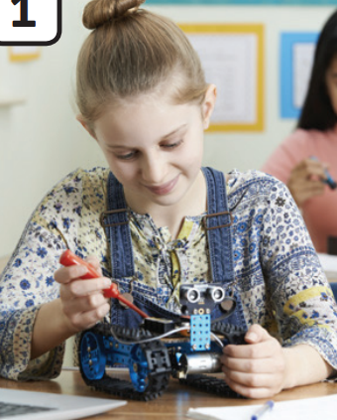
VOCABULARY – Hobbies
c
Let’s spell!
build a robot
b
u
i
l
d
a
r
o
b
o
t
Have students look at the pictures, listen, repeat and spell the word.

Slide 7
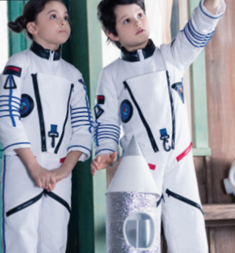
VOCABULARY – Hobbies
c
Let’s spell!
dress up
d
r
e
s
s
u
p
Have students look at the pictures, listen, repeat and spell the word.

Slide 8
VOCABULARY – Hobbies
Let’s spell!
c
knit
k
n
i
t
Have students look at the pictures, listen, repeat and spell the word.

Slide 9
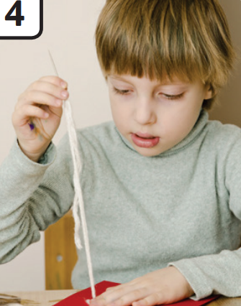
VOCABULARY – Hobbies
Let’s spell!
c
sew
s
e
w
Have students look at the pictures, listen, repeat and spell the word.

Slide 10
VOCABULARY – Hobbies
c
Let’s spell!
skip ropes
s
k
i
p
r
o
p
e
s
Have students look at the pictures, listen, repeat and spell the word.

Slide 11
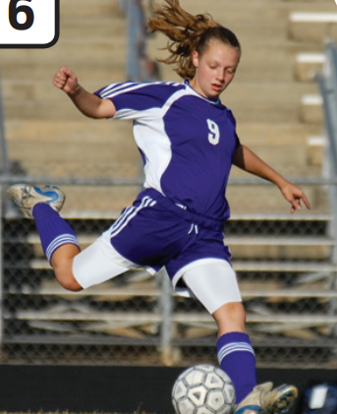
VOCABULARY – Hobbies
c
Let’s spell!
kick a ball
k
i
c
k
a
b
a
l
l
Have students look at the pictures, listen, repeat and spell the word.

Slide 12
VOCABULARY - REVIEW
1
2
3
4
5
6
build a robot
skip ropes
kick a ball
dress up
knit
sew
The teacher says a number and the students say a word.
Click on “Number” to show the word to check.

Slide 13
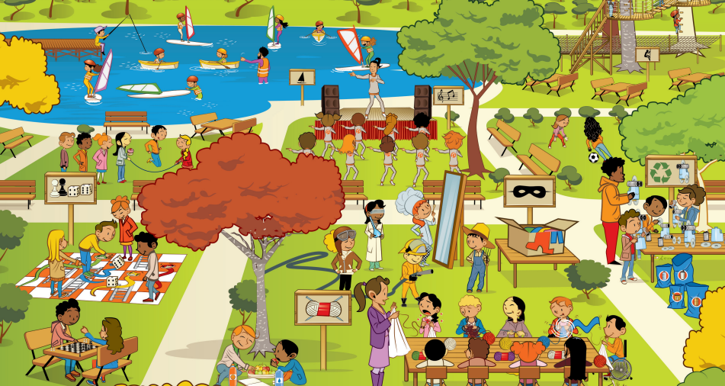
PUPILS’ BOOK p.35
Have students work in pairs and look at the picture on page 32 and find activities.

Slide 14
PUPILS’ BOOK p.35
LOOK AT THE NUMBER IN THE PICTURE
1
4
skip ropes
kick a ball
2
5
play board games
dress up
3
6
play chess
knit
Look at the number, teacher reads the number and students read the word out loud.
Look at the example on the next slide.

Slide 15
PUPILS’ BOOK p.35
EXAMPLE
skip ropes
play chess
Number 1
Number 2
Number 3
knit
sew
Number 4

Slide 16
VOCABULARY – Practice
Activity: BLOCKS GAME
Divide the class into groups of 4 to 6 students and each group takes out a mini-board.
Each member takes a turn playing a game.
Show unscrambled letters on the slide, students look at them and write into the correct word.
After finishing, they raise the board to check the answer.
The fastest student with the correct answer receives 2 points for the team.

Slide 17
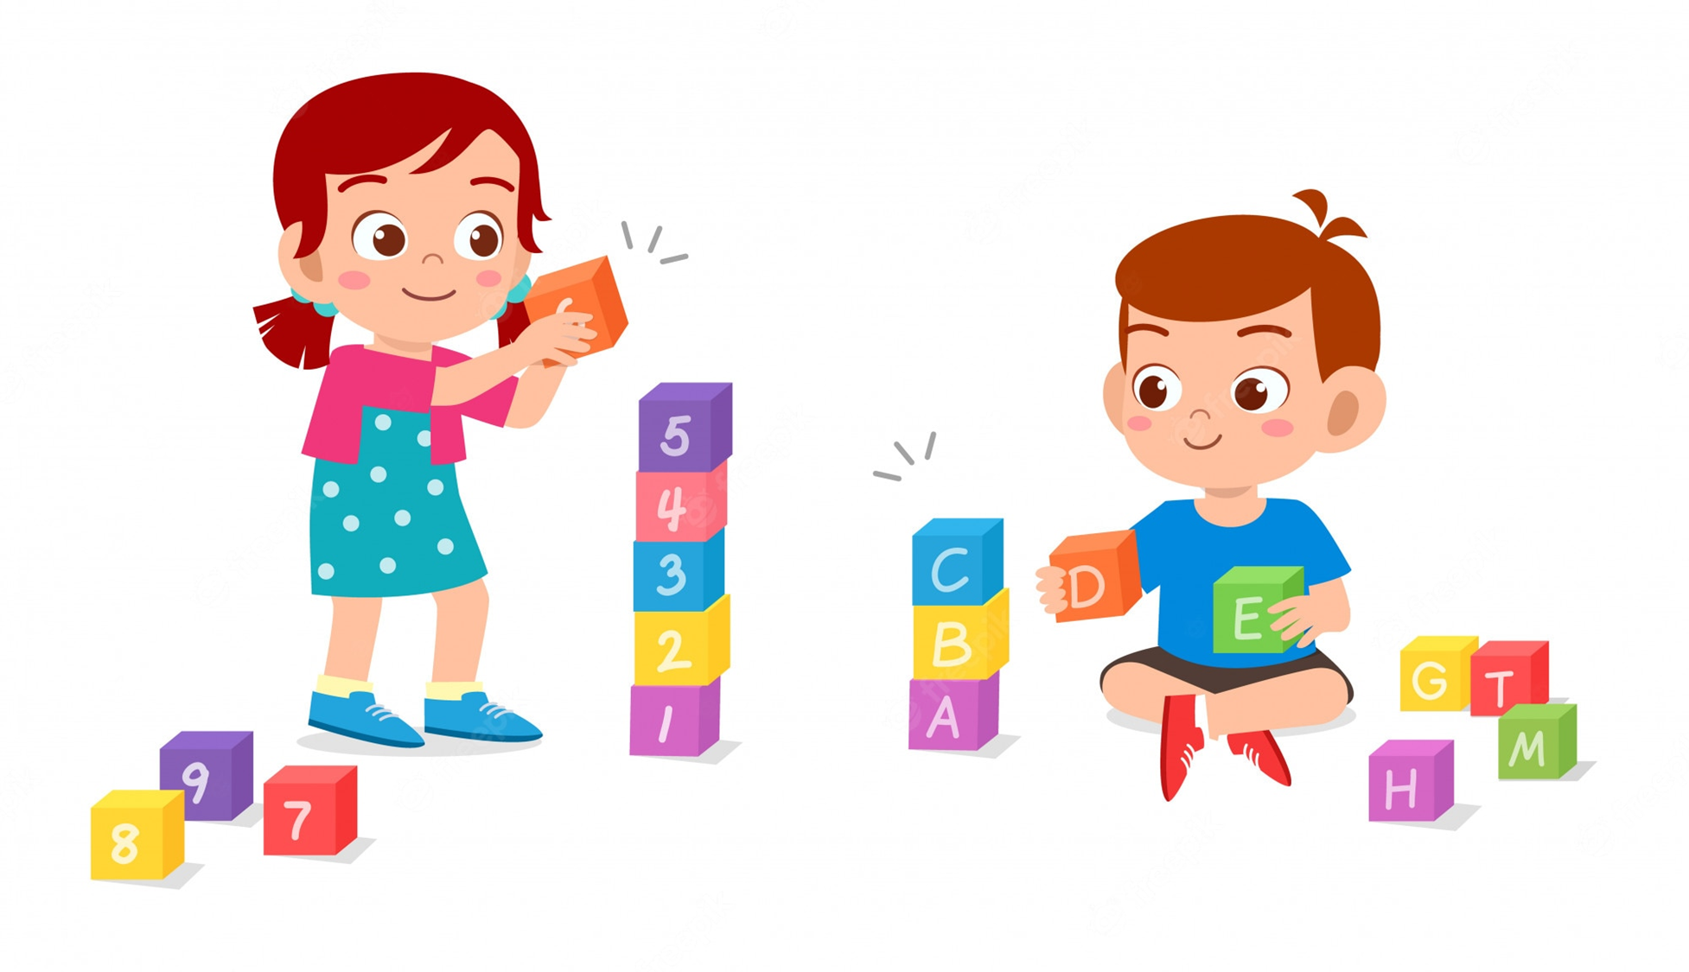
VOCABULARY – Practice
L
C
S
B
O
K

Slide 18
VOCABULARY – Practice
r
d
u
p
s
s
e
CHECK
Click on “Check” to check the answer.

Slide 19
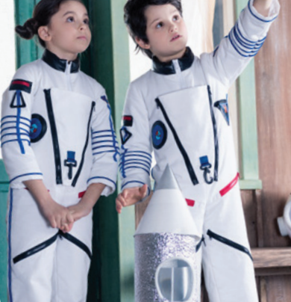
VOCABULARY – Practice
c
NEXT
d
r
e
s
s
u
p

Slide 20
VOCABULARY – Practice
k
i
t
n
CHECK
Click on “Check” to check the answer.

Slide 21
VOCABULARY – Practice
c
NEXT
k
n
i
t
Click on “Check” to check the answer.

Slide 22
VOCABULARY – Practice
b
d
o
i
b
u
o
a
t
r
l
CHECK
Click on “Check” to check the answer.

Slide 23
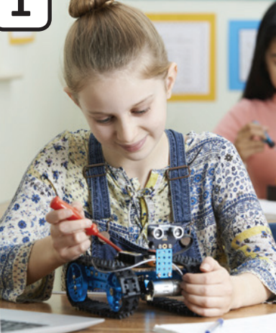
VOCABULARY – Practice
c
NEXT
b
u
i
l
d
a
r
o
b
o
t

Slide 24
VOCABULARY – Practice
s
p
o
k
s
e
r
i
p
CHECK
Click on “Check” to check the answer.

Slide 25
VOCABULARY – Practice
c
NEXT
s
k
i
p
r
o
p
e
s

Slide 26
VOCABULARY – Practice
i
a
k
l
c
b
a
l
k
CHECK
Click on “Check” to check the answer.

Slide 27
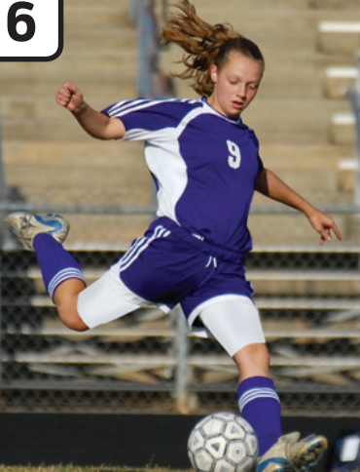
VOCABULARY – Practice
c
NEXT
k
i
c
k
a
b
a
l
l

Slide 28
VOCABULARY – Practice
e
w
s
CHECK
Click on “Check” to check the answer.

Slide 29
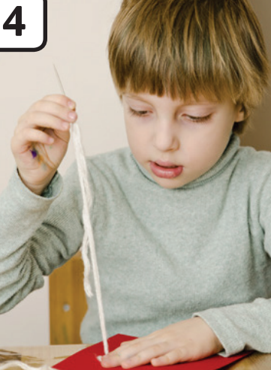
VOCABULARY – Practice
c
NEXT
s
e
w

Slide 30
VOCABULARY – Practice
G
O
O
D
J
O
B

Slide 31
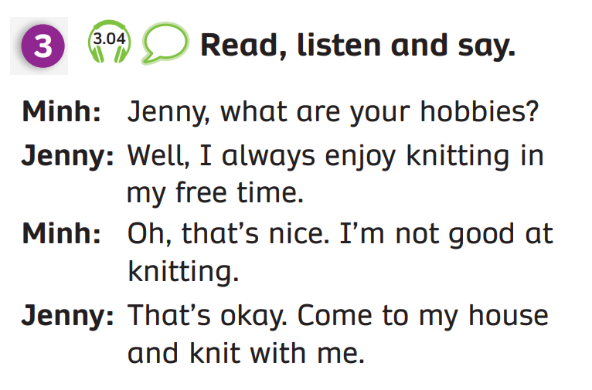
GRAMMAR – Pupils’ book (p.35)
Minh
Jenny
Have students look at the conversation and read it.
Play the audio, students listen to the dialogue.
Put students in pairs.
Then look at the conversation and switch roles to speak it.

Slide 32
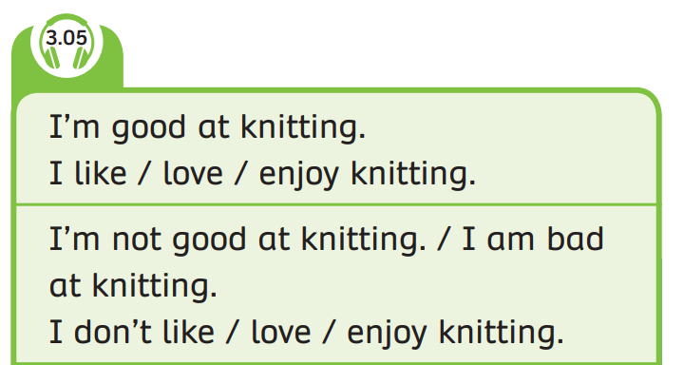
GRAMMAR – Pupils’ book (p.35)
Have students look at the box.
Play the audio, students listen.

Slide 33
GRAMMAR – Pupils’ book (p.35)
STRUCTURE – SENTENCES
Use these sentences when you are/ are not good at something.
- I’m good at ….
- I’m not good at/ bad at ….

Slide 34
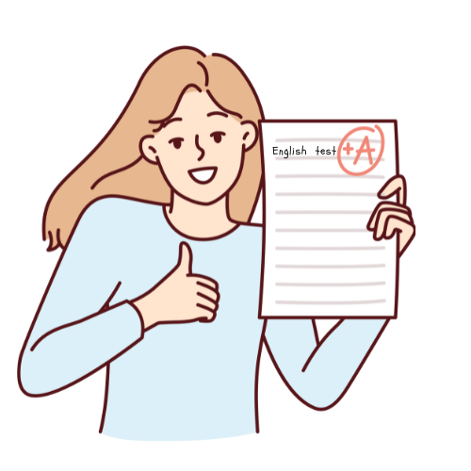
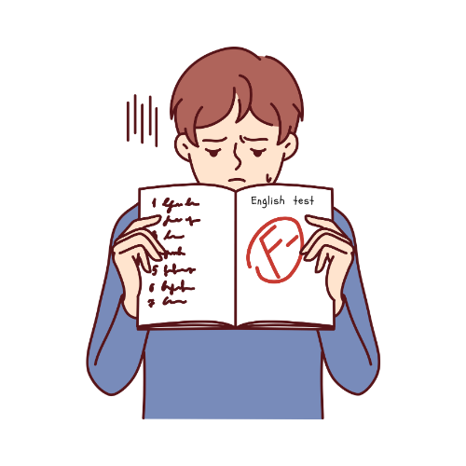
GRAMMAR – Pupils’ book (p.35)
be good at + V_ing/ Noun
- I’m good at English.
- I’m not good at English.
- I’m bad at English.

Slide 35
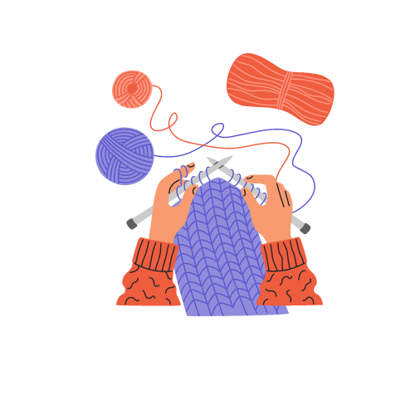
GRAMMAR – Pupils’ book (p.35)
like/ love/ enjoy + V_ing/ Noun
I like knitting.
I love knitting.
I enjoy knitting.
I don’t like knitting.
I don’t love knitting.
I don’t enjoy knitting.

Slide 36
PRODUCE
ANSWER
I’m bad at/ not good at knitting.
Have students look at the slide and make these sentences with “be good at” and “like/ love/ enjoy”.
Click on “answer” to check the correct answer.

Slide 37
PRODUCE
ANSWER
I like/ love/ enjoy skipping ropes.
Have students look at the slide and make these sentences with “be good at” and “like/ love/ enjoy”.
Click on “answer” to check the correct answer.

Slide 38
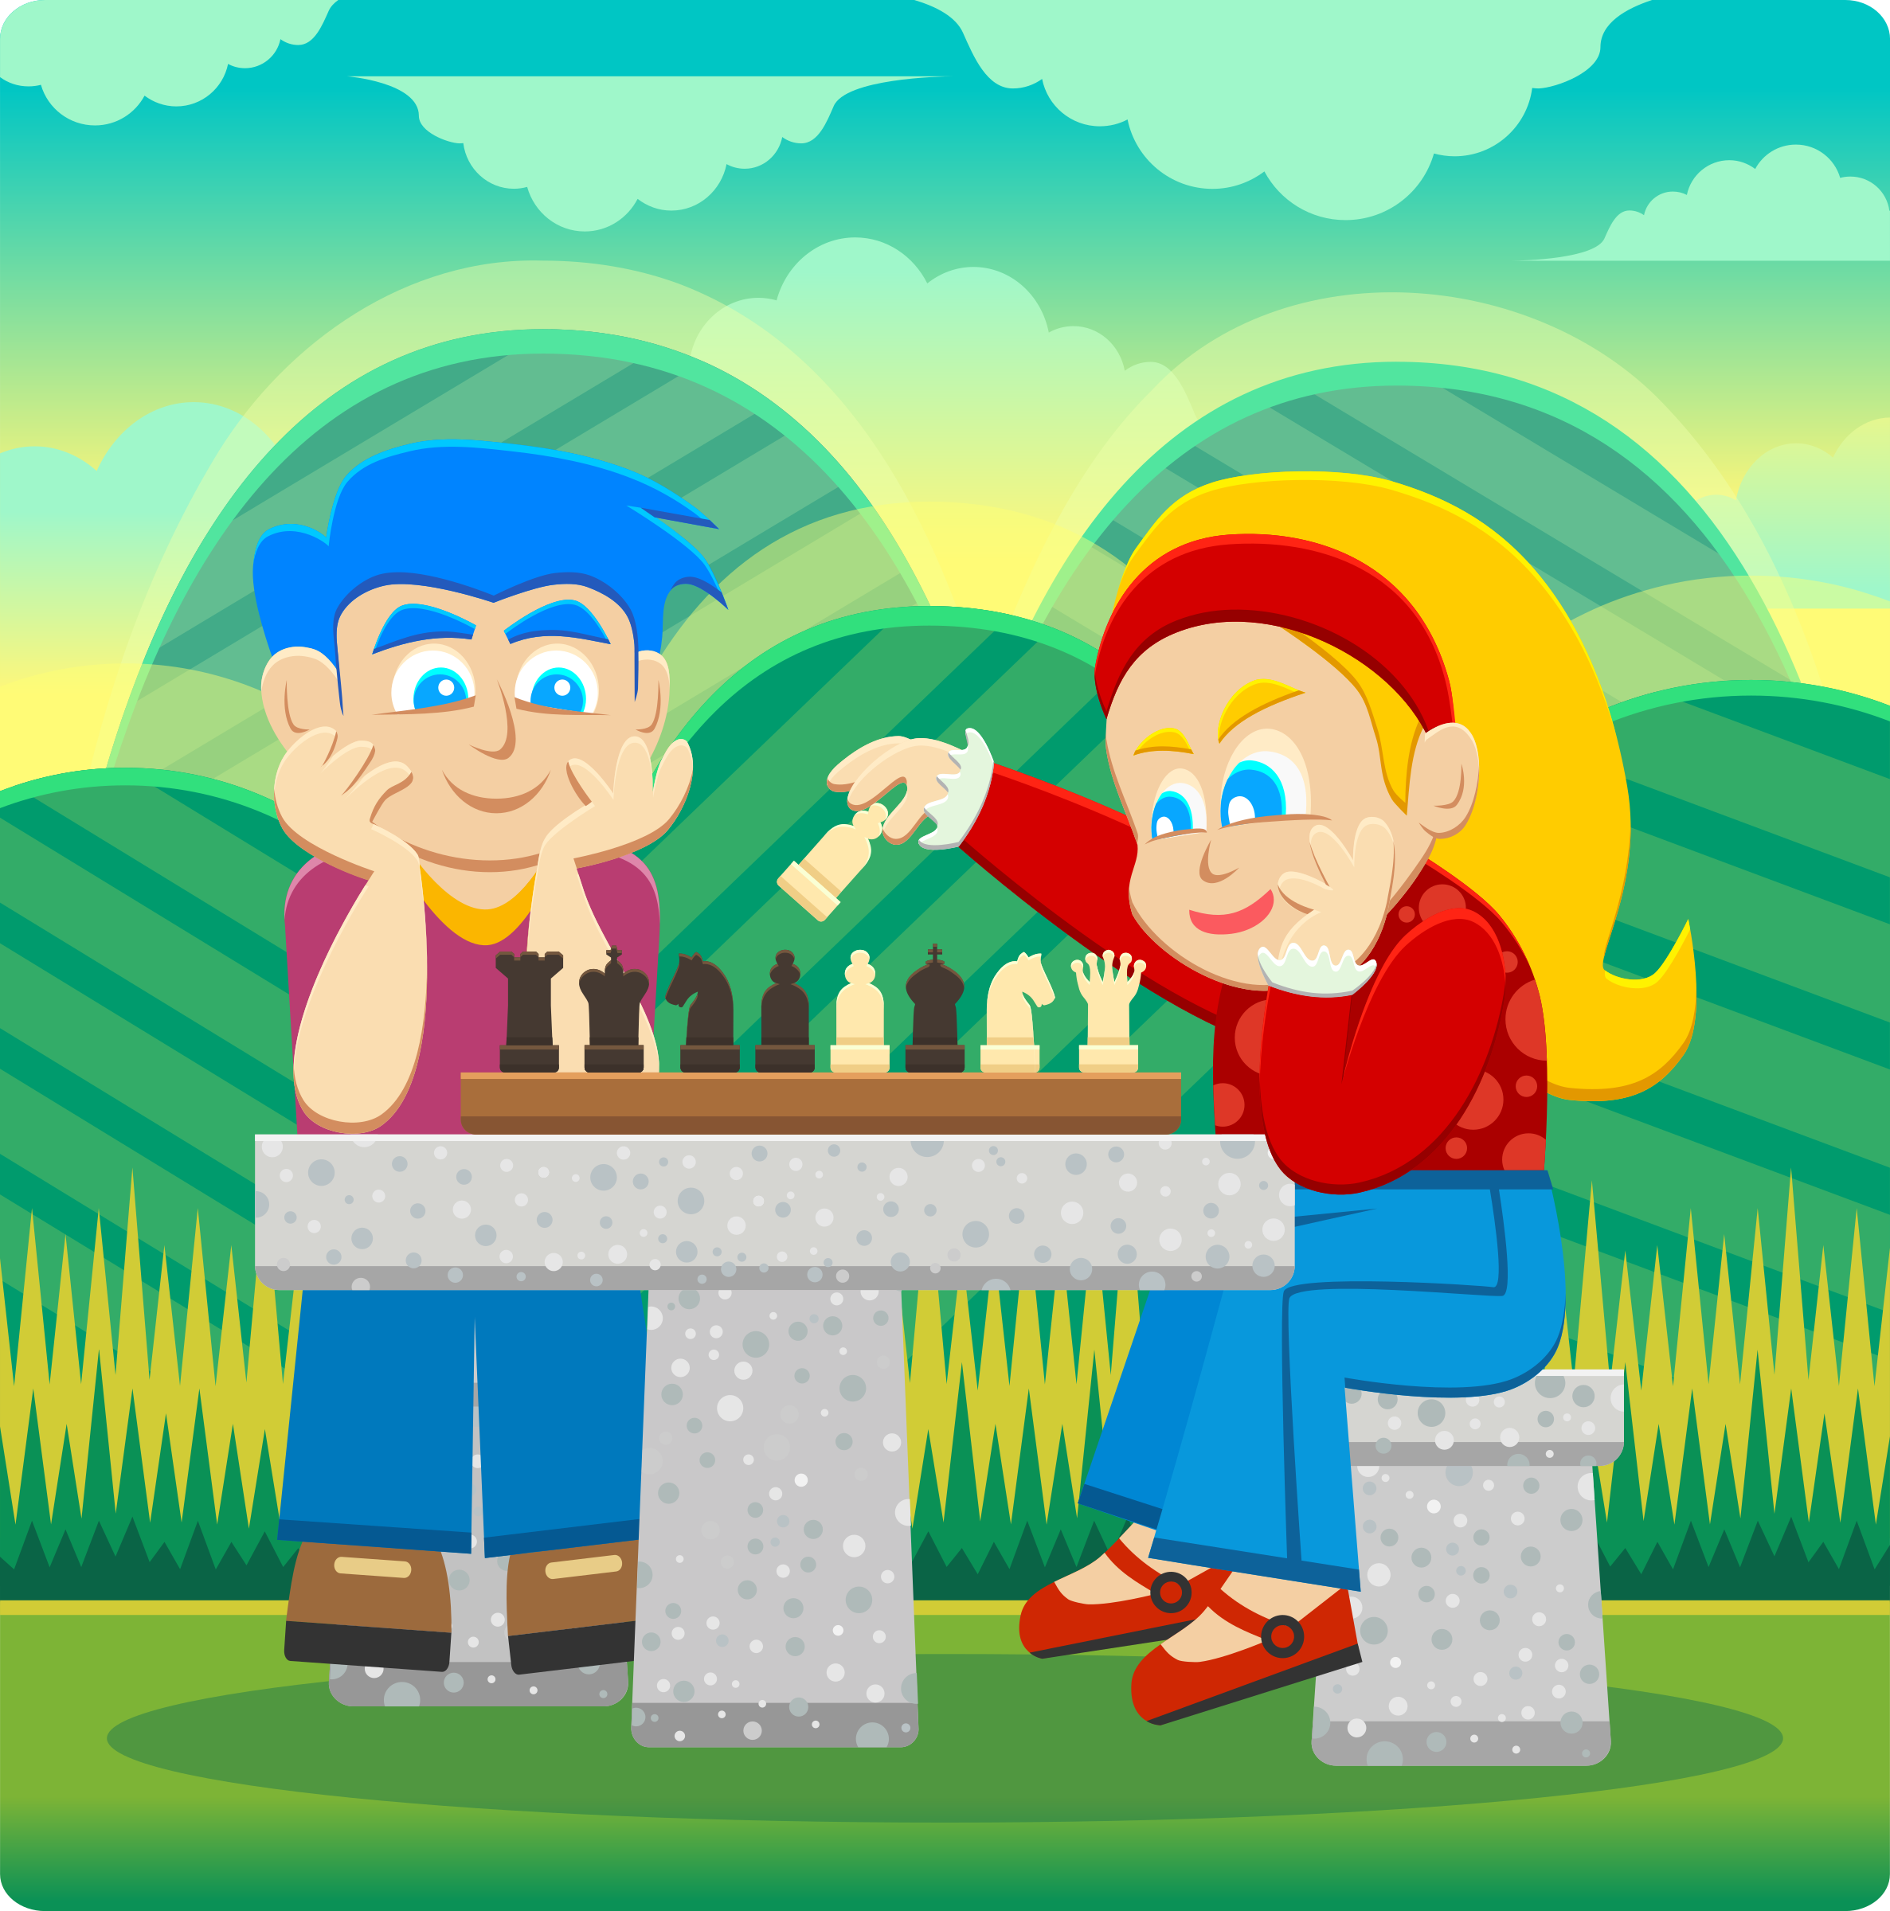
PRODUCE
ANSWER
I don’t like/ love/ enjoy playing chess.
Have students look at the slide and make these sentences with “be good at” and “like/ love/ enjoy”.
Click on “answer” to check the correct answer.

Slide 39
HOMEWORK
Review Vocabulary and Grammar.
Do exercises in the Activity Book (page 28).
Check answers in the Teacher’s book (page 64) or Active Teach.

Slide 40
UNIT 3 – Lesson 3A
We’ve learned…
To read and pronounce the verb used in hobbies.
To use the structure:
“I am/ am not good at…”
“Are you good at…?”
- PB p.35
- AB p.28

