Slide 1



UNIT 3 – HOBBIES
Lesson 5A – Vocabulary and Grammar 2

Slide 2
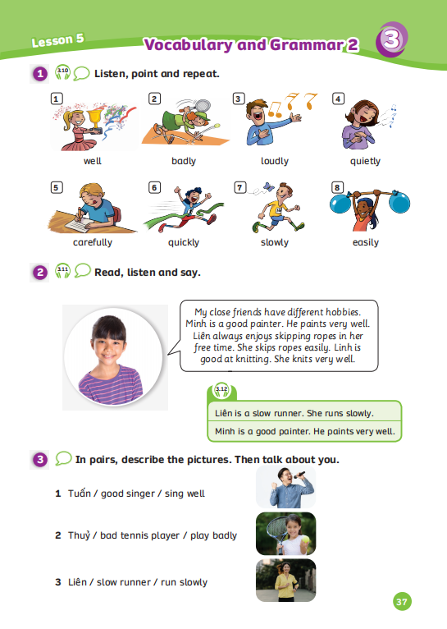
UNIT 3 – Lesson 5A
We’re learning…
To use the adverbs of manners correctly.
To use the structure: I can/ can’t knit easily.
- PB p.37
- AB p.30

Slide 3


WARM-UP ACTIVITY
Divide the class into groups of 3 or 4. Each group takes out a mini-board.
Play the video about adverb song.
Students look, listen, and count how many words ended “-ly” in the video.
Then, they write answer on the board. After finishing, they raise the paper to check the answers.
The fastest group with all the correct answers receives 2 points.

Slide 4

WARM-UP ACTIVITY
4
lazily
happily
eagerly
gracfully
ANSWER
Students look, listen, and count how many words ended “-ly” in the video.
Then, they write answer on the board.
Click on “Answer” to check the answer.

Slide 5
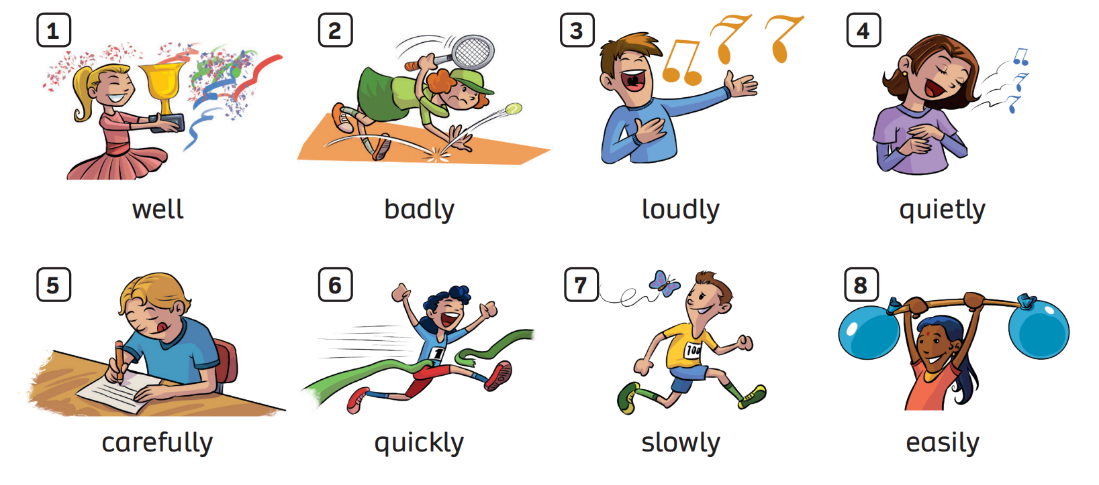
LEAD-IN
ANSWER
Have students look at the picture.
Ask students find the word ended differently from the rest.
Click on “Answer” to check the answer.

Slide 6

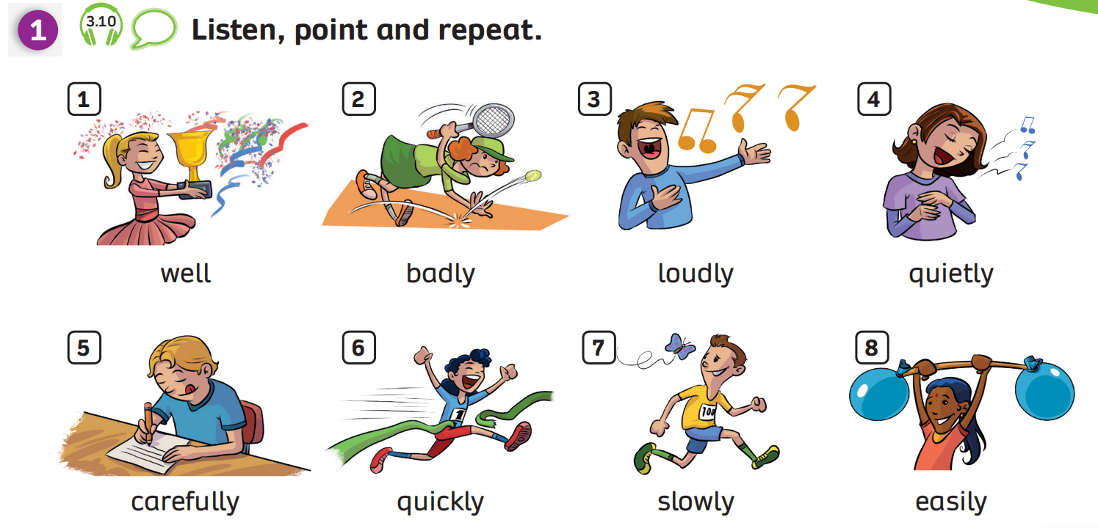
VOCABULARY
Listen and point
Have students look at the pictures and explain that in this lesson they will learn the adverbs of manners.
Students listen and point to each picture.

Slide 7
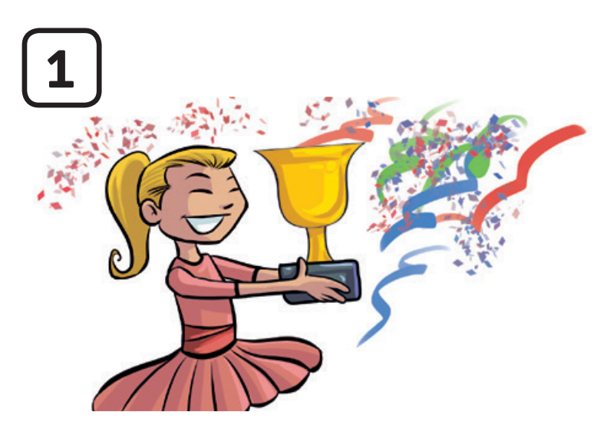


VOCABULARY
Let’s spell!
c
well
w
e
l
l
Have students look at the pictures, listen, repeat and spell the word.

Slide 8
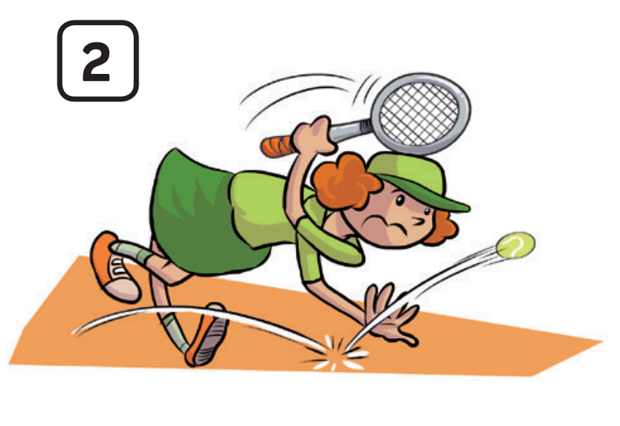
VOCABULARY
Let’s spell!
c
badly
b
a
d
l
y
Have students look at the pictures, listen, repeat and spell the word.

Slide 9

VOCABULARY
Let’s spell!
c
loudly
l
o
u
d
l
y
Have students look at the pictures, listen, repeat and spell the word.

Slide 10

VOCABULARY
c
Let’s spell!
quietly
q
u
i
e
t
l
y
Have students look at the pictures, listen, repeat and spell the word.

Slide 11
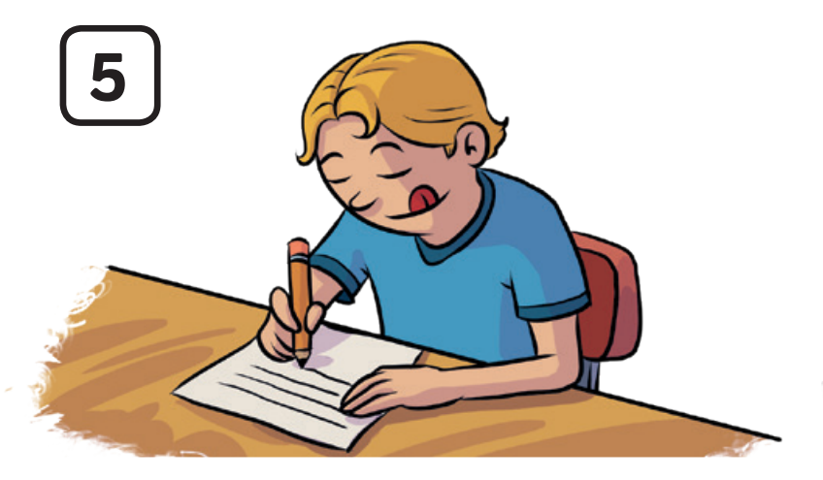
VOCABULARY
c
Let’s spell!
carefully
c
a
r
e
f
u
l
l
y
Have students look at the pictures, listen, repeat and spell the word.

Slide 12
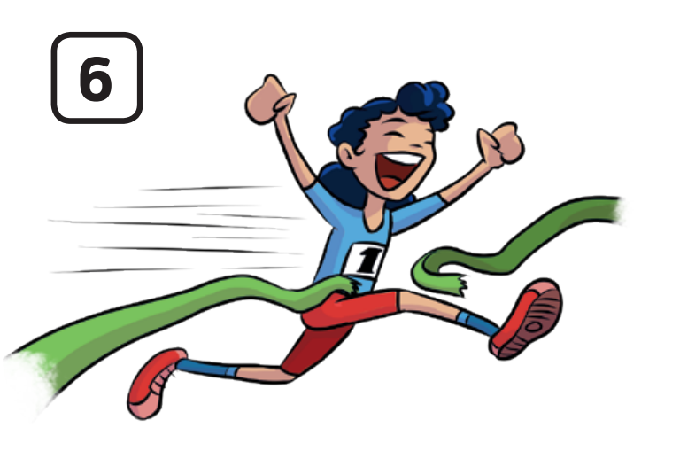
VOCABULARY
c
Let’s spell!
quickly
q
u
i
c
k
l
y
Have students look at the pictures, listen, repeat and spell the word.

Slide 13
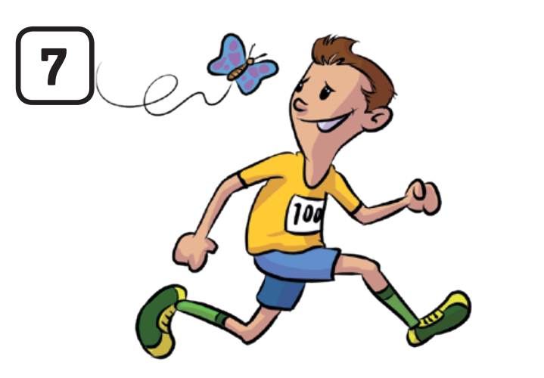
VOCABULARY
Let’s spell!
c
slowly
s
l
o
w
l
y
Have students look at the pictures, listen, repeat and spell the word.

Slide 14
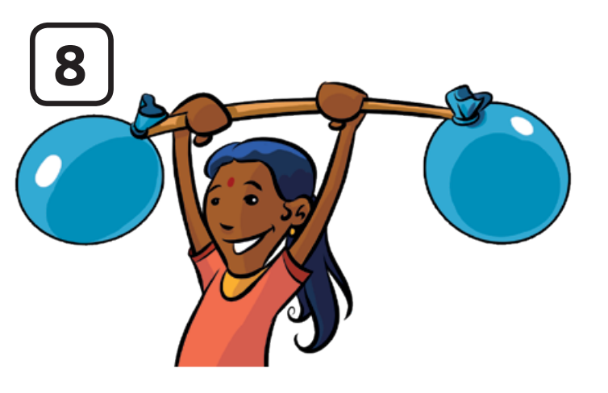
VOCABULARY
Let’s spell!
c
easily
e
a
s
i
l
y
Have students look at the pictures, listen, repeat and spell the word.

Slide 15
PUPIL’S BOOK p.37
Activity: ADVERBS OF MANNERS
Divide the class into groups of 3 or 4.
Students look at 8 words on Task 1.
When teacher says “bad” and students say “badly” (starting with number two).
The group speaks faster and clearly the answers receives 2 points.

Slide 16


PUPIL’S BOOK p.37
bad
badly
loudly
loud
Students look at 8 words on Task 1.
When teacher says “bad” and students say “badly” (starting with number two).

Slide 17
VOCABULARY - REVIEW
c
c
c
c
well
badly
loudly
quietly
c
c
c
c
carefully
quickly
slowly
easily
Show each picture, students look at and say the word.

Slide 18
VOCABULARY – Practice
Activity: BEES FIND HONEY
Divide the class into groups of 4 to 6 students and each group takes out a mini-board.
Each member takes a turn playing a game.
Show the slide with picture and sentences that missing words, students look at them and choose the correct answer.
After finishing, they raise the board to check the answer.
The fastest group with the correct answer receives 2 points for the team.

Slide 19





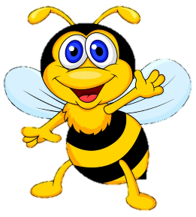






Ms Huyền Phạm
0936.082.789
Ms Huyền Phạm
0936.082.789
Ms Huyền Phạm
0936.082.789
Ms Huyền Phạm - 0936.082.789 – YOUTUBE: MsPham. Facebook: Dạy và học cùng công nghệ.
Ms Huyền Phạm
0936.082.789
Notes:
Ms Huyền Phạm - 0936.082.789 – YOUTUBE: MsPham. Facebook: Dạy và học cùng công nghệ.

Slide 20

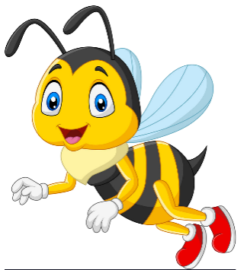
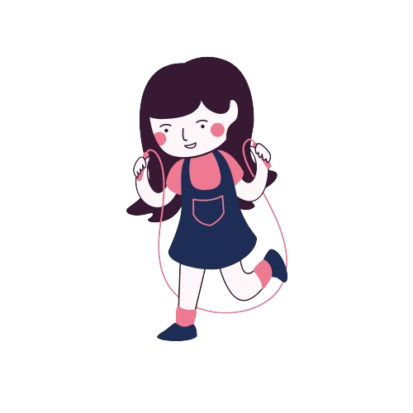





She skips ropes very ……...
well
Next
badly
loudly
quietly
well
Notes:
Ms Huyền Phạm - 0936.082.789 – YOUTUBE: MsPham. Facebook: Dạy và học cùng công nghệ.

Slide 21
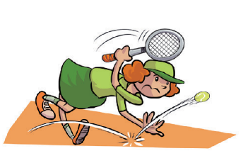
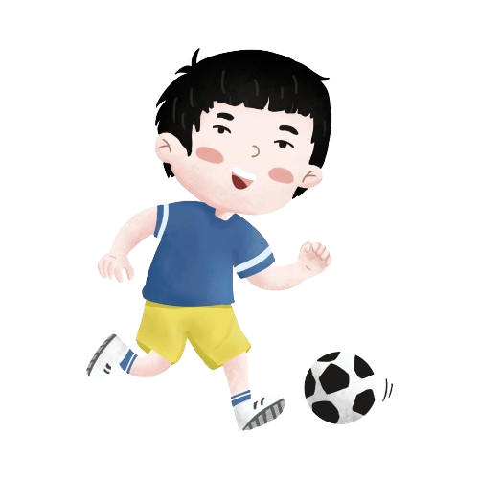
badly
He kicks a ball …….....
Next
easily
slowly
badly
quickly
Notes:
Ms Huyền Phạm - 0936.082.789 – YOUTUBE: MsPham. Facebook: Dạy và học cùng công nghệ.

Slide 22
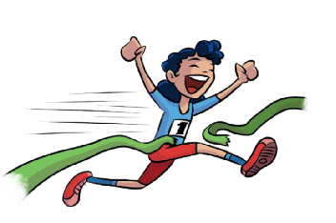
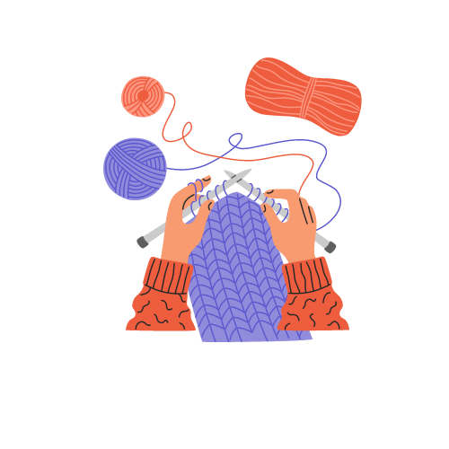
quickly
She knits …………...
Next
well
quickly
drowing
dawing
Notes:
Ms Huyền Phạm - 0936.082.789 – YOUTUBE: MsPham. Facebook: Dạy và học cùng công nghệ.

Slide 23


quietly
He sings …………..
Next
quietly
badly
easily
carefully
Notes:
Ms Huyền Phạm - 0936.082.789 – YOUTUBE: MsPham. Facebook: Dạy và học cùng công nghệ.

Slide 24

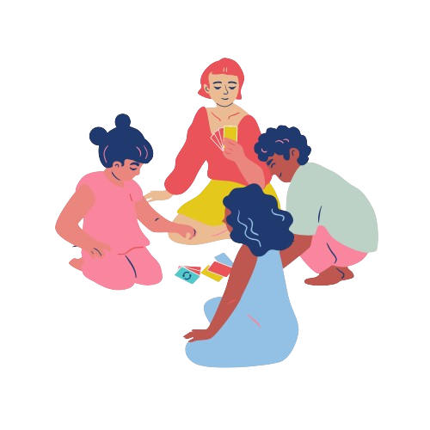
They play board games …………...
loudly
Next
quietly
loudly
well
slowly
Notes:
Ms Huyền Phạm - 0936.082.789 – YOUTUBE: MsPham. Facebook: Dạy và học cùng công nghệ.

Slide 25


She goes fishing ………..
easily
Next
quietly
badly
easily
loudly
Notes:
Ms Huyền Phạm - 0936.082.789 – YOUTUBE: MsPham. Facebook: Dạy và học cùng công nghệ.

Slide 26
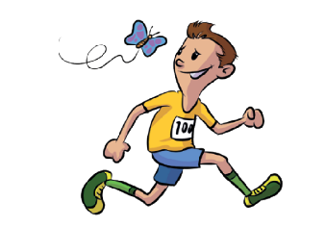
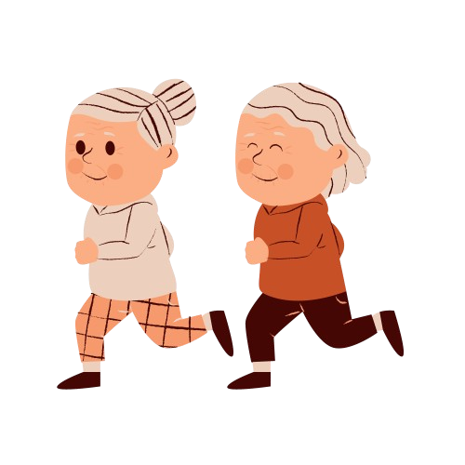
slowly
They run ……....
Next
slowly
easily
loudly
carefully
Notes:
Ms Huyền Phạm - 0936.082.789 – YOUTUBE: MsPham. Facebook: Dạy và học cùng công nghệ.

Slide 27
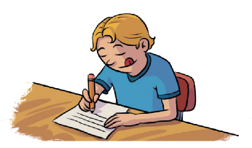

She does homework …………...
carefully
Next
easily
slowly
carefully
quickly
Notes:
Ms Huyền Phạm - 0936.082.789 – YOUTUBE: MsPham. Facebook: Dạy và học cùng công nghệ.

Slide 28
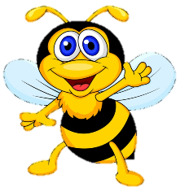







Notes:
Ms Huyền Phạm - 0936.082.789 – YOUTUBE: MsPham. Facebook: Dạy và học cùng công nghệ.

Slide 29
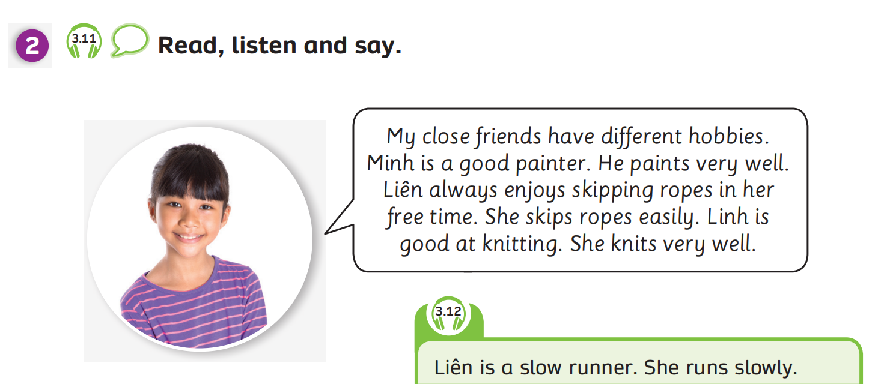

GRAMMAR – Pupils’ book (p.37)
VERBS
ADVERBS
Have students look at the speech bubble and read it.
Play the audio, students listen and circle the verbs and underline the adverbs of manners that they can remember from the passage.
Click on “Verbs” to check answer of verbs, “Adverbs” to check answer of adverbs.

Slide 30
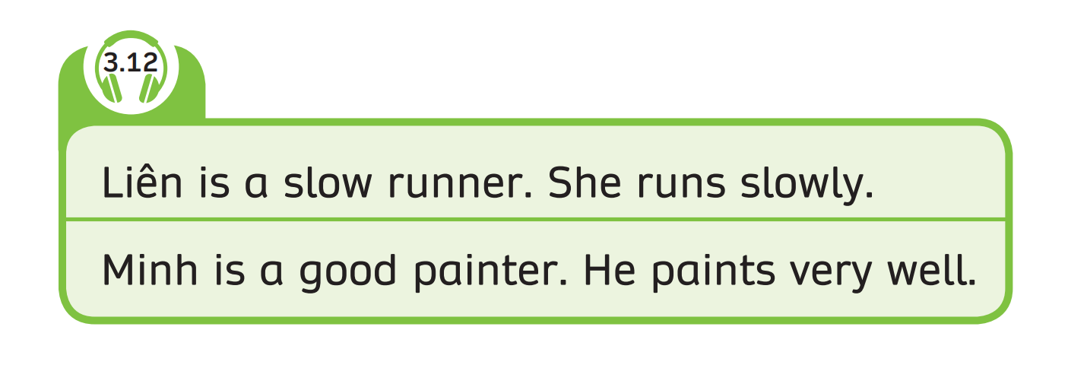
GRAMMAR – Pupils’ book (p.37)
Have students look at the box.
Play the audio, students listen.

Slide 31
GRAMMAR – Pupils’ book (p.37)
STRUCTURE – SENTENCES
Use these sentences about hobbies with the adverbs of manners.
S + V + Adv

Slide 32
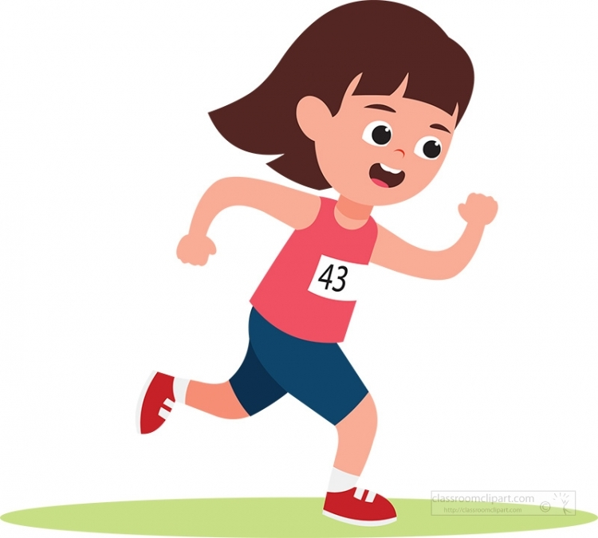


GRAMMAR – Pupils’ book (p.37)
S + V + Adv
Liên
run/ slowly
Liên runs slowly.

Slide 33
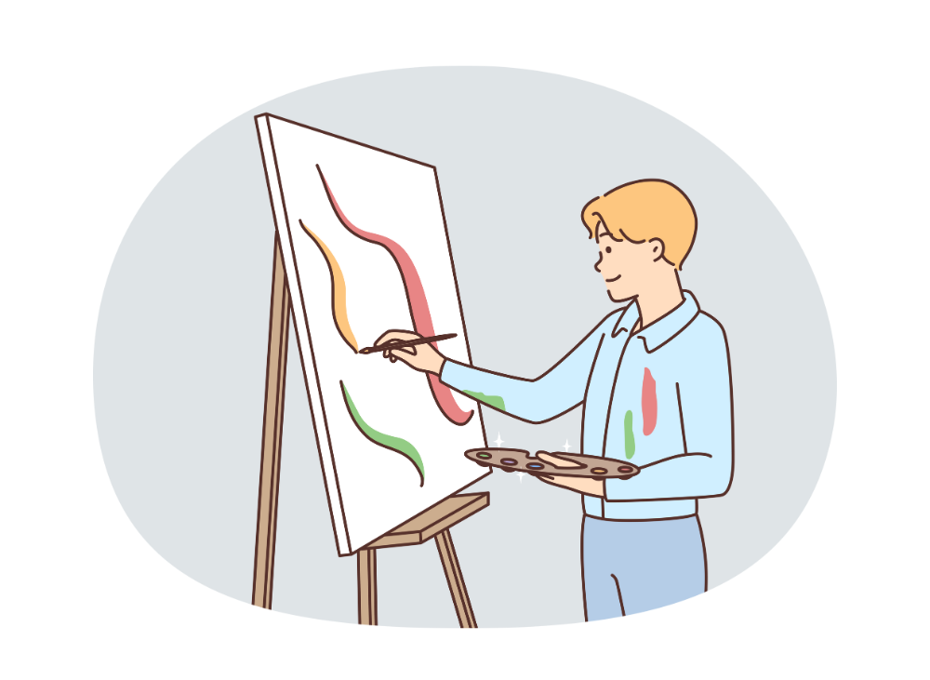
GRAMMAR – Pupils’ book (p.37)
S + V + Adv
Minh
paint/ well
Minh paints very well.

Slide 34
PRODUCE
She / go / badly.
ANSWER
She goes fishing badly.
Have students look at the slide and make these sentences with the prompt words.
Click on “answer” to check the correct answer.

Slide 35
PRODUCE
I / knit / quickly
ANSWER
I knit quickly.
Have students look at the slide and make these sentences with “be good at” and “like/ love/ enjoy”.
Click on “answer” to check the correct answer.

Slide 36
PRODUCE
They / run / slowly
ANSWER
They run slowly.
Have students look at the slide and make these sentences with “be good at” and “like/ love/ enjoy”.
Click on “answer” to check the correct answer.

Slide 37
HOMEWORK
Review Vocabulary and Grammar.
Do exercises in the Activity Book (page 30).
Check answers in the Teacher’s book (page 68) or Active Teach.

Slide 38
UNIT 3 – Lesson 5A
We’ve learned…
To use the adverbs of manners correctly.
To use the structure: I can/ can’t knit easily.
- PB p.37
- AB p.30

