Slide 1



UNIT 3 – HOBBIES
Lesson 5B – Vocabulary and Grammar 2

Slide 2
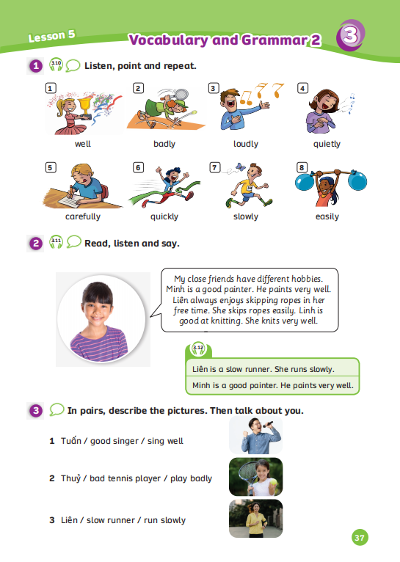
UNIT 3 – Lesson 5B
We’re learning…
To use the adverbs of manners correctly.
To use the structure: I can/ can’t knit easily.
- PB p.37
- AB p.30

Slide 3

WARM-UP ACTIVITY
Divide the class into groups of 3 or 4. Each group takes out a mini-board or a sheet of paper.
Show unscrambled words on the slide, students look at them and write the correct sentences.
After finishing, they raise the board or paper to check the answers.
The fastest group with all the correct answers receives 2 points.

Slide 4




slowly. / skips ropes / She
Check
She skips ropes slowly.

Slide 5

play
the piano / They / easily.
Check
They play the piano easily.

Slide 6
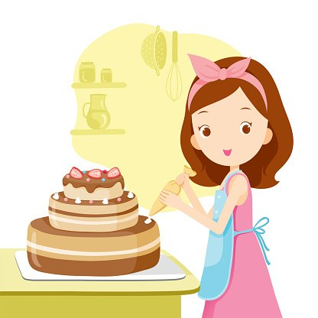

sings / Buddy /
loudly.
Check
Buddy sings loudly.

Slide 7
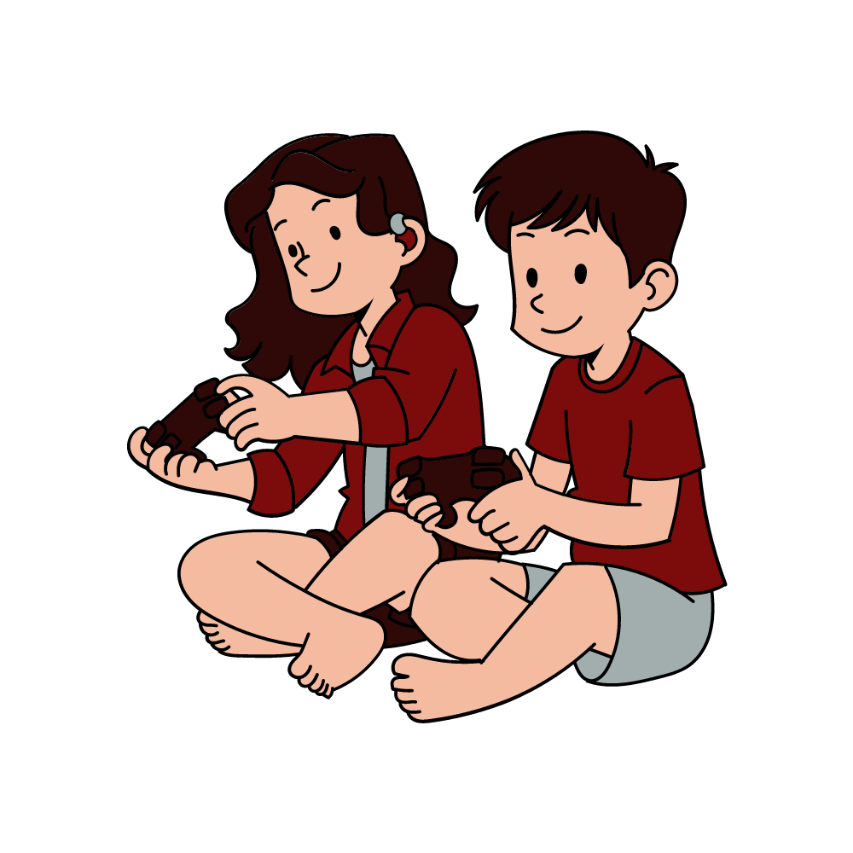
play computer games / badly. / They
Check
They play computer games badly.

Slide 8
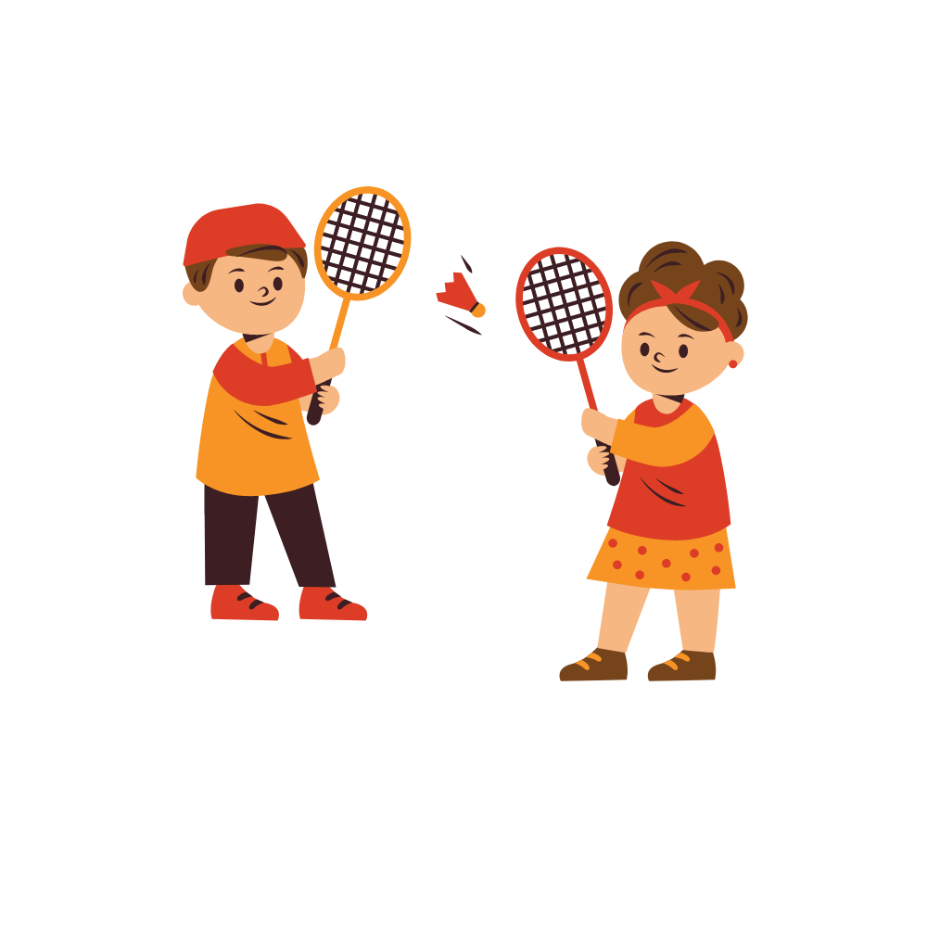
Sammy and Tom /
play badminton / very well.
Check
Sammy and Tom play badminton very well.

Slide 9
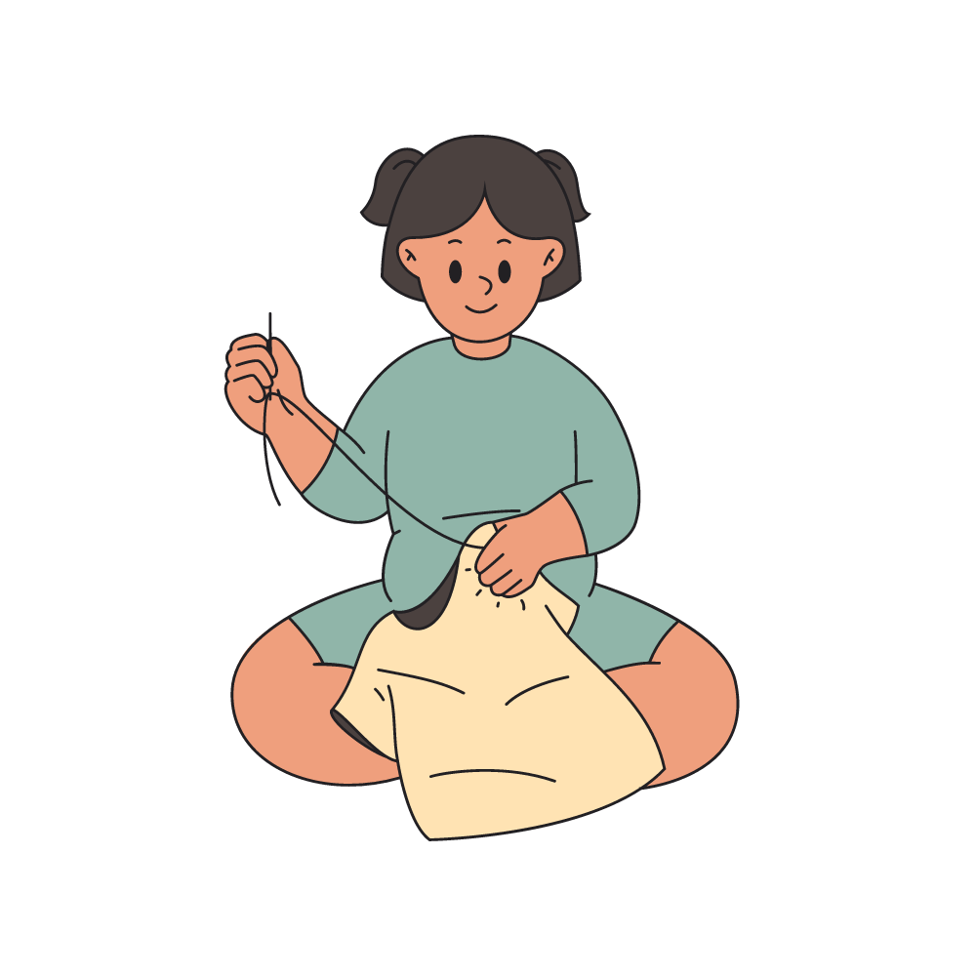
sews / quickly. /
Lily
Check
Lily sews quickly.

Slide 10
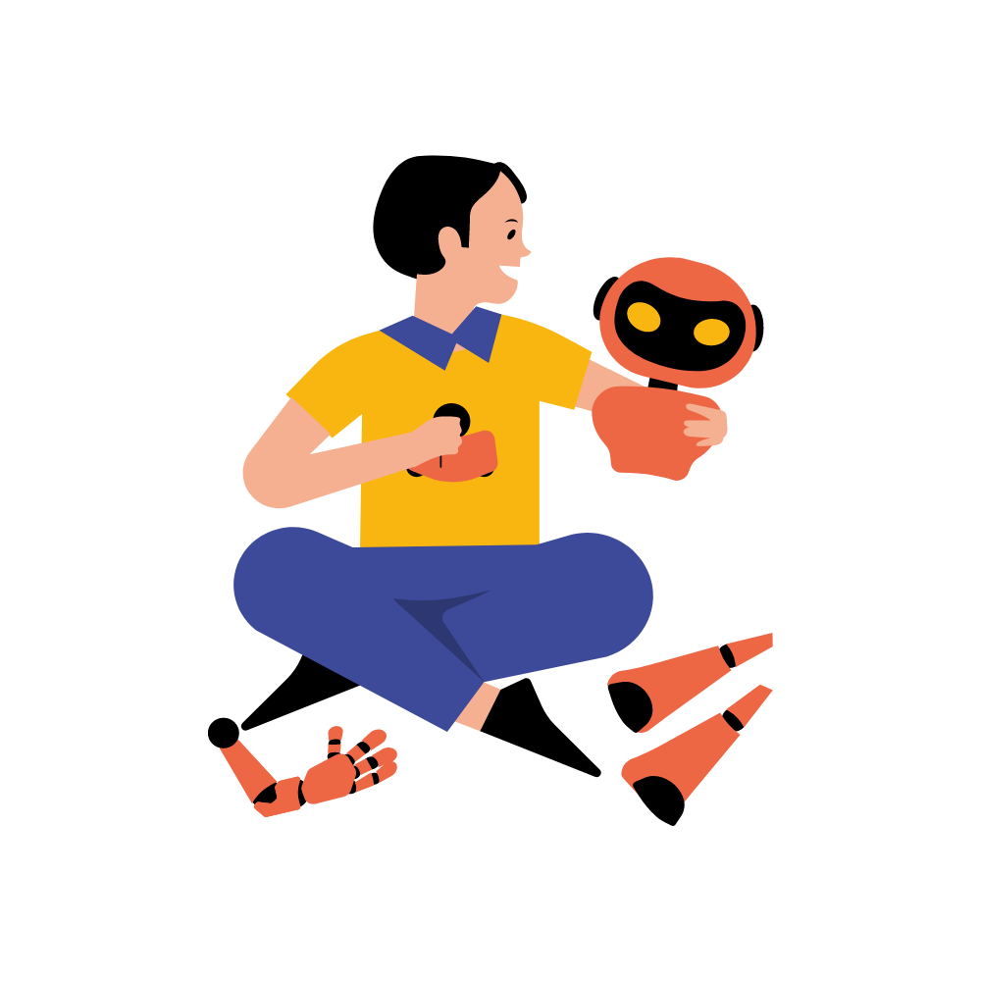
carefully. / builds a robot / Minh
Check
Minh builds a robot carefully.

Slide 11

End

Slide 12
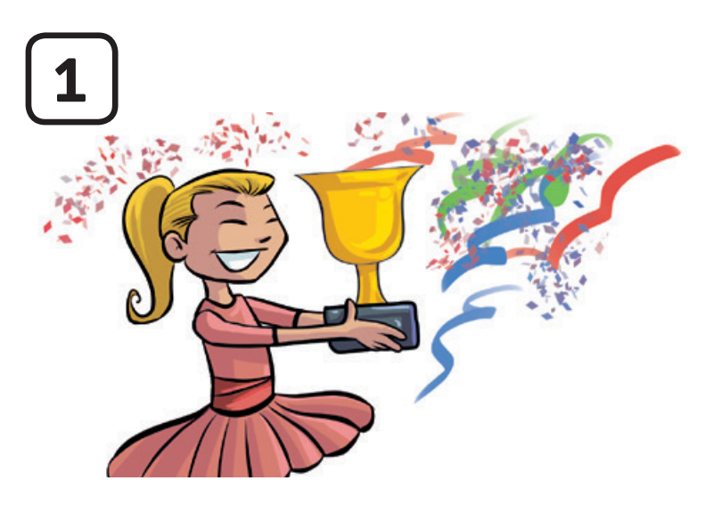
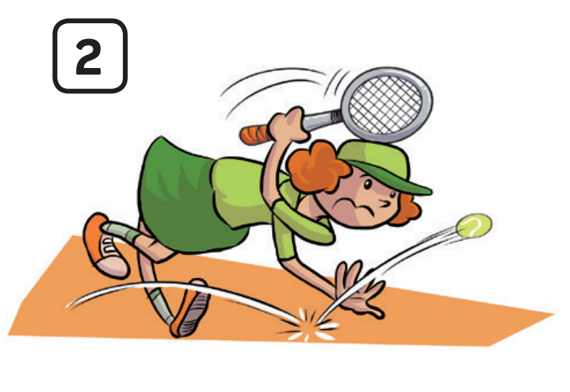


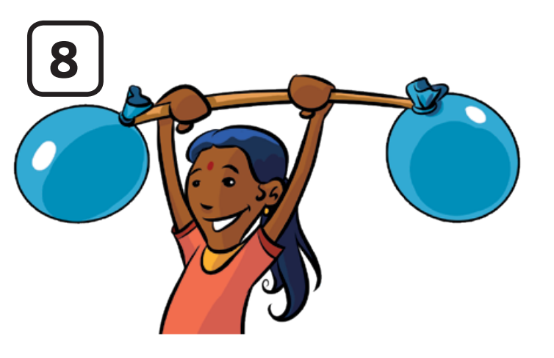
VOCABULARY REVIEW
1
2
3
4
c
c
c
c
well
badly
loudly
easily
The teacher says a number and the students say a word.
Click on “Number” to show the word to check.

Slide 13

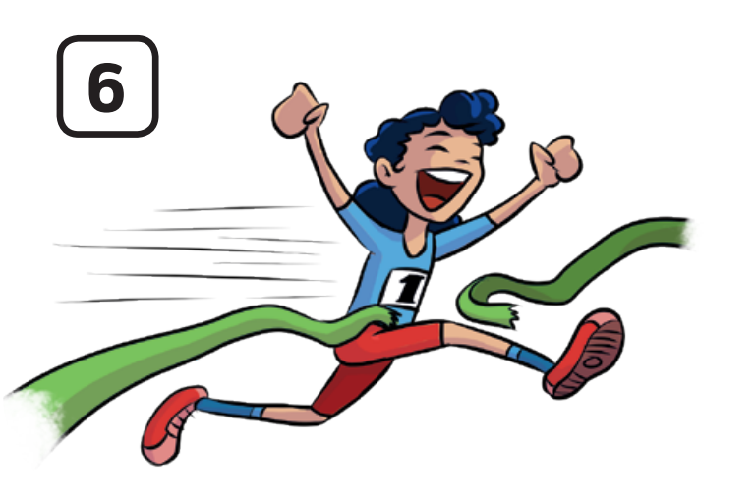
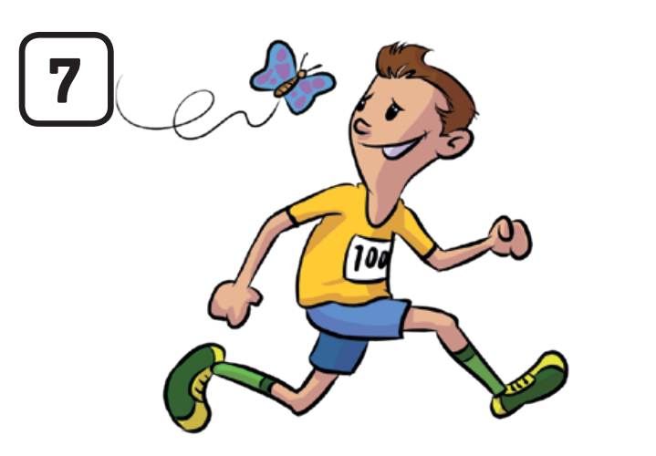
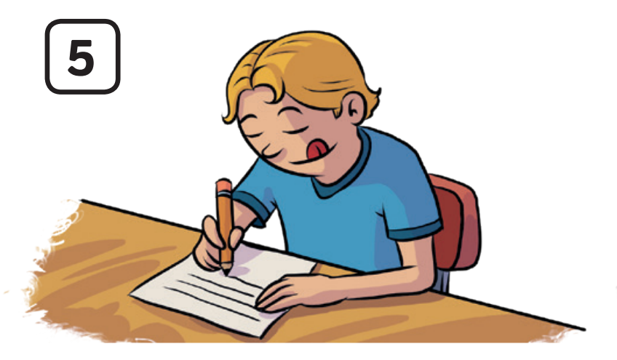
VOCABULARY REVIEW
5
6
7
8
c
c
c
c
quietly
carefully
quickly
slowly
The teacher says a number and the students say a word.
Click on “Number” to show the word to check.

Slide 14

GRAMMAR PRACTICE
STRUCTURE – SENTENCES
Use these sentences about hobbies with the adverbs and adjective.
S + V + Adv
S + is/am/are + Adj + Noun

Slide 15

GRAMMAR PRACTICE
ADJECTIVE
ADVERB
good
well
bad
badly
loud
loudly
quiet
quietly
careful
carefully
quick
quickly
slow
slowly
easy
easily

Slide 16
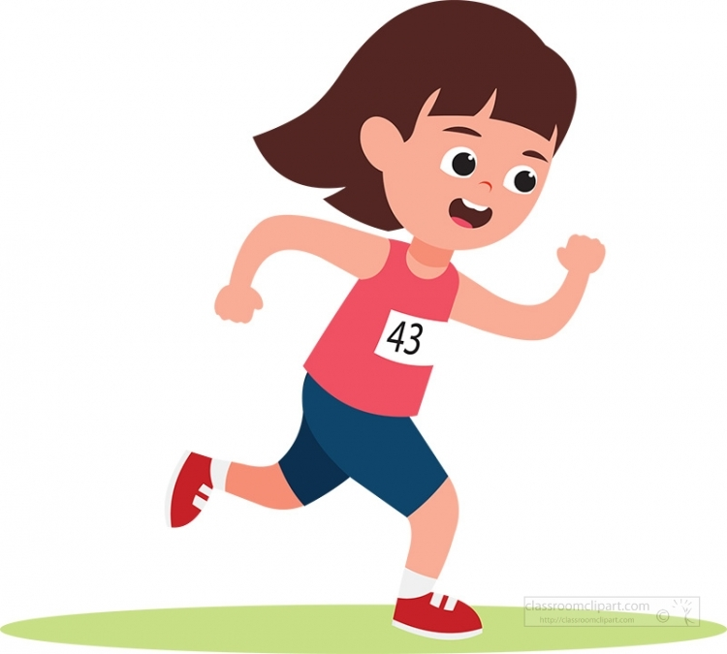


GRAMMAR PRACTICE
S + V + Adv
S + is/am/are + Adj + Noun
run/ slowly
slow / runner
Liên runs slowly.
Liên is a slow runner.
Liên

Slide 17
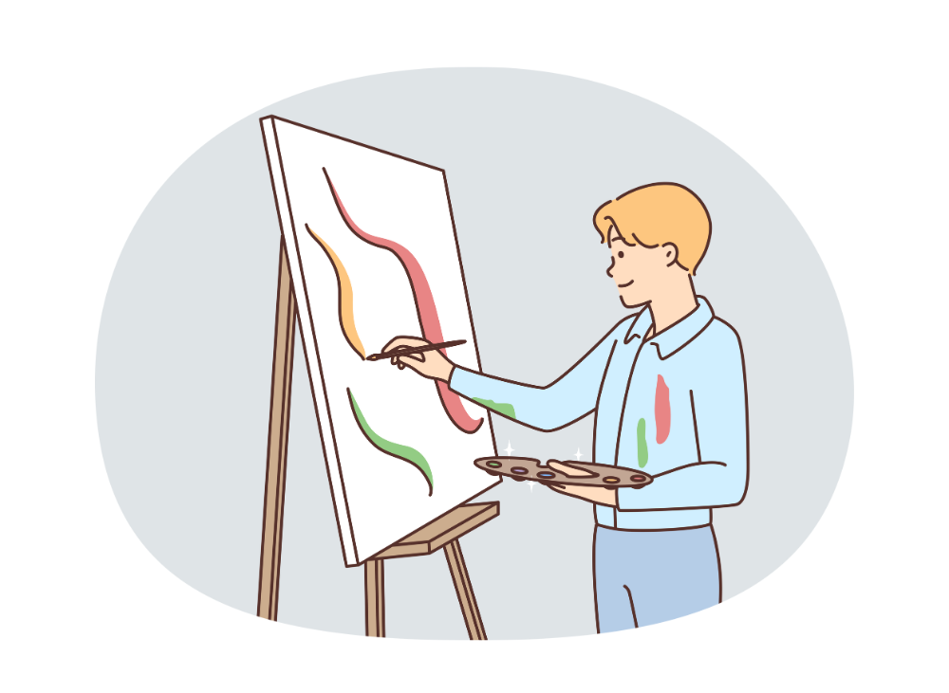
GRAMMAR PRACTICE
S + V + Adv
S + is/am/are + Adj + Noun
paint/ well
good / painter
Minh paints very well.
Minh is a good painter.
Minh

Slide 18
GRAMMAR PRACTICE
Divide the class into groups of 3 or 4. Take out a sheet of paper or mini-board.
Students look at the slide with the prompt words and write the final sentences on the paper or board.
After finishing, they raise the paper or board to check answer.
The fastest group with correct the answers receives 2 points.

Slide 19
GRAMMAR PRACTICE
She / sew / badly.
ANSWER
She sews badly.
Have students look at the slide and make these sentences with the prompt words.
Click on “answer” to check the correct answer.

Slide 20
GRAMMAR PRACTICE
They / bad / badminton players
ANSWER
They are bad badminton players.
Have students look at the slide and make these sentences with “be good at” and “like/ love/ enjoy”.
Click on “answer” to check the correct answer.

Slide 21
GRAMMAR PRACTICE
They / play computer games / very well
ANSWER
They play computer games very well.
Have students look at the slide and make these sentences with “be good at” and “like/ love/ enjoy”.
Click on “answer” to check the correct answer.

Slide 22
GRAMMAR PRACTICE
Liên / run / quickly
ANSWER
Liên runs quickly.
Have students look at the slide and make these sentences with “be good at” and “like/ love/ enjoy”.
Click on “answer” to check the correct answer.

Slide 23
GRAMMAR PRACTICE
He / build a robot / easily
ANSWER
He builds a robot easily.
Have students look at the slide and make these sentences with “be good at” and “like/ love/ enjoy”.
Click on “answer” to check the correct answer.

Slide 24
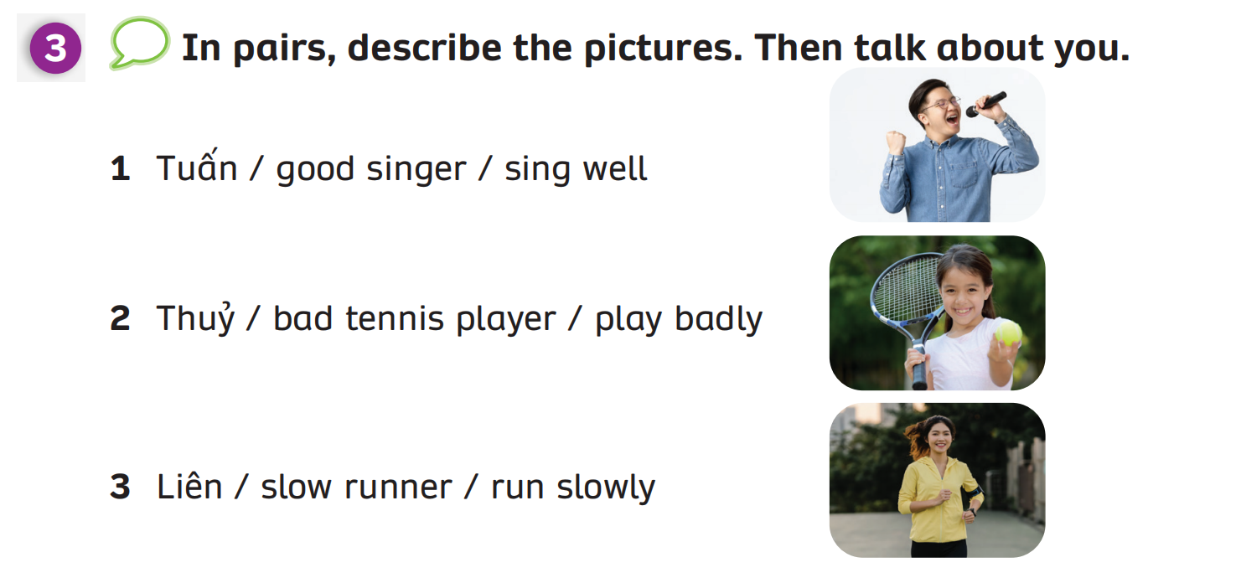
GRAMMAR PRACTICE
Have students work in pairs look at the picture.
Then, describe the pictures with the prompt words.
Invite some students present in front of class.

Slide 25


GRAMMAR PRACTICE
Tuấn is a good singer.
He sings very well.
Have students work in pairs look at the picture.
Then, describe the pictures with the prompt words.
Invite some students to present in front of class.

Slide 26
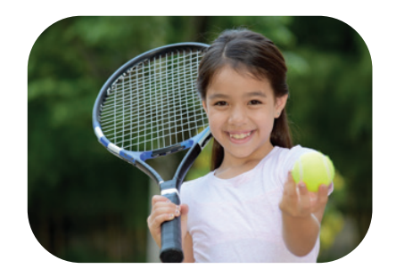

GRAMMAR PRACTICE
Thủy is a bad tennis player.
She plays badly.
Have students work in pairs look at the picture.
Then, describe the pictures with the prompt words.
Invite some students to present in front of class.

Slide 27


GRAMMAR PRACTICE
Liên is a slow runner.
She runs slowly.
Have students work in pairs look at the picture.
Then, describe the pictures with the prompt words.
Invite some students to present in front of class.

Slide 28
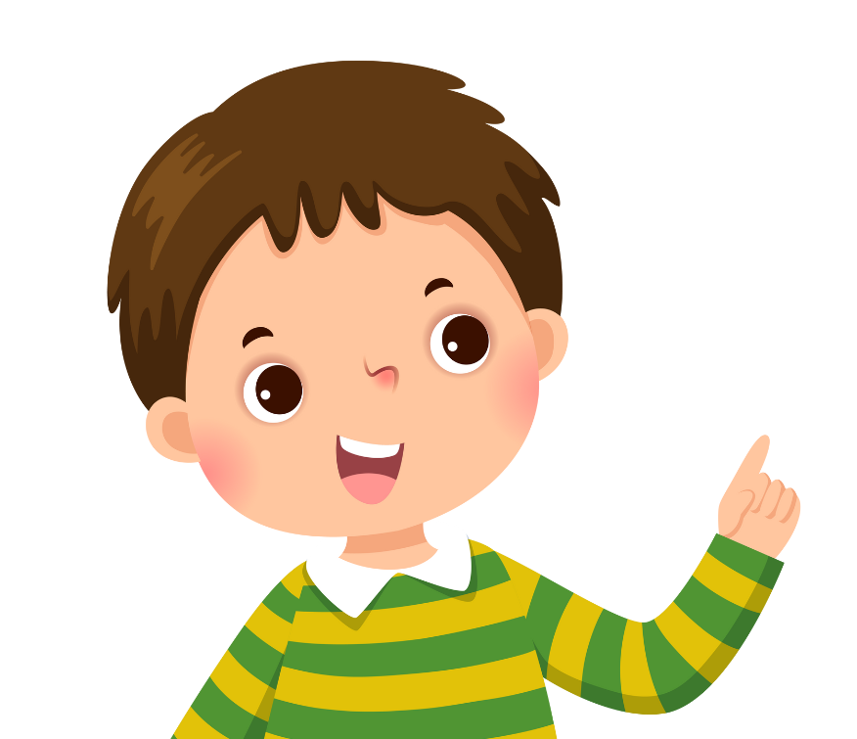

PRODUCTION
What are your hobbies?
Well, I always enjoy
.....
Oh, you are a .... .....!
I .... ....
Put students in pairs.
Students ask/answer about their hobbies with adjective or adverb sentences and then switch roles.
Invite some students to present in front of class and receives 2 points.
Example on the next slide.

Slide 29
PRODUCTION
EXAMPLE
What are your hobbies?
Well, I always enjoy
playing chess.
Oh, you are a good chess player!
I play chess very well.

Slide 30
HOMEWORK
Review Vocabulary and Grammar.
Do exercises in the Activity Book (page 30).
Check answers in the Teacher’s book (page 68) or Active Teach.

Slide 31
UNIT 3 – Lesson 5B
We’ve learned…
To use the adverbs of manners correctly.
To use the structure: I can/ can’t knit easily.
- PB p.37
- AB p.30

