Slide 1



UNIT 3 – HOBBIES
Lesson 8 – Skills

Slide 2
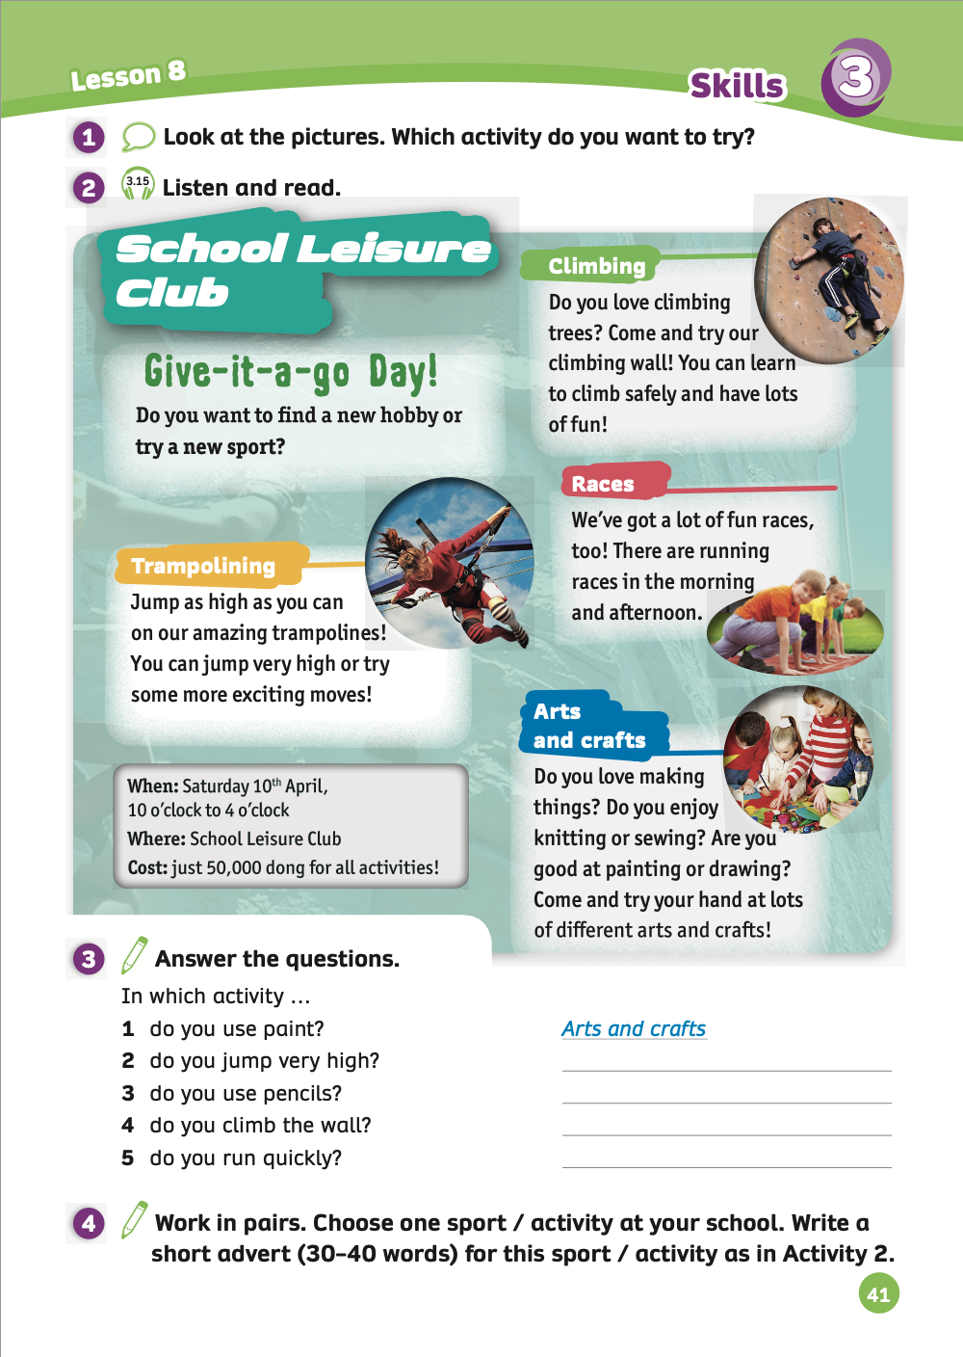
UNIT 3 – Lesson 8
We’re learning…
To read and listen about school leisure clubs.
- PB p.41
- AB p.33

Slide 3


WARM-UP ACTIVITY
- Divide the class into pairs. Each pair takes out a mini-board.
Students look at the slide and discuss with their partners to choose one activity different from the other three activities.
Each student takes turns writing the answer.
After finishing, students raise their boards to check the answers.
The 5 fastest pairs with the correct answer receive 2 points.

Slide 4

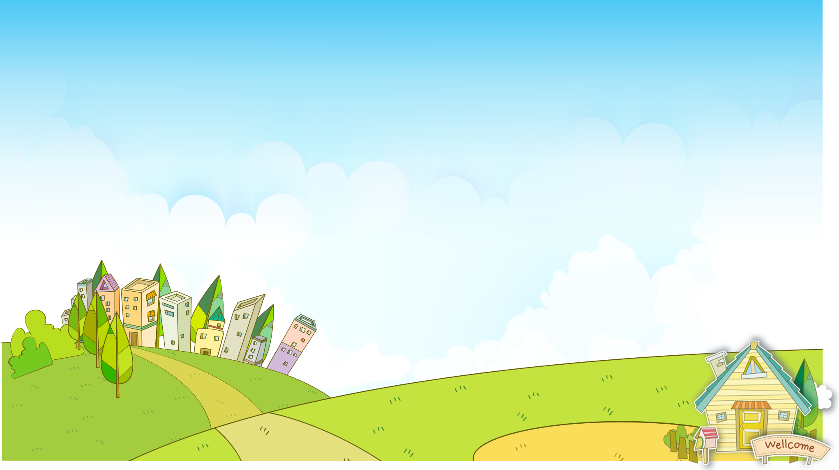




Odd one out
PLAY

Slide 5
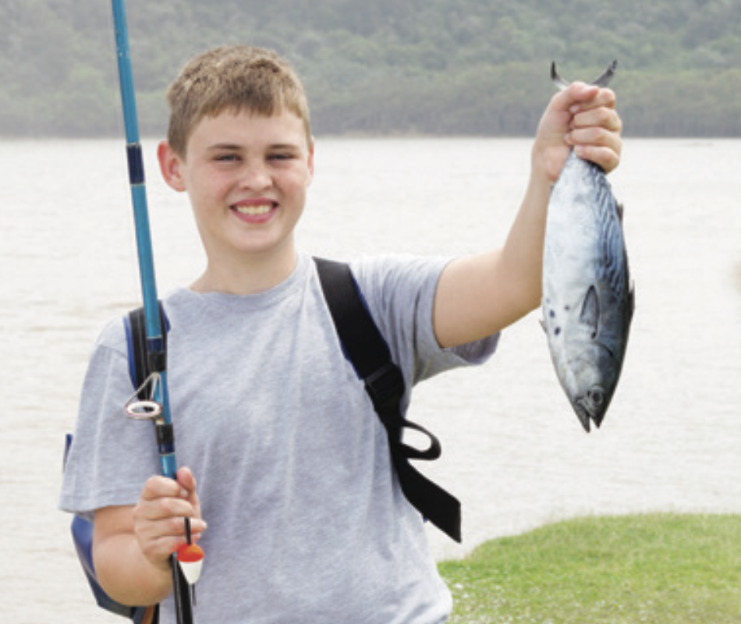

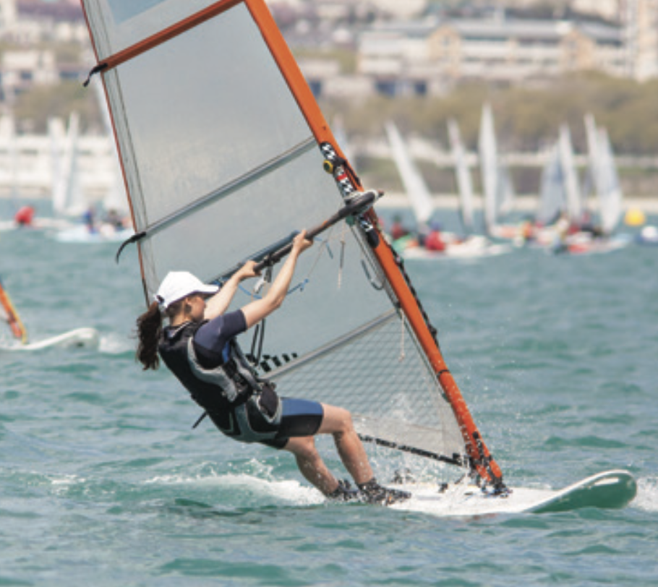
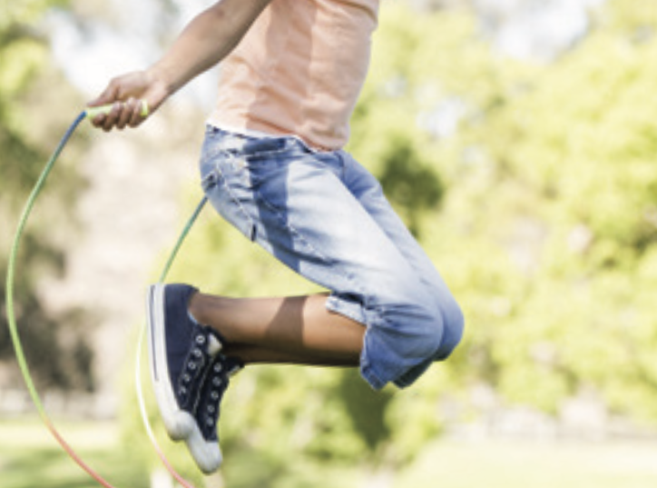
Odd one out
Next

Slide 6
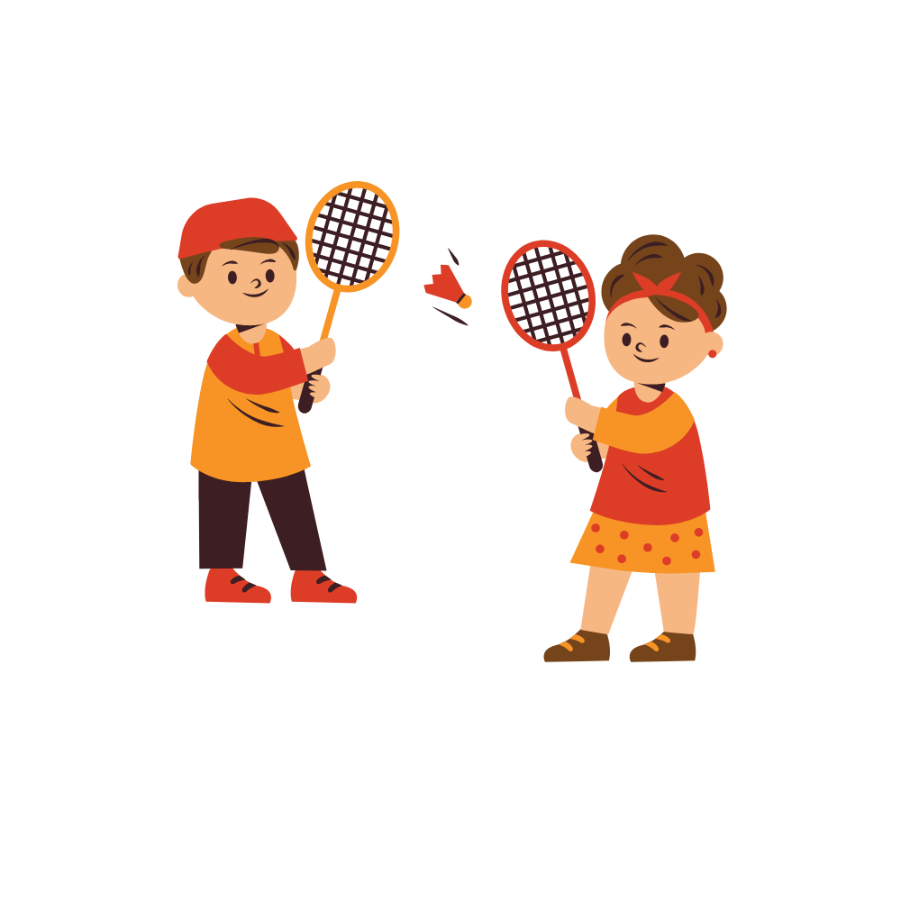
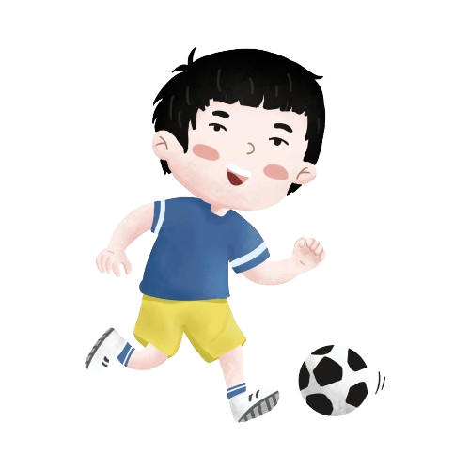

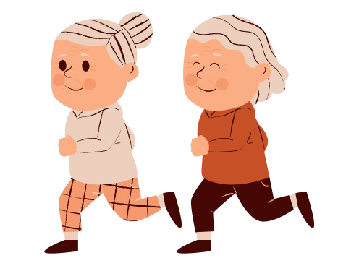
Odd one out
Next

Slide 7
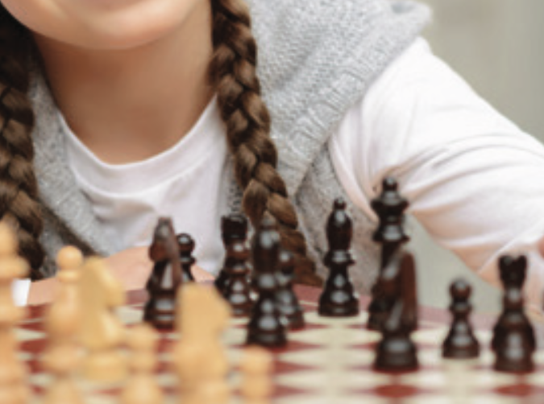
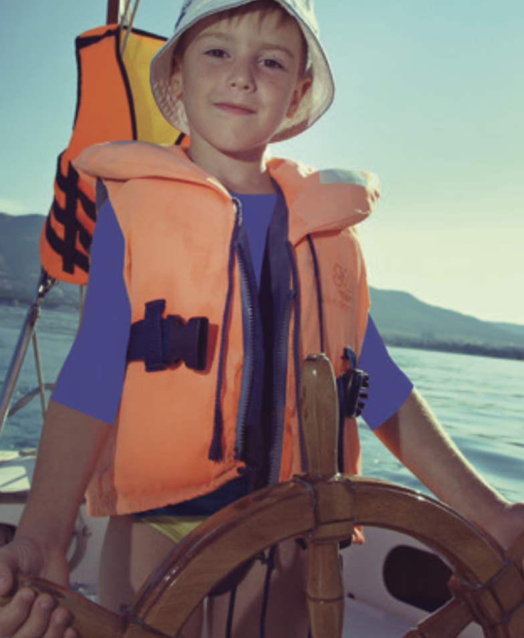
Odd one out
Next

Slide 8
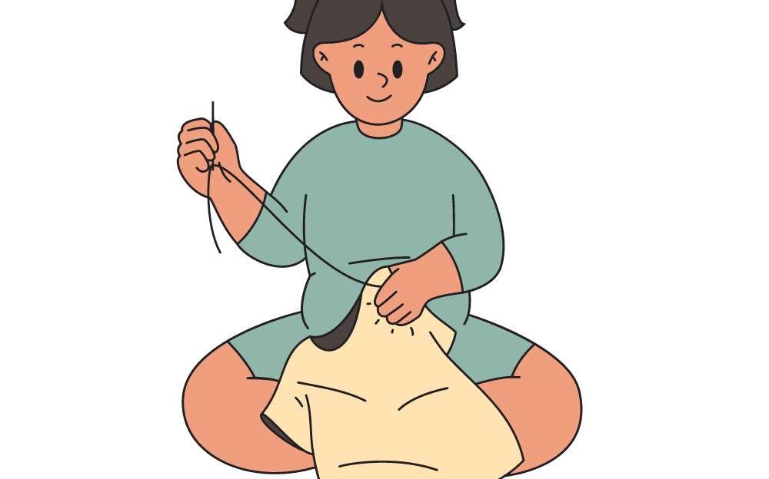

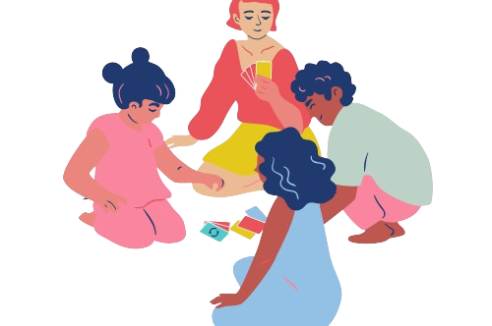
Odd one out
Next

Slide 9

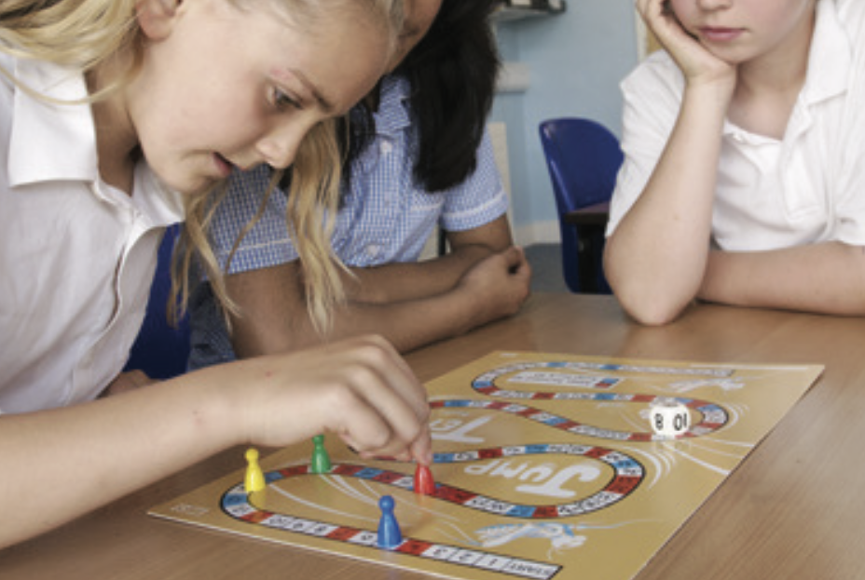
Odd one out
Next

Slide 10




Great job!
End

Slide 11




VOCABULARY
Let’s spell!
Trampolining
t
r
a
m
p
o
l
i
n
i
n
g
Students look, listen, and read out loud.

Slide 12
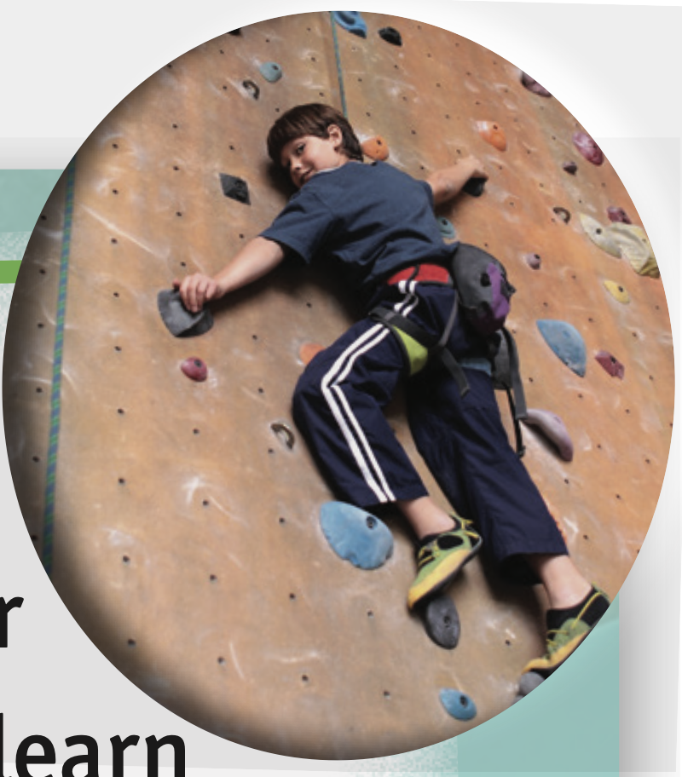
VOCABULARY
Let’s spell!
Climbing
c
l
i
m
b
i
n
g
Students look, listen, and read out loud.

Slide 13


PUPILS’ BOOK p.41
Trampolining
Climbing
Races
Arts and crafts
Have students look at the picture, then name the activity.
Have students work in pairs to ask about the question:” Which activity do you want to try?” and answer:” I want to try….”
Example on the next slide.

Slide 14



PUPILS’ BOOK p.41
EXAMPLE
Which activity do you want to try?
I want to try trampolining.
Invite some pairs to present in front of the class and give them 2 points.

Slide 15
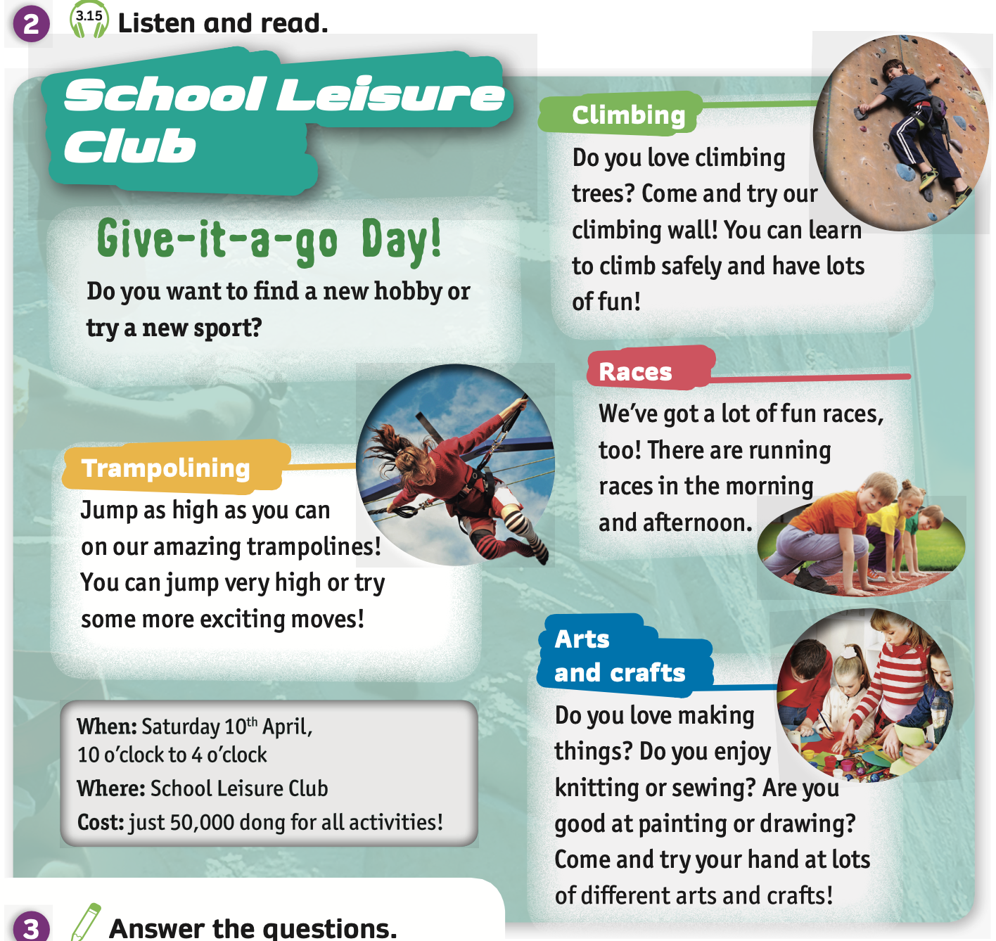
PUPILS’ BOOK p.41
Listen and point
Listen
Play the audio, students listen and point each activity.

Slide 16
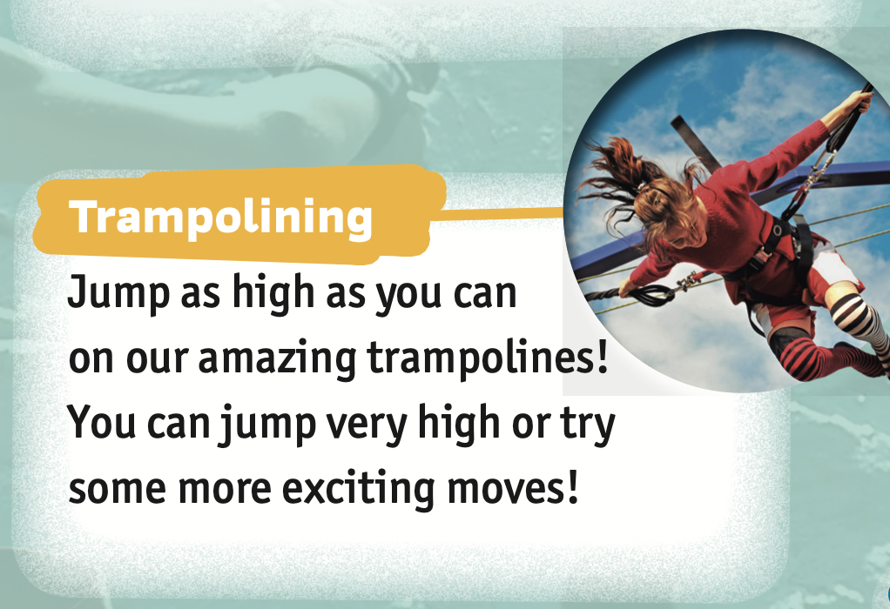
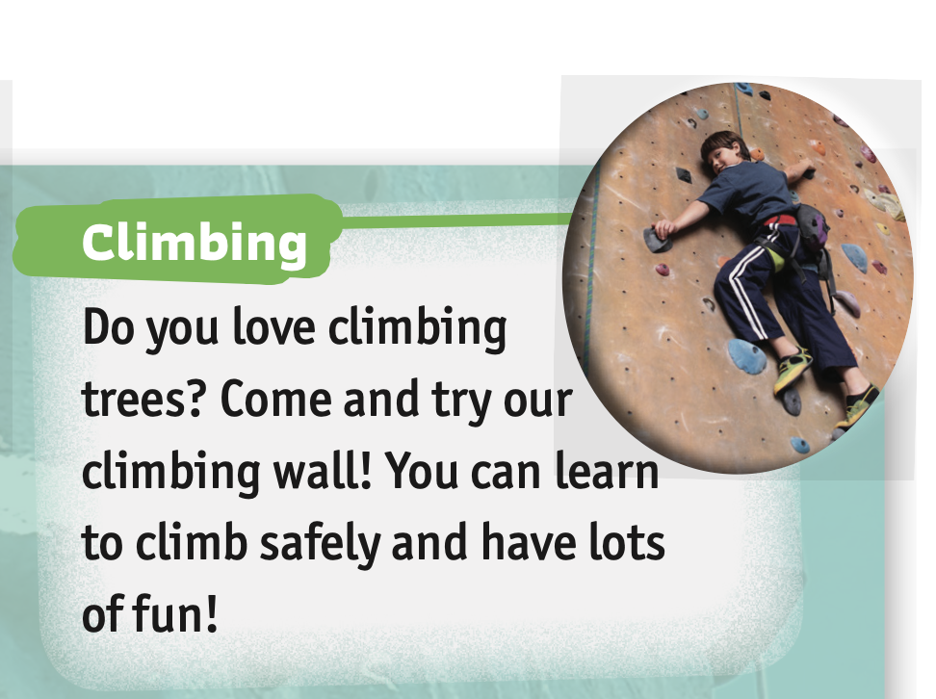
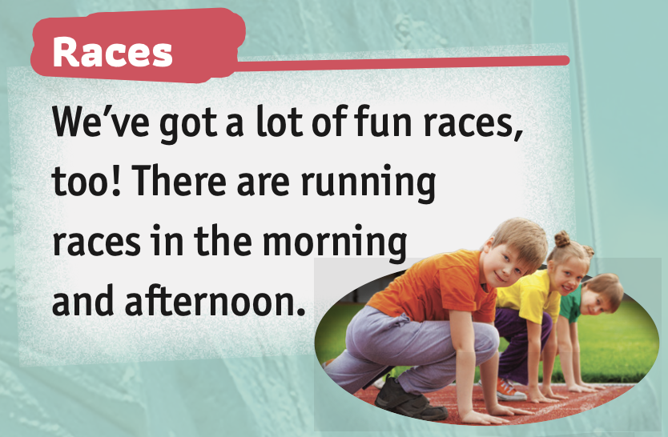
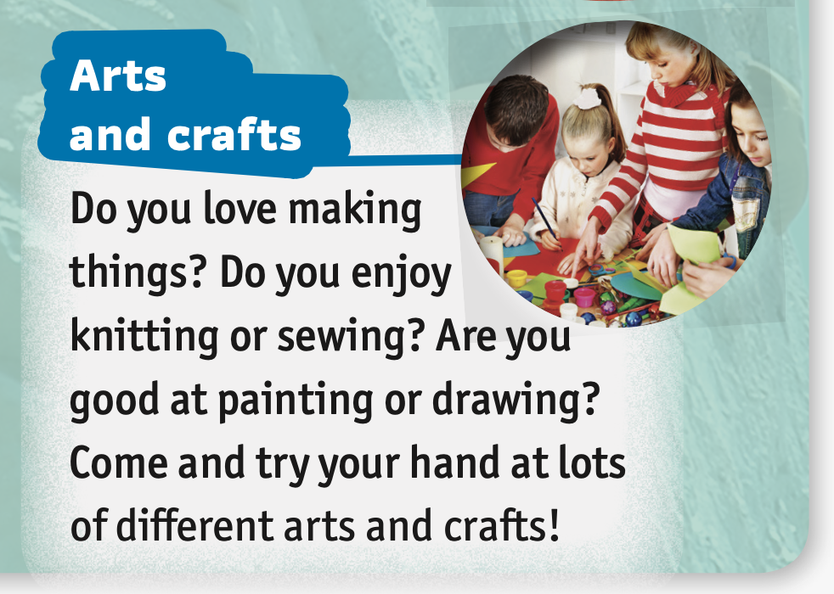
PUPILS’ BOOK p.41
Listen and read
1
2
1
2
3
3
4
4
Play the audio again, students listen and read each activity.

Slide 17
PUPILS’ BOOK p.41
- Divide the class into pairs. Each pair takes out 4 sheet of papers.
Students write 4 activities from Task 2 on 4 papers.
Teacher says different statements from the passage. Ex: You can jump on trampolines.
Then, students guess what it’s about and raise the answer.
The 5 fastest pairs with the correct answer receive 2 points.

Slide 18



PUPILS’ BOOK p.41
EXAMPLE
You can jump on a trampoline.
trampolining
climbing

Slide 19
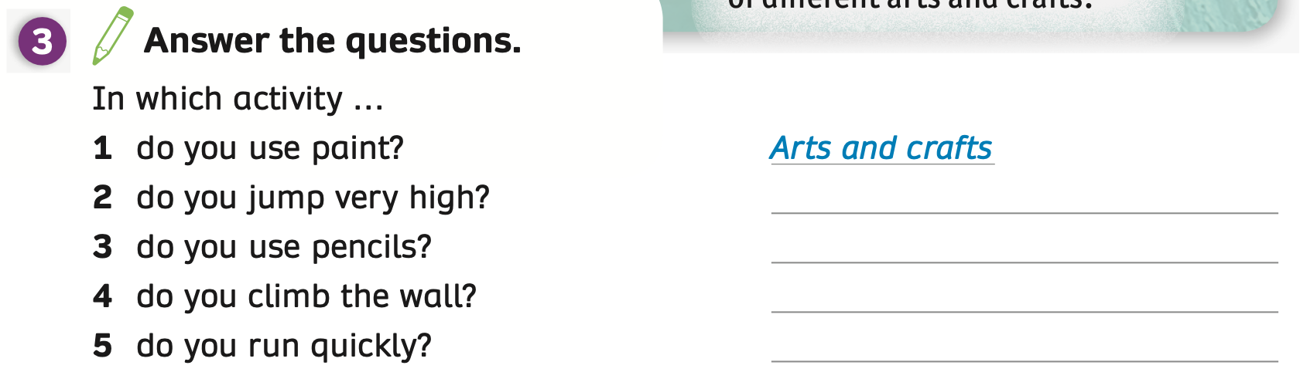
PUPILS’ BOOK p.41
Trampolining
Arts and crafts
Climbing
Races
ANSWER
Have students read the passage on Task 2.
Put students in pairs to discuss and answer about 5 questions.
Click on “Answer” to check.

Slide 20


PUPILS’ BOOK p.41
Build a robot
Trampolining
Dress up
Climbing
Skip ropes
Races
Knit
Football
Play chess
Badminton
Put students work in pairs and call out the names of activities or sports at school.

Slide 21

PUPILS’ BOOK p.41
- Divide the class into groups of 3 or 4. Each group takes out a sheet of paper.
Students discuss and lead out the adverbs, verbs, and adjectives related to activities..
After finishing, invite some groups to check the answer and receive 2 points.

Slide 22
PUPILS’ BOOK p.41
Adverbs
Verbs
Adjectives
quickly
play
good
slowly
be good at
funny
well
be bad at
amazing
carefully
kick
badly
practice
enjoy
Football
love

Slide 23

PUPILS’ BOOK p.41
Adverbs
Verbs
Adjectives
quickly
knit
amazing
slowly
sew
creative
well
cut
carefully
paint
badly
draw
Arts and crafts
relax
enjoy

Slide 24

PRODUCTION
Invite some students to present in front of the class. Give points if they give a good presentation.

Slide 25
PUPILS’ BOOK p.41
EXAMPLE
Sports/Activities: football, climbing, knit,….
Adjectives: love, enjoy, like,….
Verbs: play, kick, draw, climb,…
Adverbs: well, quickly, slowly, carefully,…
Do you …. ….?
You can ….
Are you good/bad at ….
Come and try ….
Invite some students to present in front of the class. Give points if they give a good presentation.

Slide 26
HOMEWORK
Review vocabulary and grammar.
Do exercises in the Activity book (page 33).
Check answers in the Teacher’s book (page 74) or Active Teach.

Slide 27
UNIT 3 – Lesson 8
We’ve learned…
To read and listen about school leisure clubs.
- PB p.41
- AB p.33

