Slide 1
UNIT 4 – PLACES IN VIỆT NAM
Lesson 1 - VOCABULARY

Slide 2
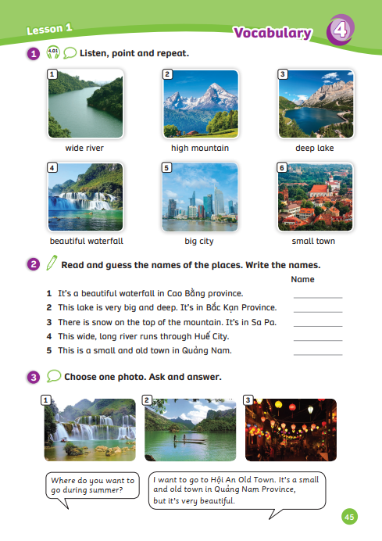
UNIT 4 – Lesson 1
We’re learning…
- Outdoor Places
- PB p. 44,45
- AB p.36

Slide 3
WARM-UP ACTIVITY
Activity: The Hungry Shark
Divide the class into two teams. Each team has a character.
Quickly review the hobbies by showing flashcards from the previous unit.
Each team got five lines between the shark’s mouth and their character.
The teacher shows the flashcard and asks a random student in the team how to spell it.
If the student is correct, continue with a different student. If that student is wrong, erase a line.
The team that loses all lines first will be out of the game.

Slide 4
WARM-UP ACTIVITY
☹
☹
The teacher shows the flashcard and asks a random student to spell that word.
Click on “sad face” to erase one line.

Slide 5
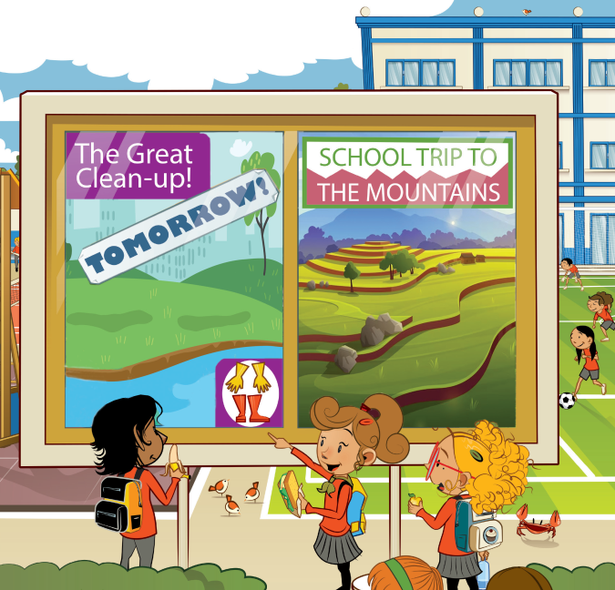
VOCABULARY – Lead-in
Where is the school trip?
The school trip is in the mountains.
Look at the picture and answer the question.

Slide 6
VOCABULARY – Lead-in
Tomorrow
When is the great
clean-up happening?
Look at the picture and answer the question.

Slide 7
VOCABULARY – Lead-in
beautiful, big, deep,
high, lake, small, wide
beautiful lake
big waterfall
city, lake, mountain,
river, town, waterfall
Example
Look and read these words on the slide.
In pairs, discuss how to make word friends (collocations) out of the word. (ex: big city)

Slide 8
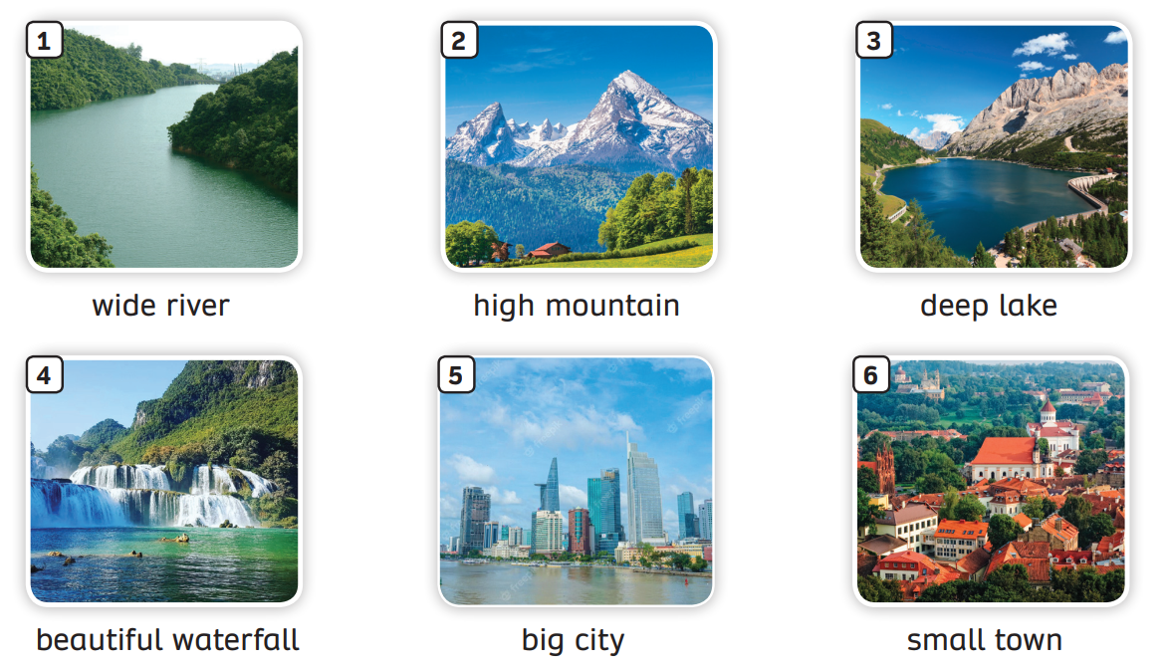
VOCABULARY – Outdoor Places
- Have students look at the pictures, listen and repeat.

Slide 9
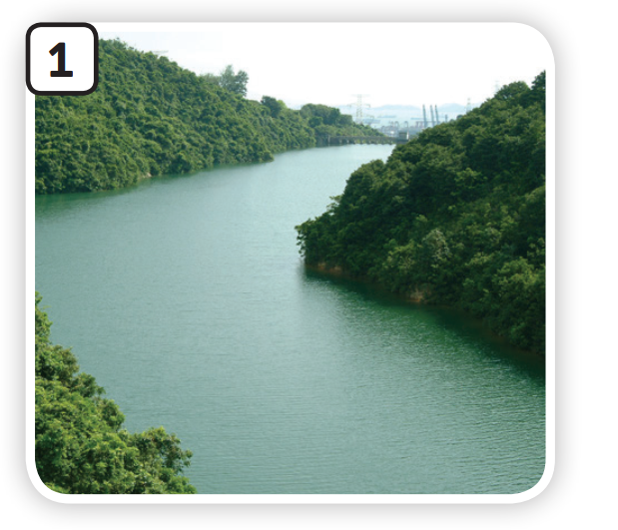
VOCABULARY – Outdoor Places
c
Let’s spell!
wide river
w
i
d
e
r
i
v
e
r

Slide 10
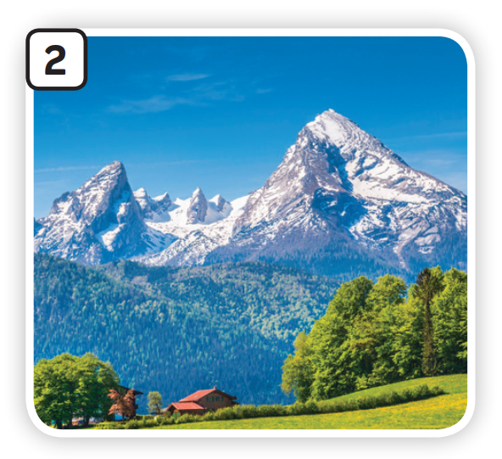
VOCABULARY – Nationality
c
Let’s spell!
high mountain
h
i
g
h
m
o
u
n
t
a
i
n

Slide 11
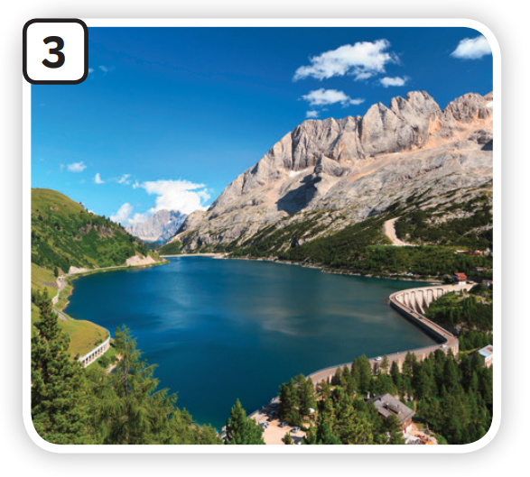
VOCABULARY – Nationality
c
Let’s spell!
deep lake
d
e
e
p
l
a
k
e

Slide 12
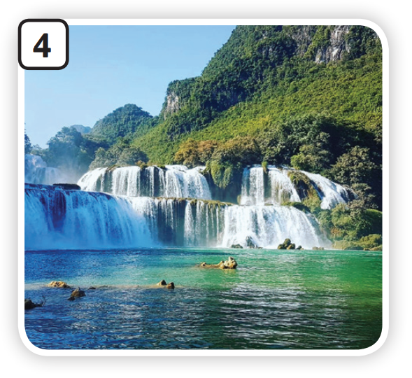
VOCABULARY –Nationality
c
Let’s spell!
beautiful
waterfall
b
e
a
u
t
i
f
u
l
w
a
t
e
r
f
a
l
l

Slide 13
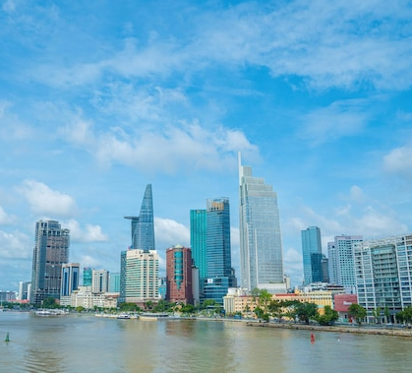
VOCABULARY – Nationality
c
Let’s spell!
big city
b
i
g
c
i
t
y

Slide 14
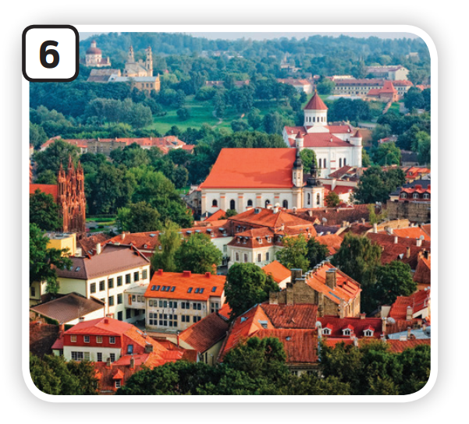
VOCABULARY – Nationality
c
Let’s spell!
small town
s
m
a
l
l
t
o
w
n

Slide 15
VOCABULARY – Outdoor Places
REVIEW
The teacher says an item and deliberately says its name incorrectly.
The students correct them.

Slide 16
VOCABULARY – Outdoor Places
Activity: Fill in the blank.
Divide the class into 2 teams.
Look at the picture and read the sentence.
Discuss with your friends to fill in the blank.
Raise your hand to answer.
The whole team say the correct answer together.
The team with the highest points win the game.

Slide 17
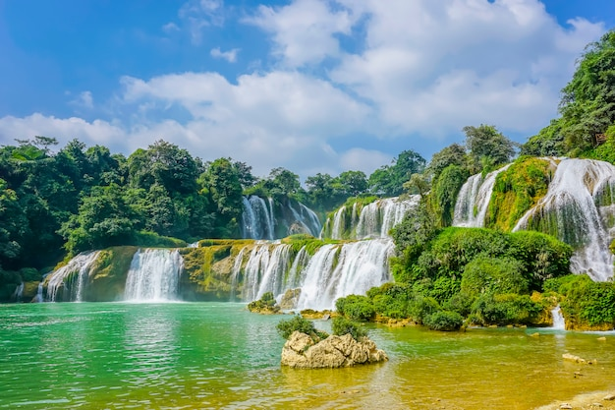
Check
Next
beautiful waterfall
It’s a _______________ in Cao Bằng province.
go

Slide 18
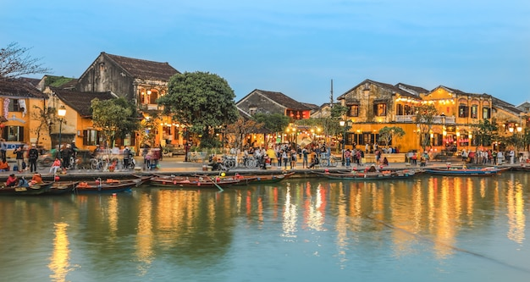
Check
Next
small town
This is an old and ___________ in Quảng Nam.
go

Slide 19
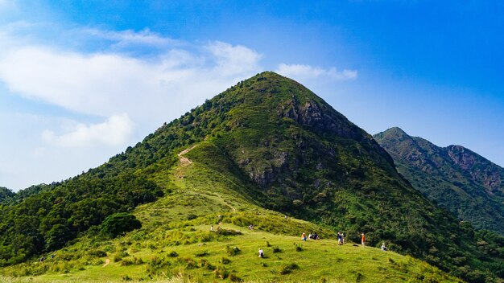
Check
Next
In Sa Pa, there are many ______________.
high mountains
go

Slide 20
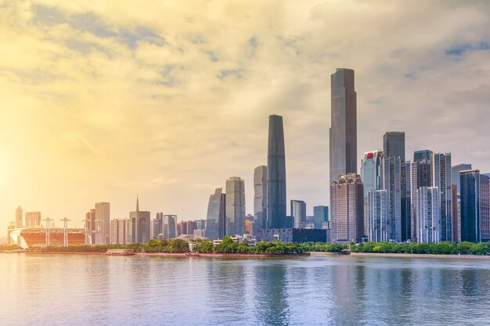
Check
Next
My grandparents live in the ________.
big city
go

Slide 21
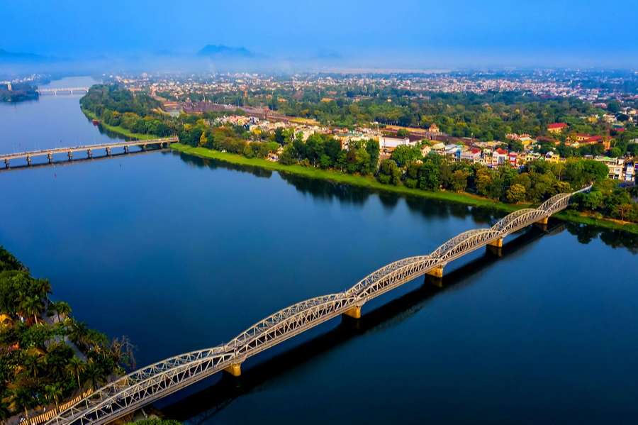
Check
Next
wide river
This long, _________ runs through Huế City.
go

Slide 22
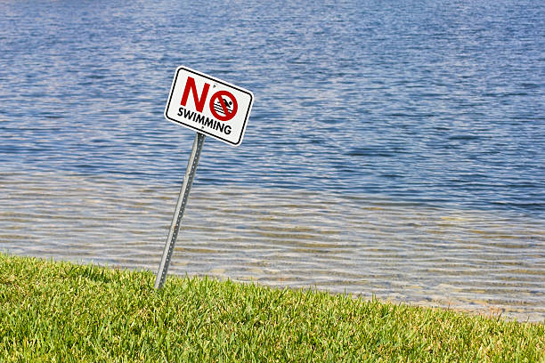
Check
Next
Look at the danger signs! This is a _________. Be careful!
deep lake
go

Slide 23
You’re welldone!

Slide 24
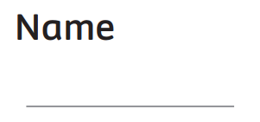
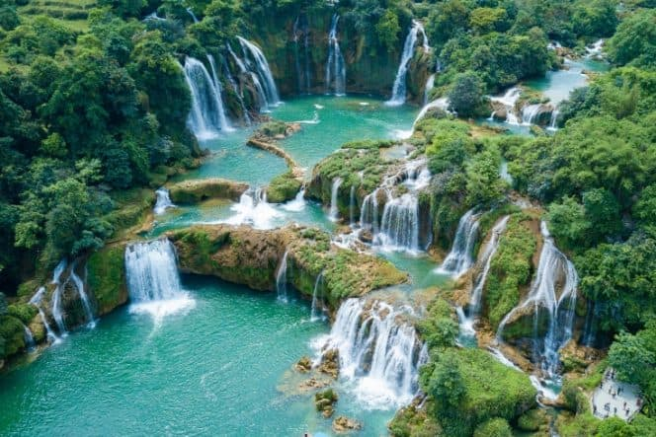
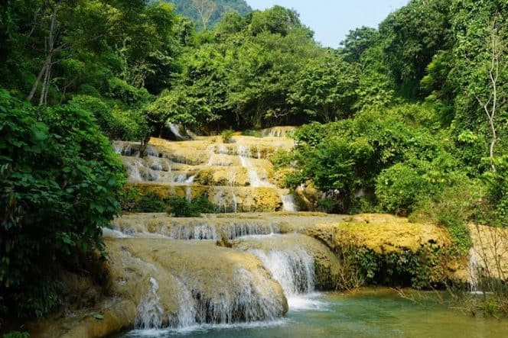
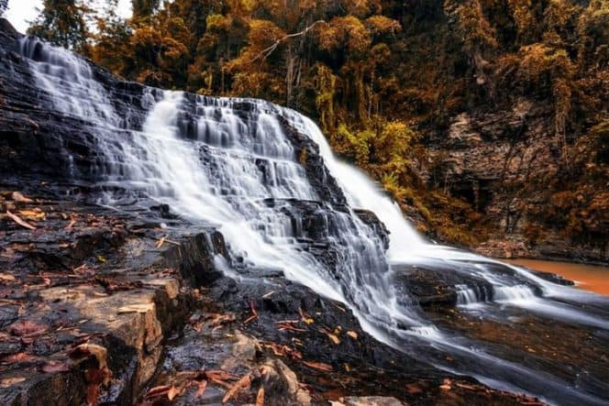
Pupils’ book (p.45)
Bản Giốc Waterfall
Mây Waterfall
Thủy Tiên Waterfall
Clues
In groups of four, read and guess the name of the place.
They can use the clues to choose the answer. Then, write.

Slide 25
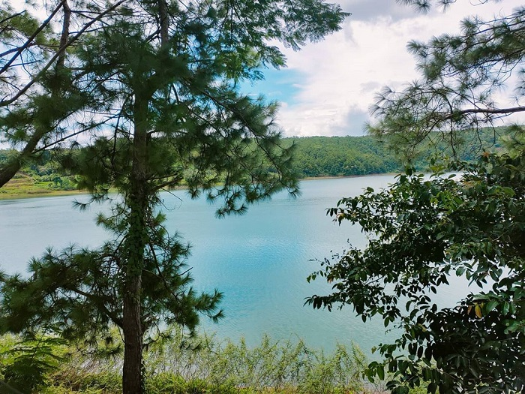
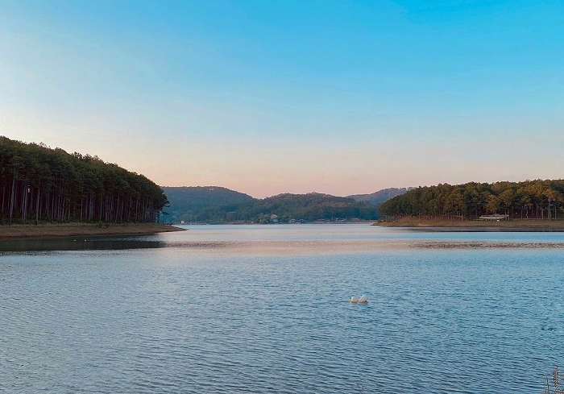
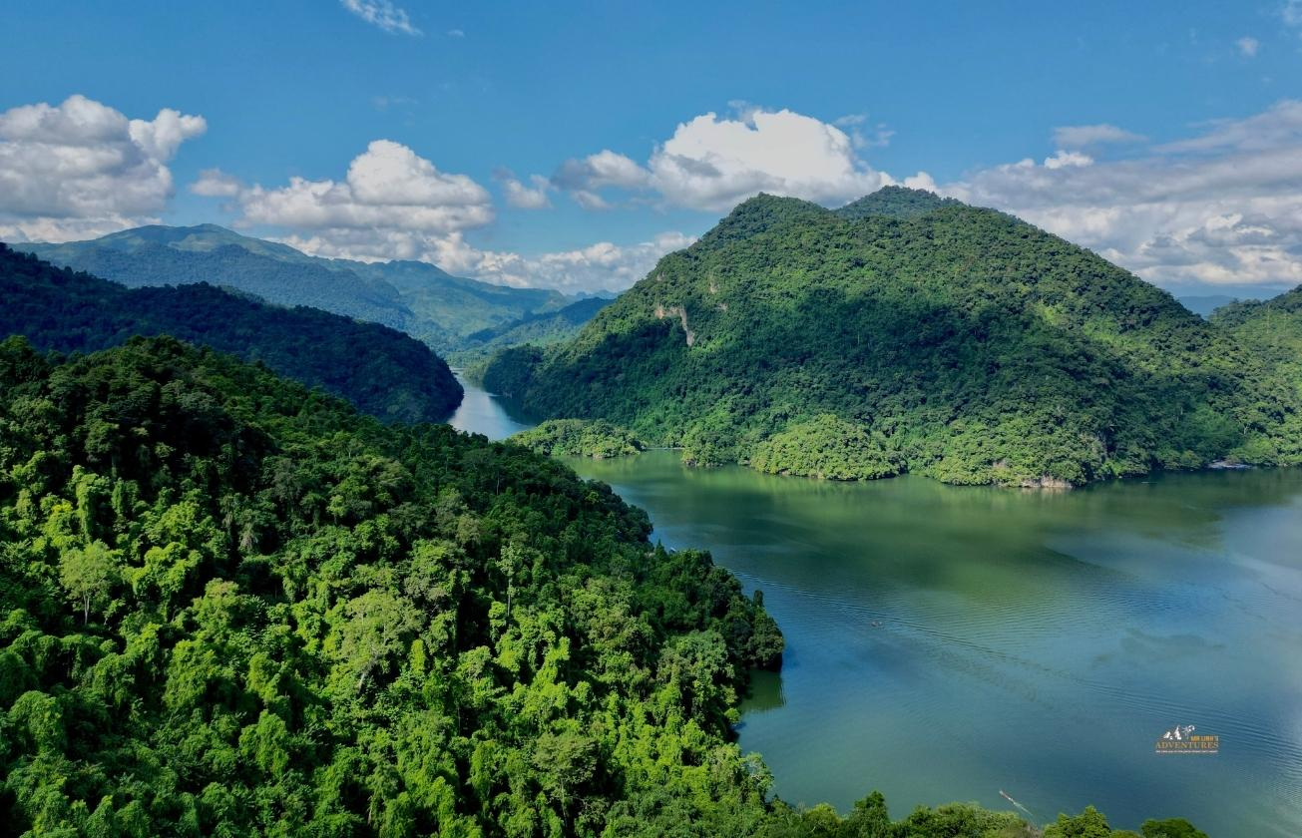
Pupils’ book (p.45)
Biển Hồ Lake
Tuyền Lâm Lake
Ba Bể Lake
Clues
In groups of four, read and guess the name of the place.
They can use the clues to choose the answer. Then, write.

Slide 26
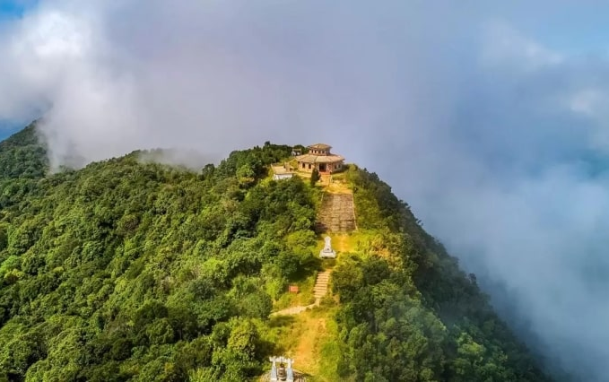
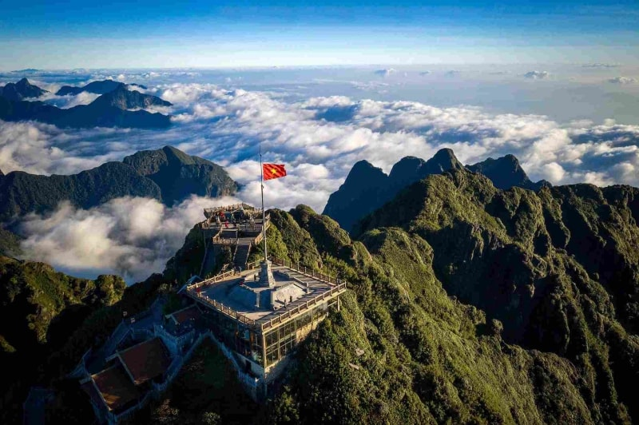
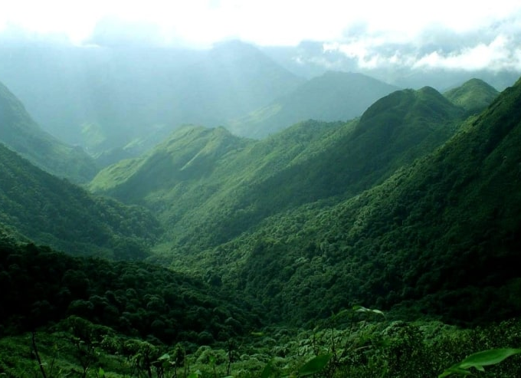
Pupils’ book (p.45)
Ba Vì
Phan Xi Păng
Tà Xùa
Clues
In groups of four, read and guess the name of the place.
They can use the clues to choose the answer. Then, write.

Slide 27
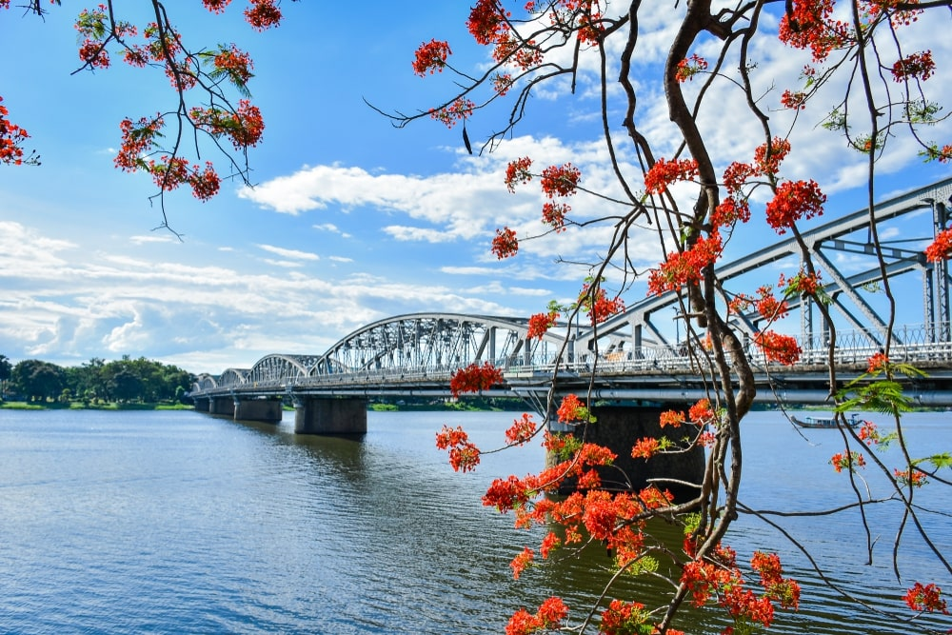
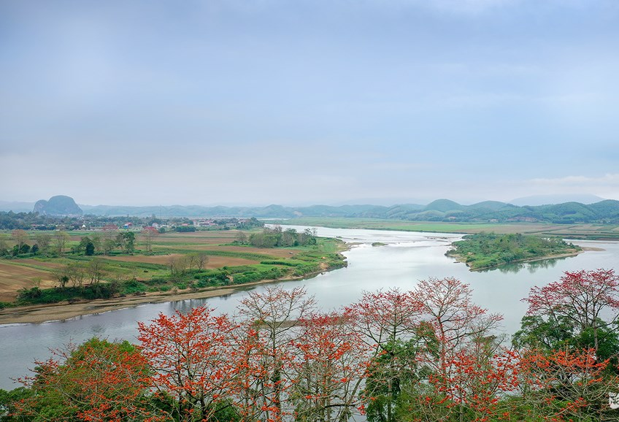
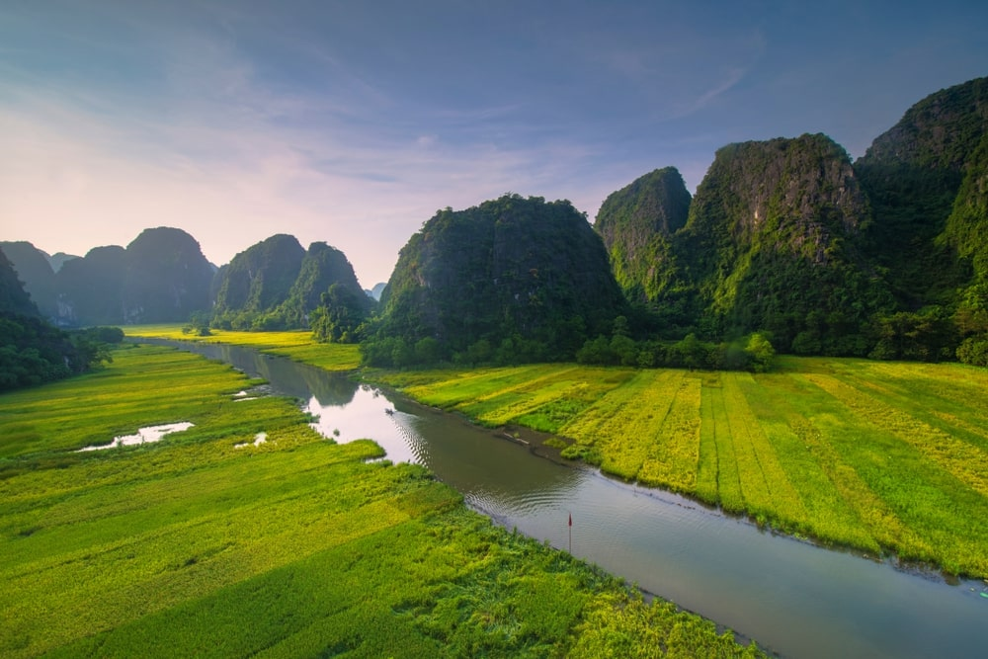
Pupils’ book (p.45)
Hương River
Lam River
Ngô Đồng River
Clues
In groups of four, read and guess the name of the place.
They can use the clues to choose the answer. Then, write.

Slide 28
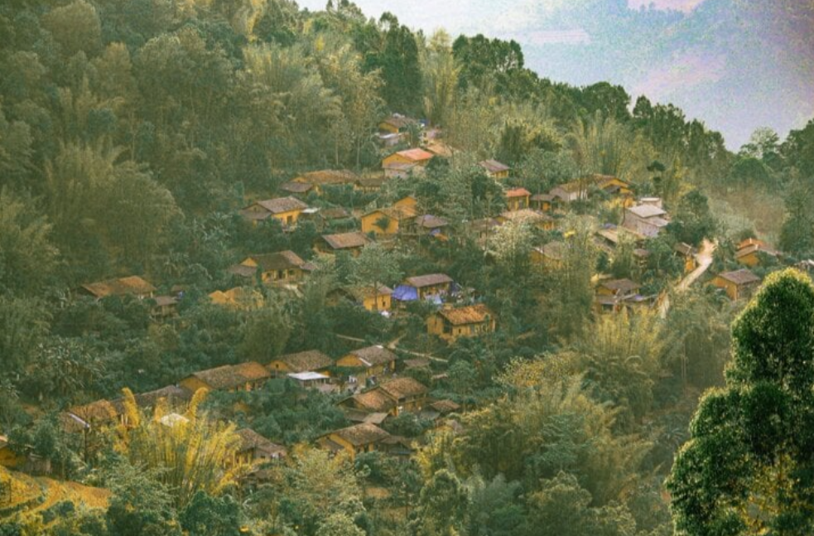
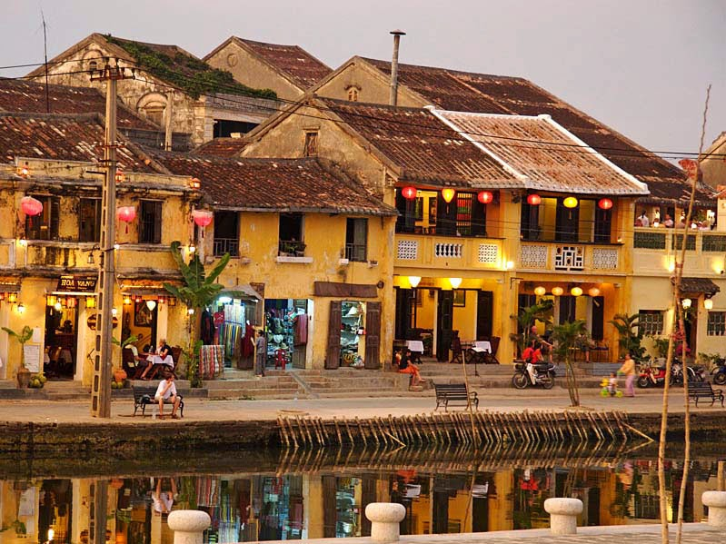
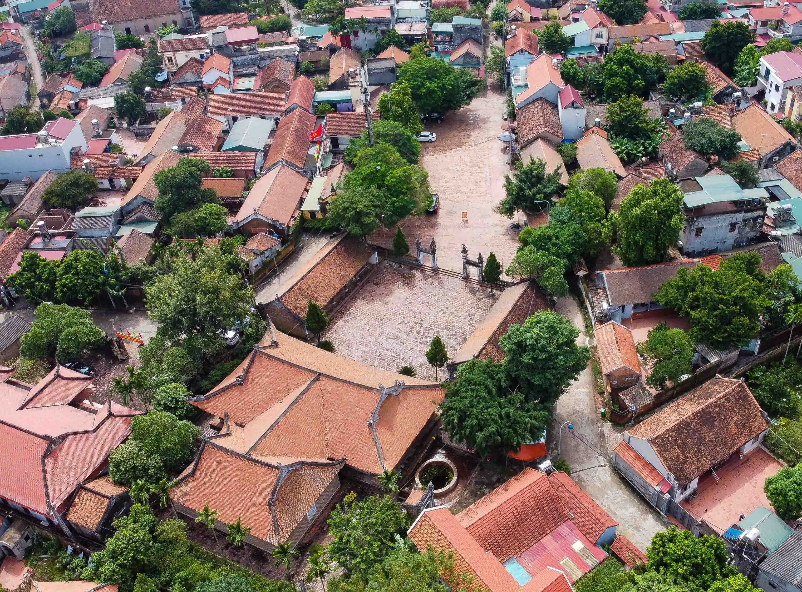
Pupils’ book (p.45)
Thiên Hương
Hội An
Đường Lâm
Clues
In groups of four, read and guess the name of the place.
They can use the clues to choose the answer. Then, write.

Slide 29
Pupils’ book (p.45)
Bản Giốc
Ba Bể
Phan Xi Păng
Hương River
Hội An
Answer
Go over the answer as a class.

Slide 30
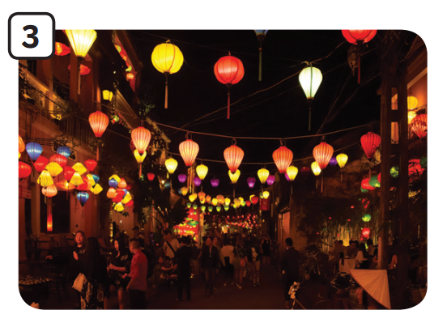
Pupils’ book (p.45)
Look and say
I want to go to Hội An Old Town. It’s a small and old town in
Quảng Nam Province, but it’s
very beautiful.
Where do you want to
go during summer?
Ask them to look at the picture and ask, “Where is this?”
Have students look at the example on the slide.

Slide 31
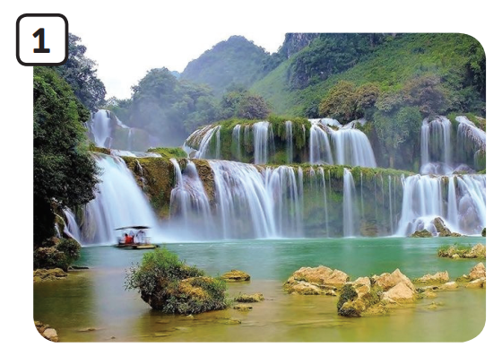
Pupils’ book (p.45)
Look and say
I want to go to Bản Giốc Waterfall. It’s a beautiful waterfall in Cao Bằng Province. I want to go with my family.
Where do you want to
go during summer?
Ask them to look at the picture and ask, “Where is this?”
Have students look at the example on the slide.

Slide 32
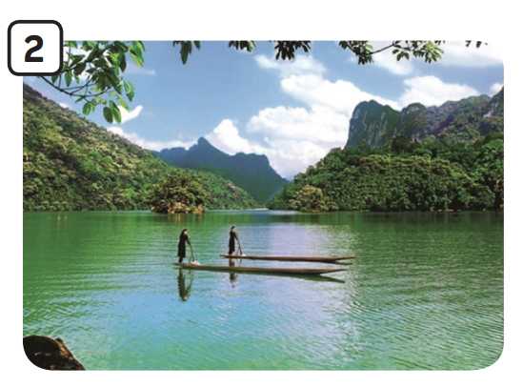
Pupils’ book (p.45)
Look and say
I want to go to Ba Bể Lake. This lake is very big and deep. It’s in Bắc Kạn Province. It’s got many landscapes to discover.
Where do you want to
go during summer?
Ask them to look at the picture and ask, “Where is this?”
Have students look at the example on the slide.

Slide 33
Pupils’ book (p.45)
In groups of 4, students look at the picture. Each student chooses one and answers the question in 30s.
Change the partner to keep going asking and answering.
Invite a few pairs to come to the front of the class.
Count how many lines they say to describe the place.
Award points to the pair with the most lines.

Slide 34
SUM - UP
Invite a student to the slide and point to the random pictures.
The class say the word.
Note: The students can point to 2-3 pictures simultaneously.

Slide 35
HOMEWORK
HOMEWORK
Review Vocabulary and Grammar.
Do exercises in the Activity Book (page 36).
Check answers in the Teacher’s book (page 80) or Active Teach.

Slide 36
UNIT 4 – Lesson 1
We’ve learned…
- Outdoor Places
- PB p. 44,45
- AB p.36

