Slide 1
UNIT 4 – PLACES IN VIỆT NAM
Lesson 3a – Vocabulary and Grammar 1

Slide 2
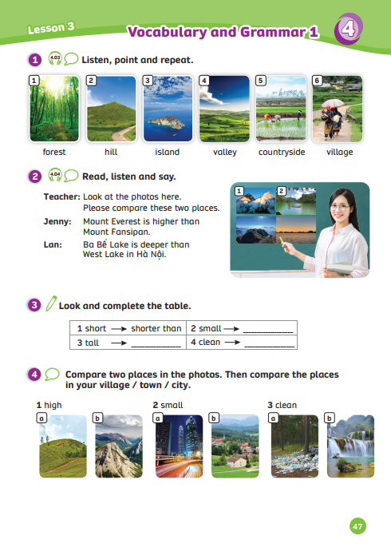
UNIT 4 – Lesson 3A
We’re learning…
- Outdoor Places
- PB p.47
- AB p.38

Slide 3
WARM-UP ACTIVITY
Activity: The Pizza
Divide the class into two teams.
Draw a pizza cut into six pieces. Each team got a pizza
The teacher calls a random student from 2 teams.
Then, the teacher says a word and students must spell it.
If they make a mistake, remove a piece of the pizza from the board. If they spell it correctly, draw another pizza (piece by piece).
The team that has the most pizza pieces will win the game.

Slide 4
VOCABULARY – Outdoor Places
- Have students look at the pictures, listen and repeat.

Slide 5
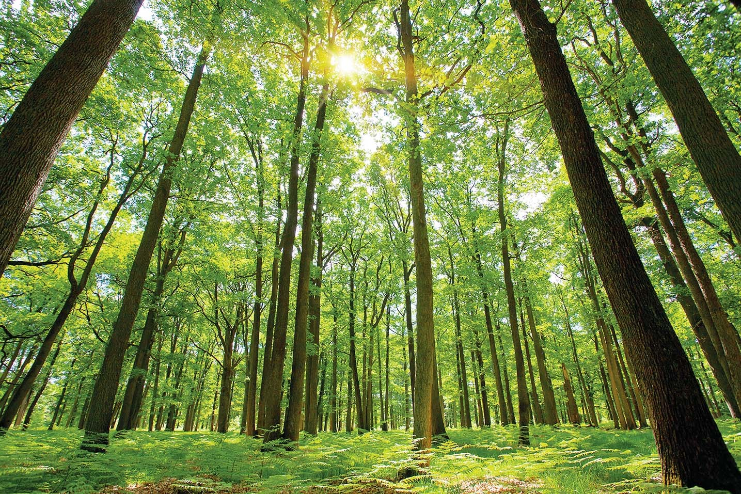
VOCABULARY – Outdoor Places
This is a large area full of
trees and plants.
rừng
forest
Look at the picture and the definition.
Read together.

Slide 6
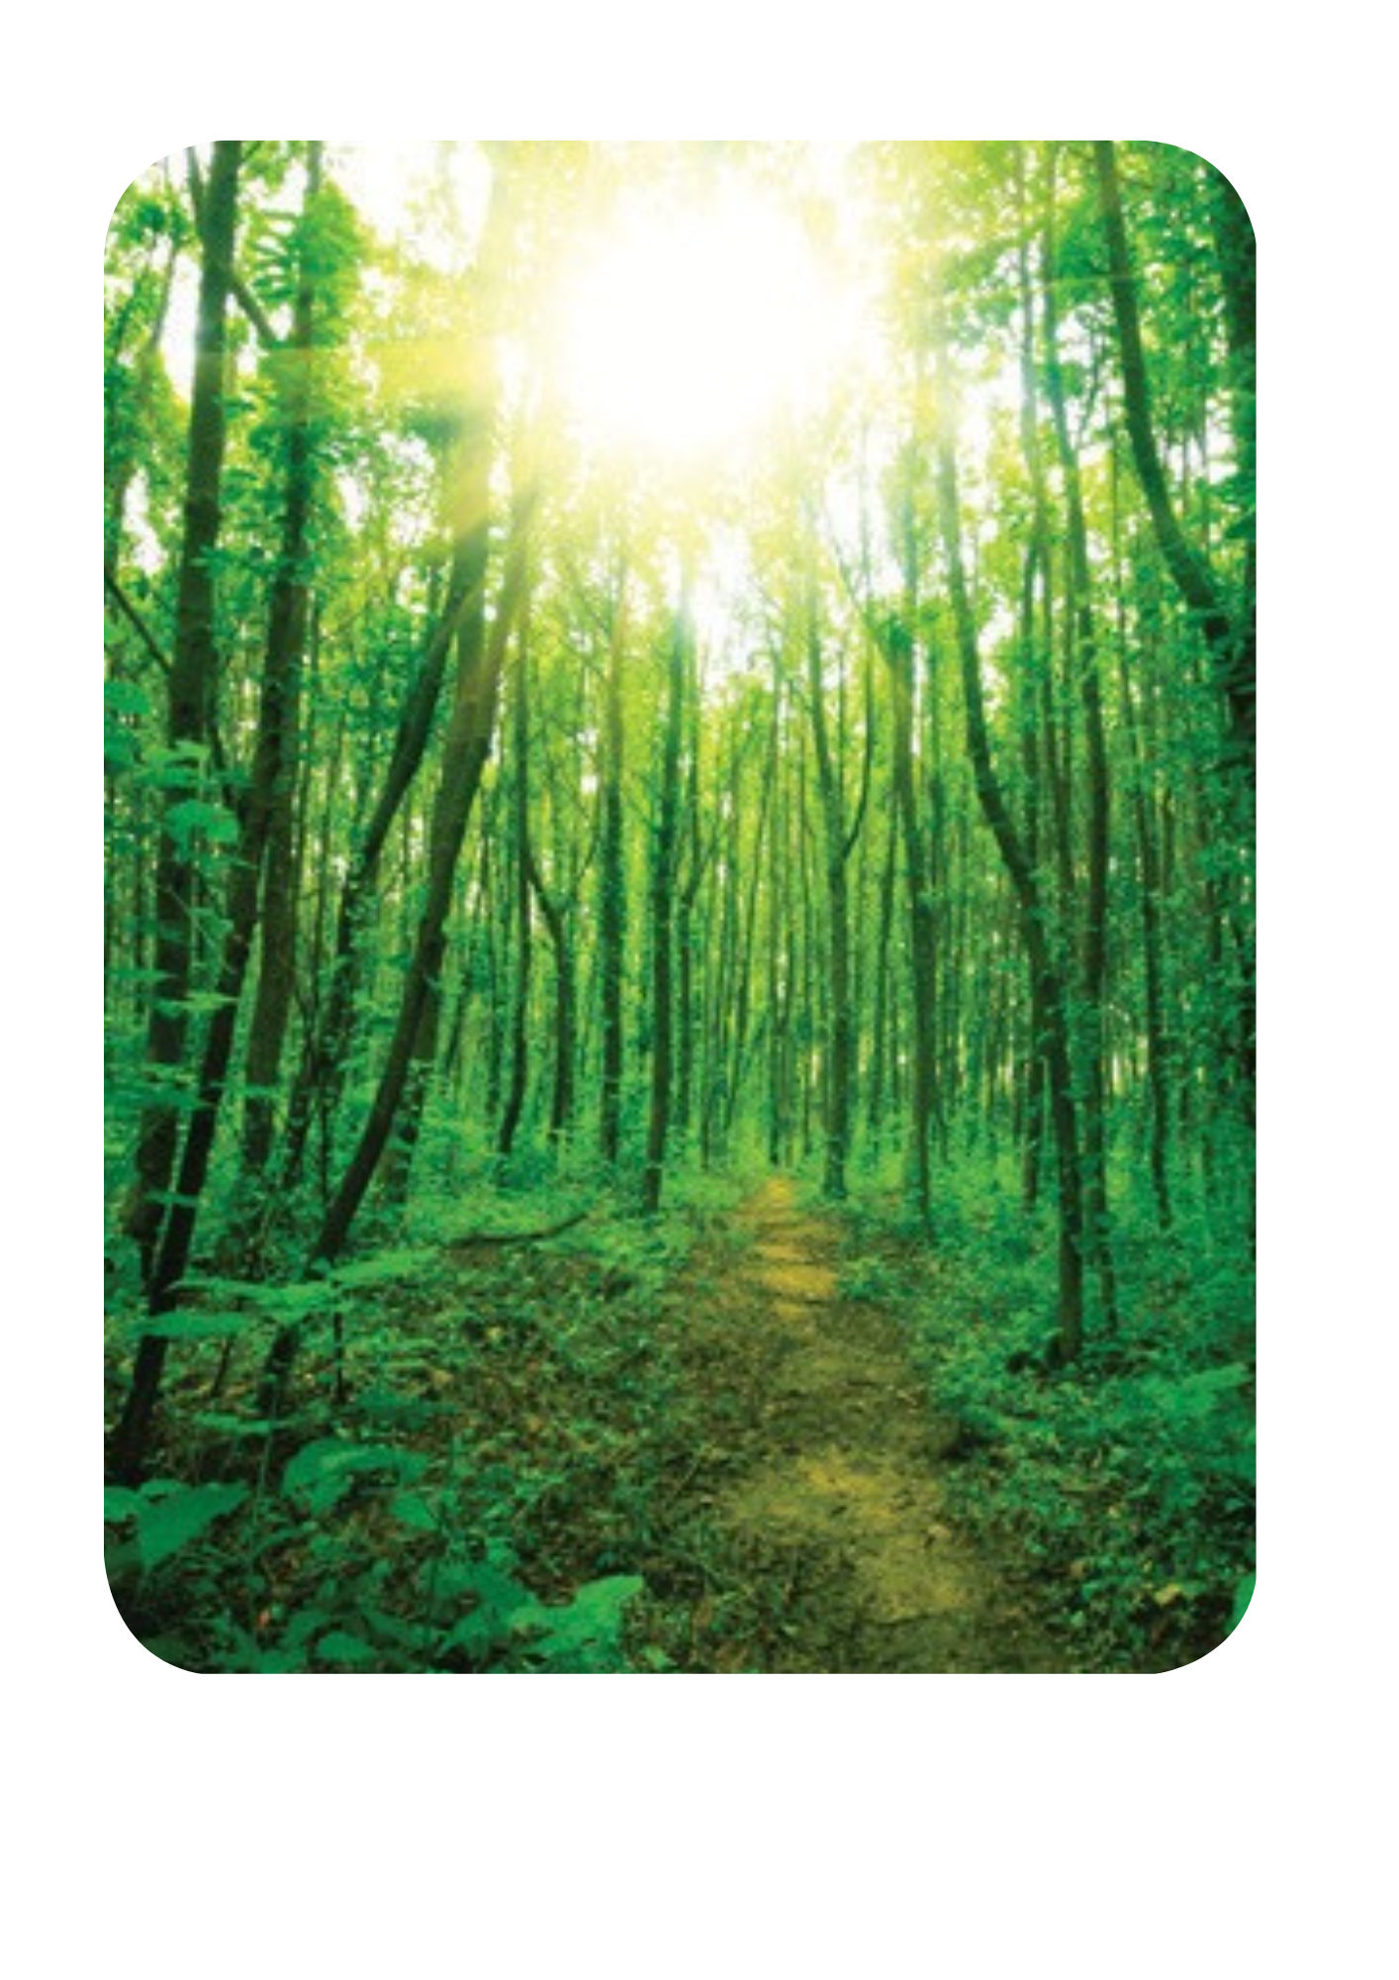
VOCABULARY – Outdoor Places
Let’s spell!
forest
f
o
r
e
s
t

Slide 7
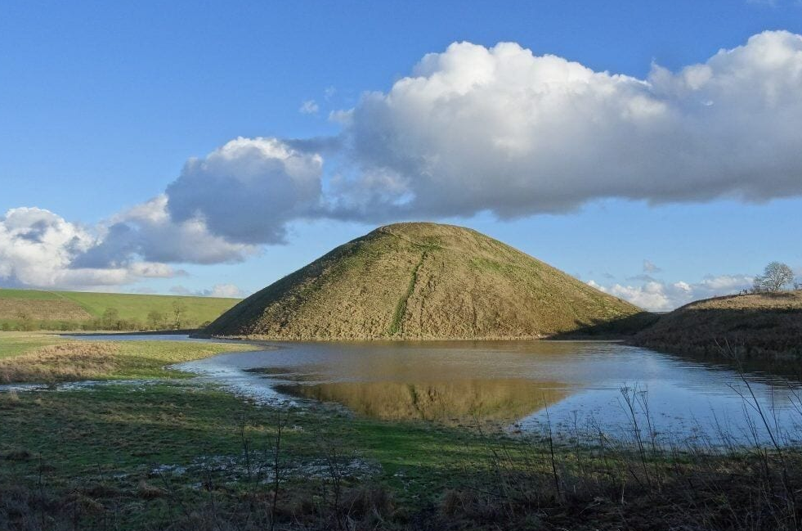
VOCABULARY – Outdoor Places
This a mound of land.
It's different from the mountain.
đồi
hill
Look at the picture and the definition.
Read together.

Slide 8
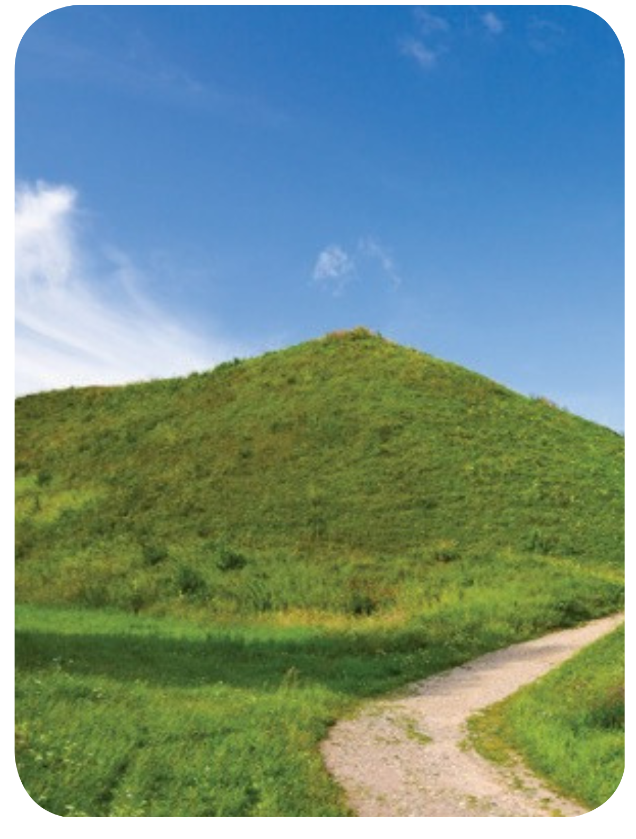
VOCABULARY – Outdoor Places
c
Let’s spell!
hill
h
i
l
l

Slide 9
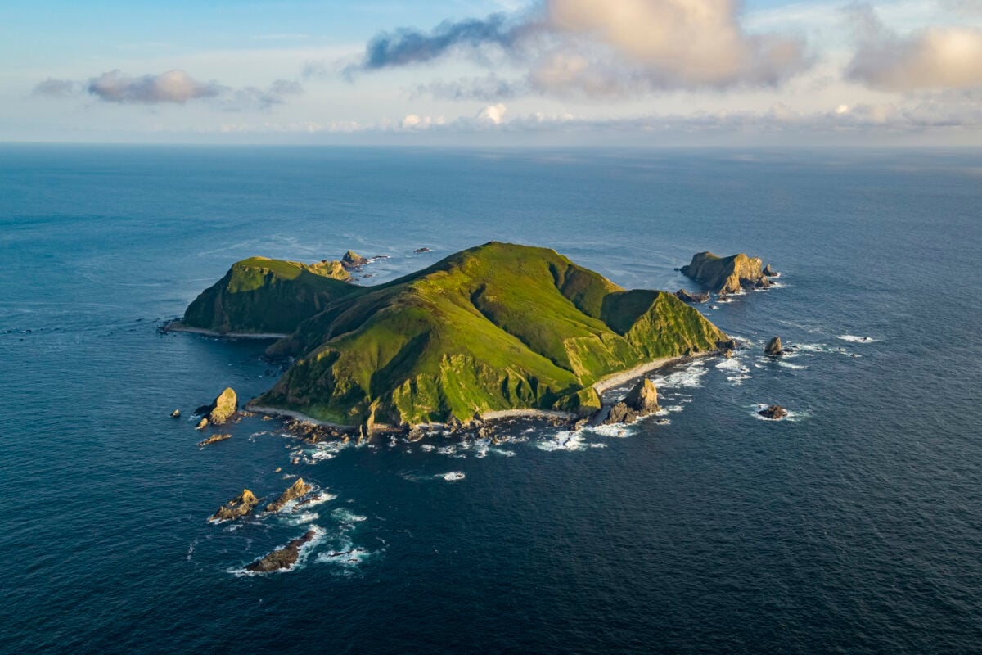
VOCABULARY – Outdoor Places
This is a piece of land
surrounded by water.
hòn đảo
island
Look at the picture and the definition.
Read together.

Slide 10
VOCABULARY – Outdoor Places
c
Let’s spell!
island
i
s
l
a
n
d

Slide 11
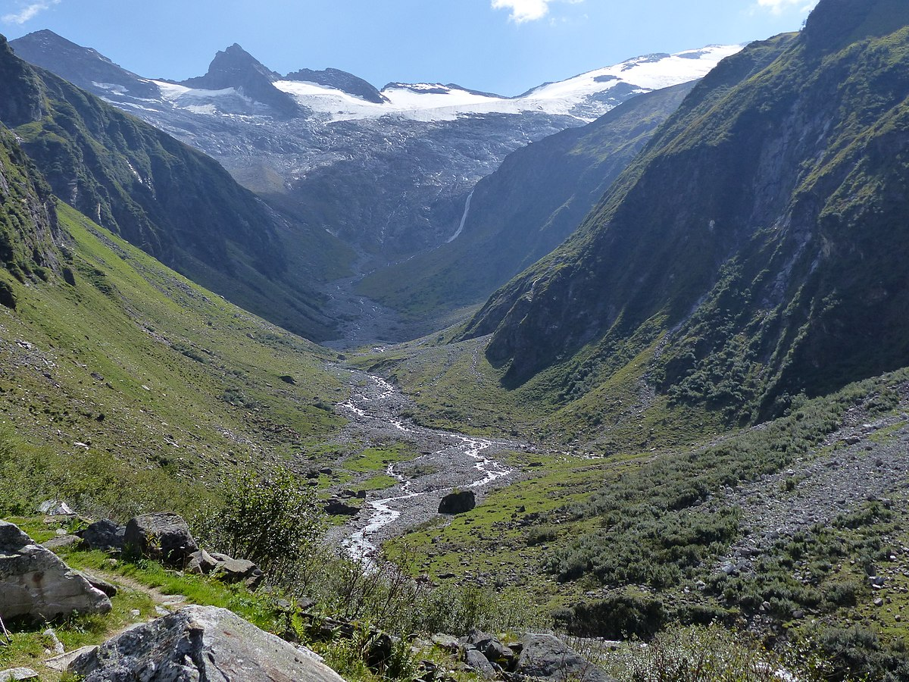
VOCABULARY – Outdoor Places
This is an area of lowland
between hills or mountains
thung lũng
valley
Look at the picture and the definition.
Read together.

Slide 12
VOCABULARY – Outdoor Places
c
Let’s spell!
valley
v
a
l
l
e
y

Slide 13
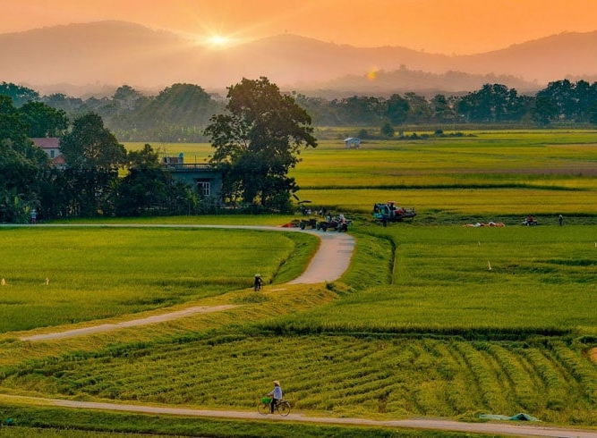
VOCABULARY – Outdoor Places
This is a land not in towns or cities.
nông thôn
countryside
Look at the picture and the definition.
Read together.

Slide 14
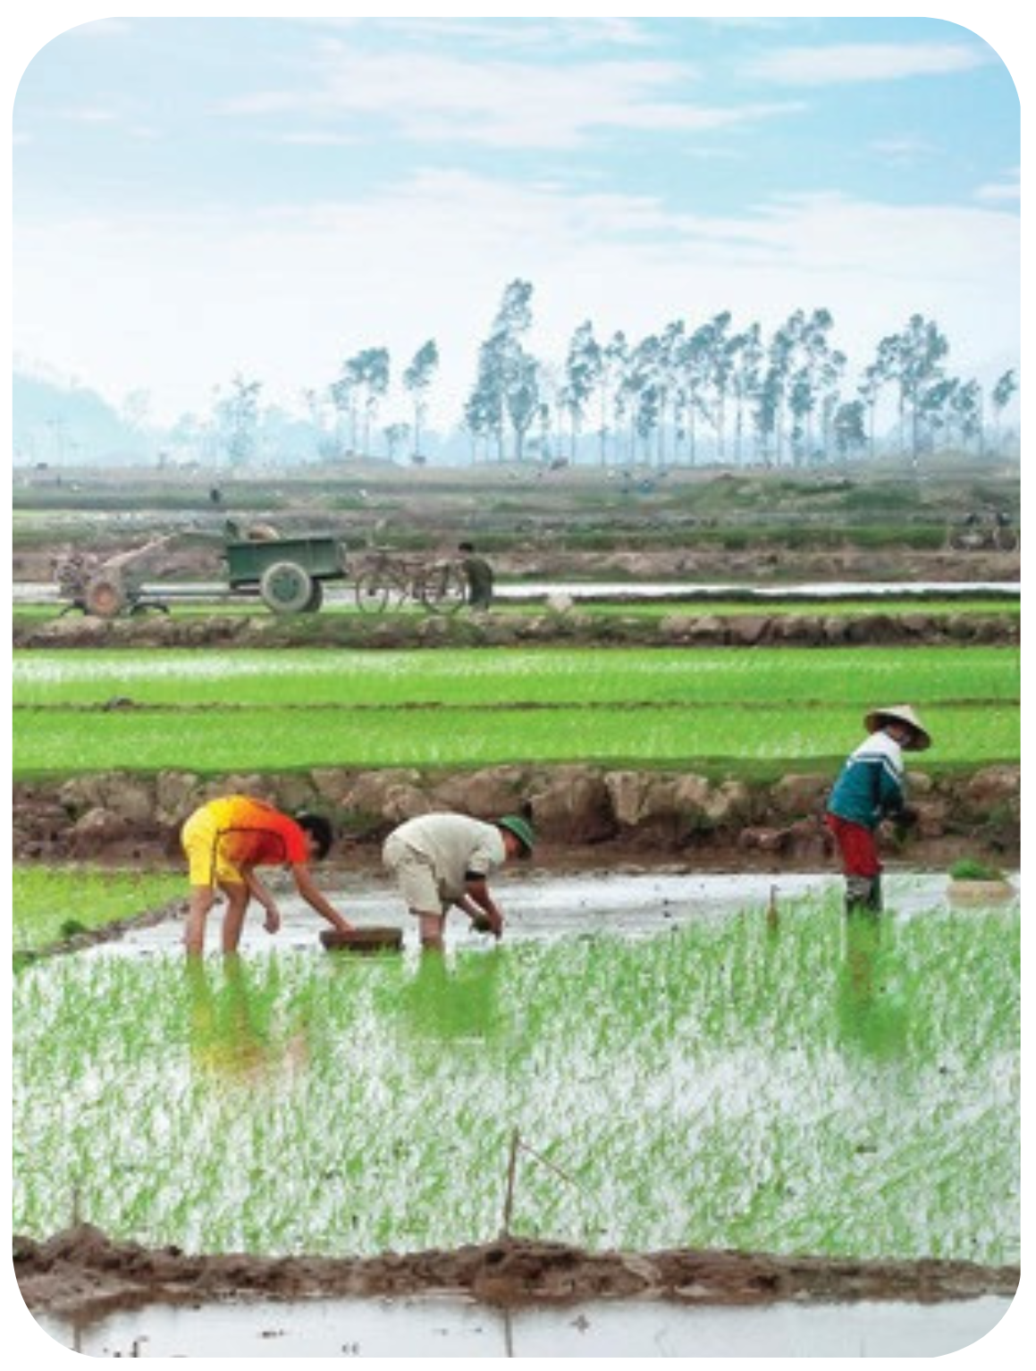
VOCABULARY – Outdoor Places
c
Let’s spell!
countryside
c
o
u
n
t
r
y
s
i
d
e

Slide 15
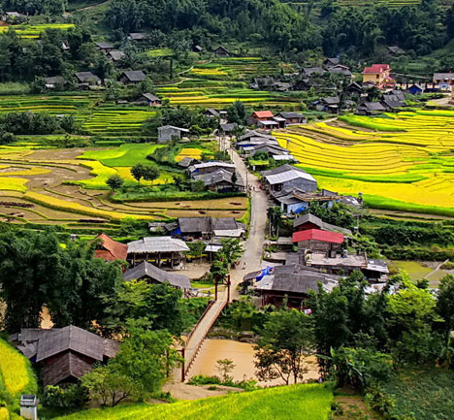
VOCABULARY – Outdoor Places
This is a group of houses in the countryside.
làng bản
village
Look at the picture and the definition.
Read together.

Slide 16
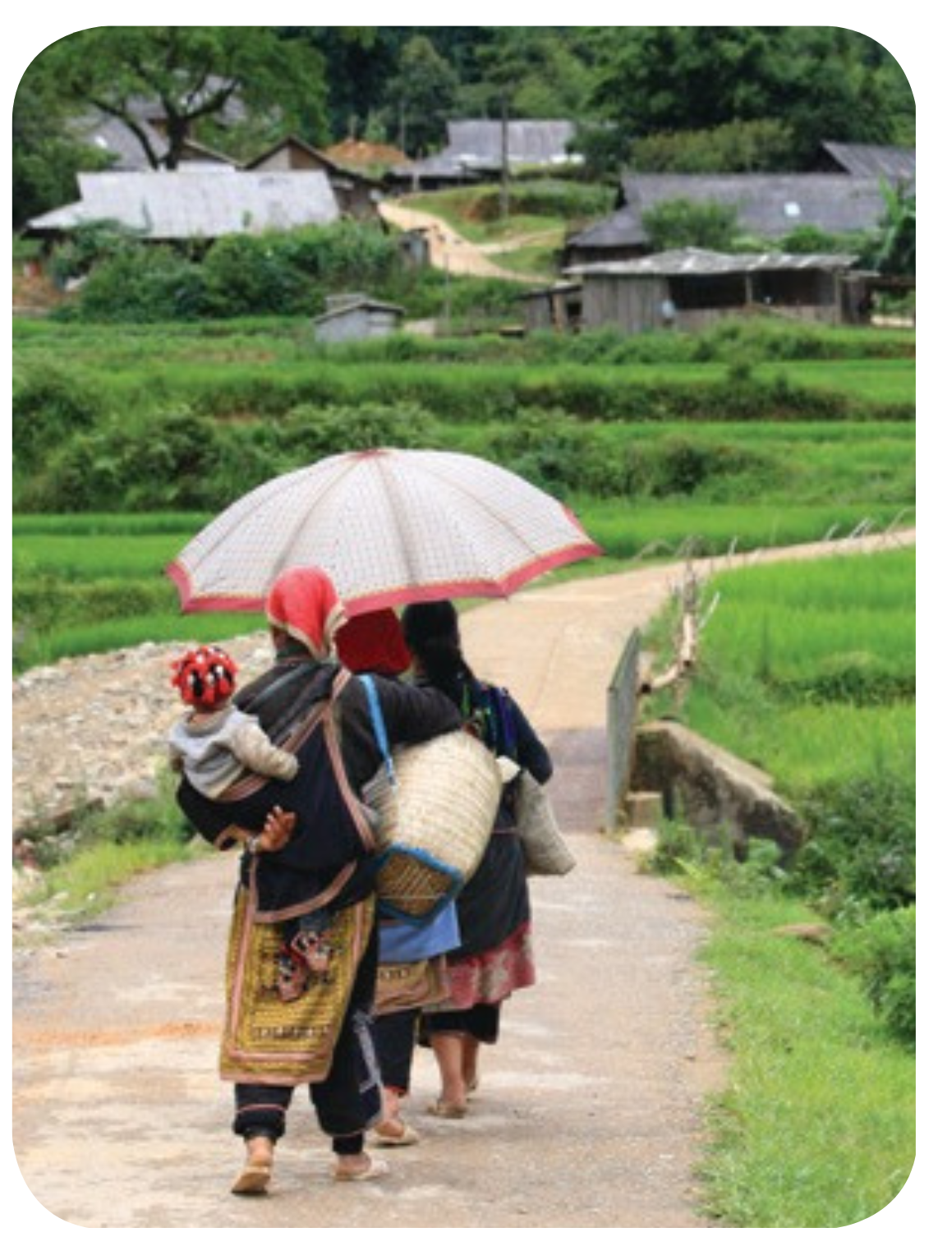
VOCABULARY – Outdoor Places
c
Let’s spell!
village
v
i
l
l
a
g
e

Slide 17
VOCABULARY – Outdoor Places
REVIEW
Invite a student to the slide and point to the random pictures.
The class say the word.
Note: The students can point to 2-3 pictures simultaneously.

Slide 18
PRACTICE
Activity: Pictionary.
Divide the class into two teams.
The teacher chooses a random student from two teams to come to the front of the class.
Show a picture and students have to sketch it.
Draw a word without using letters or sounds in the 30s.
The team that has the first correct answer can get 2 points.
Move to the next turn.

Slide 19
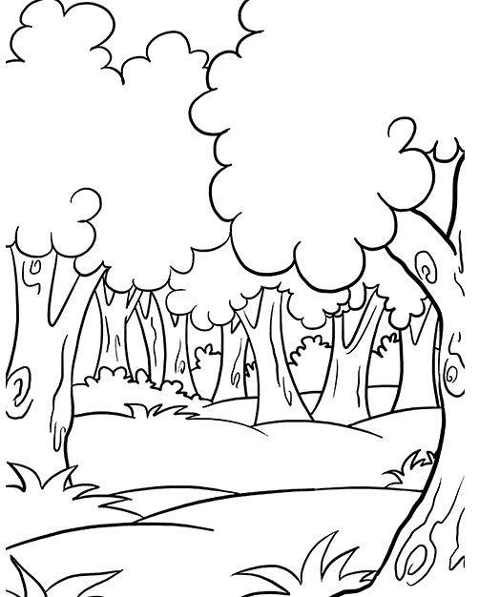
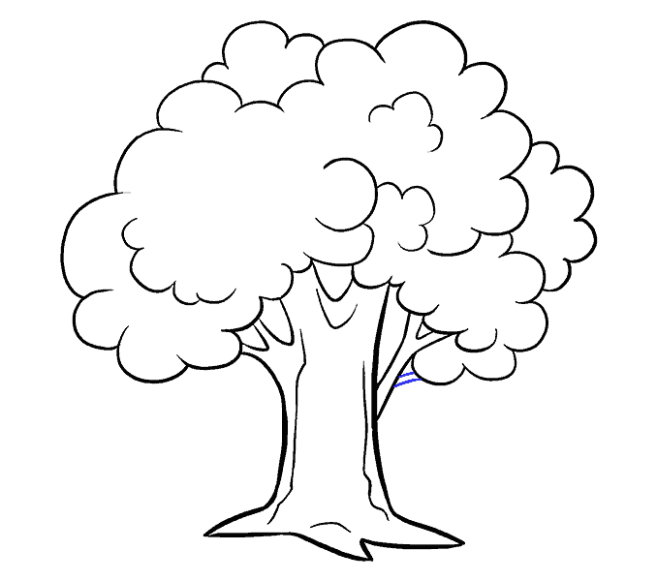
PRACTICE
forest
Look at the example.

Slide 20
PRACTICE
Activity: Finding Nemo
Divide the class into groups of 4.
Each team prepares a pencil case and puts it in the middle.
Read the definition and raise the pencil case to answer after 10 seconds.
The team that has the first correct answer can get 2 points.
The team with the highest points will win the game.

Slide 22
5s
2s
7s
3s
0
1s
9s
10s
4s
8s
6s
This is a group of houses
in the countryside.
village
hill
island

Slide 23
5s
2s
7s
3s
0
1s
9s
10s
4s
8s
6s
This is a large area full of
trees and plants.
countryside
forest
valley

Slide 24
5s
2s
7s
3s
0
1s
9s
10s
4s
8s
6s
This is an area of lowland
between hills or mountains.
island
forest
valley

Slide 25
5s
2s
7s
3s
0
1s
9s
10s
4s
8s
6s
This is a piece of land
surrounded by water.
island
countryside
hill

Slide 26
5s
2s
7s
3s
0
1s
9s
10s
4s
8s
6s
This is a land not in towns or cities.
village
countryside
forest

Slide 27
5s
2s
7s
3s
0
1s
9s
10s
4s
8s
6s
This is a mound of land.
It's different from the mountain.
valley
hill
island

Slide 29
PRODUCTION
l
n
r
is_a_d
fo_est
hi_ _
l
l
e
v_ll_ _
a
y
i
v_ll_g_
n
r
d
a
e
cou_t_ysi_e
Divide the class into pairs, each pair prepares a mini-board.
Look at the slide and fill in the missing letters.
Students take turns to write.
Answer

Slide 30
SUM - UP
Review all words together.

Slide 31
HOMEWORK
HOMEWORK
Review Vocabulary and Grammar.
Do exercises in the Activity Book (page 38).
Check answers in the Teacher’s book (page 84) or Active Teach.

Slide 32
UNIT 4 – Lesson 3A
We’ve learned…
- Outdoor Places
- PB p.47
- AB p.38

