Slide 1
UNIT 4 – PLACES IN VIỆT NAM
Lesson 3a – Vocabulary and Grammar 1

Slide 2
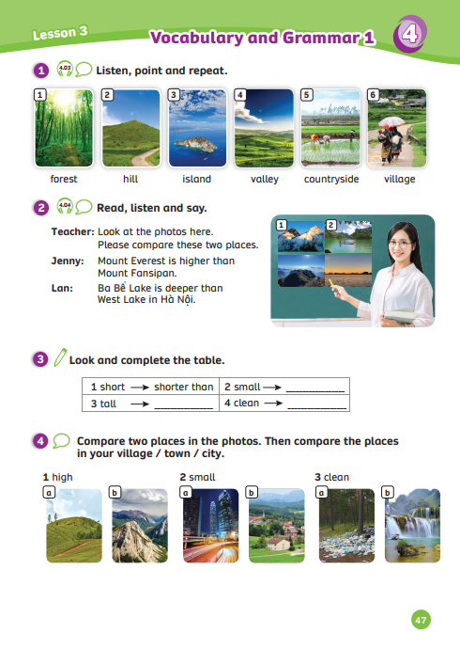
UNIT 4 – Lesson 3B
We’re learning…
- Outdoor Places
- to use comparative adjectives + than
- PB p.47
- AB p.38

Slide 3
WARM-UP ACTIVITY
Activity: The Missing Picture
Divide the class into groups of 6. Each team prepares a mini-board.
Students take turns to write the answer.
Look at these pictures and spell.
After 5s, look carefully at the missing picture and write it on the board.
The faster team with the correct word gets 3 points.
The team with the highest points will win the game.
Note: The missing word needs to be spelt correctly.

Slide 4
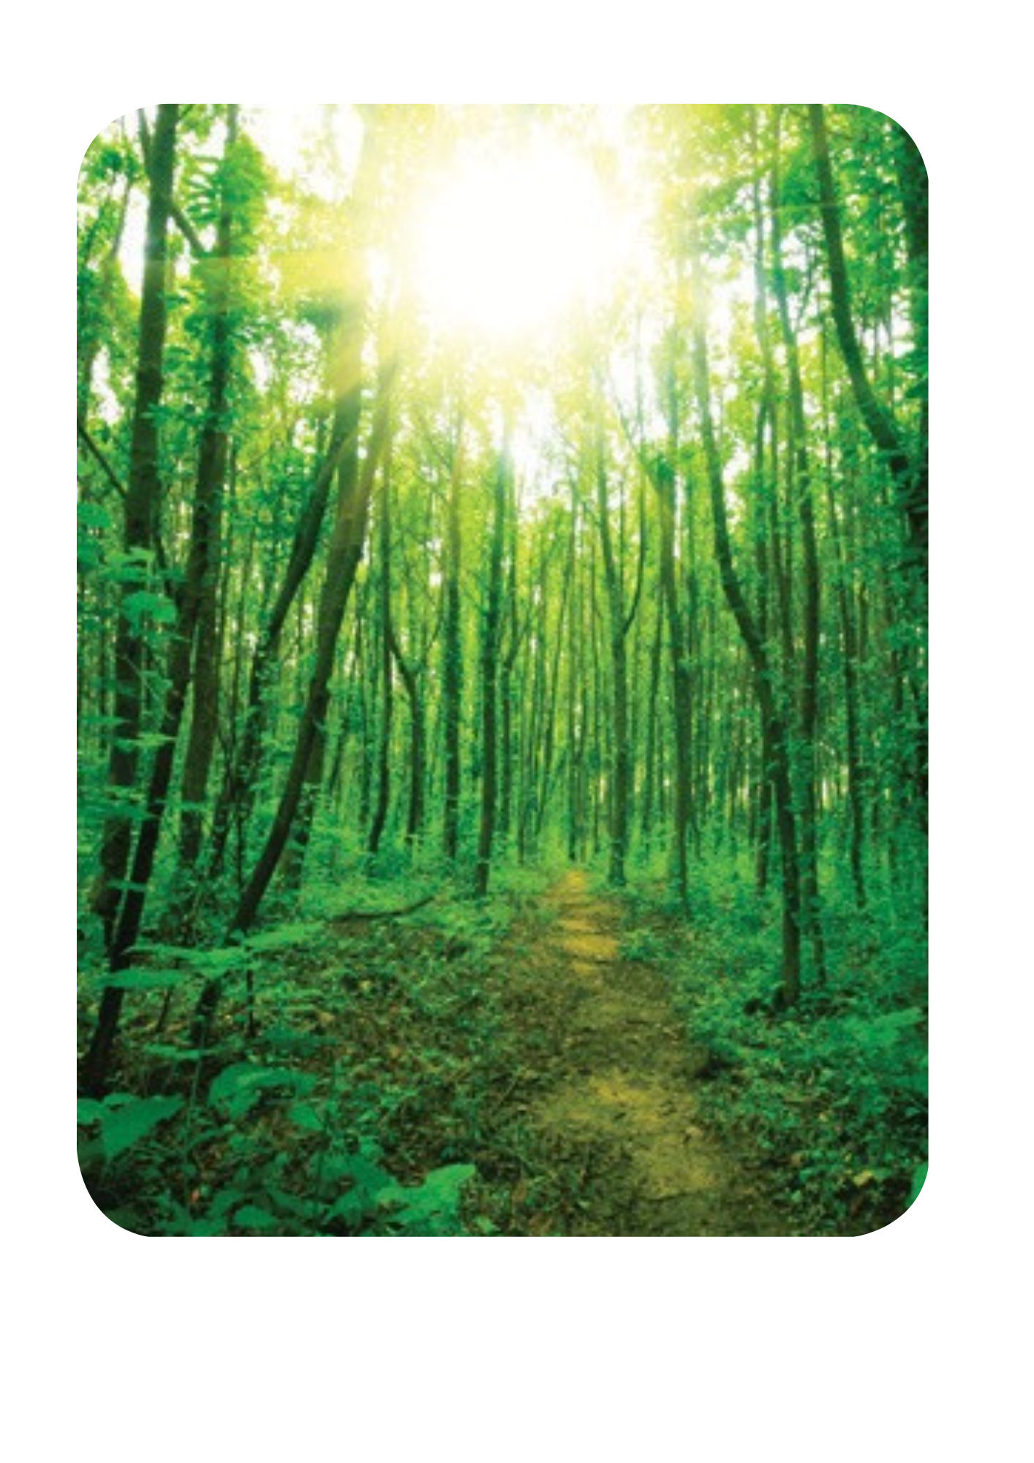
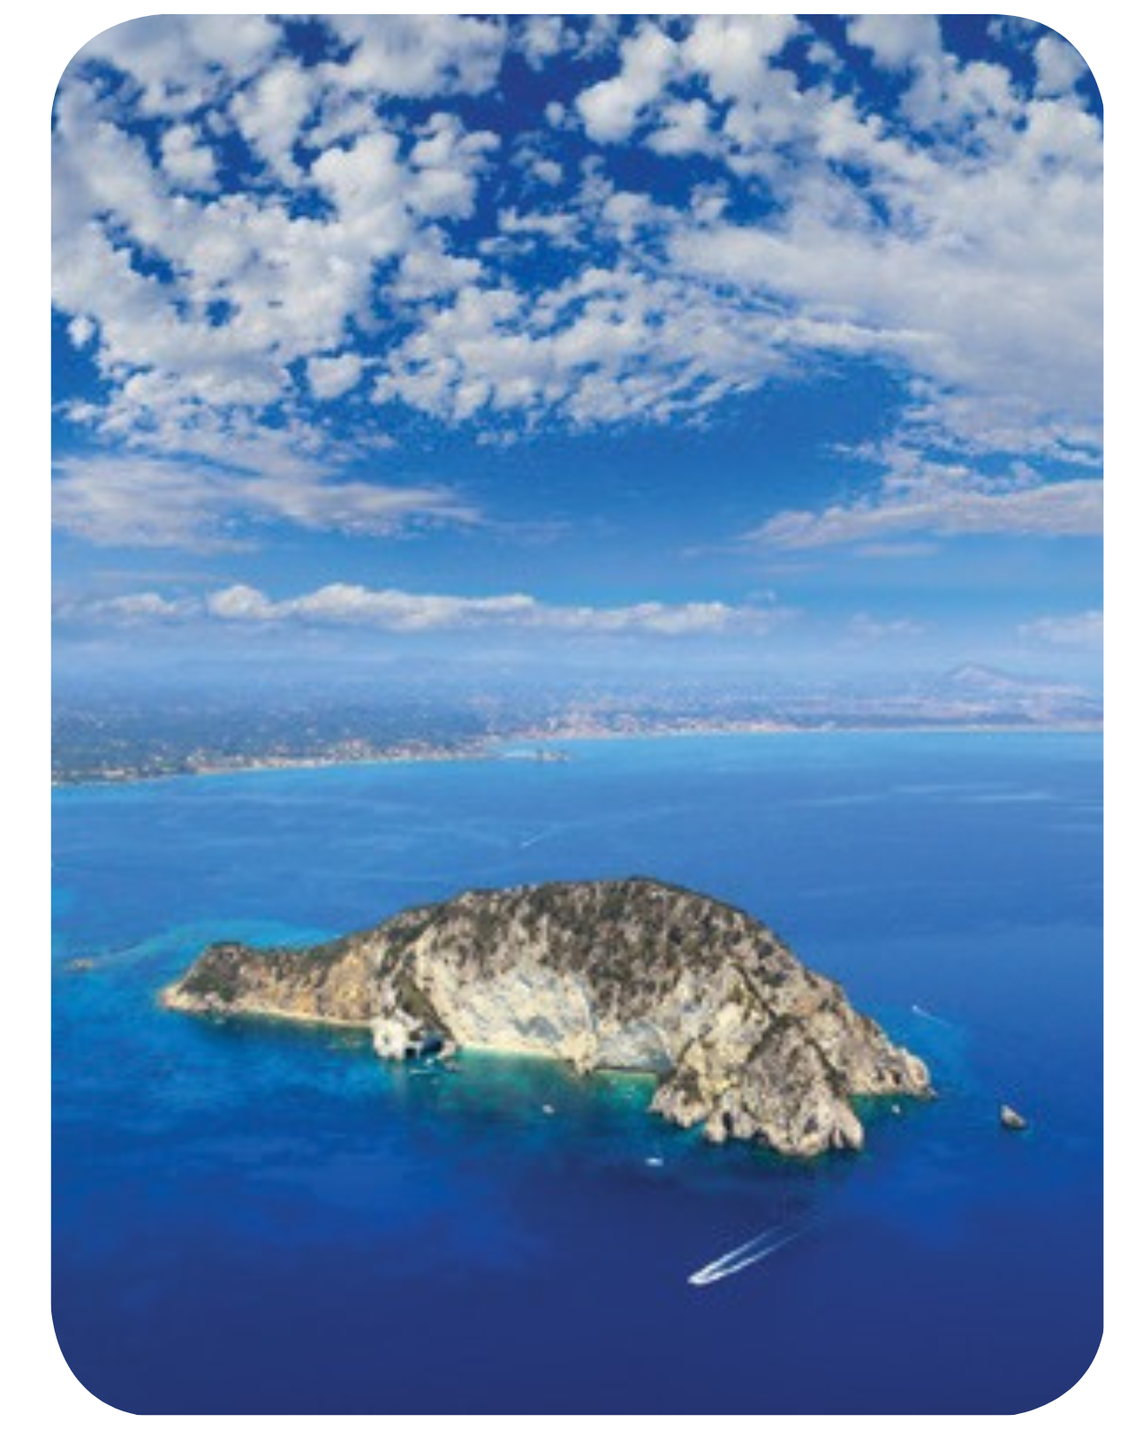
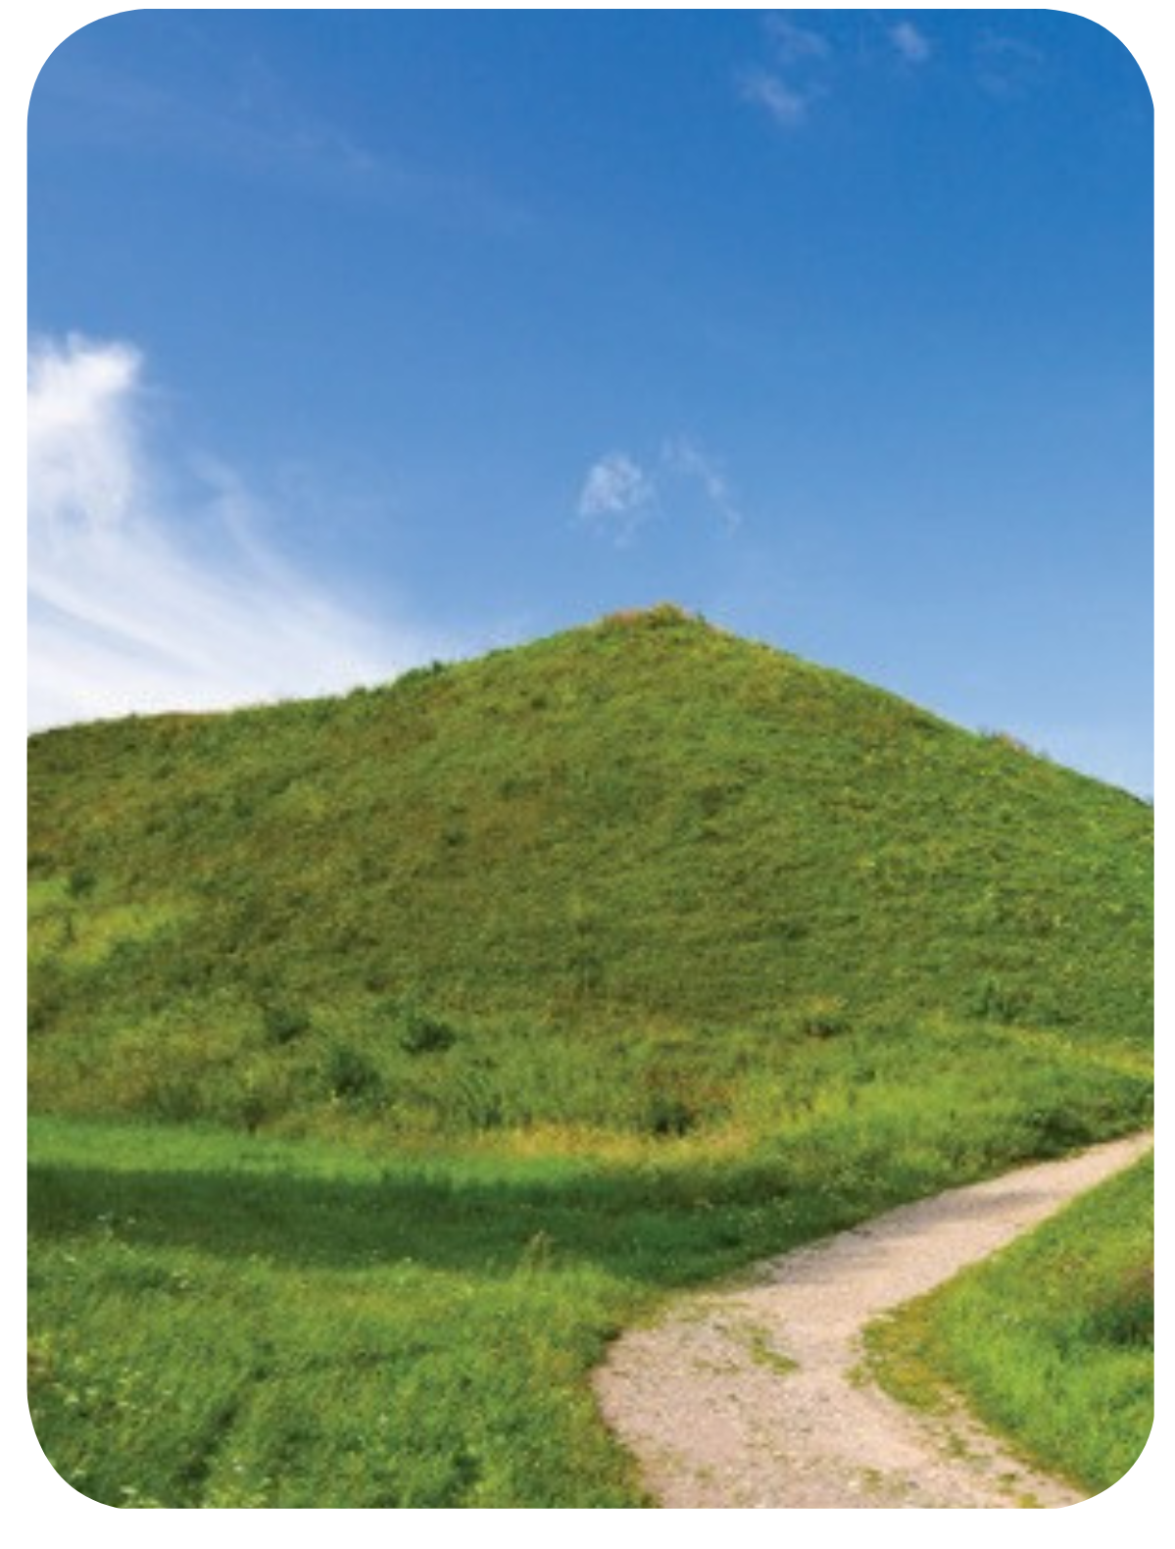
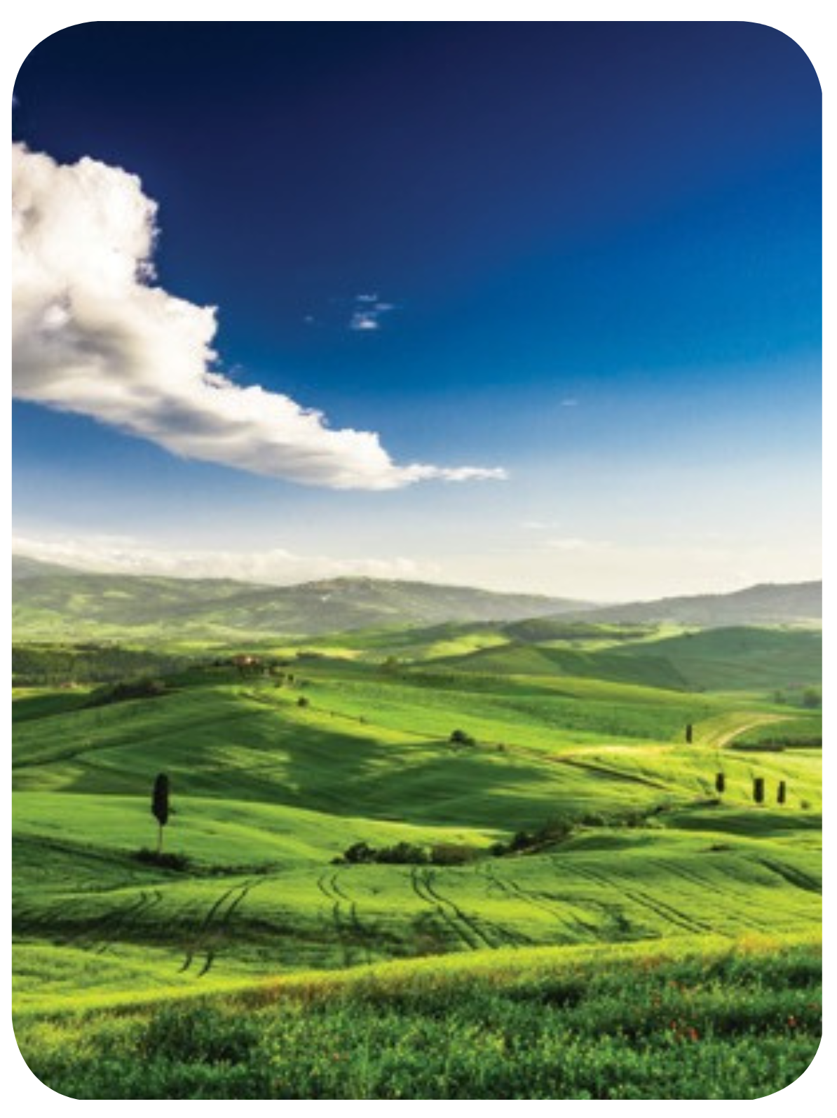
WARM – UP ACTIVITY
1s
3s
2s
5s
0
4s
hill
Answer
Look carefully and write the missing word on the mini-board.
Check the answer together.

Slide 5
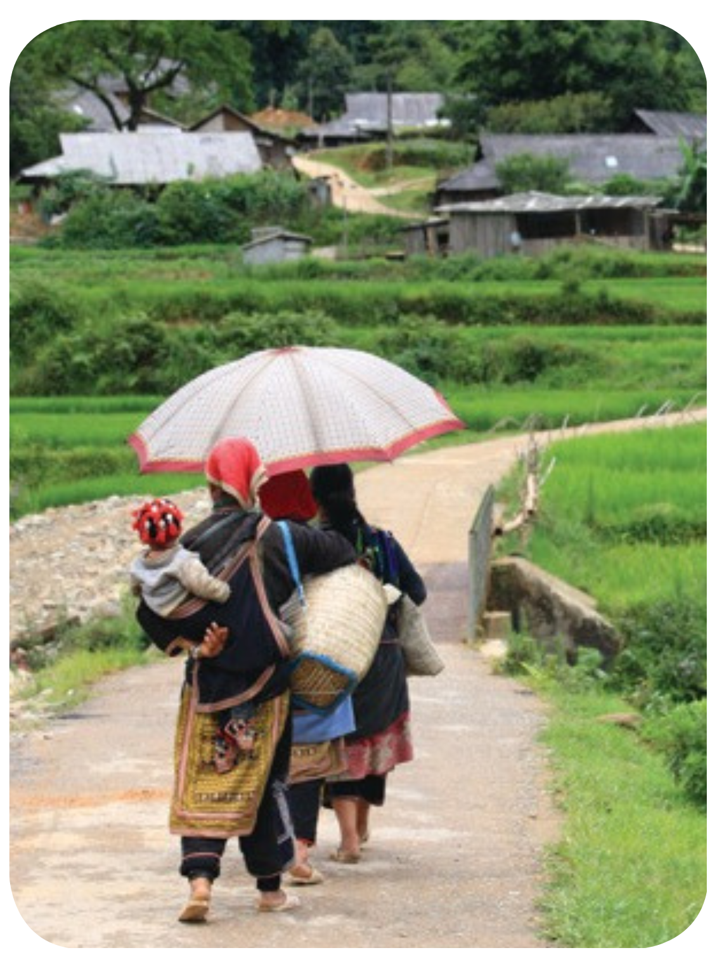
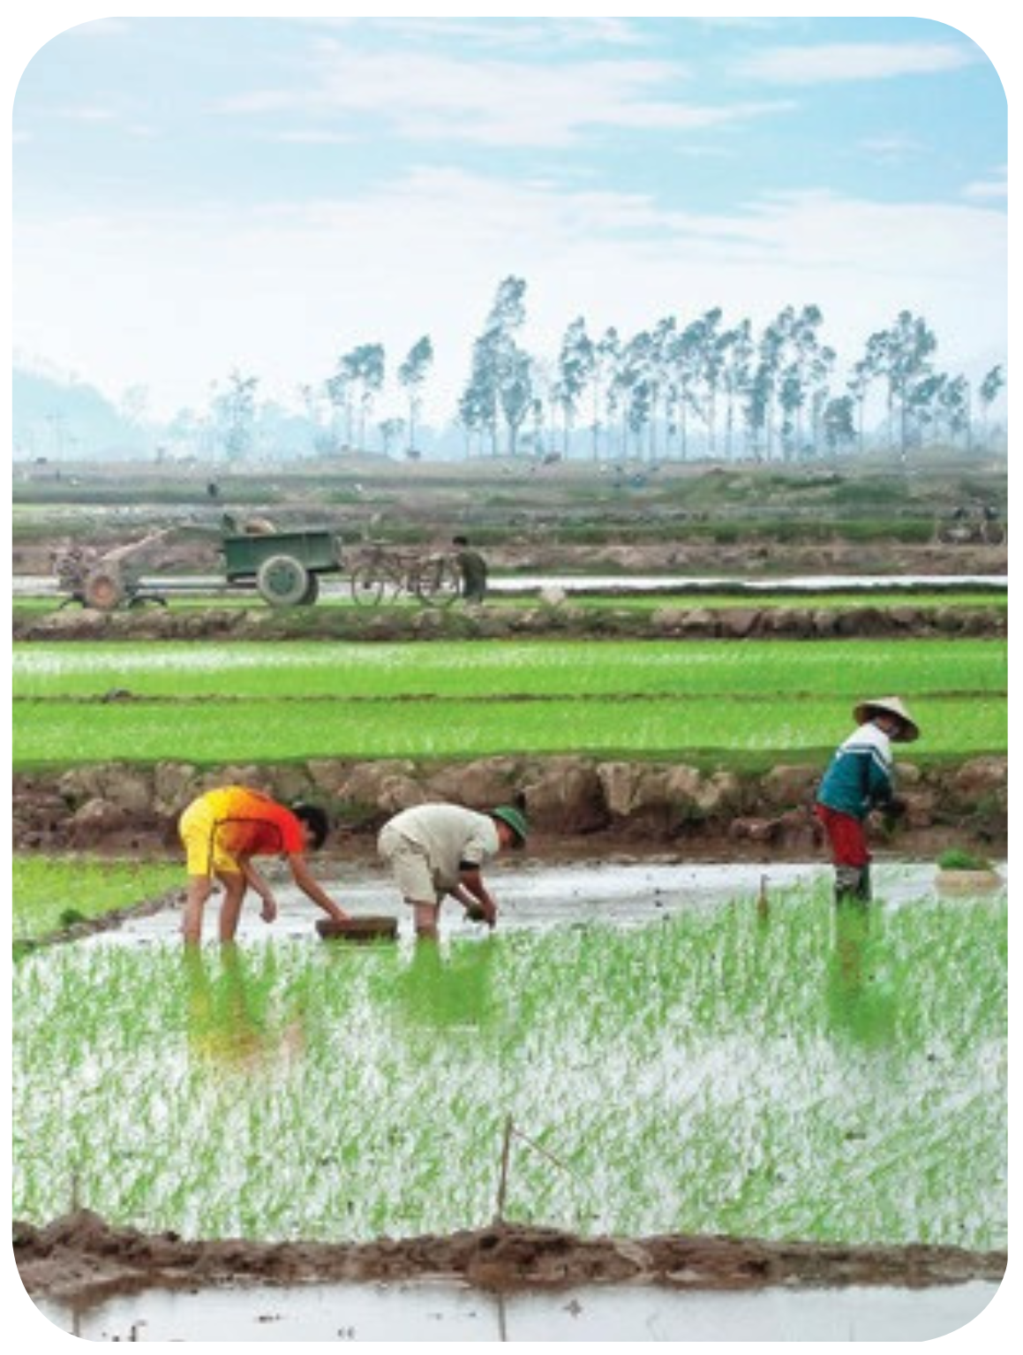
WARM – UP ACTIVITY
1s
3s
2s
5s
0
4s
island
Answer
Look carefully and write the missing word on the mini-board.
Check the answer together.

Slide 6
WARM – UP ACTIVITY
1s
3s
2s
5s
0
4s
village
Answer
Look carefully and write the missing word on the mini-board.
Check the answer together.

Slide 7
WARM – UP ACTIVITY
1s
3s
2s
5s
0
4s
forest
Answer
Look carefully and write the missing word on the mini-board.
Check the answer together.

Slide 8
WARM – UP ACTIVITY
1s
3s
2s
5s
0
4s
countryside
Answer
Look carefully and write the missing word on the mini-board.
Check the answer together.

Slide 9
WARM – UP ACTIVITY
1s
3s
2s
5s
0
4s
valley
Answer
Look carefully and write the missing word on the mini-board.
Check the answer together.

Slide 10
STRUCTURE – Pupils’ book (p.47)
Listen and repeat.

Slide 11
STRUCTURE – Pupils’ book (p.47)
Please compare these two places.
The mountain is higher than the hill.
- Show a question and an answer with audio, students listen and repeat.
- Divide class into two teams. One team asks and one team answers.

Slide 12
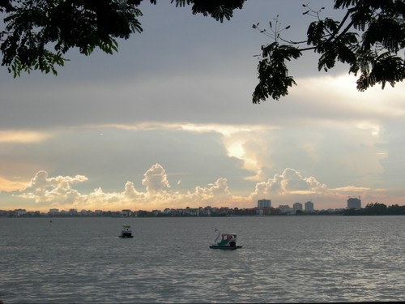
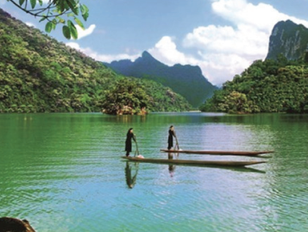
STRUCTURE – Pupils’ book (p.47)
Please compare these two places.
Ba Bể Lake is deeper than West Lake in Hà Nội.
- Show a question and an answer with audio, students listen and repeat.
- Divide class into two teams. One team asks and one team answers.

Slide 13
STRUCTURE – Pupils’ book (p.47)
Please compare these two places.
A town is smaller than
a city.
- Show a question and an answer with audio, students listen and repeat.
- Divide class into two teams. One team asks and one team answers.

Slide 14
STRUCTURE – Pupils’ book (p.47)
higher
deeper
smaller
Adj + er
Ask students how these words are similar.
Ask students to tell another comparative form of other adjectives they know.

Slide 15
STRUCTURE – Pupils’ book (p.47)
The comparative form of adjectives
The mountain is higher than the hill.
S1 + to be + Adj + er + than + S2
Point to the example.
Explain the adjective with “than” to show what is being compared.

Slide 16
PRACTICE – Finish The Comparative Activity
deep
deeper than
old
older than
→
→
small
smaller than
young
→
younger than
→
clean
cleaner than
tall
taller than
→
→
fast
faster than
short
shorter than
→
→
Answer
In pairs, prepare a mini-board.
Look at the adjective and finish the comparative form of that adjective.
Look at the example first.

Slide 17
PRACTICE – Pupils’ Book (p.47)
small than
taller than
cleaner than
Answer
In pairs, work together to complete the table.
Check the answer with the whole class.

Slide 18
PRACTICE
Activity: The Comparative
Divide the class into two teams.
The teacher chooses a random student from two teams to come to the front of the class.
Ask them to look at slide, complete the sentence.
Raise hand to get a chance to answer. Say the full sentence.
The first team that has the correct answer can get 2 points.
Note: If the student answers incorrectly, the other team will have the right to answer

Slide 19
London / small / Sydney
London is smaller than Sydney.
Answer
Notes:
Ms Huyền Phạm - 0936.082.789 – YOUTUBE: MsPham. Facebook: Dạy và học cùng công nghệ.

Slide 20
Ba Bể Lake / deep / Biển Hồ Lake.
Ba Bể Lake is deeper than Biển Hồ Lake.
Answer
Notes:
Ms Huyền Phạm - 0936.082.789 – YOUTUBE: MsPham. Facebook: Dạy và học cùng công nghệ.

Slide 21
Hương River / short / Mekong River
Hương River is shorter than Mekong River.
Answer
Notes:
Ms Huyền Phạm - 0936.082.789 – YOUTUBE: MsPham. Facebook: Dạy và học cùng công nghệ.

Slide 22
The mountain / high / the hill
The mountain is higher than the hill.
Answer
Notes:
Ms Huyền Phạm - 0936.082.789 – YOUTUBE: MsPham. Facebook: Dạy và học cùng công nghệ.

Slide 23
The forest / clean / the city
The forest is cleaner than the city
Answer
Notes:
Ms Huyền Phạm - 0936.082.789 – YOUTUBE: MsPham. Facebook: Dạy và học cùng công nghệ.

Slide 24
Bản Giốc Waterfall / large / Thủy Tiên Waterfall
Bản Giốc Waterfall is larger than Thủy Tiên Waterfall.
Answer
Notes:
Ms Huyền Phạm - 0936.082.789 – YOUTUBE: MsPham. Facebook: Dạy và học cùng công nghệ.

Slide 25
The countryside / small / the big city
The countryside is smaller than the big city.
Answer
Notes:
Ms Huyền Phạm - 0936.082.789 – YOUTUBE: MsPham. Facebook: Dạy và học cùng công nghệ.

Slide 26
Living in the town / cheap / living in the city.
Living in the town is cheaper than living in the city
Answer
Notes:
Ms Huyền Phạm - 0936.082.789 – YOUTUBE: MsPham. Facebook: Dạy và học cùng công nghệ.

Slide 27
Notes:
Ms Huyền Phạm - 0936.082.789 – YOUTUBE: MsPham. Facebook: Dạy và học cùng công nghệ.

Slide 28
PRACTICE – Pupils’ Book (p.47)
Look at the adjectives and pictures.
In pairs, compare pictures A and B. Make comparative sentences.

Slide 29
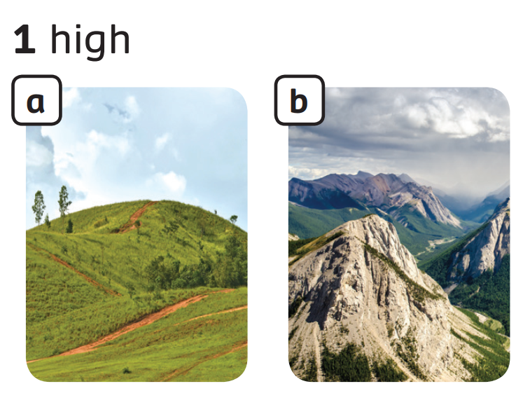
PRACTICE – Pupils’ Book (p.47)
The mountain is higher than the hill
Example Answer
Look at the adjectives and pictures.
In pairs, compare pictures A and B. Make comparative sentences.
Check the answer with the whole class.

Slide 30
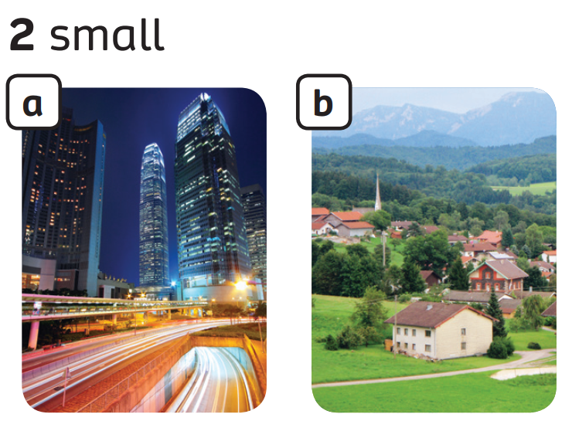
PRACTICE – Pupils’ Book (p.47)
The town is smaller than the city.
Example Answer
Look at the adjectives and pictures.
In pairs, compare pictures A and B. Make comparative sentences.
Check the answer with the whole class.

Slide 31
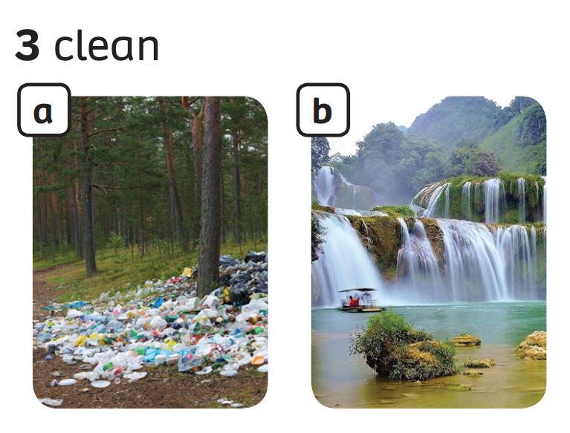
PRACTICE – Pupils’ Book (p.47)
The waterfall is cleaner than the forest.
Example Answer
Look at the adjectives and pictures.
In pairs, compare pictures A and B. Make comparative sentences.
Check the answer with the whole class.

Slide 32
PRODUCTION
Compare the places in your village / town / city.
In my city, Hoàn Kiếm Lake is smaller than West Lake.
In my town, Thủy Tiên Waterfall is higher than Gia Long Waterfall
In groups of 4, work together to compare places in their village, town, or city.
Look at the example. Invite some groups to present.

Slide 33
HOMEWORK
HOMEWORK
Review Vocabulary and Grammar.
Do exercises in the Activity Book (page 38).
Check answers in the Teacher’s book (page 84) or Active Teach.

Slide 34
UNIT 4 – Lesson 3B
We’ve learned…
- Outdoor Places
- to use comparative adjectives + than
- PB p.47
- AB p.38

