Slide 1
UNIT 4 – PLACES IN VIỆT NAM
Lesson 5a – Vocabulary and Grammar 1

Slide 2
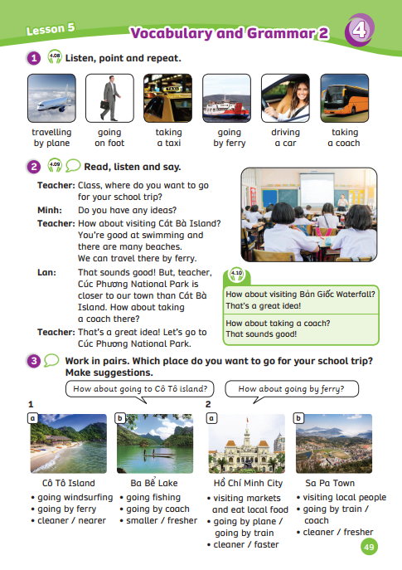
UNIT 4 – Lesson 5A
We’re learning…
- words to describe places
- PB p.49
- AB p.40

Slide 3
WARM-UP ACTIVITY
Activity: Make a sentence
Divide the class into groups of three.
Say a random word and wait for 30 seconds.
All groups think of a sentence to describe the word they hear in their 30s.
After the 30s, each team must give one sentence. If their sentence makes sense and gets correct grammar, award them 2 points.
Continue with the other words.
Words list: forest, hill, island, valley, countryside, village

Slide 4
VOCABULARY – Lead-in
a taxi
by ferry
on foot
a car
by plane
a coach
Say these words and ask students to guess the phrases of these words.
The teacher can help them by saying example words.
(Ex: teacher says “taking” and students say “a taxi”)
Tell them that in this lesson, they will learn more words to describe places.

Slide 5
VOCABULARY – Words to describe places
- Have students look at the pictures, listen and repeat.

Slide 6
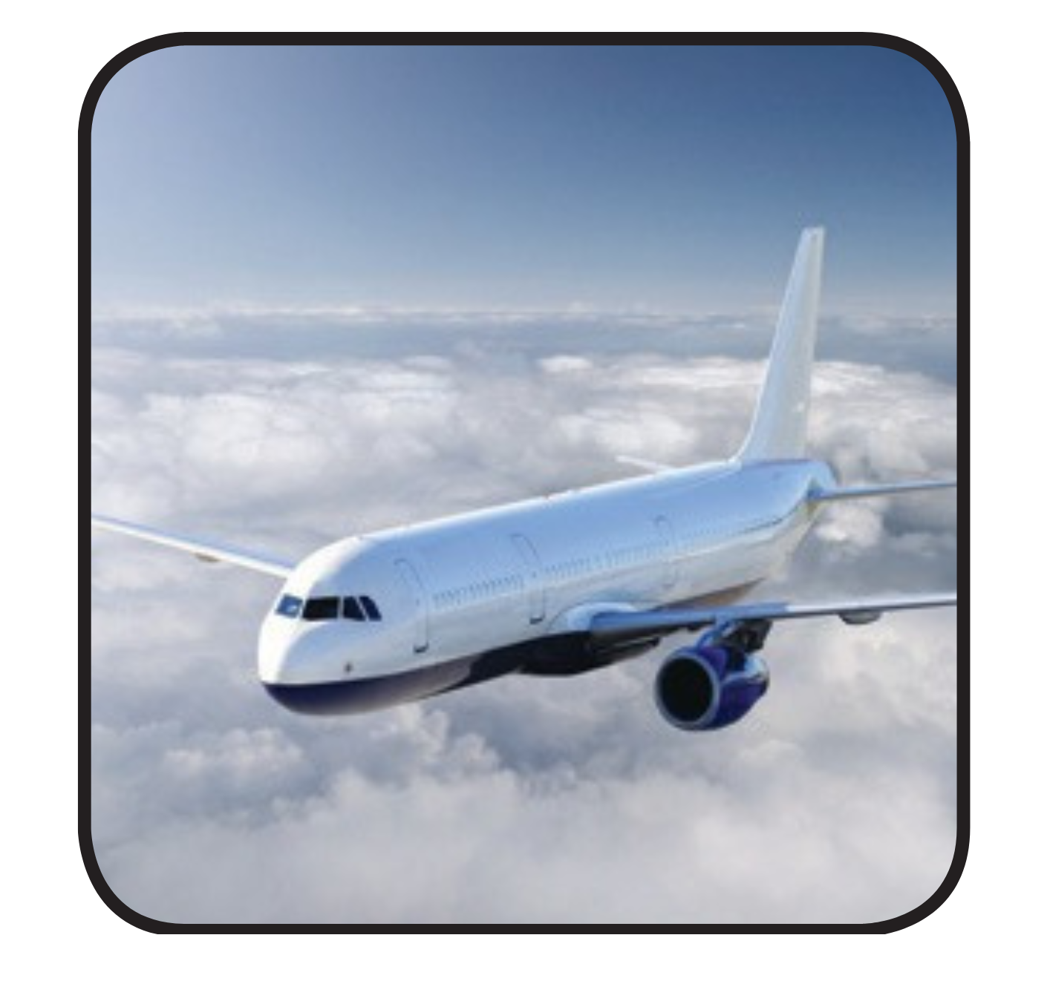
VOCABULARY – Words to describe places
Let’s spell!
travelling
by plane
t
r
a
v
e
l
l
i
n
g
b
y
p
l
a
n
e

Slide 7
VOCABULARY – Words to describe places
Let’s spell!
going on foot
g
o
i
n
g
o
n
f
o
o
t

Slide 8
VOCABULARY – Words to describe places
Let’s spell!
taking a taxi
t
a
k
i
n
g
a
t
a
x
i

Slide 9
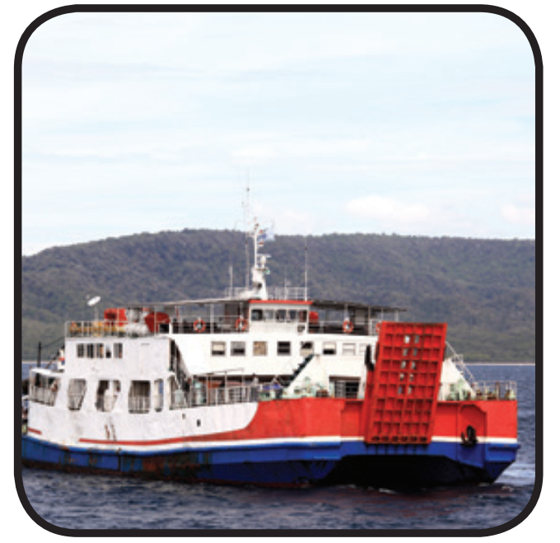
VOCABULARY – Words to describe places
Let’s spell!
going by
ferry
g
o
i
n
g
b
y
f
e
r
r
y

Slide 10
VOCABULARY – Words to describe places
Let’s spell!
driving a car
d
r
i
v
i
n
g
a
c
a
r

Slide 11
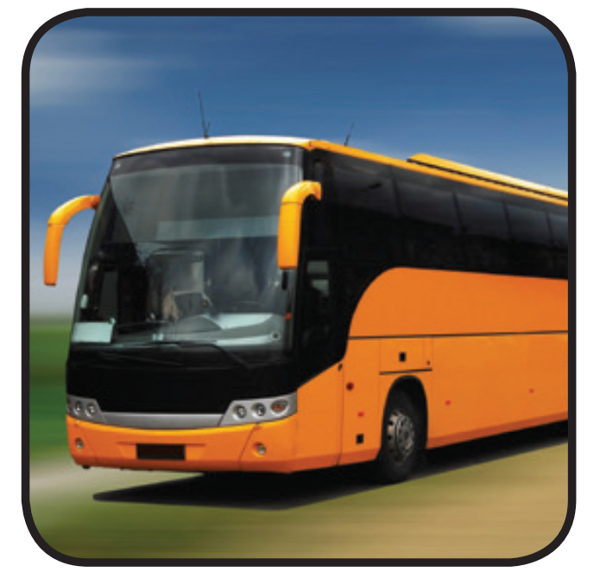
VOCABULARY – Words to describe places
Let’s spell!
taking a coach
t
a
k
i
n
g
a
c
o
a
c
h

Slide 12
VOCABULARY – Words to describe places
REVIEW
Review all the new words

Slide 13
PRACTICE
Activity: Guess what I do
Divide the class into two teams.
The teacher chooses a random student.
That student can only see the picture the teacher shows.
After seeing the picture, that student needs to use his/her body language to describe the word without saying it.
Other students guess the word.
The faster team with the correct answer can get 2 points.

Slide 14
PRACTICE
Activity: Fill in the blank.
Divide the class into pairs.
Each pair prepares a mini-board. Each student takes turns to write the answer.
Look, discuss to find out the missing letters and write the whole word on the board.
The faster team with the correct answer can get 2 points.
The whole class spells the word together.

Slide 15
PRACTICE – Fill in the blank
Answer
c
t_king _ coa_h
a
a

Slide 16
PRACTICE – Fill in the blank
Answer
g
f
y
_oing by _err_

Slide 17
PRACTICE – Fill in the blank
Answer
a
x
tak_ng a t_ _i
i

Slide 18
PRACTICE – Fill in the blank
Answer
o
n
t
g_ing o_ foo_

Slide 19
PRACTICE – Fill in the blank
Answer
r
dr_v_ng a ca_
i
i

Slide 20
PRACTICE – Fill in the blank
Answer
v
l
a
tra_el_ing by pl_ne

Slide 21
STRUCTURE REVISION
How do you go to Ba Bể Lake?
I go to Ba Bể Lake by car.
Look at the example.

Slide 22
STRUCTURE REVISION
How does your mom travel to Hội An Old Town?
She travels to Hội An Old Town by plane.
Look at the example.

Slide 23
PRACTICE
Activity: The traveller
Divide the class into groups of 4.
Each team prepares a pencil case and puts it in the middle.
Read the question and answer it.
The whole team say the answer together
The team that has the first correct answer can get 2 points.
The team with the highest points will win the game.

Slide 24
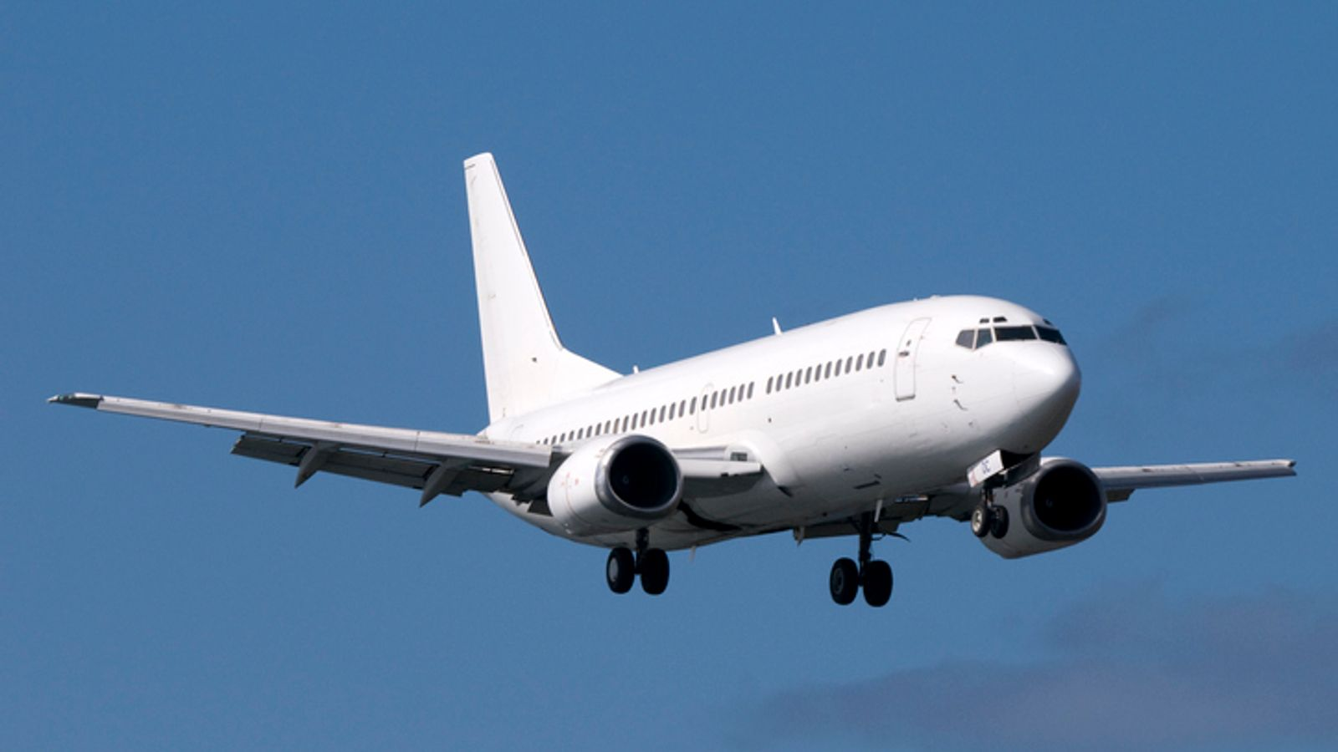
How do you travel to Đà Nẵng City?
Answer
Next
I travel to Đà Nẵng City by plane.

Slide 25
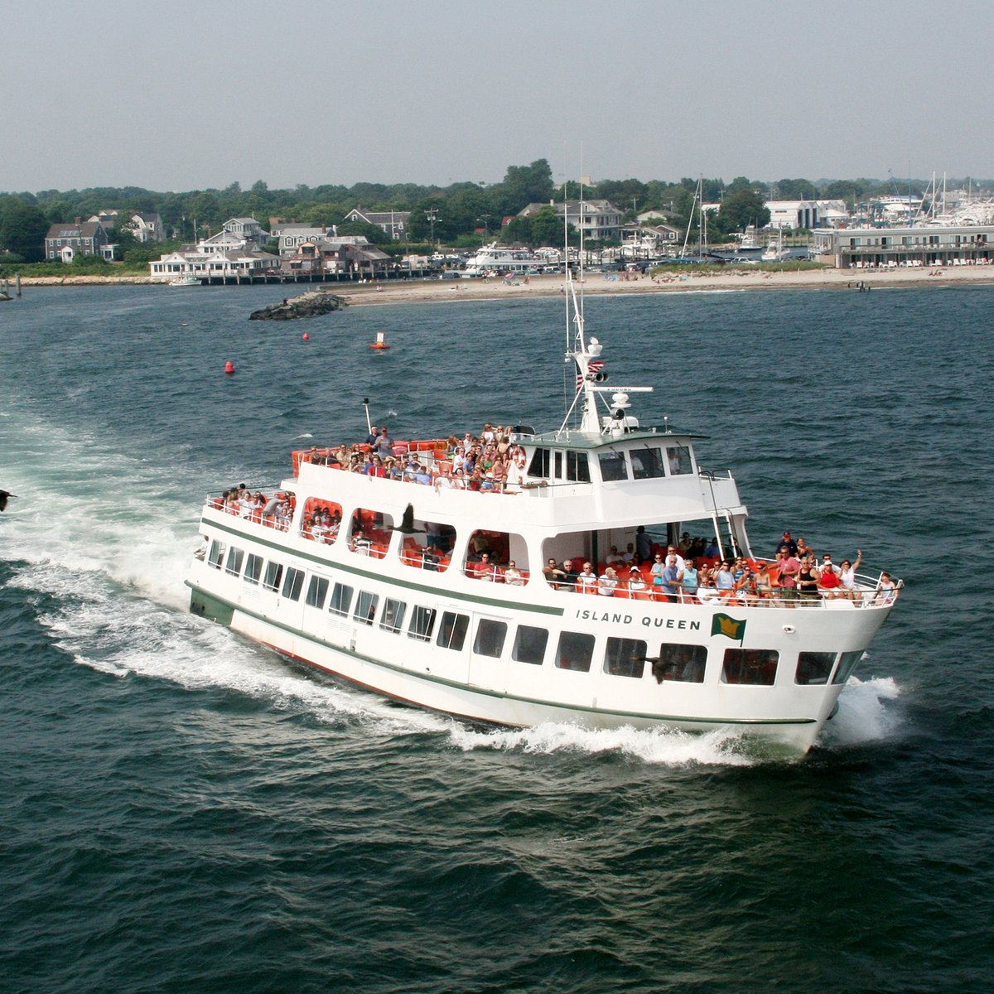
How does Linh go to Lý Sơn Island?
Answer
Next
She goes to Lý Sơn Island by ferry.

Slide 26
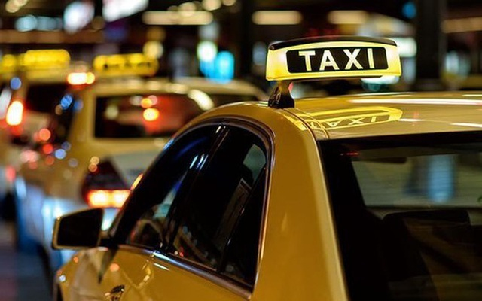
How do your friends go to
Hoàn Kiếm Lake?
Answer
Next
They go to Hoàn Kiếm Lake by a taxi.

Slide 27
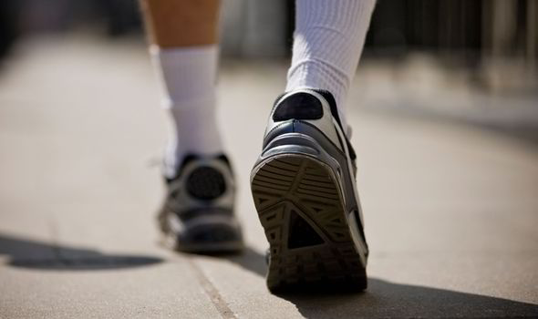
How does your uncle travel to Phan Xi Făng Mountain?
Answer
Next
He goes to Phan Xi Făng Mountain on foot.

Slide 28
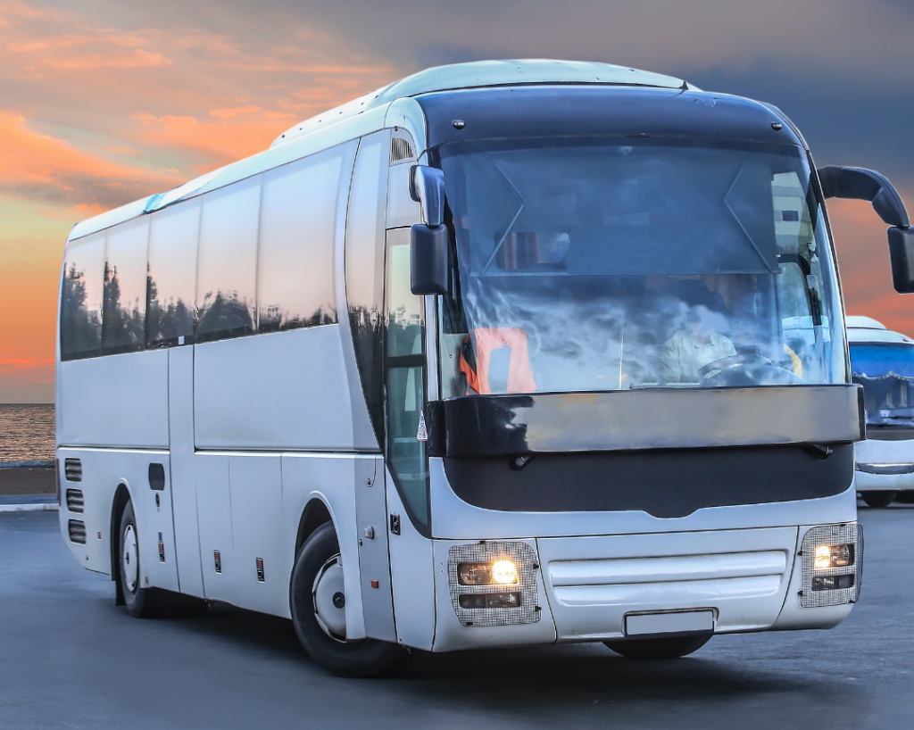
How does your family travel to
Sa Pa Town?
Answer
Next
My family travel to Sa Pa Town by coach.

Slide 29
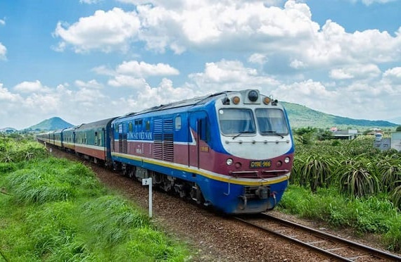
How does Nam go to Thủy Tiên Waterfall?
Answer
Next
He goes to Thủy Tiên Waterfall by train.

Slide 30
Welldone!
End

Slide 31
SUM - UP
REVIEW
The teacher says “travelling” and the students say “by plane”. Keep going with other words.
Then, ask students to make sentences using these phrases.

Slide 32
HOMEWORK
HOMEWORK
Review Vocabulary and Grammar.
Do exercises in the Activity book (page 40).
Check answers in the Teacher’s book (page 88) or Active Teach.

Slide 33
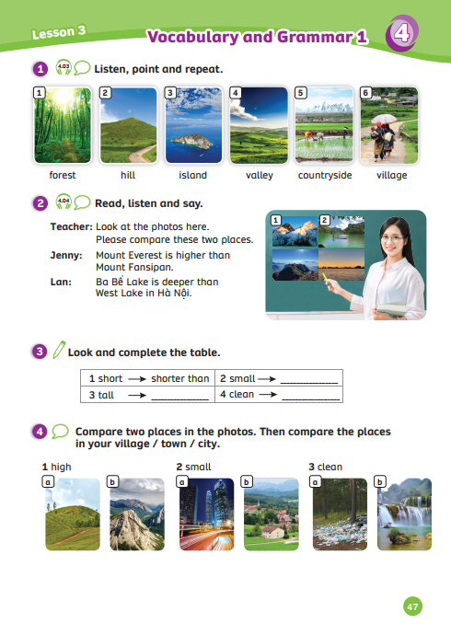
UNIT 4 – Lesson 5A
We’ve learned…
- words to describe places
- PB p.49
- AB p.40

