Slide 1
UNIT 4 – PLACES IN VIỆT NAM
Lesson 6 - REVIEW

Slide 2
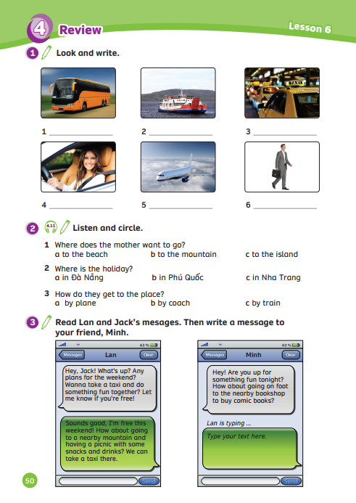
UNIT 4 – Lesson 6
We’re learning…
- to review words to describe places.
- to make suggestions.
- PB p.50
- AB p.41

Slide 3
WARM-UP ACTIVITY
Activity: Where is it?
Divide the class into groups of 4.
Ask them to remember the name of the place in the previous lesson.
Read the given clue, discuss to find the answer.
The faster team raising hands can answer the question.
The team with the correct answer can get 2 points.

Slide 4
WARM-UP ACTIVITY
I want to go windsurfing. I want to go there by ferry. Where should I go?
You should go to Cô Tô Island.
Answer

Slide 5
WARM-UP ACTIVITY
I want to go visit markets and eat local food. I want to go there by plane or train. Where should I go?
You should go to Hồ Chí Minh City.
Answer

Slide 6
WARM-UP ACTIVITY
I want to go fishing. I want to go there by coach. Where should I go?
You should go to Ba Bể Lake.
Answer

Slide 7
WARM-UP ACTIVITY
I want to visit the local people. I want to go there by train or coach.
Where should I go?
You should go to Sa Pa Town.
Answer

Slide 8
REVIEW: Vocabulary
Activity: Guess the word
Divide the class into groups of 6.
Each team chooses a student to come to the whiteboard.
Students take turns to play the game.
There is a small picture next to the bird. Look and guess the word then run to the board and write the answer.
The faster team with the correct answer can get 2 points.

Slide 9
Guess the word

Slide 10
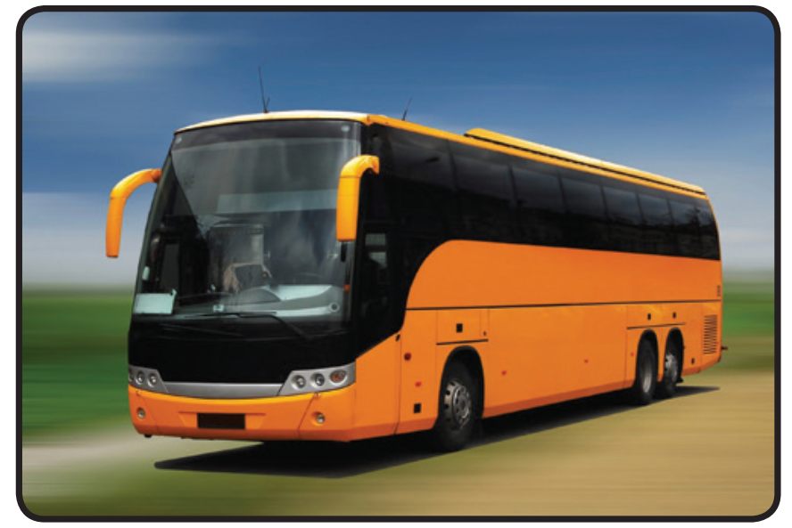
Can you guess what the word is?
taking a coach

Slide 11
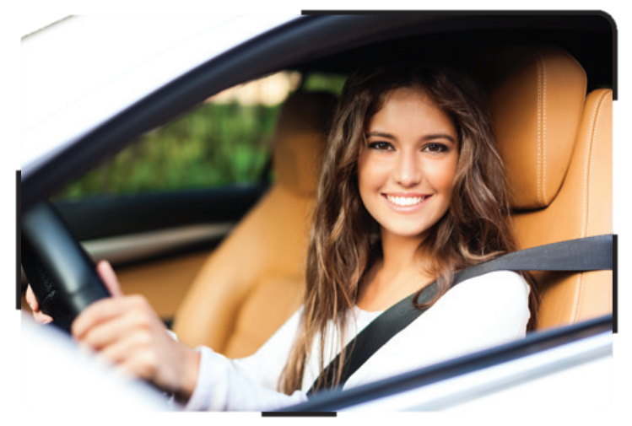
Can you guess what the word is?
driving a car

Slide 12
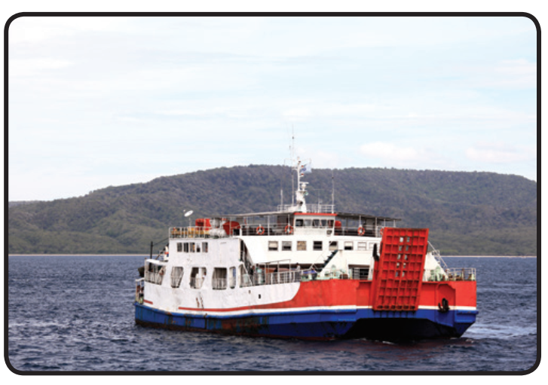
Can you guess what the word is?
going on ferry

Slide 13
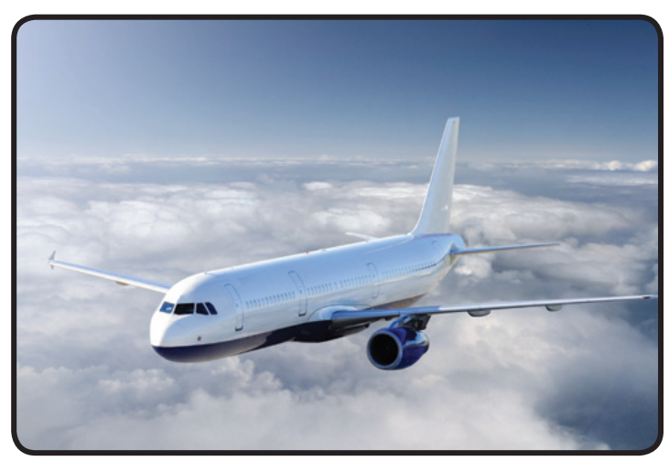
Can you guess what the word is?
travelling by plane

Slide 14
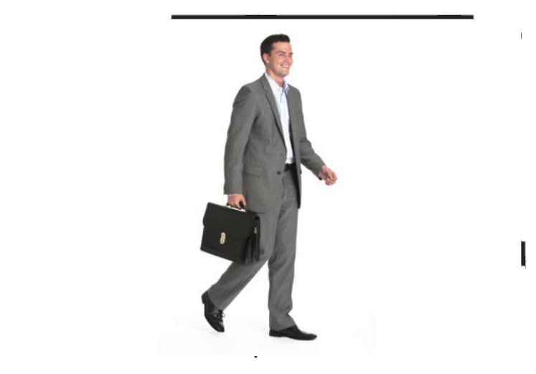
Can you guess what the word is?
going on foot

Slide 15
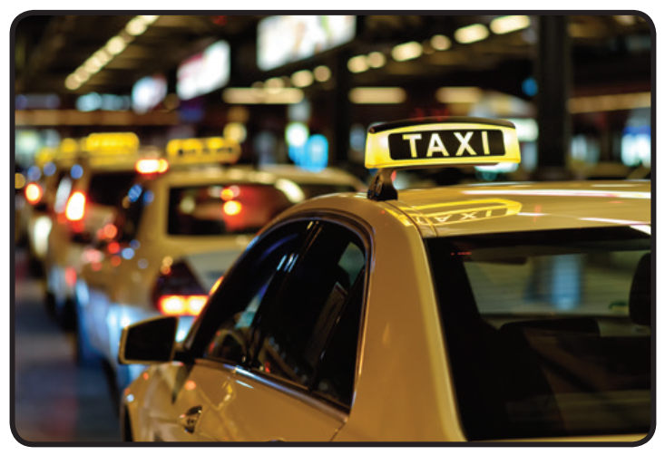
Can you guess what the word is?
taking a taxi

Slide 16
Great job!

Slide 17
STRUCTURE – Pupils' Book (p.50)
taking a coach
going by ferry
taking a taxi
Answer
Click on “Answer” to show the answer

Slide 18
STRUCTURE – Pupils' Book (p.50)
driving a car
travelling by plane
going on foot
Answer
Click on “Answer” to show the answer

Slide 19
STRUCTURE REVISION
How do I go to the bank?
You should go by a taxi.

Slide 20
STRUCTURE REVISION
How do I go from Hà Nội to Phú Quốc Island?
You should go by plane.

Slide 21
Pupils' Book (p.49)
Pre-listening: Activity. Guess the answer
The mother wants to go to the island.
Where does the mother want to go?
The mother wants to go to the mountain.
Where does the mother want to go?
Example
In pairs, one student asks and the other answers.
Then switch the role. Look at the example.

Slide 22
Pupils' Book (p.50)
Answer
Listen and circle individually.
Check the answer with the whole class.

Slide 23
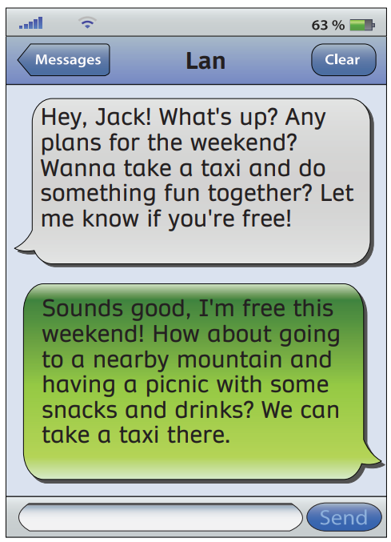
PRODUCTION - Pupils' Book (p.50)
Divide the class into two teams to read the message between Jack and Lan.

Slide 24
PRODUCTION - Pupils' Book (p.50)
Answer the questions.
1. Is Jack free on the weekend?
Yes, he is.
2. What is Jack’s suggestion?
They are going to a nearby mountain and
having a picnic with some snacks.
3. How do they go?
They can go there by a taxi.
Answer
After reading, answer these questions in pairs.

Slide 25
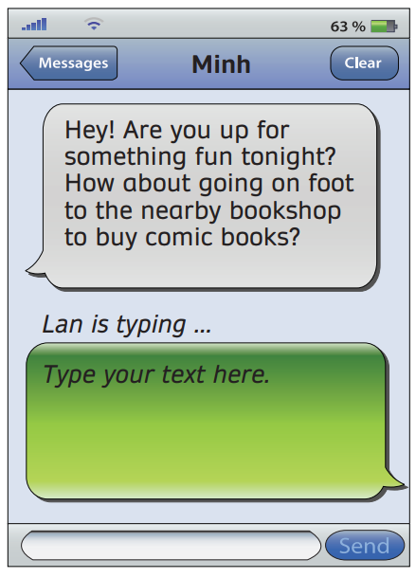
PRODUCTION - Pupils' Book (p.50)
Underline
Read two messages and underline the suggestion questions. Then read these sentences together.

Slide 26
PRODUCTION - Pupils' Book (p.50)
Individually responds to Minh’s message.
Invite a few students to show their message on the board.

Slide 27
PRODUCTION (OPTIONAL)
home
the bank
How do I go from home to the bank?
You should go on foot.
In pairs, look at these places, ask and answer which form(s) of transport you should use to travel between them.
Look at the example. Invite a few pairs to present.

Slide 28
PRODUCTION (OPTIONAL)
1.
2.
home
the bank
Đà Nẵng
Hồ Chí Minh City
3.
4.
supermarket
restaurant
school
Cô Tô Island
In pairs, look at these places, ask and answer which form(s) of transport you should use to travel between them.
Look at the example. Invite a few pairs to present.

Slide 29
HOMEWORK
HOMEWORK
Review Vocabulary and Grammar.
Do exercises in the Activity Book (page 41).
Check answers in the Teacher’s book (page 90) or Active Teach.

Slide 30
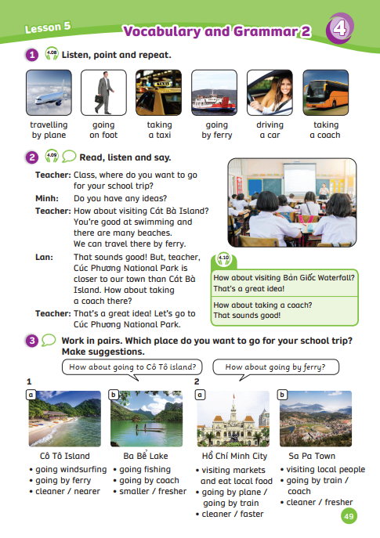
UNIT 4 – Lesson 6
We’ve learned…
- to review words to describe places
- to make suggestions.
- PB p.50
- AB p.41

