Slide 1
UNIT 4 – PLACES IN VIỆT NAM
Lesson 8 - Skills

Slide 2
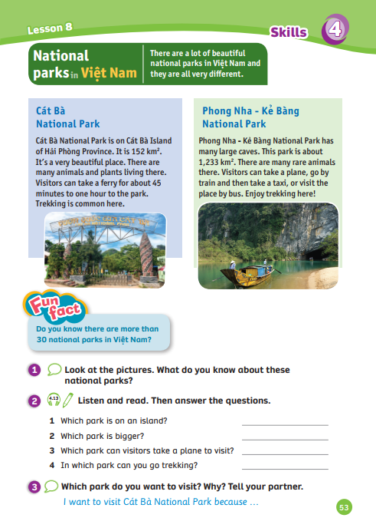
UNIT 4 – Lesson 8
We’re learning…
- Skill: national parks in Việt Nam
- PB p.53
- AB p.43

Slide 3
WARM-UP ACTIVITY
Activity: Who has more?
Divide the class into groups of 6. Each team prepares a piece of paper.
In 2 minutes, list as many national parks in Việt Nam as possible.
Then, each team chooses one member to come to the board to write all the names they got.
Check the answers together.

Slide 4
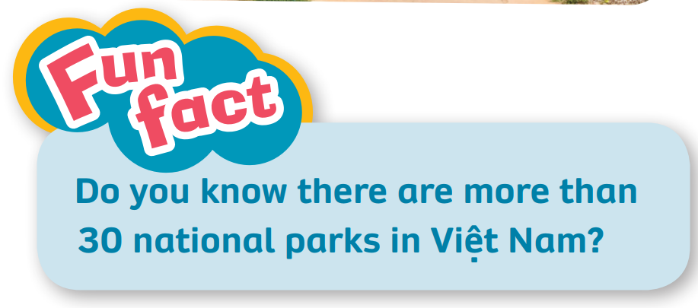
LEAD - IN
Answer
Ask the class to guess how many national parks are there in Việt Nam.
Check the answer together. Explain that we will describe national park in this lesson.

Slide 5
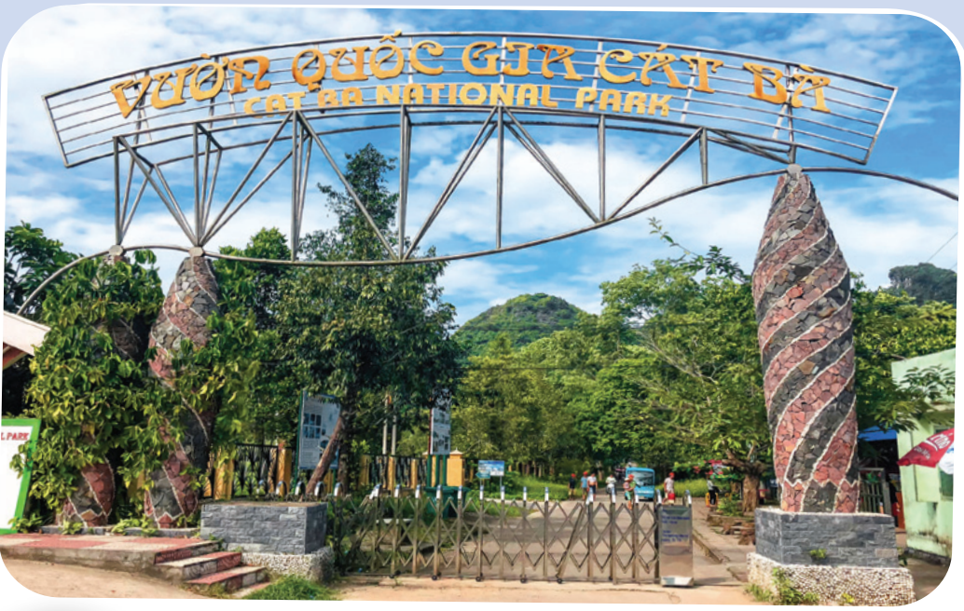
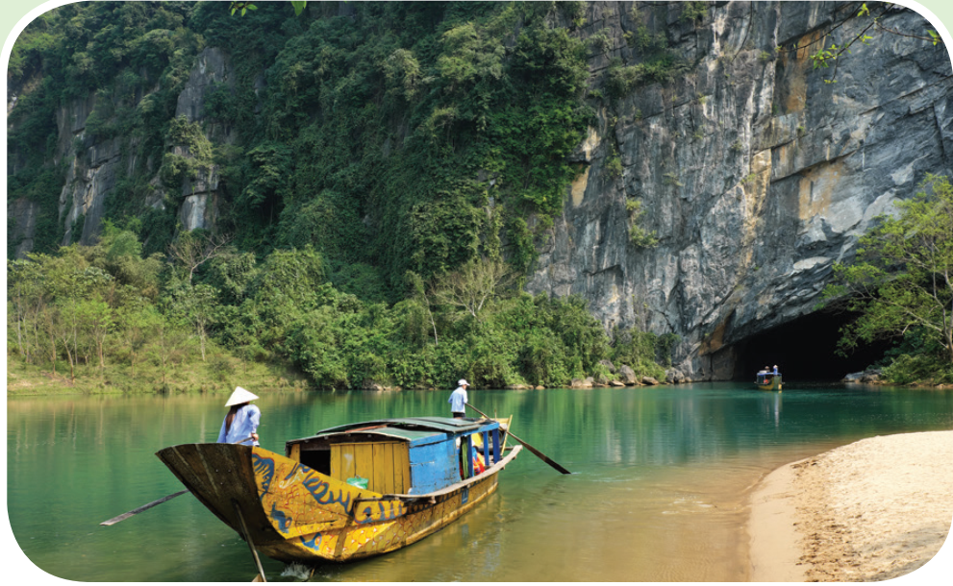
SKILLS (Pupils' Book –p.53)
I see many trees.
I see a boat
Example
Look at the picture and ask students, “What do you see in these pictures?
Ask them to guess where they are and answer the question on the title.

Slide 6
SKILLS (Pupils' Book –p.53)
Ask students to close their books, ask them to tell you what they know about these parks.
Open the audio, ask students to listen and read. Stop at each line.

Slide 7
SKILLS (Pupils' Book –p.53)
Underline
Look at the texts, read through and underline the information (name of the national parks, size, transportation, activity)

Slide 8
Activity: School bus
Divide the class into four teams.
Ask them to look at the sentence and two given answers. Tell them the red box = clap their hands; the green box = pound on the table.
Read the sentence and choose the correct national park
The faster team with the correct answer can get more points.
Note: All members need to show the answer together.

Slide 9
School bus
Play

Slide 10
Next
This is on Cát Bà Island of
Hải Phòng.
a. Cát Bà National Park
b. Phong Nha – Kẻ Bàng National Park

Slide 11
Next
This park is about 1,233 km².
a. Cát Bà National Park
b. Phong Nha – Kẻ Bàng National Park

Slide 12
Next
There are many rare
animals there.
a. Cát Bà National Park
b. Phong Nha – Kẻ Bàng National Park

Slide 13
Next
You can take a ferry
to go there.
a. Cát Bà National Park
b. Phong Nha – Kẻ Bàng National Park

Slide 14
Next
There are many ways to go there. You can take a plane or go by train.
a. Cát Bà National Park
b. Phong Nha – Kẻ Bàng National Park

Slide 15
Next
Trekking is common here.
a. Cát Bà National Park
b. Phong Nha – Kẻ Bàng National Park

Slide 16
End

Slide 17
Pupils' Book – p.53
Then answer the questions.
Cát Bà Island National Park
Phong Nha – Kẻ Bàng National Park
Phong Nha – Kẻ Bàng National Park
Both Parks
Answer
- Have students look at the pictures, listen and repeat.

Slide 18
Pupils' Book (p.53) – List out
Cát Bà Island National Park
Phong Nha – Kẻ Bàng National Park
beautiful place
many animals and plants
take a ferry
Trekking
many large caves
many rare animals
take a plane, go by train, take a taxi, place by bus
Trekking
Answer
Ask them to list some information that they remember about 2 national parks.

Slide 19
Pupils' Book (p.53)
I want to visit Cát Bà National Park because it is a beautiful place. There are many animals and plants here. I can take a ferry for about 45 minutes. Trekking is common here.
I want to visit Phong Nha – Kẻ Bàng National Park because it has many large caves. I can see many rare animals living there. I can visit the place by bus.
Example
Ask the whole class to say the title of Exercise 3.
Look at the example. Then, work in pairs to answer. Invite a few students to present.

Slide 20
PRODUCTION
Write a short text (30-40 words) about a national park in Việt Nam.
Ask students to show the information about a national park in Việt Nam that they prepared at home.
In case some students forget to prepare. Tell them to use some given clues on the next slide.
Ask students to write a short text (30-40 words) about a national park in Việt Nam in 3 minutes.
Share the text with the class.

Slide 21
PRODUCTION
Write a short text (30-40 words) about a national park in Việt Nam.
Cát Bà Island National Park
Phong Nha – Kẻ Bàng National Park
beautiful place
many animals and plants
take a ferry
Trekking
many large caves
many rare animals
take a plane, go by train, take a taxi, place by bus
Trekking
Ask students to look at the given clues.

Slide 22
PRODUCTION
Write a short text (30-40 words) about a national park in Việt Nam.
Phú Quốc National Park
Ba Bể National Park
beautiful island
many species of plants and animals.
take a ferry, go by plain
camping
peaceful place
mountains, waterfalls, Ba Bể Lake
traditional homestays
take a plane, go by coach,
Ask students to look at the given clues.

Slide 23
PRODUCTION
Write a short text (30-40 words) about a national park in Việt Nam.
My name is Mai. Ba Bể National Park is one of national parks in Việt Nam.
This is a peaceful place. It has many beautiful mountains, waterfalls and Ba Bể Lake.
We can live in the traditional homestays.
You can visit there by taking a coach.
Example
Look at the example. Write a short text individually.

Slide 24
HOMEWORK
HOMEWORK
Review Vocabulary and Grammar.
Do exercises in the Activity book (page 43).
Check answers in the Teacher’s Book (page 94) or Active Teach.

Slide 25
UNIT 4 – Lesson 8
We’ve learned…
- Skill: national parks in Việt Nam
- PB p.53
- AB p.43

