Slide 1
UNIT 5 – OUR TOWN
Lesson 1 - VOCABULARY

Slide 2
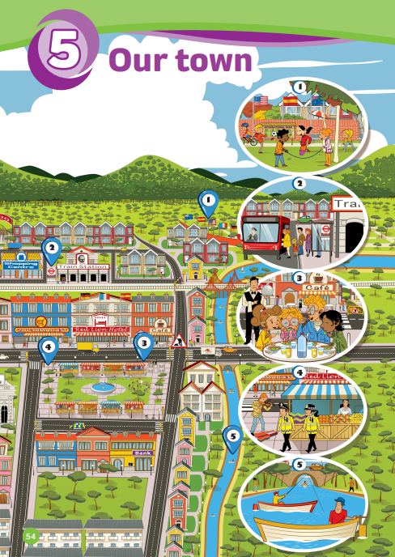
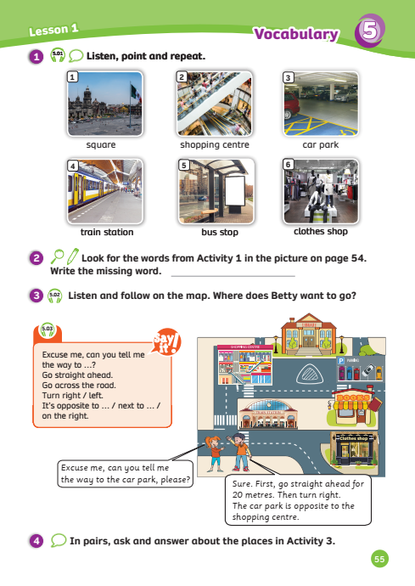
UNIT 5 – Lesson 1
We’re learning…
places in town
directions used in town.
- PB p.54, 55
- AB p.44

Slide 3
WARM-UP ACTIVITY
Activity: The chorus
Divide the class into groups of 6.
Quickly review the outdoor places by showing pictures from the previous unit.
In this game, students need to correctly spell the words together (6 members in the team)
The teacher shows a mix-up word, a member raises hands, then all members stand up and spell the correct word.
The fastest team with the correct answer can get 2 points.

Slide 4
WARM-UP ACTIVITY
1. EFTSOR
forest
2. LLYVAE
valley
3. LILH
hill
4. SNDLAI
island
5. TRYEFCOSIUN
countryside
6. GLLIAVE
village
Answer
The teacher shows the flashcard and asks a random student to spell that word.
Click on “sad face” to erase one line.

Slide 5
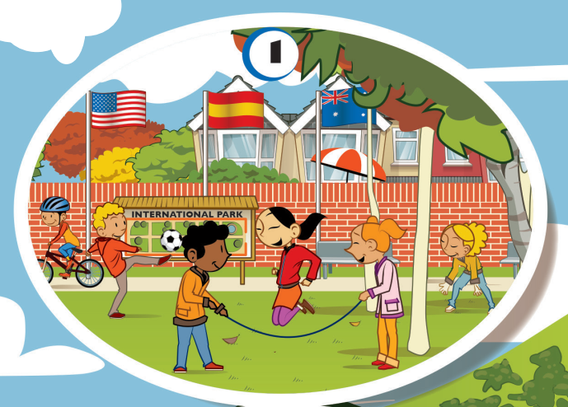
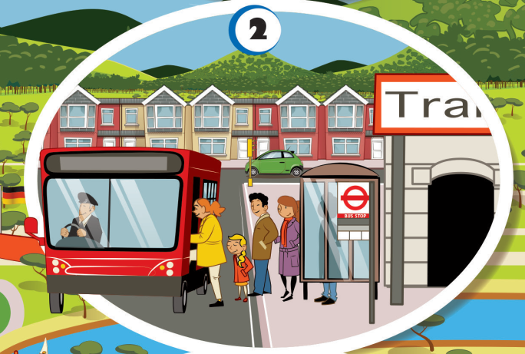
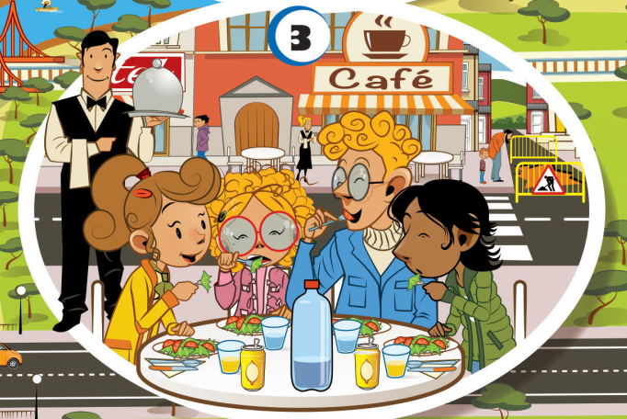
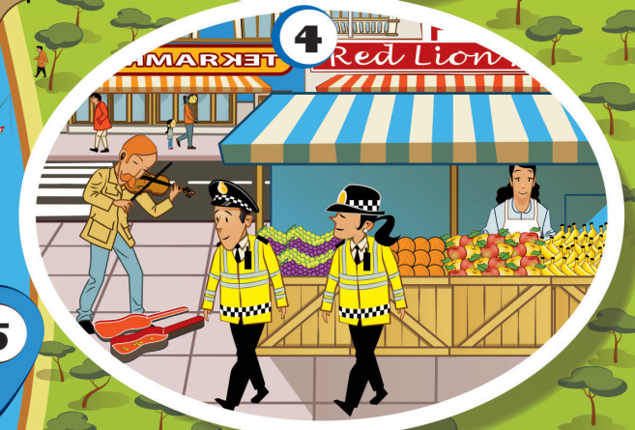
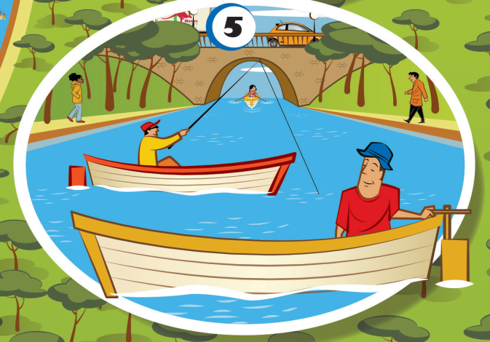
VOCABULARY – Lead-in
What happens in this town, 1-5?
In picture 1, they’re playing in the park.
Look at the picture and answer the question.

Slide 6
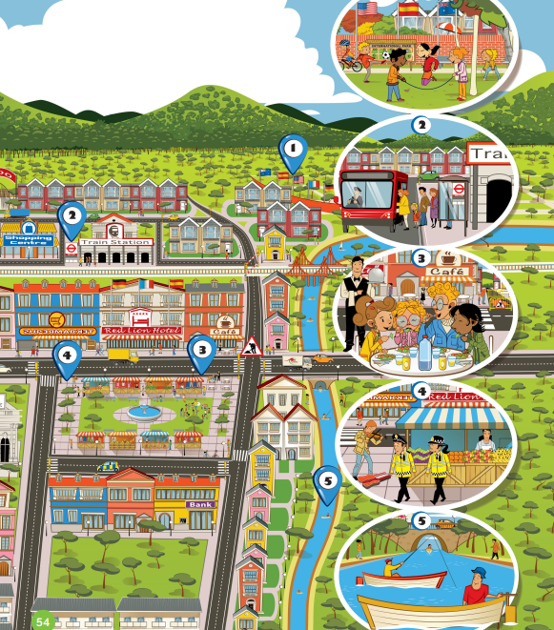
VOCABULARY – Lead-in
How is this town different from yours?
In my town, there isn’t a river at all.
Look at the picture and answer the question.

Slide 7
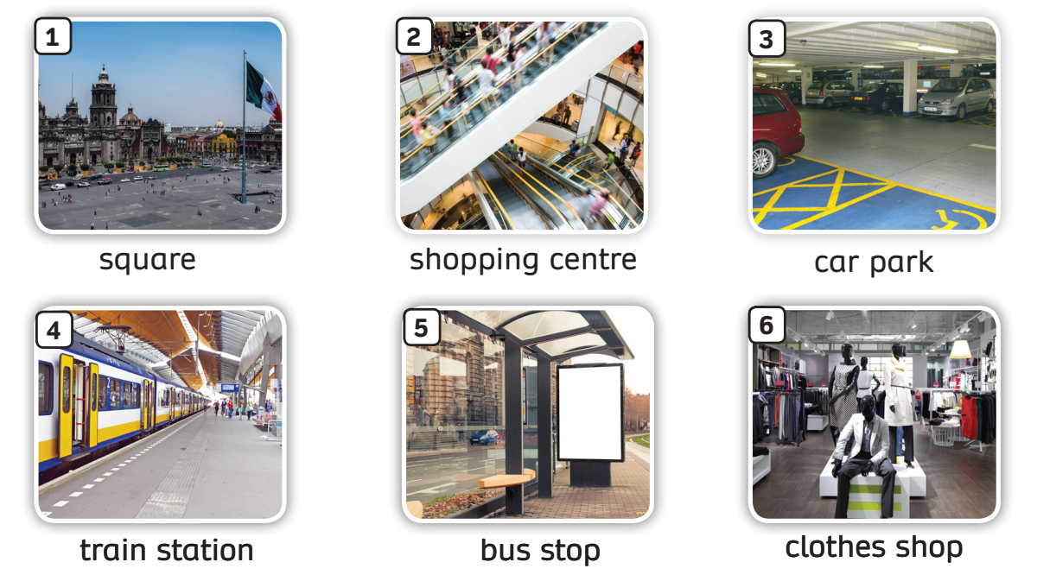
VOCABULARY – Places in Town
- Have students look at the pictures, listen and repeat.

Slide 8
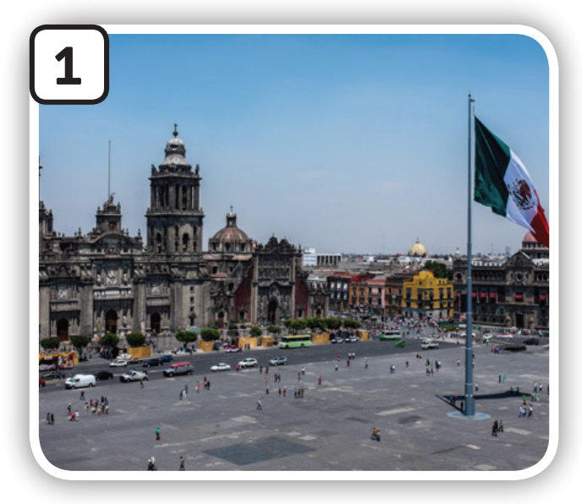
VOCABULARY – Places in Town
c
Let’s spell!
square
s
q
u
a
r
e

Slide 9
VOCABULARY – Places in Town
Let’s spell!
c
shopping
centre
s
h
o
p
p
i
n
g
c
e
n
t
r
e

Slide 10
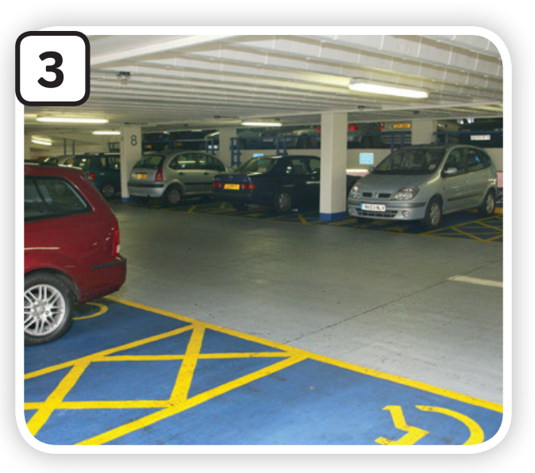
VOCABULARY – Places in Town
c
Let’s spell!
car park
c
a
r
p
a
r
k

Slide 11
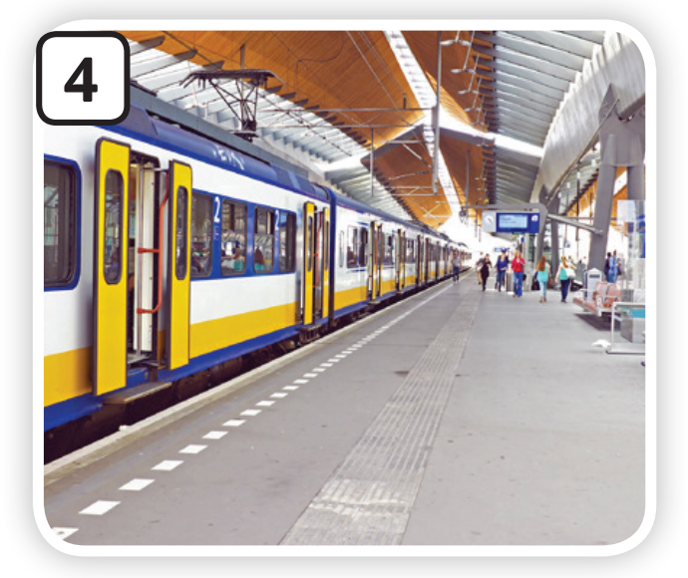
VOCABULARY – Places in Town
Let’s spell!
c
train station
t
r
a
i
n
s
t
a
t
i
o
n

Slide 12
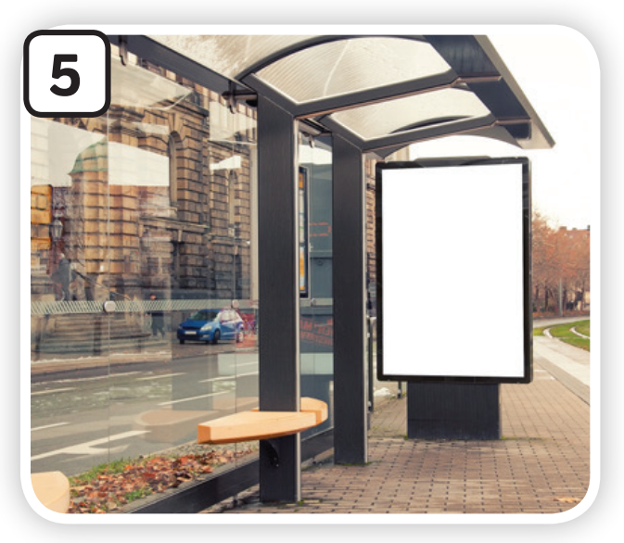
VOCABULARY – Places in Town
c
Let’s spell!
bus stop
b
u
s
s
t
o
p

Slide 13
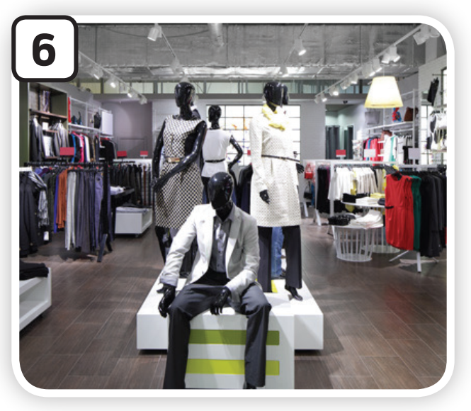
VOCABULARY – Places in Town
Let’s spell!
c
clothes shop
c
l
o
t
h
e
s
s
h
o
p

Slide 14
VOCABULARY – Places in Town
Try to memorise all the pictures and the numbers within 30 seconds.
The teacher moves to a different slide, calls a number randomly. (Ex: Number 2)
Students raise their hands and answer.

Slide 15
VOCABULARY – Places in Town
Activity: Where can I?
Divide the class into 4 teams.
Each team prepares a mini-board.
Read the question and discuss it with your team to find the answer.
Write no more than TWO words.
Students take turns to write

Slide 16
Where can I?
PLAY

Slide 17
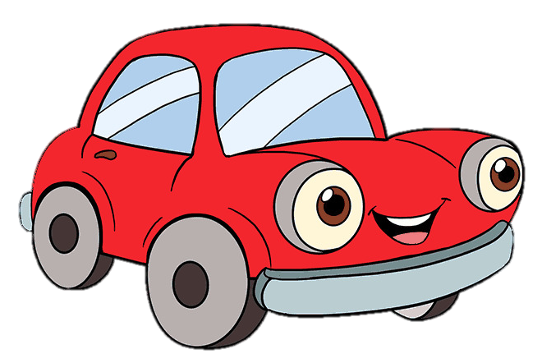
Where can I park my car?
car park
Answer
Next

Slide 18
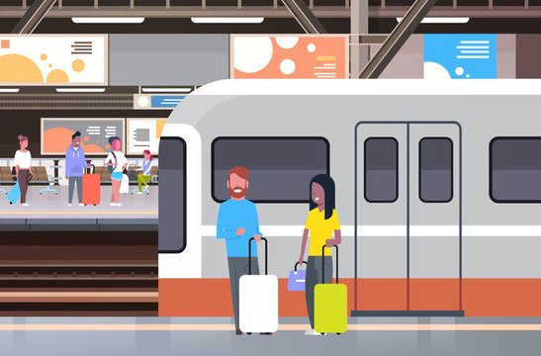
Where can I take a train?
train station
Answer
Next

Slide 19
Where can I buy clothes?
clothes shop
Answer
Next

Slide 20
Where can I take the bus?
bus stop
Answer
Next

Slide 21
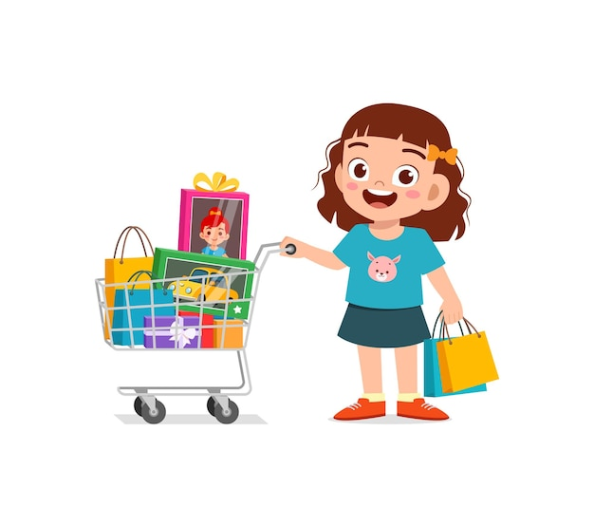
Where can I go shopping?
shopping centre
Answer
Next

Slide 22
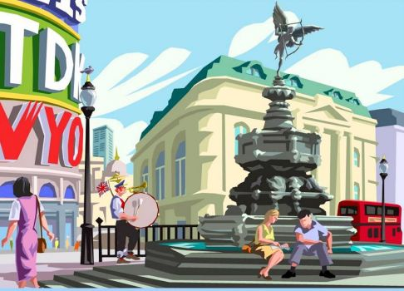
Where can I go to play?
square
Answer
Next

Slide 23
Great job!
s
EXIT

Slide 24
Pupils' Book – p.55
clothes shop
Answer
Ask students to close their books, look at the pictures on page 54.
Remember the words they learn in lesson 1, then write the missing word.

Slide 25
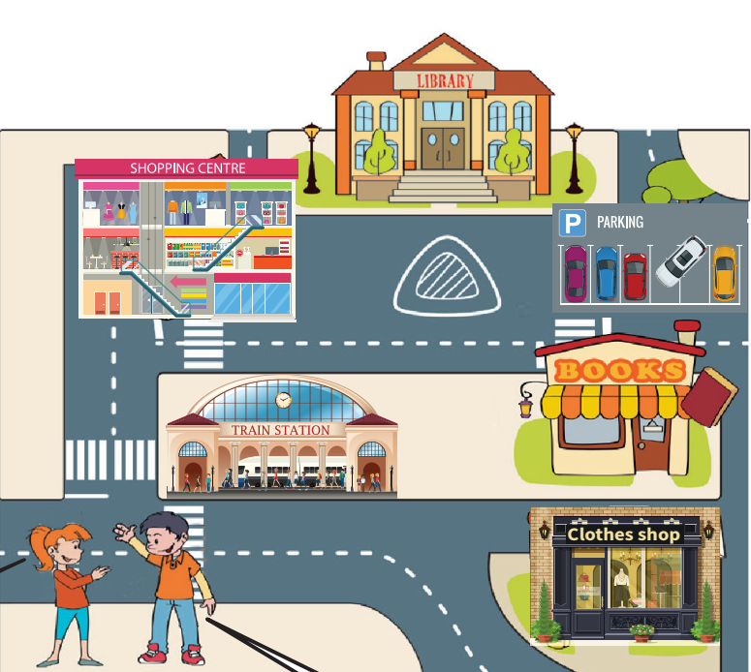
Activity – List out
There are 6 places in the picture.
shopping centre
train station
clothes shop
library
books store
car park
Answer
In pairs, list out how many places in the picture.
Raise your hand to answer.

Slide 26
STRUCTURE REVISION
Answer
She wants to go to car park.
Listen to the audio and decide where Betty wants to go. Check the answer.
Divide the class into 2 teams (boys and girls), ask them to say the speech.
Click on the rectangle to erase them.

Slide 27
STRUCTURE REVISION
Ask students to listen and look at the “Say it” box.
In pairs, take turns reading the sentences.

Slide 28
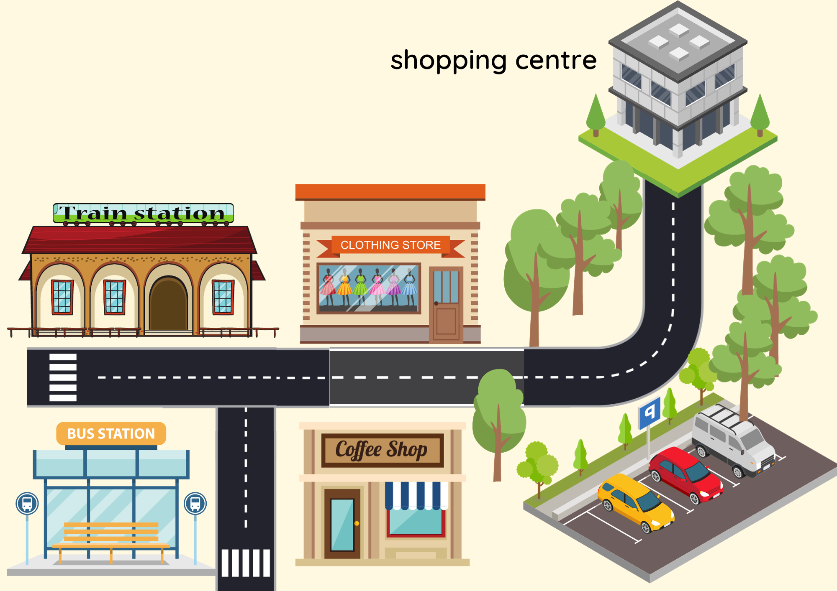
STRUCTURE REVISION
Excuse me, can you tell me the way to the clothes shop?
Sure. First, go straight ahead for 30 meters. Then turn left. The clothes shop is opposite the coffee shop.
Look at the example on the slide.
Practice the speech.

Slide 29
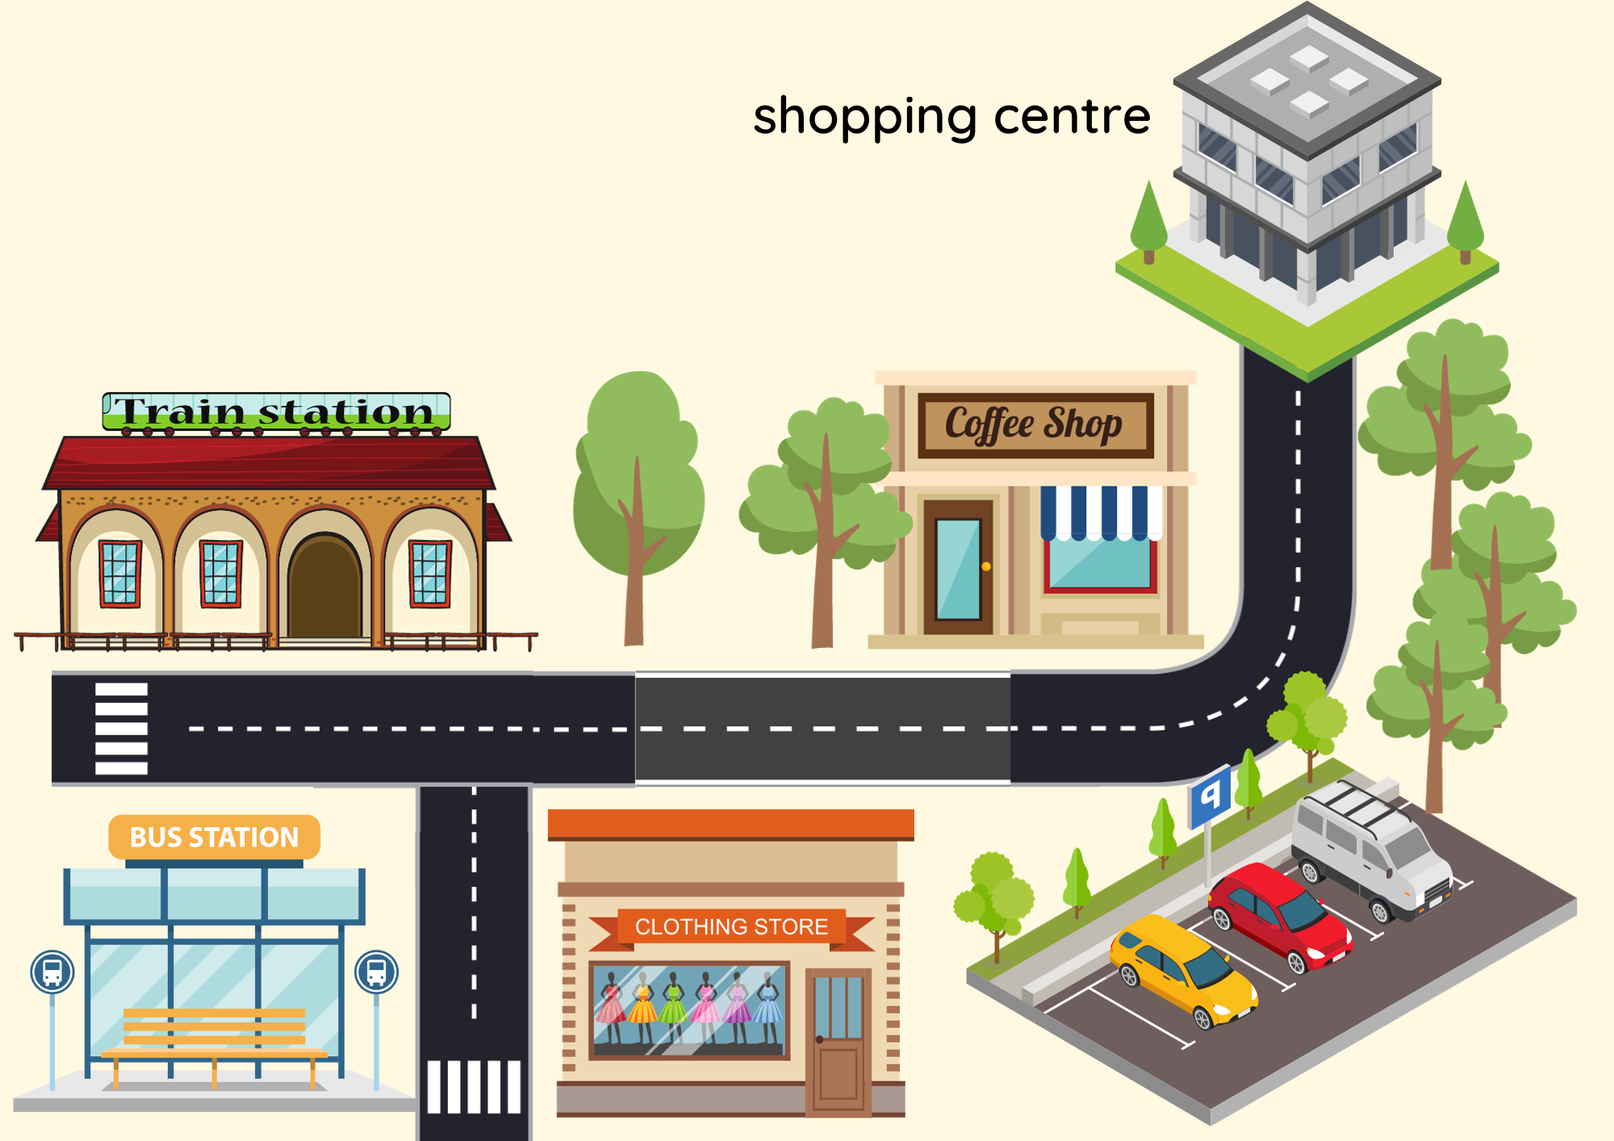
STRUCTURE REVISION
Excuse me, can you tell me the way to the train station?
Sure. First, turn left and go straight ahead for 30 meters. Then turn left. It’s on the right.
Look at the example on the slide.
Practice the speech.

Slide 30
Pupils' Book – p.55
Look at the picture in Activity 3. Read the speech. Choose Yes or No.
Sure. First, turn right. Then go straight ahead. The books store is on the left.
Excuse me, can you tell me the way to the books store?
Look at the picture in Activity 3 and read the speech.
Then choose “yes” if the answer is the correct way to go.
“No” for the incorrect answer.

Slide 31
Pupils' Book – p.55
Look at the picture in Activity 3. Read the speech. Choose Yes or No.
Sure. First, go straight ahead for 20 meters. Then turn right. The clothes shop is on the right.
Excuse me, can you tell me the way to the clothes shop?
Look at the picture in Activity 3 and read the speech.
Then choose “yes” if the answer is the correct way to go.
“No” for the incorrect answer.

Slide 32
Pupils' Book – p.55
Look at the picture in Activity 3. Read the speech. Choose Yes or No.
Sure. First, turn right. Go across the road. The shopping centre is on the left.
Excuse me, can you tell me the way to the shopping centre?
Look at the picture in Activity 3 and read the speech.
Then choose “yes” if the answer is the correct way to go.
“No” for the incorrect answer.

Slide 33
Pupils' Book – p.55
Look at the picture in Activity 3. Read the speech. Choose Yes or No.
Excuse me, can you tell me the way to the library?
Sure. First, go straight ahead for 20 meters. Then turn right. The library is on the left.
Look at the picture in Activity 3 and read the speech.
Then choose “yes” if the answer is the correct way to go.
“No” for the incorrect answer.

Slide 34
Pupils' Book – p.55
Look at the picture in Activity 3. Read the speech. Choose Yes or No.
Excuse me, can you tell me the way to the train station?
Sure. First, go straight ahead for 20 meters. Then turn right. The library is on the left.
Look at the picture in Activity 3 and read the speech.
Then choose “yes” if the answer is the correct way to go.
“No” for the incorrect answer.

Slide 35
Pupils' Book (p.55)
Shopping centre
Library
Car park
Book store
Clothes shop
In pair, ask and answer about the places in Activity 3.

Slide 36
SUM - IN

Slide 37
HOMEWORK
HOMEWORK
Review vocabulary and grammar.
Do exercises in the Activity book (page 44).
Check answers in the Teacher’s book (page 98) or Active Teach.

Slide 38
UNIT 5 – Lesson 1
We’ve learned…
places in town
directions use in town.
- PB p. 54,55
- AB p.44

