Slide 1
UNIT 5 – OUR TOWN
Lesson 2 - REVIEW

Slide 2
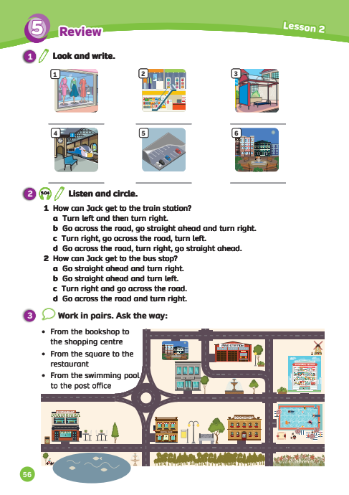
UNIT 5 – Lesson 2
We’re learning…
- Places in town
- PB p. 56
- AB p.45

Slide 3
WARM-UP ACTIVITY
Activity: Places in Town
Divide the class into two groups.
Quickly review the places in town by showing pictures from the previous unit.
The teacher says a few words that describe a place in town.
The students listen and say the correct word.
The fastest team with the correct answer can get 2 points.

Slide 4
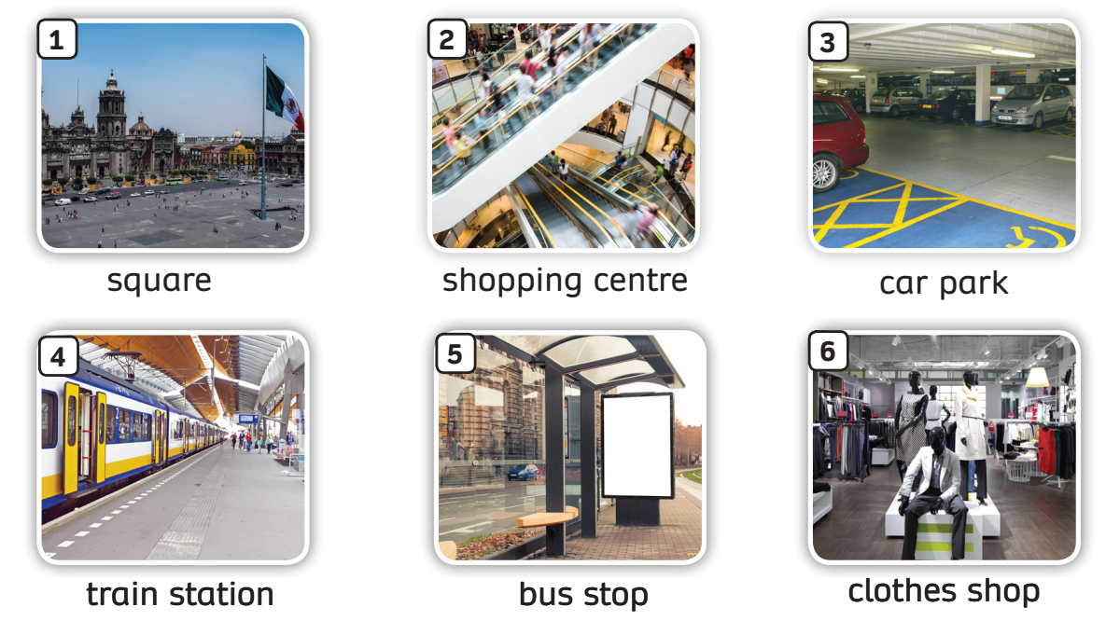
REVIEW – Places in Town
Review all the places in town

Slide 5
WARM-UP ACTIVITY
1. You can buy clothes here
clothes shop
2. You can take a bus here
bus stop
3. You can park your car here
bus stop
4. You can play here
square
5. You can take a train here
train station
6. You can go shopping here
shopping centre
Answer
The teacher can say the given sentence (or ask students say).
Guess the places.

Slide 6
VOCABULARY – Places in Town
Activity: The missing letters
Divide the class into groups of 6.
Tell students to number themselves in their group (Ex: Student A – 1, student B – 2,…)
The teacher says the number (Ex: number 2)
All students who are number 2 in each team stand up and say the complete phrase (Ex: square)
The faster students with the correct answer can get 2 points for their team.

Slide 7
The missing letters

Slide 8
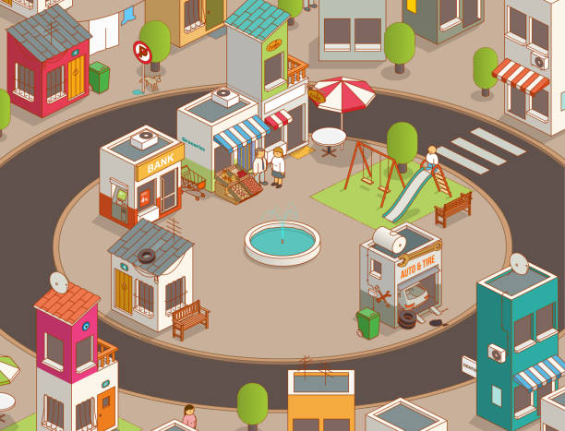
sq_are
u
Check

Slide 9
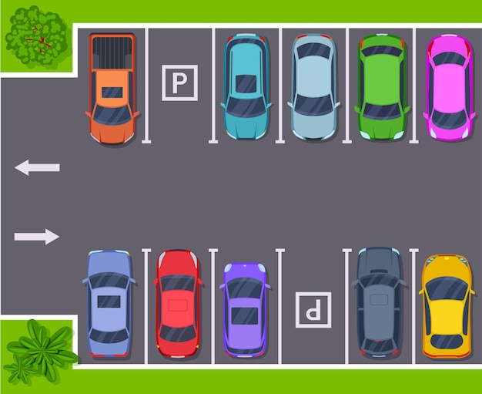
ca_ p_rk
r
a
Check

Slide 10
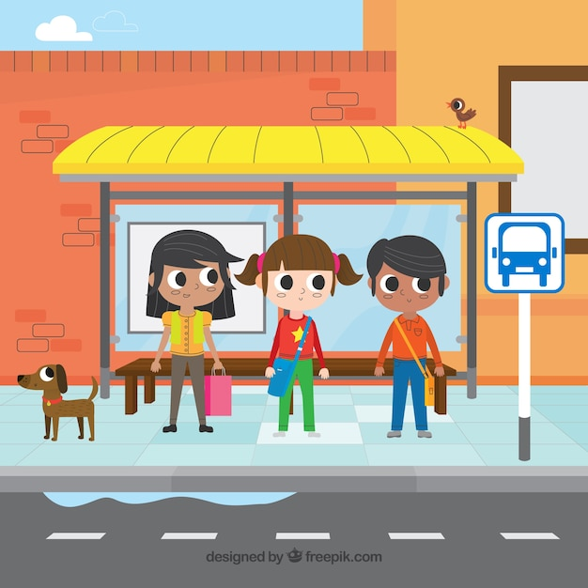
u
b_s sto_
p
Check

Slide 11
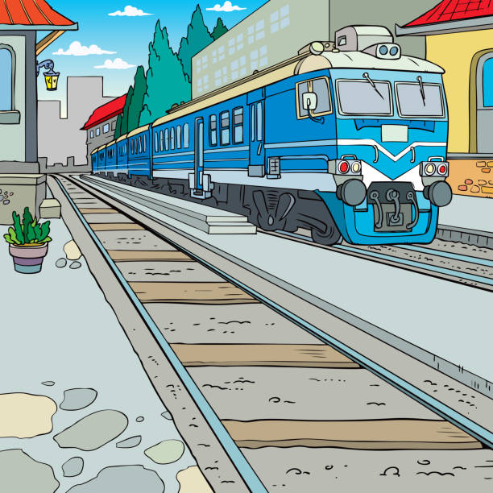
i
o
tra_n sta_i_n
t
Check

Slide 12
c
h
o
_lot_es sh_p
Check

Slide 13
p
r
sho_pi_g c_nt_e
n
e
Check

Slide 14
Well done!!!

Slide 15
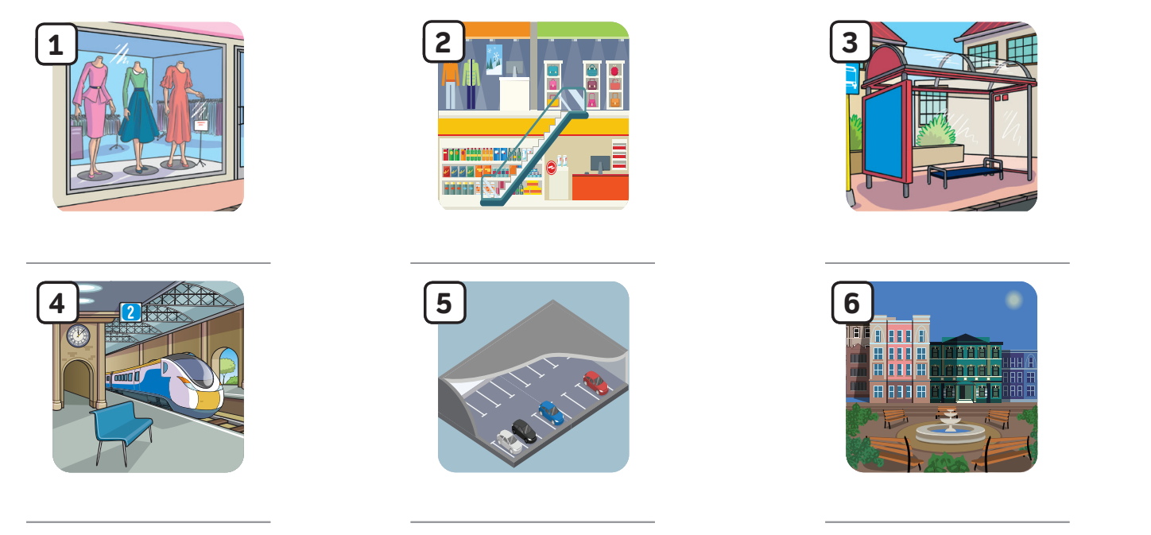
Pupils’ book – p.56
clothes shop
shopping centre
bus stop
train station
car park
square
Answer
In pairs, label the pictures.
Check the answer with the whole class.

Slide 16
Pupils’ book – p.56
Pre-listening: Guess the answer
Go across the road, turn right, go straight ahead.
How can Jack get to the train station?
Turn left and then turn right.
Example
In groups of 3, read the question and guess the answer.
Look at the examples.

Slide 17
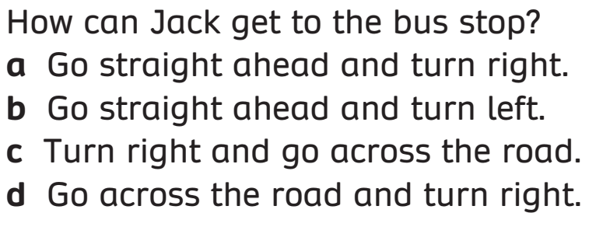
Pupils’ book – p.56
Pre-listening: Guess the answer
How can Jack get to the bus stop?
Go straight ahead and turn right.
Turn right and go cross the road.
Example
In groups of 3, read the question and guess the answer.
Look at the examples.

Slide 18
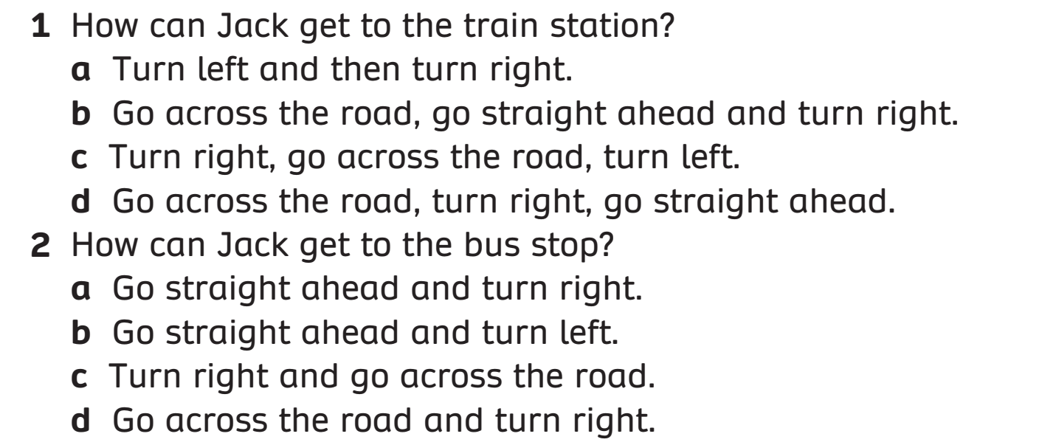
Pupils’ book – p.56
Answer
Listen to the audio and circle the correct answer.
Check the answer with the whole class.

Slide 19
Places in Town
Activity: Thumb up or Thumb down
Divide the class into groups of 4.
The teacher asks the whole class to say the sentence and the answer first.
In 15s, discuss in teams, raise thump up or thump down fingers to choose the answer
The faster students with the correct answer can get 2 points for their team.
Note: All members show their fingers at the same time.

Slide 20
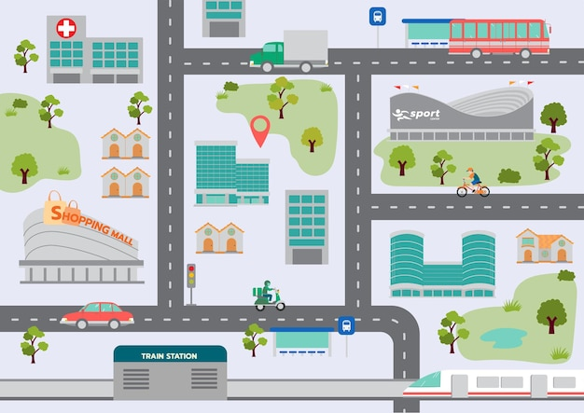
Thumb Up or Thumb Down Activity
Can you tell me the way to the bus stop?
Sure. We are in the shopping centre. First, turn left and go straight ahead. Then turn right. The bus stop is on the left.

Slide 21
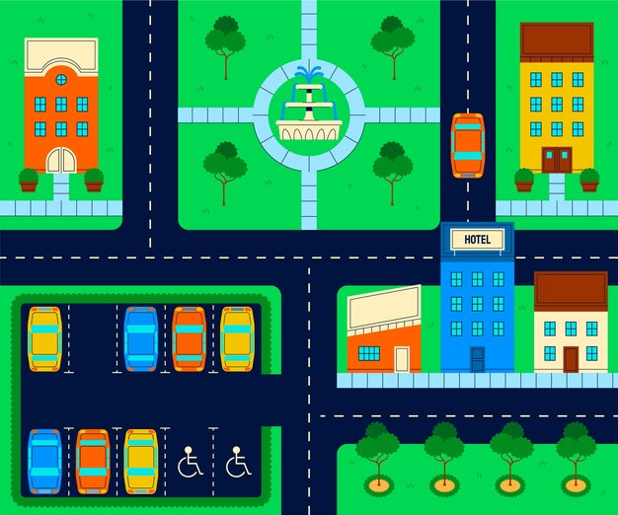
Thumb Up or Thumb Down Activity
Can you tell me the way to the square?
Sure. We are in the hotel. First, turn right and go across the road. Then turn right. The square is opposite the car park.

Slide 22
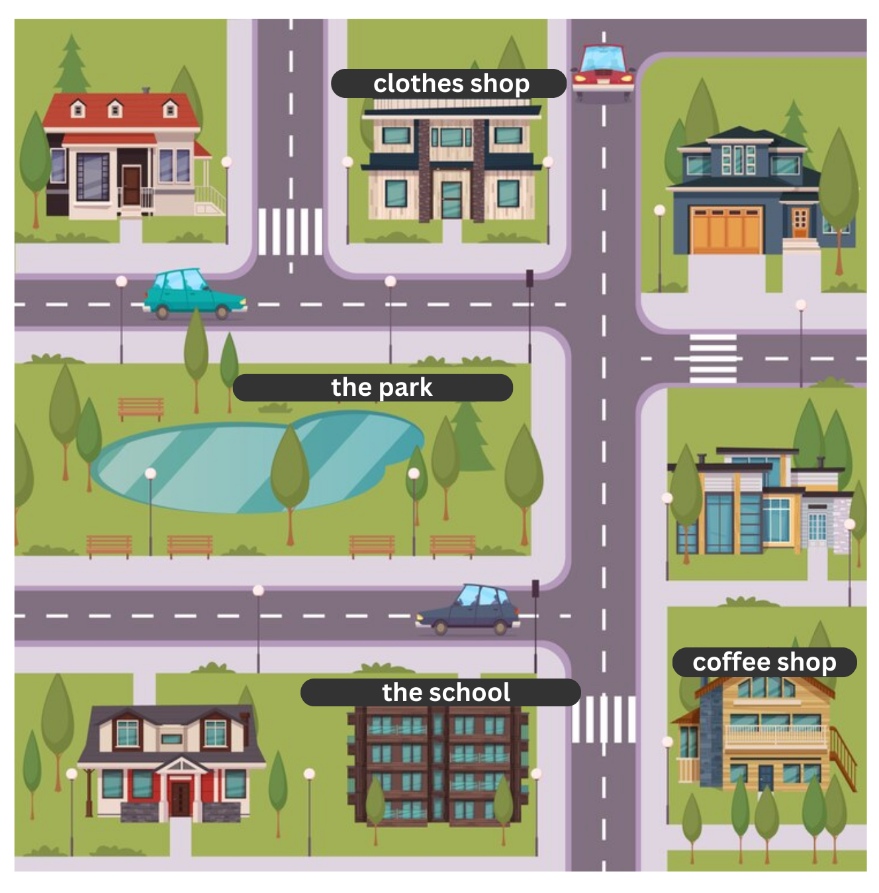
Thumb Up or Thumb Down Activity
Can you tell me the way to the clothes shop?
Sure. We are in the school. First, turn left and go straight ahead for 100m. Then turn left. The clothes shop is on the right.

Slide 23
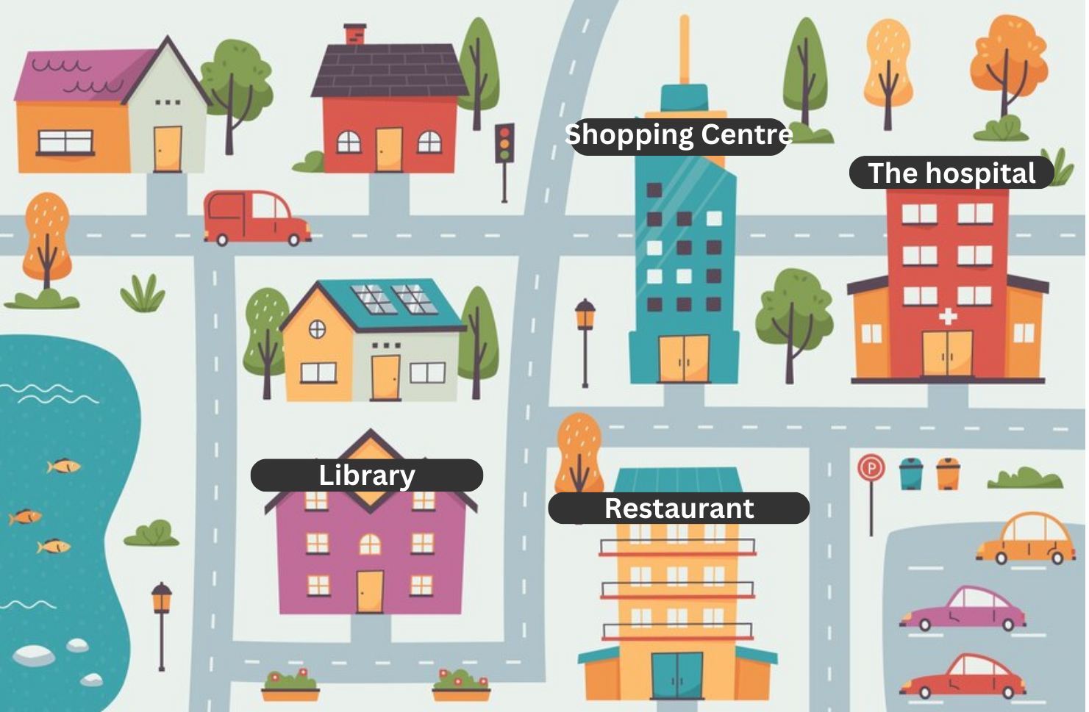
Thumb Up or Thumb Down Activity
Can you tell me the way to the hospital?
Sure. We are in the library. First, turn left. Then turn right. The hospital is next to the shopping centre.

Slide 24
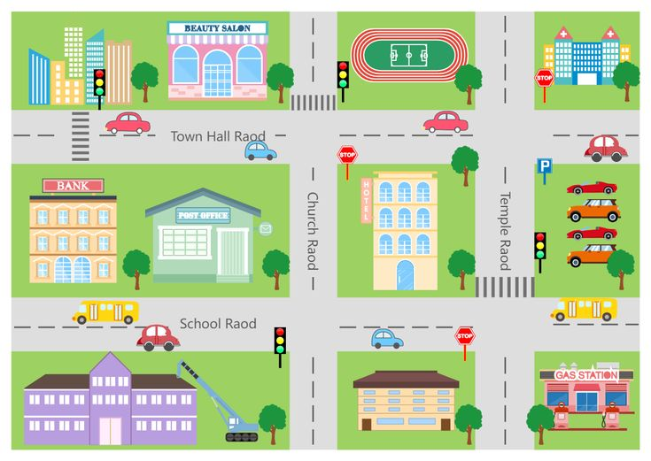
Thumb Up or Thumb Down Activity
Can you tell me the way to the bank?
Sure. We are in the beauty Salon. First, turn left and go straight ahead for 170m. Then turn right. The bank is next to the post office.

Slide 25
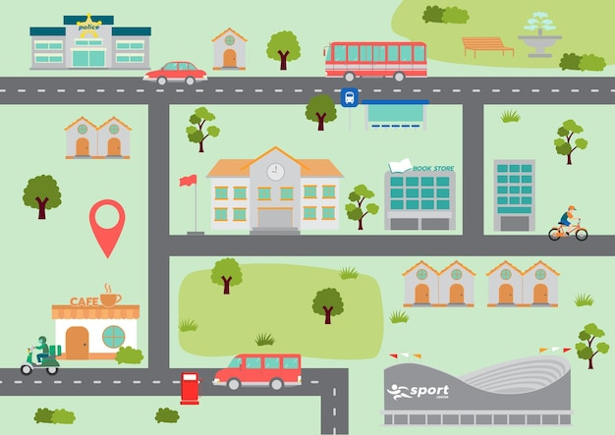
Thumb Up or Thumb Down Activity
Can you tell me the way to the bus stop?
Sure. We are in the café shop. First, turn left and go across the road. Then turn left. The bus stop is on the right.

Slide 26
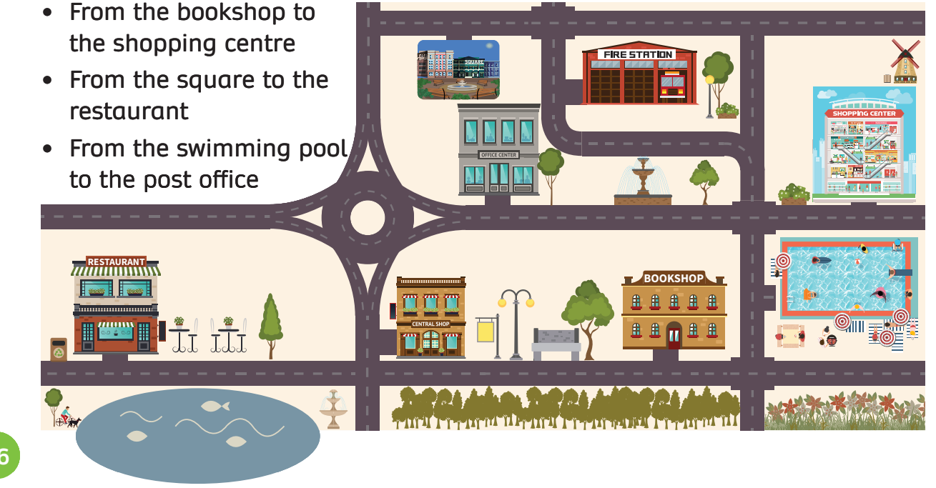
PRODUCTION - Pupils’ book (p.56)
In groups of 4, prepare a piece of paper.
Write down the names of the places you see in the picture.
Raise hands to show the answer.

Slide 27
PRODUCTION - Pupils’ book (p.56)
Excuse me, can you tell my the way from the square to the restaurant?
Excuse me, can you tell me the way from the swimming pool to the post office?
Excuse me, can you tell me the way from the bookshop to the shopping centre?
Question
In groups of 4, use the given prompt to ask questions about how to go from one place to another.

Slide 28
Pupils’ book (p.56)
In groups of 4, prepare a piece of paper.
Write down the answer for three questions given clues.
The teacher chooses random students to write the answer on the board.

Slide 29
SUM - IN
- From the bookshop to the post office
- From the shopping centre to the square
- From the fire station to the bookshop
In pairs, use the map for Activity 3 to ask and answer the way from one place to another on the map.
Invite some pairs to present in front of the class.

Slide 30
HOMEWORK
HOMEWORK
Review Vocabulary and Grammar.
Do exercises in the Activity book (page 45).
Check answers in the Teacher’s book (page 100) or Active Teach.

Slide 31
UNIT 5 – Lesson 2
We’ve learned…
- Places in town
- PB p. 56
- AB p.45

