Slide 1
UNIT 5 – OUR TOWN
Lesson 4 - PHONICS

Slide 2
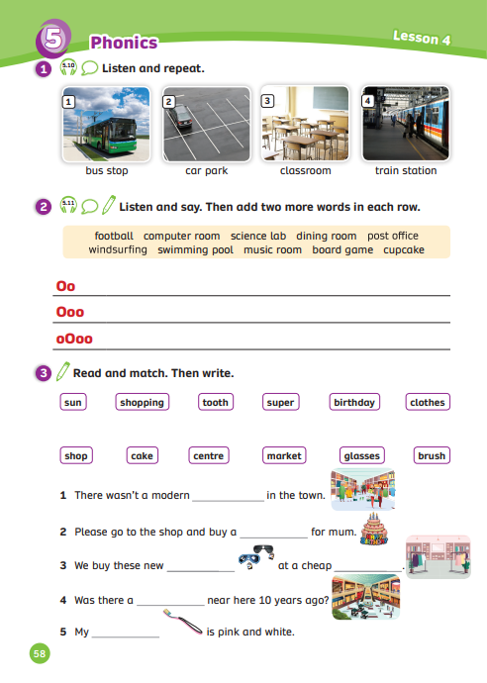
UNIT 5 – Lesson 4
We’re learning…
- to correctly read and stress in compound words.
- PB p.58
- AB p.47

Slide 3
WARM-UP ACTIVITY
Activity: Guess the word
Divide the class into four teams. Each pair in the teams prepare a mini-board.
Each team already got 3 points to begin.
The teacher chooses a random word that students have already learned.
Draws underscores on the board. (the number of underscores depending on the word) ( Ex: quiet → _ _ _ _ _ )
Show one-by-one letters, students write the answer on the board.
Note: All team members write the answer to win the game.

Slide 4
Pupils’ book (p.58)
BUS stop
CAR park
CLASSroom
TRAIN station
O o
O o
O o
O o
Listen and repeat the words. Then, ask students to listen again and clap their hands when they see the BOLD WORDS.

Slide 5
Compound Nouns
Are made of 2 nouns together
Ex: classroom = class + room
Can be written as one word or two words
Ex: bus stop, car park, train station
Introduce to the class that they learn about word stress in compound nouns.

Slide 6
Pupils’ book (p.58)
BUS stop
CAR park
CLASSroom
TRAIN station
O o
O o
O o
O o
The STRESS is usually on the first word or syllable.

Slide 7
ACTIVITY
Activity: Choose the correct answer
Divide the class into groups of four. Each team prepares a pencil case and puts it in the middle.
Look and listen to the audio
Catch the pencil case to get a chance to answer.
Choose the correct number. Then, the whole team need to say the word and clap their hands on the stress of that word.
The faster team with the correct answer can get 2 points.

Slide 8
football
Oo
2
Ooo
3
oOoo
1

Slide 9
dining room
Oo
2
Ooo
3
oOoo
1

Slide 10
windsurfing
Oo
2
Ooo
3
oOoo
1

Slide 11
board game
Oo
2
Ooo
3
oOoo
1

Slide 12
computer room
Oo
2
Ooo
3
oOoo
1

Slide 13
post office
Oo
2
Ooo
3
oOoo
1

Slide 14
cupcake
Oo
2
Ooo
3
oOoo
1

Slide 15
Pupil’s book (p.58)
football
Oo
Ask the class to listen and say all the words in the box.
Explain that the words can be classified into three groups depending on where the stress lies.
We got the example of the word “football” Ask them to listen and clap on the stress work.

Slide 16
Pupil’s book (p.58)
Answer
football,
board game,
cupcake
dining room,
post office,
windsurfing,
swimming pool,
science lab,
music room
computer room
Ask students which line of the chart to add the word “football”.
Work in pairs, try the remaining items
The teacher can play the audio again to check their answers,

Slide 17
PRODUCTION
Activity: How many noun phrases?
Divide the class into groups of 4. Each team prepares a piece of paper.
Look at the words, use one work from the top row and one from the bottom row to make a noun phrase.
In 2 minutes, write as many noun phrases on the paper as possible.
After that, the teacher asks students how many noun phrases each team has.
Ask them to call out all their noun phrases.
A right noun phrase = 1 point.

Slide 18
sun
shopping
tooth
super
birthday
clothes
shop
cake
centre
market
glasses
brush

Slide 19
Pupil’s book (p.58)
sunglasses
shopping centre
toothbrush
supermarket
birthday cake
clothes shop
Answer
In pairs, draw lines to match the word from the top row to the bottom row to make a noun phrase. Say all the noun phrases together.

Slide 20
Pupil’s book (p.58)
supermarket
birthday cake
sunglasses
clothes shop
shopping
centre
toothbrush
Answer
After matching, use the noun phrases to fill in the blank.
Ask a few students to show their sentences.

Slide 21
HOMEWORK
HOMEWORK
Review vocabulary and grammar.
Do exercises in the Activity book (page 47).
Check answers in the Teacher’s book (page 104) or Active Teach.

Slide 22
UNIT 5 – Lesson 4
We’ve learned…
- to correctly read and stress in compound words.
- PB p.58
- AB p.47

