Slide 1
UNIT 5 – OUR TOWN
Lesson 6 - REVIEW

Slide 2
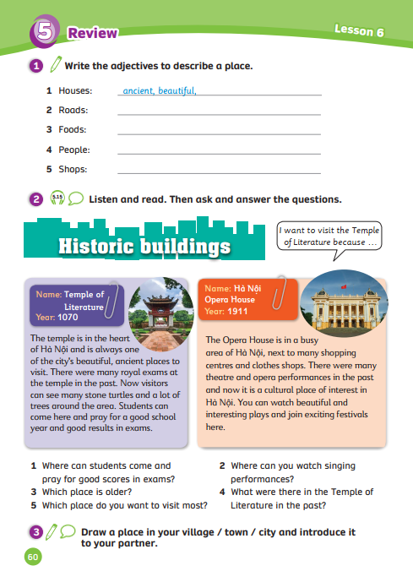
UNIT 5 – Lesson 6
We’re learning…
- Places in town
- PB p. 60
- AB p.49

Slide 3
WARM – UP ACTIVITY
Activity: Guess the adjectives
Divide the class into two groups.
Quickly review the long adjectives by showing pictures from the previous unit.
Ask students to look at the picture, use the given letters and guess the adjective describing the picture.
Raise your hand to get a chance to answer
The fastest team with the correct answer can get 2 points.

Slide 4
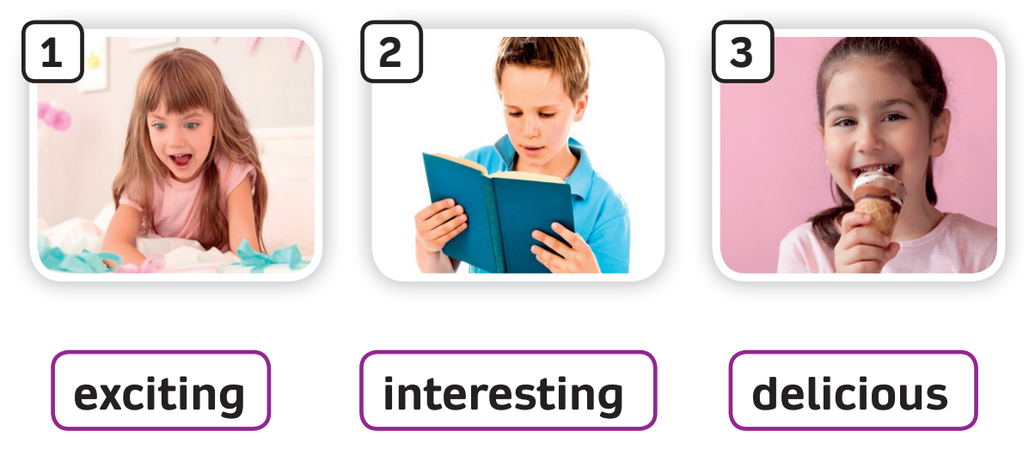
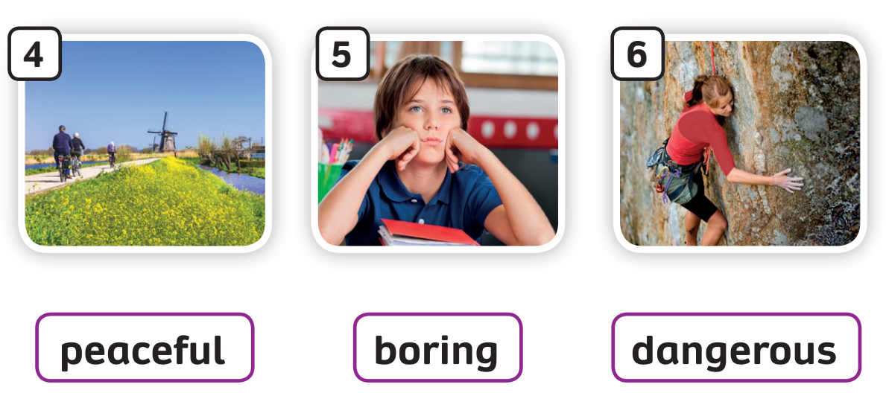
REVIEW – Long Adjectives
Review all the long adjectives

Slide 5
Guess the adjective of the picture
d
e
l
i
c
i
o
u
s

Slide 6
Guess the adjective of the picture
e
x
c
i
t
i
n
g

Slide 7
Guess the adjective of the picture
p
e
a
c
e
f
u
l

Slide 8
Guess the adjective of the picture
b
o
r
i
n
g

Slide 9
Guess the adjective of the picture
d
a
n
g
e
r
o
u
s

Slide 10
Guess the adjective of the picture
i
n
t
e
r
e
s
t
i
n
g

Slide 11
REVIEW
Activity: Fill in the blank
Divide the class into groups of 4. Each team prepare a mini-board
Look and read the sentence on the slide, then fill in the blank.
Write the answer on the board.
The faster team with the correct answer can get 2 points
Check the answers together.

Slide 12
REVIEW – Long Adjectives
This book is about the planets.
This is an ___________ science book I know.
interesting
Answer
Read the sentence, choose a suitable adjective and raise your hand to answer.

Slide 13
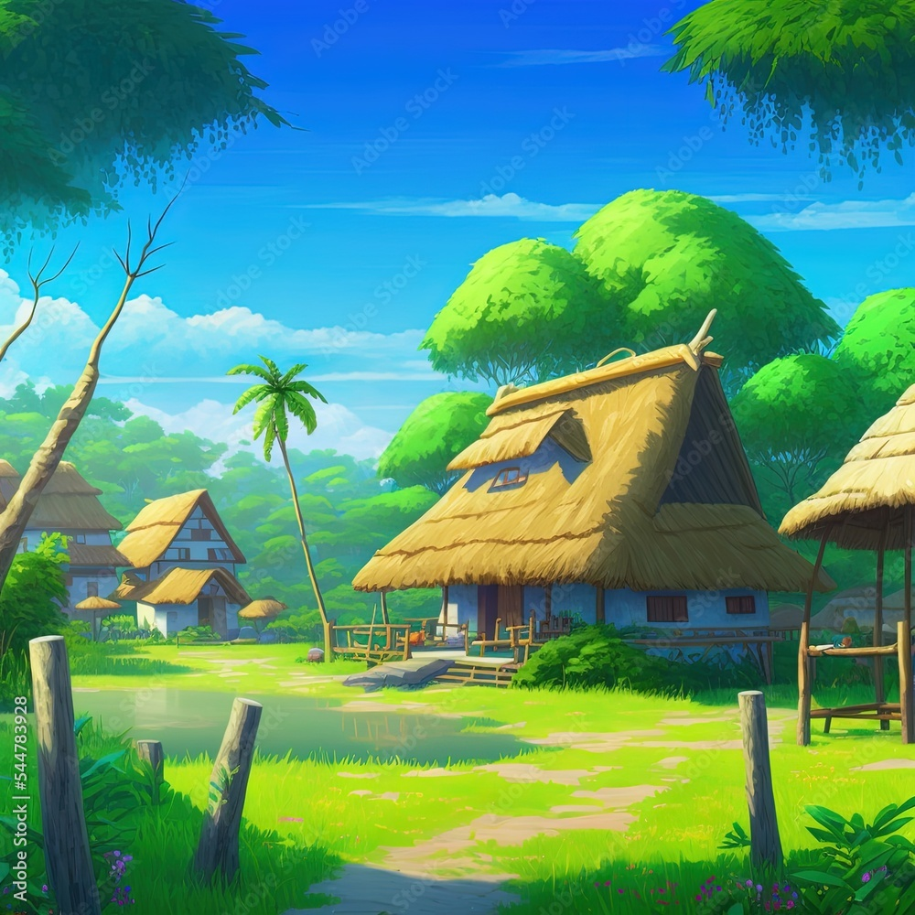
REVIEW – Long Adjectives
I love my hometown. It’s small and not modern. But it’s beautiful and _________.
peaceful
Answer
Read the sentence, choose a suitable adjective and raise your hand to answer.

Slide 14
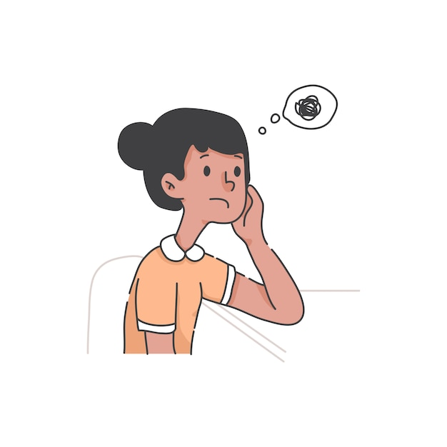
REVIEW – Long Adjectives
Maths is difficult and _______. Mary likes music and PE.
boring
Answer
Read the sentence, choose a suitable adjective and raise your hand to answer.

Slide 15
REVIEW – Long Adjectives
Nam and his friends watch a film in his living room. It’s an _______ film.
exciting
Answer
Read the sentence, choose a suitable adjective and raise your hand to answer.

Slide 16
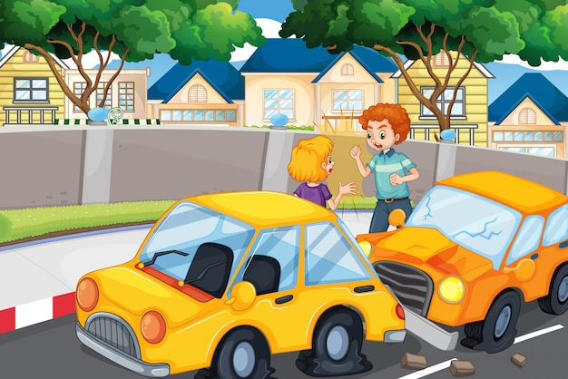
REVIEW – Long Adjectives
There are many cars on the roads. The roads are modern but __________. Be careful!
dangerous
Answer
Read the sentence, choose a suitable adjective and raise your hand to answer.

Slide 17
REVIEW – Long Adjectives
Can we eat pizza for lunch?
It looks __________.
delicious
Answer
Read the sentence, choose a suitable adjective and raise your hand to answer.

Slide 18
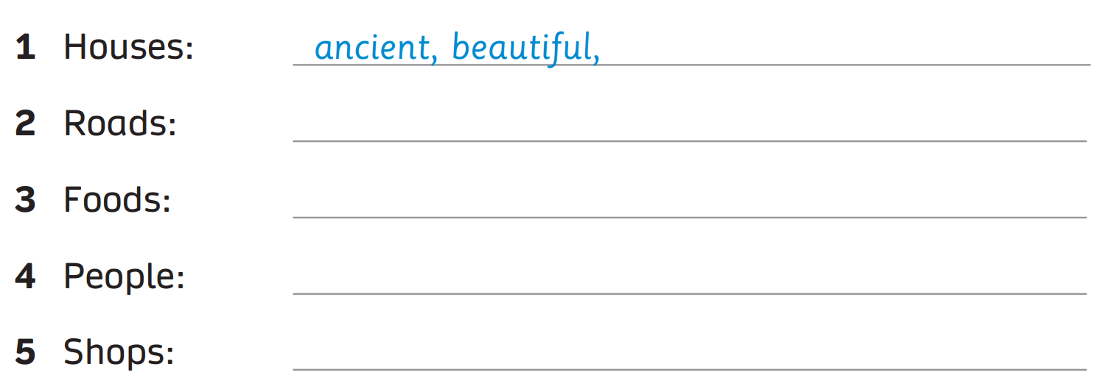
Pupils’ book – p.60
narrow,
dangerous
delicious,
expensive
happy,
healthy
boring,
expensive
Example Answer
Ask the whole class to say the given words aloud.
In pairs, write the adjective used to describe those given words.

Slide 19
Pupils’ book – p.60
Pre-reading: Answer the questions
Ask students to look at the picture and the information (Name & Year), then answer the questions.

Slide 20
Pupils’ book – p.60
1. What are they?
They’re Temple of Literature
and Hà Nội Opera House.
2. Where are they?
They’re in Hà Nội.
Answer
3. Which place is older?
Temple of Literature is older than
Hà Nội Opera House.
In pairs, scan and answer the questions.

Slide 21
Pupils’ book – p.60
Play the audio and ask students to listen and read.
Ask them to underline the unknown words while reading along.

Slide 22
Activity - Sorting
Temple of Literature
Hà Nội Opera House.
1
3
4
2
5
6
1.beautiful and ancient place
4. pray for a good student year
2. many theatres and opera performances
5. watch beautiful and interesting plays
3. many stone turtles
6. join exciting festivals
Answer
Divide the class into groups of 4, ask them to read through the given phrases and discuss sorting them to the correct place.

Slide 23
Pupils’ book – p.60
Temple of Literature
Hà Nội Opera House
Temple of Literature
There were many royal exams in the past.
Answer
In groups of 3, read and answer the questions.

Slide 24
Pupils’ book – p.60
I want to visit the Temple of Literature
because this is a beautiful and ancient place in Hà Nội.
There were many royal exams at the temple in the past.
You can see many stone turtles here.
Every new year, I can come here and pray for a good school year.
Example Answer
In groups of 3, ask them to think about the place that they want to visit most. Then, take turns asking and answering.
Invite a few students to share their answers.

Slide 25
PRODUCTION – Pupils’ book (p.60)
Ask each student to prepare an A4 paper, pencil and colour. (optional)
Tell them to draw a picture of their village, town and city by themselves.
Then, give them a few minutes to rehearse mentally how they present their picture to their partner.
In pairs, present the picture.
Invite a few pairs to demonstrate in front of the class.
Look at the example on the next slide.
Look at the example on the next slide.

Slide 26
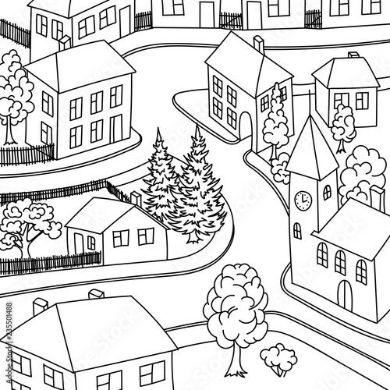
PRODUCTION – Pupils’ book (p.60)
This is my home town.
It is small and peaceful.
There are new buildings, hotels, and restaurants.
Foods are delicious and cheap.
Roads are small and noisy but not dangerous.
Example

Slide 27
HOMEWORK
HOMEWORK
Review vocabulary and grammar.
Do exercises in the Activity book (page 49).
Check answers in the Teacher’s book (page 108) or Active Teach.

Slide 28
UNIT 5 – Lesson 6
We’ve learned…
- Places in town
- PB p. 60
- AB p.49

