Slide 1

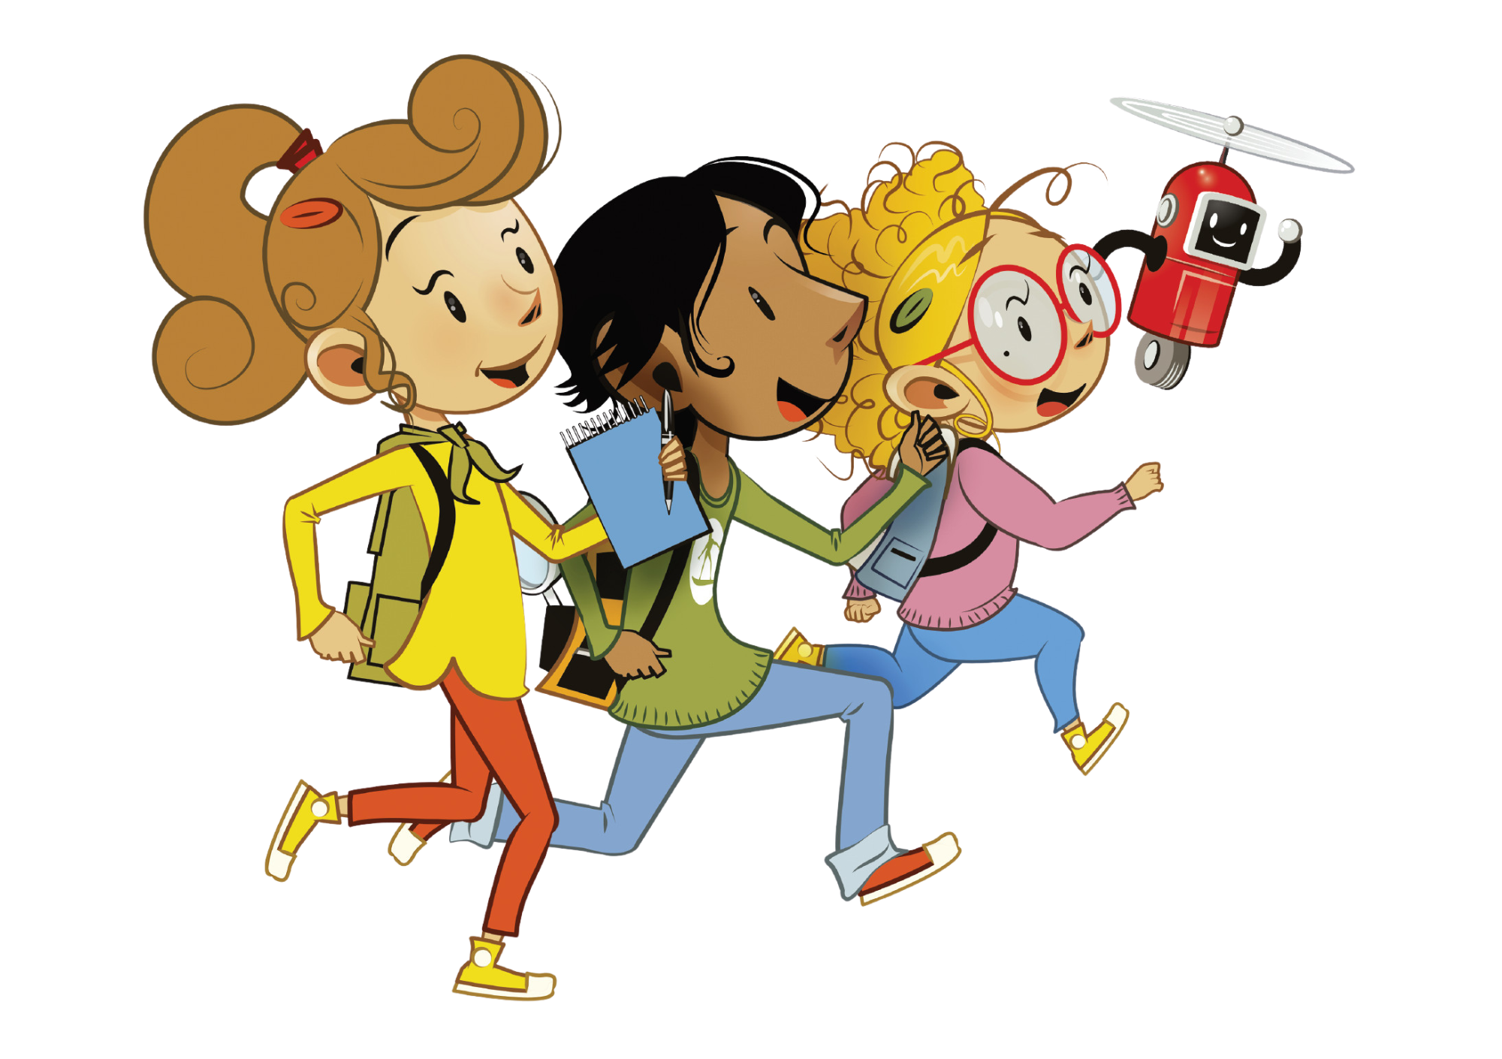
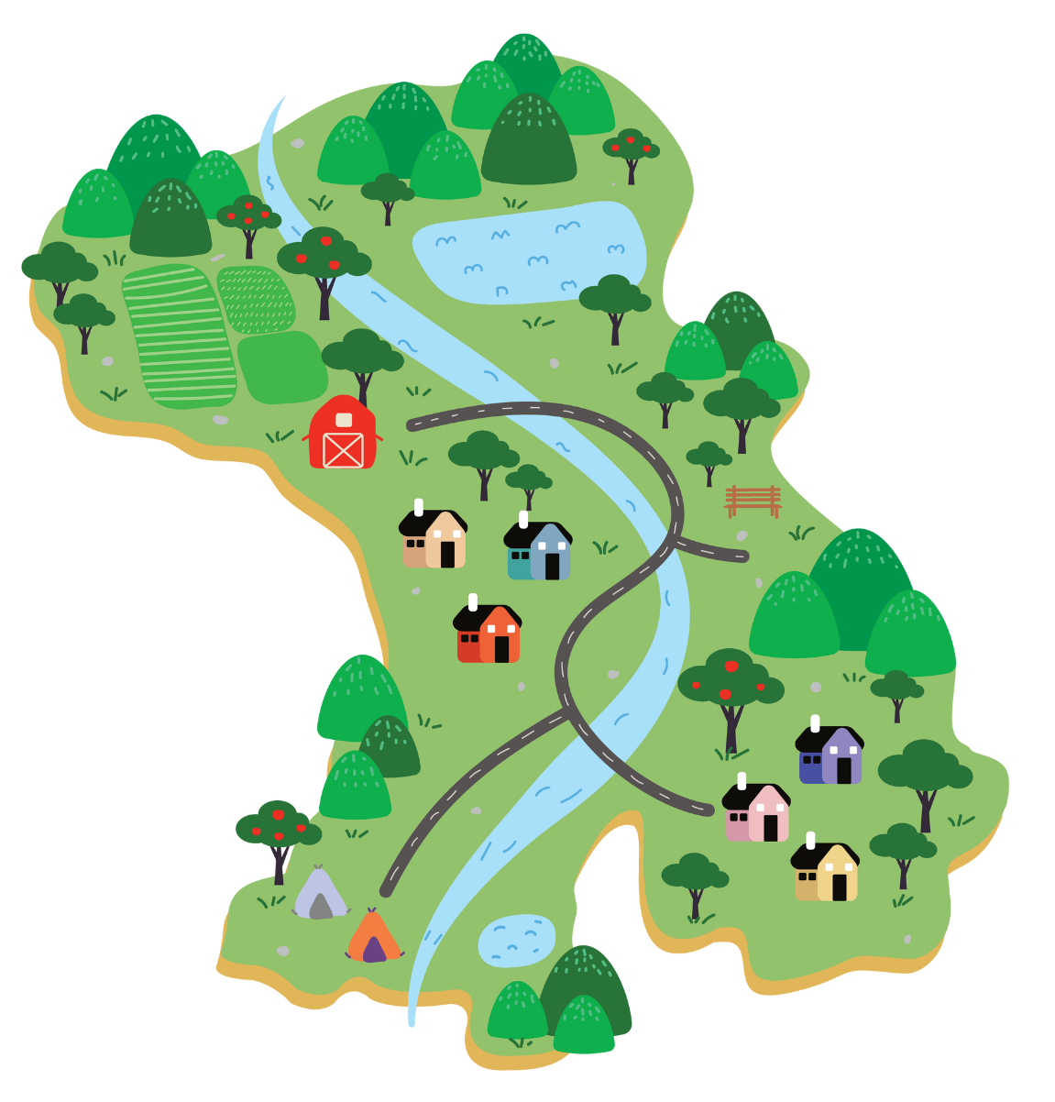
UNIT 5 – OUR TOWN
Lesson 7A - STORY

Slide 2

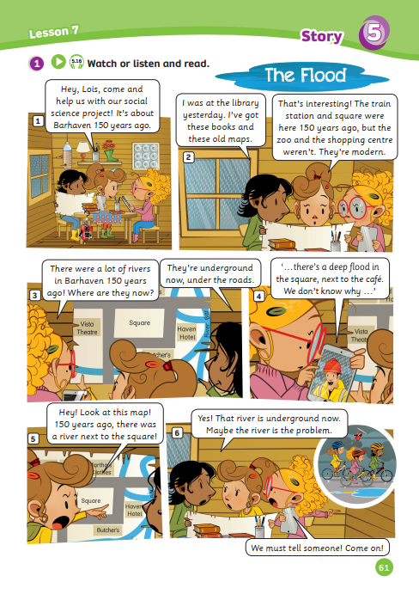
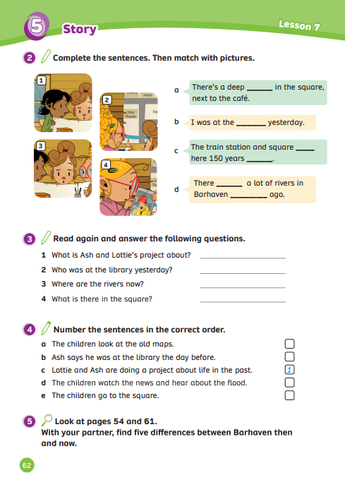
UNIT 5 – Lesson 7A
We’re learning…
- to understand simple cartoon stories.
- PB p. 61,62
- AB p.50

Slide 3

WARM-UP ACTIVITY
Activity: Making sentence
Divide the class into groups of 6. Each team prepare a mini-board.
Each student takes turns writing the answer.
Look at the picture and the given time, then use two adjectives to describe that picture.
Raise the board when finishing. The teacher checks their answer (Note: The teacher can ask all members to say the sentence to check)
The faster team with the right sentence can get 2 points.

Slide 4
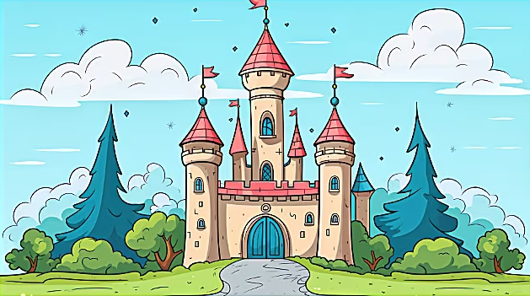
WARM-UP ACTIVITY
The castle 150 years ago
The castle was ancient and beautiful.
Example Answer

Slide 5

WARM-UP ACTIVITY
The shopping centres now
The shopping centres are modern and busy.
Example Answer

Slide 6
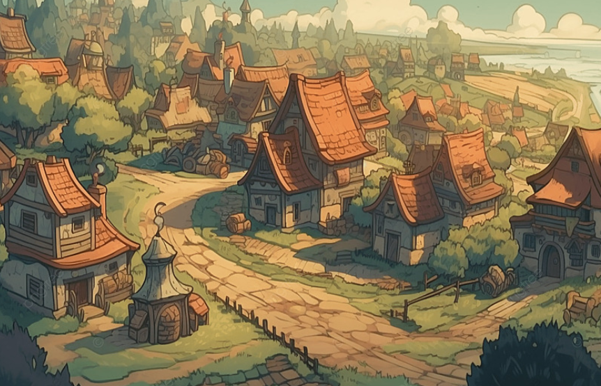
WARM-UP ACTIVITY
The villages in 1993
The villages were quiet and peaceful.
Example Answer

Slide 7
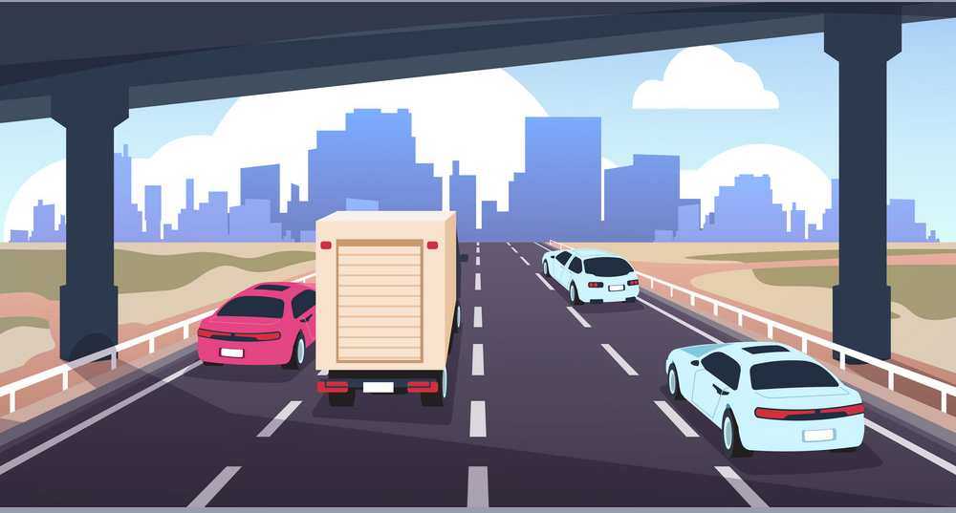
WARM-UP ACTIVITY
Roads now
The roads are narrow and dangerous.
Example Answer

Slide 8
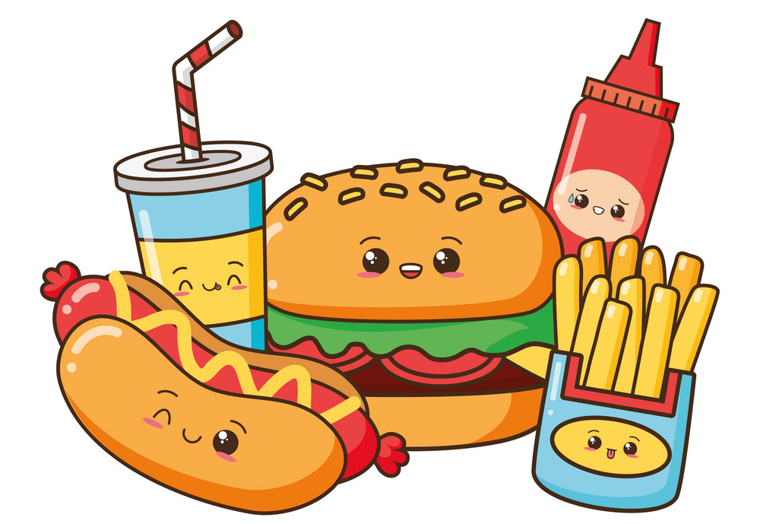
WARM-UP ACTIVITY
Foods now
Foods are delicious and expensive.
Example Answer

Slide 9
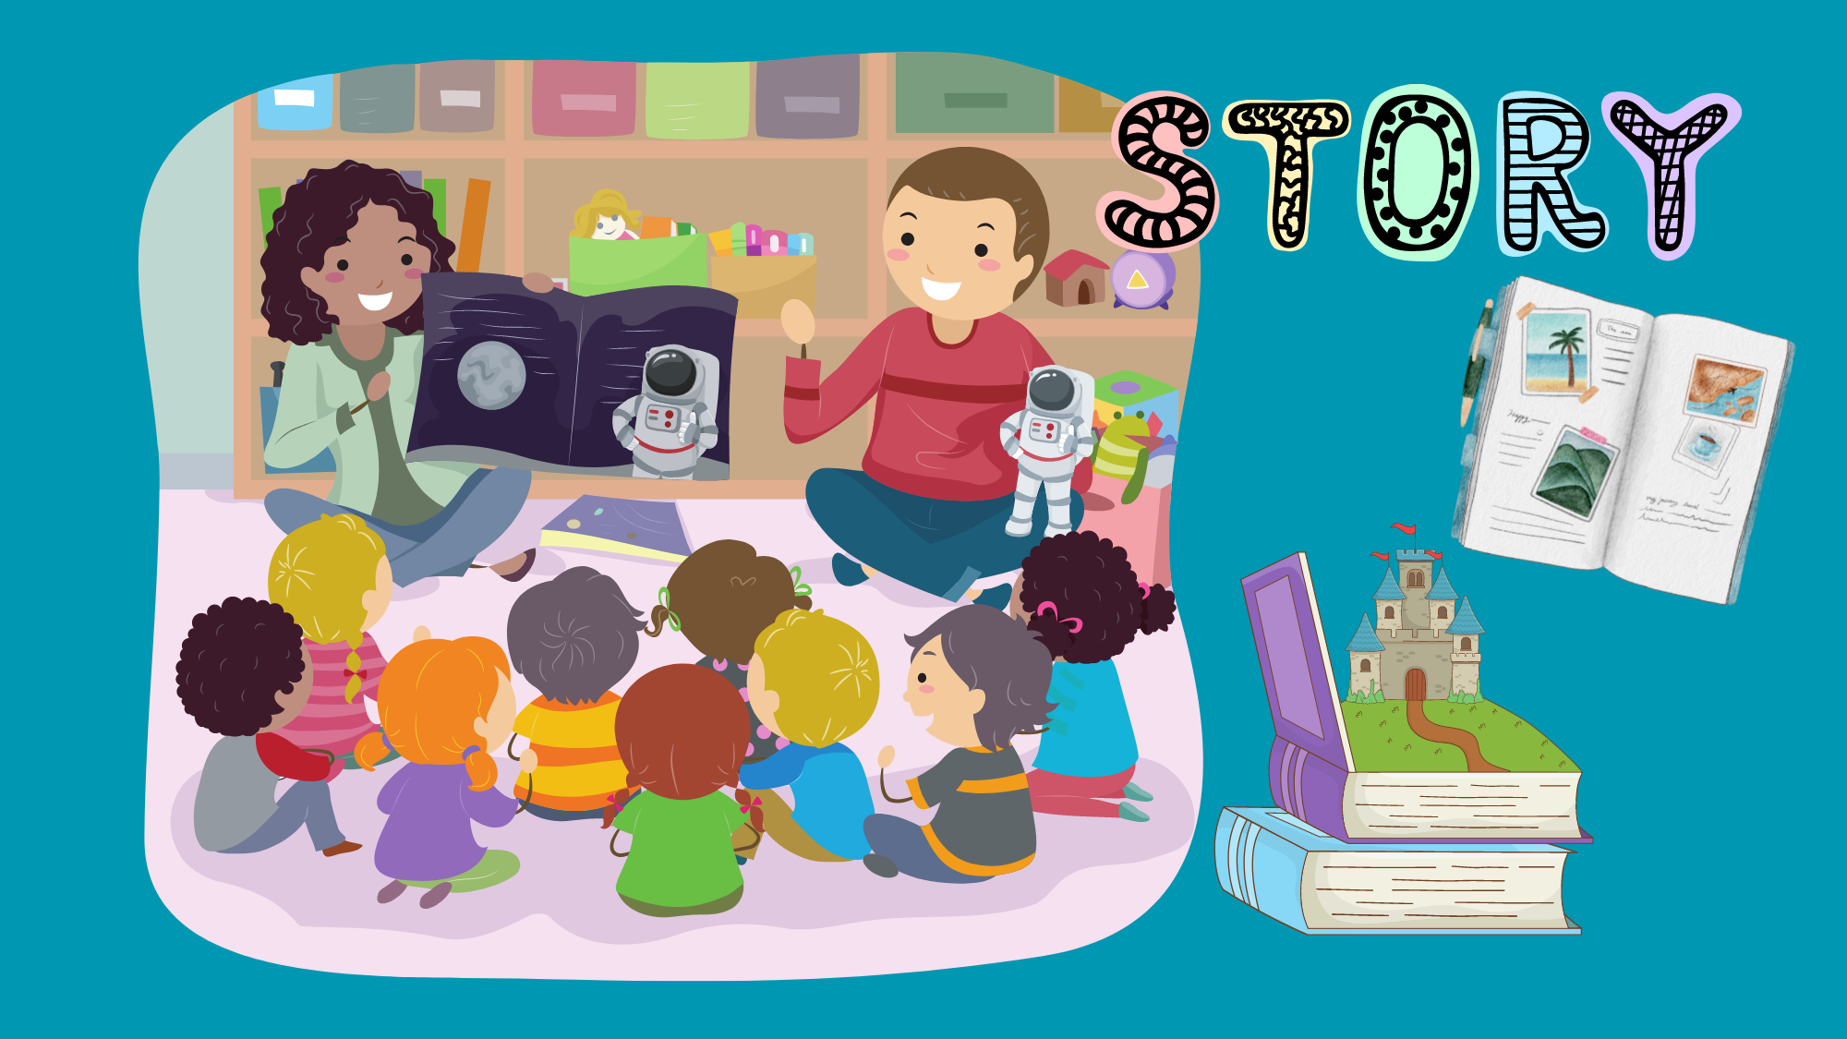
STORY

Slide 10

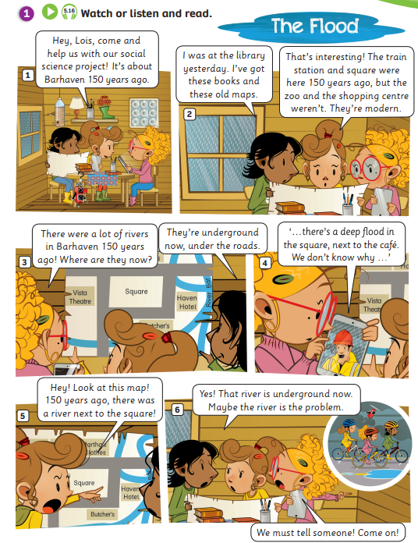
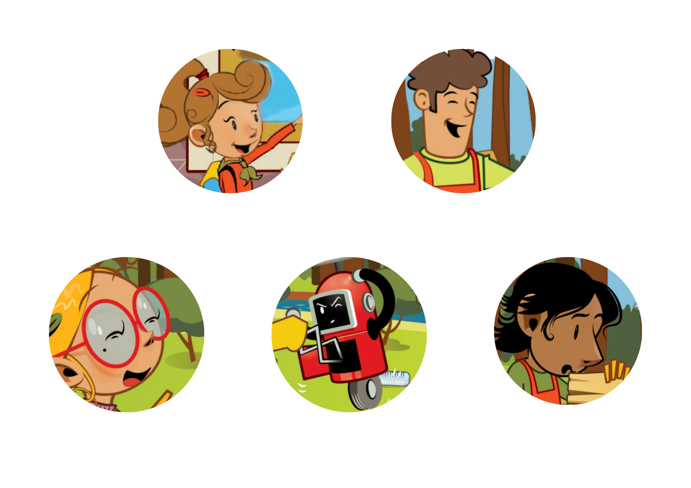
STORY: Introduction
1. What’s the story title?
→
2. How many story frames?
→
3. How many characters?
→
The Flood
6 story frames
3 characters
Click on each number, students look, say and clap the word out loud.

Slide 11
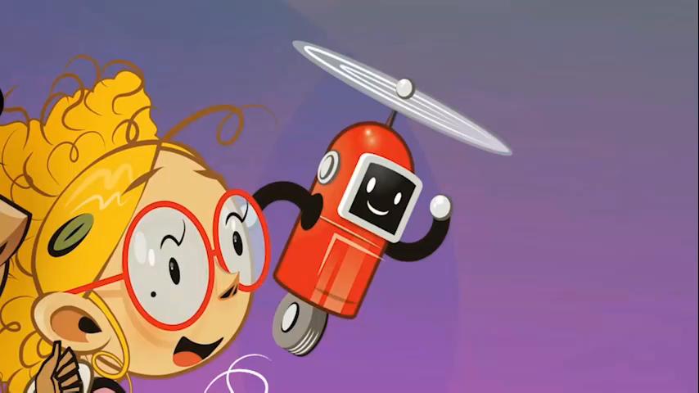
STORY: Watch a video

Slide 12


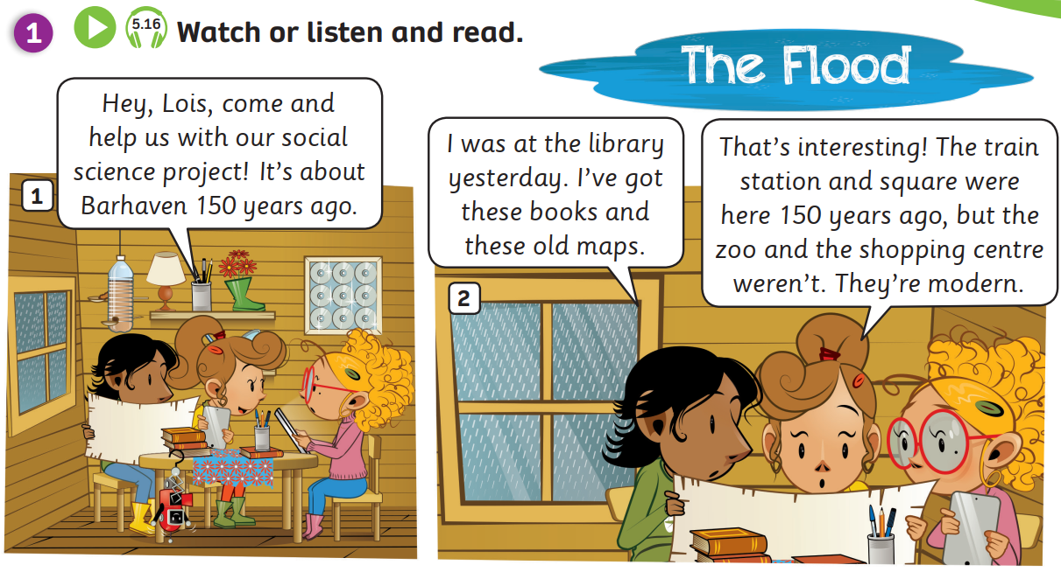
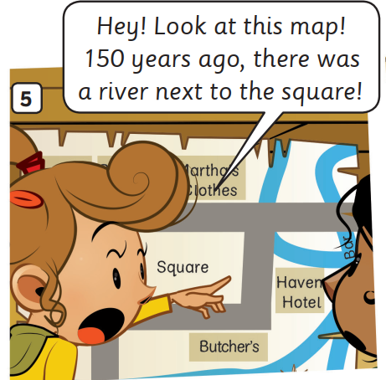
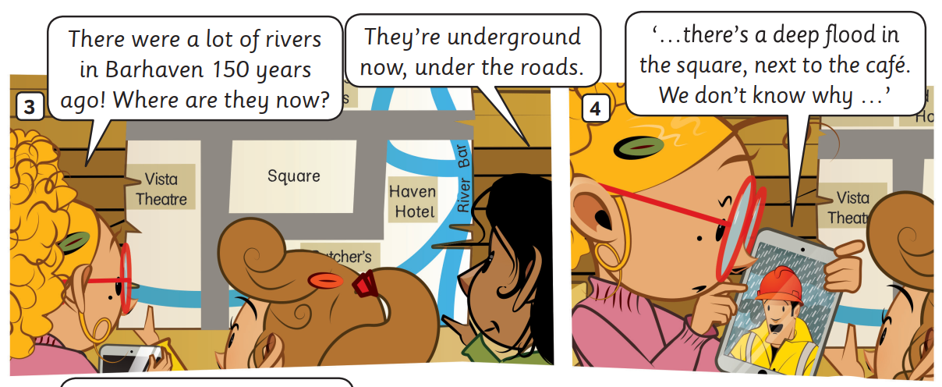
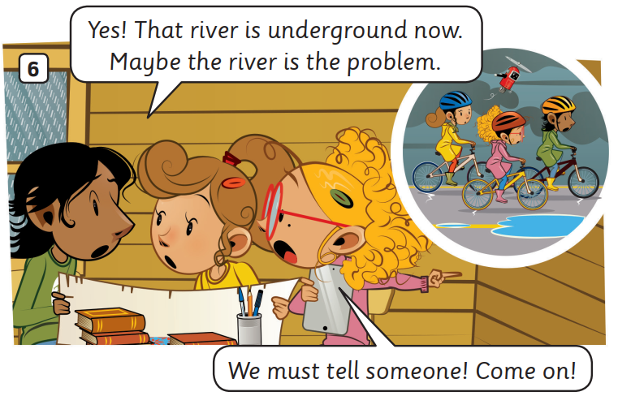
Listen
STORY: Listen to the story
Students open their book, listen to the story.

Slide 13
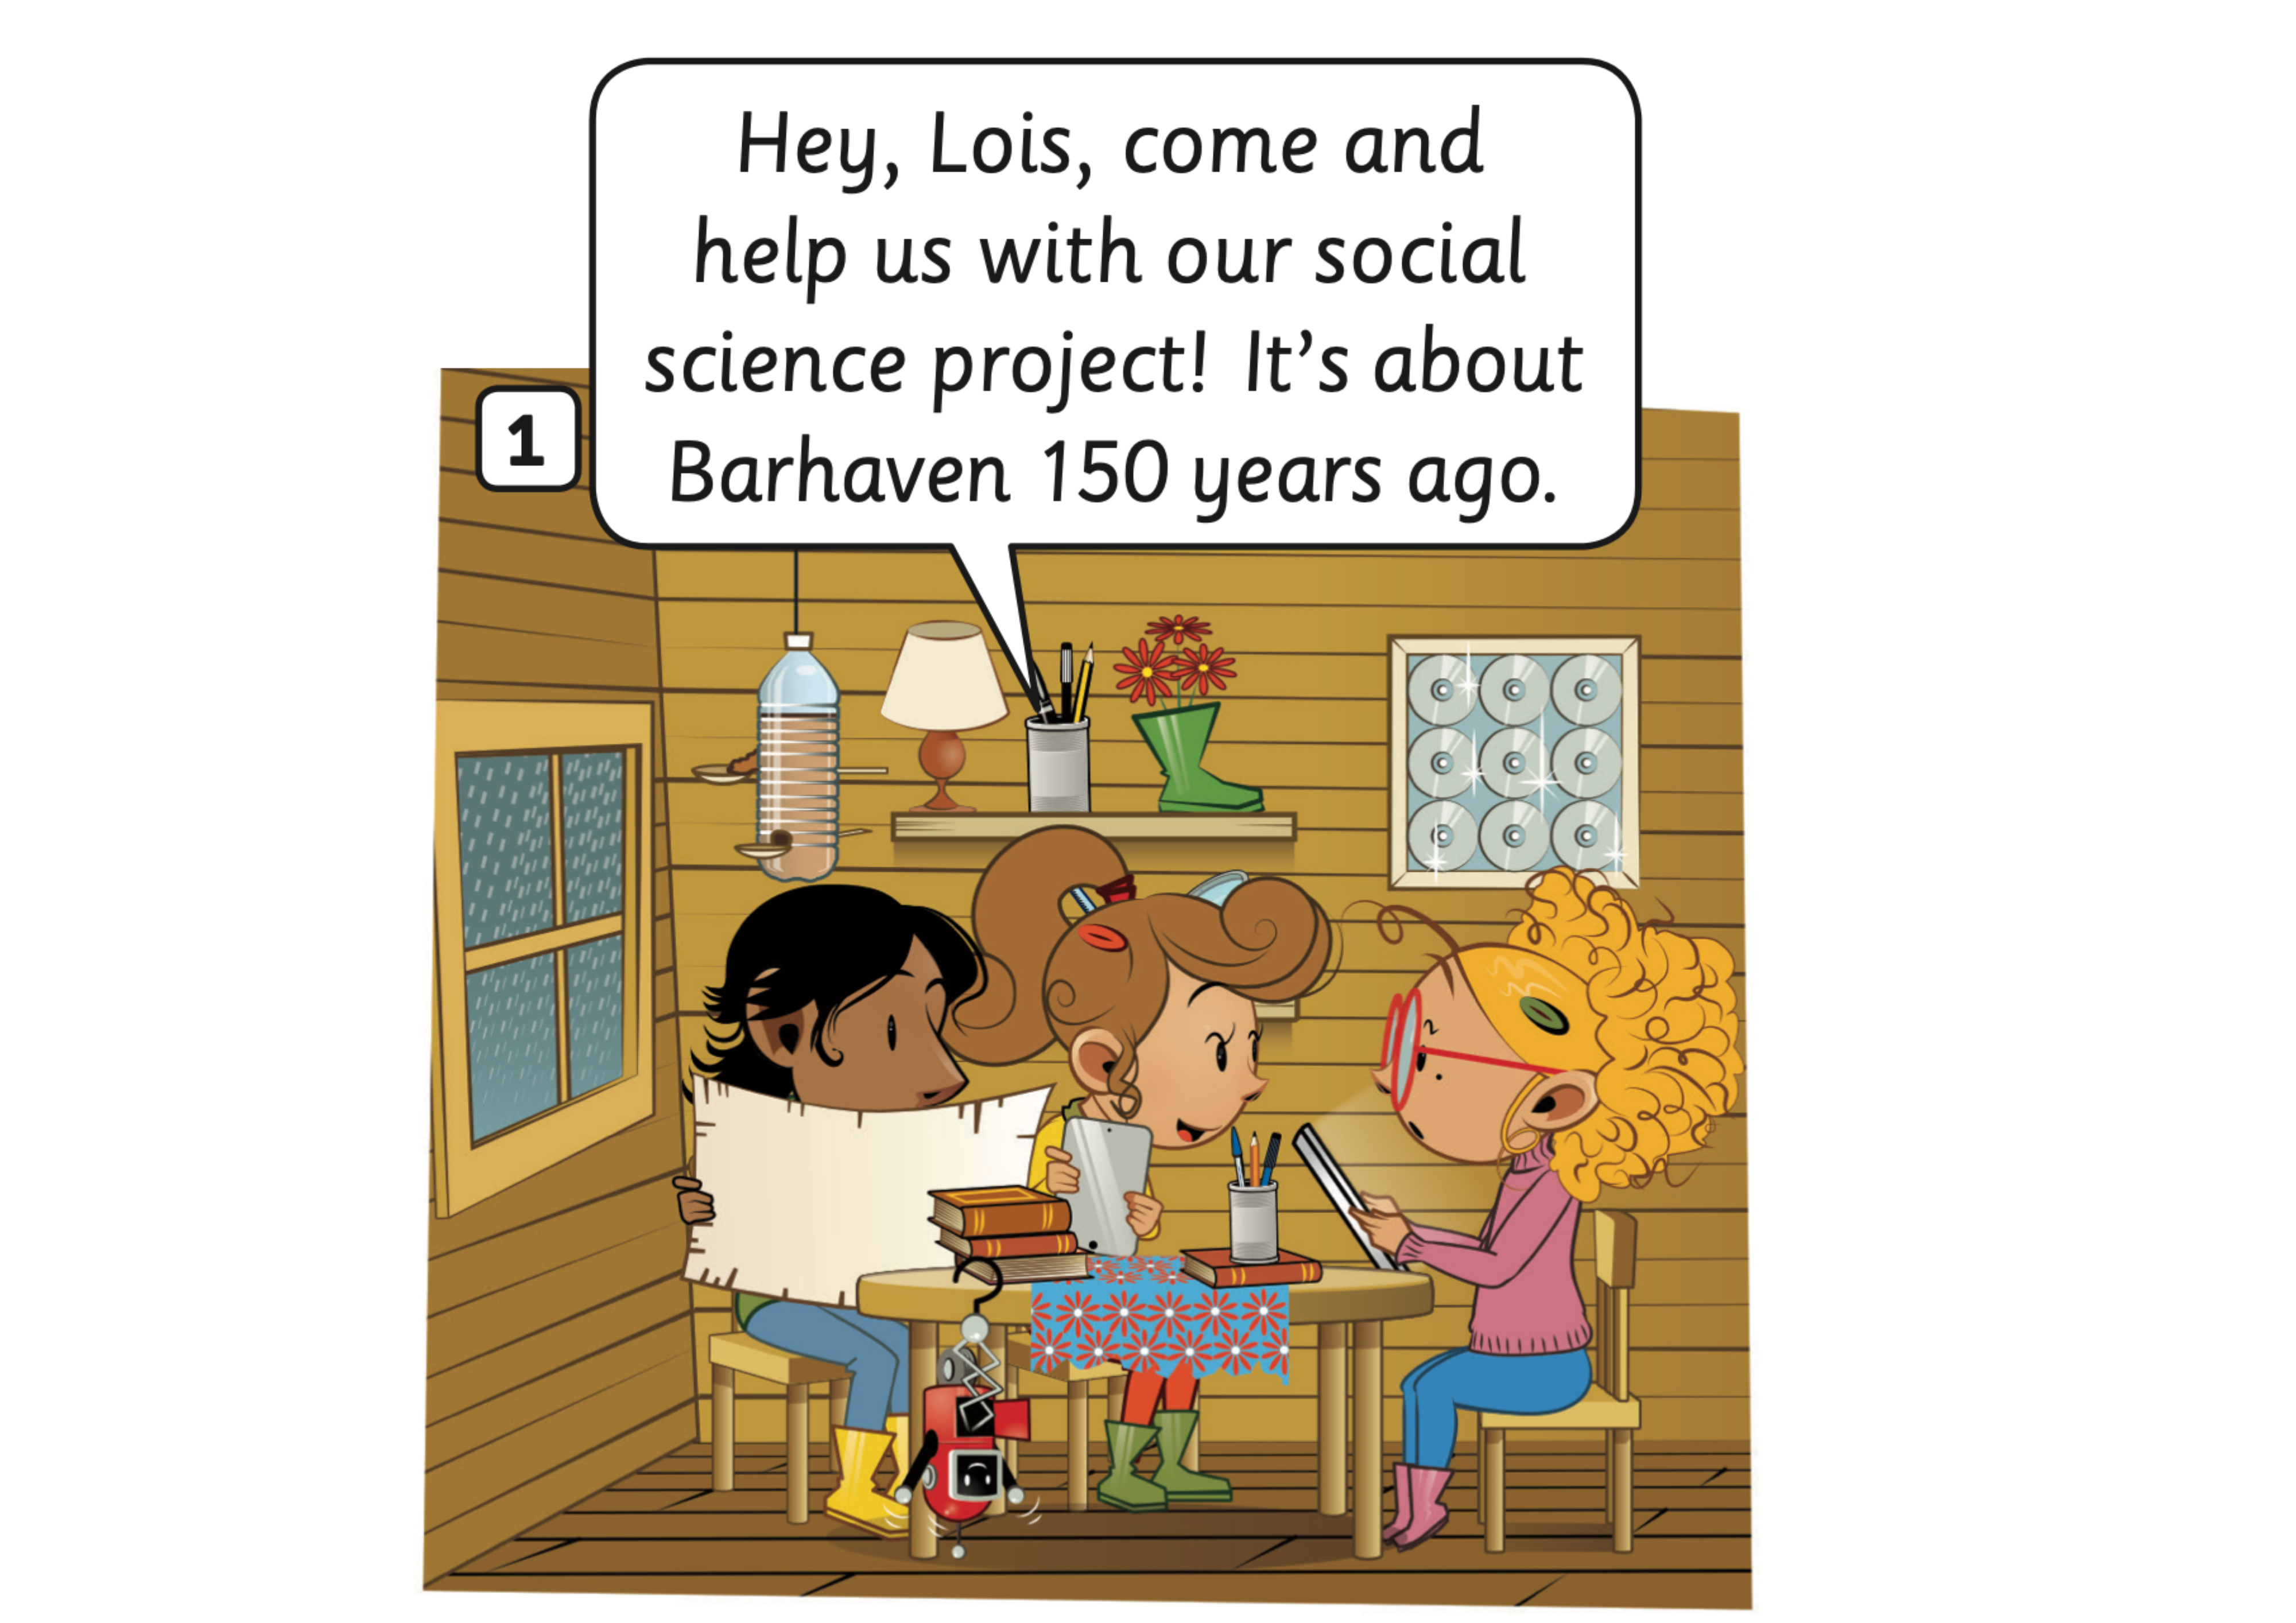
STORY: Listen and read
1
1
Click on the number, students listen and repeat

Slide 14
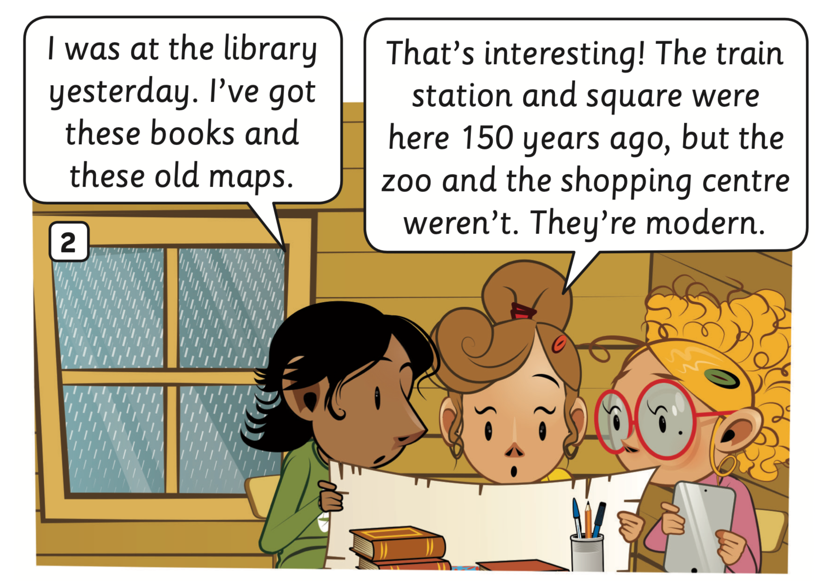
STORY: Listen and read
1
2
1
2
Click on the number, students listen and repeat

Slide 15
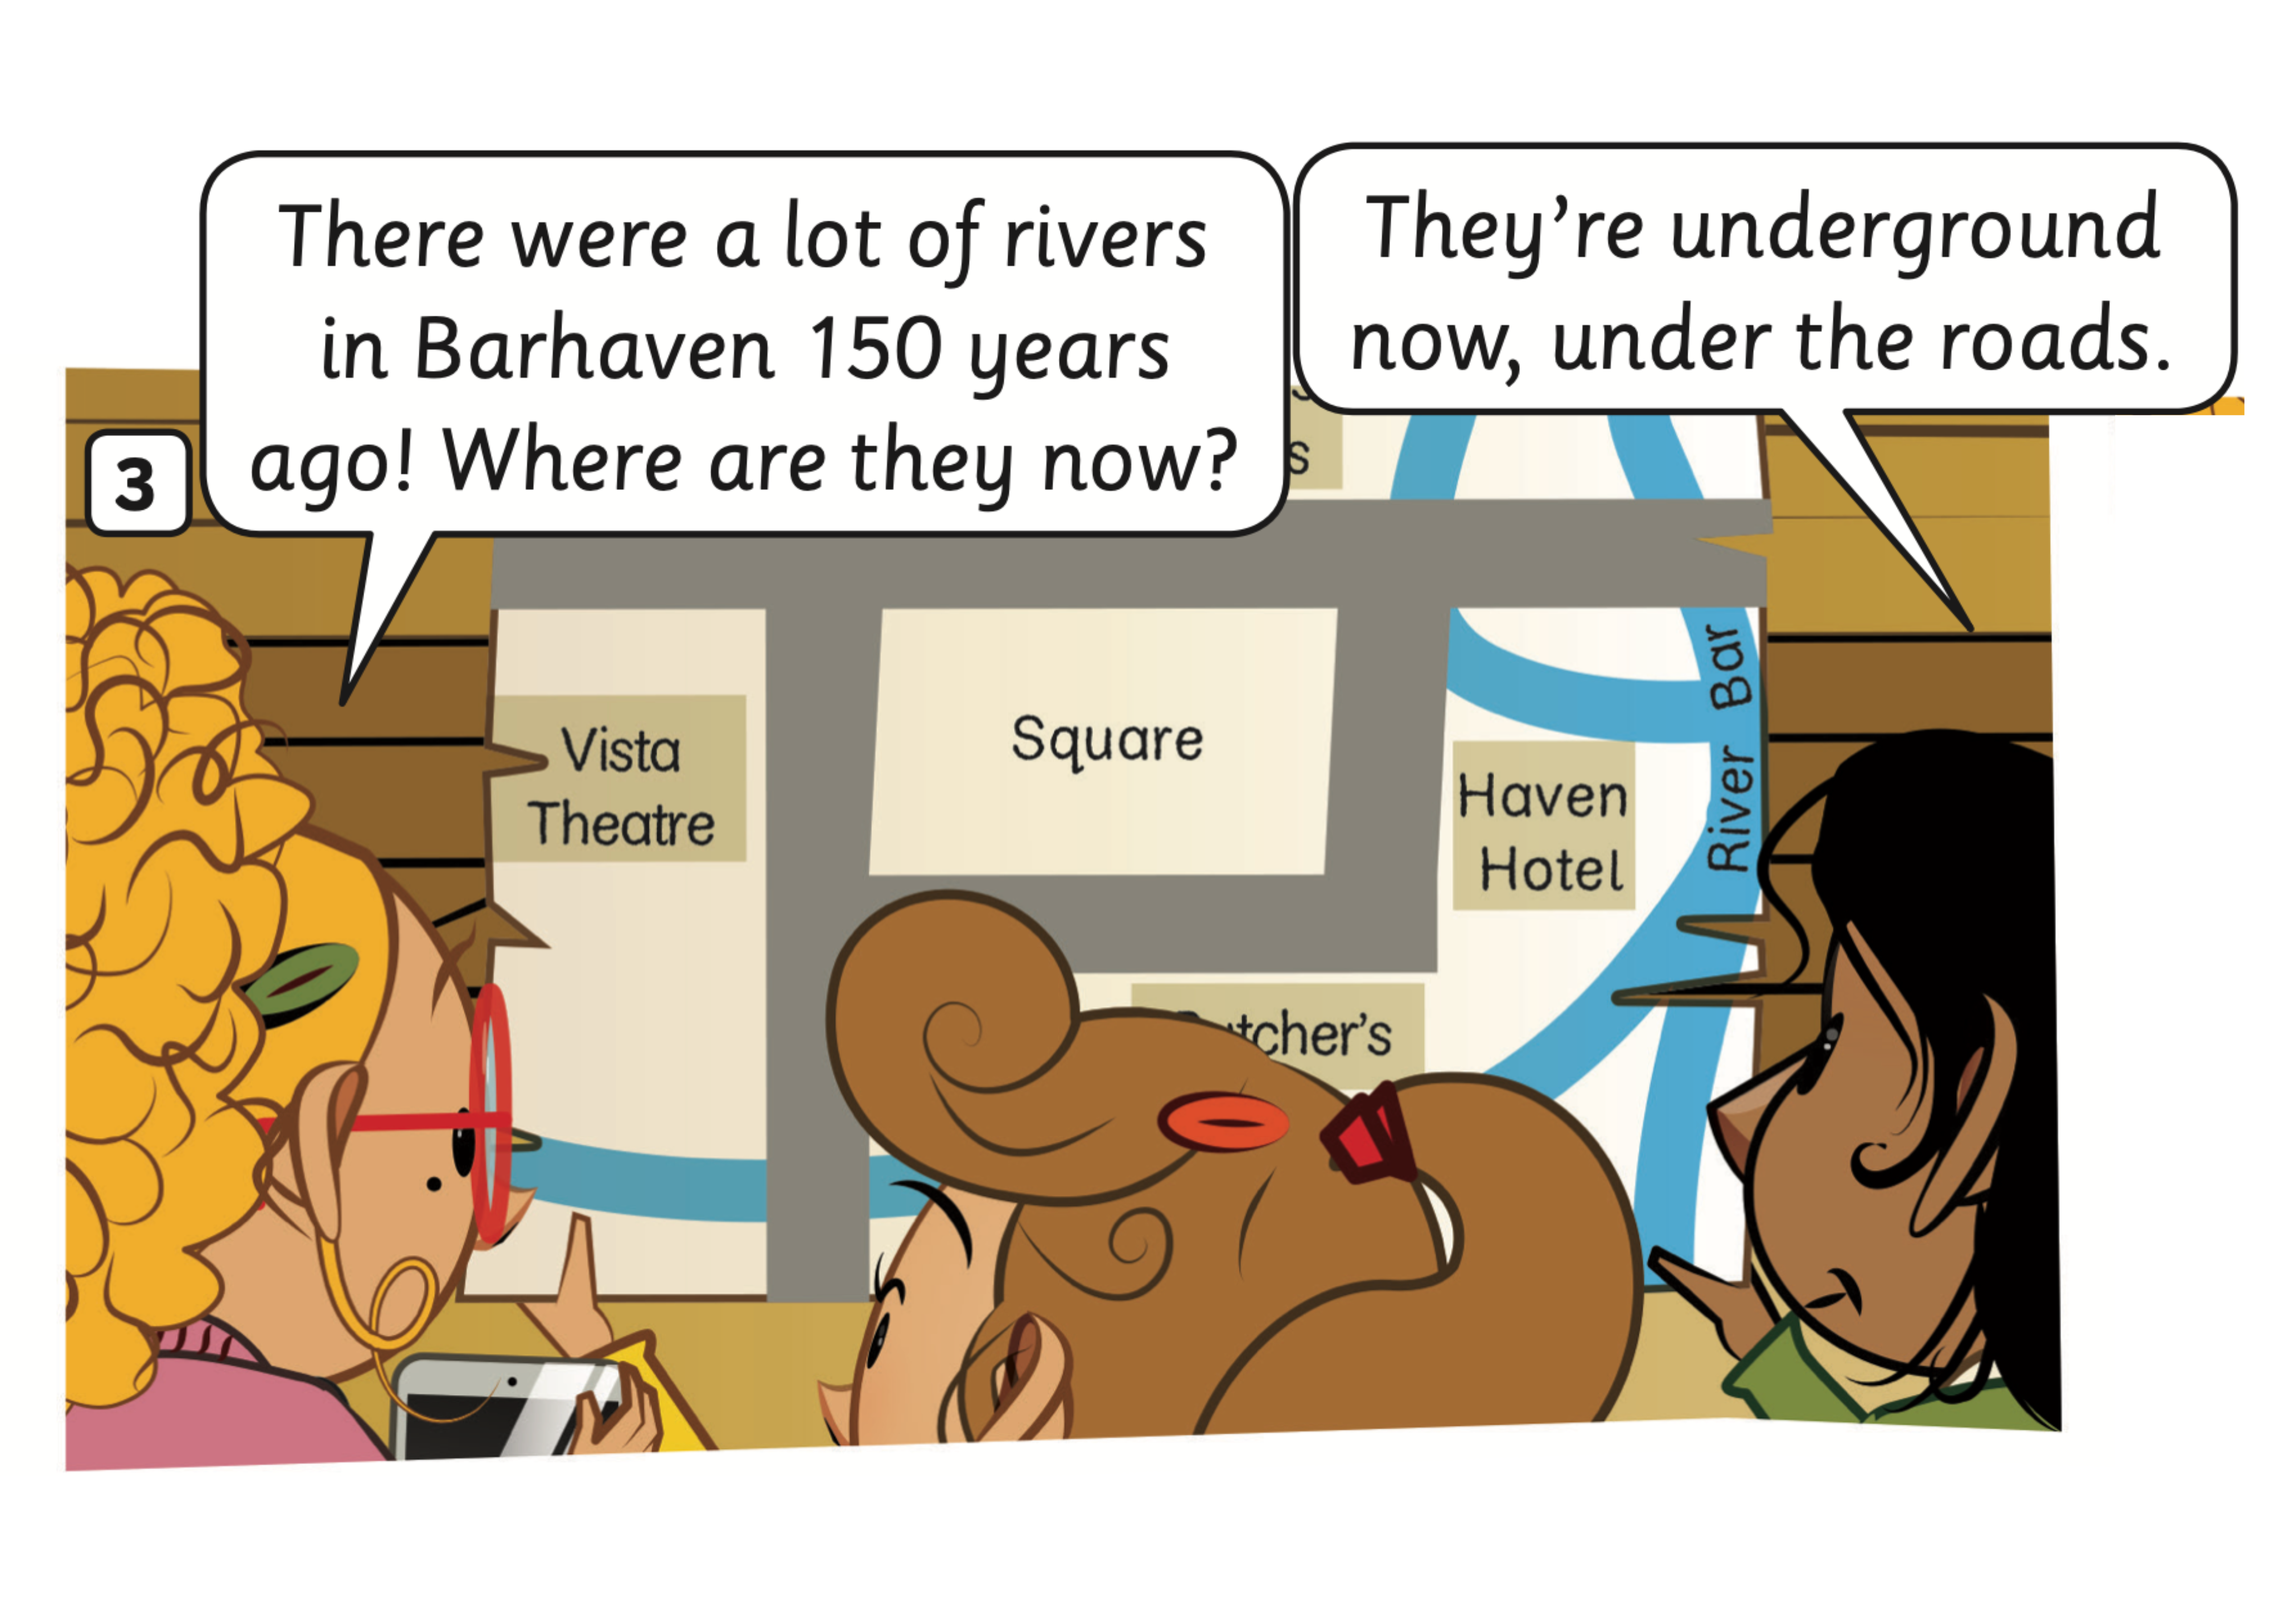
STORY: Listen and read
1
2
1
2
Click on the number, students listen and repeat

Slide 16
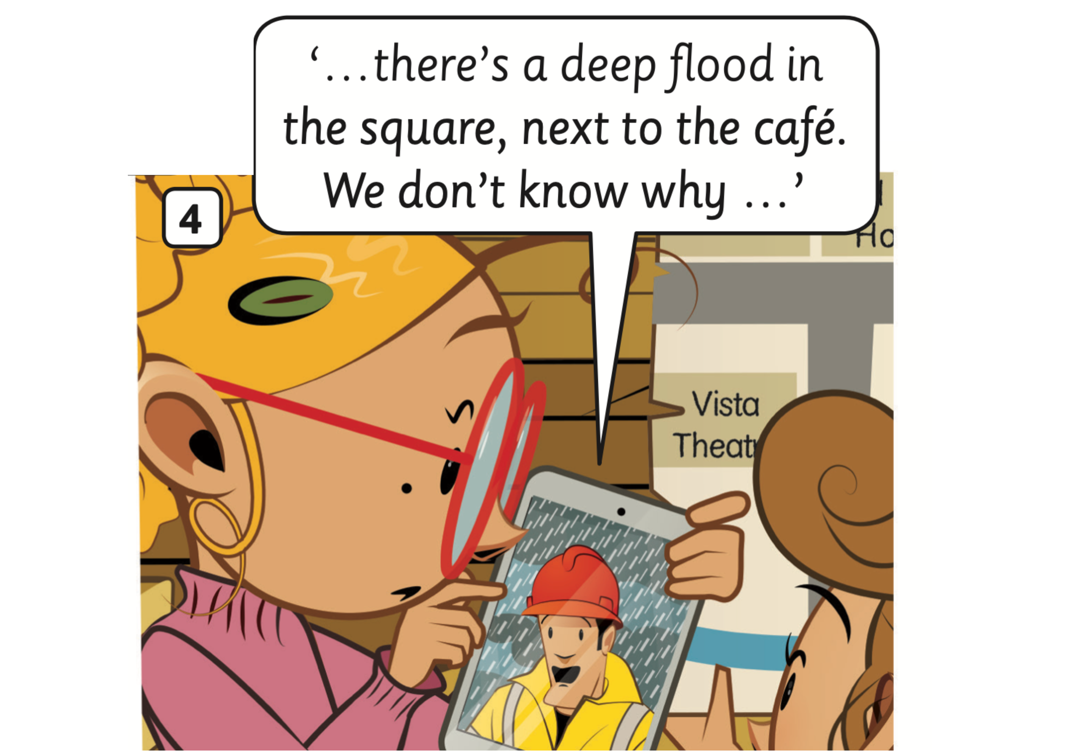
STORY: Listen and read
1
1
Click on the number, students listen and repeat

Slide 17
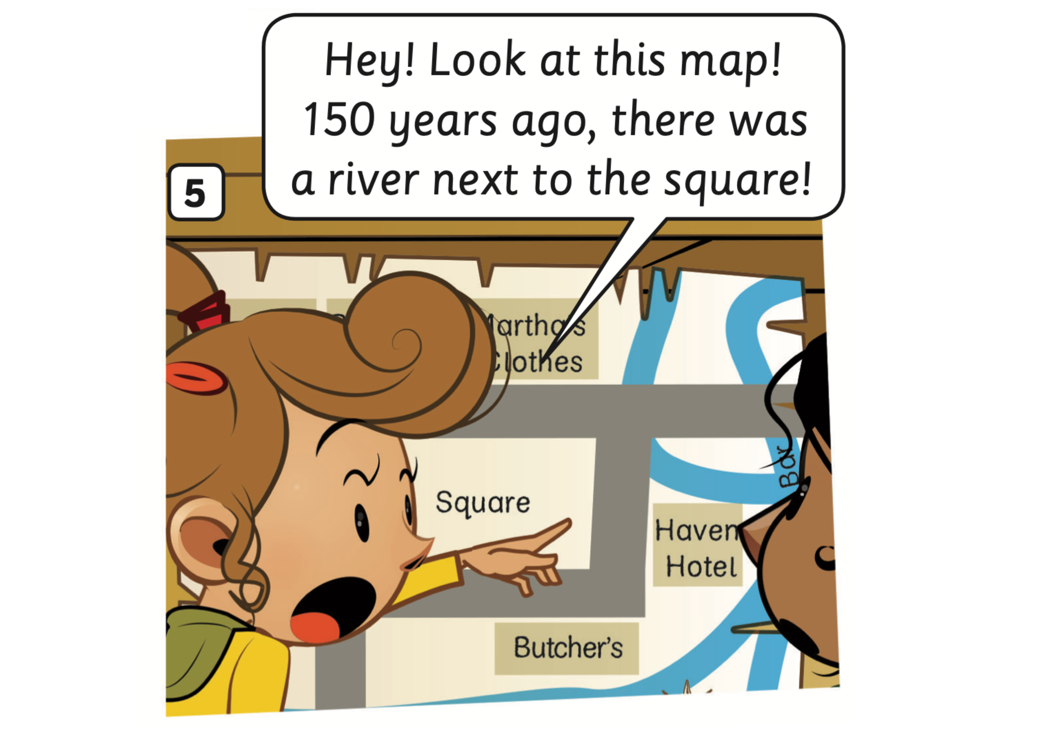
STORY: Listen and read
1
1
Click on the number, students listen and repeat

Slide 18
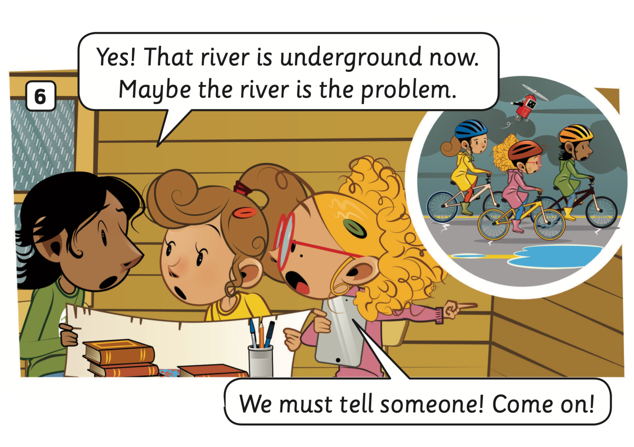
STORY: Listen and read
1
1
2
2
Click on the number, students listen and repeat

Slide 19
PRACTICE
Activity: Choose the correct character
Divide the class into groups of 4.
Read the sentence and discuss it with your teammate to choose the correct character who says that line.
Show the finger to choose the correct answer (all members of the team).
The faster team with the correct answer can get 2 points.
Note: Click on the picture to check.

Slide 20
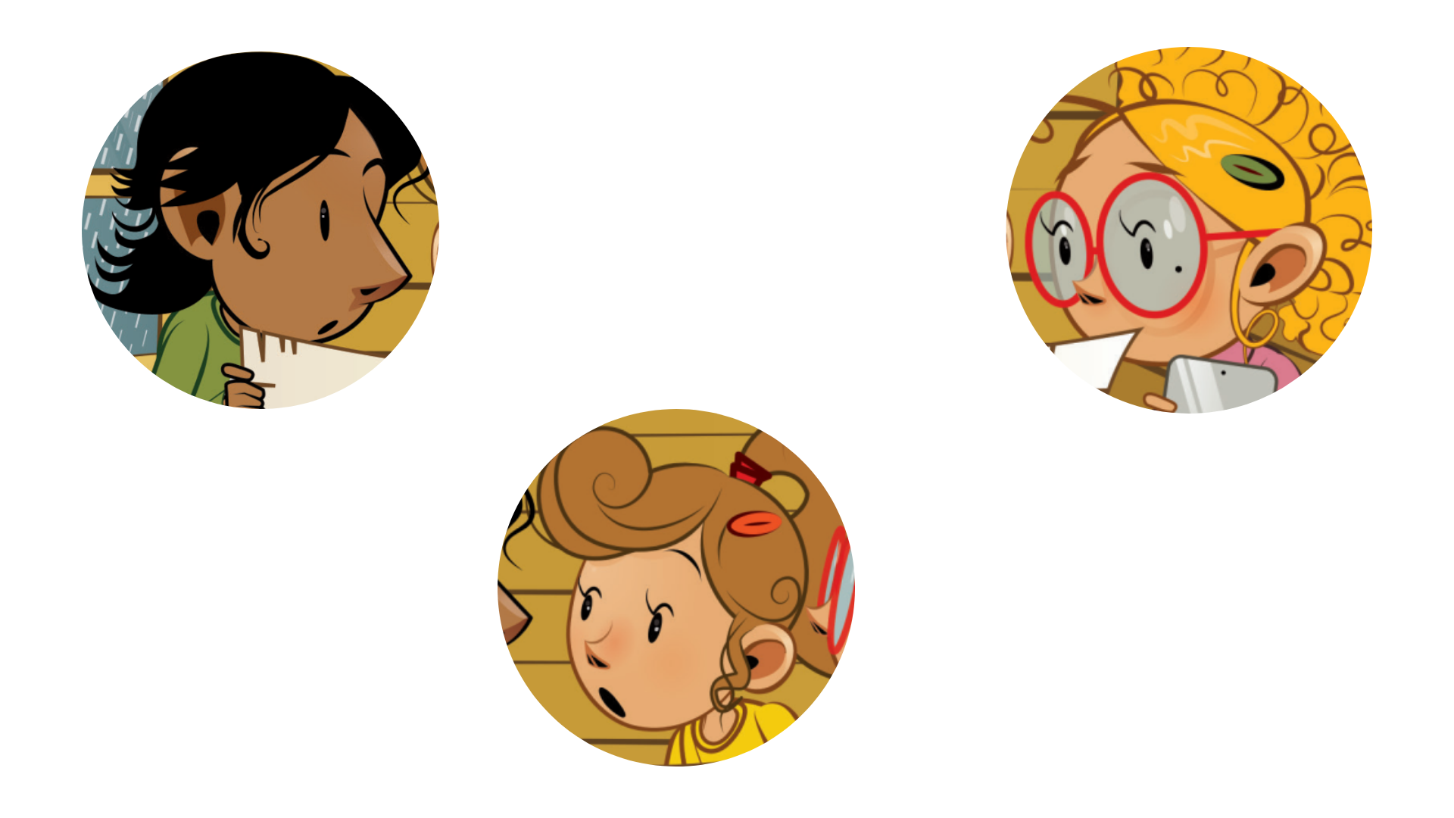


Choose the correct character
I was at the library yesterday.
1
2
3

Slide 21
Choose the correct picture
The train station and square were here 150 years ago, but the zoo and the shopping centre weren’t.
a
b
c

Slide 22
Choose the correct picture
There were a lot of rivers in Barhaven
150 years ago!
a
b
c

Slide 23
Choose the correct picture
They’re underground now, under the roads.
a
b
c

Slide 24
Choose the correct picture
150 years ago, there was a river next to the square!
a
b
c

Slide 25
Choose the correct picture
Maybe the river is the problem.
a
b
c

Slide 26
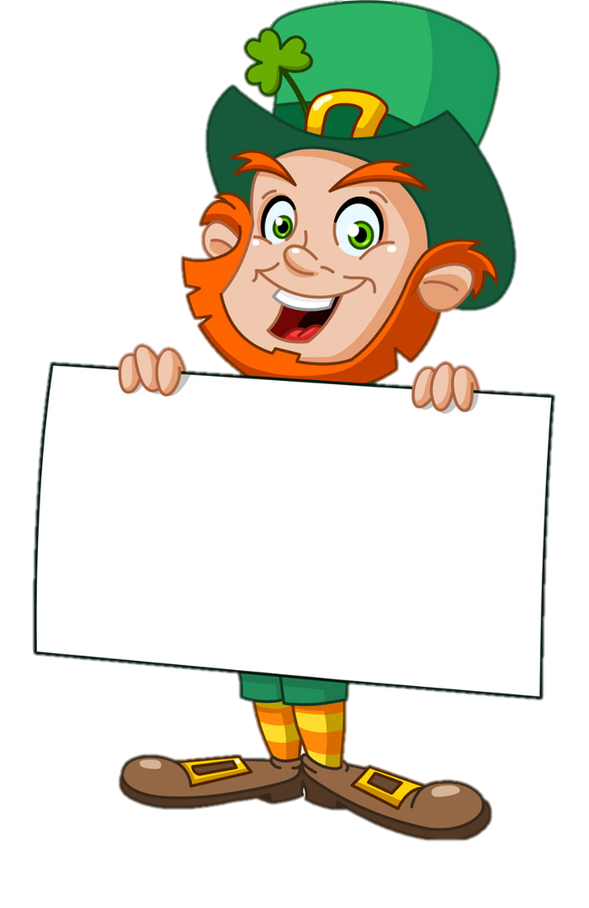
Well-done

Slide 27
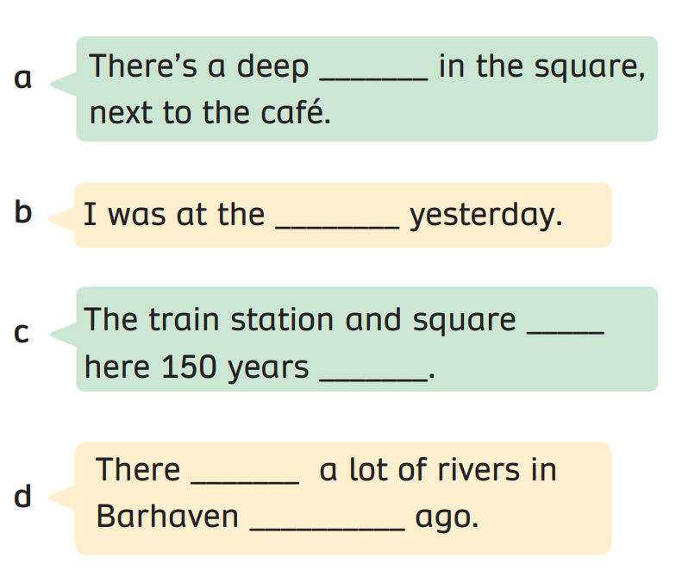
PRACTICE (Pupils’ book (p.62)
In groups of 3, read and answer the question by using their memory.
Check the answer with the whole class.

Slide 28
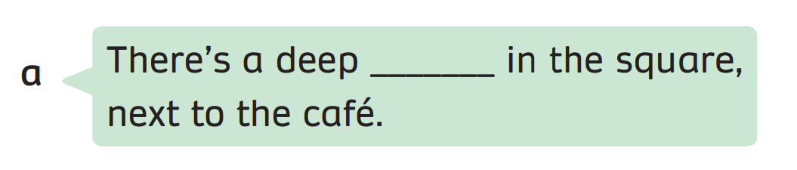
PRACTICE (Pupils’ book (p.62)
floor
Answer
In groups of 3, read and answer the question by using their memory.
Check the answer with the whole class.

Slide 29
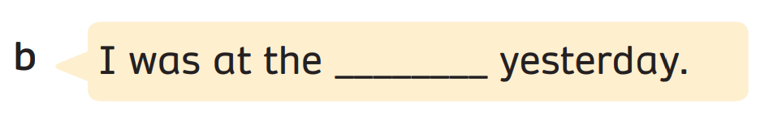
PRACTICE (Pupils’ book (p.62)
library
Answer
In groups of 3, read and answer the question by using their memory.
Check the answer with the whole class.

Slide 30
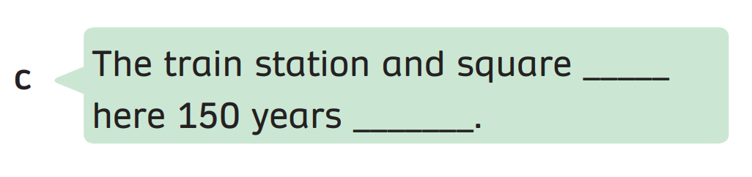
PRACTICE (Pupils’ book (p.62)
were
ago
Answer
In groups of 3, read and answer the question by using their memory.
Check the answer with the whole class.

Slide 31
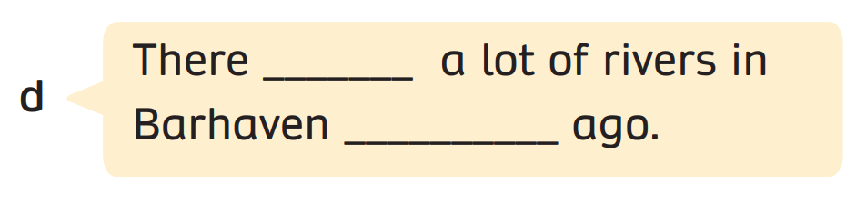
PRACTICE (Pupils’ book (p.62)
were
150 years
Answer
In groups of 3, read and answer the question by using their memory.
Check the answer with the whole class.

Slide 32
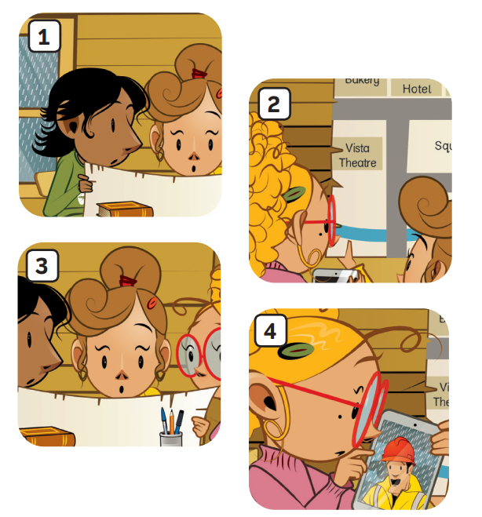
PRACTICE (Pupils’ book (p.62)
floor
library
were
ago
were
150 years
Match
In groups of 3, read and answer the quesion by using their memory.
Check the answer with the whole class.

Slide 33
STORY: Wrap-up
1. What’s the story title?
→
2. How many story frames?
→
3. How many characters?
→
The Flood
6 story frames
3 characters
Click on each number, students look, say and clap the word out loud.

Slide 34
HOMEWORK
HOMEWORK
Review Vocabulary and Grammar.
Do exercises in the Activity Book (page 50).
Check answers in the Teacher’s book (page 110) or Active Teach.

Slide 35
UNIT 5 – Lesson 7A
We’ve learned…
- to understand simple cartoon stories.
- PB p. 61,62
- AB p.50

