Slide 1


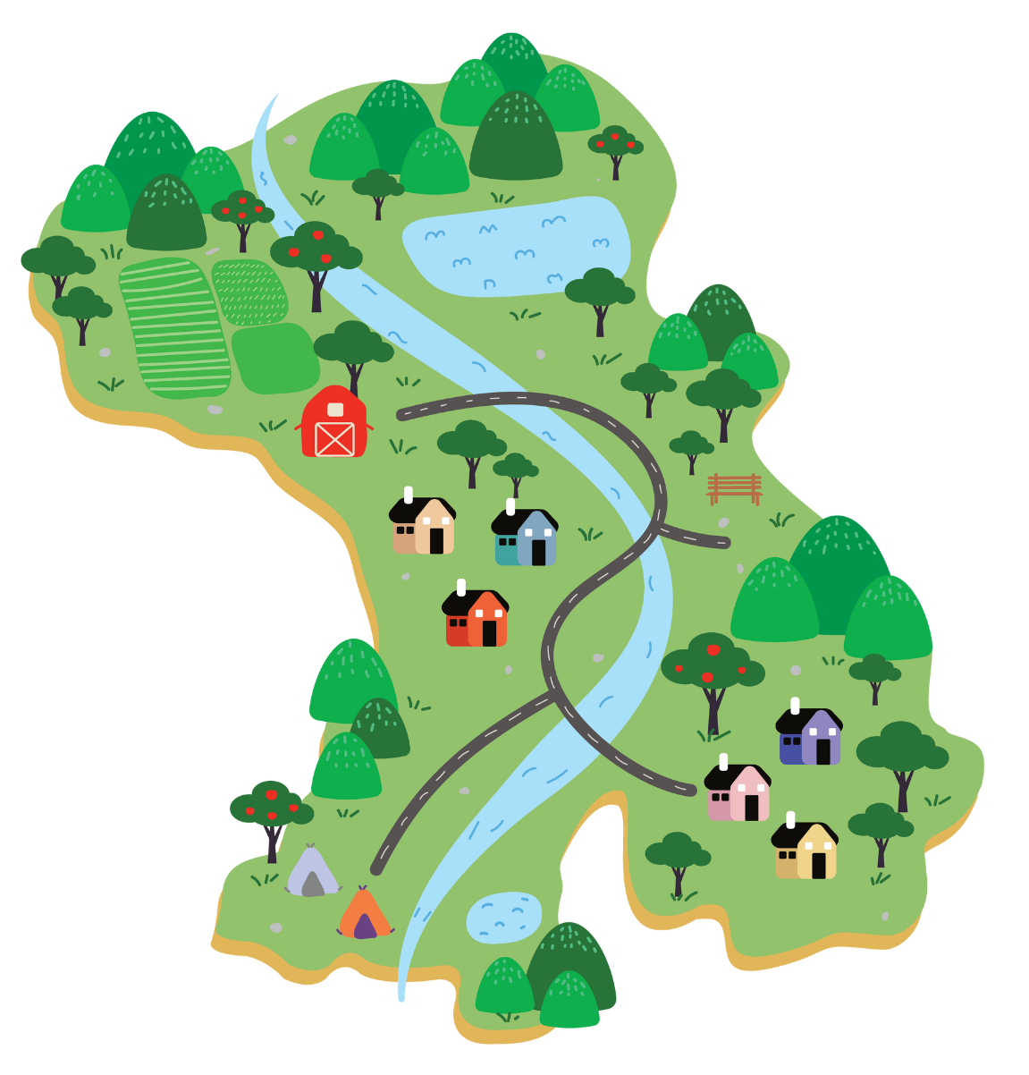
UNIT 5 – OUR TOWN
Lesson 8 - SKILLS

Slide 2
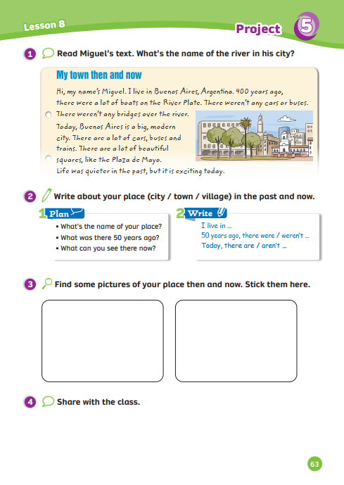
UNIT 5 – Lesson 8
We’re learning…
- to write about your place in the past and now.
- PB p.63
- AB p.51

Slide 3

WARM-UP ACTIVITY
Activity: Answer the question
Put students into groups of 4. Each group takes out a pen or ruler and puts it in the middle of each group.
Show the text and give 2 minutes for students to read the information.
Ask the questions and students listen, find the information in the picture, then raise their pens or ruler to get a chance to say the answer.
The fastest group with the correct information receives 2 points.

Slide 4
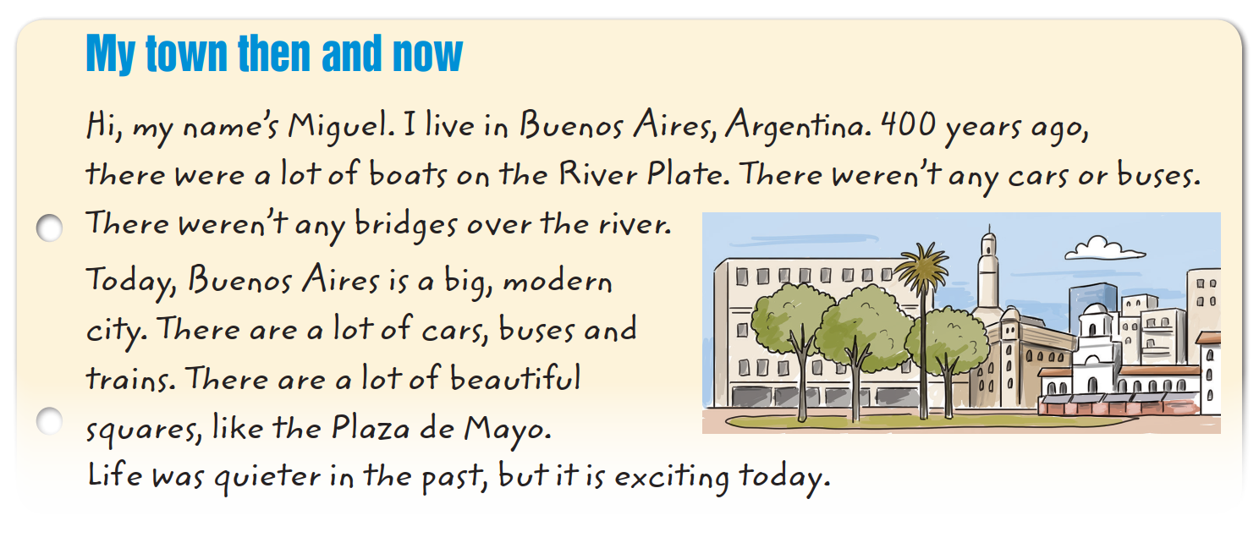

WARM-UP ACTIVITY

Slide 5

WARM-UP ACTIVITY
It’s about Miguel’s town then and now.
What does the text talk about?
Answer

Slide 6
WARM-UP ACTIVITY
He’s from Buenos Aires, Argentina.
Where is he from?
Answer

Slide 7
WARM-UP ACTIVITY
What weren’t there in his town 400 years ago?
There weren’t any cars or buses.
Answer

Slide 8
WARM-UP ACTIVITY
There are a lot of cars, buses, trains and beautiful squares.
What are there in his town now?
Answer

Slide 9
WARM-UP ACTIVITY
It’s about Miguel’s town then and now.
What does the text talk about?
Answer

Slide 10
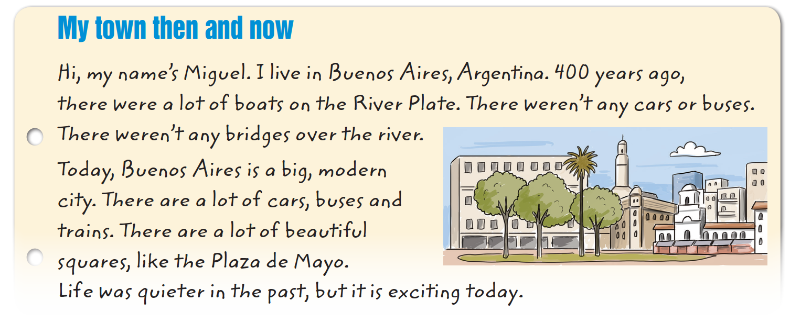
Pupils’ book – p.63
Answer
Have students open their books and read the text again. Students read and answer the question. Circle the name. Show the answer to check.

Slide 11
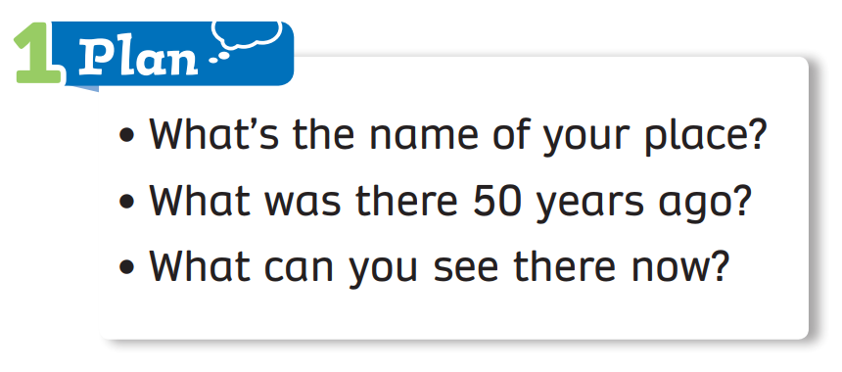
Pupils’ book – p.63
Activity: My Town
Put students into groups of 4. Each group takes out a sheet of paper. Students in the group discuss and write the answer for each question.
Each member takes turns writing the answer.
Show the example on the next slide.

Slide 12



Pupils’ book – p.63
Example
Activity: My Town
1. Name of city:
Đà Nẵng
2. 50 years ago:
small houses, quiet roads, boats, beaches
no new bridges, building
3. Now:
many beautiful bridges, shopping centres, modern hotels, cars,
no quiet road, old cinema

Slide 13
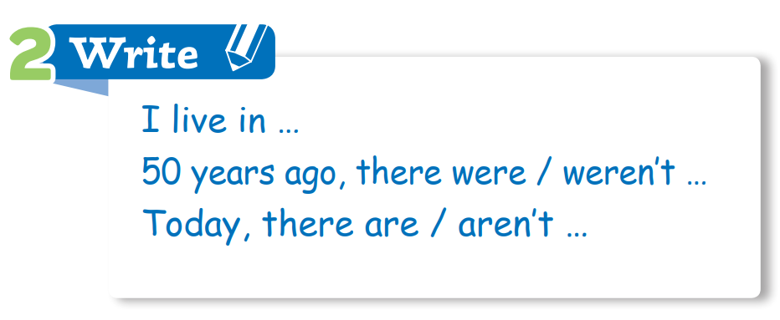
Pupils’ book – p.63
Activity: My Town
Next, students in the group discuss writing about their town.
Using the clues and the helpful language on top.
Show the example on the next slide.

Slide 14
Pupils’ book – p.63
Activity: My Town
I live in Đà Nẵng City.
50 years ago, there were small houses, quiet roads and boats. There were beautiful beaches, but there weren’t new bridges and building.
Today, there are many beautiful bridges. There
are a lot of modern hotels and shopping centres.
There aren’t quiet roads and there is no old cinema.

Slide 15

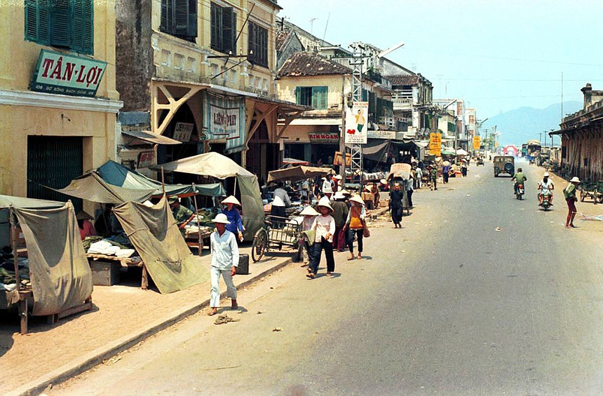
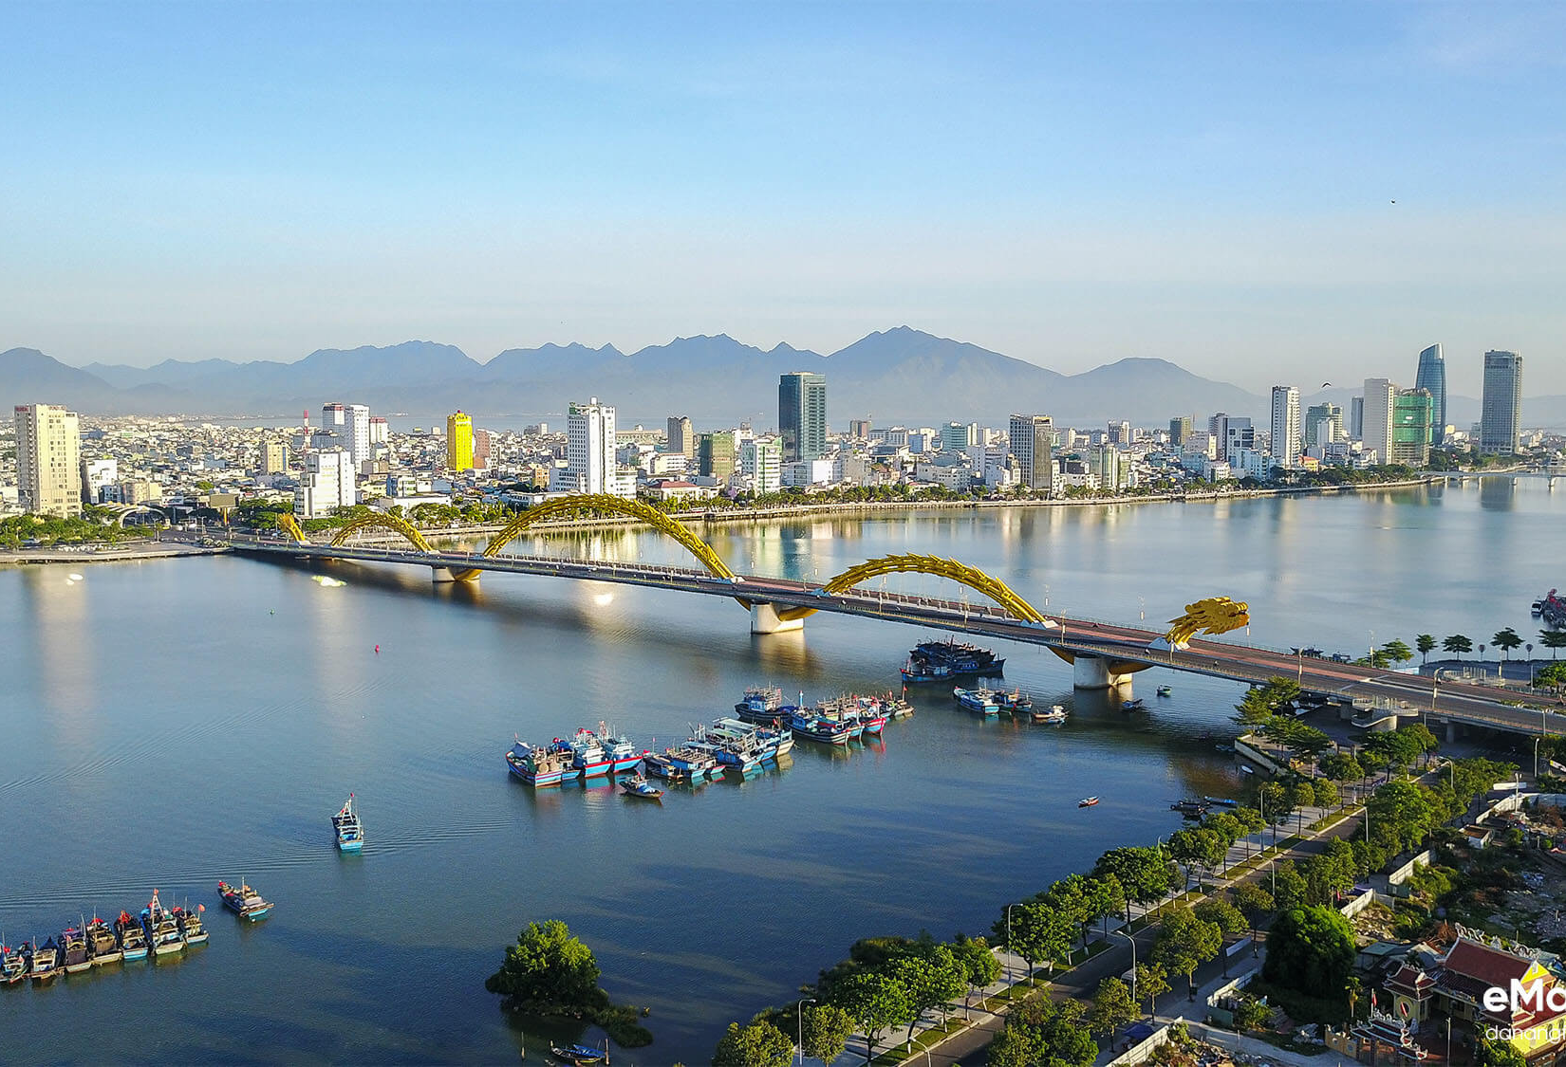
Pupils’ book – p.63
Đà Nẵng 50 years ago
Đà Nẵng now
Ask students to stick pictures of their place in the past and now that they prepared at home
and show them to the class.
In case they forget to bring the picture. Students can dram or stick their pictures later.

Slide 16


Pupils’ book – p.63
I live in
Đà Nẵng City.
50 years ago, there were small houses, quiet roads and boats. There were beautiful beaches, but there weren’t new bridges and building.
Today, there are many beautiful bridges. There are a lot of modern hotels and shopping centres.
There weren’t quiet roads and an old cinema.
Students take turns sharing their pictures with the class and they can introduce their town in the past and now. Say and point to the pictures along.

Slide 17
HOMEWORK
HOMEWORK
Review vocabulary and grammar.
Do exercises in the Activity Book (page 51).
Check answers in the Teacher’s Book (page 113) or Active Teach.

Slide 18
UNIT 5 – Lesson 8
We’ve learned…
- to write about your place in the past and now.
- PB p.63
- AB p.51

