Slide 1
UNIT 6 – THEN AND NOW
Lesson 1 – Vocabulary

Slide 2
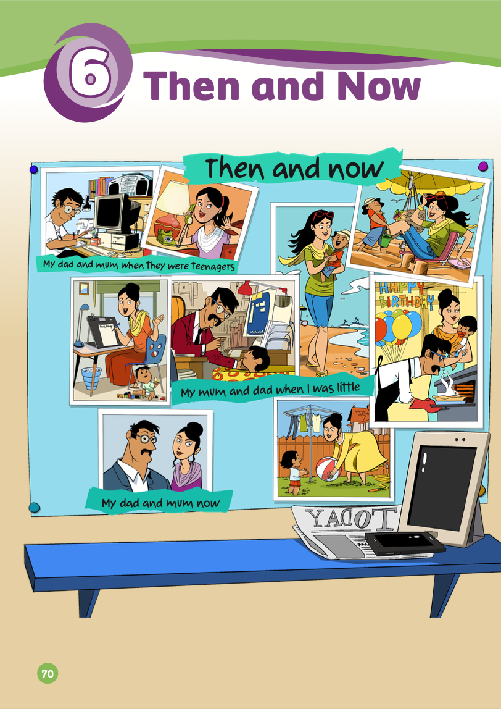
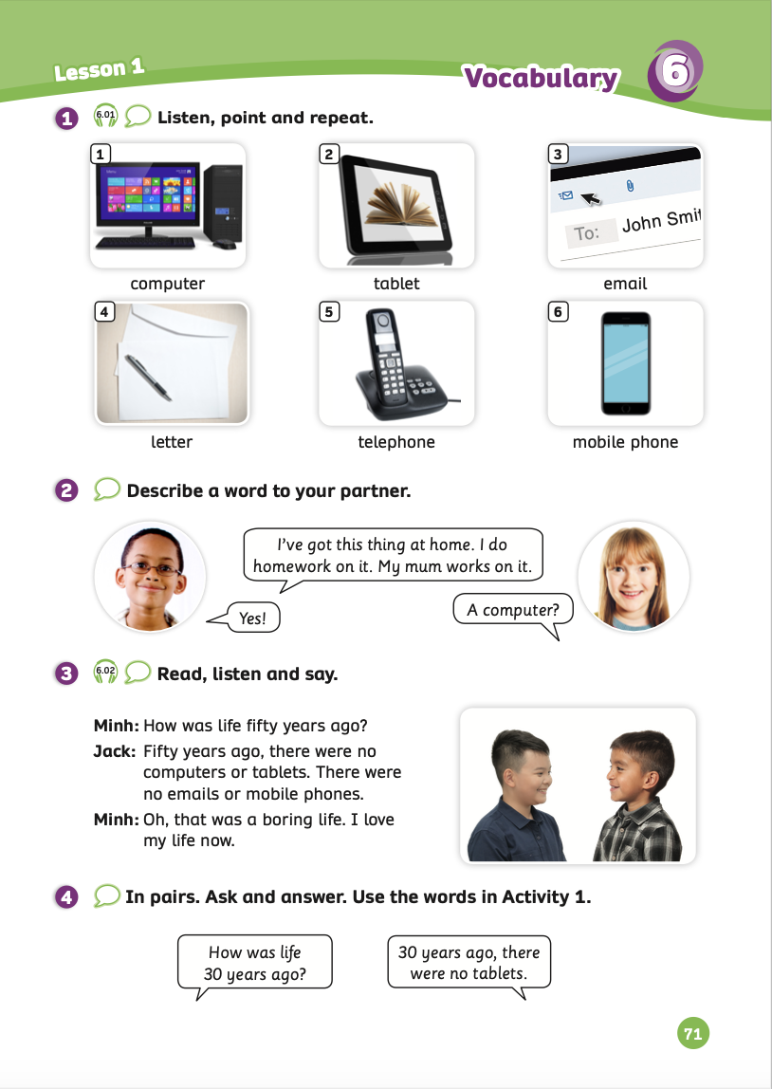
UNIT 6 – Lesson 1
We’re learning…
- To correctly read and pronounce words related to electrical devices.
- To describe electrical devices.
- To use the structures: How was life 30 years ago?
- PB p.71
- AB p.54

Slide 3
WARM-UP ACTIVITY
Song: The Hokey Pokey Song With Actions
Stand up
Listen to the song
Dance along
Notes:
Link youtube: https://www.youtube.com/watch?v=YzSJBowPECY&t=1s

Slide 4
LEAD-IN
Then, they were teenagers.
Then, they had a baby.
Now, they are adults.
- Have students look at the poster and guess the topic of this unit.
- Ask the class: How have things/people changed in the pictures?

Slide 5
VOCABULARY – Then and Now
- Play the audio, students listen and repeat the words.

Slide 6
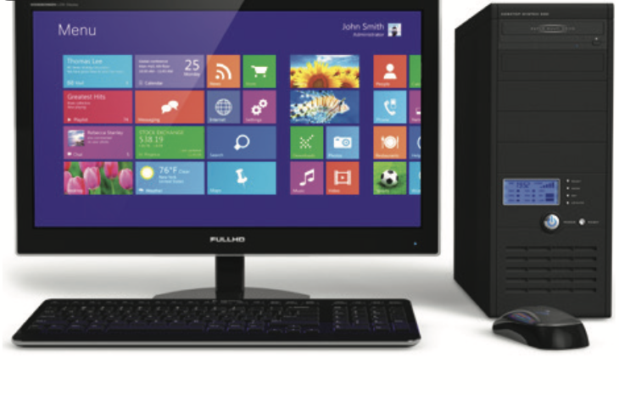
VOCABULARY – Then and Now
Let’s spell!
c
computer
c
o
m
p
u
t
e
r
Students listen and repeat the word.

Slide 7
VOCABULARY – Then and Now
c
Let’s spell!
tablet
t
a
b
l
e
t
Students listen and repeat the word.

Slide 8
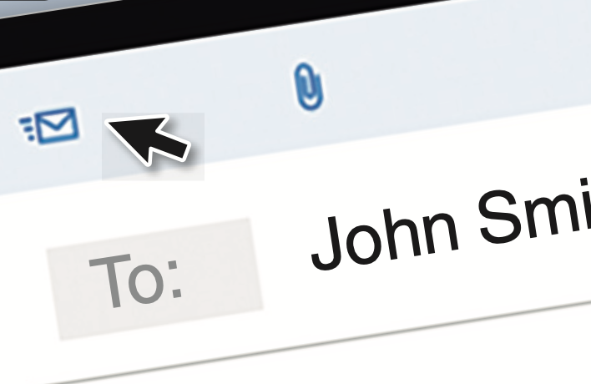
VOCABULARY – Then and Now
Let’s spell!
c
email
e
m
a
i
l
Students listen and repeat the word.

Slide 9
VOCABULARY – Then and Now
Let’s spell!
c
letter
l
e
t
t
e
r
Students listen and repeat the word.

Slide 10
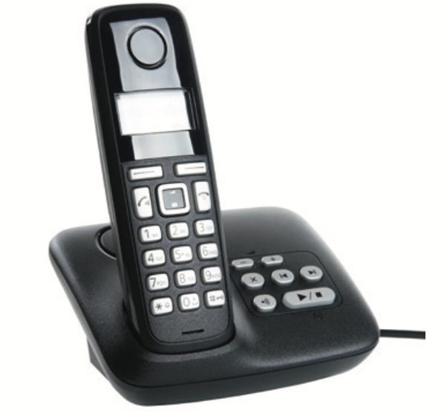
VOCABULARY – Then and Now
c
Let’s spell!
telephone
t
e
l
e
p
h
o
n
e
Students listen and repeat the word.

Slide 11
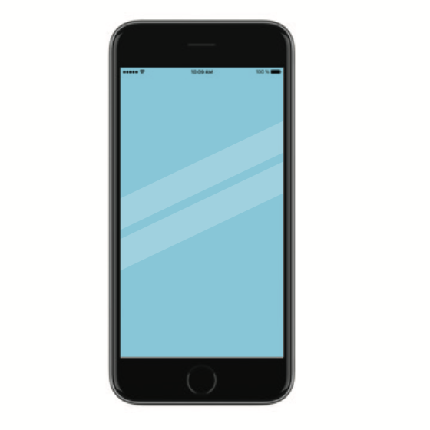
VOCABULARY – Then and Now
c
Let’s spell!
mobile phone
m
o
b
i
l
e
p
h
o
n
e
Students listen and repeat the word.

Slide 12
VOCABULARY – Then and Now
REVIEW
computer
tablet
email
letter
telephone
mobile phone
- Show picture one by one, students look and say the word.
- Show the word, students spell it again.

Slide 13
VOCABULARY – Practice
Put students work in groups of 3 or 4.
Show the slide with pictures zoomed, and then students look at and guess the corresponding words.
Raise their hands to say the answer out loud.
The fastest group that speaks clearly and correctly will receive 2 points.

Slide 15
Are you ready?

Slide 16
What is this?

Slide 17
tablet

Slide 18
What is this?

Slide 19
email

Slide 20
What is this?

Slide 21
telephone

Slide 22
What is this?

Slide 23
computer

Slide 24
What is this?

Slide 25
letter

Slide 26
What is this?

Slide 27
mobile phone

Slide 28
Good job!

Slide 29
STRUCTURE – Pupils’ book (p.71)
Have students look at the picture on page 71.
Put in pairs to describe a word from Activity 1 and then switch roles to describe and guess.
Then, open the bubbles speech on the next slide to see the example.

Slide 30
STRUCTURE – Pupils’ book (p.71)
EXAMPLE
A telephone?
I’ve got this thing at home.
I use it to call my mom.
Yes!
Invite some pairs to present in front of the class. Give points if they have good conversation.

Slide 31
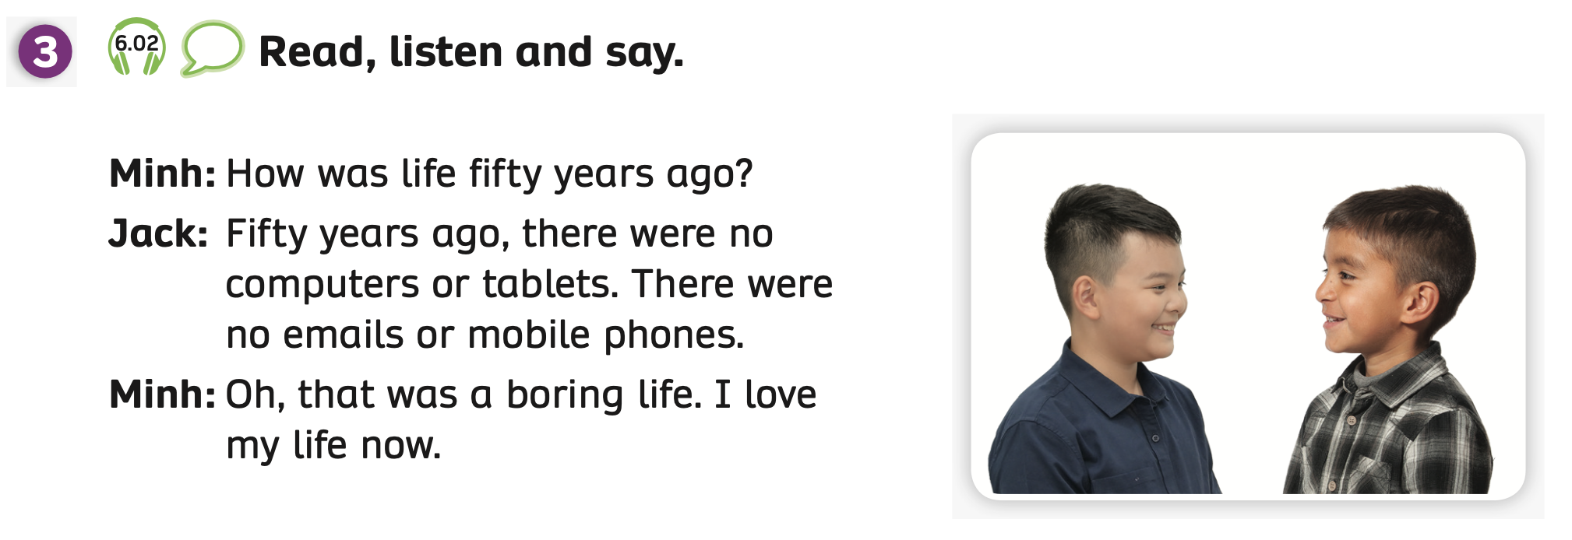
STRUCTURE – Pupils’ book (p.71)
Have students look at the conversation and read it.
Play the audio, students listen to the dialogue.
Then, put students in pairs to play roles ask and answer the dialogue.

Slide 32
PRODUCTION
30 years ago, there were no tablets.
Put students work in pairs and have them ask/answer the questions: “How was life 30 years ago?”. Then switch roles.
Invite some pairs to present in front of the class. Give points if they give a good dialogue.

Slide 33
PRODUCTION
EXAMPLE
How was life 30 years ago?
30 years ago, there were no tablets.
Invite some pairs to present in front of the class. Give points if they have good conversation.

Slide 34
HOMEWORK
Review vocabulary and grammar.
Do exercises in the Activity book (page 54).
Check answers in the Teacher’s book (page 120) or Active Teach.

Slide 35
UNIT 6 – Lesson 1
We’ve learned…
- To correctly read and pronounce words related to electrical devices.
- To describe electrical devices.
- To use the structures; How was life 30 years ago?
- PB p.71
- AB p.54

