Slide 1

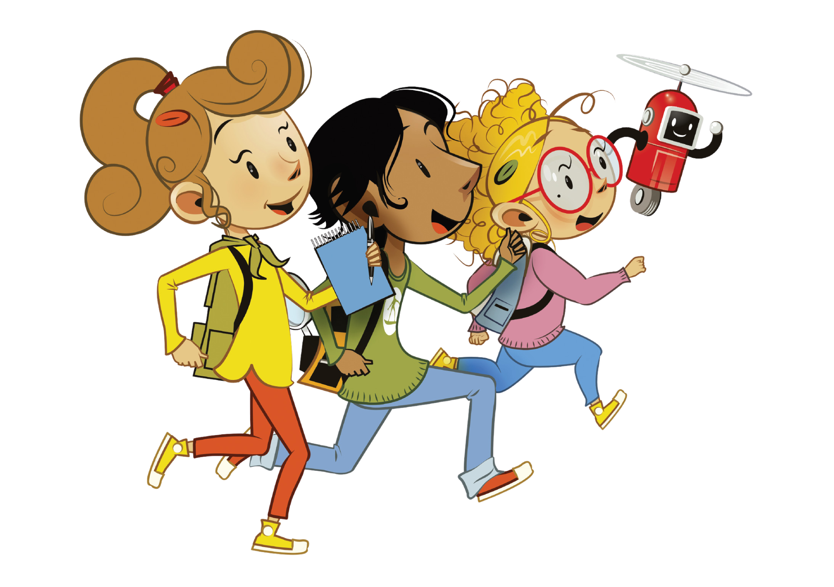

UNIT 6 – THEN AND NOW
Lesson 3A – Vocabulary And Grammar 1

Slide 2
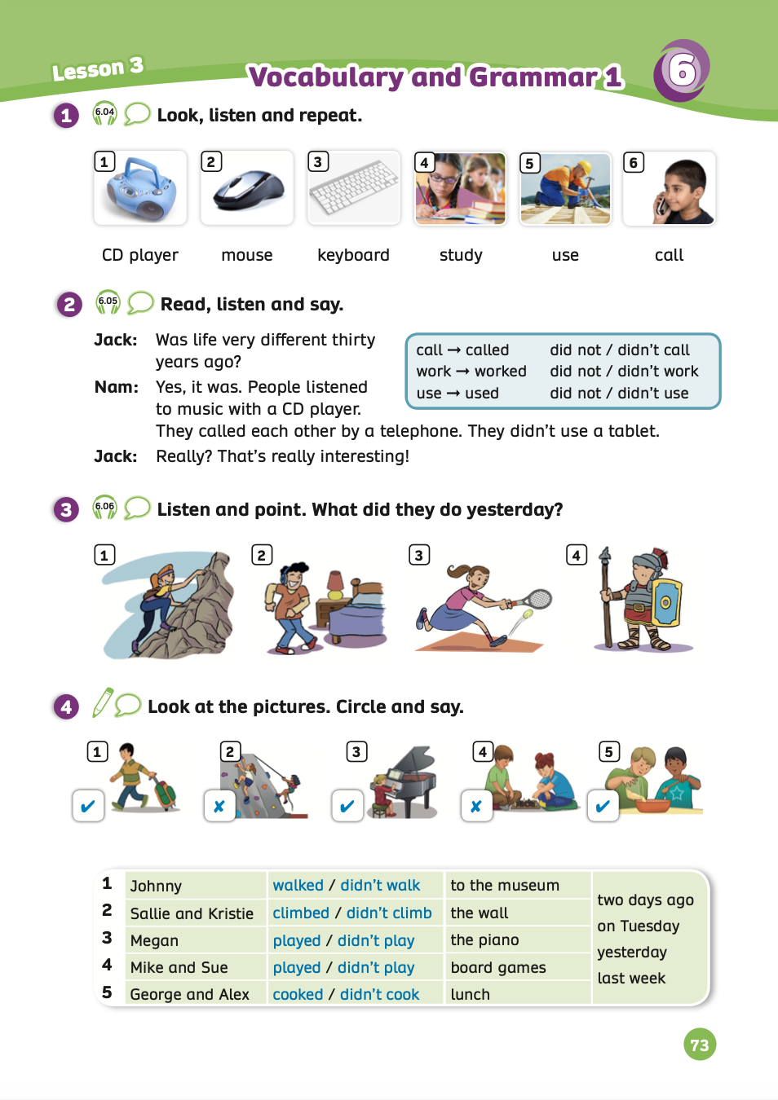
UNIT 6 – Lesson 3A
We’re learning…
- To form simple past tense of regular verbs.
- To use the structures: People listened to music with a CD player.
They called each other by telephone.
They didn’t use a tablet.
- PB p.73
- AB p.56

Slide 3

WARM-UP ACTIVITY
Activity: QUIZ GAME
Divide the class into groups of 3 or 4. Takes out a mini-board
Show the slide with pictures about learned vocabulary, then students look at and write the correct answer on the board.
After finishing, they raise the board to check.
The fastest group with all correct answers receives 2 points.

Slide 4
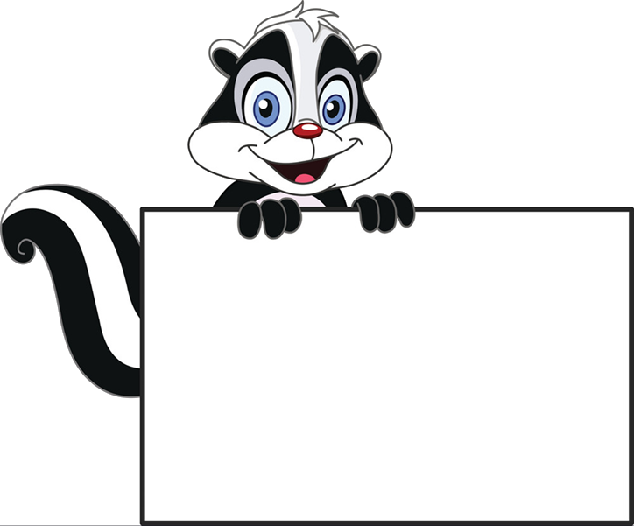

QUIZ GAME

Slide 5
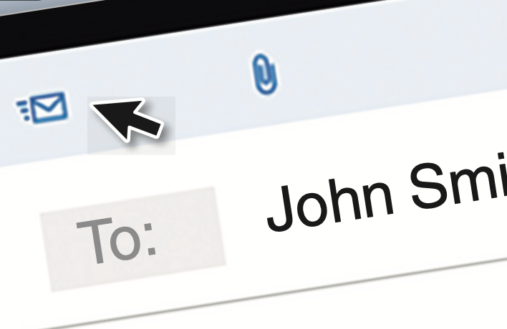

Read and tick
a
computer
b
tablet
c
email

Slide 6
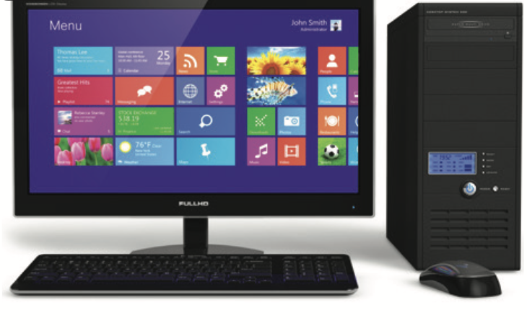
Read and tick
a
computer
b
mobile phone
c
letter

Slide 7
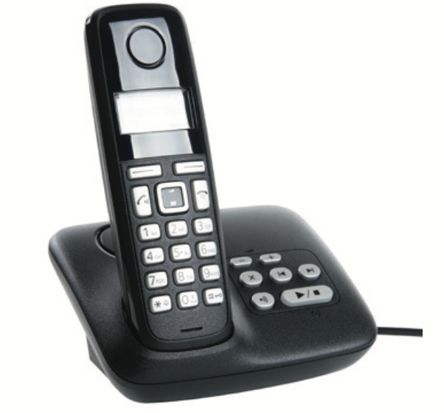
Read and tick
a
letter
b
email
c
telephone

Slide 8

Read and tick
a
tablet
b
computer
c
letter

Slide 9
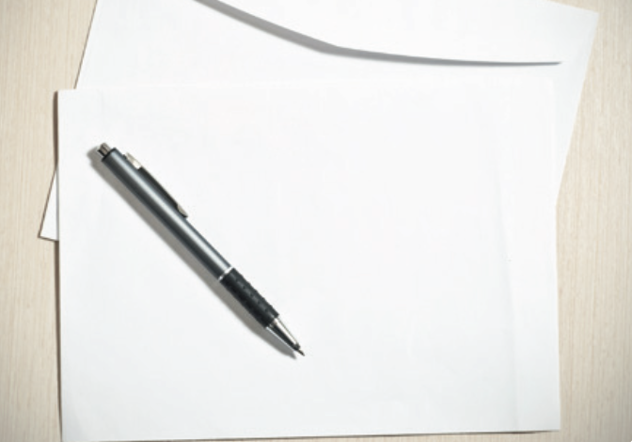
Read and tick
a
mobile phone
b
letter
c
email

Slide 10
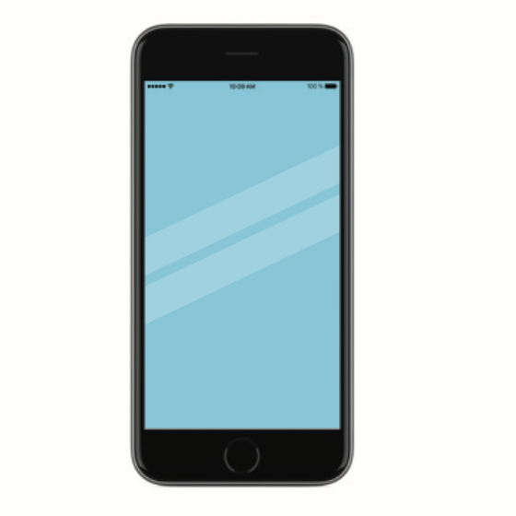
Read and tick
a
email
b
tablet
c
mobile phone

Slide 11

GOOD JOB!

Slide 12

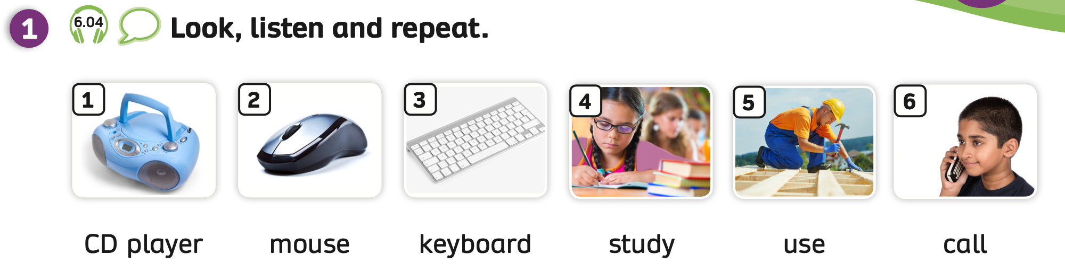
VOCABULARY – Then and Now
- Play the audio, students listen and repeat the words.

Slide 13
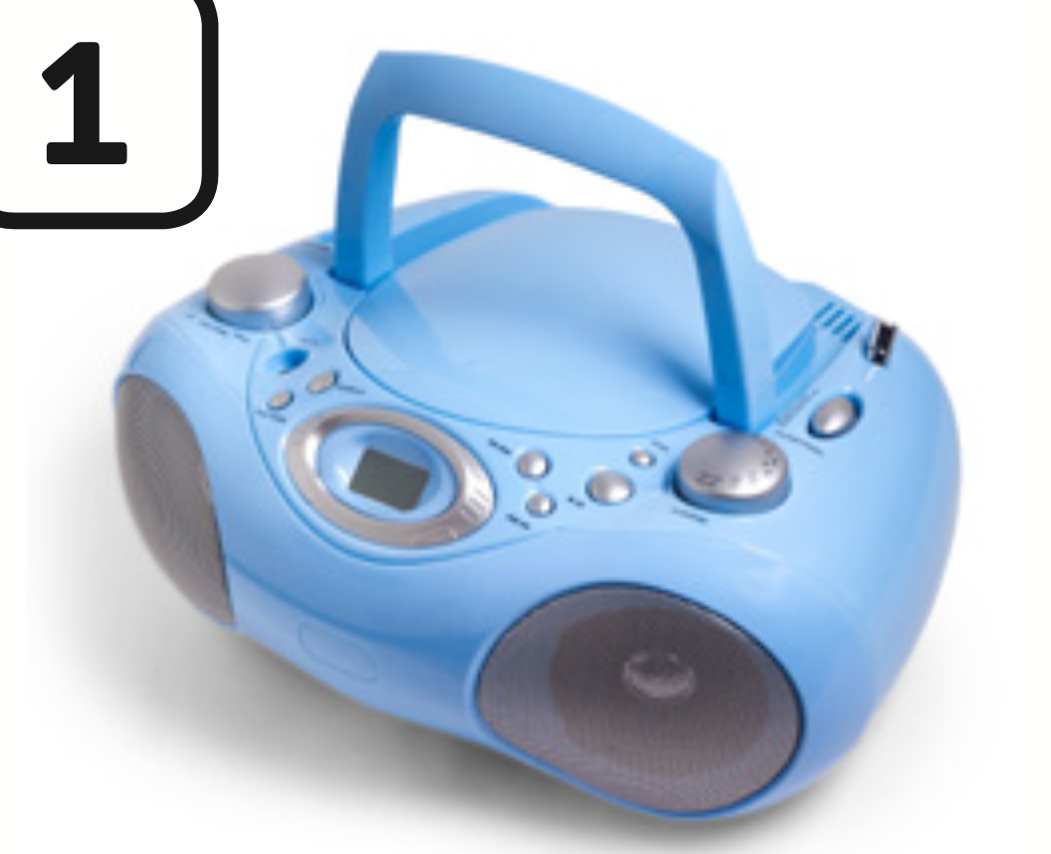


VOCABULARY – Then and Now
Let’s spell!
c
CD player
C
D
p
l
a
y
e
r
Students listen and repeat the word.

Slide 14
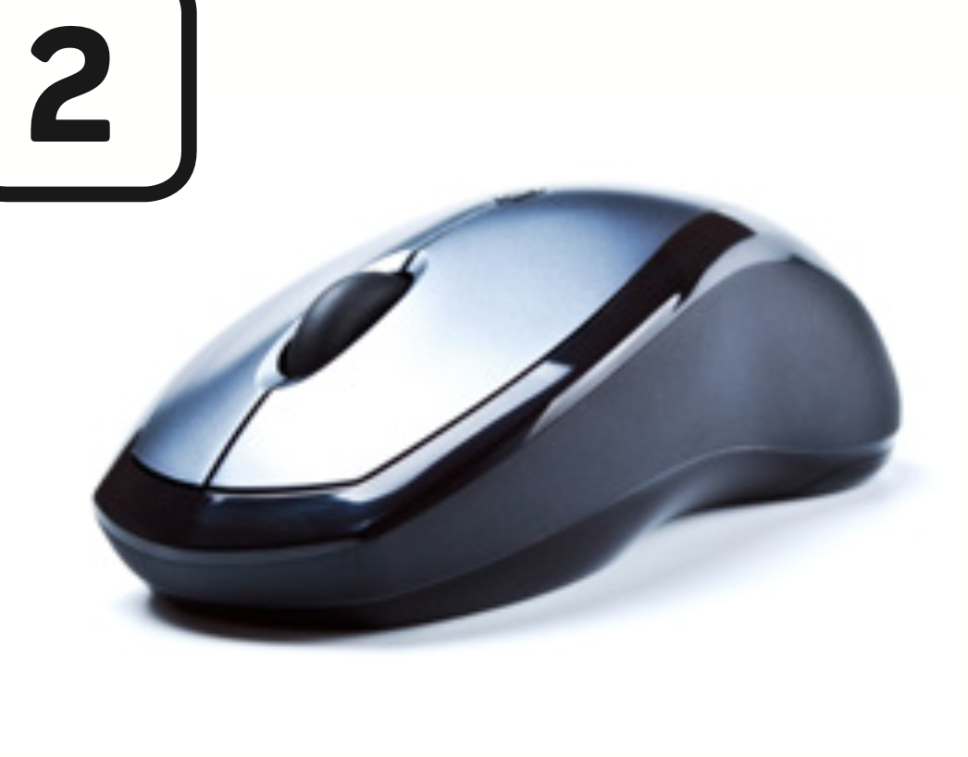
VOCABULARY – Then and Now
c
Let’s spell!
mouse
m
o
u
s
e
Students listen and repeat the word.

Slide 15

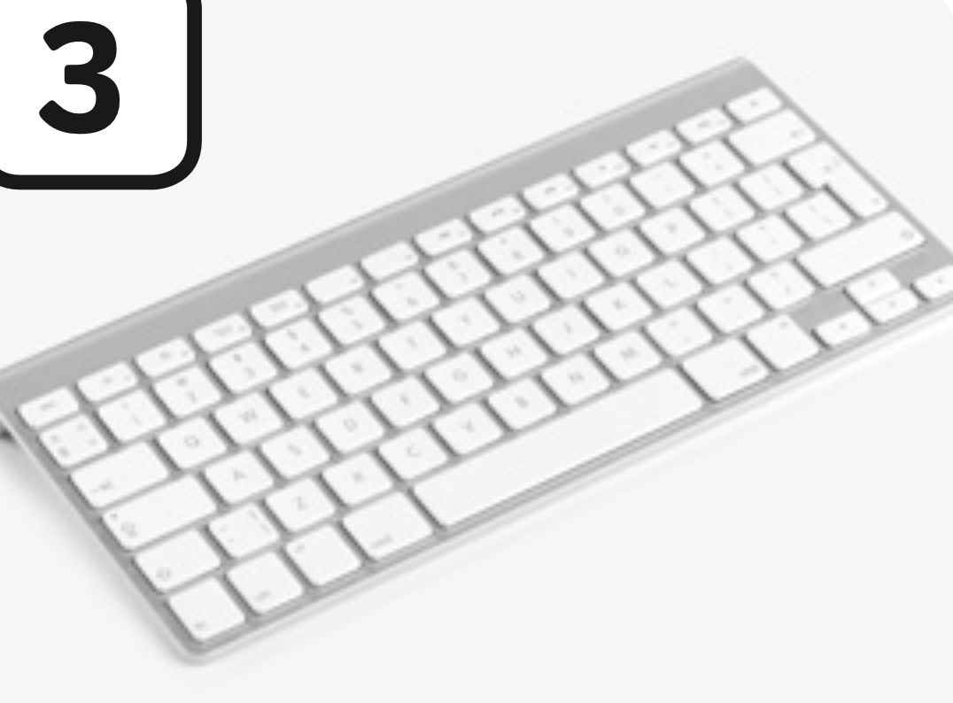
VOCABULARY – Then and Now
c
Let’s spell!
keyboard
k
e
y
b
o
a
r
d
Students listen and repeat the word.

Slide 16
VOCABULARY – Then and Now
Let’s spell!
c
study
s
t
u
d
y
Students listen and repeat the word.

Slide 17


VOCABULARY – Then and Now
Let’s spell!
c
use
u
s
e
Students listen and repeat the word.

Slide 18
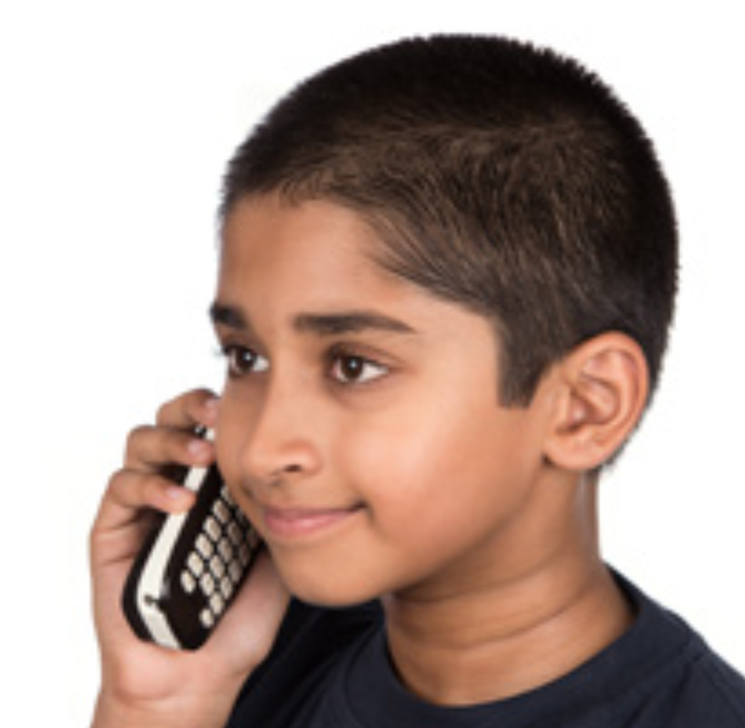
VOCABULARY – Then and Now
Let’s spell!
c
call
c
a
l
l
Students listen and repeat the word.

Slide 19
VOCABULARY – REVIEW
CD player
mouse
keyboard
study
use
call
- Show picture one by one, students look and say the word.
- Show the word, students spell it again.

Slide 20

VOCABULARY PRACTICE
Divide the class into groups of 3 or 4. Each group takes out a mini-board.
Show the slide with sentences, they look at them and write the correct answer on the board.
After finishing, they raise the board to check.
The fastest group with all the correct answers receives 2 points.

Slide 21



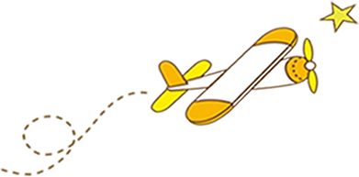

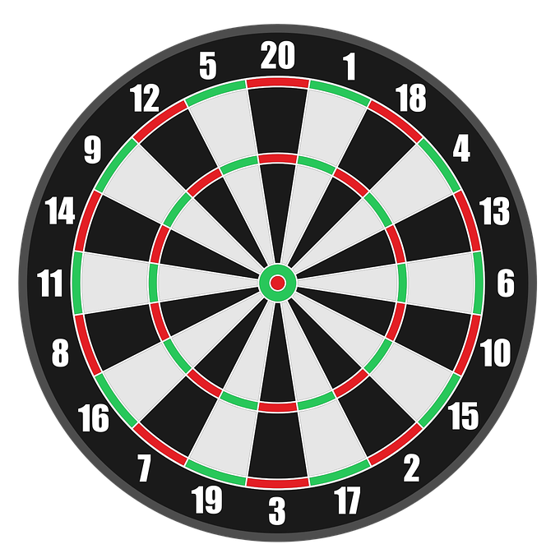
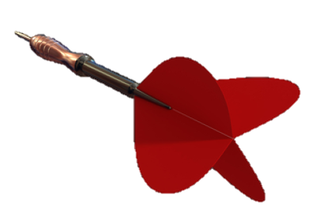
Luật chơi: Bạn có 5s để suy nghĩ và
trả lời các câu hỏi.
Trả lời đúng, mũi tiêu tương ứng trúng đích bạn nhận được điểm tương ứng vị trí mũi tiêu.
Trả lời sai, mũi tiêu rơi xuống hoặc không trúng đích và không có điểm.
PLAY

Slide 22
There were no _______.
+50
keyboards
keyboard
an keyboard
Next
Abc.xyz789

Slide 23
They _____ each other
by a telephone in
the past.
+50
called
calls
calling
Next
Abc.xyz789

Slide 24
People didn’t _____
a tablet.
+25
used
use
to use
Next
Abc.xyz789

Slide 25
There were no
_______ 20 years ago.
+25
amouse
mouse
mouses
Next
Abc.xyz789

Slide 26
She ______ English
yesterday.
+25
studied
studies
study
Next
Abc.xyz789

Slide 27
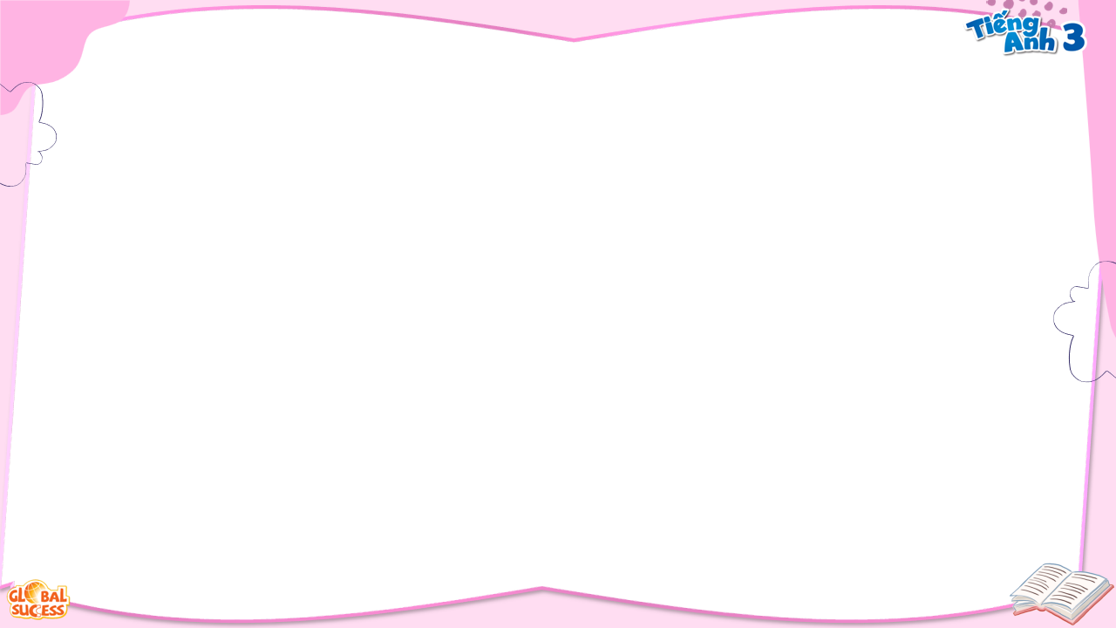
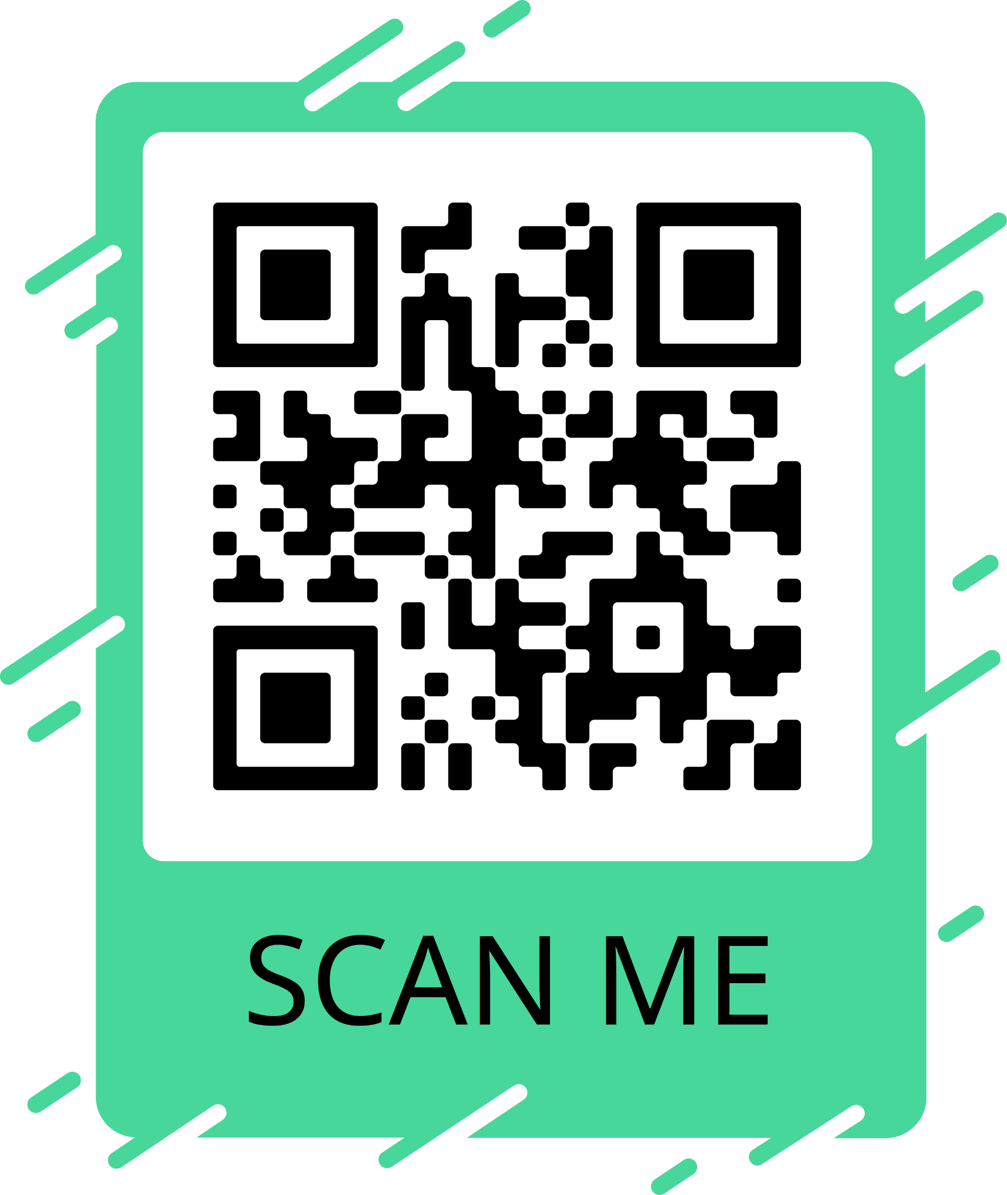
People listened to
music with a ________.
+25
Audio
CD player
Cassette
Next
Abc.xyz789

Slide 28
WELL DONE!
EXIT

Slide 29
PRODUCTION
CD player
mouse
keyboard
study
use
call
- Show picture one by one, students look and say the word.
- Show the word, students spell it again.

Slide 30

HOMEWORK
Review vocabulary and grammar.
Do exercises in the Activity book (page 56).
Check answers in the Teacher’s book (page 124) or Active Teach.

Slide 31
UNIT 6 – Lesson 3A
We’ve learned…
- To form simple past tense of regular verbs.
- To use the structures: People listened to music with a CD player.
They called each other by telephone.
They didn’t use a tablet.
- PB p.71
- AB p.56

