Slide 1
UNIT 6 – THEN AND NOW
Lesson 5B – Vocabulary And Grammar 2

Slide 2
UNIT 6 – Lesson 5B
We’re learning…
- To review the vocabulary.
- To use the Yes - No Question form of Simple past tense with regular verbs.
- PB p.75
- AB p.58

Slide 3
WARM-UP ACTIVITY
Divide the class into 2 teams.
Each team chooses any numbers from 1 to 10 to open the questions.
Then, students raise their hands to answer.
The correct answer will get points on the screen.
After finishing, the team with the highest point in the game receives 2 points.

Slide 4
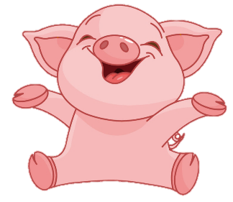
Rules:
Teams take turns choosing numbers from 1-10.
Correct answers are added, and wrong answers are deducted from the opened points.
The box with the blue star gets +200 points.
The box with the black star has -200 points.
Lucky number
PLAY

Slide 5
2
100
200
4
1
100
-200
3
100
7
5
6
+200
200
8
100
100
9
10
200

Slide 6
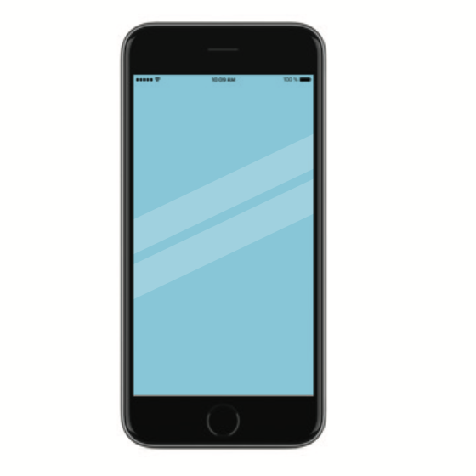
Choose the best answer
There are no
mobile phone.
There was no mobile phone.
There were no mobile phone.

Slide 7
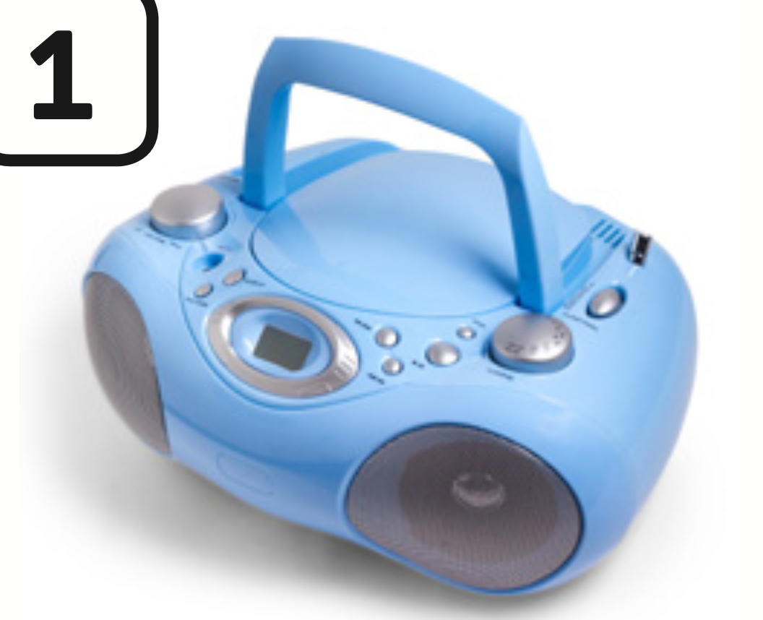
Choose the best answer
They listens to music with a CD player.
They listened to music with a CD player.
They listenes to music with a CD player.

Slide 8
Choose the best answer
She didn’t used tablet last week.
She didn’t uses tablet last week.
She didn’t use tablet last week.

Slide 9
Choose the best answer
They visited the museum yesterday.
They visitted the museum yesterday.
They visit the museum yesterday.

Slide 10
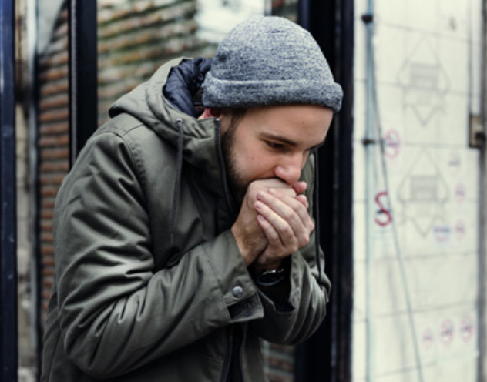
Choose the best answer
He need warm clothes.
He needed
warm clothes.
He needes
warm clothes.

Slide 11
Choose the best answer
They loves
this country.
They likes
this country.
They liked
this country.

Slide 12
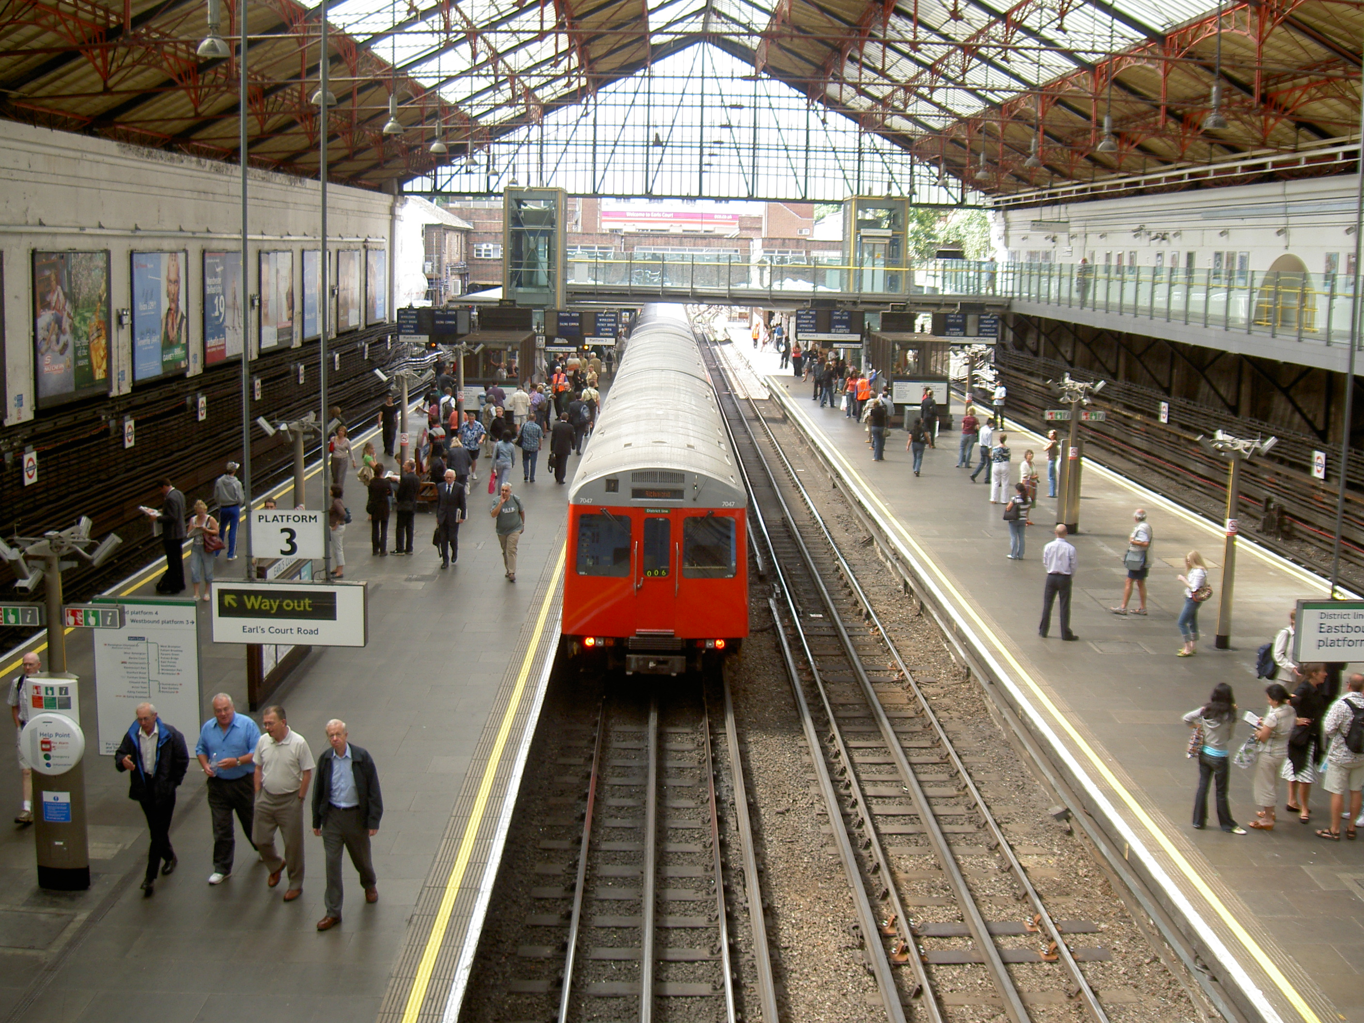
Choose the best answer
She arrivees at
train station.
She arrive at
train station.
She arrived at
train station.

Slide 13
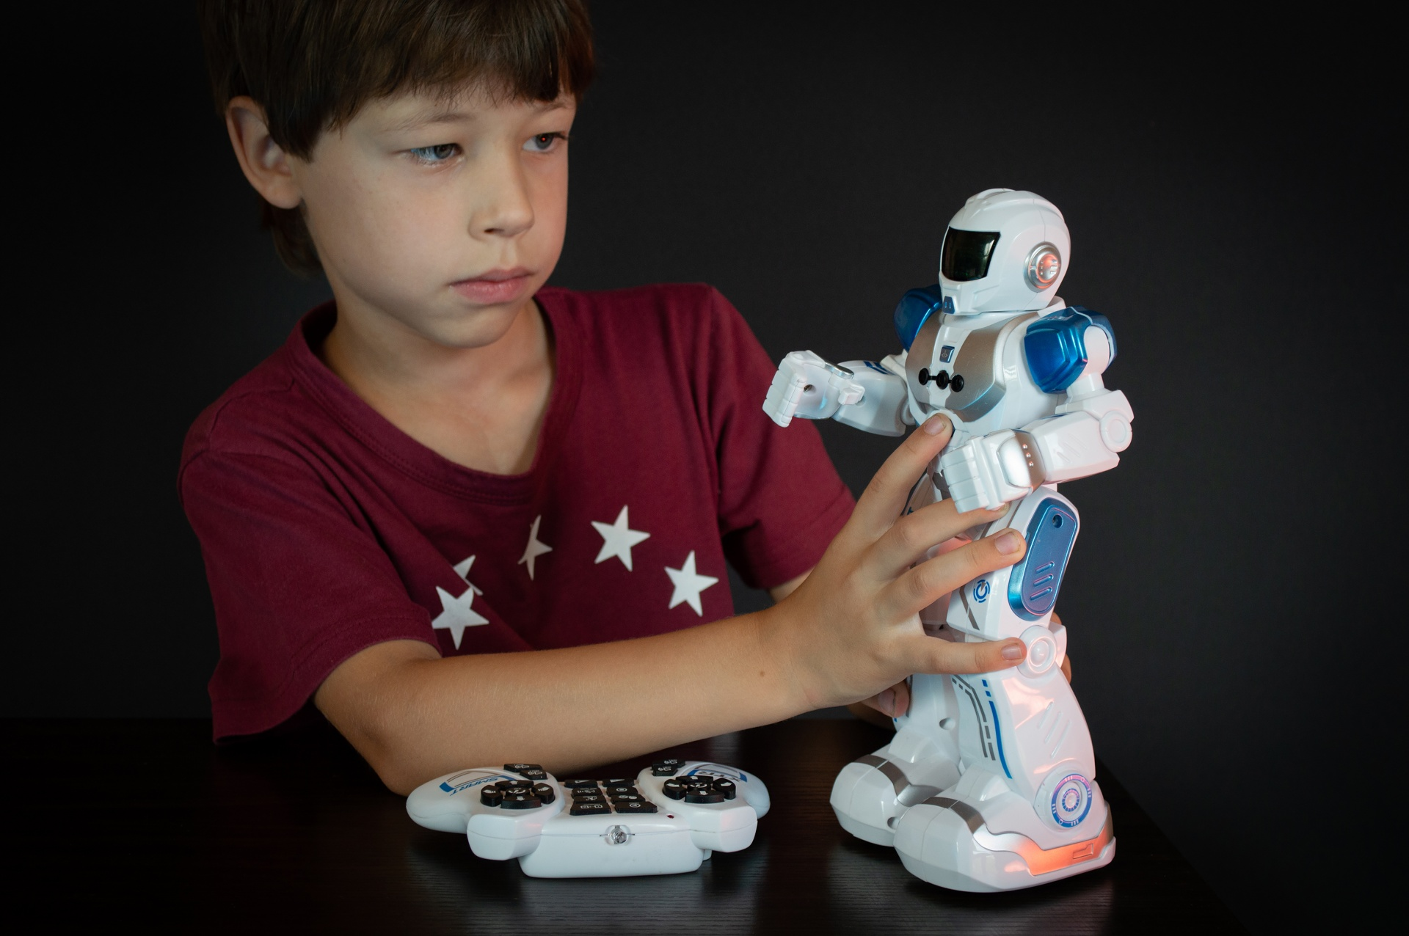
Choose the best answer
He had a robot yesterday.
He have a robot yesterday.
He has a robot yesterday.

Slide 14
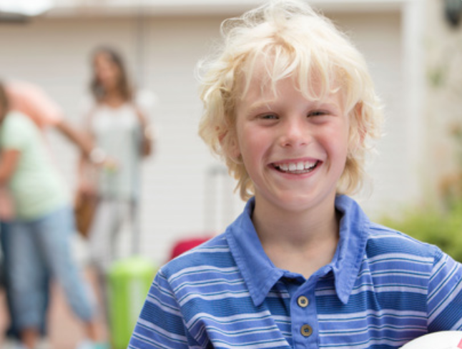
VOCABULARY REVIEW
1
2
3
c
c
c
live
arrive
visit
The teacher says a number and the students say a word.
Click on “Number” to show the word to check.

Slide 15
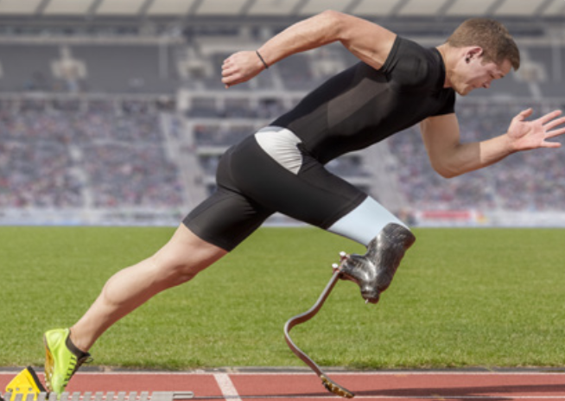
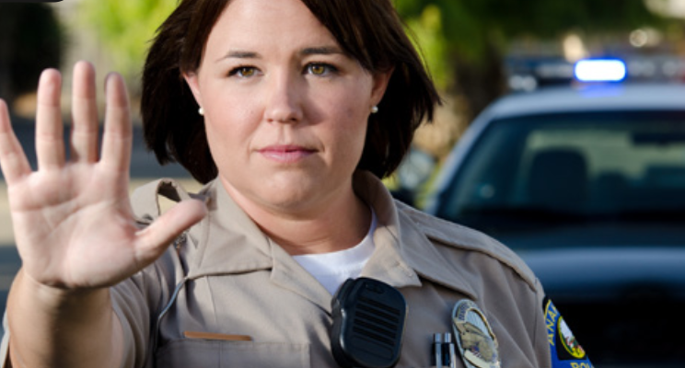
VOCABULARY REVIEW
4
5
6
c
c
c
start
stop
need
The teacher says a number and the students say a word.
Click on “Number” to show the word to check.

Slide 16
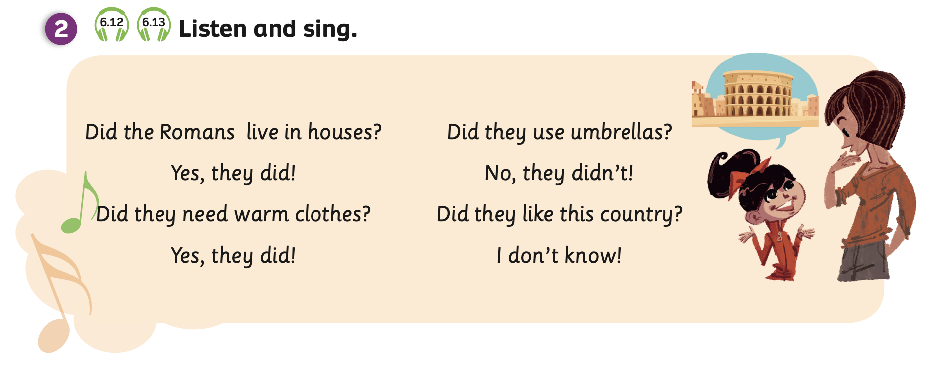
GRAMMAR – Pupils’ book (p.75)
Listen
Look at the song and read it.
Listen to the song.

Slide 17
GRAMMAR – Pupils’ book (p.75)
Sing
Play the song for students to sing along.

Slide 18
GRAMMAR – Pupils’ book (p.75)
Look at Activity 3 on page 75.
Listen and repeat.

Slide 19
GRAMMAR
STRUCTURE – SENTENCES
How to make questions in the past simple
Did + S + V_inf + O?
Yes, S + did.
No, S + didn’t.

Slide 20
GRAMMAR PRACTICE
Did + S + V_inf + O?
Did Lily do homework yesterday?
Yes, she did.
Lily

Slide 21
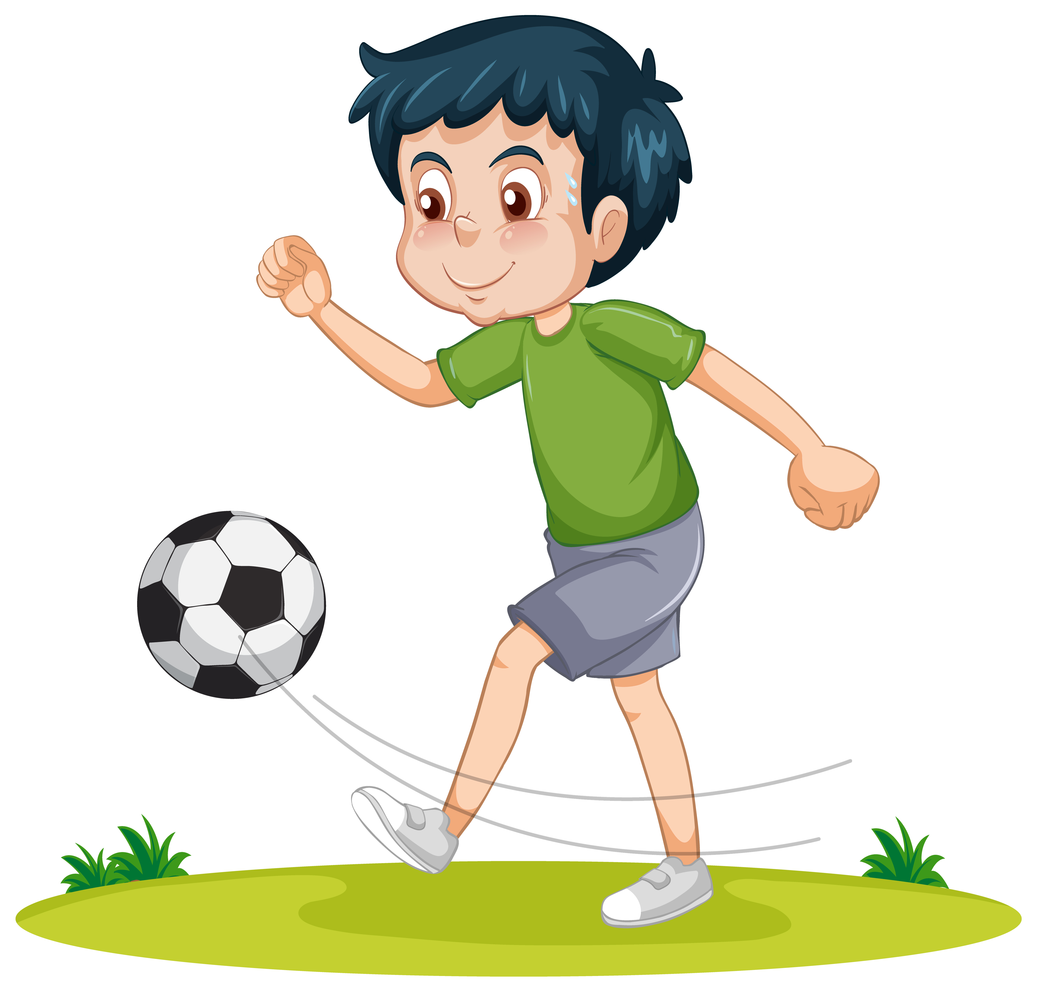
GRAMMAR PRACTICE
Did + S + V_inf + O?
Did Jimmy play football last week?
No, he didn’t.
Jimmy

Slide 22
GRAMMAR PRACTICE
Divide the class into groups of 4 to 6 students.
The teacher prepares 8 phrase cards from Activity 4 and each member from the groups will take one card.
Then, students ask and answer in their group about cards with the structure: “Did + S + V_inf + O?”
After finishing, teacher invites some groups to present in front of the class and give them 2 points if they speak clearly and correctly.

Slide 23
GRAMMAR PRACTICE
listen to music
live in a castle
play board games
start school
like vegetables
dress up
use a pencil to write
work in an office
Did you start school?
Did you live in a castle?
No, I didn’t.
Yes, I did.

Slide 24
GRAMMAR PRACTICE
Look at Activity 4.
Work in groups of 3 or 4 to ask and answer with the structure: “Did + S + V_inf + O?”

Slide 25
GRAMMAR PRACTICE
Did you like vegetables?
Yes, I did.
Did you dress up?
No, I didn’t.
Look at Activity 4.
Work in groups of 3 or 4 to ask and answer with the structure: “Did + S + V_inf + O?”

Slide 26
PRODUCTION
They used a telephone to call each other.
visit
robot
letter
need
Did you build a robot?
telephone
music
live
email
use
arrive
Work in groups of 3 or 4 and write about 3-4 learned vocabulary on paper.
Then, each pair invites any pairs in class to take one word and make sentences with it.
Switch roles to practice.

Slide 27
HOMEWORK
Review vocabulary and grammar.
Do exercises in the Activity book (page 58).
Check answers in the Teacher’s book (page 129) or Active Teach.

Slide 28
UNIT 6 – Lesson 5B
We’ve learned…
- To review the vocabulary.
- To use the Yes - No Question form of Simple past tense with regular verbs.
- PB p.75
- AB p.58

