Slide 1



UNIT 6 – THEN AND NOW
Lesson 7A – Story

Slide 2
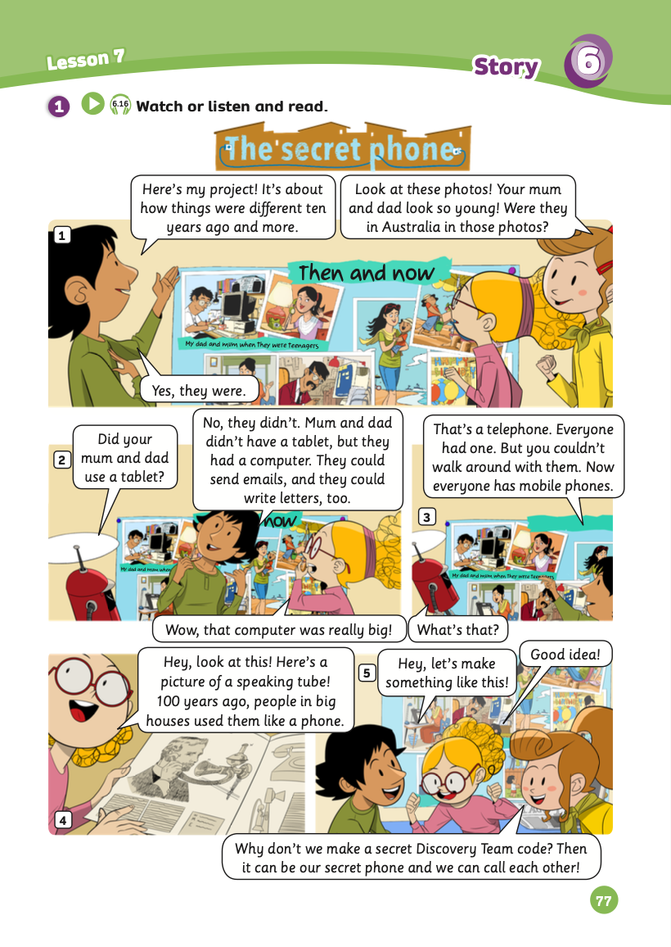
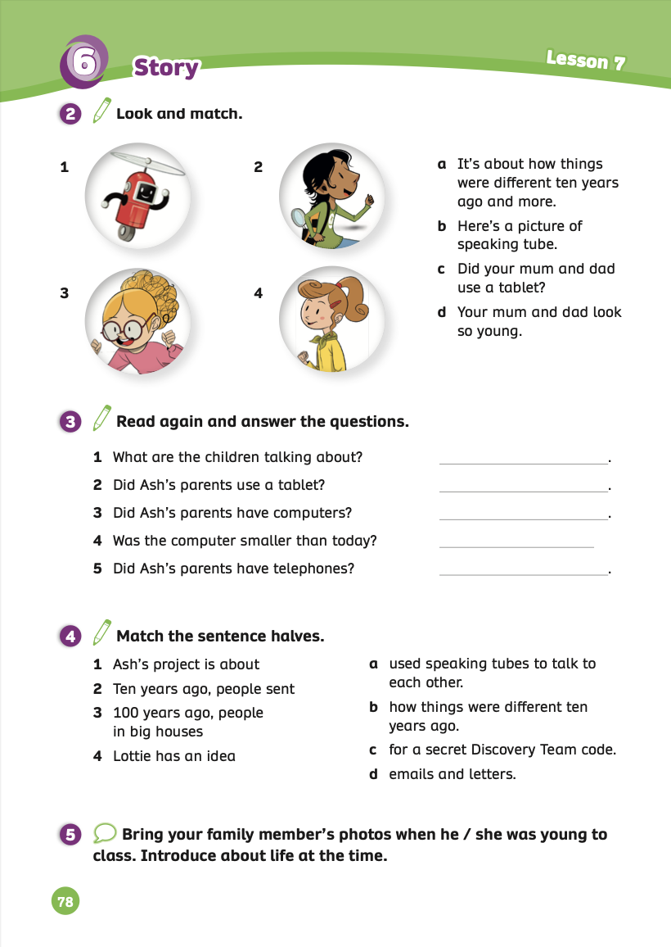
UNIT 6 – Lesson 7A
We’re learning…
- To review
- To understand simple cartoon stories
- PB p.77 & 78.
- AB p.60

Slide 3


WARM-UP ACTIVITY
Divide the class into groups of 3 or 4. Each group takes out a mini-board or a sheet of paper.
Ask students to open their books and look at the story on page 77.
Then, students find the learned vocabulary and write answers on the boards or paper.
After finishing, students raise the boards or paper to check the answers.
The fastest group with all the correct answers receives 2 points.

Slide 4
WARM-UP ACTIVITY
ANSWER
Open the books and look at the story on page 78.
Write learned vocabulary.
Click on “Answer” to check the answer.

Slide 5


STORY TIME

Slide 6

STORY TIME - INTRODUCTION
1. What’s the story title?
->
2. How many story frames?
->
3. How many characters?
->
The secret phone
5 frames
4 characters

Slide 7
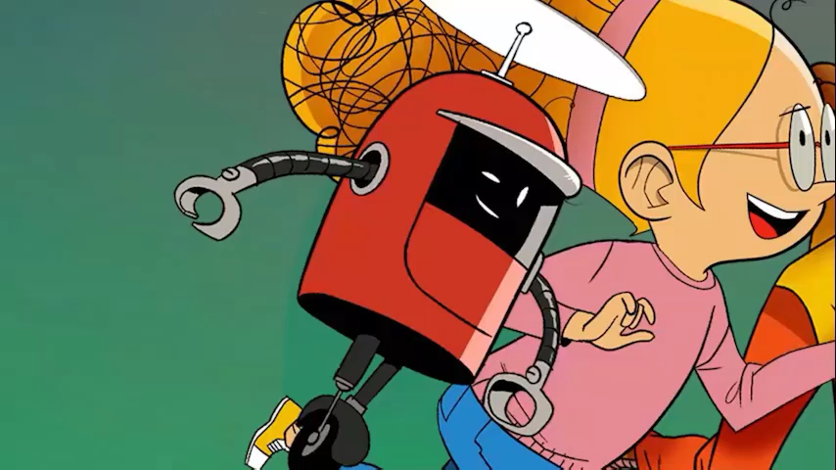
STORY TIME
Watch a video

Slide 8
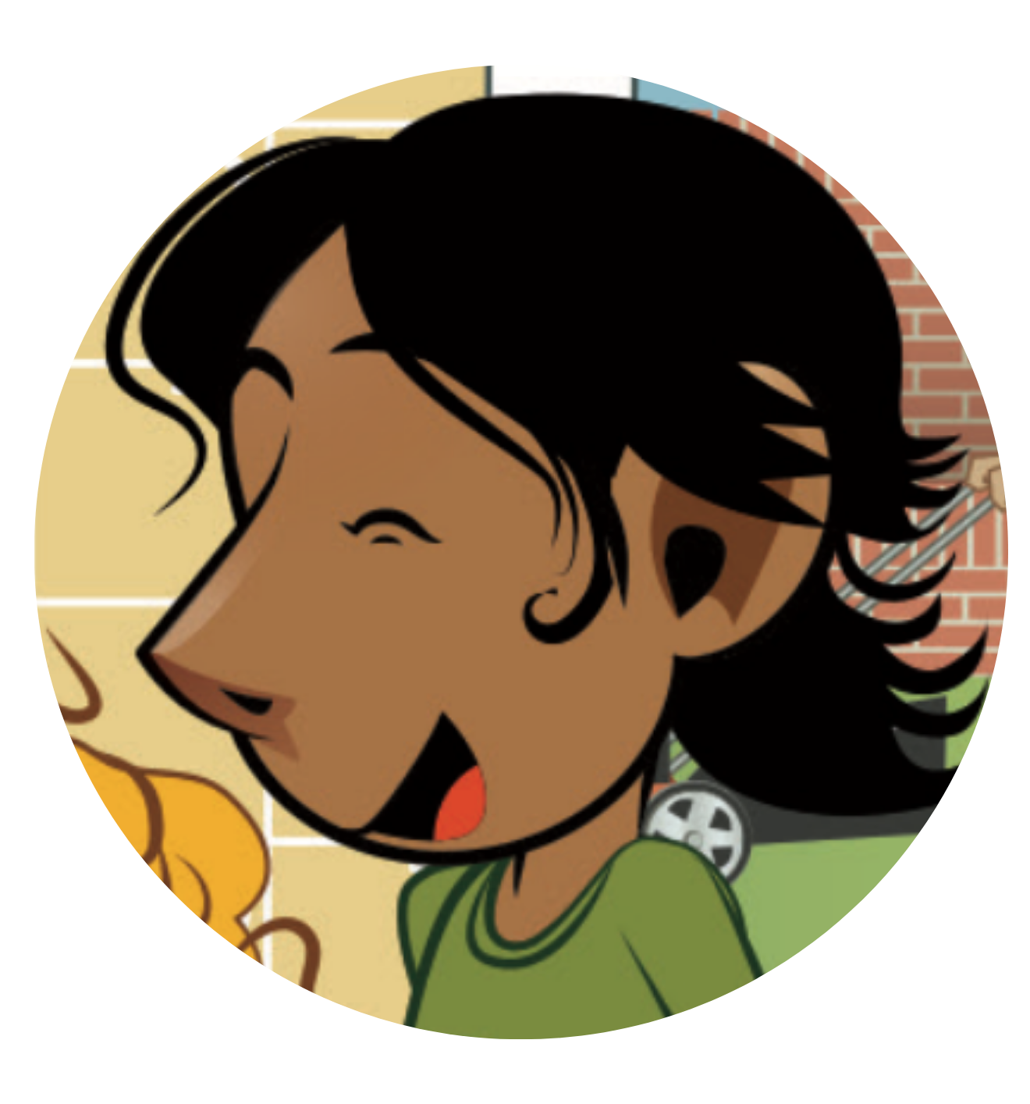

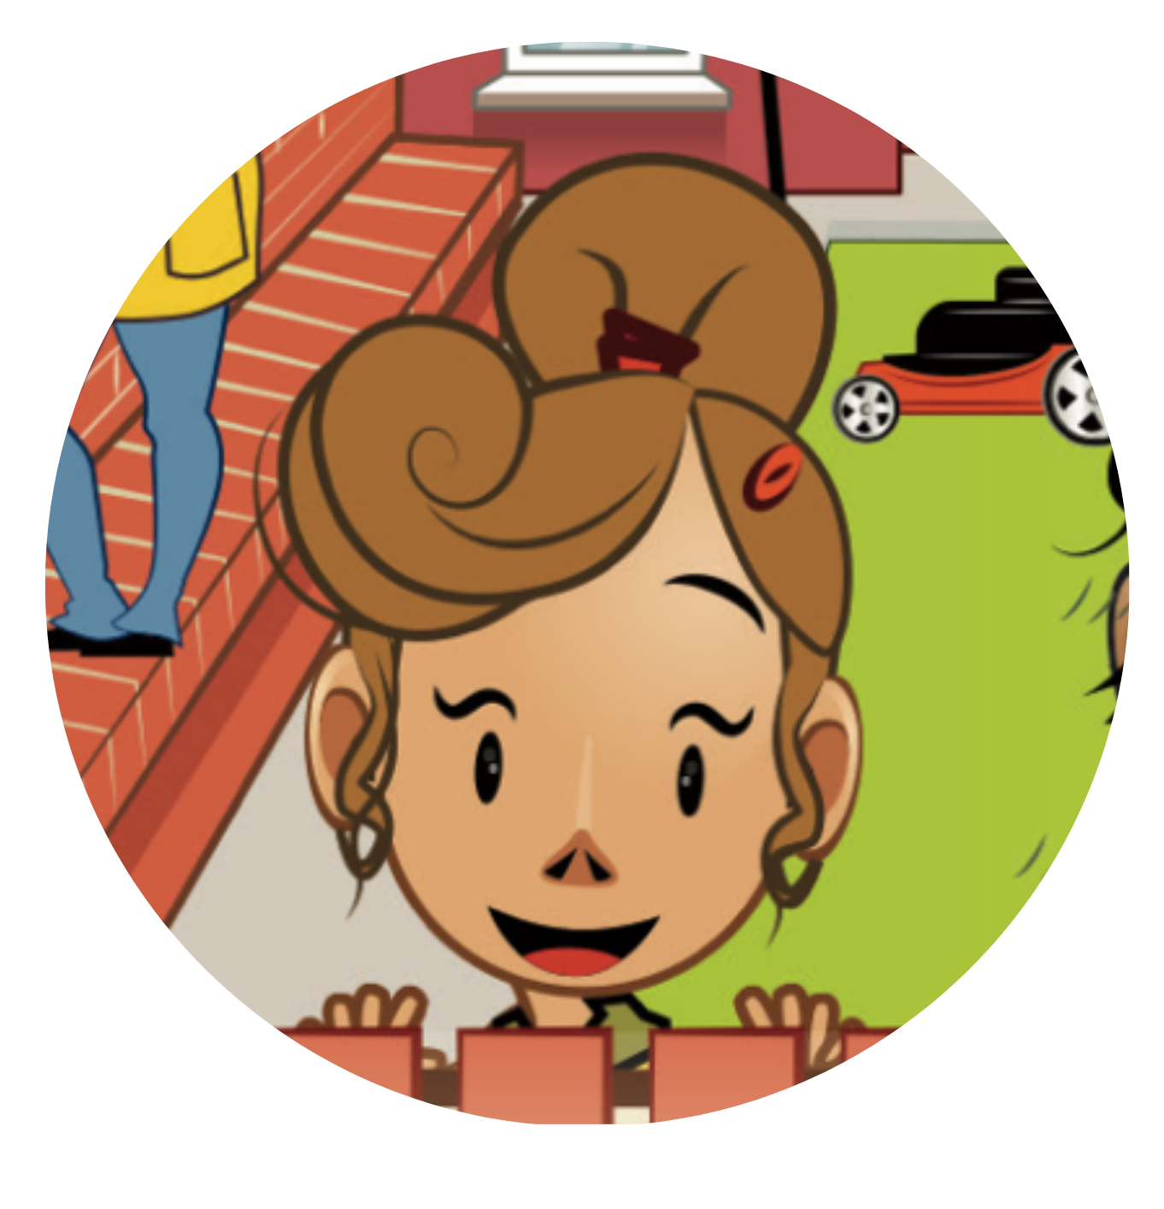

STORY TIME
CHARACTERS IN THE STORY
Ash
Lottie
Bo
Lois

Slide 9
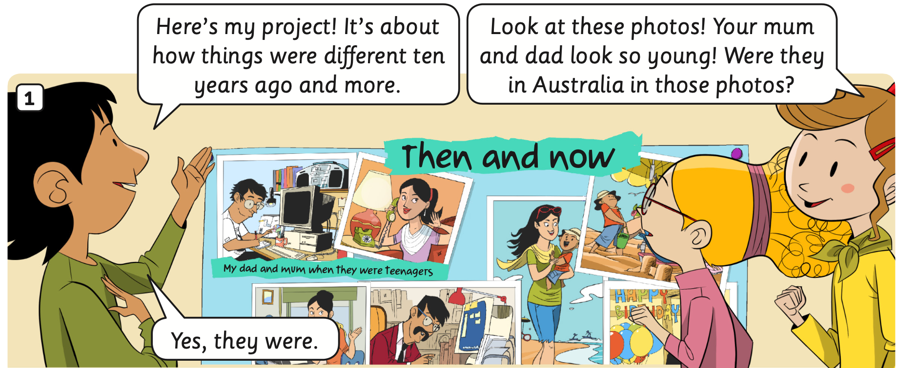

STORY TIME
Listen and point
Listen
- Look at the story and listen.

Slide 10
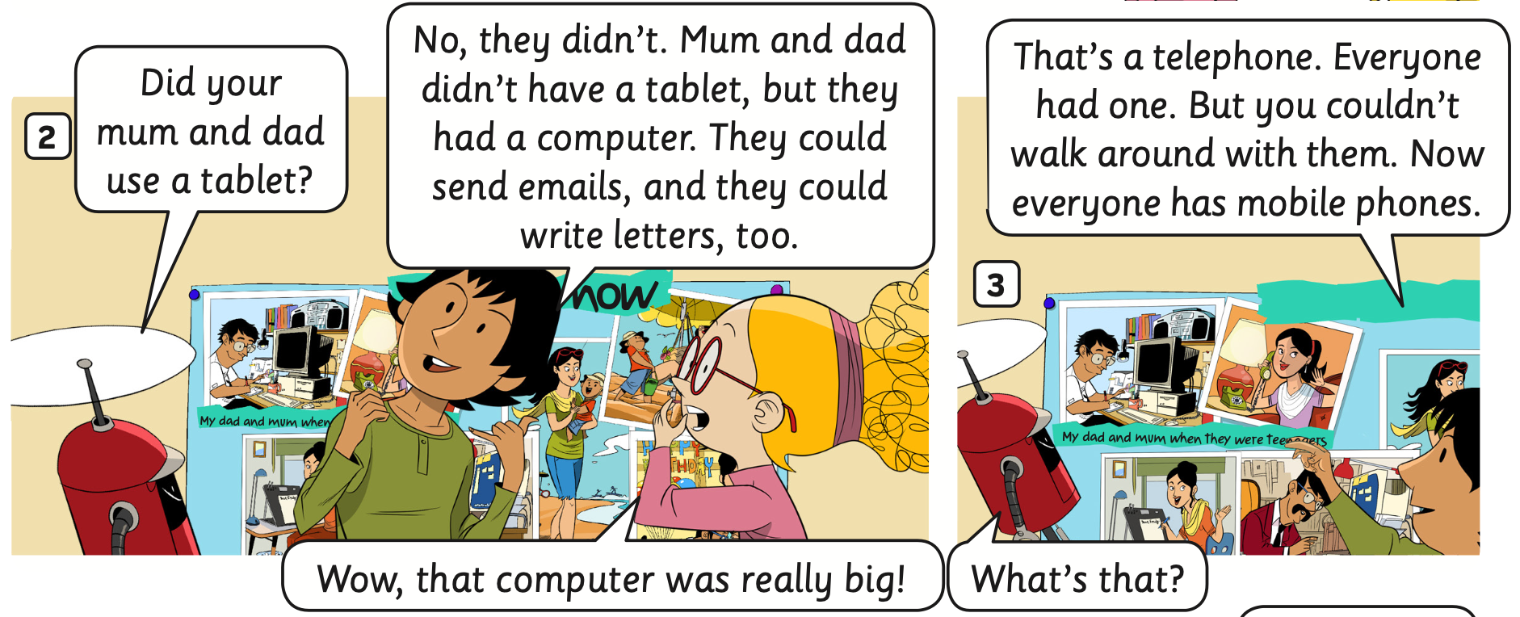
STORY TIME
Listen and point
Listen
- Look at the story and listen.

Slide 11
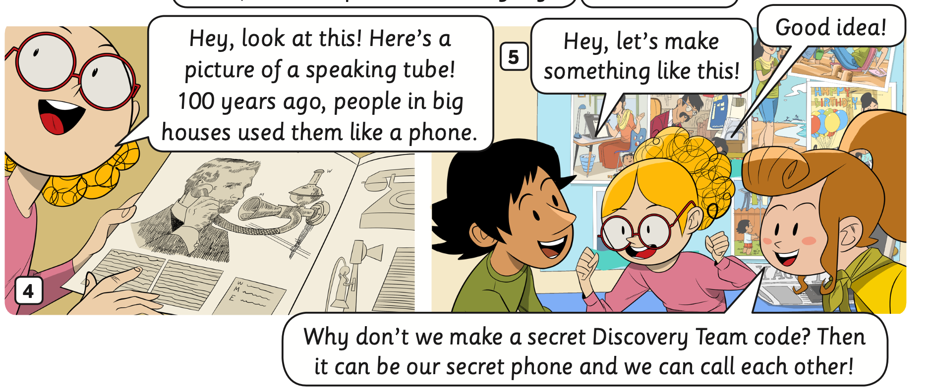
STORY TIME
Listen and point
Listen
- Look at the story and listen.

Slide 12
STORY TIME
Listen and read
1
1
2
2
3
3
- Click on each number corresponding to the character and let students listen and read aloud.
- Play the audio, students listen and read again.
- Work in groups. Students practice acting out the story.

Slide 13
STORY TIME
Listen and read
2
1
1
2
3
3
- Click on each number corresponding to the character and let students listen and read aloud.
- Play the audio, students listen and read again.
- Work in groups. Students practice acting out the story.

Slide 14
STORY TIME
Listen and read
2
1
2
1
- Click on each number corresponding to the character and let students listen and read aloud.
- Play the audio, students listen and read again.
- Work in groups. Students practice acting out the story.

Slide 15
STORY TIME
Listen and read
1
1
2
3
2
3
4
4
- Click on each number corresponding to the character and let students listen and read aloud.
- Play the audio, students listen and read again.
- Work in groups. Students practice acting out the story.

Slide 16

PUPIL’S BOOK p.78
Divide the class into groups of 3 or 4. Take out a sheet of paper
Students read the story, look and match, and then write the answers on the paper. Ex: 1-a, 2-c,...
Check the answer.
Ask students to look at the book and write the correct answers.

Slide 17
PUPIL’S BOOK p.78
Why don’t we make a secret Discovery Team code?
ANSWER
Read the story, look and match, and then write the answers on the paper. Ex: 1-a, 2-c,...
Check the answer.
Look at the book and write the correct answers.

Slide 18
PUPIL’S BOOK p.78
Activity: FINDING PIKACHU
Work in group of 4. Each pair takes out a mini-board.
Teacher clicks on each star, and students look at the questions with 3 answers and choose the correct answer by writing it on the boards. Each member takes turns writing.
After finishing, students raise the boards to check the answers.
The team with the correct answer receives a point.

Slide 19











Finding PIKACHU

Slide 20

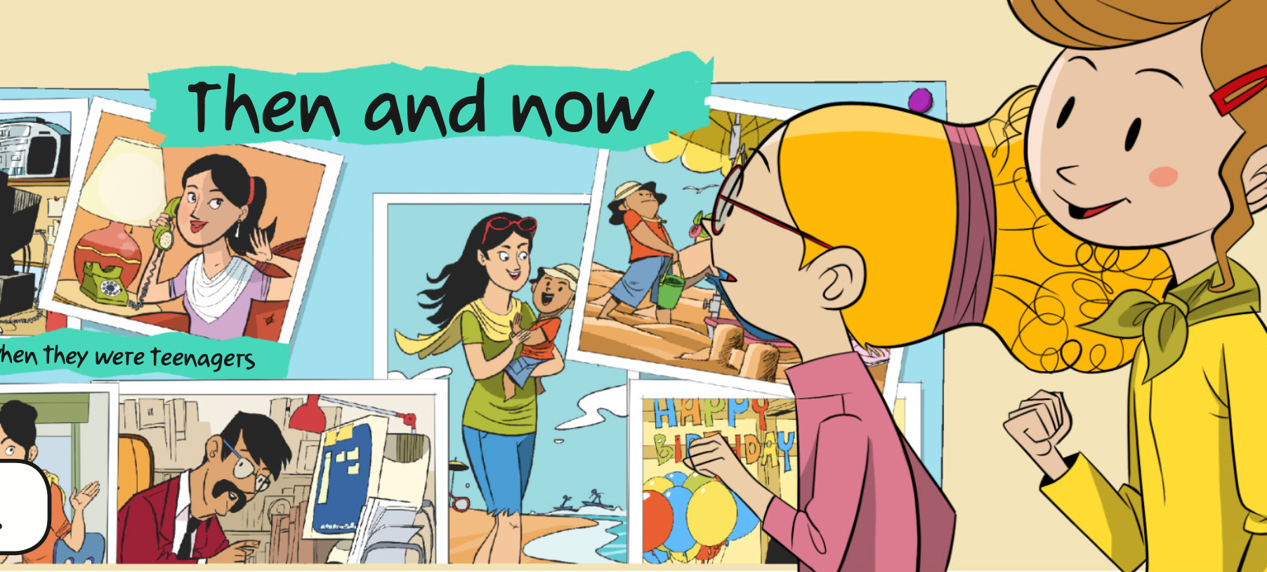


What are the children talking about?
The past
Lottie’s Mum and Dad
How things were different
10 years ago and more

Slide 21
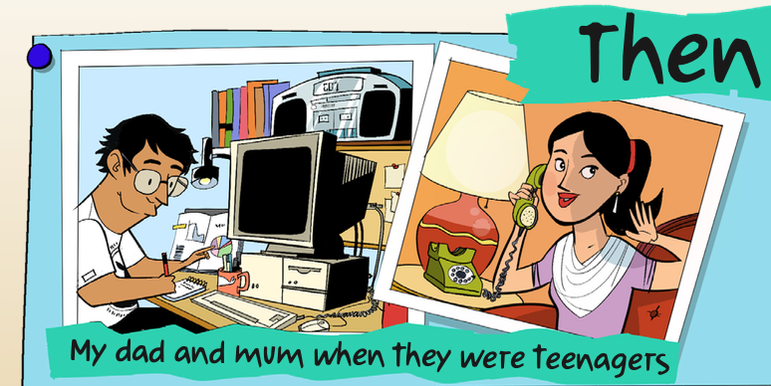
What did Ash’s Mum and Dad look like
when were young?
They looked so young.
They looked old.
They looked beautiful.

Slide 22
Did Ash’s parents use a computer?
No, they didn’t.
Yes, they did.
Yes, they didn’t.

Slide 23
Did Ash’s parents use a tablet?
No, they didn’t.
Yes, they did.
Yes, they didn’t.

Slide 24
Ash’s Mum used a _______ to call.
mobile phone
telephone
waking

Slide 25
Was the computer smaller than today?
Yes, it were.
No, it was.
No, it wasn’t.

Slide 26



Excellent!

Slide 27
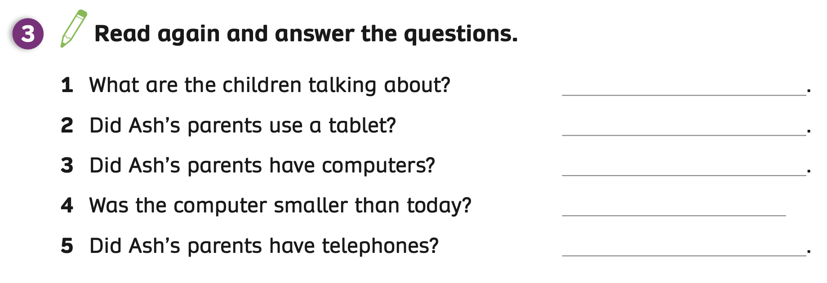
PUPILS’ BOOK p.78
The children are talking about how things were different ten years ago and more.
No, they didn’t
Yes, they did
No, it wasn’t
Yes, they did
ANSWER
Ask students to open their books and look at task 3 on page 78.
Students read the story again and answer the question.
Show the answers to check.

Slide 28
HOMEWORK
Review vocabulary and grammar.
Do exercises in the Activity Book (page 60).
Check answers in the Teacher’s book (page 133) or Active Teach.

Slide 29
UNIT 6 – Lesson 7A
We’ve learned…
- To review
- To understand simple cartoon stories
- PB p.77 & 78.
- AB p.60

