Slide 1

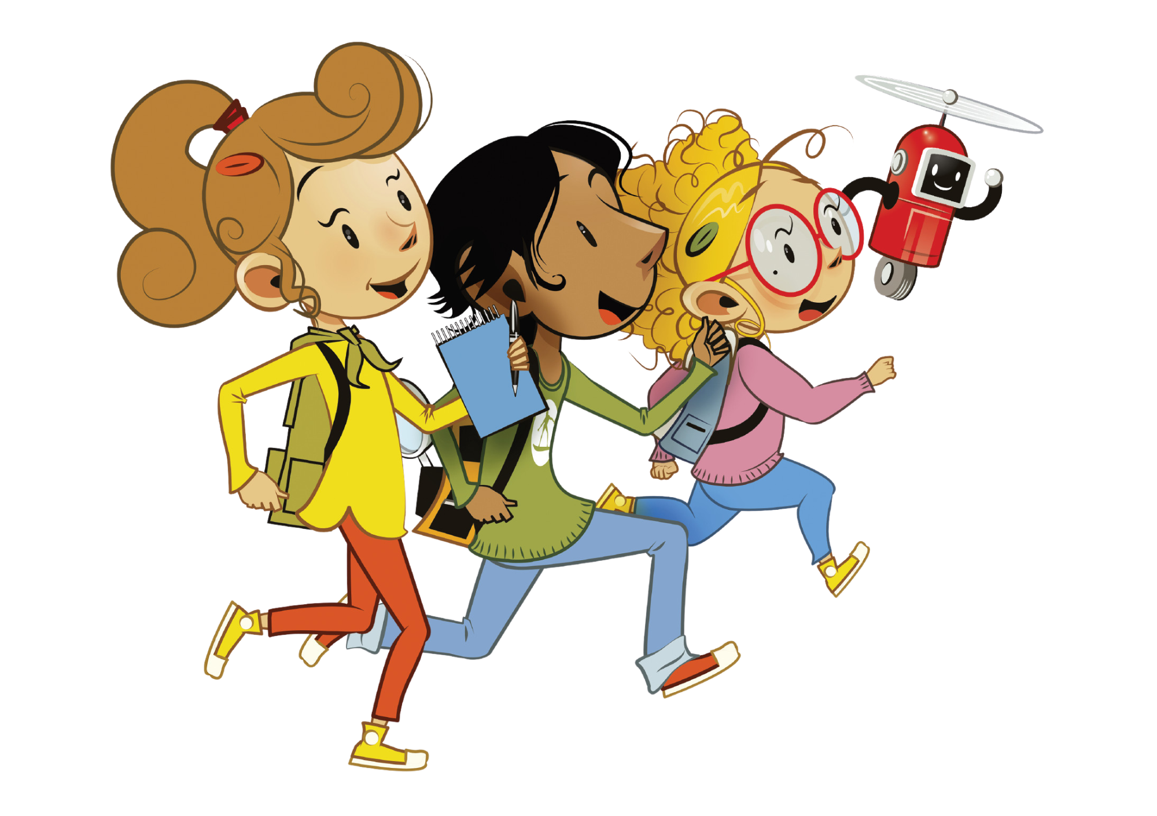

UNIT 7 – MY PARTY
Lesson 3A – Vocabulary and Grammar 1

Slide 2
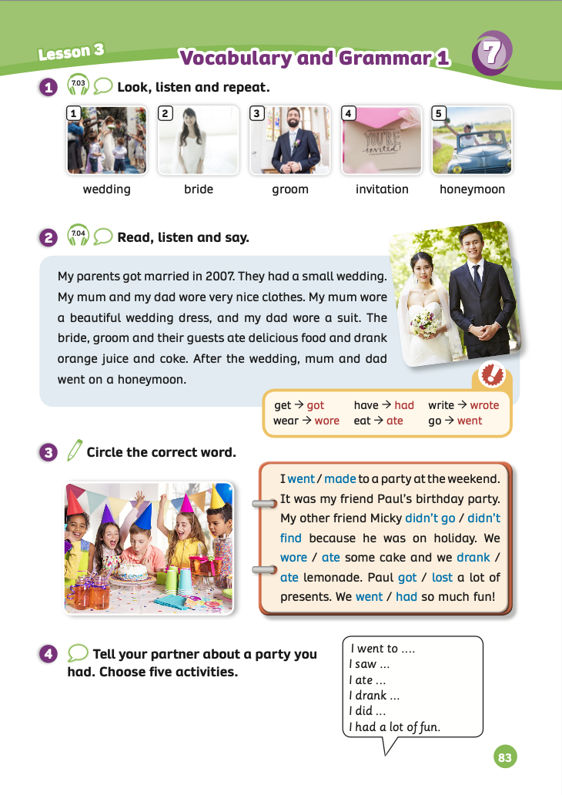
UNIT 7 – Lesson 3A
We’re learning…
To correctly read and pronounce words related to Weddings.
To introduce Simple past forms of irregular verbs.
- PB p.83
- AB p.64

Slide 3


WARM-UP ACTIVITY
- Draw 2 columns on the board: “like, dislike” and a column about words related to party in Lesson 1.
- Students take out 2 pieces of paper and write: “like or dislike” on each piece.
- The teacher asks the question for each word: Do you like …..?
Ex: Do you like riding the big wheel?
- Students listen and raise their papers to choose the answers.
- The teacher counts and writes the number of answers on the boards.
- Tally up the responses to find what students like best about the party.

Slide 4



WARM-UP ACTIVITY
funfair
big wheel
rollercoaster
band
party games
costume
party hats

Slide 5
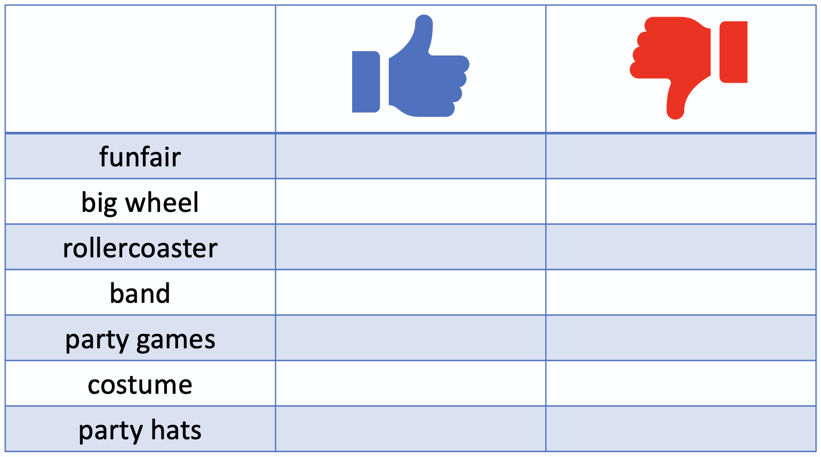
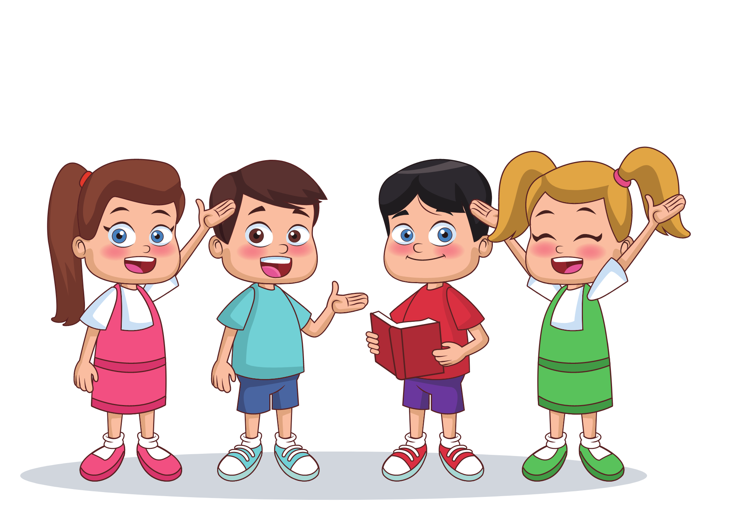
WARM-UP ACTIVITY
Do you like riding the big wheel?
2
1
No, I don’t.
Yes, I do.
Yes, I do.

Slide 6

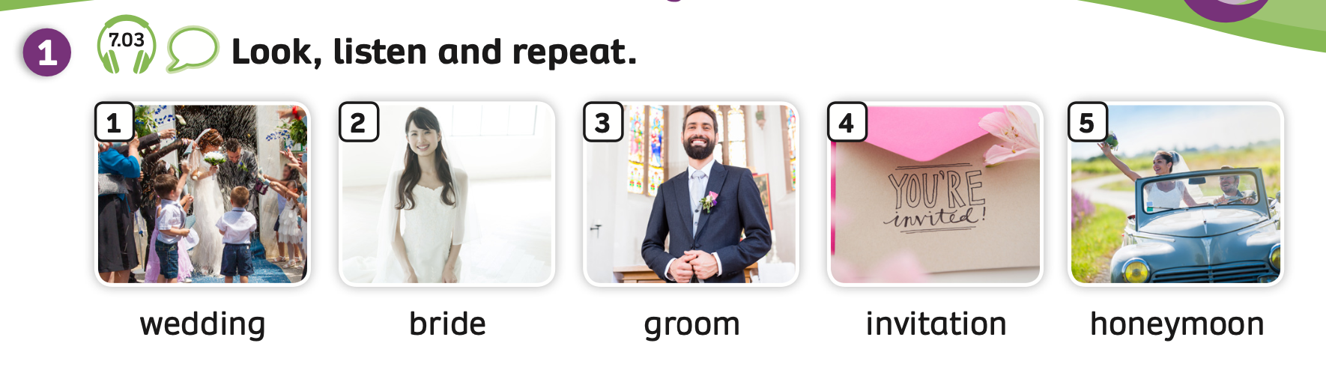
VOCABULARY – My party
- Play the audio, students listen and repeat the words.

Slide 7
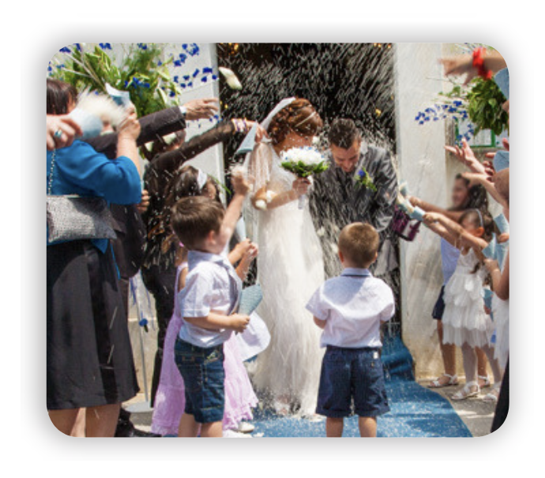

VOCABULARY – My party
c
Let’s spell!
wedding
w
e
d
d
i
n
g
Students listen and spell the word.

Slide 8
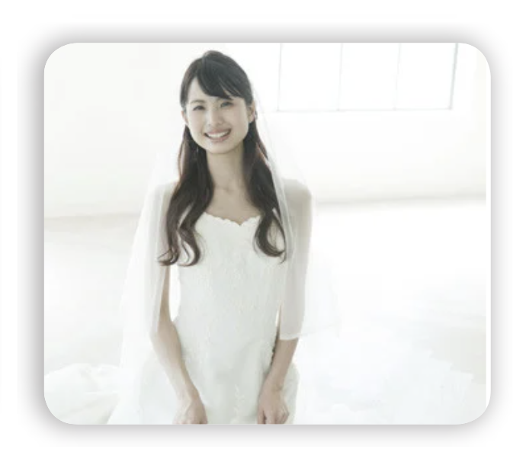
VOCABULARY – My party
Let’s spell!
c
bride
b
r
i
d
e
Students listen and spell the word.

Slide 9
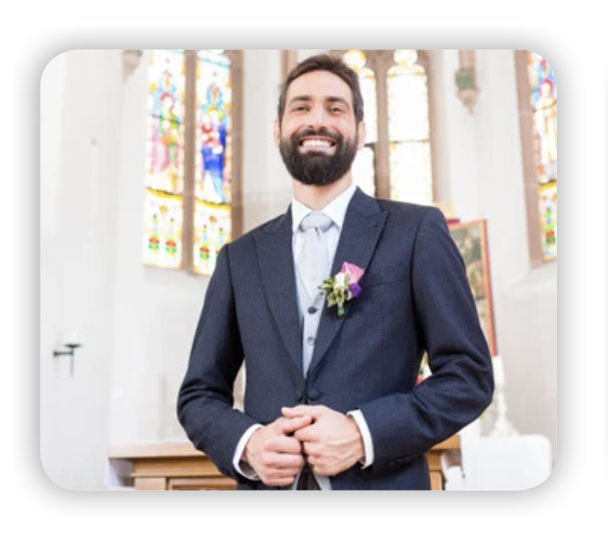
VOCABULARY – My party
Let’s spell!
c
groom
g
r
o
o
m
Students listen and spell the word.

Slide 10

VOCABULARY – My party
c
Let’s spell!
invitation
i
n
v
i
t
a
t
i
o
n
Students listen and spell the word.

Slide 11
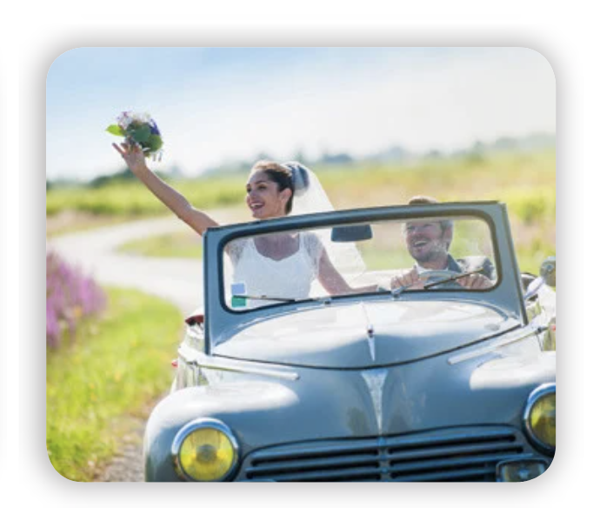
VOCABULARY – My party
c
Let’s spell!
honeymoon
h
o
n
e
y
m
o
o
n
Students listen and spell the word.

Slide 12

VOCABULARY - REVIEW
wedding
bride
groom
invitation
honeymoon
Students look at the pictures and say the words.

Slide 13


VOCABULARY – Practice
Divide the class into two teams: team A and team B.
Each student takes out a mini-board.
Students look at the pictures and write down the answers.
If all students in the team write the correct answer, that team will receive 2 points. But if the team has 2 or 3 students write the wrong picture, they won’t receive points.
The team with the highest points wins the game.

Slide 14




Slide 15


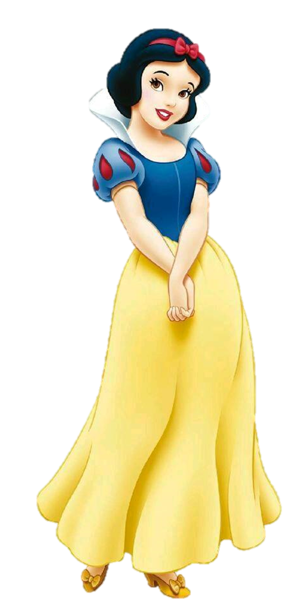
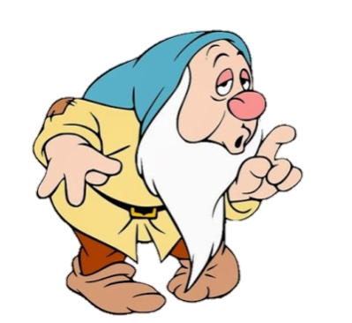
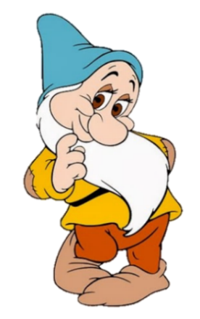
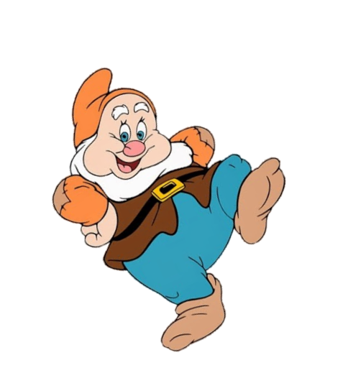
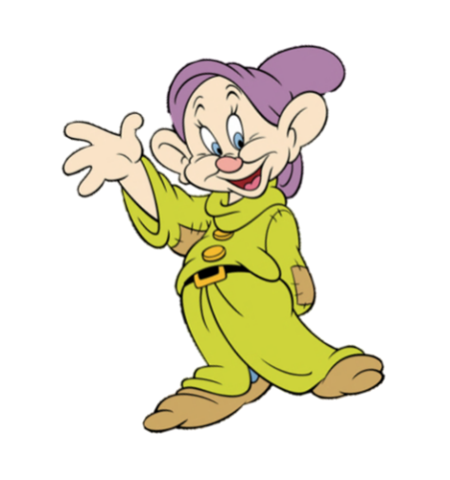
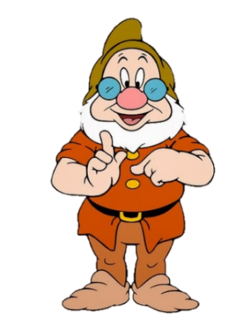
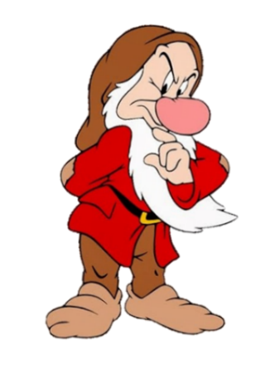
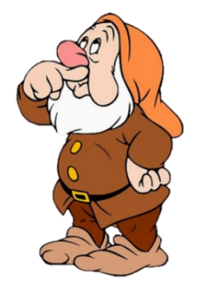

bride
groom
invitation
honeymoon
next

Slide 16
wedding
groom
honeymoon
invitation
next

Slide 17
groom
bride
honeymoon
wedding
next

Slide 18
honeymoon
groom
bride
invitation

Slide 19
groom
bride
letter
invitation
next

Slide 20
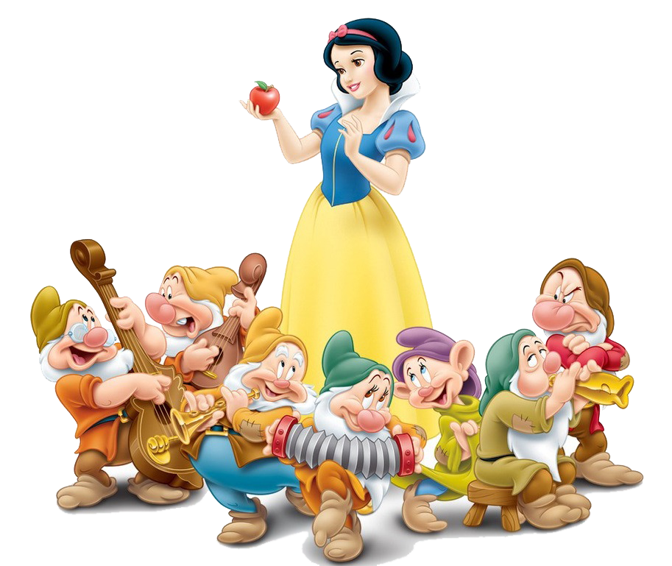

Slide 21
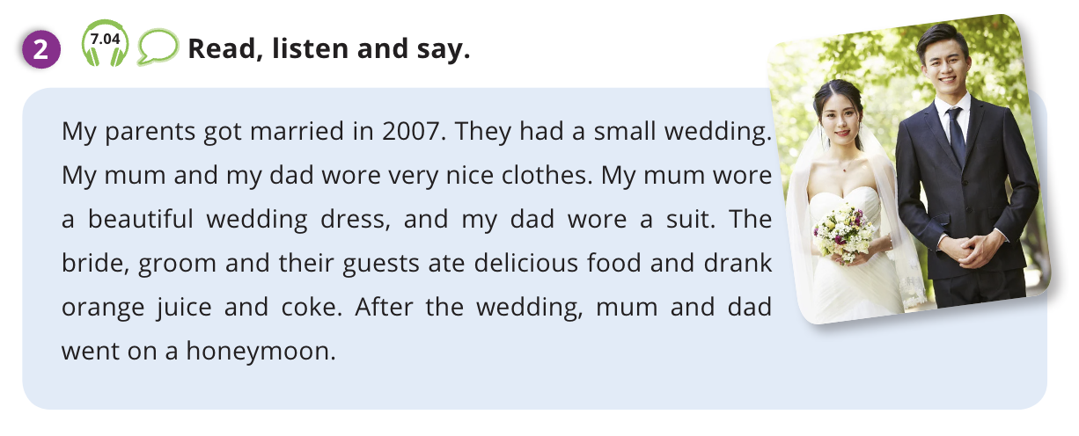
Pupils’ book p.83 – PRE LISTENING
Look and read
ANSWER
Work in pairs.
Look, read and underline verbs in the text.
Check the answers with the whole class.

Slide 22
Pupils’ book p.83 – LISTENING
Listen and say
Play the audio, students listen.
Play the audio again, students listen and say aloud.

Slide 23
PRODUCTION
1
wedding
3
bride
groom
2
invitation
4
honeymoon
5
- The teacher says a random number.
- Students listen and raise their hands to get a chance to say the correct word. Then, make a sentence with that word behind the number. The first student with the correct word receives 2 points.

Slide 24
HOMEWORK
Review vocabulary.
Do exercises in the Activity book (page 64).
Check the answers in the Teacher’s book (page 143) or Active Teach.

Slide 25
UNIT 7 – Lesson 3A
We’ve learned…
To correctly read and pronounce words related to Weddings.
To introduce Simple past forms of irregular verbs.
- PB p.83
- AB p.64

